Slide 1
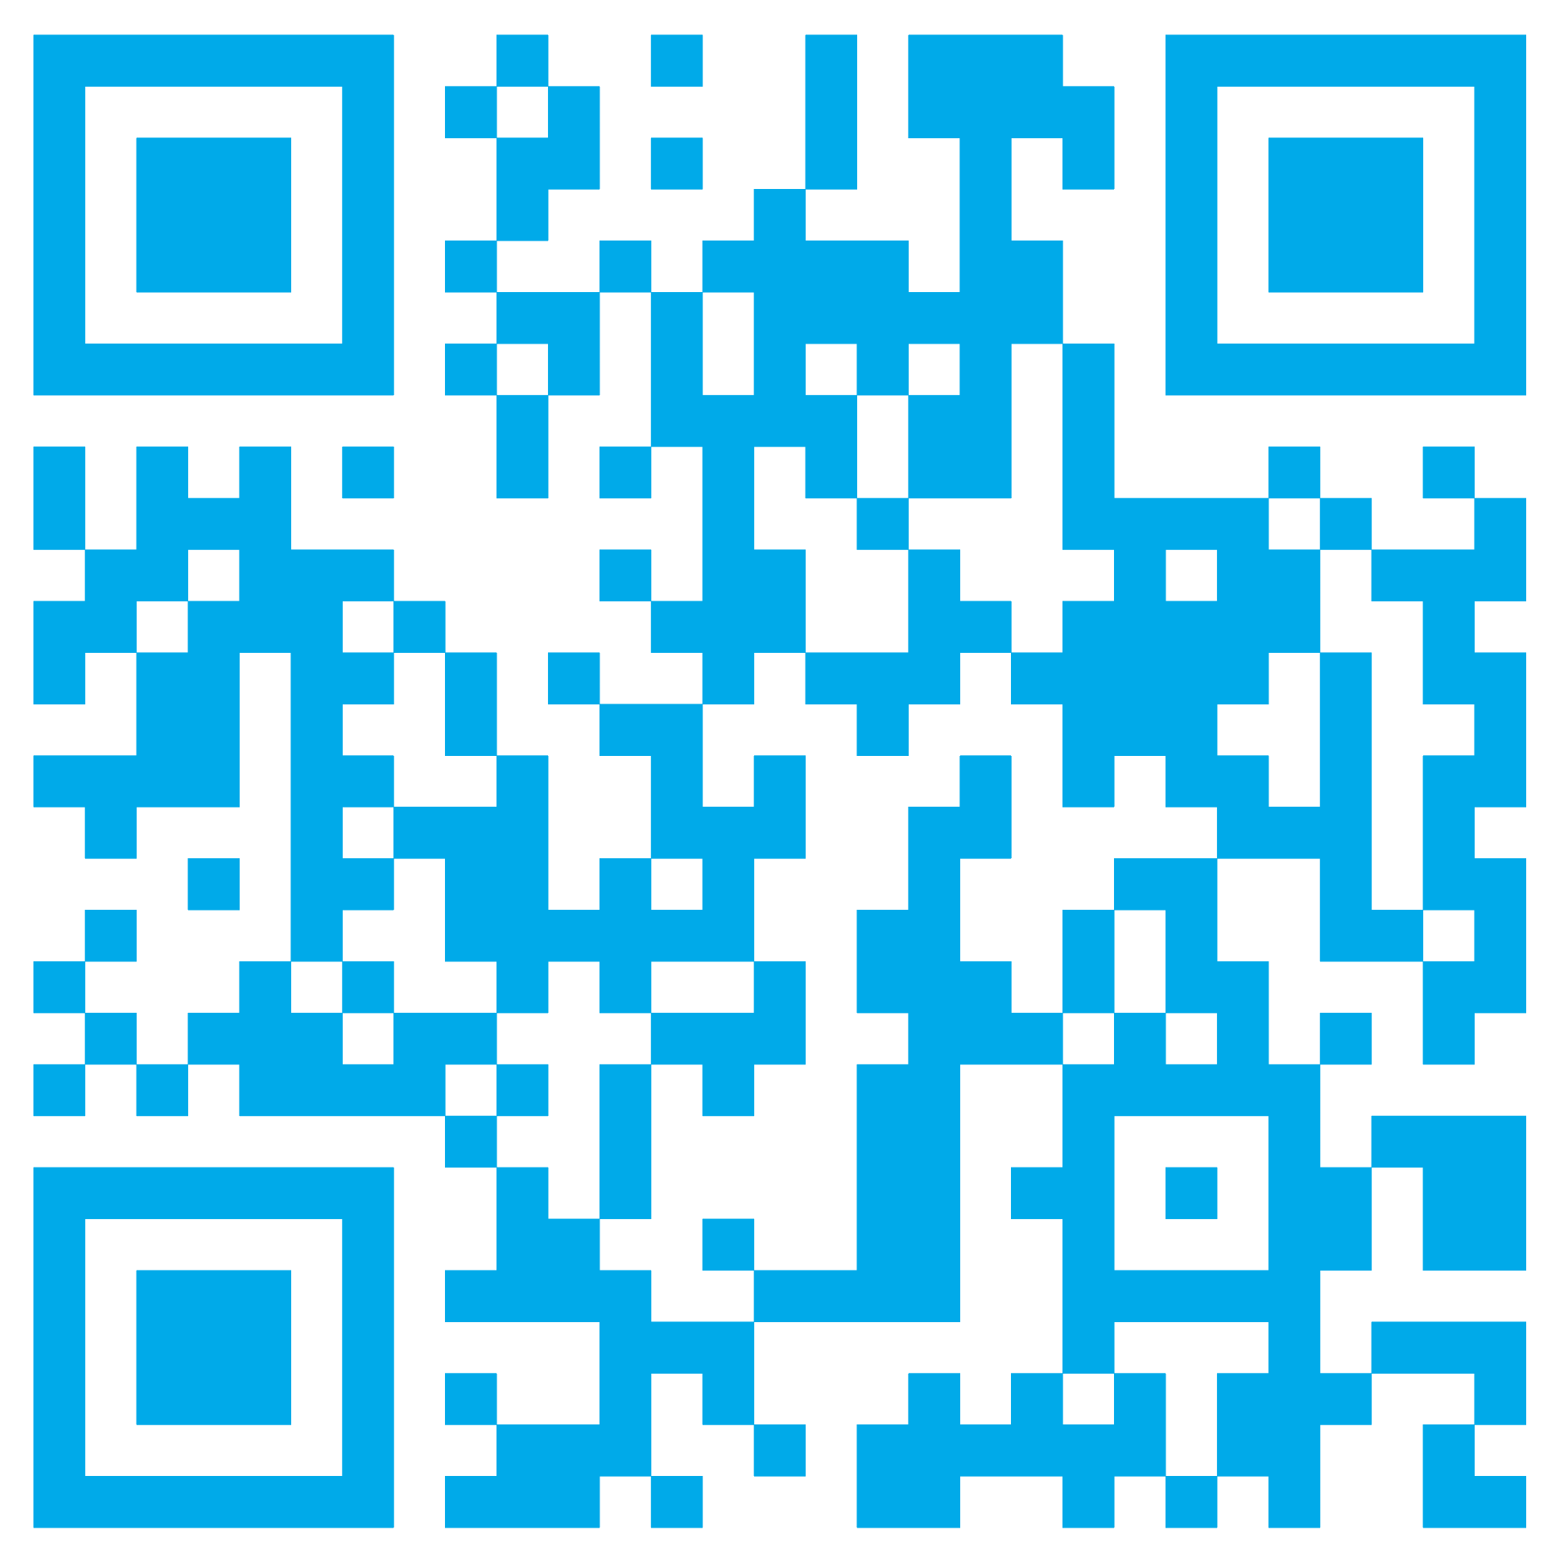
Come say hi on BlueSky!

Slide 2
Have fish for dinner!
The Gala Dinner on Thursday evening includes complimentary access to the Georgia Aquarium – site of the biggest viewing wall on this side of the world!
Family are welcome – please contact ICFOG2025 staff if you would like a plus-one (or plus little ones).

Slide 3
Disclosures
S.A.F. has the following competing interests: Honoraria: Lundbeck, Teva, Sunovion, Biogen, Acadia, Neuroderm, Acorda, CereSpire. Grants: Ipsen, Medtronics, Boston Scientific, Teva, US World Meds, Sunovion Therapeutics, Vaccinex, Voyager, Jazz Pharmaceuticals, Lilly, CHDI Foundation, Michael J. Fox Foundation, NIH, Royalties: Demos, Blackwell Futura for textbooks, Uptodate, Other Bracket Global LLC, CNS Ratings LLC.

Slide 4
Disclosures
A. Mueller and F. Kluge are employees of, and may hold stock in, Novartis. B. Eskofier reports consulting activities with adidas AG, Siemens AG, Siemens Healthineers AG, WSAudiology GmbH outside of the study.

Slide 5
No Disclosures
The authors of this material report no relevant disclosures.

Slide 6
Photos and Social Media OK
The presenters grant permission to photograph and share all elements of this presentation, including on social media, with the tag #ICFOG2025.

Slide 7
Limited Photos and Social Media OK
The presenters grant permission to photograph and share elements of this presentation, including on social media based on the following icons.
It’s ok to share
this slide
It’s not ok to share
this slide

Slide 8
No Photos or Social Media Please!
Please do not photograph or disseminate the materials in this presentation.

Slide 9
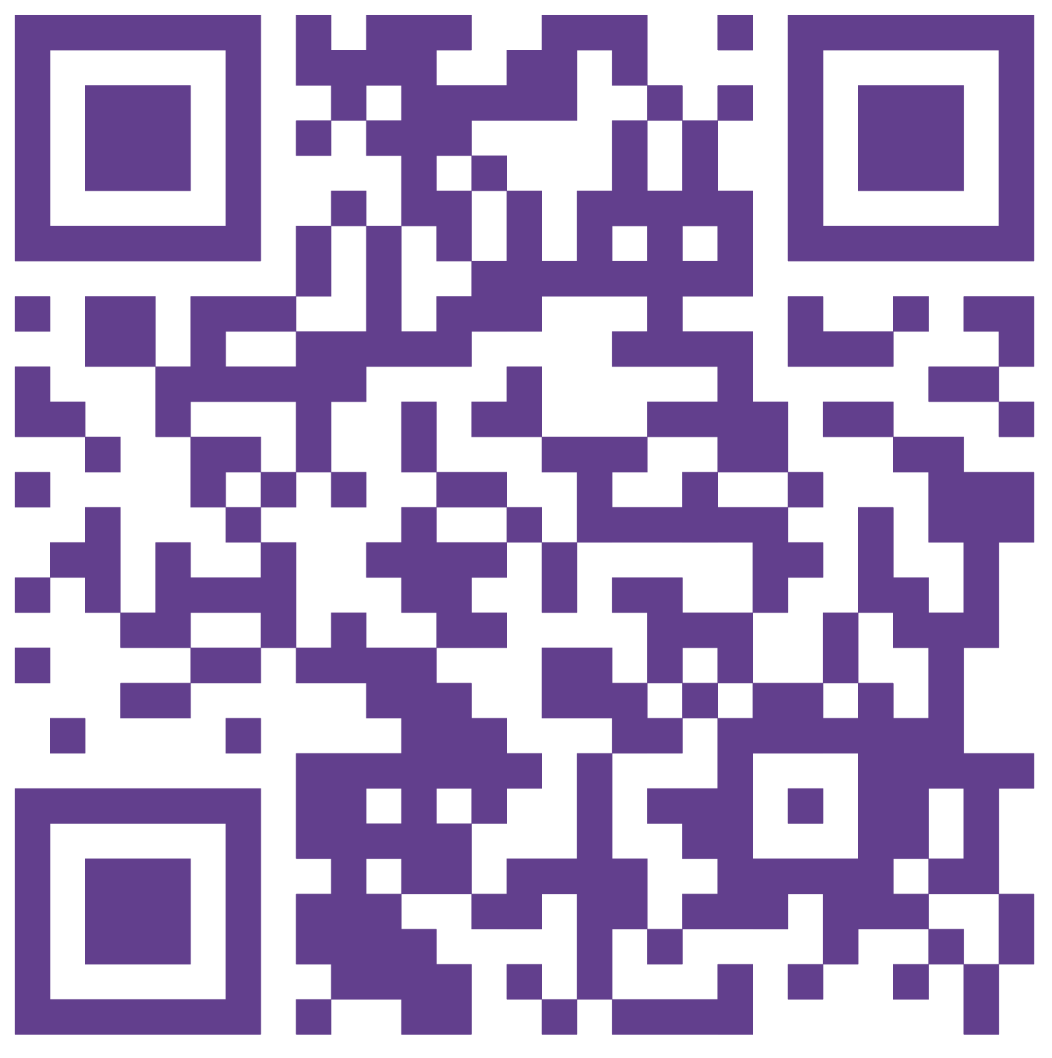
Discussion Questions?
Microphone line too long?
Was that last question more of a comment?
Use the QR code to the right to log your questions with the session moderators any time during the conference!

Slide 10
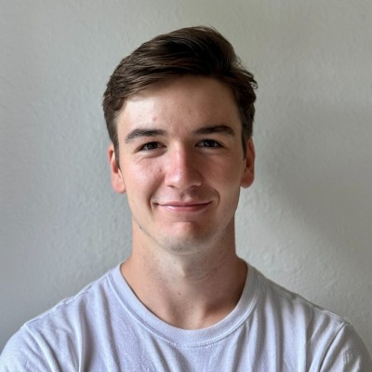
See it at the Data Blitz!
Freezing of repetitive alternating finger tapping worsens in PD freezers
Kerry Daley
Stanford University, California, USA🇺🇸

