Slide 1
BMI 510: Ethics for AI
J. Lucas McKay, Ph.D., M.S.C.R.
Departments of Biomedical Informatics and Neurology, Emory University, Atlanta, GA USA
Department of Biomedical Engineering, Georgia Institute of Technology, Atlanta, GA, USA

Slide 2
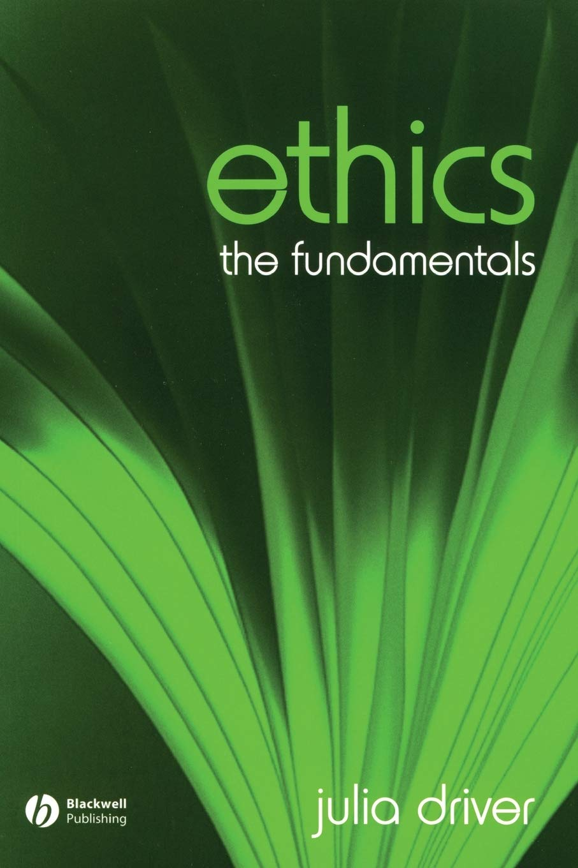
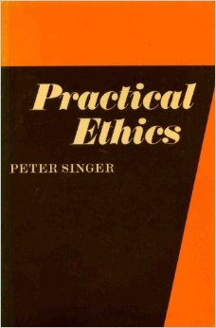
References

Slide 3
Outlines
Moral and other types of “oughts”
Sources of normativity
Virtue-based
Duty-based
Consequence-based
Some schools of consequentialism and #ethics
The harm principle
Harms in AI

Slide 4
Moral and other types of “oughts”

Slide 5
Moral and other types of "oughts"
Moral norms primarily concern our interactions with others in ways that have significance to their well-being.
Some different normative concepts are associated with prudence, some with rationality, and some with aesthetic norms.
Julia Driver. Ethics: The Fundamentals

Slide 6
Moral and other types of "oughts"
Moral norms primarily concern our interactions with others in ways that have significance to their well-being.
Some different normative concepts are associated with prudence, some with rationality, and some with aesthetic norms.
We ought to eat at least five servings of fruits and vegetables a day, but this ought is not a moral one.
If we fail to do this, we have harmed only ourselves - so it is a failure of prudence, not of morality.
(This is debatable)
Julia Driver. Ethics: The Fundamentals

Slide 7
Moral and other types of "oughts"
Moral norms primarily concern our interactions with others in ways that have significance to their well-being.
Some different normative concepts are associated with prudence, some with rationality, and some with aesthetic norms.
We ought to not waste money on intangible things like video game skins.
If we fail to do this, we have harmed only ourselves - so it is a failure of rationality, not of morality.
(This is debatable)
Julia Driver. Ethics: The Fundamentals

Slide 8
Moral and other types of "oughts"
Moral norms primarily concern our interactions with others in ways that have significance to their well-being.
Some different normative concepts are associated with prudence, some with rationality, and some with aesthetic norms.
We ought not to hang a psychedelic black velvet painting over our colonial fireplace.
However, doing so is not a moral failure. If anything, it is a failure of aesthetics.
(This is also debatable.)
Julia Driver. Ethics: The Fundamentals

Slide 9
Sources of normativity

Slide 10
In what way are immoral things wrong?
Normative ethics is the study of ethical behaviour and is the branch of philosophical ethics that investigates the questions that arise regarding how one ought to act, in a moral sense.
(e.g., not in the sense of prudence, rationality, or aesthetics.)
One way to think about normativity is to think about how (and why) certain situations are clearly immoral.
Wikipedia

Slide 11
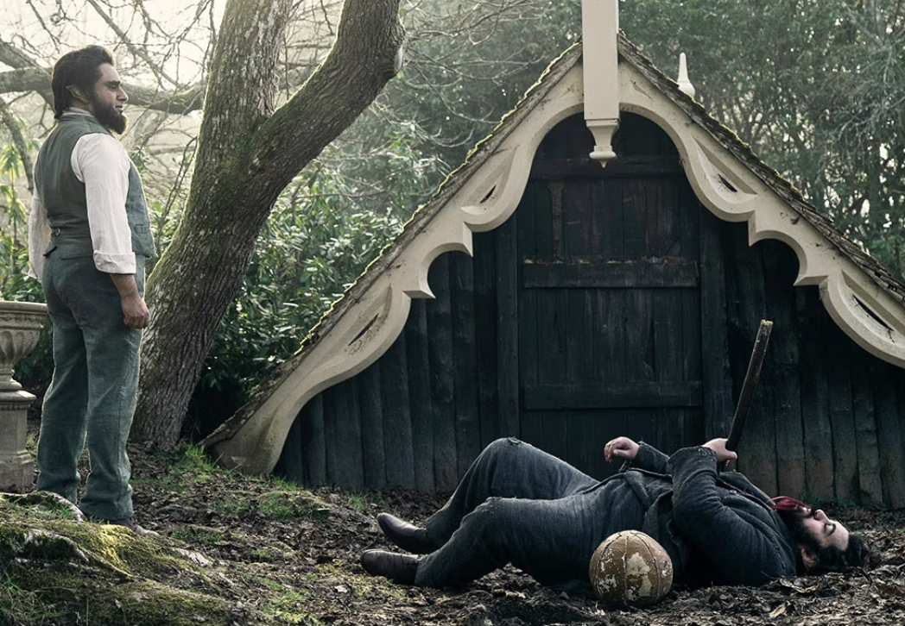
Based on the biblical story of the first murderer, Cain murdering his brother Abel, Cain, unable to control his temper and desire to hurt his brother is always killing Abel, only for his brother to rise from the dead, and for the deed to continue in a seemingly endless cycle.
Netflix “Sandman”

Slide 12
Cain killed Abel
Let’s allow the proposition that Cain killing his brother Abel is morally wrong.
In some way, it violates our sense of normative moral behavior.
Why exactly does it appear morally wrong?
There are three major schools of thought on the question of where this moral violation comes from.

Slide 13
Cain killed Abel
https://forum.effectivealtruism.org/posts/S5Hq4Dc8Q8ptq562L/cain-killed-abel-a-heuristic-guide-to-the-three-major

Slide 14
Sources of normativity
For the sake of our example, let’s allow that this sentence, “Cain killed Abel”, represents an immoral fact of the world that has occurred.
Note this sentence has three grammatical parts, a subject, a verb, and a predicate.
Character-based ethics says that the moral substance inhabits the subject, Cain
Duty-based ethics says that morality stems from the verb, killed
Consequences-based ethics says that the moral content of the sentence resides with the predicate, Abel
https://forum.effectivealtruism.org/posts/S5Hq4Dc8Q8ptq562L/cain-killed-abel-a-heuristic-guide-to-the-three-major

Slide 15
Cain killed Abel
Virtue /
Character-
based
(Aristotle et al.)
Deontological /
Action or Duty-
based
(Kant, Locke et al.)
Consequence-
based
(Bentham et al.)
https://forum.effectivealtruism.org/posts/S5Hq4Dc8Q8ptq562L/cain-killed-abel-a-heuristic-guide-to-the-three-major

Slide 16
Sources of normativity in virtue-based ethics
What was it about Cain that was immoral?
Although virtue-based ethics do not allow for a great deal of agency on the part of the subject, perhaps they could apply to an AI (which has no agency).
Aristotle thought that virtue corresponded to balance between extremes in different “spheres”

Slide 17
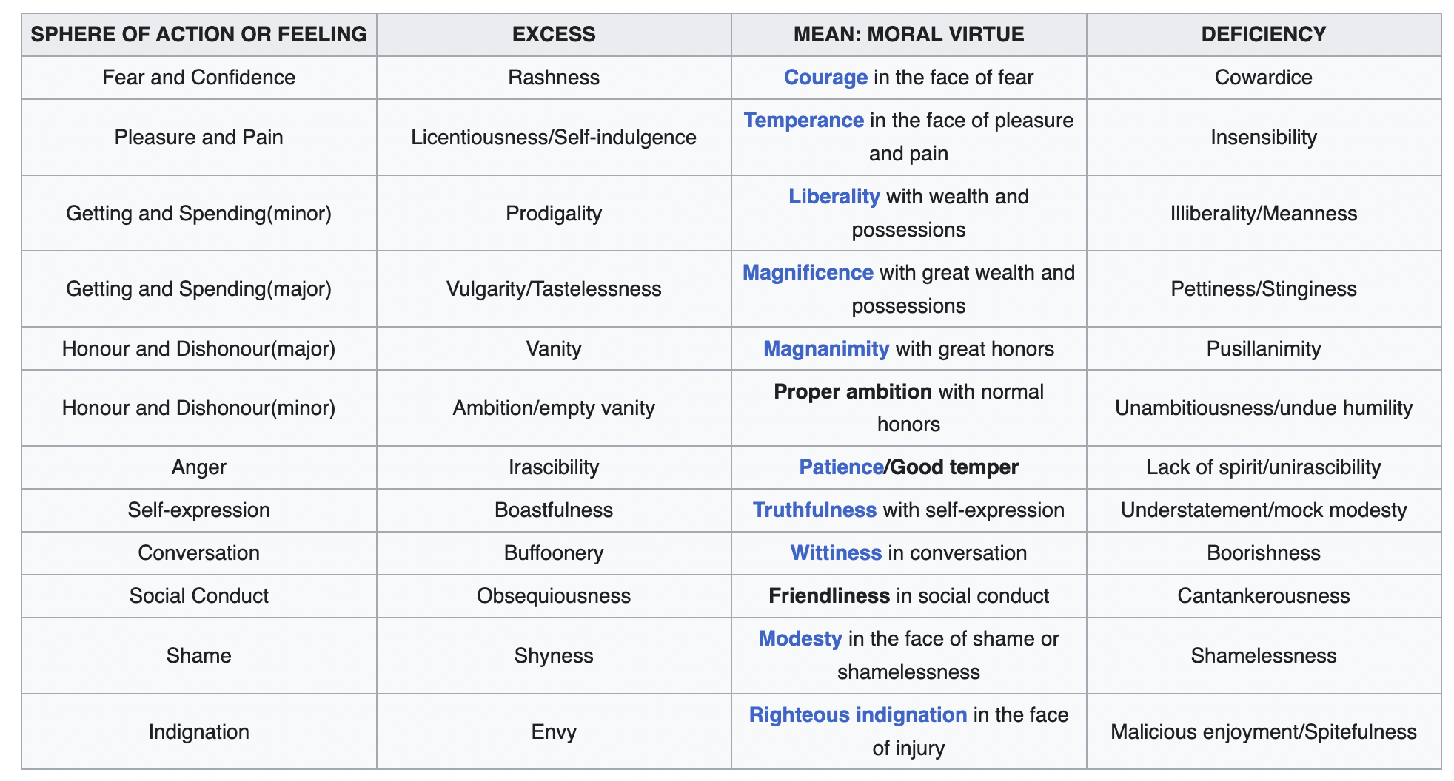
Sources of normativity in virtue-based ethics
What was it about Cain that was immoral? Although virtue-based ethics do not allow for a great deal of agency on the part of the subject, perhaps they could apply to an AI (which has no agency).

Slide 18
Sources of normativity in duty-based ethics
One should choose an action because of divine command (very early, before ethics and religion were distinct concepts)
One should choose an action because of moral principles derived from concepts of human dignity and autonomy (Kant et al.)
One should choose an action out of self interest (ethical egoism), potentially with benefit to society as a whole

Slide 19
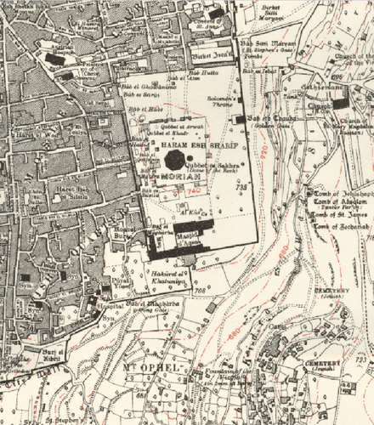
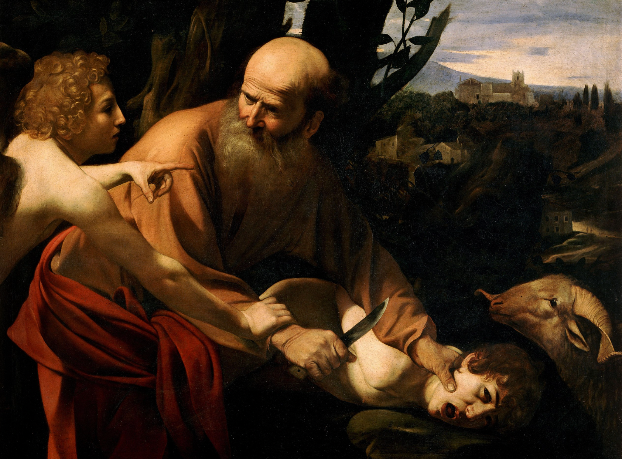
Divine command theory
In the (Judeo-Christian) Bible, Abraham is commanded by God to kill his son Isaac. Abraham goes along, but at the last moment, God intervenes, and Isaac's life is spared.
This story represents Divine command theory, which holds the view the source of rightness (or wrongness) is solely a matter of God's will. (Or judgment.) (Or fiat.) The action or duty chosen should conform with God’s will.
Killing Isaac would have been morally acceptable because it was God's command. But did God intend to change his mind at the last minute? Did Abraham expect this?

Slide 20
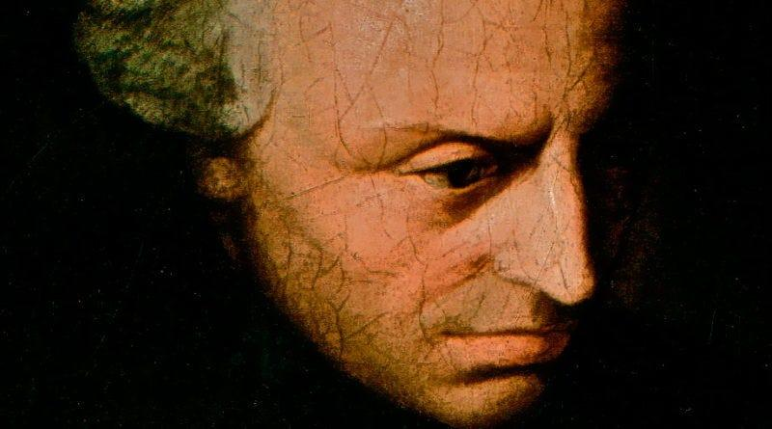
Kantian ethics
To Kant, whether or not a contemplated course of action is morally permissible will depend on whether or not it conforms to the moral law, even if respecting the moral law leads to bad effects rather than good ones.
e.g., we are obligated to keep our promises, even when keeping them results in less good. Suppose that Maria, who is very poor, has promised to pay back a loan she received from Charlotte, who is very rich and who doesn't need the money at all.
Even though there is a sense in which more good would be accomplished if Maria could keep the money - since that money would make much more of a positive difference to a her than it would to Charlotte - it would still be wrong of her to keep it.
What makes an action wrong, then, is not the bad it produces, but something else, the kind of action that it is.

Slide 21
Kantian ethics
Kant and other deontologists are united in that they all reject a consequentialist approach to ethical theory.
They believe that there are deontological constraints on action that undermine consequentialist justifications.
Some actions are just wrong, even if they maximize the good.
For example, it is wrong to kill an innocent person even to save the lives of 10 other innocent persons. (?)
The basic idea is that some things are just plain wrong even if they produce the maximally good result, and that consequentialism (later) doesn't recognize this important moral fact.

Slide 22
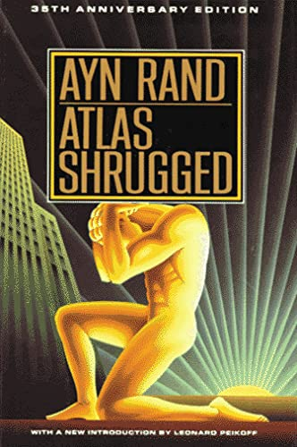
(Ethical) Egoism
An Egoistic view is one that either explains or justifies the morality of something in terms of the consequences to the agents’ self interest.
In Ethical Egoism, the view is that the agent should act in their own self-interest to be ethical.
Ayn Rand, a well-known author, famously argued that a universal commitment to egoism could lead to a harmonious distribution of resources that, while not necessarily fair, could be justified.
Rand believed that if everyone prioritized their own self-interest, it could actually benefit society as a whole.
Some would argue that this was a side-effect of, rather than justification for, egoism.

Slide 23
Some Consequent Schools

Slide 24
Cain killed Abel
Virtue /
Character-
based
(Aristotle et al.)
Deontological /
Action or Duty-
based
(Kant, Locke et al.)
Consequence-
based
(Bentham et al.)
The ethics arguably most relevant to deciding how an agent should act in a modern context are consequentialist.
https://forum.effectivealtruism.org/posts/S5Hq4Dc8Q8ptq562L/cain-killed-abel-a-heuristic-guide-to-the-three-major

Slide 25
Some schools of consequentialism
Classical utilitarianism
Pragmatism
#Ethics
Longtermism
Effective altruism

Slide 26
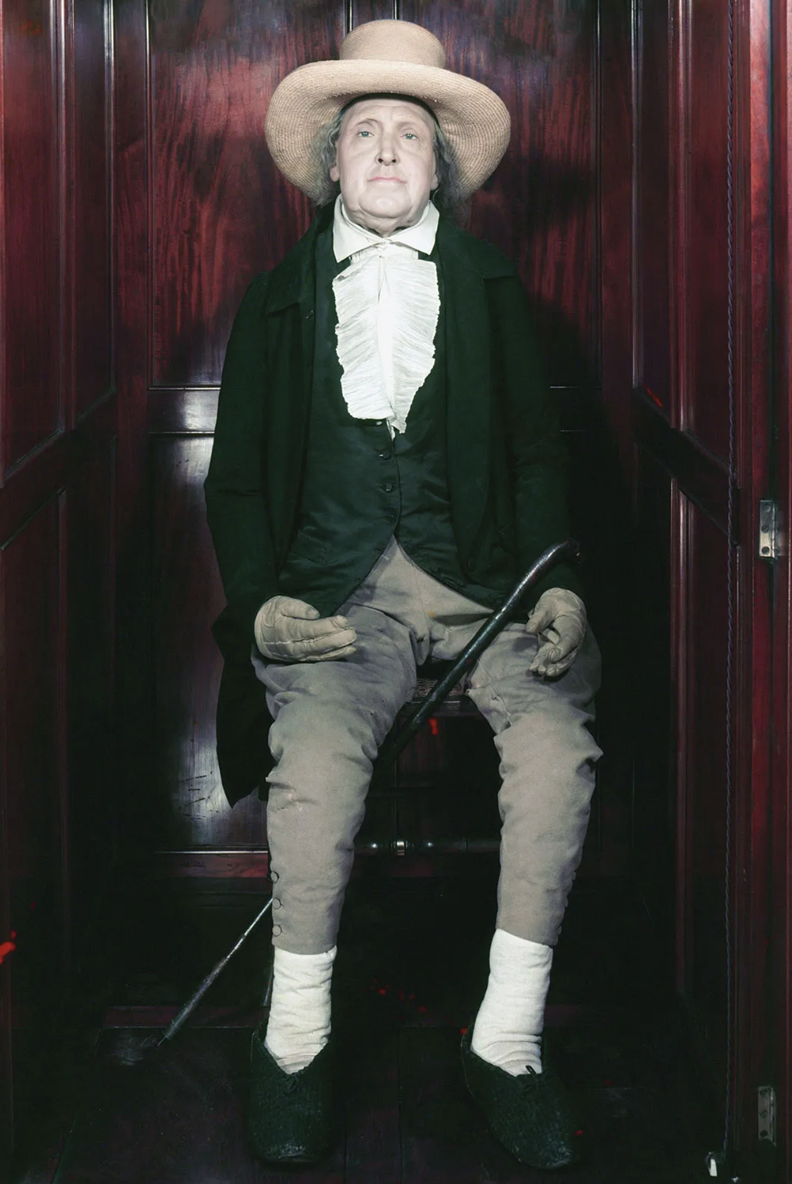
Classical utilitarianism
The foundation of morals is “utility” or the “greatest happiness principle:” actions are right in proportion as they tend to promote happiness; wrong as they tend to produce the reverse of happiness.
Utilitarianism is characterized by the tradeoffs present in a “hedonistic calculus” – e.g., decision making on whether to expend resources on universal healthcare or defense is cast as a (conceptual) mathematical problem to be solved.
Non-humans are not excluded from this.
Bentham’s “Auto Icon”

Slide 27
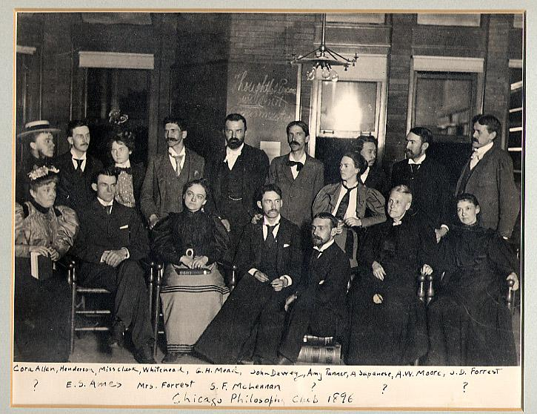
Pragmatism
Ethical pragmatists like John Dewey viewed ethics through an evolutionary lens.
Scientists can pursue inquiry into the truth of a hypothesis and accept the hypothesis, in the sense that they act as though the hypothesis were true; nonetheless, they think that future generations can advance science, and thus future generations will refine or replace (at least some of) their accepted hypotheses.
Similarly, ethical pragmatists think that norms are likely to be improved as a result of inquiry – as opposed to being fixed guidelines.
This is similar to moral relativism, although it could be argued that to pragmatists, like scientists, an eventual stable solution will be reached. Not so with relativists.

Slide 28
#Ethics

Slide 29
Longtermism
Longtermism is an ethical stance which gives priority to improving the long-term future. It is an important concept in effective altruism and serves as a primary motivation for efforts that claim to reduce existential risks to humanity.
The key argument for longtermism has been summarized as follows: “future people matter morally just as much as people alive today; ... there may well be more people alive in the future than there are in the present or have been in the past; and ... we can positively affect future peoples' lives.”
These three ideas taken together suggest, to those advocating longtermism, that it is the responsibility of those living now to ensure that future generations get to survive and flourish.

Slide 30
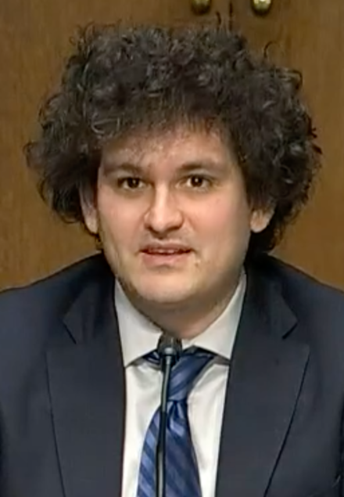
Effective Altruism
“Effective altruism is a movement that encourages individuals to use their resources and talents to make a positive impact on the world in the most effective way possible. It is based on the belief that we have a moral obligation to help others and that we should use reason and evidence to guide our efforts to do so.” –ChatGPT
This can lead to very serious moral lapses, e.g., justifying a Ponzi scheme propped up by securities fraud because part of the profits are donated to #EA charities.

Slide 31
Eugenics: Longtermism - Pragmatism + Hubris

Slide 32
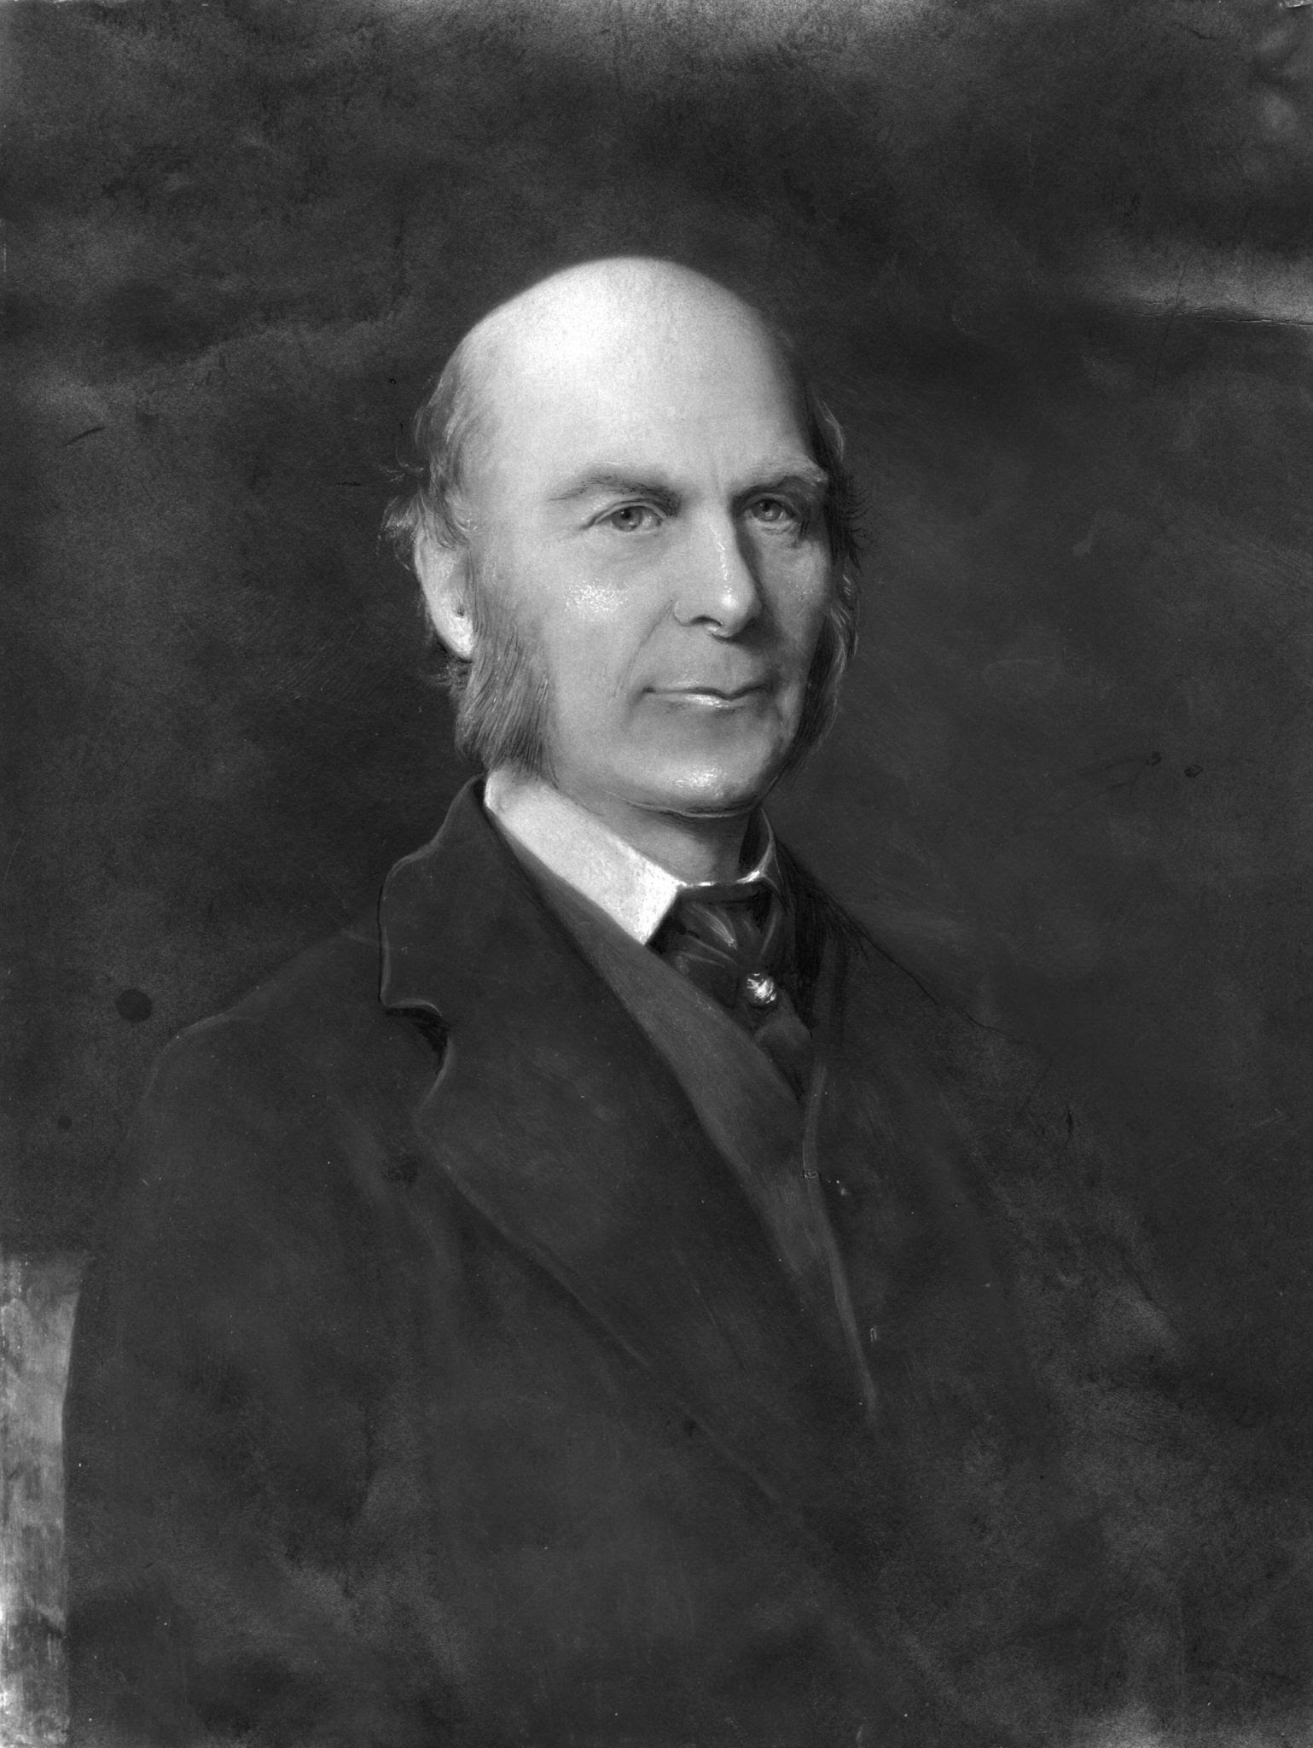
Eugenics
“We greatly want a brief word to express the science of improving stock… to give to the more suitable races or strains of blood a better chance of prevailing speedily over the less suitable…The word eugenics would sufficiently express the idea”
-Sir Francis Galton

Slide 33
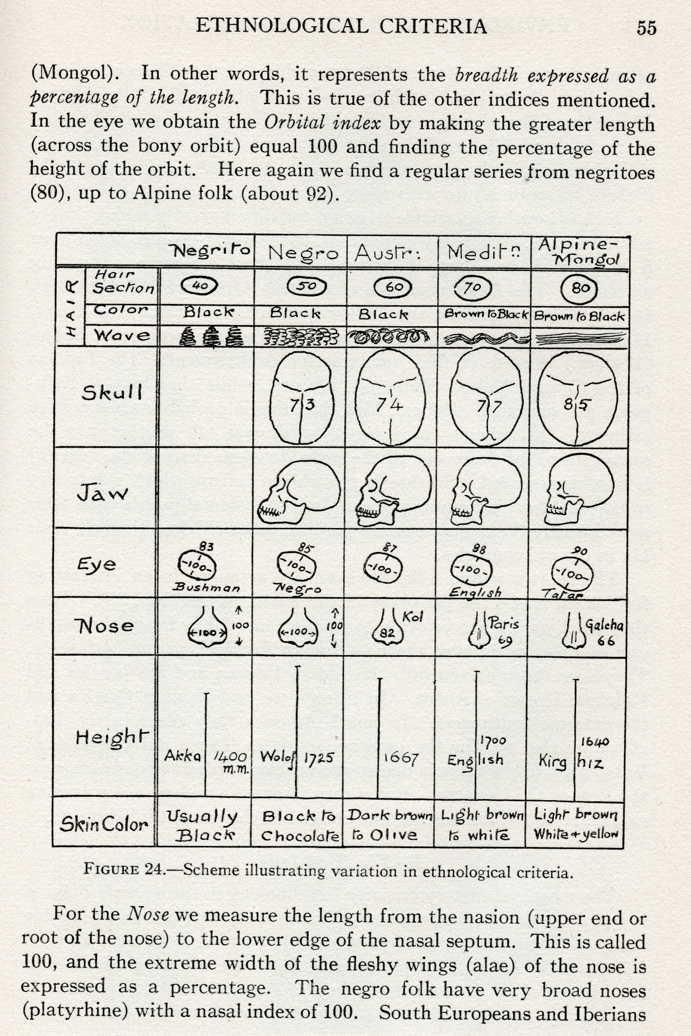
Eugenics
This figure is from 1937. What will your figures look like in 80 years?
Taylor, Environment, Race and Migration (1937).

Slide 34
Eugenics
“Eugenists are, in general, sincerely enthusiastic persons who are honestly anxious to be of service to their fellows, not to mention future generations, but they are also, in many instances, dangerous persons. A little knowledge is a dangerous thing, and a great deal of the world's unhappiness is due to well-meaning persons who, possessing a little knowledge, attempt on the basis of it to make decisions for others whose true nature they do not understand and whose future it would be impossible for anyone to predict.”
Ashley Montague, "Man's most dangerous myth," 5th ed. (1974) p.236
(original publication 1942)

Slide 35
The harm principle
Individuals should be free to do as they please, as long as their actions do not cause harm to others.
The harm principle is a key concept in the philosophy of ethics and political theory, first introduced by the philosopher John Stuart Mill in his book "On Liberty."

Slide 36
The harm principle
The harm principle has been influential in shaping modern liberal democracies and has been used as a basis for many legal and political policies.
For example, laws against assault and murder are based on the harm principle, as these actions clearly cause harm to others and infringe on their rights.
However, laws regulating consensual activities, such as drug use or same-sex marriage, are also often debated based on the (lack of) harm caused to others.

Slide 37
The harm principle - question
What harm might a company inflict upon a user if it uses their information in a way that they have not permitted?

Slide 38
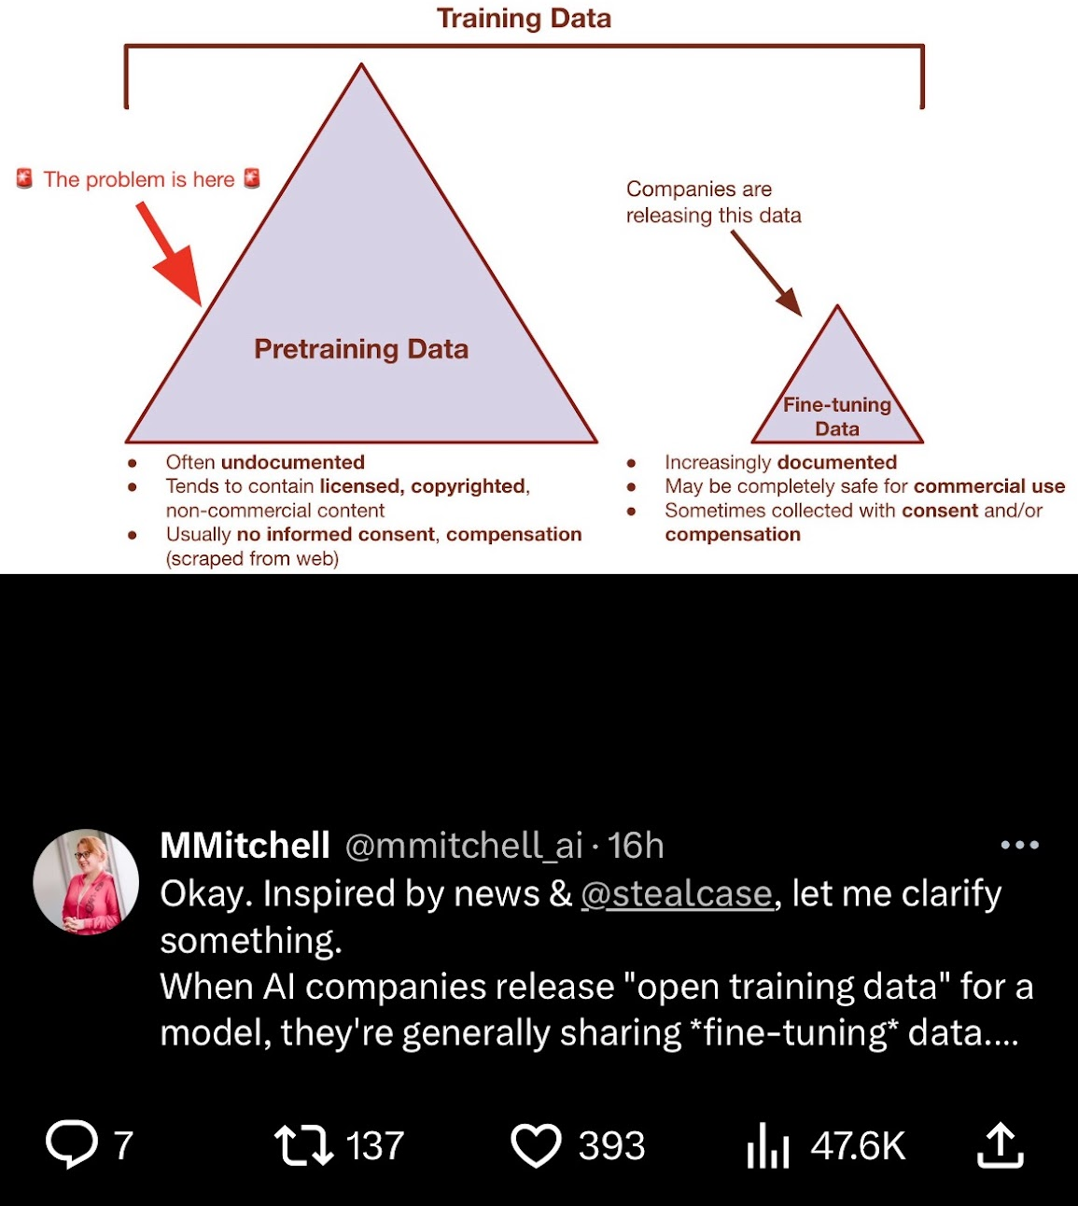
Harms in AI

Slide 39
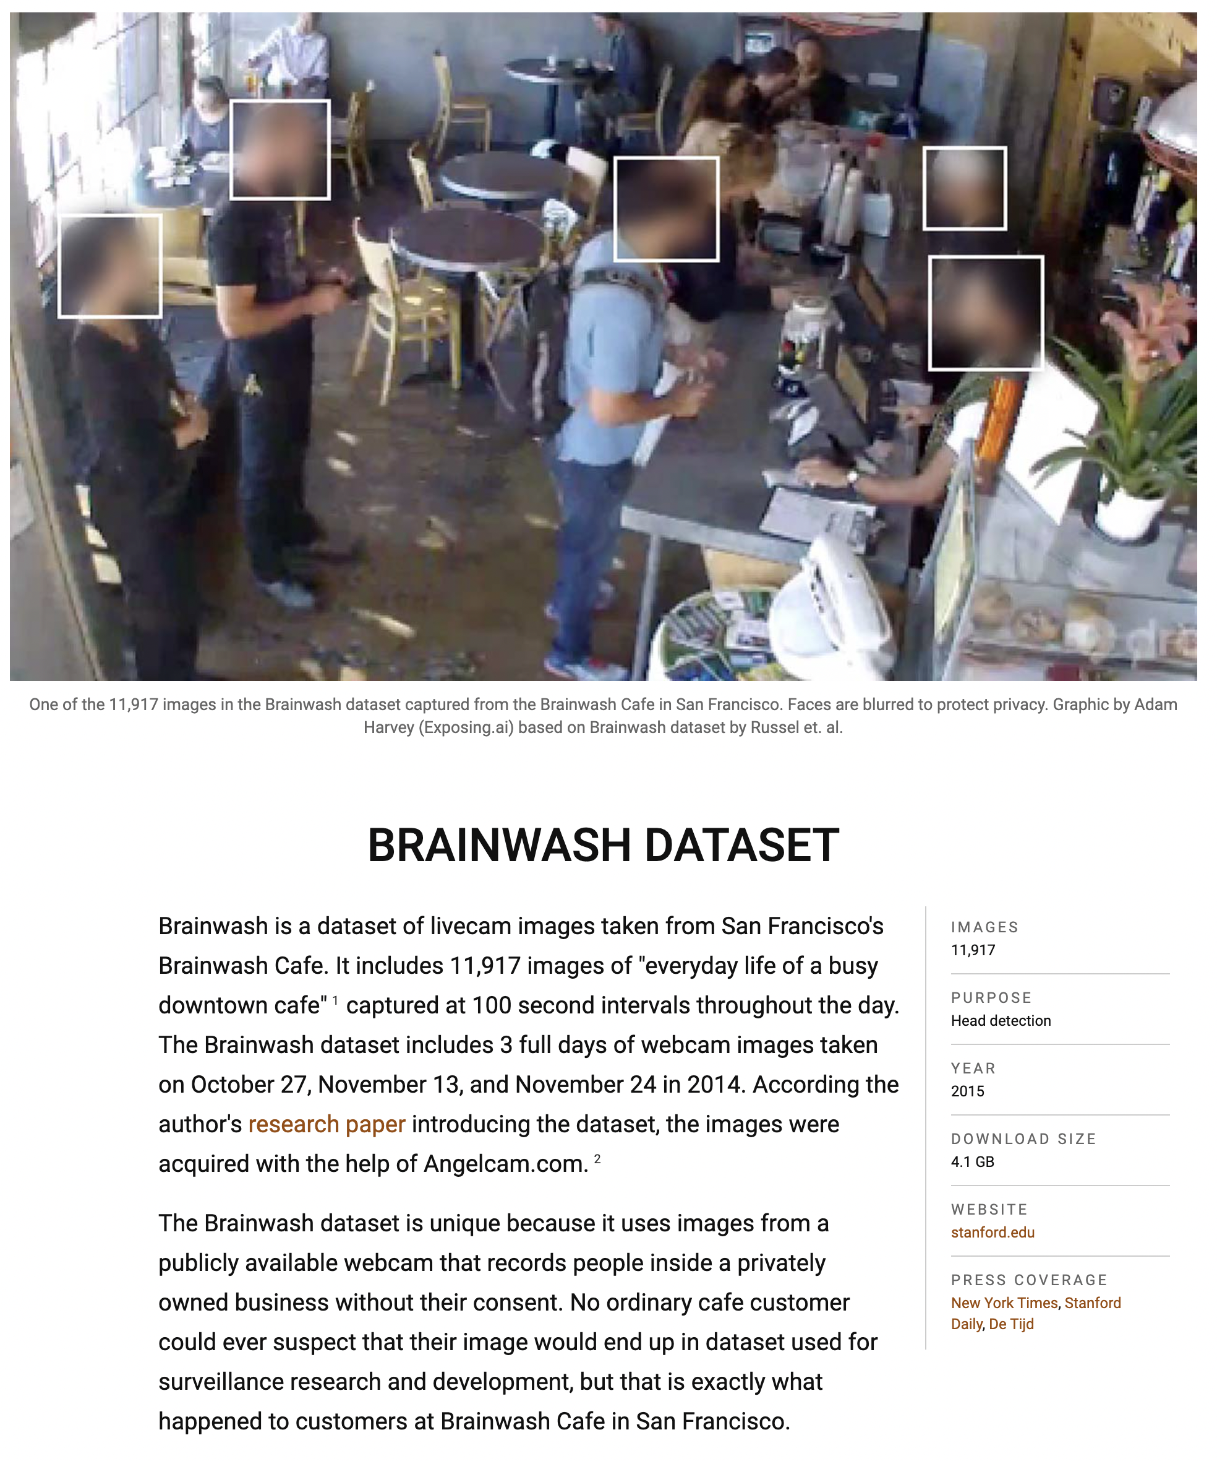
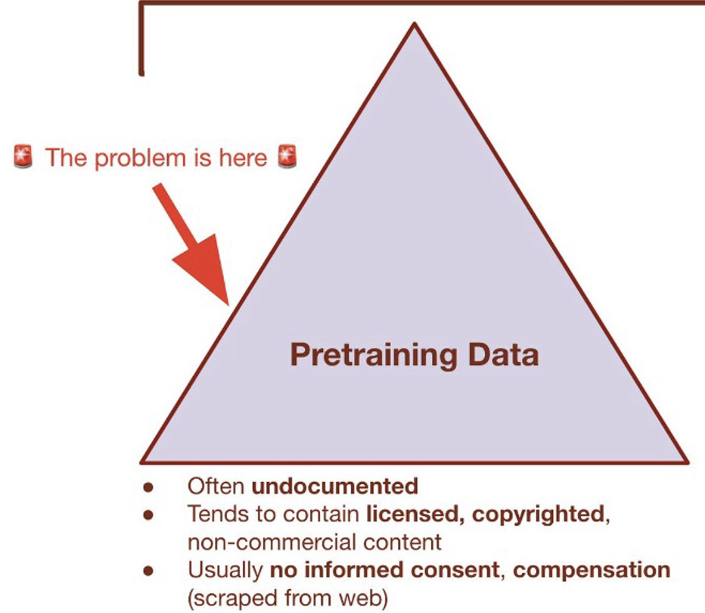
Harms in AI

Slide 40
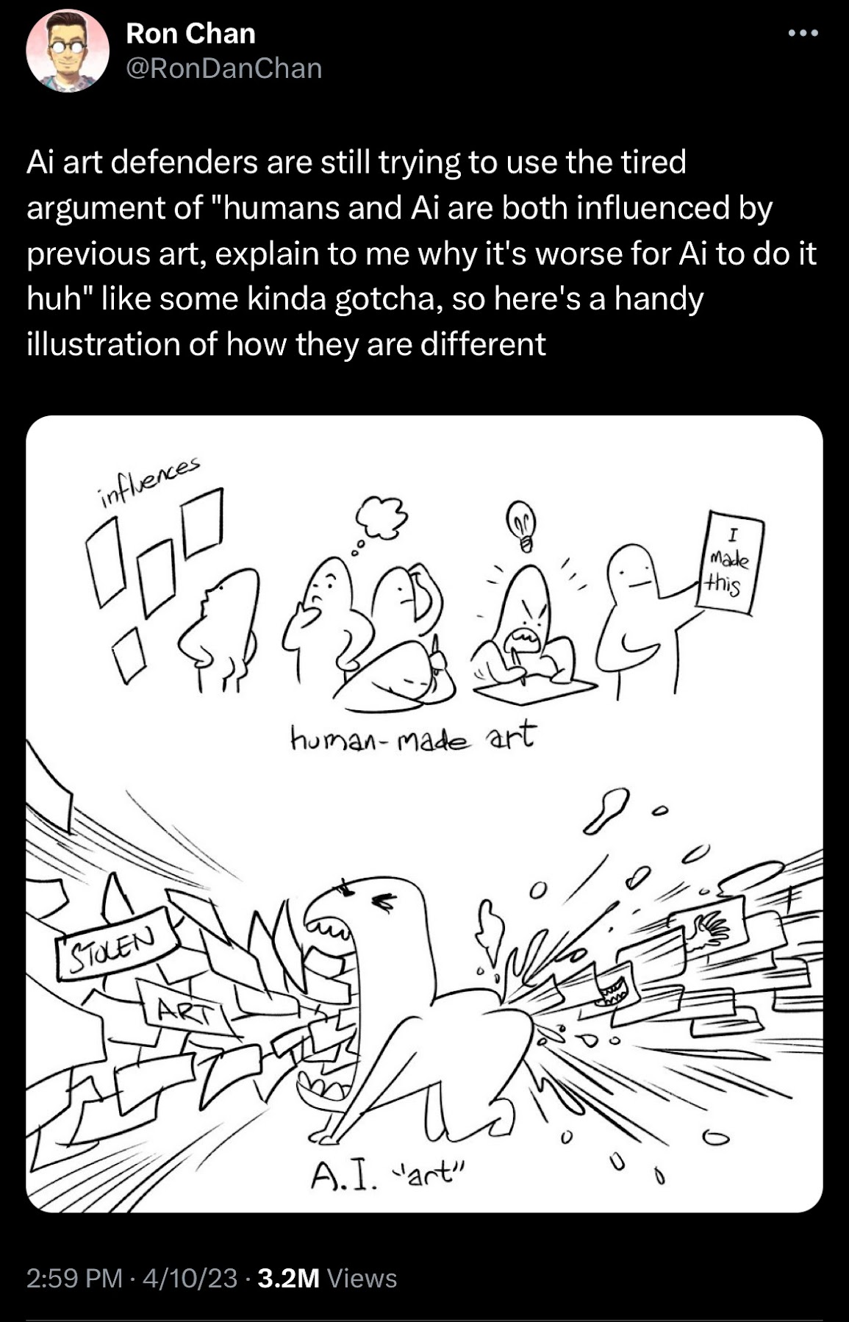
Harms in AI

Slide 41
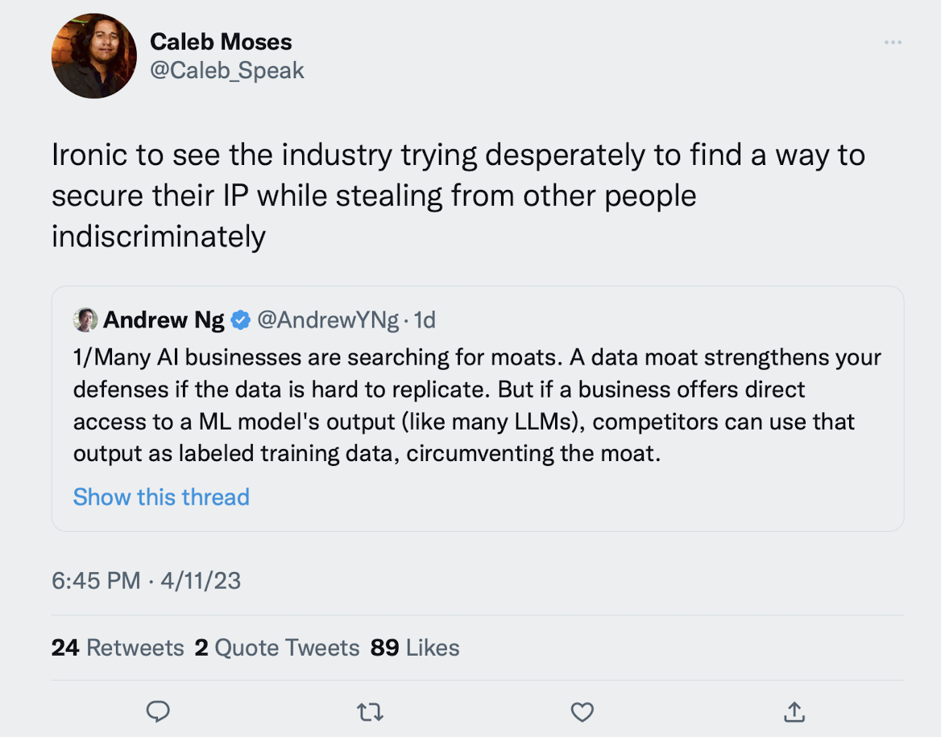
Harms in AI

Slide 42
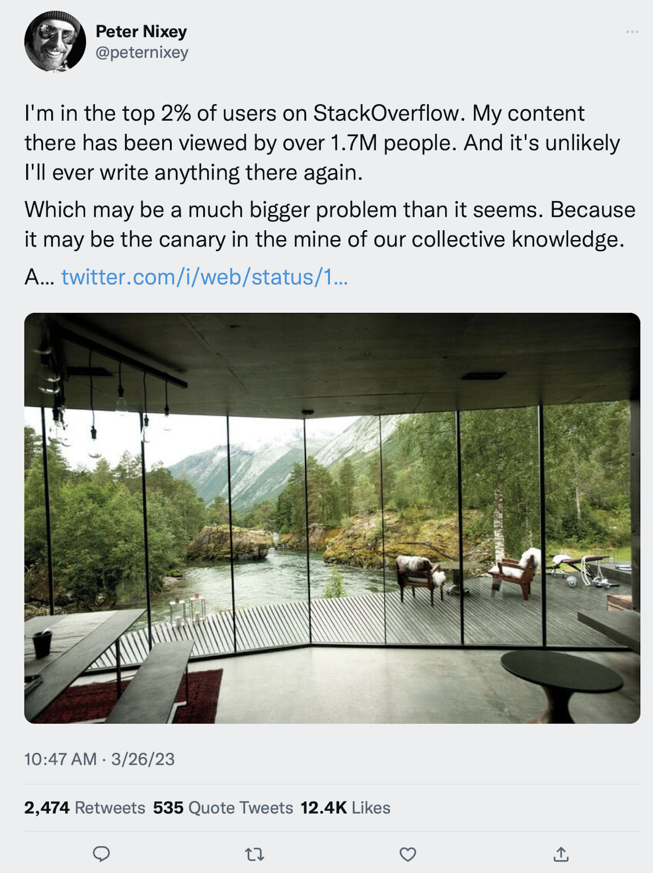
Harms in AI

Slide 43
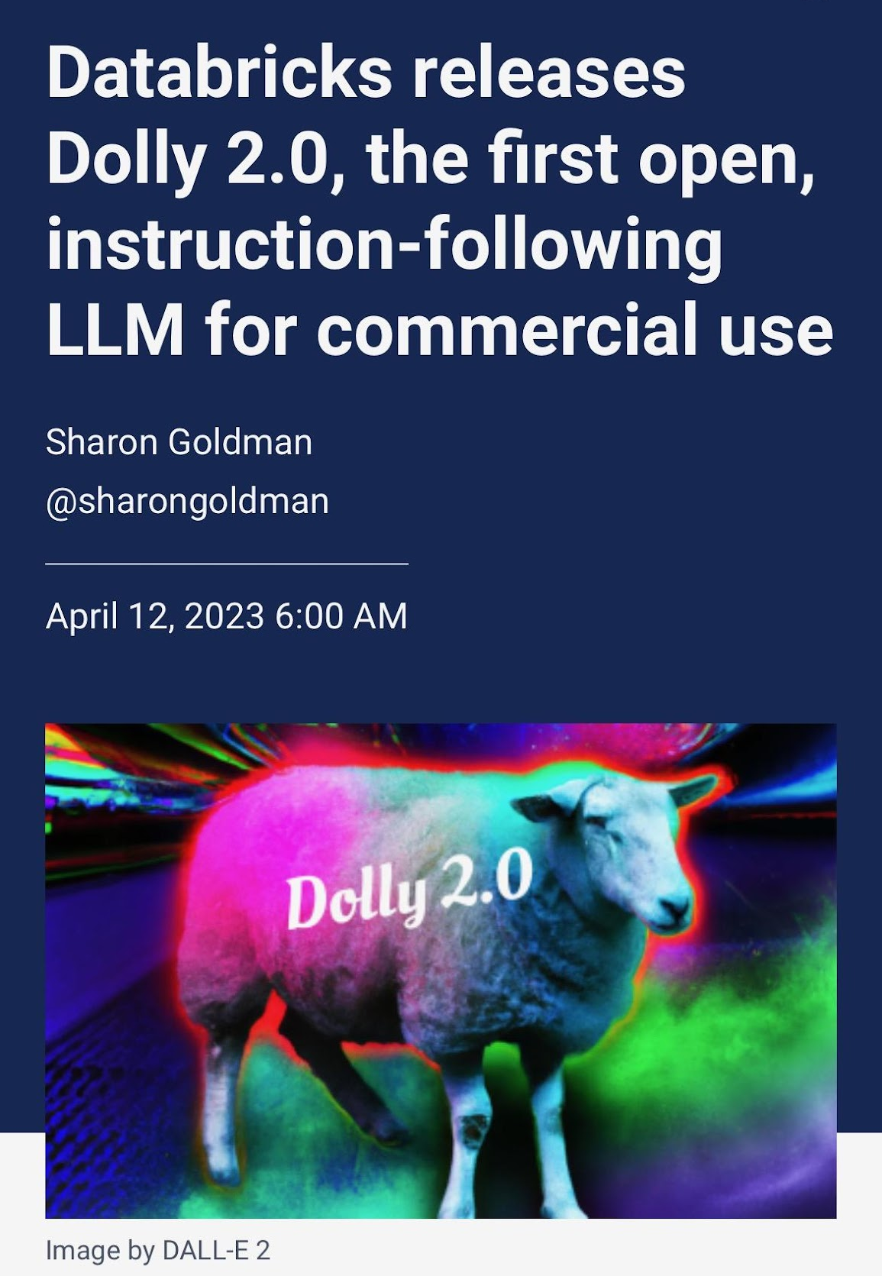
Harms in AI

Slide 44
Galton considered himself an expert on human difference, on the finer qualities that make a person better or worse. If not quite the genius that Darwin was, he certainly aspired to be. “I find that talent is transmitted by inheritance in a very remarkable degree,” he had once written in an essay titled “Hereditary Character and Talent.” His logic, drawing on his cousin's theories of natural selection and the survival of the fittest, was that a race of people could be improved if the most intelligent were encouraged to reproduce and the stupidest were not-the same way you might breed a fatter cow or a redder apple. Some saw it as a way of artificially speeding up human evolution, driving the race closer to mental and physical perfection.
Superior, Angela Saini (2019), p. 48

Slide 45
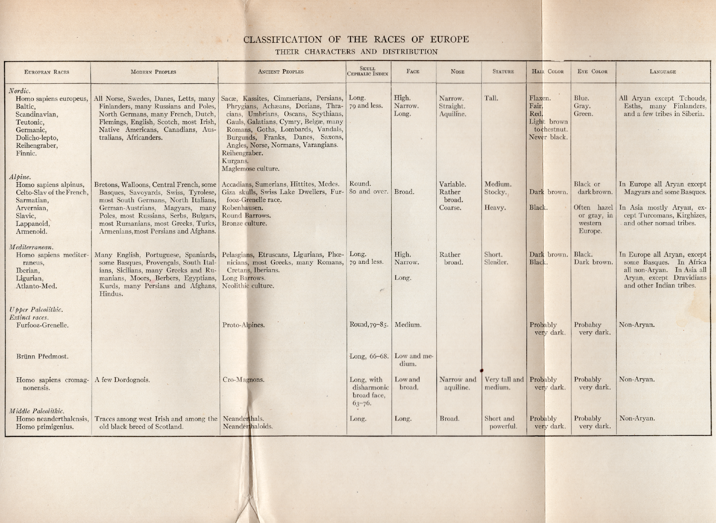

Slide 46
In dealing with European populations the best method of determining race has been found to lie in a comparison of proportions of the skull, the so-called cephalic index. This is the ratio of maximum length to maximum width taken at the widest part of the skull above the ears. Skulls with an index of 75 or less, that is, when the width is three-fourths or less than the length, are considered dolichocephalic, or long skulls. Skulls of an index of 80 or over are round skulls, or brachycephalic. Intermediate indices, between 75 and 80, are considered mesocephalic. These are cranial indices. To allow for the flesh on living specimens, about two per cent is to be added to the index, and the result is the cephalic index. In the following pages only long and round skulls are considered and the intermediate forms, or mesocephs, are assigned to the dolichocephalic group.
This cephalic index, though an extremely important if not the controlling unit character, is, nevertheless, but a single character and must be checked up with other somatological traits.
“The Passing of the Great Race” (1916), p. 16

Slide 47
[Intermarriage between] two races, in the long run, gives us a race reverting to the more ancient, generalized and lower type. The cross between a white man and an Indian is an Indian; the cross between a white man and a negro is a negro; the cross between a white man and a Hindu is a Hindu; and the cross between any of the three European races and a Jew is a Jew.
“The Passing of the Great Race” (1916), p. 16

Slide 48
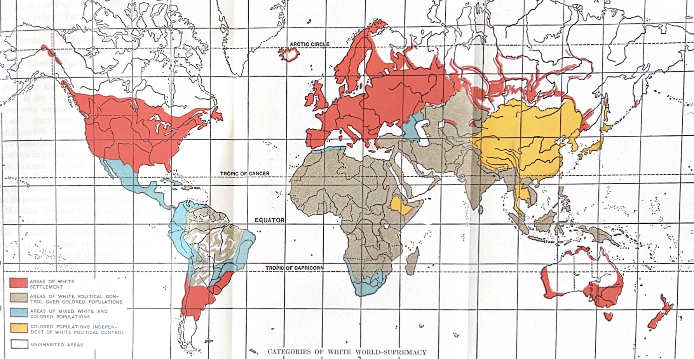
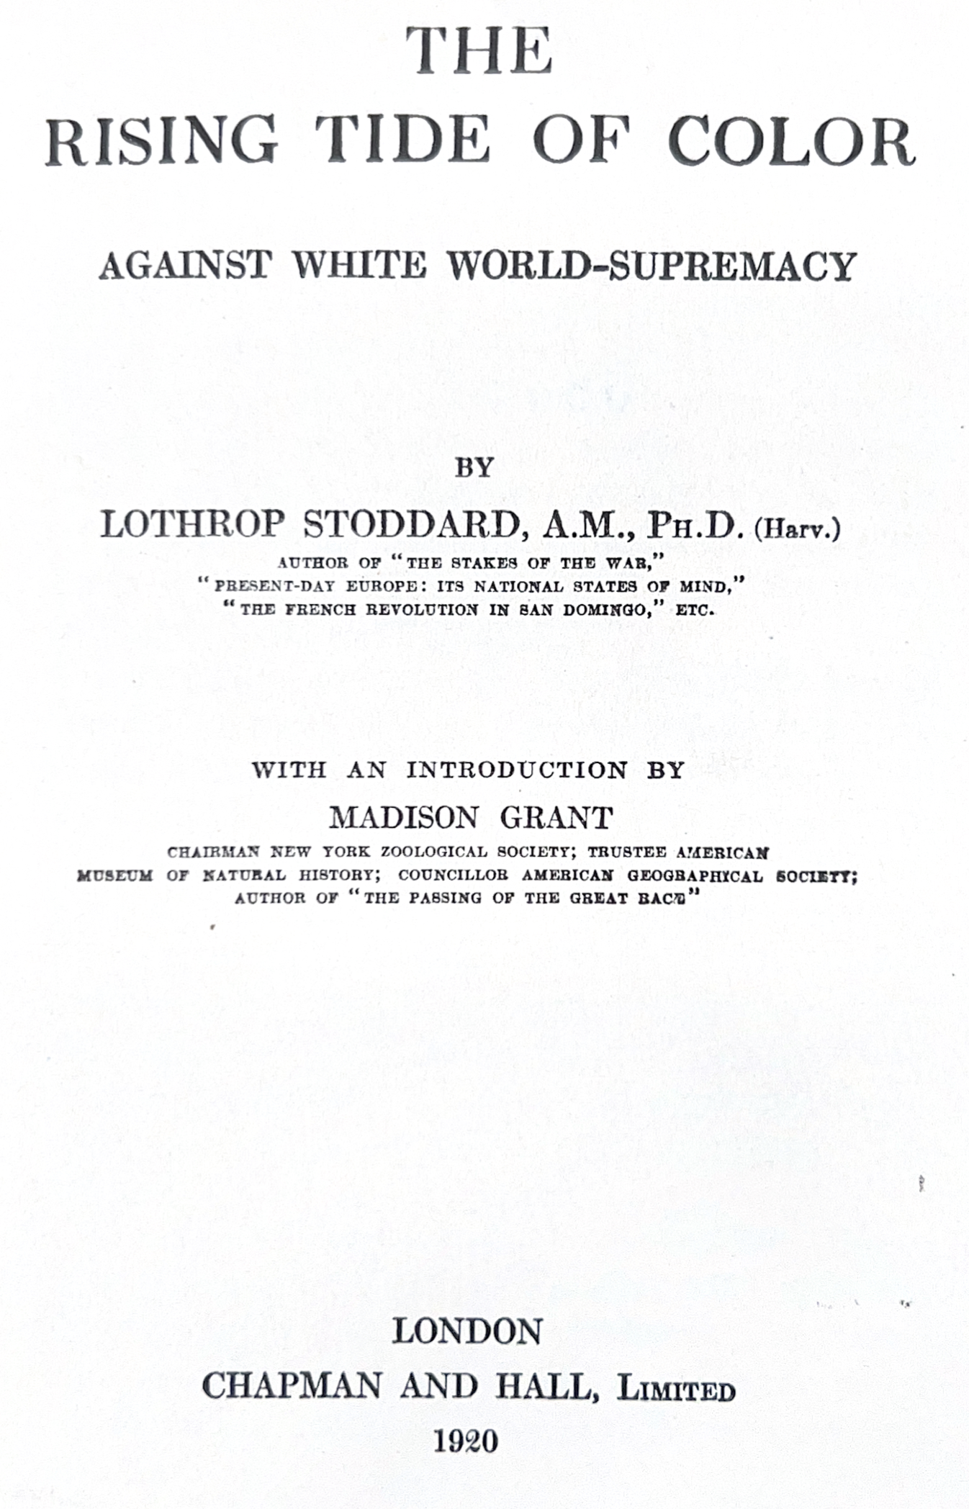

Slide 49
During the closing decades of the past century, not only were biology and economics less advanced than to-day, but they were also infinitely less widely understood, exact knowledge being confined to academic circles… biologists had recently formulated the law of the "Survival of the Fittest." This sounded very well. Accordingly, the public, in conformity with the prevailing optimism, promptly interpreted "fittest" as synonymous with "best," in utter disregard of the grim truth that by "fittest" nature denotes only the type best adapted to existing conditions of environment, and that if the environment favors a low type, this low type (unless humanly prevented) will win, regardless of all other considerations.
So again with economics. A generation ago relatively few persons realized that low-standard men would drive out high-standard men as inevitably as bad money drives out good, no matter what the results to society and the future of mankind. These are but two instances of that shallow, cocksure nineteenth-century optimism, based upon ignorance and destined to be so swiftly and tragically disillusioned.
The Rising Tide of Color (1920), p. 150

Slide 50
“An Englishman Tastes the Sweat of an African” (1725)
Documents everyday life in the slave trading post of Calabar, West Africa. Part of a work that later became a kind of instructional guide for European seafarers, it shows a man being examined before he’s sold into slavery and shipped to the New World… The tall, well-built African slave dressed only in a loincloth crouches on his knees so that a skinny-legged, fully clothed Englishman with a sword hanging by his side can reach his face with an outstretched tongue to lick his chin.
The licking, Roland Fryer at Harvard University has suggested, may have been to gauge the saltiness of the African man’s body, because being a little brinier might better equip him to handle the long sea voyage to the New World. It’s an idea inspired by a scientific theory that black Americans, mostly the descendants of slaves, process salt differently from white Americans.
Superior (2019), pp. 177-178.

Slide 51
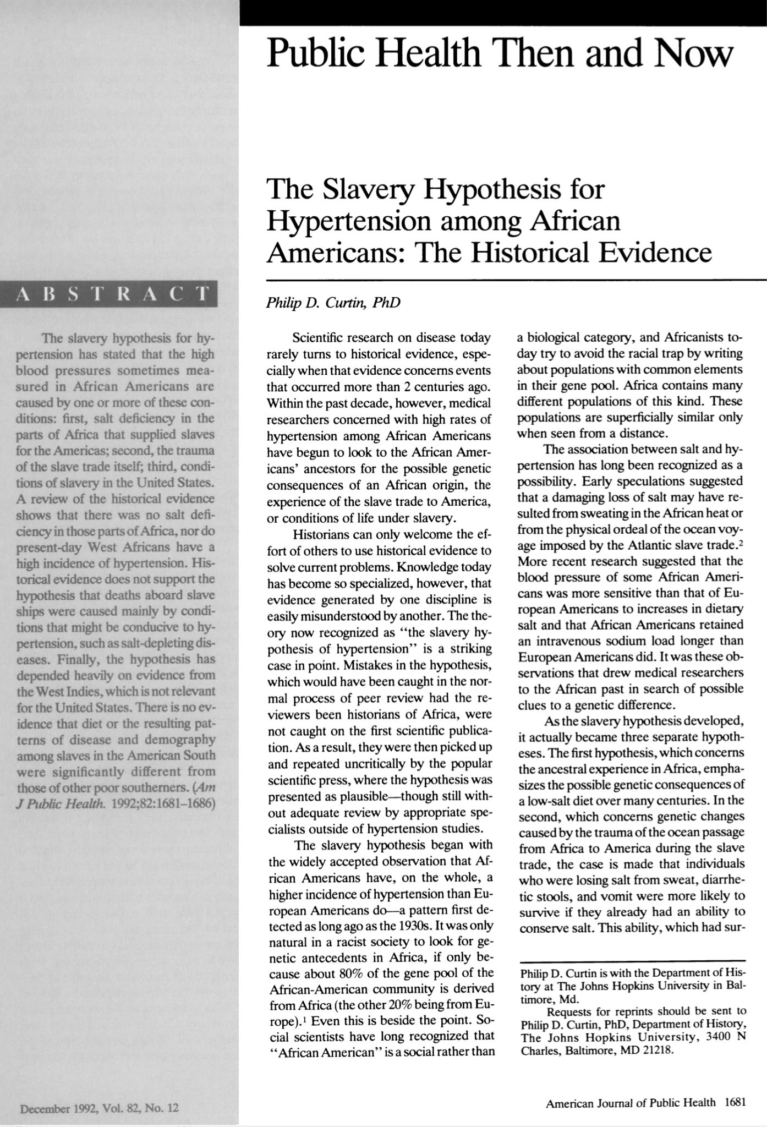
People wanted so much for the story to be true, to be able to link the trauma of slavery to the trauma of black American deaths today, that they couldn’t look past it to more mundane explanations. Hypertension, Cooper says, is a case of science being retrofitted to accommodate race. The data, the theories, the facts themselves, are rotated and warped until they fit into a racial framework we can relate to. This is the power of race. It is the power to twist science to its own ends.
Saini, Superior (2019)

Slide 52
How could it possibly be that a group called black people, which first of all is defined differently around the world—it’s been defined differently even within the United States, but the current definition in the United States is anyone with any discernible African ancestry—how could that hugely varied group, which could include someone with mostly European ancestry, someone with mostly Asian ancestry, someone with mostly Native American ancestry, how could it possibly be that that group could have a particular health outcome for an innate biological reason? That just doesn’t make sense… The most plausible, to me the only possible, explanation could be because of inferior social conditions.”
Professor Dorothy Roberts, quoted in Saini, Superior (2019), pp. 195-196.

Slide 53
“Since 1993 the National Institutes of Health, the largest funder of medical research in the world, has had a general policy of requiring the clinical trials it supports to include women and minorities and also to collect data by race, across at least six categories. The purpose of this was never to look for differences between groups, but to ensure that medical studies include a broader spread of the population. As a demographic exercise, then, it made no difference that all black people, whether born in Africa or the United States, are today lumped by the National Institutes of Health into one general category, despite the prevalence of hypertension in their birth countries being completely different.”
The US government provides millions and millions of dollars of grant money targeted to this question - which creates an incentive to answer it with whatever variables are available.
“It would be the same if funding agencies suddenly began collecting data by hair color as well as by race and sex. You would be almost certain to see studies suggesting biological differences between people with brown hair and blond hair. Just having the data invites comparisons.”
Saini, Superior (2019)

Slide 54
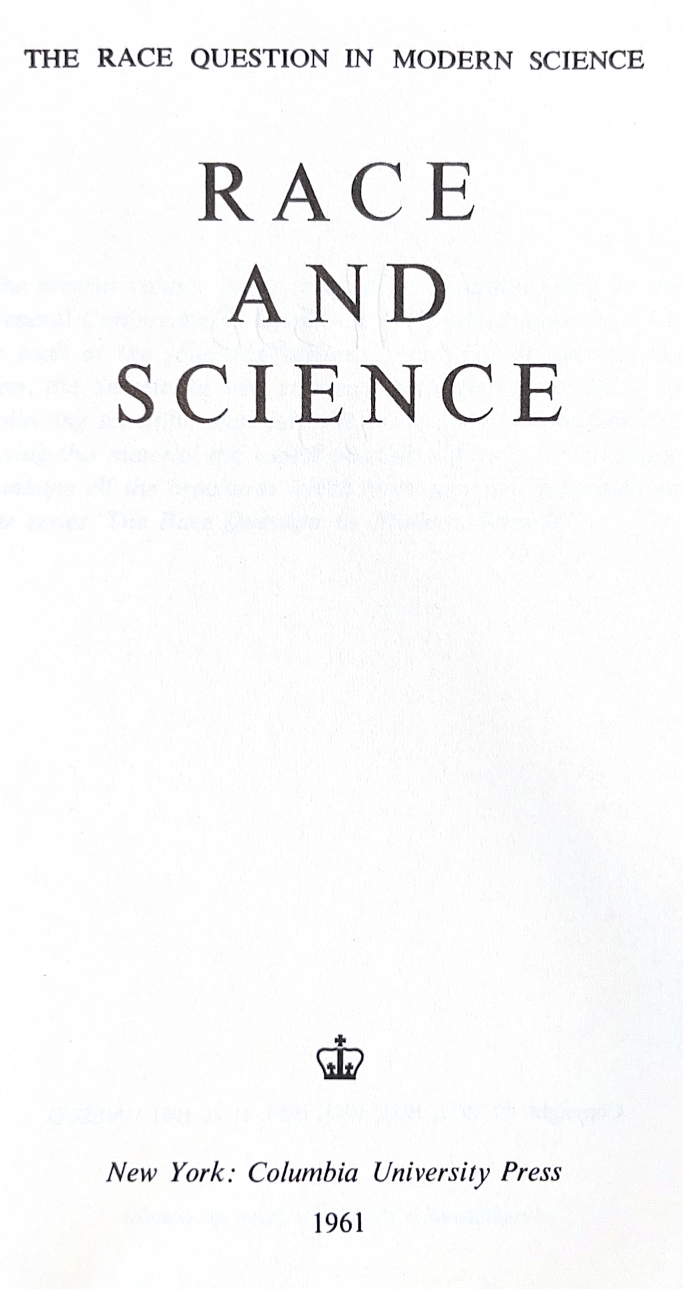
The notion of “race” is so charged with emotional force that objective discussion of its significance in relation to social problems is uncommonly difficult. There is no scientific basis whatsoever for a general classification of races according to a scale of relative superiority, and racial prejudices and myths are no more than a means of finding scapegoat when the a position of individuals and the cohesion of a group are threatened.
Persons differing in physical appearance are easily identifiable targets for aggression, while in psychological terms the feeling of “guilt” is removed or mitigated, given a more or less plausible “scientific” theory whereby it can be shown that the group attacked is “inferior” or “harmful.” Generally speaking, such “aggression” is directed either against minority groups or against cowed and powerless majority groups.
Race and Science (1961), p 51

Slide 55
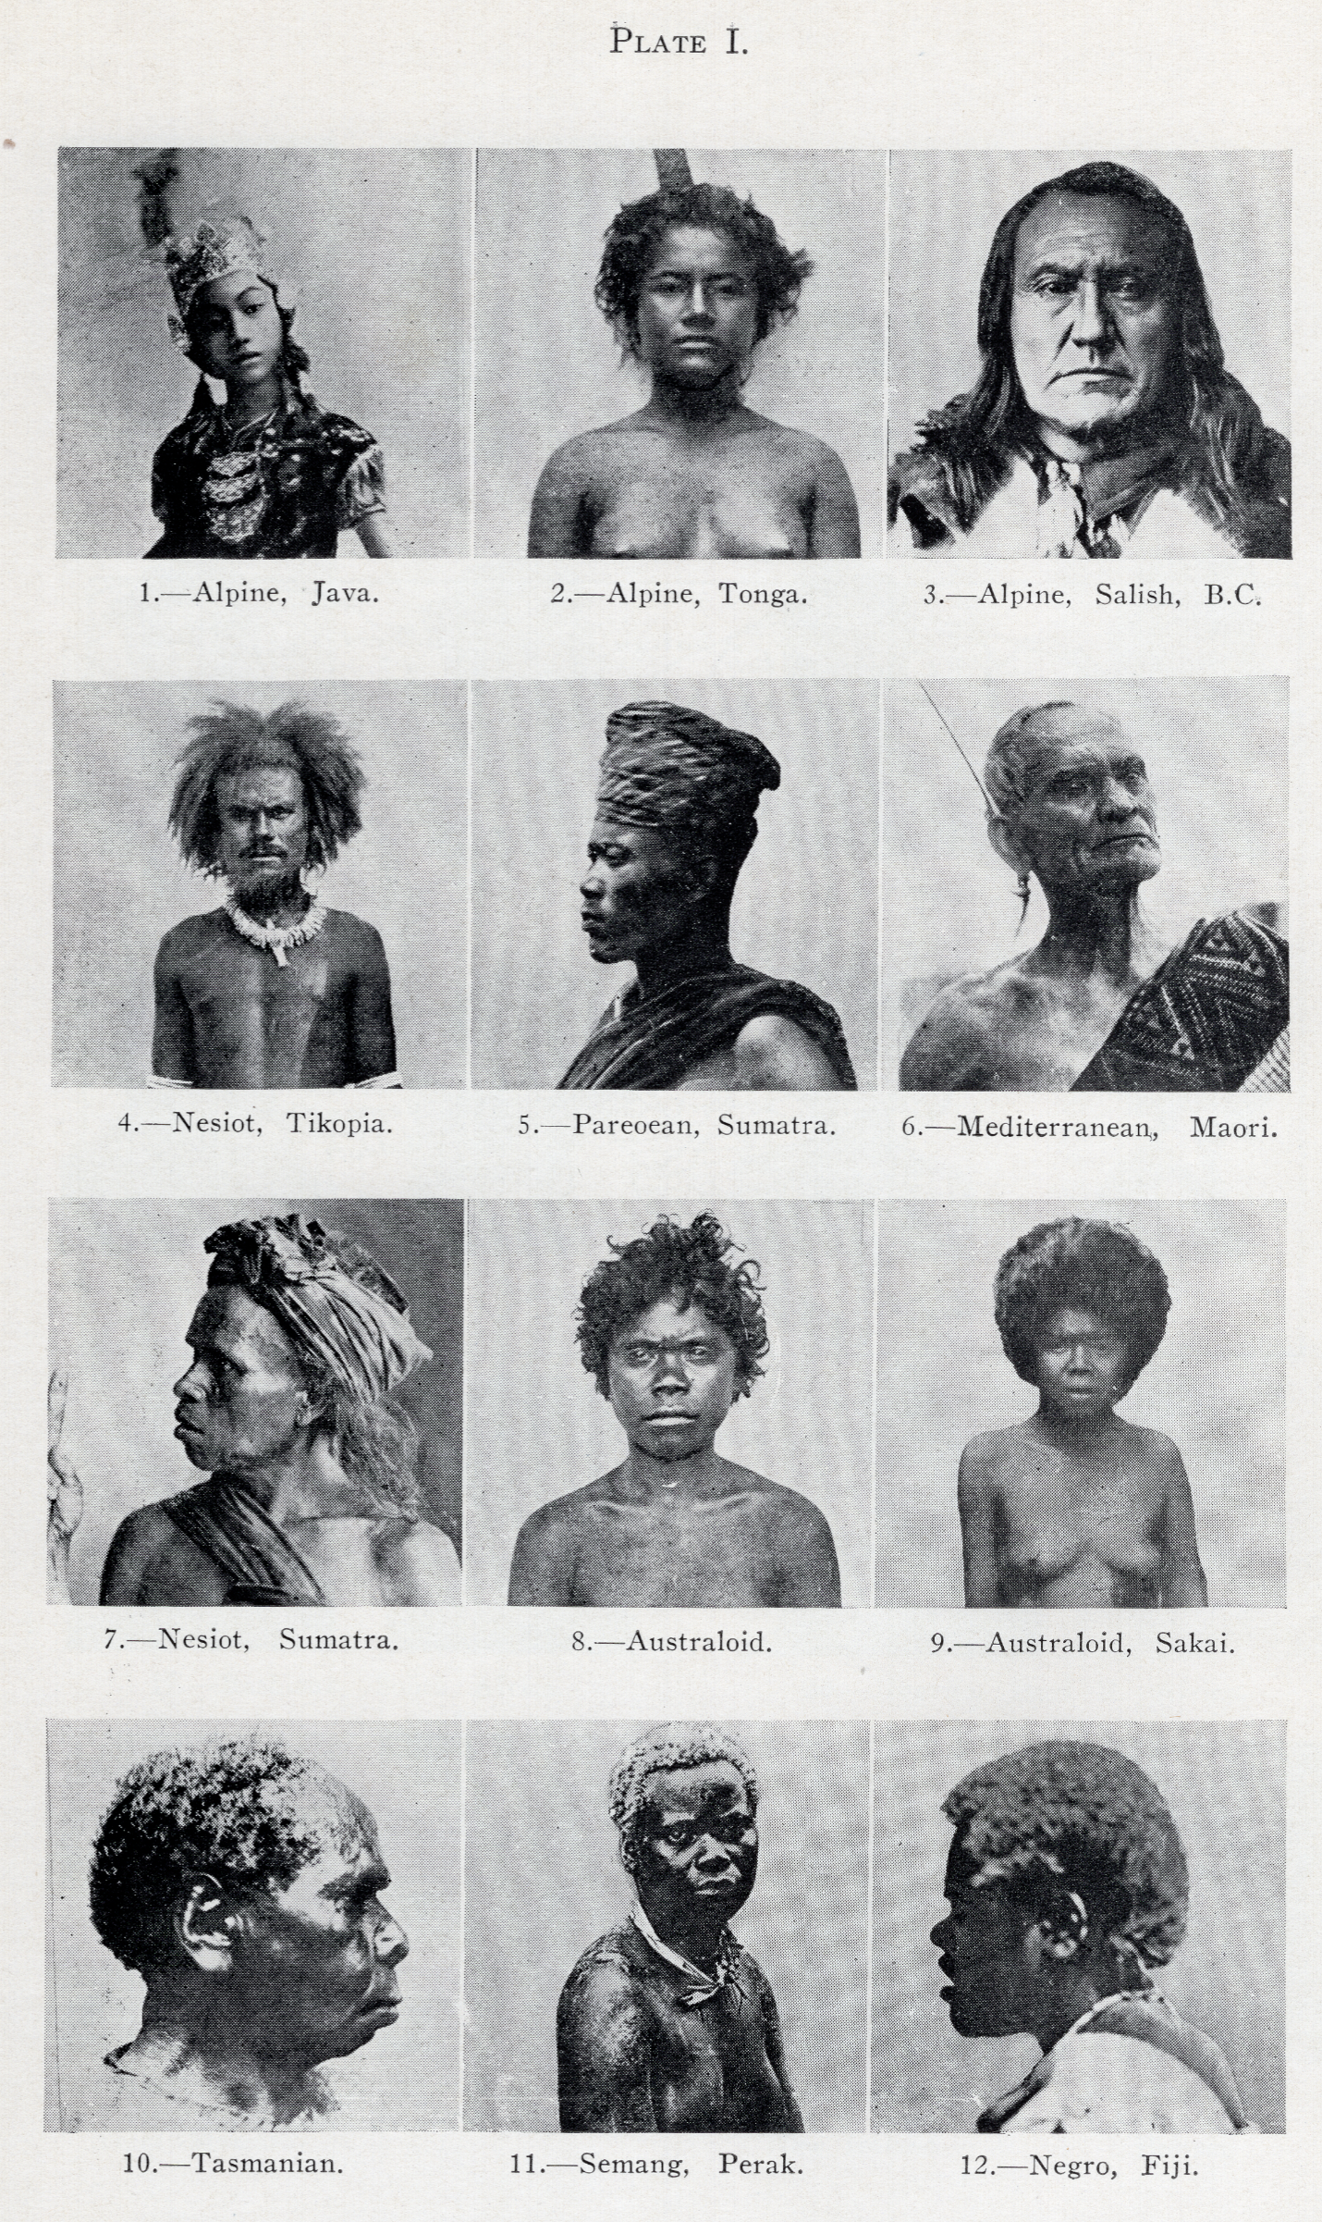
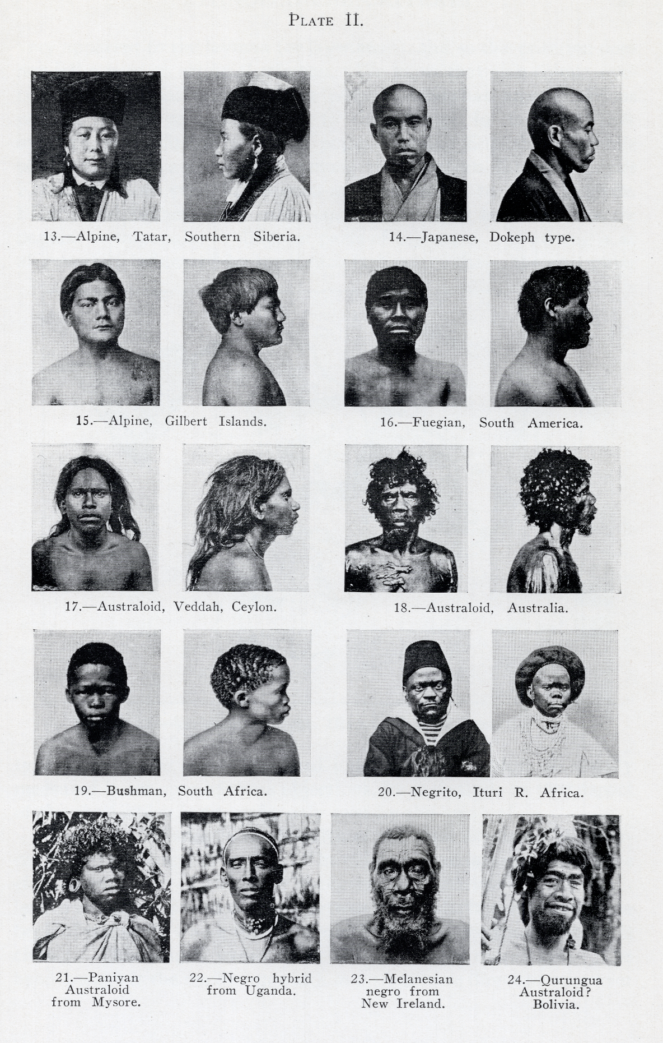
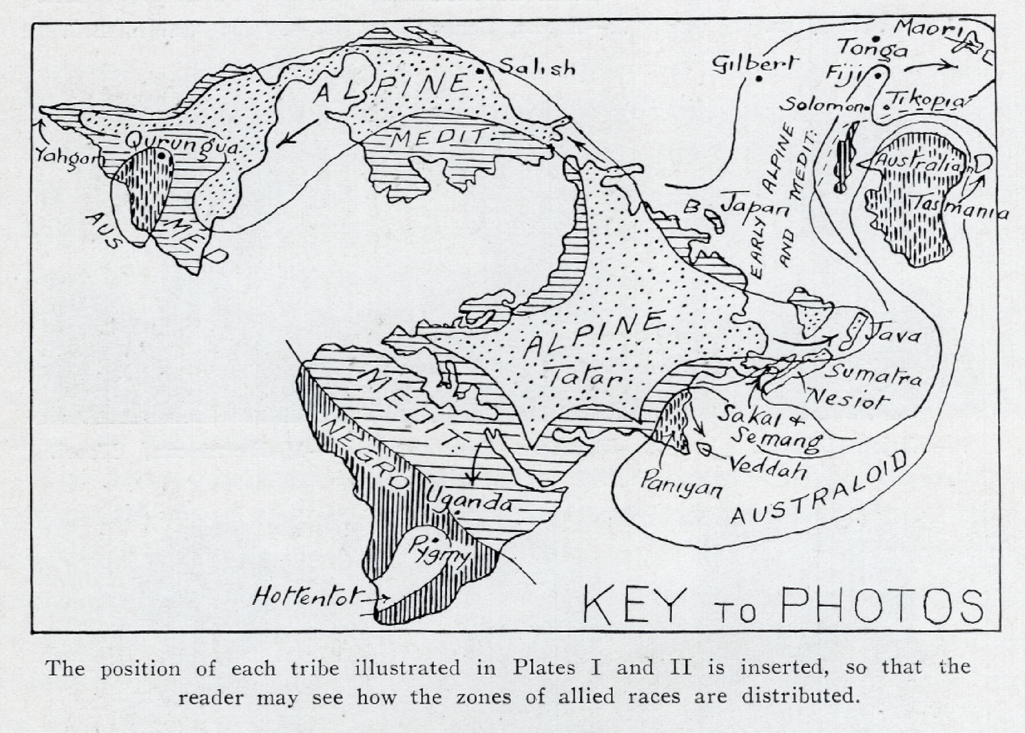
Taylor, Environment, Race and Migration (1937).

Slide 56
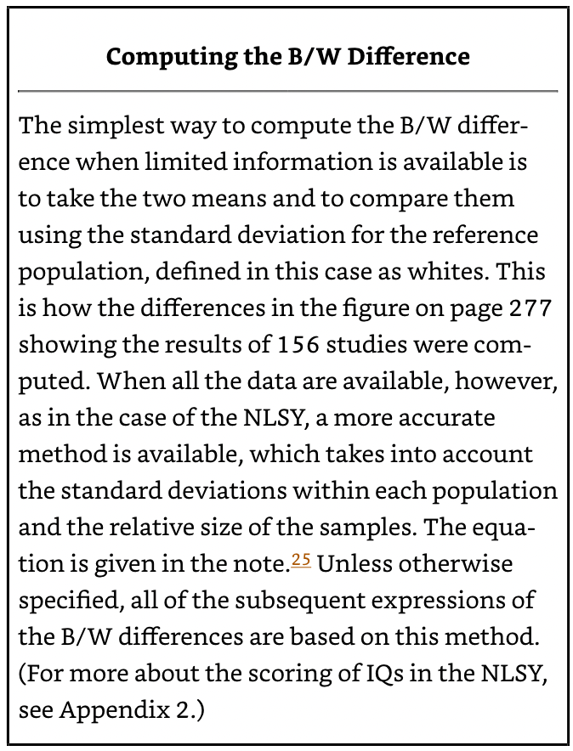
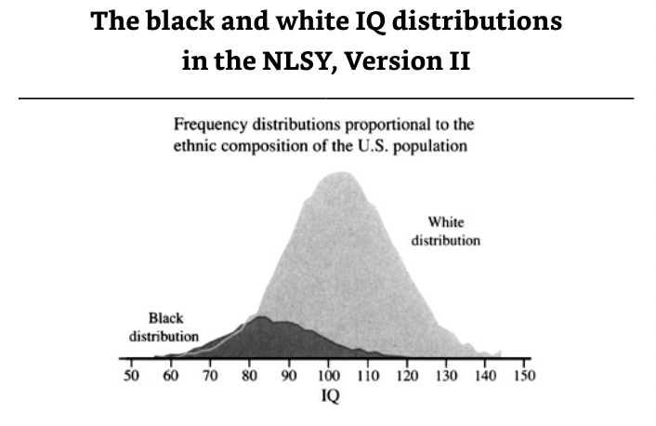
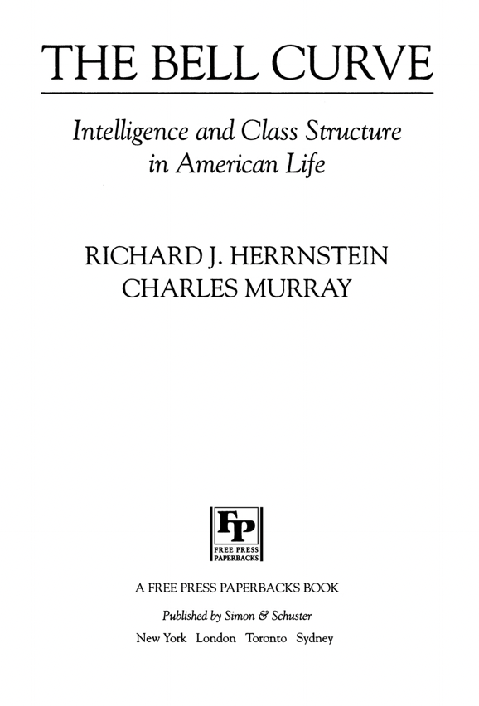
1994

