Slide 1
BMI 510: dnorm and pnorm
J. Lucas McKay, Ph.D., M.S.C.R.
Departments of Biomedical Informatics and Neurology, Emory University, Atlanta, GA USA
Department of Biomedical Engineering, Georgia Institute of Technology, Atlanta, GA, USA

Slide 2
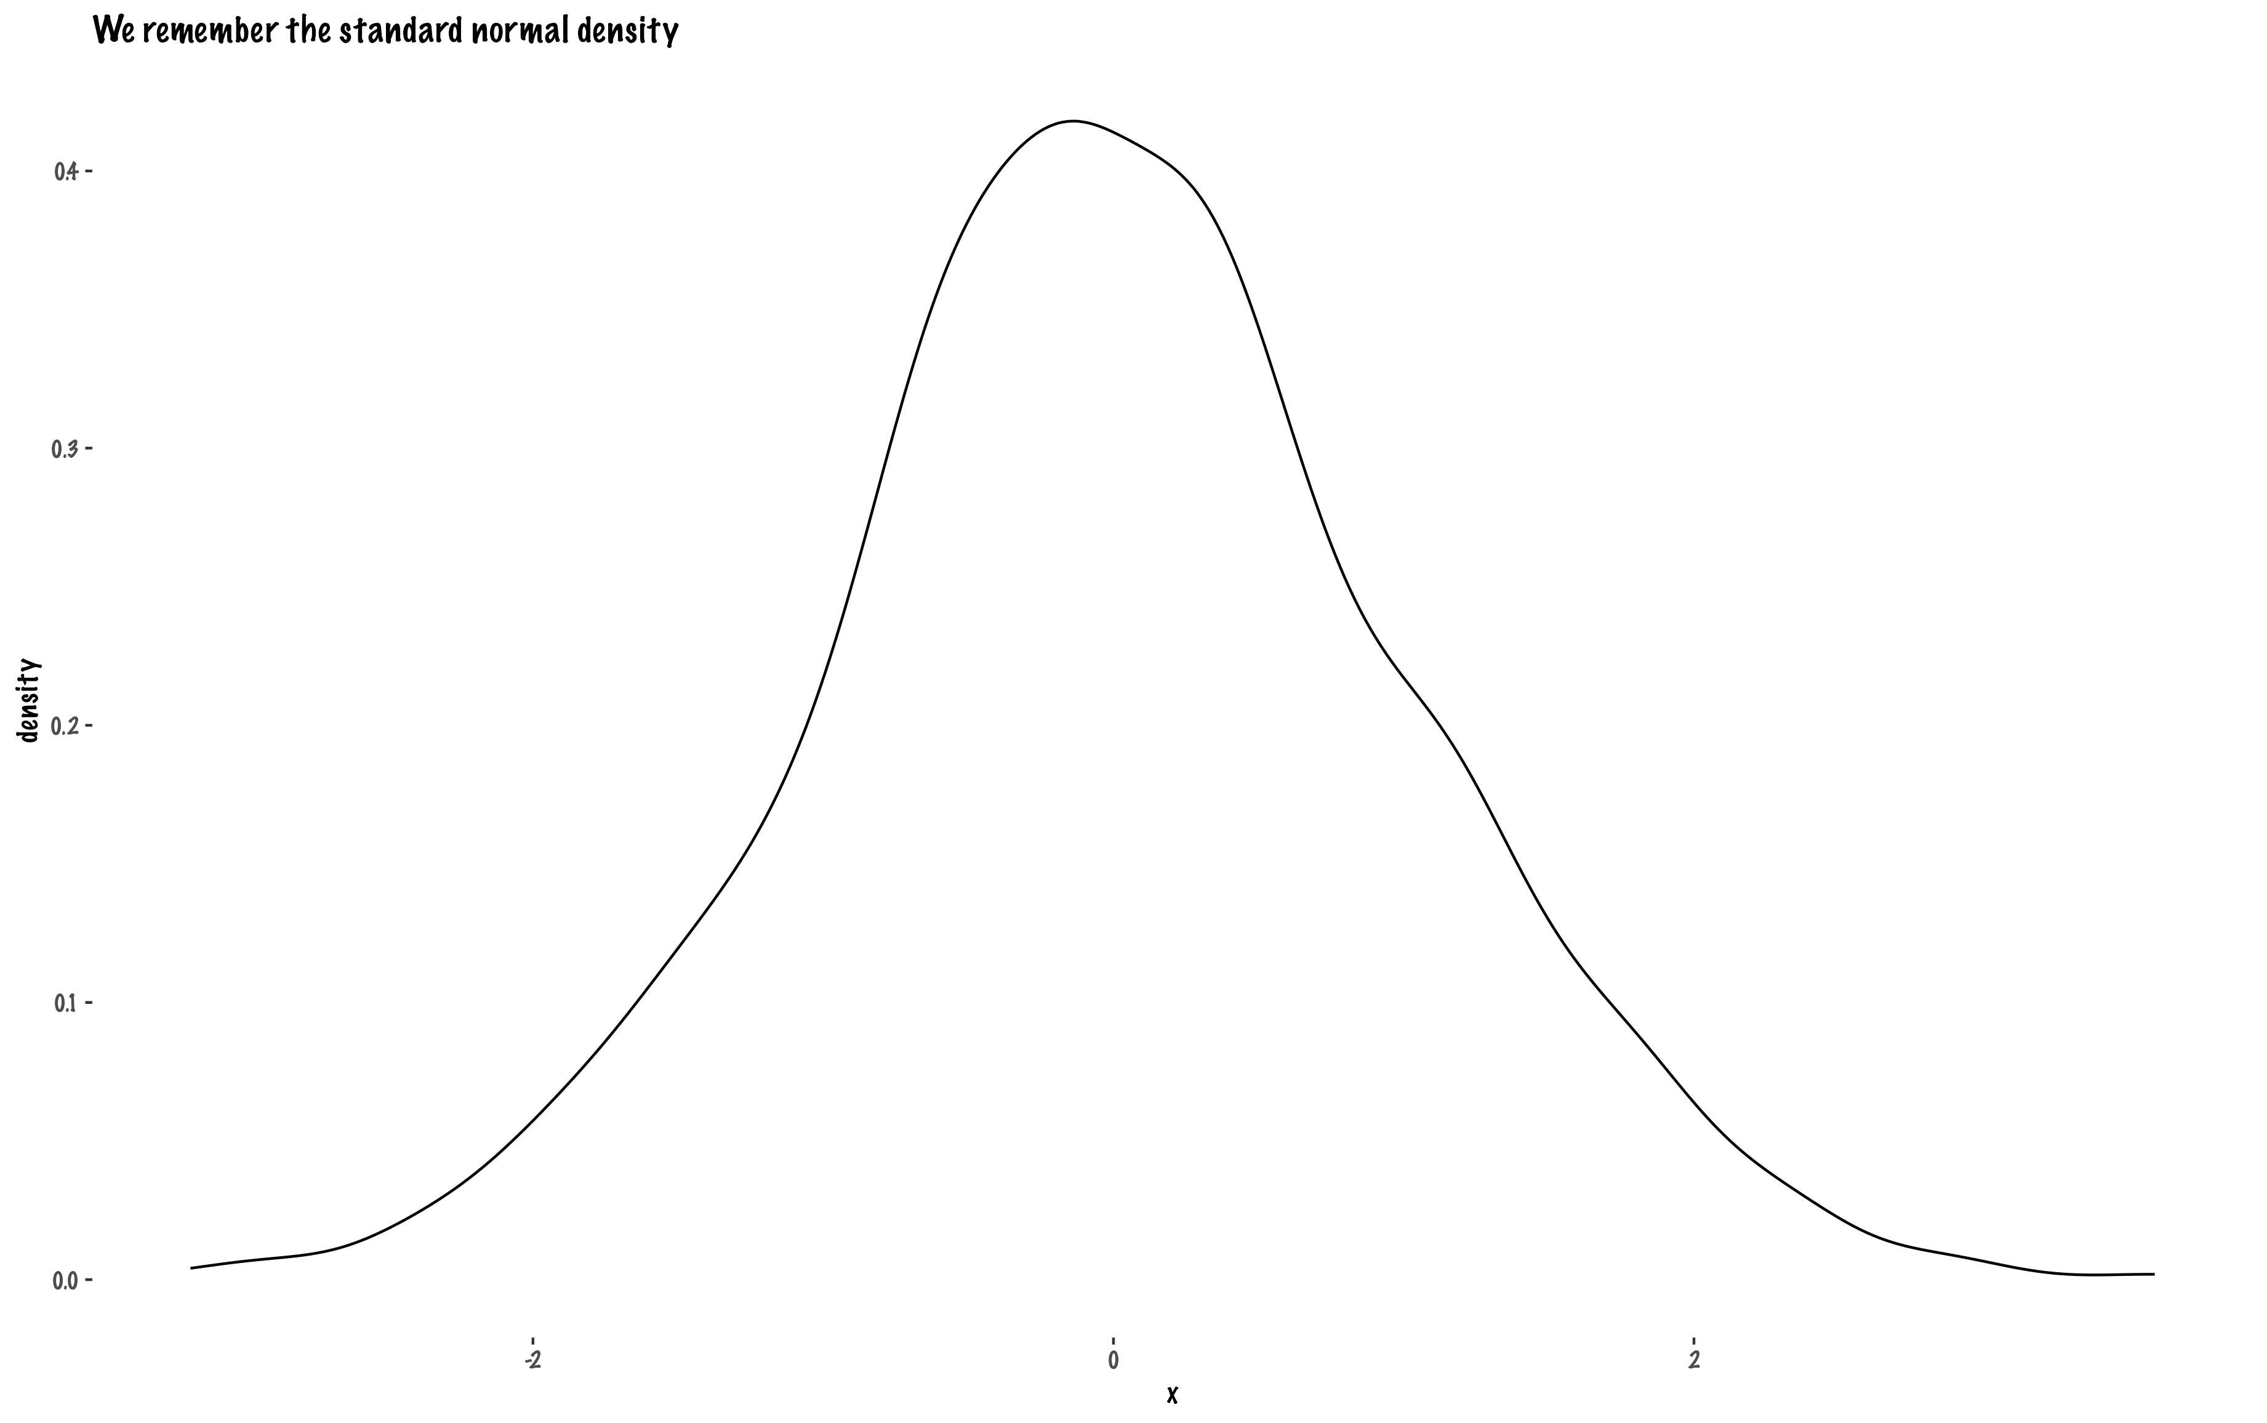

Slide 3
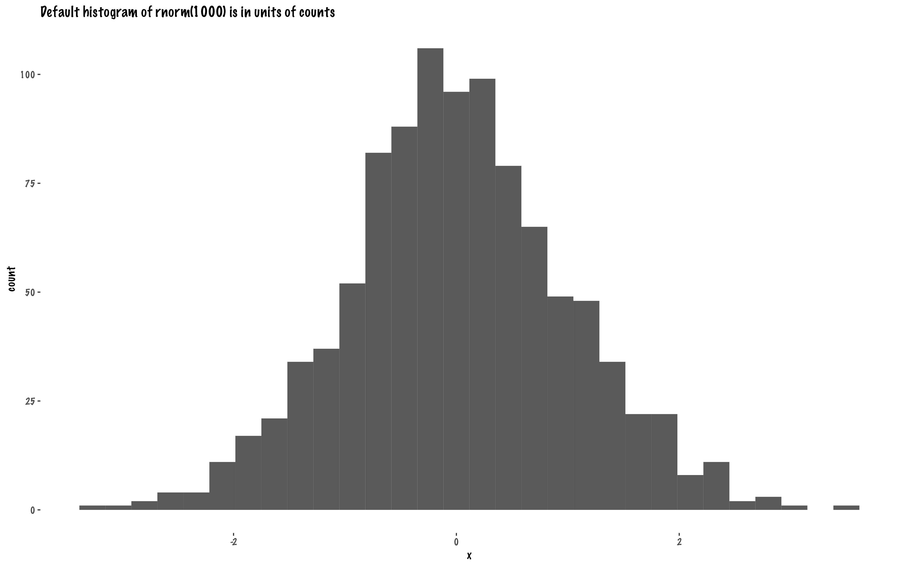

Slide 4
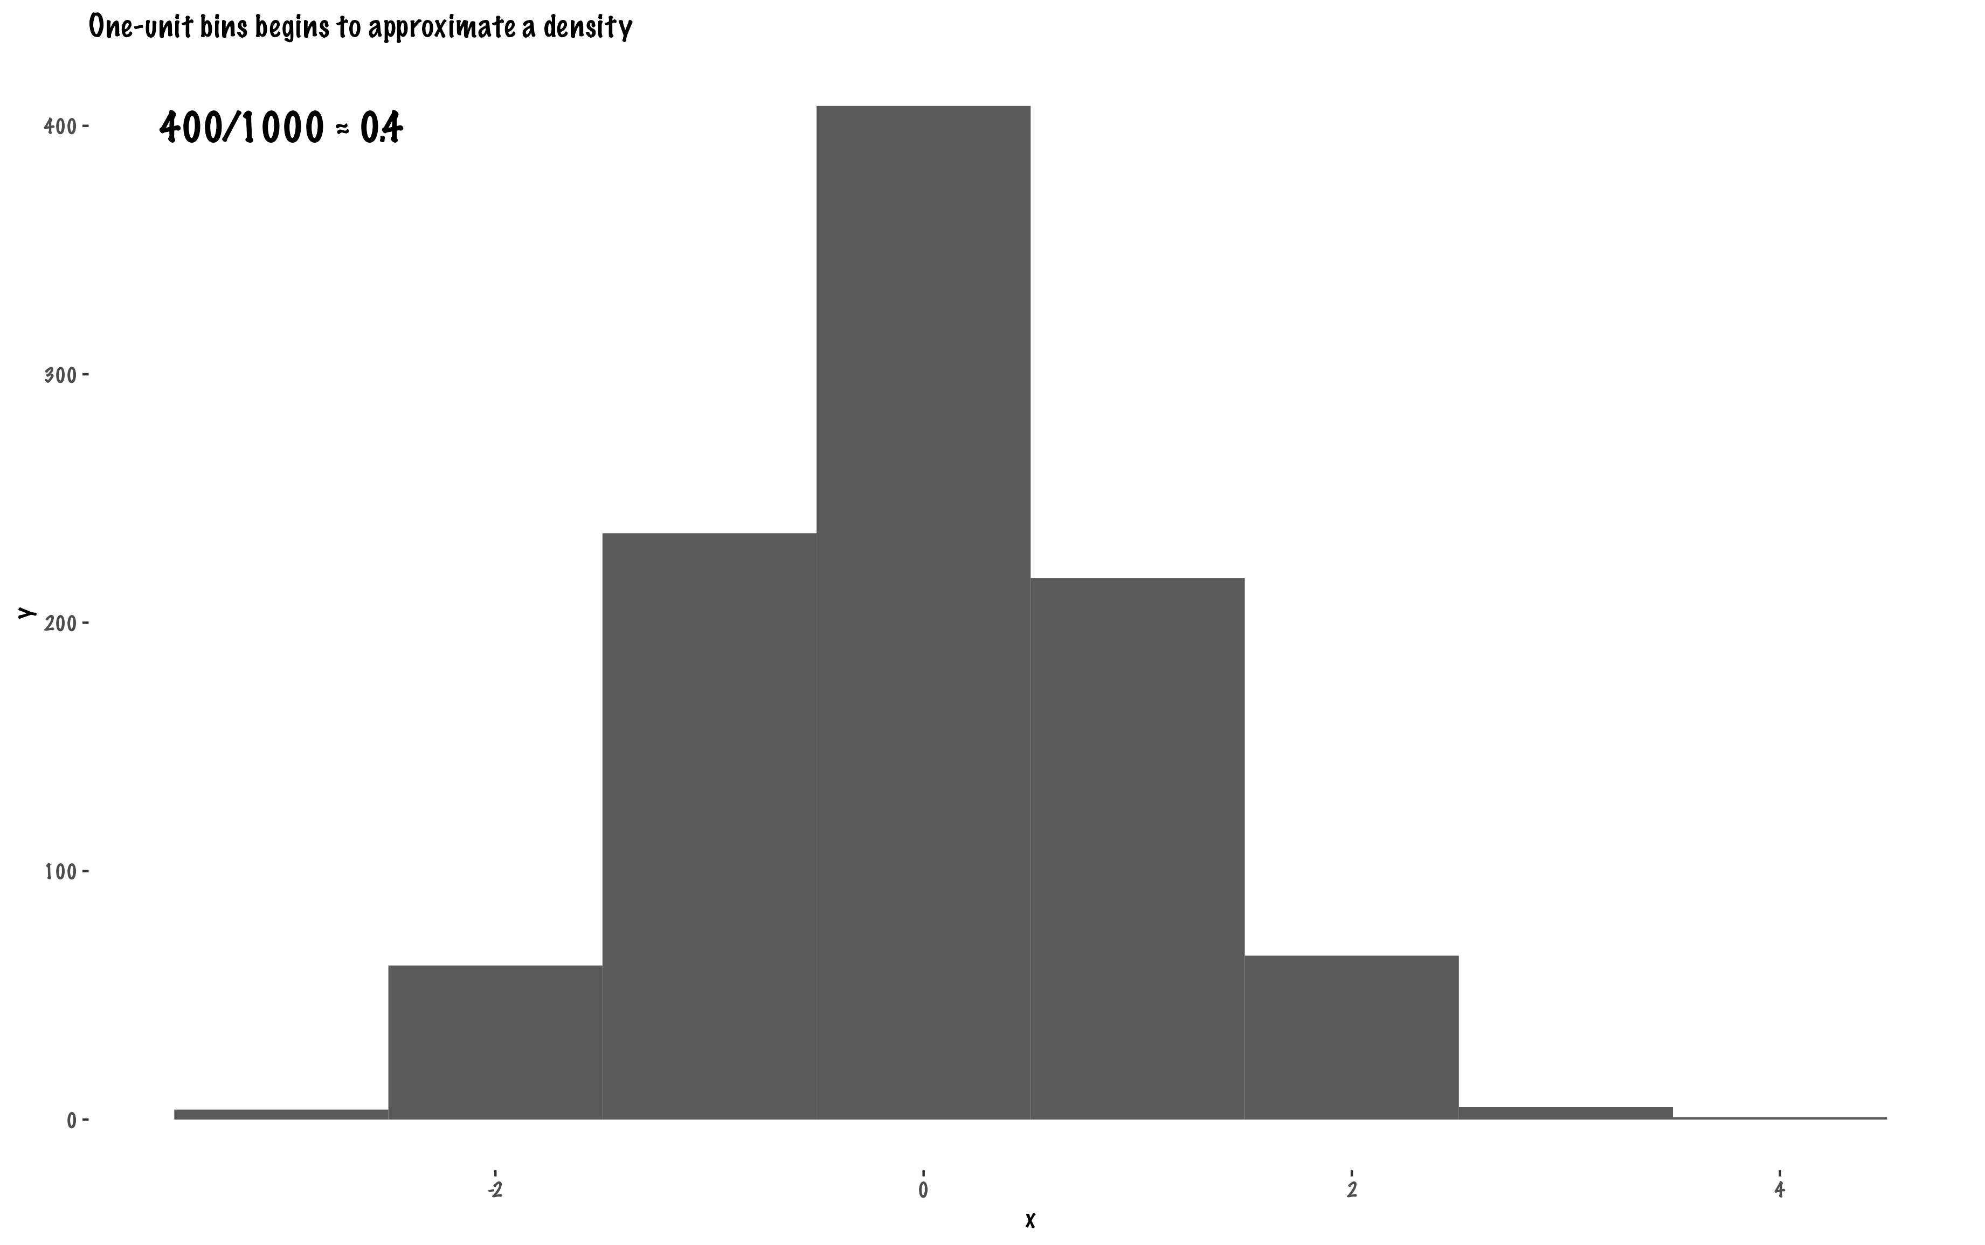

Slide 5
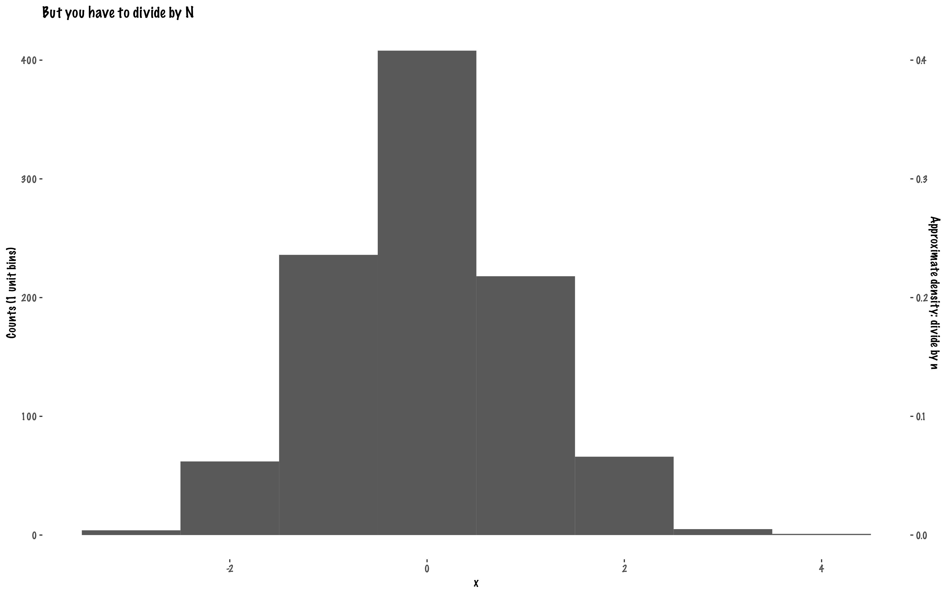

Slide 6
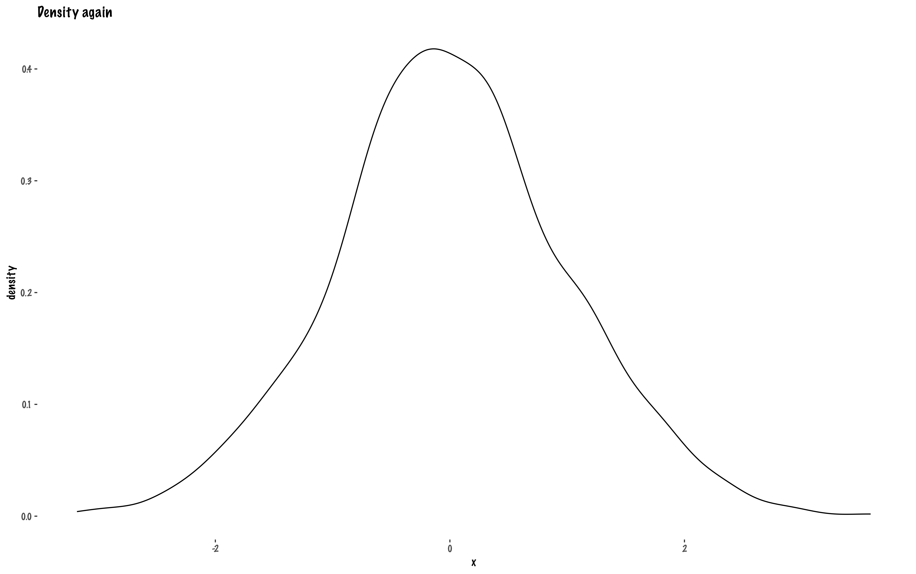

Slide 7
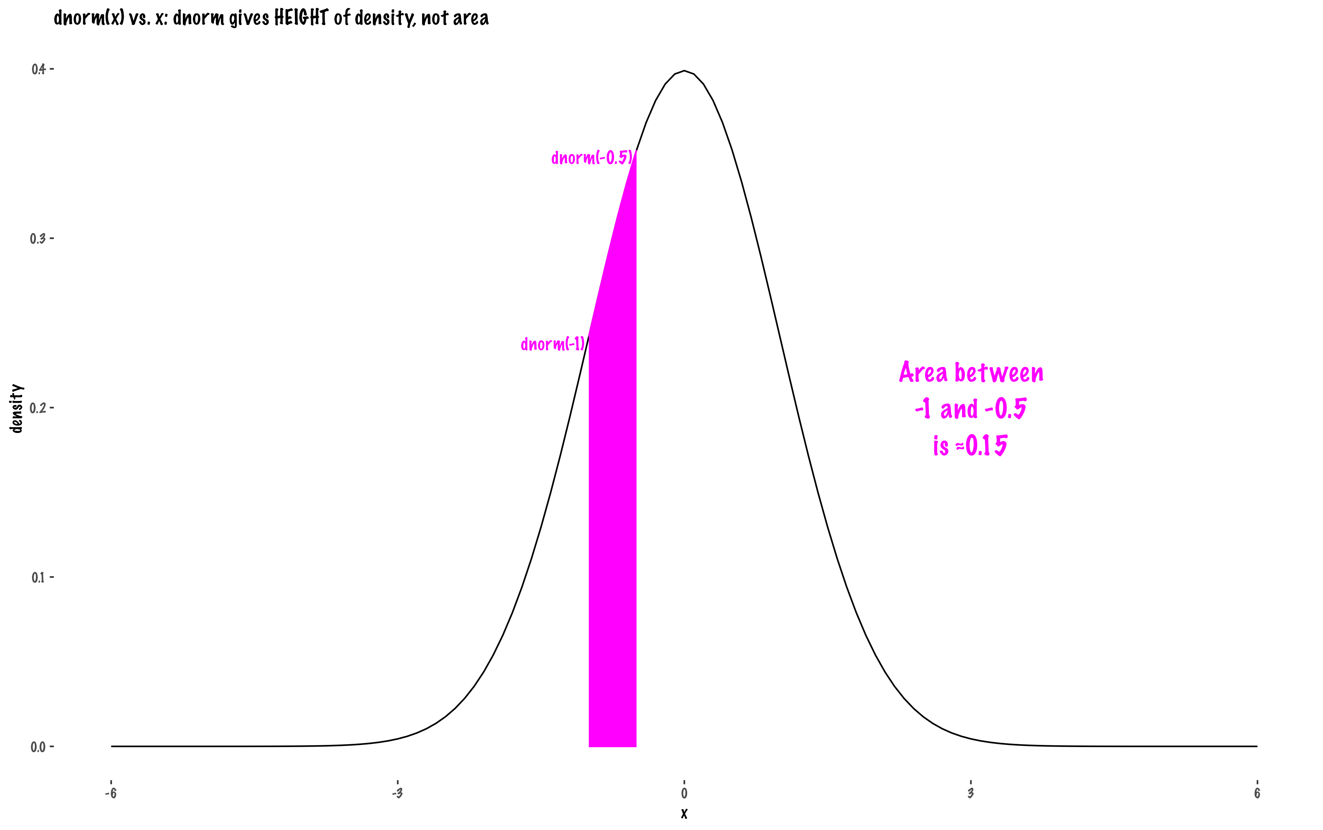

Slide 8
