Slide 1
BMI 510: Time-To-Event Analyses
J. Lucas McKay, Ph.D., M.S.C.R.
Departments of Biomedical Informatics and Neurology, Emory University, Atlanta, GA USA
Department of Biomedical Engineering, Georgia Institute of Technology, Atlanta, GA, USA

Slide 2
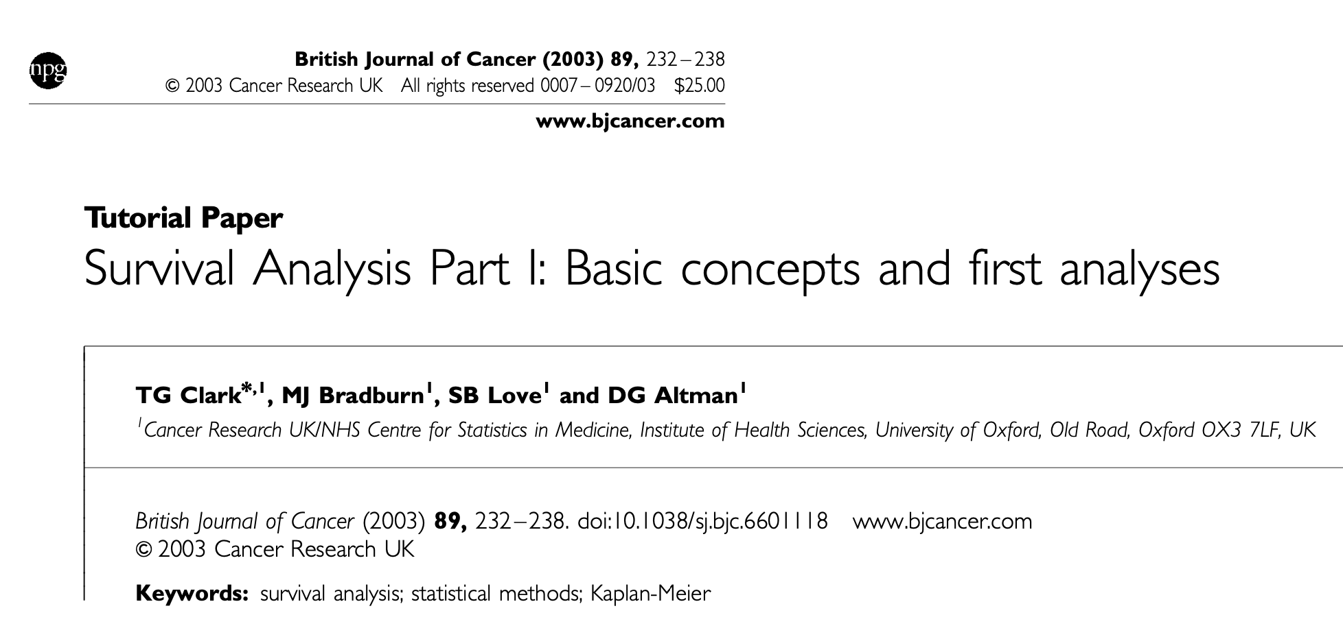
References
Some of this material is adapted from Course Notes developed by Mitch Klein, Ph.D.
Whole courses are devoted to time-to-event/survival analyses. The paper below is a nice reference.

Slide 3
Outline
Estimating survival
Kaplan-Meier and the Survival function
Comparing Survival Curves
Cox Proportional Hazards
Anderson-Gill

Slide 4
Estimating Survival
Suppose a disease free cohort of 100 people were followed over time for the purpose of estimating the risk of disease.
After 3 years, 20 of the people had the disease. Use this information to estimate the risk of obtaining disease.
Estimate the survival.
What is the relationship between risk and survival?

Slide 5
Estimating Survival
Suppose the cohort continued to be followed for an additional 2 years (5 years in all).
In the additional 2 years, 5 more people contracted disease.
Estimate the 5 year risk of disease.
Estimate the 5 year survival.

Slide 6
Estimating Survival
Similar scenario as the previous one in that:
100 people are followed
20 contract disease in the first 3 years
another 5 people contract disease over the next two years
The additional information is that:
40 people, who did not contract disease in the first three years, left the study one minute prior to the 3 year mark.
They left the country and were never heard from again.
Estimate the 5 year survival for the disease.

Slide 7
Consider 3 approaches
Approach 1
Use all 100 people in the denominator as if there was no loss to follow-up..
Approach 2
Exclude the 40 people with missing data from the analysis, as though they never entered at all.
$$8$$
Approach 3
Use a product limit approach.

Slide 8
Consider 3 approaches
Approach 1
Use all 100 people in the denominator as if there was no loss to follow-up.
$\frac{75}{100}=0.75$
Approach 2
Exclude the 40 people with missing data from the analysis, as though they never entered at all.
$\frac{35}{60}=0.58$
Approach 3
Use a product limit approach.

Slide 9
The product-limit approach
Breaks up time into subintervals:
Probability of surviving successive intervals A and B equals the probability of surviving interval A times the probability of surviving interval B given survival of interval A.
$$P\left(A and B\right)=P\left(A\right)P\left(B | A\right)$$
$$P\left(A and B and C\right)=P\left(A\right)P\left(B | A\right)P\left(C | AB\right)$$
Etc.
Suppose the probability of an individual surviving past age 70 is 0.5 and the probability of surviving past year 80 given the individual survived past year 70 is also 0.5. Then what is the probability that the individual survives past year 80?

Slide 10
The product-limit approach
Most survival methods rely on this concept to estimate survival as a time varying function.
The key thing that is going on is that censorship is not a marker for an increased (or decreased) risk of failure (i.e., independent censoring).
Example – the 40 subjects who were censored at 3 years had the same risk of event within the 3 year period as the 40 who were not lost to follow-up.
We will see that you can make this as precise as possible by adjusting the survival function every time a patient has an event, or is lost-to follow up.

Slide 11
The product-limit approach
N=100 in risk set
N=40 still in risk set
N=20 events
N=5 events
N=100
Y3
Y5
N=40 lost, assumed
to have survived until
just before end of period

Slide 12
The product-limit approach
N=100 in risk set
N=40 still in risk set
N=20 events
N=5 events
N=100
Y3
Y5
N=40 lost, assumed
to have survived until
just before end of period
P(Survived3)
= 80/100=0.8
P(Survived5|Survived3)
= 35/40=0.875
P(Survived5)=
0.8•0.875=0.70

Slide 13
Two key measures in survival analysis
The survival function $S(t)$ is defined as the probability of surviving at least to time t. The hazard function $h\left(t\right)$ is the conditional probability of dying at time t having survived to that time.
Hazard function $h(t)$ is a measure of instantaneous event rate, or the probability that the time to the event $T$ will be within a window $Δt$:
$$h\left(t\right)=lim⁡(Δt→0)\frac{P(t≤T<t+Δt)}{Δt}$$
Survival function $S(t)$ is the the probability of surviving past time $t$:
$$S\left(t\right)=P(T>t)$$
These are directly related:
$$h\left(t\right)=−\frac{d}{dt}\left[\log{S(t)}\right]$$

Slide 14
Outline
Estimating survival
Kaplan-Meier and the Survival function
Comparing Survival Curves
Cox Proportional Hazards
Anderson-Gill

Slide 15
Estimating the Survival function
There are two main ways to estimate overall the Survival function, which are good to know about but not as useful in practice as the Cox model, which we will discuss shortly.

Slide 16
Estimating the Survival function
Kaplan-Meier
Time intervals are determined by each event-time in the data.
Every time of event is used to begin a new time interval.
If a subject is censored at the beginning (or middle) of a time interval, then that subject is assumed to have survived that interval. The censored subject leaves the risk set for subsequent intervals.
Use product limit approach to estimate survival function.
Life Table
Time intervals are determined arbitrarily by the user. Decade of life is common.
If a subject is censored at the beginning (or middle) of a time interval, then that subject is assumed to have survived that interval but only contributes one-half to the risk set. The censored subject leaves the risk set for subsequent intervals.
Use product limit approach to estimate survival function.

Slide 17
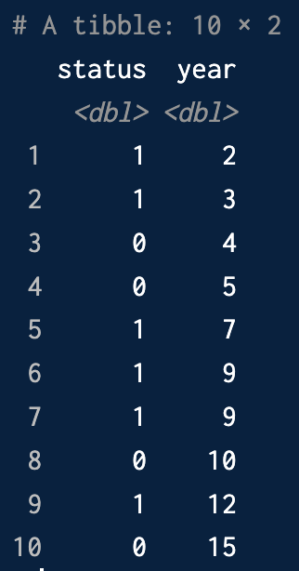
Kaplan-Meier Example
Let’s consider these data.
These are ten patients in an imaginary study. They were followed until either an event (say, a heart attack) or until they were lost to follow-up.
status==1 designates heart attack, status==0 designates loss to follow-up.
Note that these data are sorted in ascending order of time to event. This is important.

Slide 18
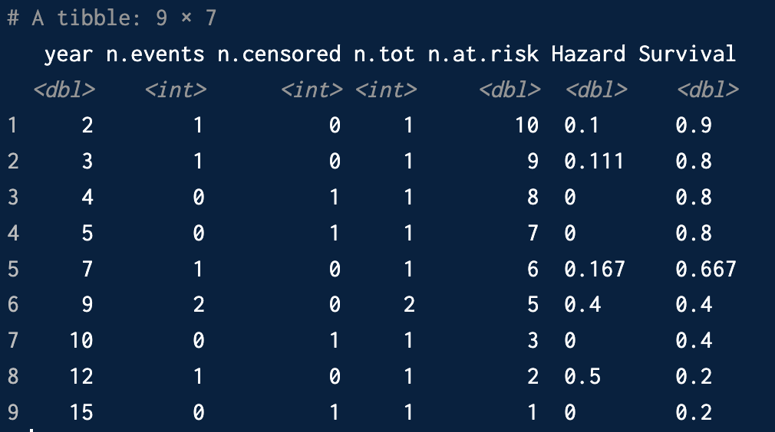
Kaplan-Meier Example
In K-M, each event cuts up the timeline.
Patients who are censored in each interval are assumed to survive until the next reported event.
The number at risk is the number of patients entering each time period; the risk will be the number of events (either one or zero) in this period/the number at risk.

Slide 19
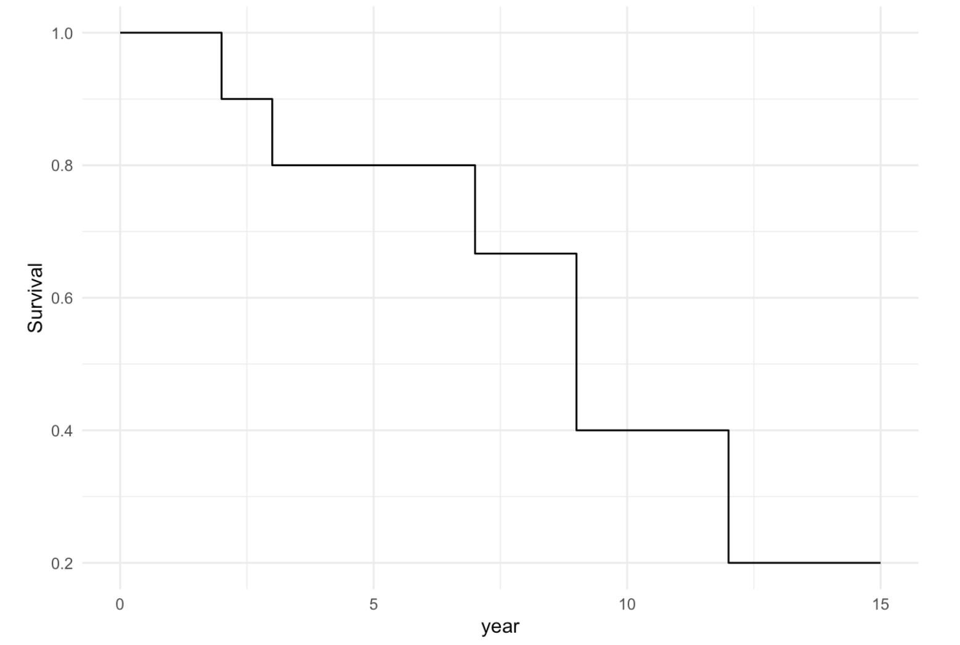
Kaplan-Meier Example
This can be assembled into a “Survival curve.”

Slide 20
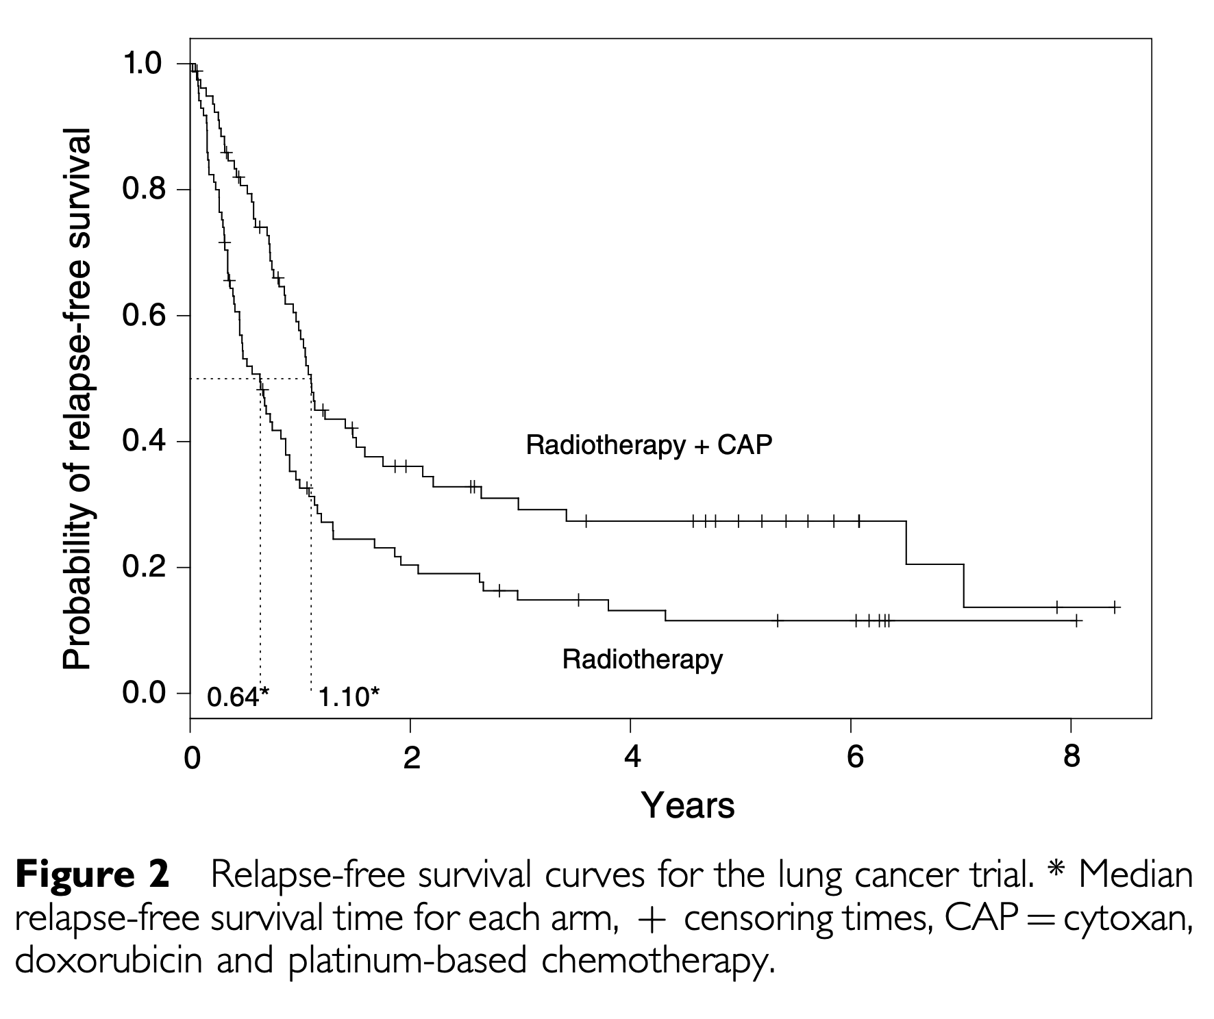
Comparing Survival Curves: Treatments
Note censoring crosses:
these patients are assumed
to survive until next event
Clark, Bradburn, Love, Altman 2003

Slide 21
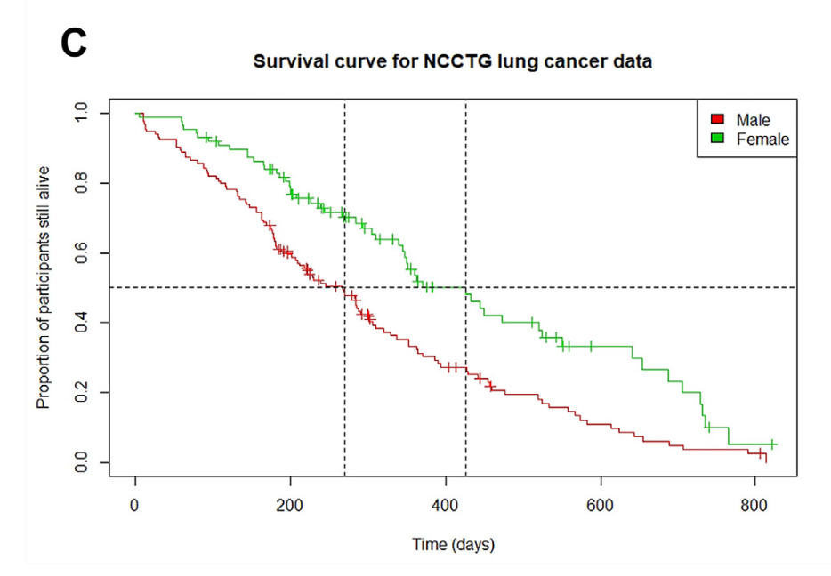
Comparing Survival Curves: Covariates
J. Emmerson, J.M. Brown / Clinical Oncology 33 (2021) 12-14

Slide 22
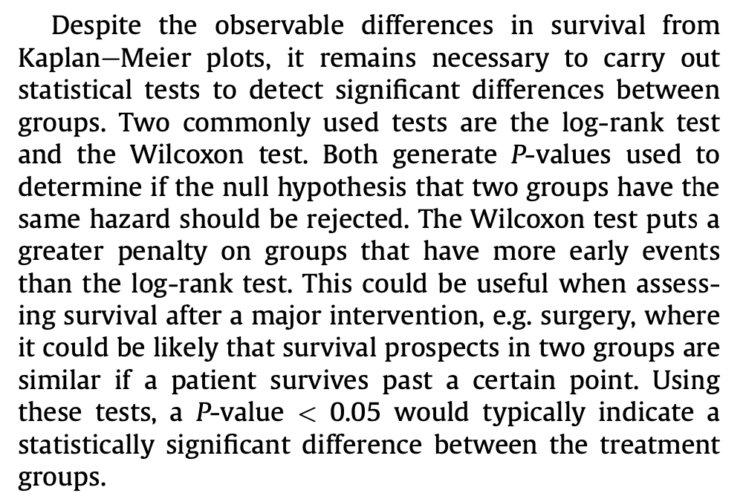
Comparing Survival Curves
J. Emmerson, J.M. Brown / Clinical Oncology 33 (2021) 12-14

Slide 23
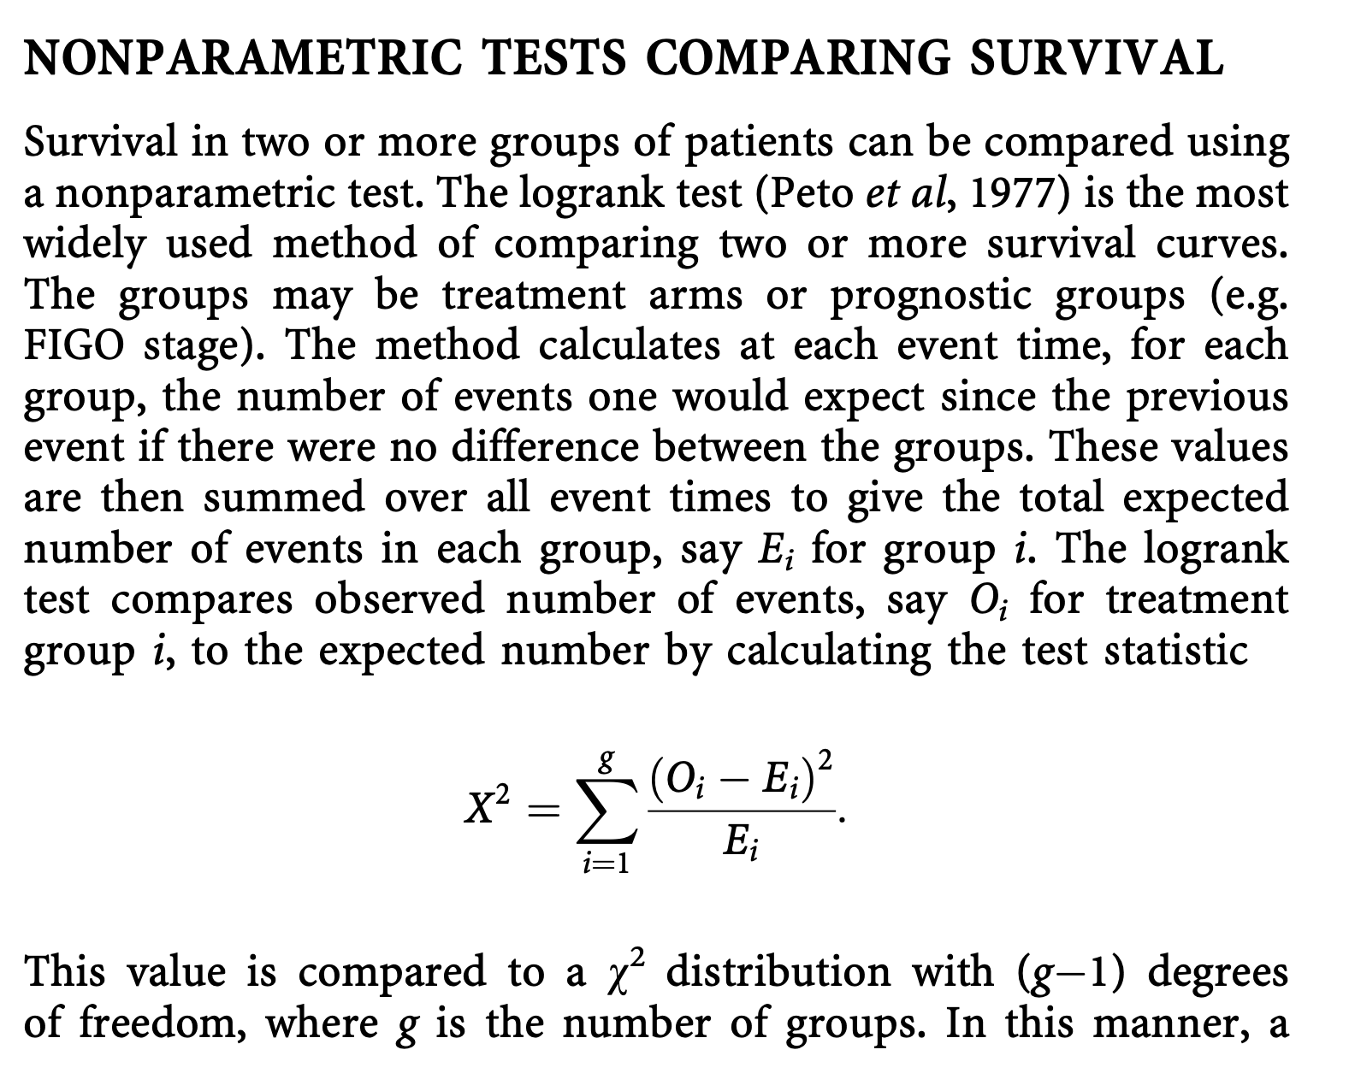
Comparing Survival Curves
Clark, Bradburn, Love, Altman 2003

Slide 24
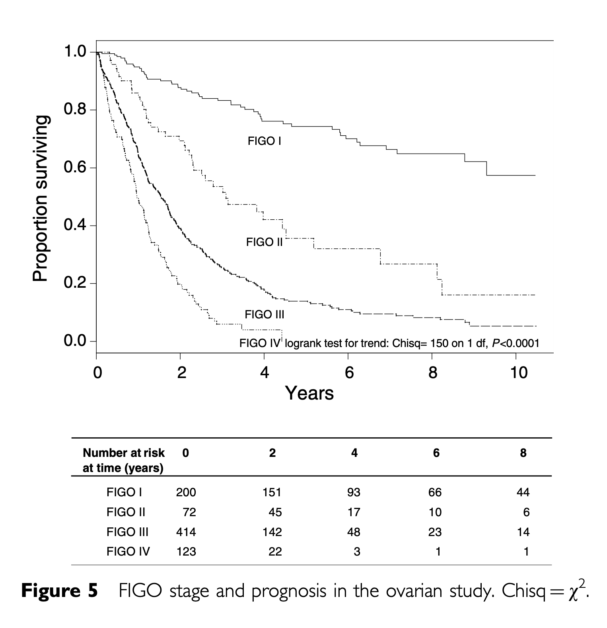
Comparing Survival Curves
Clark, Bradburn, Love, Altman 2003

Slide 25
Outline
Estimating survival
Kaplan-Meier and the Survival function
Comparing Survival Curves
Cox Proportional Hazards
Anderson-Gill

Slide 26
Cox Proportional Hazards
We have discussed the survival and hazard functions.
The most common time-to-event analysis we see is the “Cox Proportional Hazards” model.
Much like our other regression equations, Cox assumes that each person is associated with a pattern of covariates X_{i}.
It assumes that covariates scale the underlying hazard function $λ$:

Slide 27
Cox Proportional Hazards
The key assumption is that a particular covariate does not change the shape of the hazard function over time.
Therefore, we do not even need to identify it.
Instead, each person is associated with a pattern of covariates X_{i}; we will fit beta parameters to each covariate and test them as we have previously.
I have found that this makes more sense if you just do one.

Slide 28
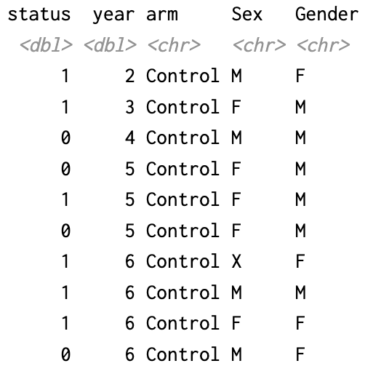
Cox Data Setup
Event:
Dead/Lost
When
----- Covariates -----

Slide 29
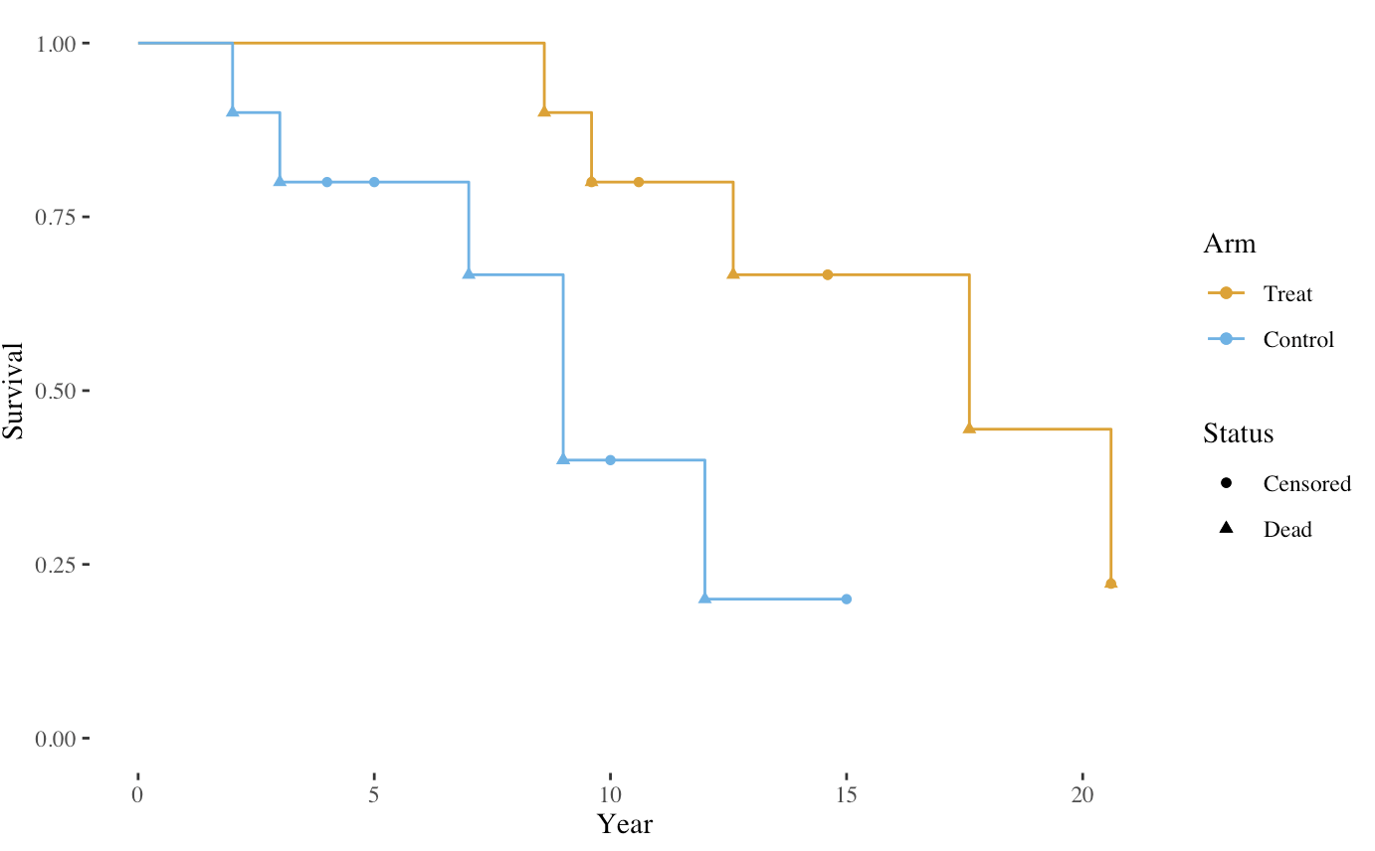
Cox Data Survival Curves

Slide 30
Cox Implementation
Cox regression is a bit strange in R because it is not configured with a simple link function like logistic or linear regression.
Instead, you typically call a function like survival::Surv() to create a composite outcome structure within the function call.

Slide 31
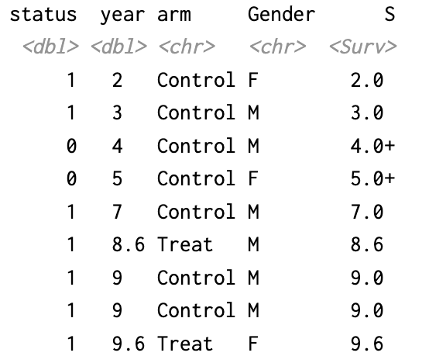
Cox Implementation
Alternatively, you can create a survival variable in the dataset. This variable is a special datatype which accommodates censoring.

Slide 32
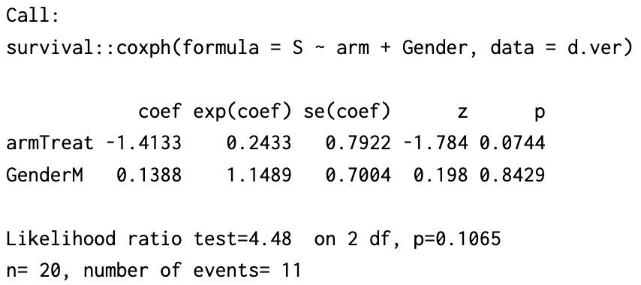
Cox Interpretation
When all this is done, you get a summary similar to linear regression models.

Slide 33
Main Cox Assumptions
Proportional Hazards Assumption: The hazard rates of different groups (defined by covariates) are assumed to be proportional over time.
Independent Censoring: Censoring is assumed to be non-informative and independent of the event of interest.
No Interaction between Covariates and Time: The effect of covariates on the hazard function does not change over time.

Slide 34
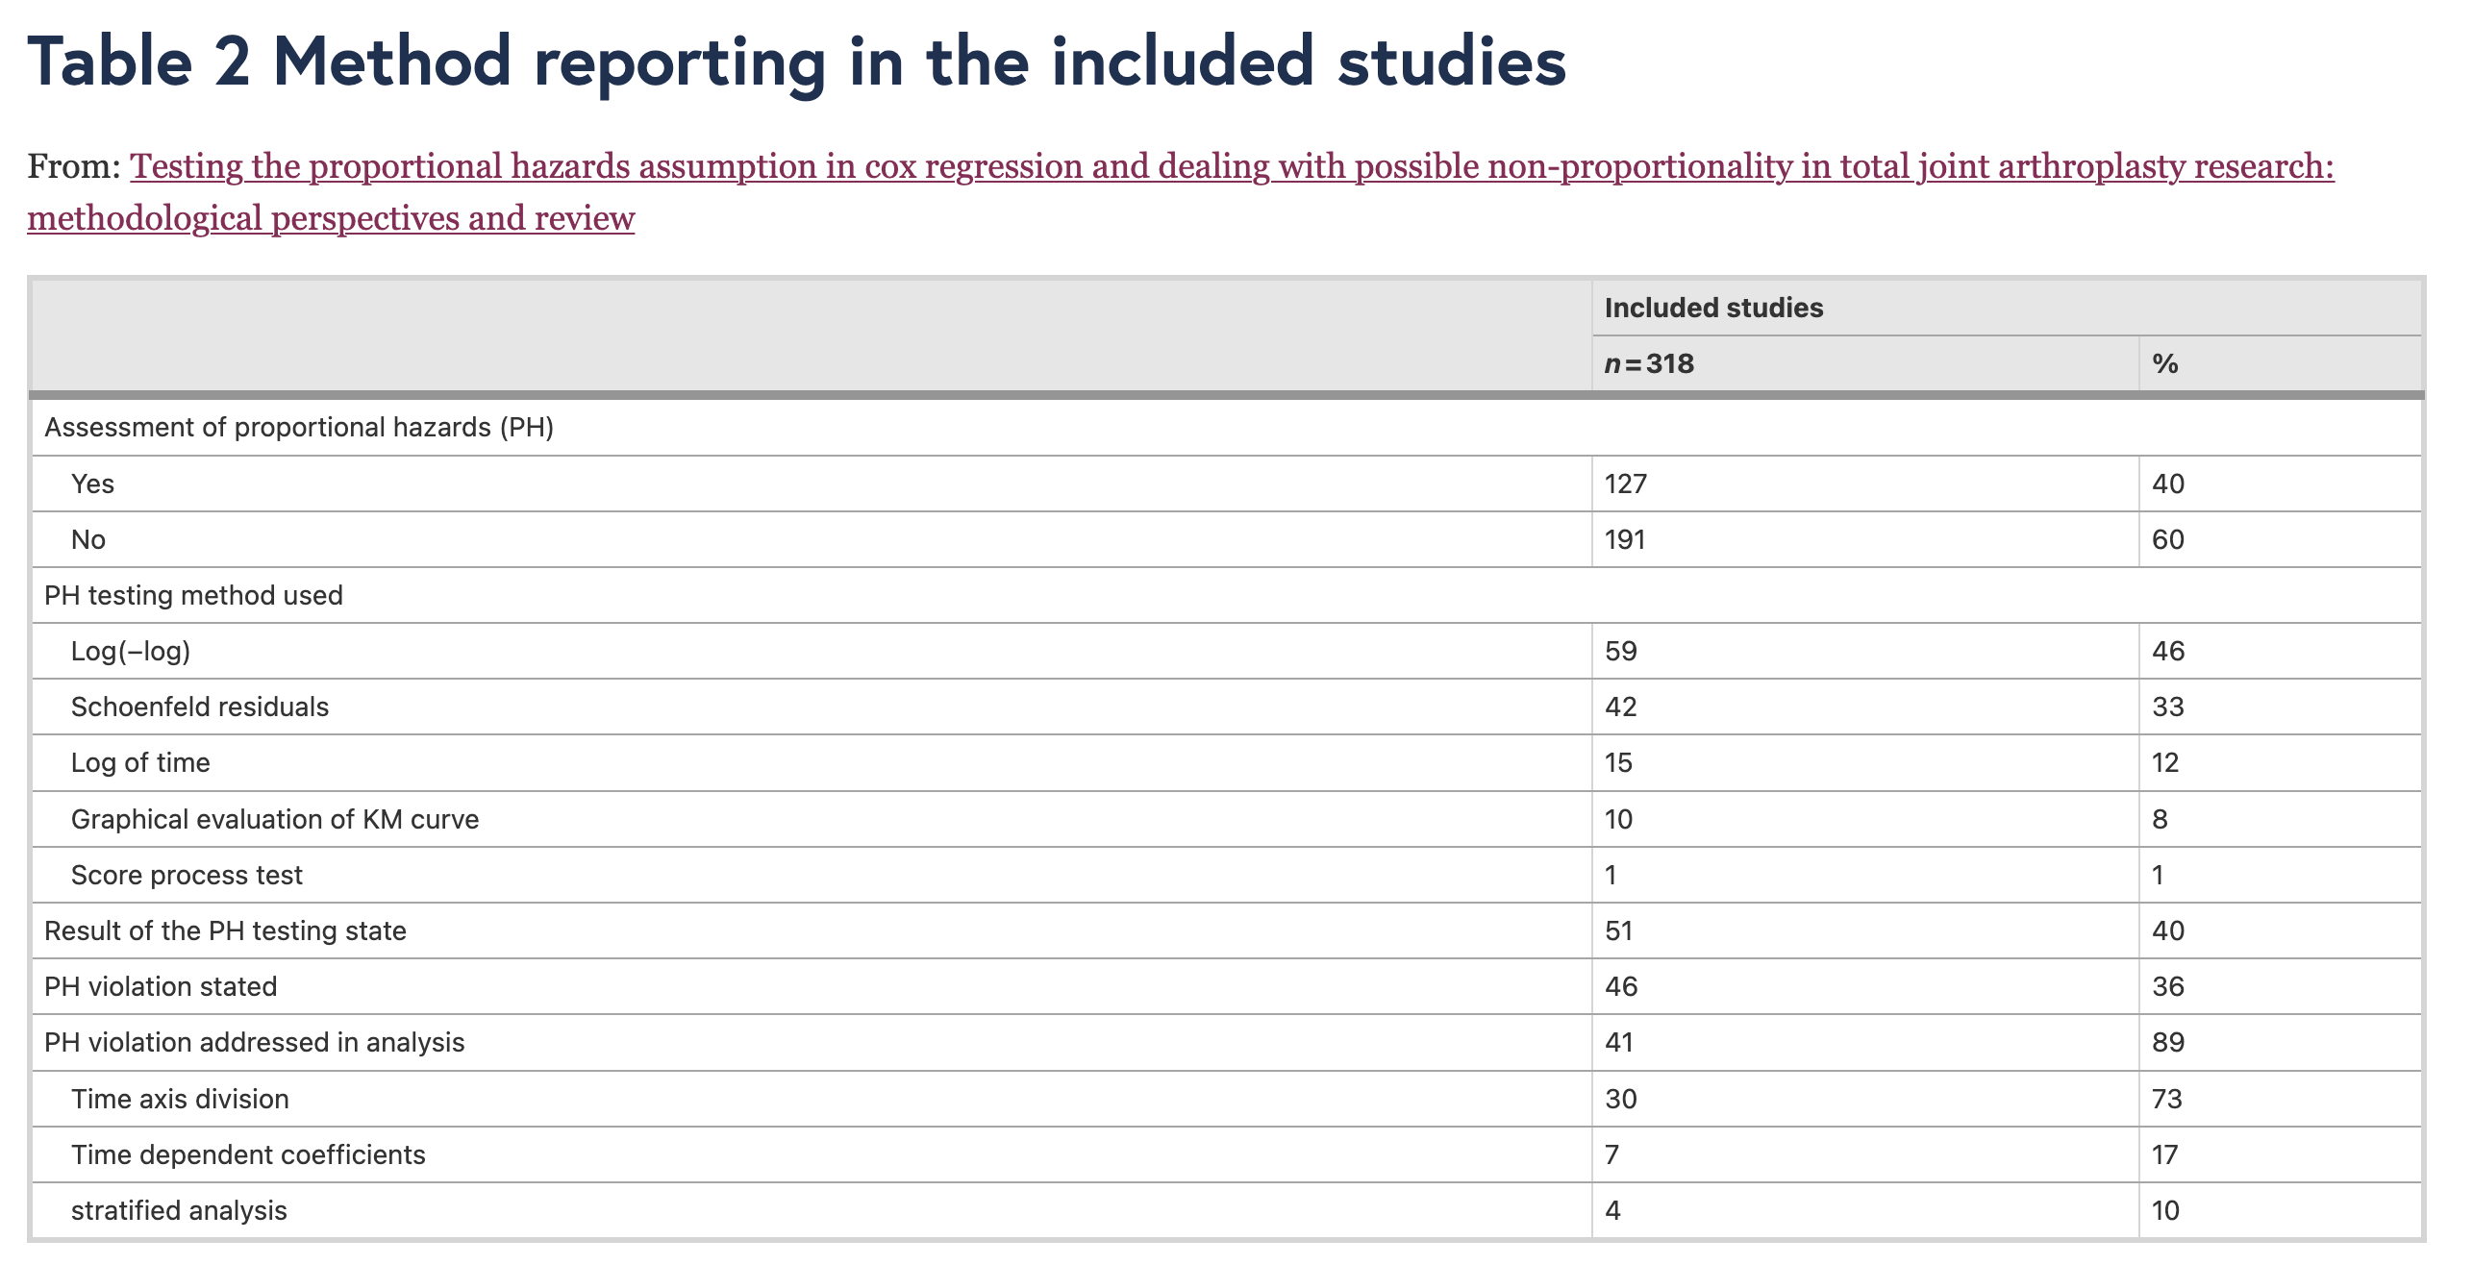
Testing Cox Assumptions
https://bmcmusculoskeletdisord.biomedcentral.com/articles/10.1186/s12891-021-04379-2

Slide 35
Outline
Estimating survival
Kaplan-Meier and the Survival function
Comparing Survival Curves
Cox Proportional Hazards
Anderson-Gill

Slide 36
Anderson-Gill
Survival analysis is conceptually pretty simple when the outcome is death. There are only two possible ways for a subject to leave a study.
What about if a patient remains in the risk set after having an event? For example:
Fall
Heart attack
Return of cancer
Etc.

Slide 37
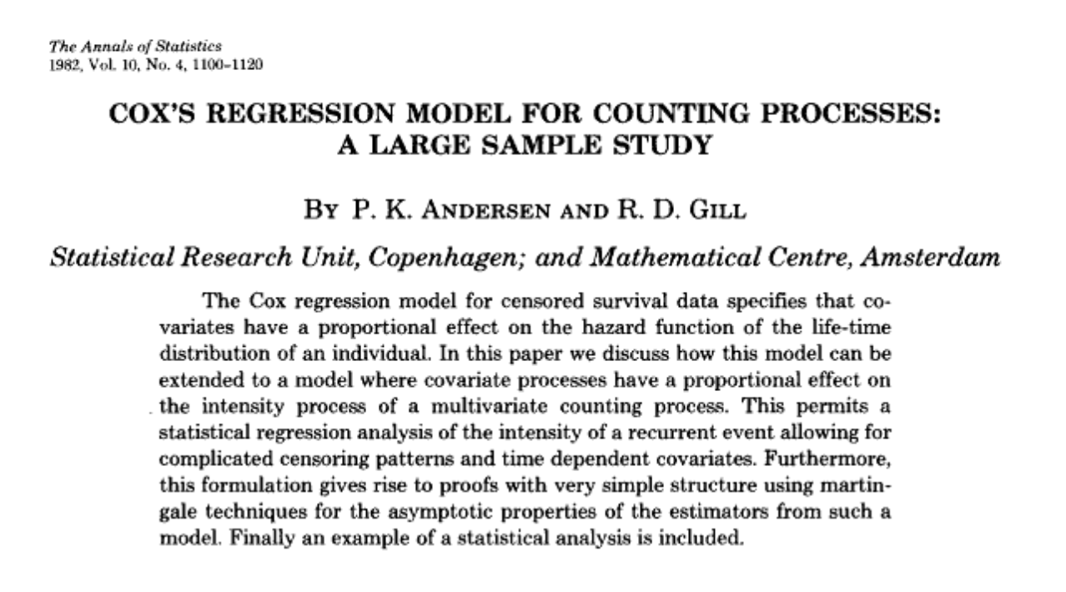
Anderson-Gill
In these cases, there are multiple ways to go about the analysis, the most common is probably Anderson-Gill analysis.

Slide 38
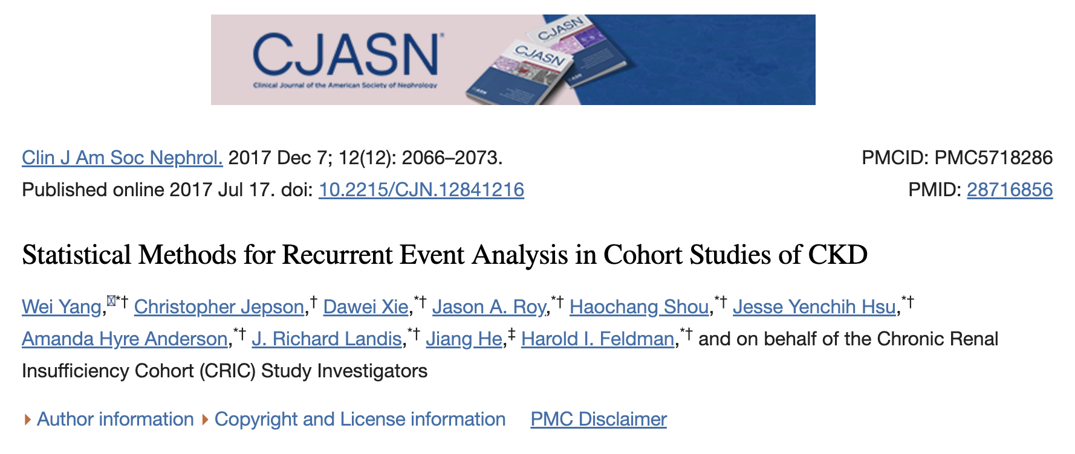
Anderson-Gill

Slide 39
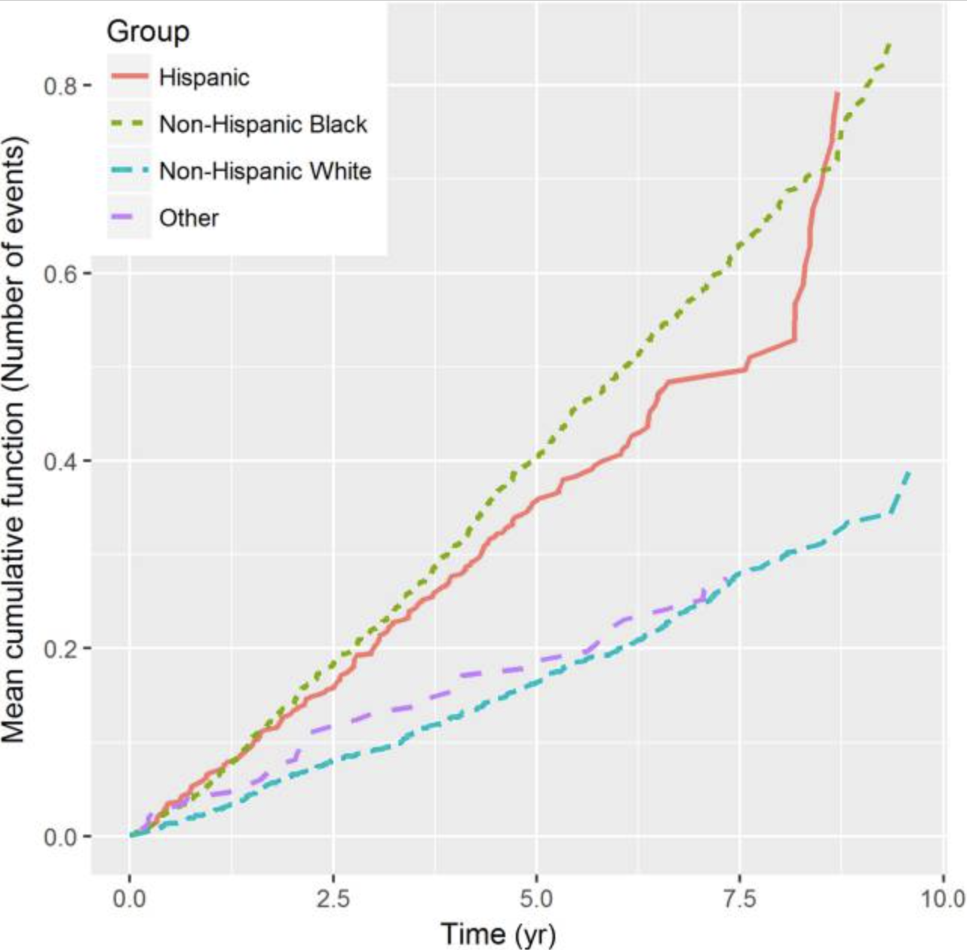
Mean cumulative event function

Slide 40
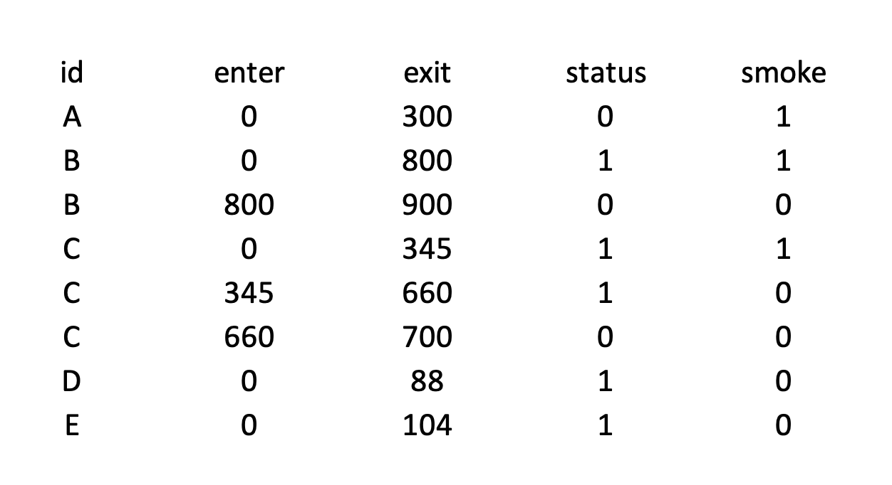
Data setup

Slide 41
Implementation
Andersen-Gill can be implemented as part of coxph by specifying start and end times in the Surv statement.

Slide 42
Outline
Estimating survival
Kaplan-Meier and the Survival function
Comparing Survival Curves
Cox Proportional Hazards
Anderson-Gill

