Slide 1
BMI 585: Power Analysis and Sample Size
J. Lucas McKay, Ph.D., M.S.C.R.
Departments of Biomedical Informatics and Neurology, Emory University, Atlanta, GA USA
Department of Biomedical Engineering, Georgia Institute of Technology, Atlanta, GA, USA

Slide 2
Outline
Types of errors
Power
A worked example in R and an alternate example
The role of simulation
Some biases resulting from systemically underpowered studies
Lab: closed-form and simulation-based power analysis

Slide 3
Statistical power
The presence of an underlying effect does not necessarily mean that a particular hypothesis test will produce a statistically-significant p-value.
The p-value depends on the underlying effect size, the sample size, and pure random chance.
The statistical power of a hypothesis test is the probability of detecting an effect, if there is a true effect present. (Typically, if the null hypothesis is false.)
Power analysis is typically used to estimate the sample size required in order to detect an effect in an experiment.

Slide 4
Type I error and $α$
It is possible to reject the null hypothesis when it is actually true. Obviously, you do not want this to happen.
The maximum probability of rejecting the null hypothesis when it is true that the researcher is willing to risk is called the significance level of the test, denoted by $α$.
Historically the value 0.05 has most commonly been used for $α$.

Slide 5
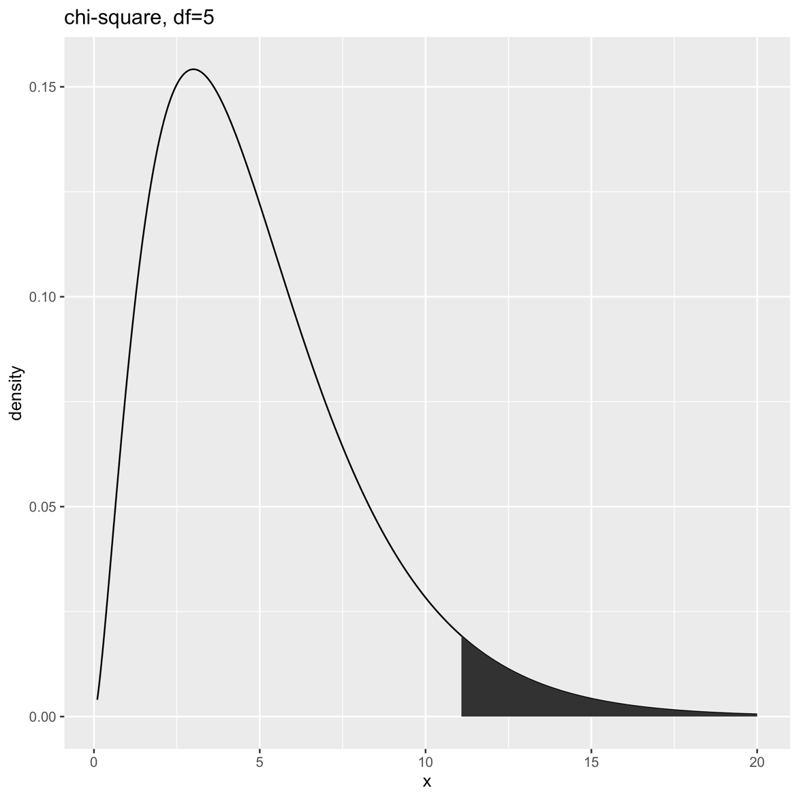
Type I error and $α$
In the hypothesis tests we've discussed, we reject the null when the data are not particularly likely.
That does not mean that the observed data are impossible if the null is true – but we will reject the null for rare events even if it is true.

Slide 6
Type II error and $β$
It is also of course possible to fail to reject the null hypothesis when it is actually false. Obviously, you do not want this to happen either.
The maximum probability of failing to reject the null hypothesis when it is false that the researcher is willing to risk is called $β$.
We often do not discuss $β$directly, instead we talk about power, which is the probability of rejecting the null hypothesis when it is false.
$$p\left(fail to reject null | false null\right)=β$$
$$p\left(reject null | false null\right)=1−β=power$$

Slide 7
Types of errors in hypothesis tests
 |  | H₀
 |  | False | True
Decision | Reject | Correct | Type I
 | Fail to reject | Type II | Correct

Slide 8
Outline
Types of errors
Power
A worked example in R and an alternate example
The role of simulation
Some biases resulting from systemically underpowered studies
Lab: closed-form and simulation-based power analysis

Slide 9
Power
Ideally, a hypothesis test should reject a null hypothesis when it is false. The probability that the test detects a false null hypothesis is called the power of the test.
If the null hypothesis is false, there are two possible outcomes for the test:
Fail to reject ($β$)
Reject
These two comprise a "sure proposition." What is p(Reject)?

Slide 10
Power
Ideally, a hypothesis test should reject a null hypothesis when it is false. The probability that the test detects a false null hypothesis is called the power of the test.
If the null hypothesis is false, there are two possible outcomes for the test:
Fail to reject ($β$)
Reject
These two comprise a "sure proposition." What is p(Reject)?
Power =$p\left(reject null | null is false\right)=1−β$

Slide 11
Power
Often, the null hypothesis is that there is no effect (or no association). Power can then be thought of as the probability of detecting an effect (or association), given that the effect (or association) actually exists.
Because power is a probability, it is between 0 and 1.
If the power is near 0, the statistical test is not very good at detecting a false null hypothesis.
If the power is near 1, the test is extremely good at detecting a false null hypothesis.

Slide 12
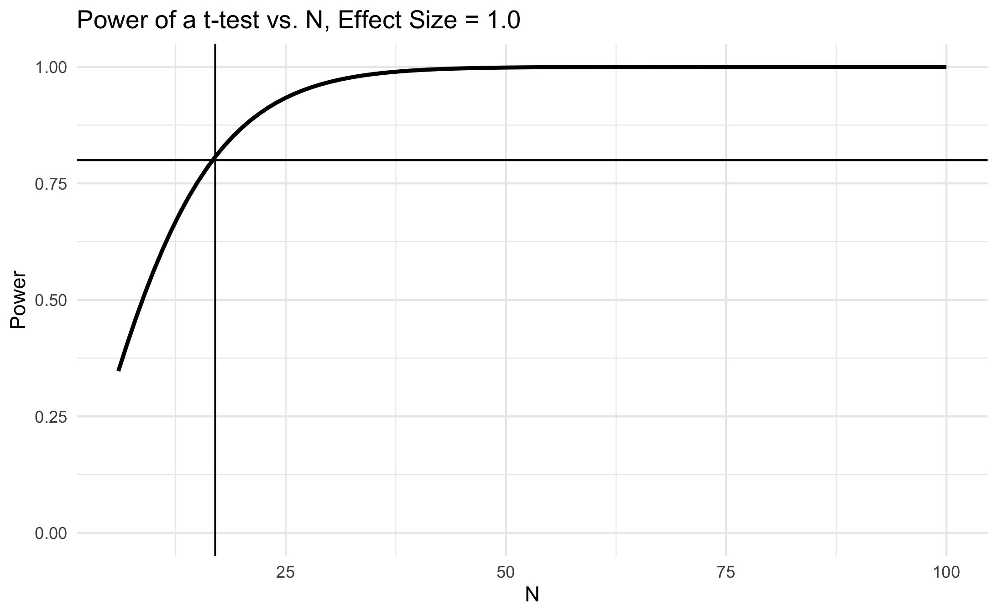
Power increases with sample size for a given effect size

Slide 13
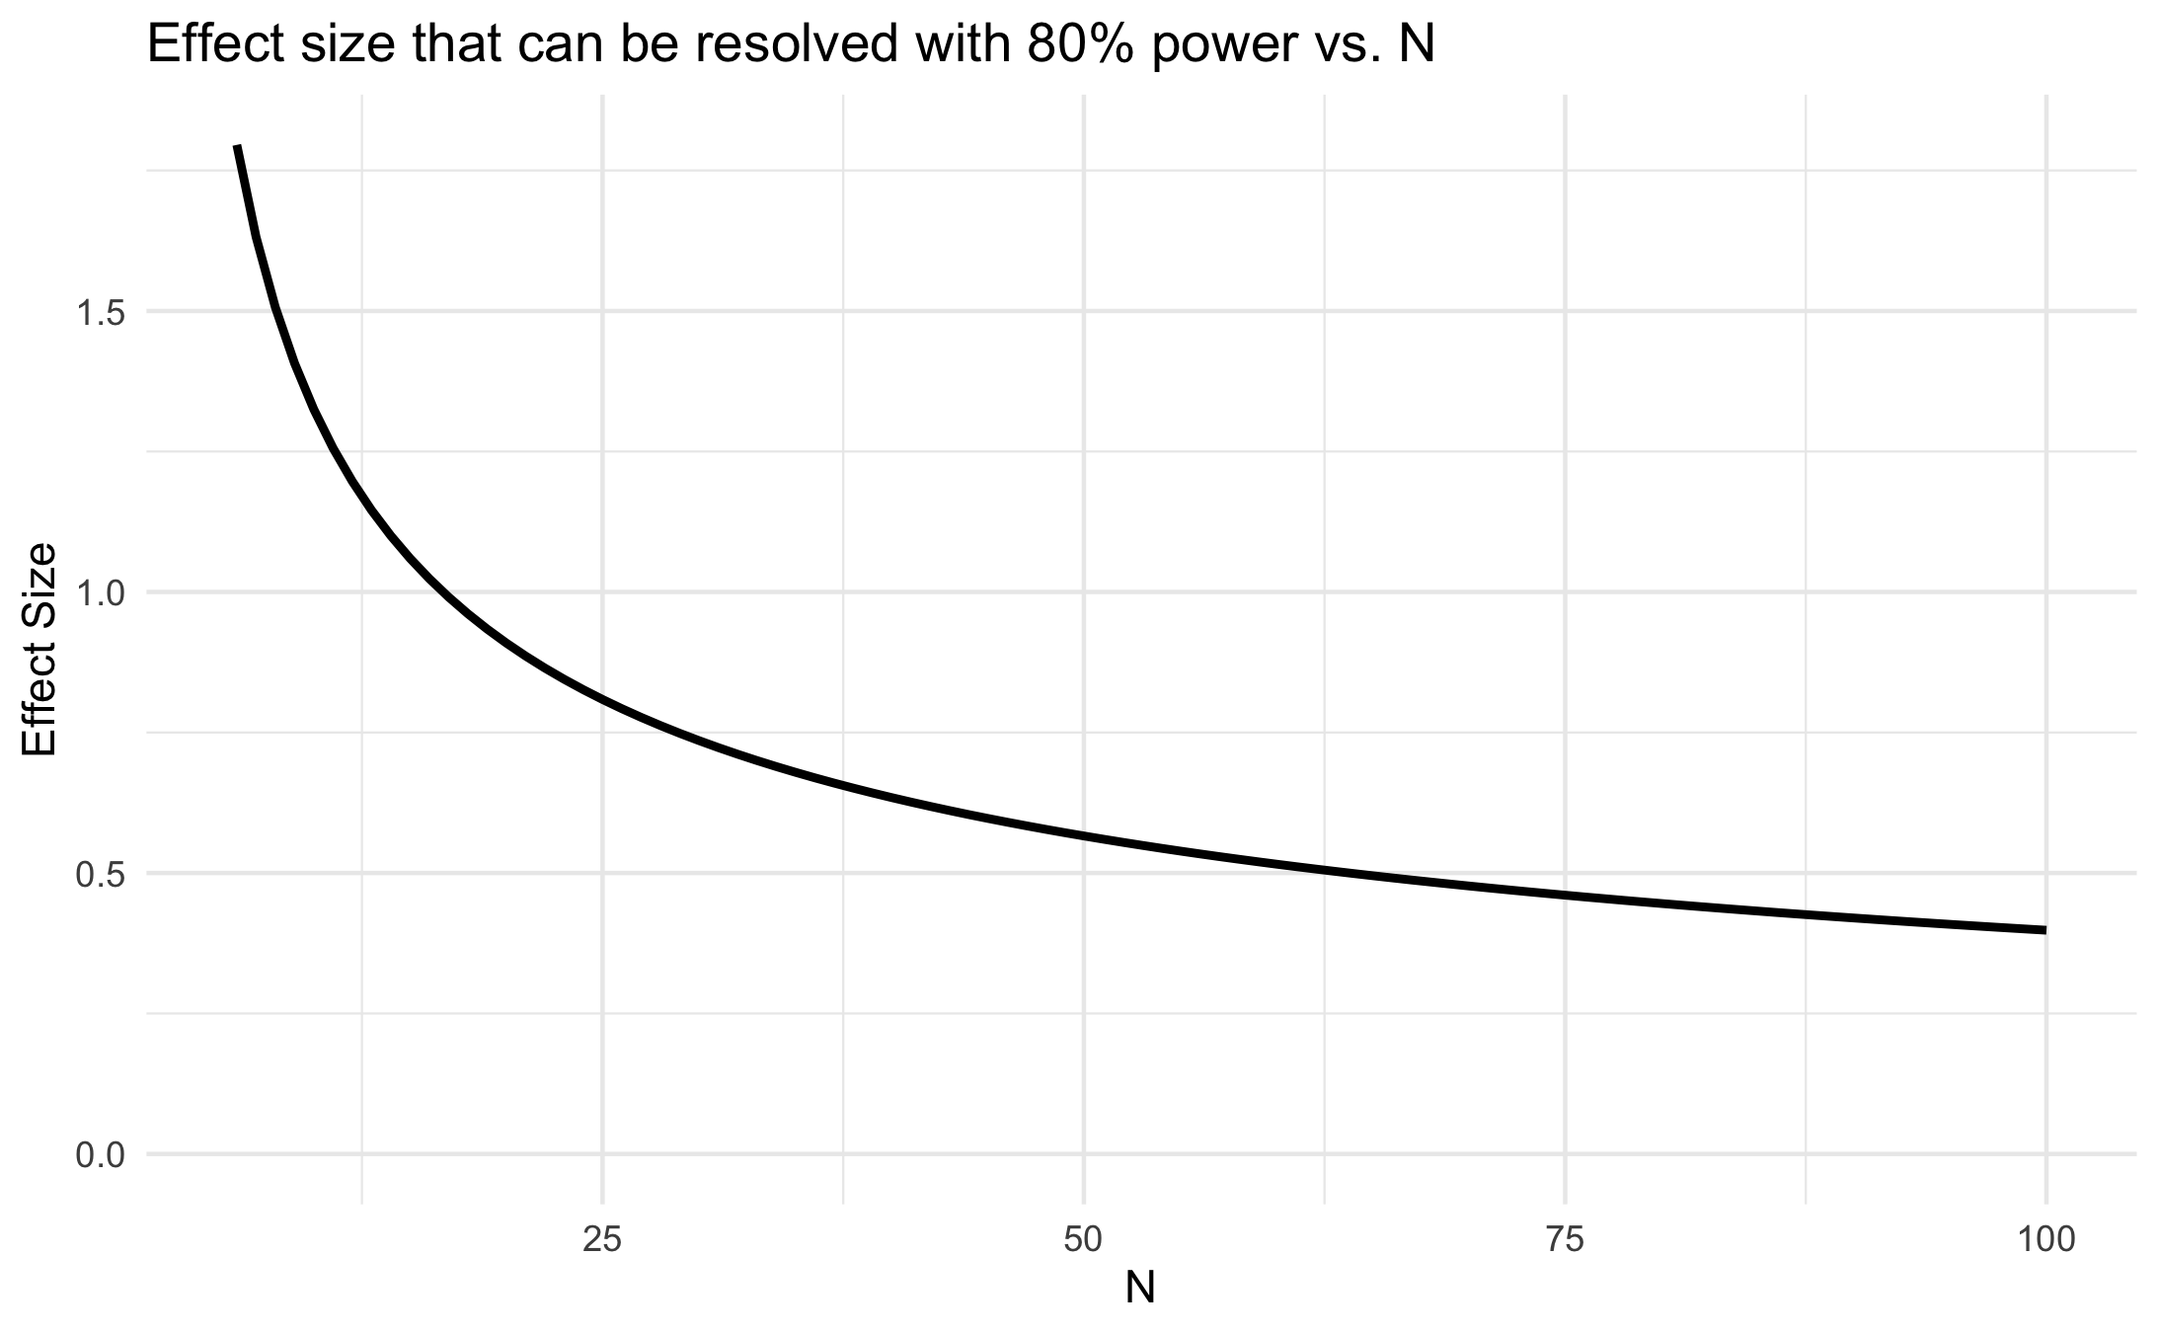
Resolvable effect size decreases with sample size for a given power

Slide 14
Selecting sample size
In general, a power analysis is conducted to identify the minimum sample size that is likely (say, 80%) to resolve the expected effect size.
The expected effect size may be justified based on clinical reasoning (10 points in blood pressure may be quite significant) or scientific rationale (any change over 0.5 SD represents a meaningful biological effect worth further investigation).
The minimum clinically-important difference (MCID) is often a critical piece of information when planning studies. Statistically-significant but clinically-insignificant effects are often a reason to apply your efforts to another problem domain.

Slide 15
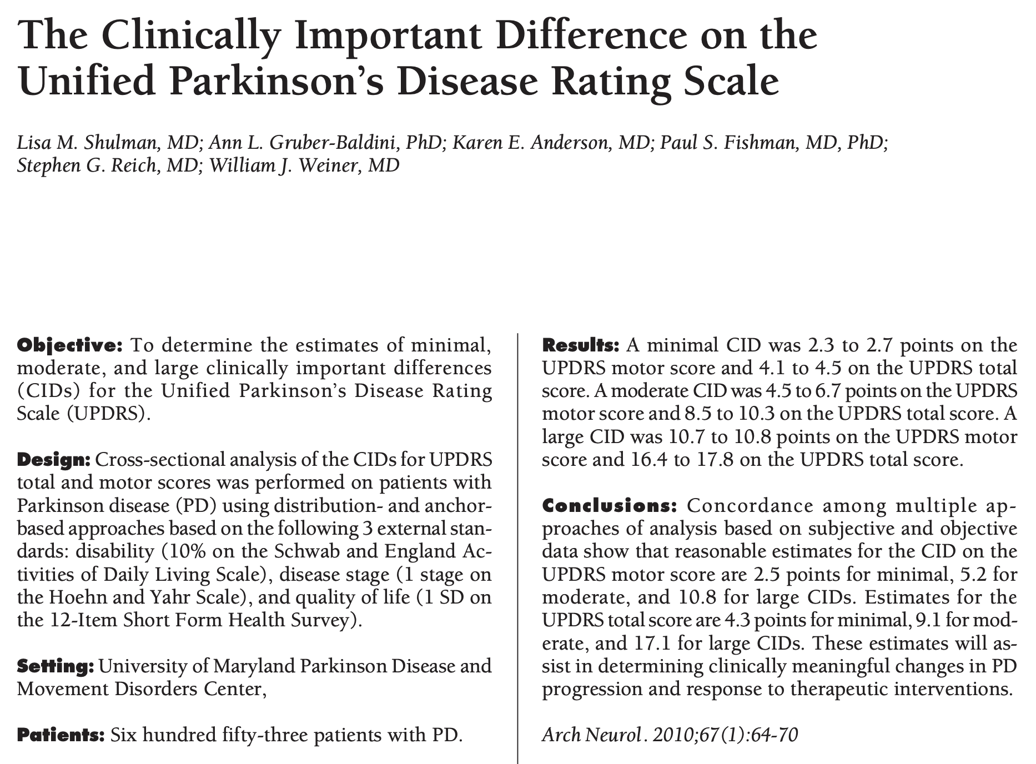
An example of minimal clinically-important difference in Parkinson's disease

Slide 16
Reasons to minimize sample size
Risk and burden to research participants
Harm and suffering inflicted on animal research subjects
Limited research resources that could be better used somewhere else

Slide 17
The way power calculations work in statistical packages
For simple cases like a t-test, most packages can do a power calculation automatically.
We saw that power and effect size have an inverse relationship vs. N for a given alpha value.
In general, the user supplies three of alpha, power, effect size and N, and the software provides the (unique) solution of all four values.
We will see a worked example next.

Slide 18
Outline
Types of errors
Power
A worked example in R and an alternate example
The role of simulation
Some biases resulting from systemically underpowered studies
Lab: closed-form and simulation-based power analysis

Slide 19
A worked example
This is an example from the PASS software documentation about SIDS (Sudden Infant Death Syndrome).
In studying SIDS mortality, one hypothesis put forward is that infants susceptible to SIDS weigh less than normal at birth. Suppose the average birth weight of infants from your center (over the last few hundred births) is 3300 ± 663 g.
Using alpha = 0.05, how many records of SIDS infants would you need to locate and abstract to detect a drop in average weight of 25%, while still maintaining a 4 out of 5 chance of finding a statistically-significant result?

Slide 20
A worked example
The "four out of five" language is really the description of the statistical power of the test.
4/5 = 0.8; power = 80%, power = 1 – beta; beta =0.2.
The 25% reduction corresponds to an effect size of 1.2. (We will show this in the lab.)

Slide 21
A worked example
power.t.test(power = 0.8, delta = 1.2)
Two-sample t test power calculation
n = 11.18502
delta = 1.244344
sd = 1
sig. level = 0.05
power = 0.8
alternative = two.sided
NOTE: n is number in *each* group

Slide 22
A variant of the worked example
Often, what we actually see is that the sample size is limited by resources, rather than being selected to best address the question at hand.
This could be due to budget limitations, patient throughput, or simply because you are working with a rare condition with a low N.
In these cases, we often ask what effect we can resolve, given a prespecified N.
What if we could only feasibly identify only 6 SIDS cases in clinic records? What effect size could we resolve?

Slide 23
A variant of the worked example
power.t.test(power = 0.8, n=6)
Two-sample t test power calculation
n = 6
delta = 1.795547
sd = 1
sig.level = 0.05
power = 0.8
alternative = two.sided
NOTE: n is number in *each* group
...then we must convert Cohen's d back to grams, and subsequently back to percent of the average weight.

Slide 24
The way power calculations work during study design
Typically, the study team collaborates to evaluate several different power scenarios.
The idea is to balance feasibility with resources while maintaining a high likelihood of a conclusive result (positive or negative).
What really should be avoided is studies with negative results due to insufficient power — these are rampant in the literature and cause substantial problems.

Slide 25
Outline
Types of errors
Power
A worked example in R and an alternate example
The role of simulation
Some biases resulting from systemically underpowered studies
Lab: closed-form and simulation-based power analysis

Slide 26
The limitations of preformulated power calculations
Unfortunately, even sophisticated power analysis packages (PASS is arguably the most established) only cover a fairly limited range of scenarios.
It often takes some considerable adaptation of the original study question to make a study design conform to a tractable power analysis.
For more complex situations, simulations are often the only recourse.
If simulations are in an analyst's toolbox they may provide more precision and increased insight over closed form solutions.

Slide 27
The role of simulation
Even simple scenarios like unbalanced sample sizes can push the limits of closed-form solutions.
In these cases, it is often reasonable to simulate the expected results, perform the analyses on the simulations, and estimate the power.
Power = # statistically-significant simulations / total # simulations
This can require a large number of simulations.

Slide 28
Difficult cases in simulation
Data with non-negligible correlation structures can be difficult to simulate.
Typically if you have a longitudinal trial or study with substantial correlations between observations you will need to have a preliminary dataset on which to base your simulation.
Barring that, packages like MASS have functionality to generate correlated data “from scratch.” This is a an advanced topic.

Slide 29
Some consequences of inadequate power

Slide 30
Inadequate power in basic science and clinical studies leads to publication bias
Power analysis is not conceptually difficult but remains uncommon in discovery research.
Over the last few years it has been increasingly recognized that this is a significant problem, because it introduces bias.
In short, because studies have tended to be underpowered, if they are positive, they are published with inflated effect size estimates. If they are negative, they are not published.
Clinical studies, particularly in Europe, have placed more emphasis on preregistration to reduce this phenomenon.

Slide 31
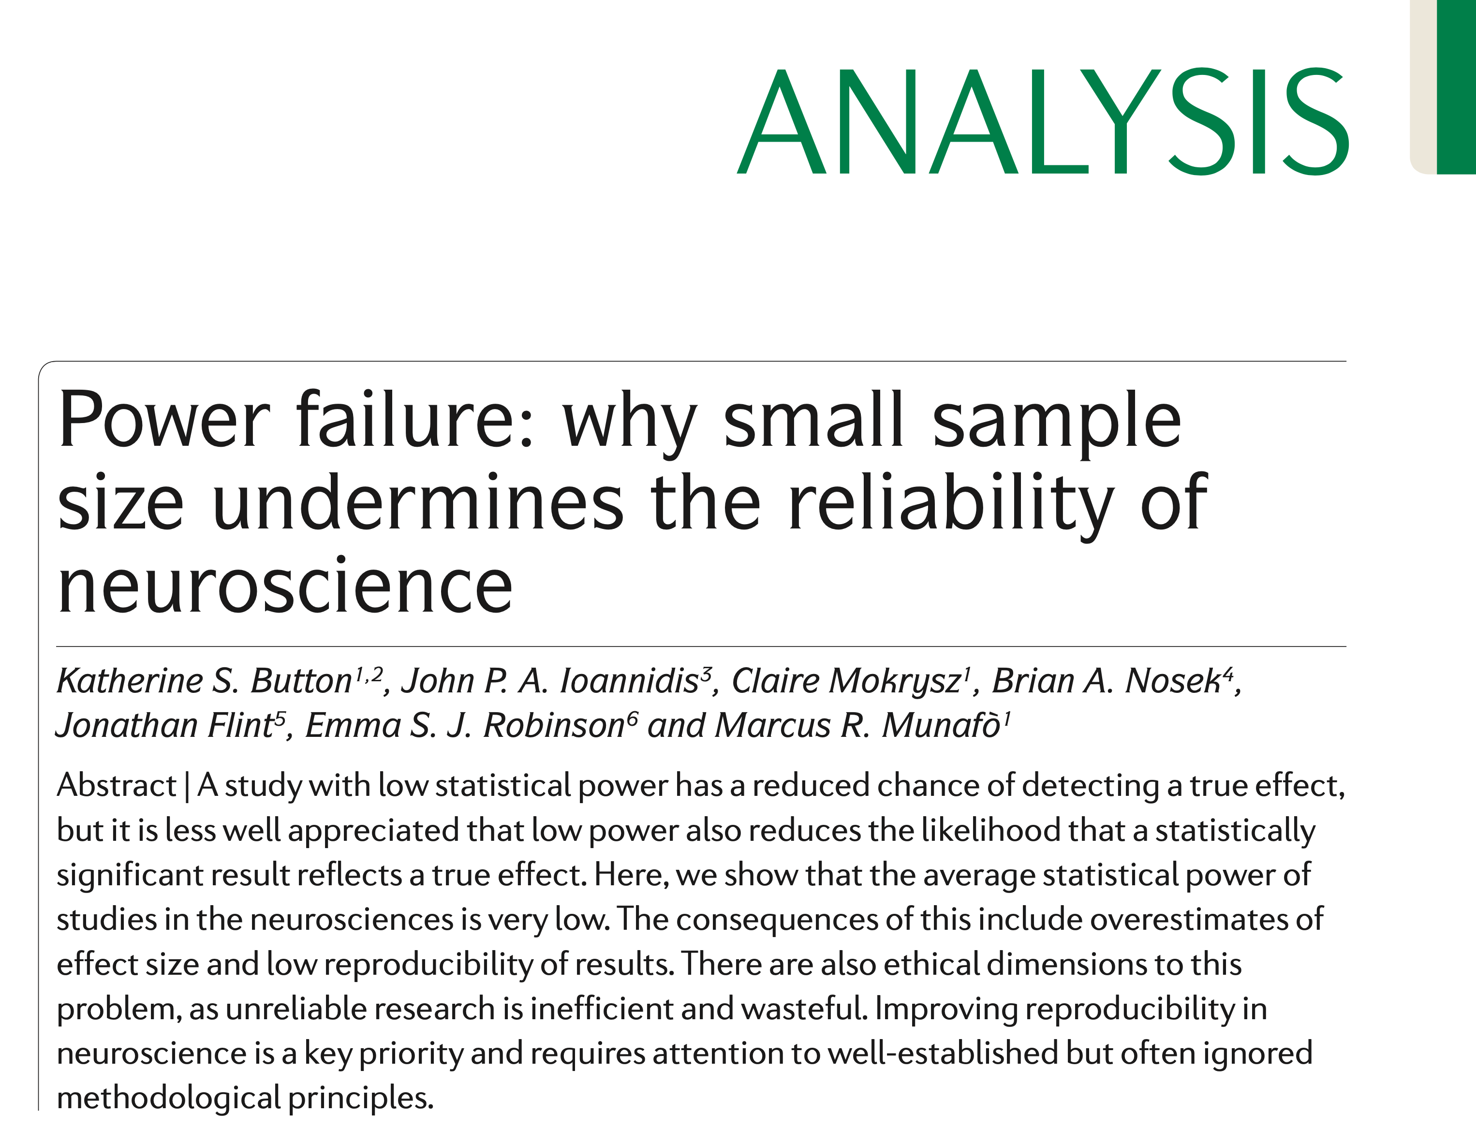

Slide 32
The winner's curse and the Proteus phenomenon
The winner’s curse refers to the phenomenon whereby the ‘lucky’ scientist who makes a discovery is cursed by finding an inflated estimate of that effect.
The winner’s curse occurs when thresholds, such as statistical significance, are used to determine the presence of an effect.
The winner’s curse is most severe when thresholds for publication are stringent and studies are underpowered.
Button et al., Nat Rev Neuro 2013

Slide 33
Most studies reporting statistically-significant results are far underpowered
Here, the authors compared average effect sizes across a large number of studies (Cohen's d = 0.49) to the resolvable effect size for any particular study (d ≈ 1.3-1.6).
The implication of this is that only abnormally large observed effects (due to chance) pass the threshold for publication.
We will see (next) why these effects are likely to be the most over-estimated.

Slide 34
The winner's curse in economics – winners in competitive auctions overestimate worth
"It is still said that, after many years of exploration, many barrels of oil found, many cubic feet of gas found, and after much red ink, the outlook for future offshore potential is bright. Maybe it is. Unexpectedly low rates of return, however, follow the industry into competitive lease sale environments year after year. This must mean that by and large industry is paying more for the property than it ultimately is worth.
"But each competitor thinks he is playing a reasonable strategy. How can the industry go astray? Our sojourn into competitive bidding theory tells us to expect exactly what has happened. It is, then, a theory not only that is mathematically sound, but also that fits reality.
"Even though each bidder estimates his values properly on average, he tends to win [tracts of land on which to drill oil]... when he most overestimates value... The problem is simply a quirk of the competitive bidding environment."
Capen et al., Journal of Petroleum Technology 1971

Slide 35
The winner's curse and the Proteus phenomenon
A direct result of the winner's curse is a very curious pattern to the effect size estimates observed in follow-up studies.
The Proteus phenomenon refers to the situation in which the first published study is often the most biased towards an extreme result (the winner’s curse).
Subsequent replication studies tend to be less biased towards the extreme, often finding evidence of smaller effects or even contradicting the findings from the initial study.
Button et al., Nat Rev Neuro 2013

Slide 36
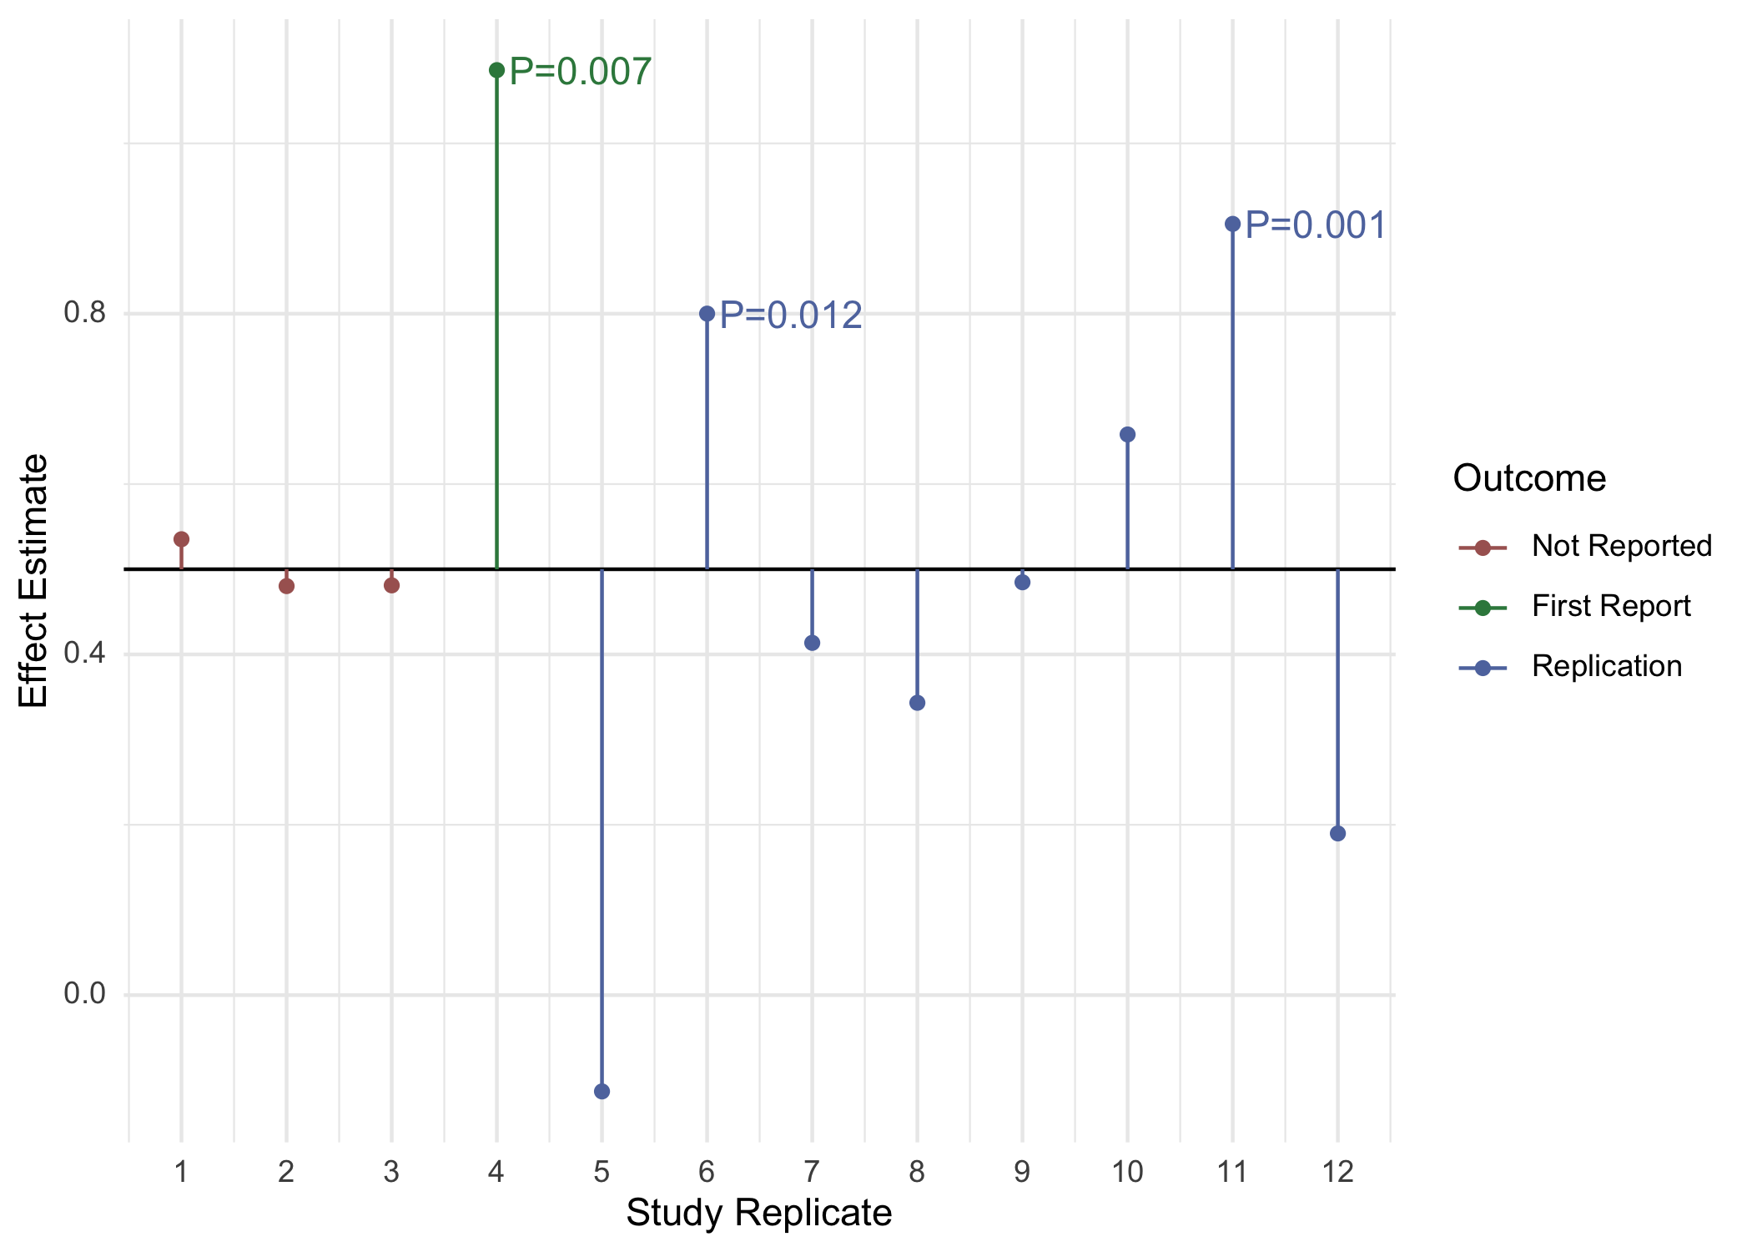
A winner's curse simulation
Notes:
Real underlying effect size of 0.5, N close to minimum N

Slide 37
Simulations suggest that publication bias causes biased effect size estimates

Slide 38
Outline
Types of errors
Power
A worked example in R and an alternate example
The role of simulation
Some biases resulting from systemically underpowered studies
Lab: closed-form and simulation-based power analysis

Slide 39
Excess significance
Excess significance is the phenomenon whereby the published literature has an excess of statistically significant results that are due to biases in reporting.
Several mechanisms contribute to reporting bias, including:
Study publication bias, where the results of statistically non-significant (‘negative’) studies are left unpublished;
Selective outcome reporting bias, where null results are omitted;
Selective analysis bias, where data are analyzed with different methods that favor ‘positive’ results.
Button et al., Nat Rev Neuro 2013

