Slide 1

BMI 510:
R Packages
J. Lucas McKay, Ph.D., M.S.C.R.
Departments of Biomedical Informatics and Neurology, Emory University, Atlanta, GA USA
Department of Biomedical Engineering, Georgia Institute of Technology, Atlanta, GA, USA

Slide 2
Final Project/Exam - an R Package
The final project for this course is a completed, documented R package comprised of functions some of which you may have already written during the course.
It should be about the same amount of work as a homework.
Please do not discuss the final project with others. Internet resources are fine.

Slide 3
Documentation in interactive languages
One of the most useful features of R is the ability to query the documentation straight from the command line, e.g., ?lm.
This is also available in iPython/similar as ?sm.OLS or help(sm.OLS) in script Python. The deeply-nested module structure in Python can make this less useful, but this is improving.
One of the most useful skills to develop as you start your thesis research is to modularize the software you develop and document it. This will prevent re-inventing the wheel, save time, and reduce random errors associated with re-implementing routines.

Slide 4
A situation to avoid
Many researchers end up compiling one file of helper routines called labfunctions.R or statsstuff.py with useful code. The problems with this include:
Version creep over multi-year projects
Suboptimal incorporation of breaking changes
Outdated or totally absent documentation

Slide 5

Documentation in industry
Time spent on documentation is just as valuable as time spent developing your projects - except the audience for documentation can be much smaller, perhaps only a few team members.
Extensive documentation is wasteful, but no documentation causes problems. “Just in time” documentation may delay a project from shipping.
Consider the benefits and trade-offs of these as you work on your projects.

Slide 6
Useful cases for re-factoring
Any method like load_data(obscure_lab_filetype.dat) will potentially be useful for multiple team members and should be re-factored for performance and documented.
Any analysis pipeline that you use more than, say, three times is probably be a good target for re-factoring as a general purpose tool and related documentation.

Slide 7
Outline
Anatomy of an R package
Basic R package creation
R package development workflow
Managing secrets
Final package description
Final Package functions

Slide 8
Anatomy of an R package
An R package is really just a directory; there is nothing compiled/compressed by default. (Although it is quite possible to incorporate other languages.)

Slide 9
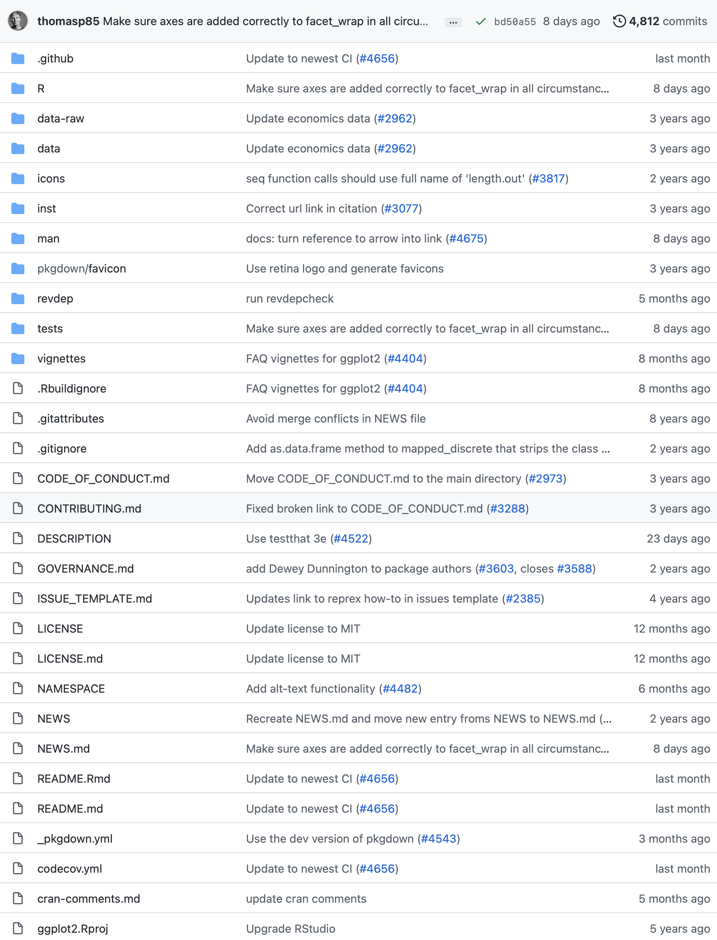
Anatomy of an R package (ggplot2)
Functions go here:
Help files (.Rd)
Unit tests:
RStudio configuration:

Slide 10
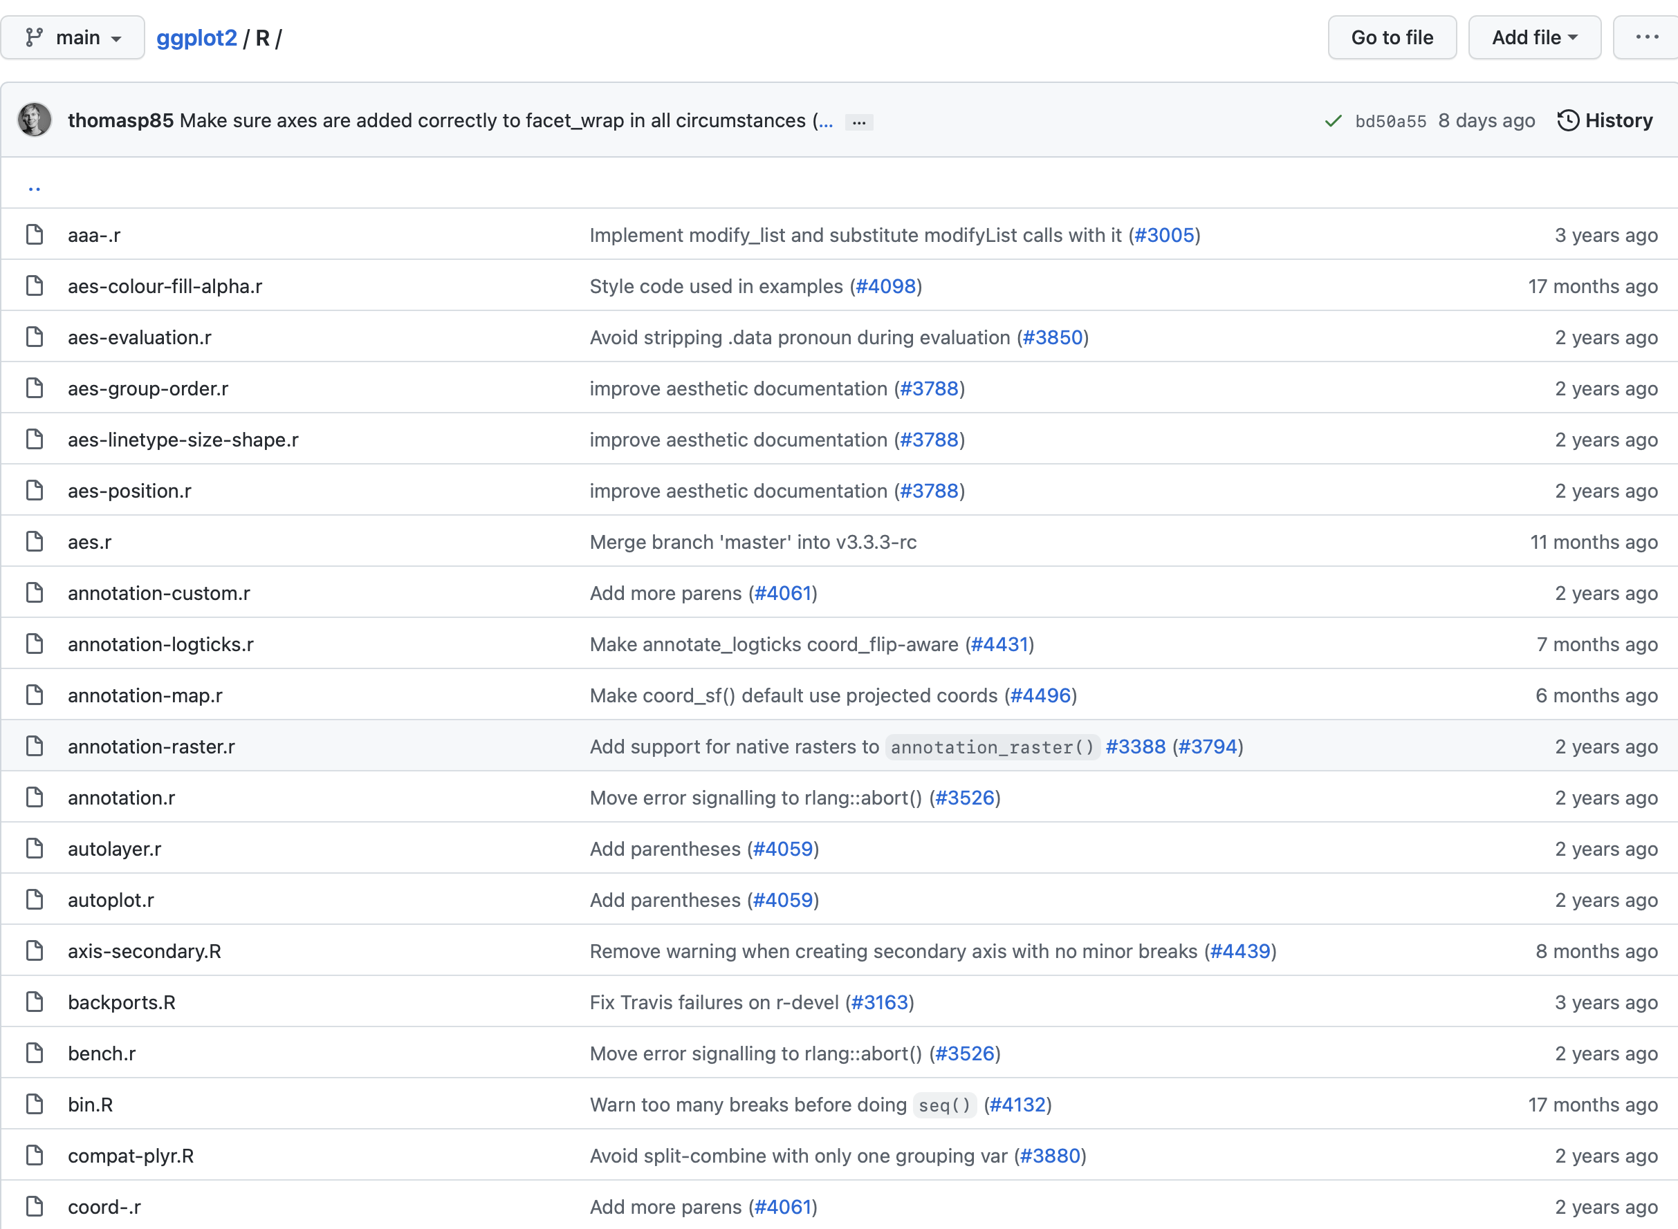
Anatomy of an R package (ggplot2)
The R directory is by far the most important.
When the package is loaded, zzz.R is executed,
and all of the R files here are sourced.

Slide 11
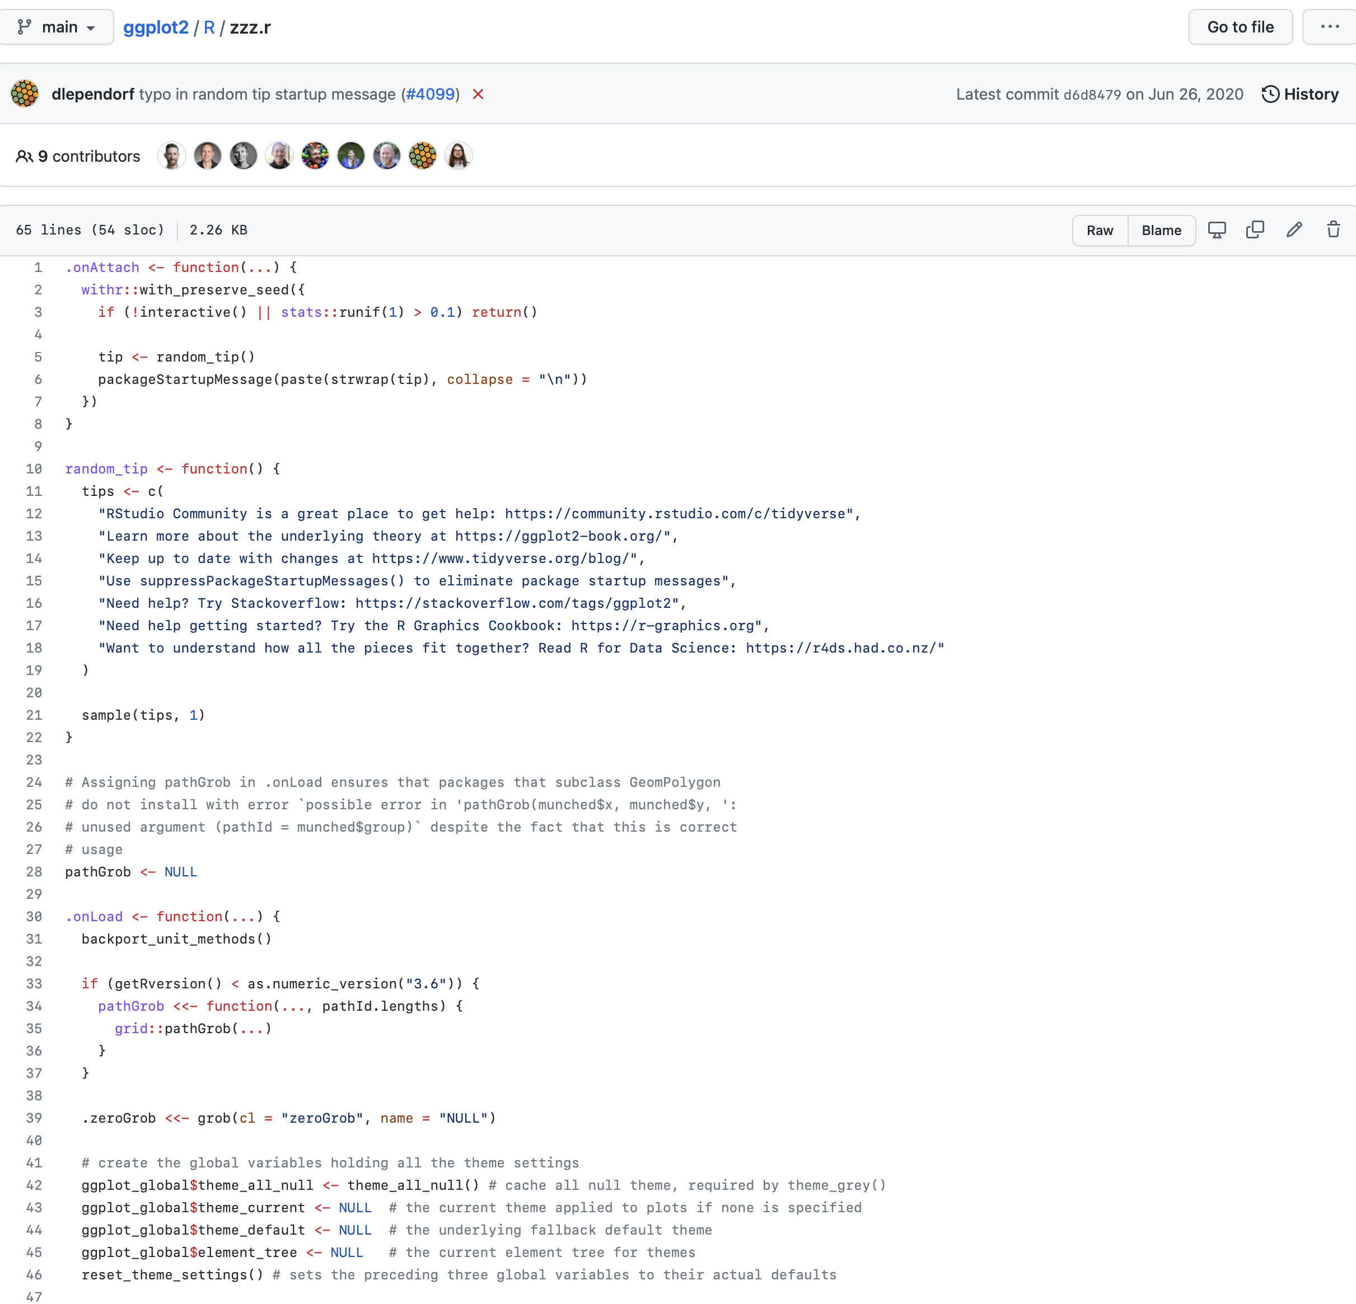
zzz.R (ggplot2)
The zzz.R file may or may not be useful to you; it is what creates the tidyverse "splash" when loaded.

Slide 12
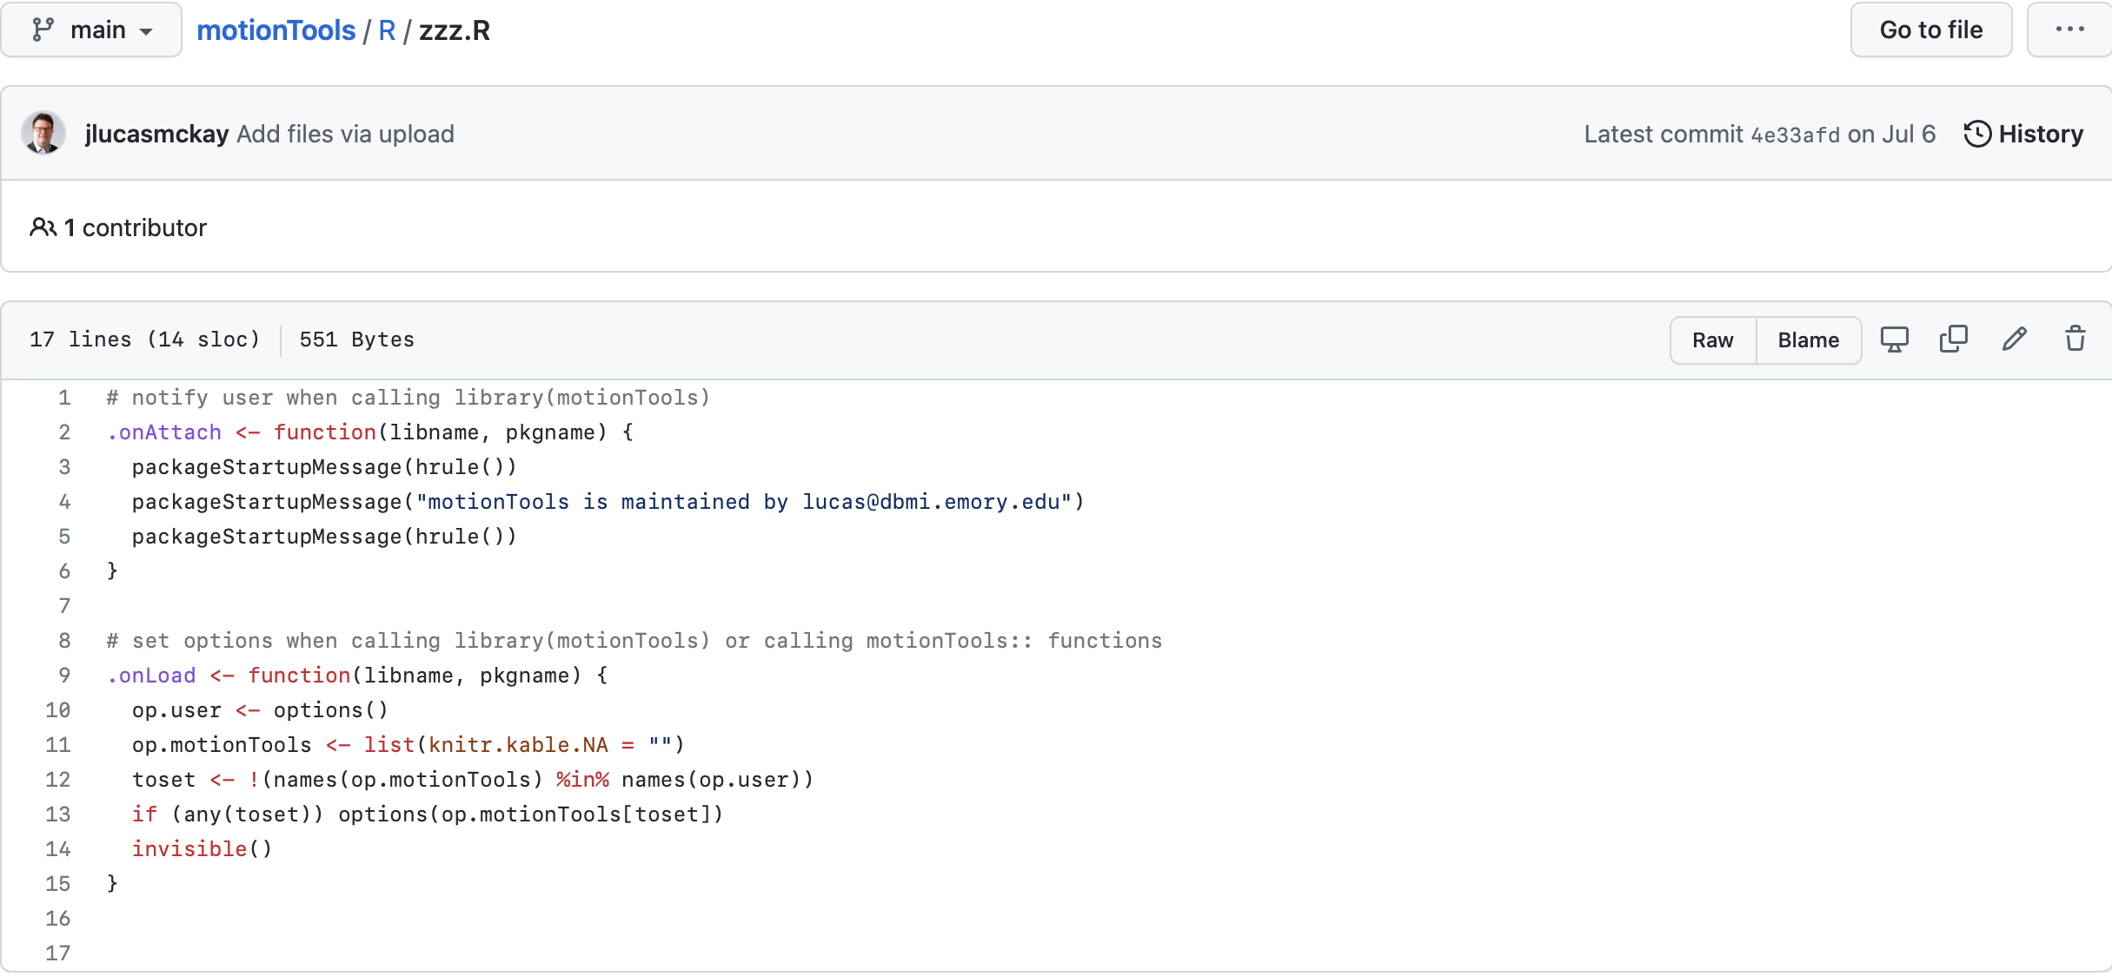
zzz.R (motionTools)

Slide 13

Bundling data with packages
There are several ways to include data with packages for use in examples, vignettes, etc.
I find it's more compact to store the data on a server somewhere and download it as needed. (e.g., the way OpenPose is documented.) There are pretty substantial limits on file sizes for both Github and CRAN.

Slide 14
Vignettes and demos
RStudio is really focused on keeping demo code as "vignettes" that are viewable through RStudio.
I usually prefer to write demo.md files directly in the package, as these are viewable in github/similar without needing to have R installed. Either way is fine.

Slide 15
The NAMESPACE file
The NAMESPACE file manages imports from other packages and lists which functions / classes need to be visible from outside the package.
For a very simple package, this could just be:
export(hello_world)

Slide 16
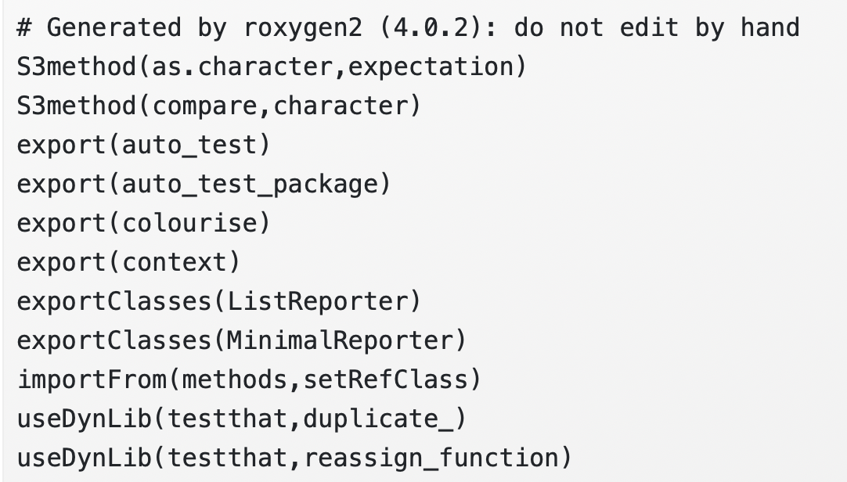
The NAMESPACE file
The NAMESPACE file manages imports from other packages and lists which functions / classes need to be visible from outside the package.
For a more complex package, it will be more complex.

Slide 17
Roxygen2
The Roxygen2 package will create the NAMESPACE file for you based on comments in your R files.
For most purposes, simply documenting your functions will be sufficient to create a streamlined package.

Slide 18
Outline
Anatomy of an R package
Basic R package creation
R package development workflow
Managing secrets
Final package description
Final Package functions

Slide 19
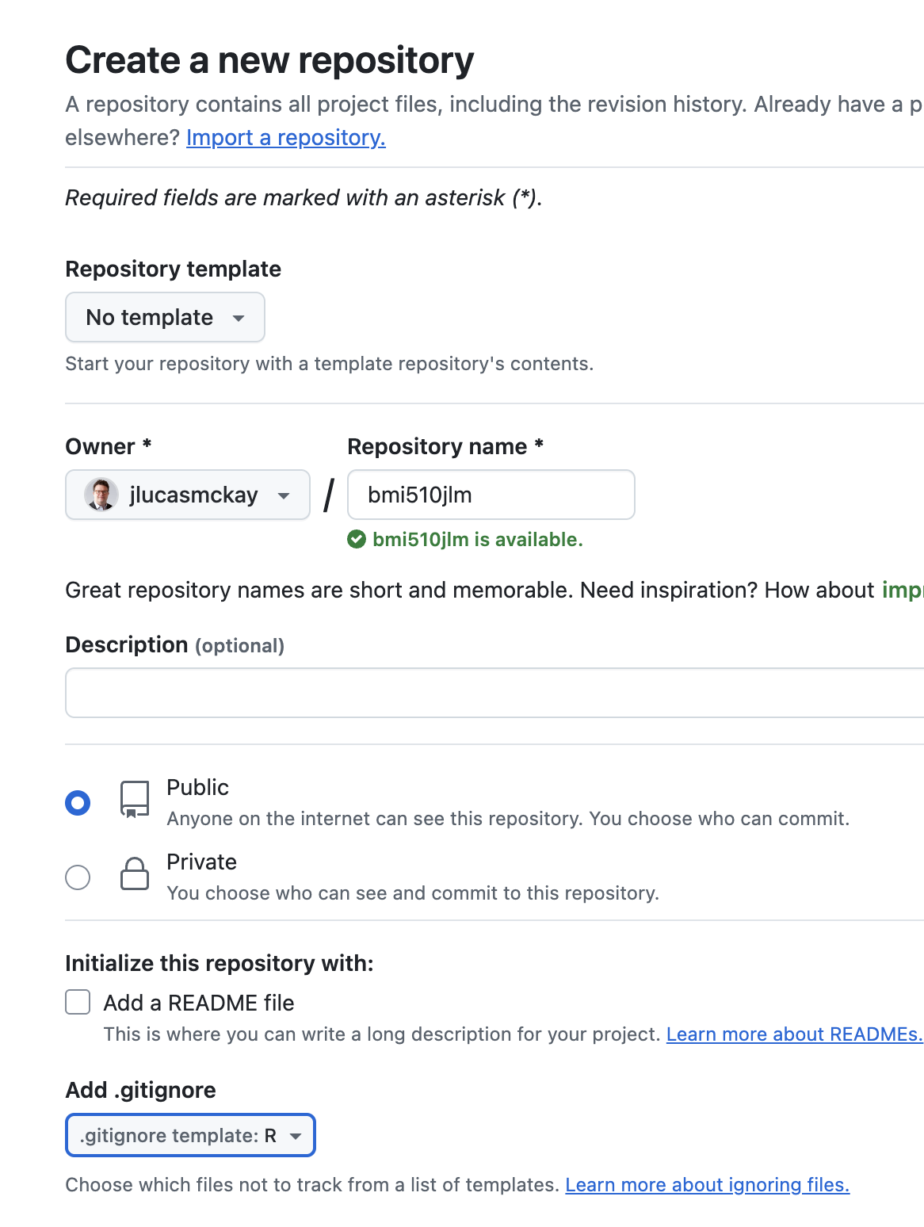
Basic R package creation
Create a github repository on github
  Add R .gitignore
Clone to local
  cd ~/tmp
  git clone https://github.com/jlucasmckay/bmi510jlm
Create a new package with devtools
  devtools::create("~/tmp/bmi510jlm")
Push up the first changes
  git add .
  git commit –m "first"
  git push

Slide 20
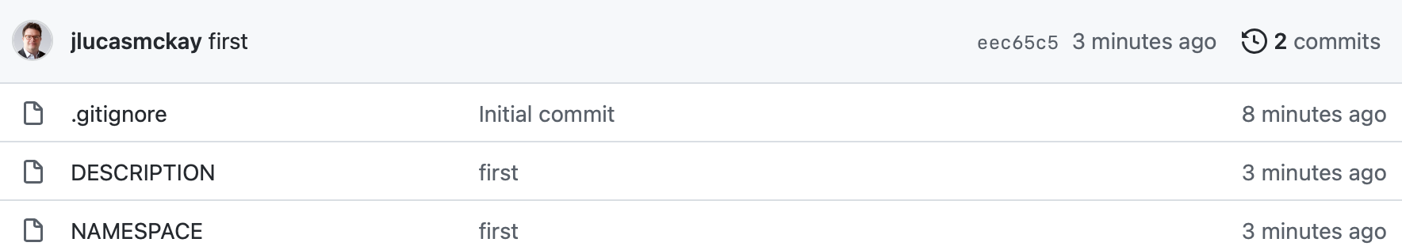
Initial package structure
*Note that devtools::create() creates an empty R directory

Slide 21
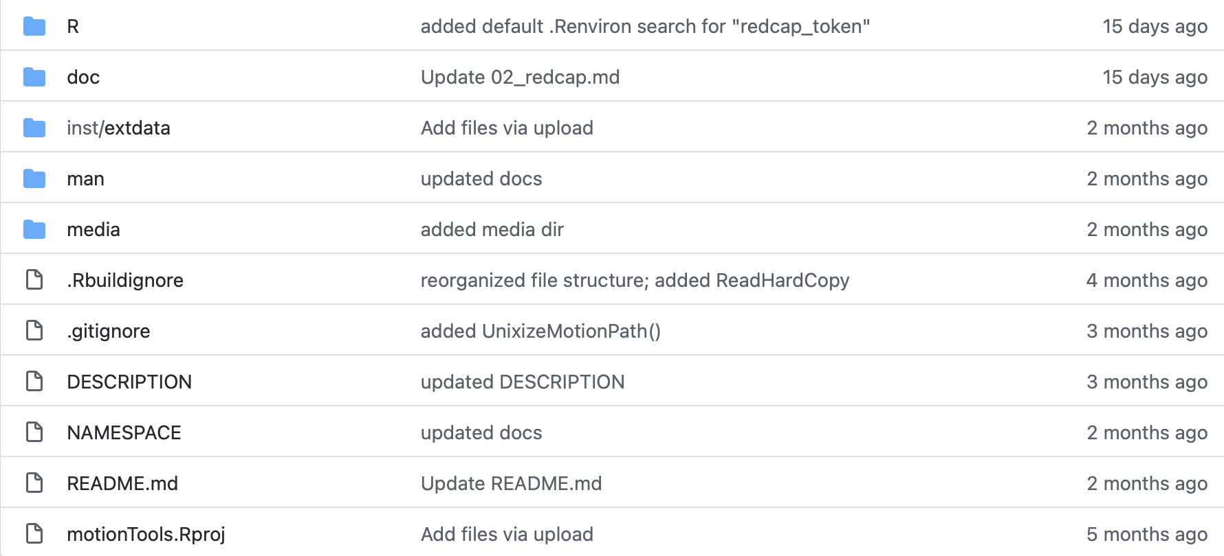
Typical package structure

Slide 22
Relationship with RStudio
You do not need RStudio to develop packages (or at all, really), but it can be helpful.
RStudio creates a few files when you create a project within an existing package directory:
.Rbuildignore (similar to .gitignore)
directoryname.Rproj – some configuration data.

Slide 23
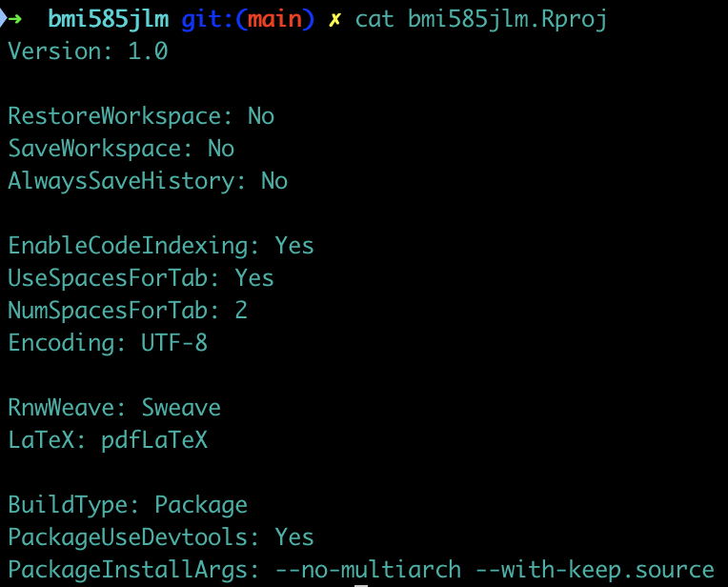
Relationship with RStudio
You do not need RStudio to develop packages (or at all, really), but it can be helpful.
RStudio creates a few files when you create a project within an existing package directory:
directoryname.Rproj
.Rbuildignore

Slide 24
Relationship with RStudio
You do not need RStudio to develop packages (or at all, really), but it can be helpful.
RStudio also creates the .Rproj.user directory; this contains information relating to chunk names in notebooks, etc.

Slide 25
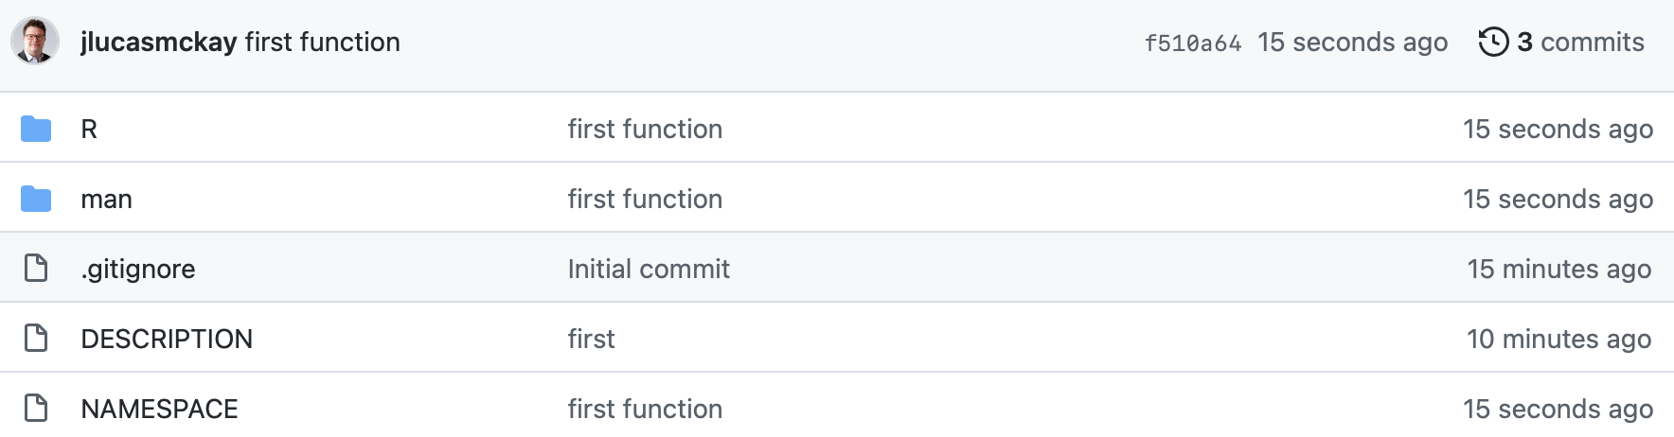
Package structure with first functions

Slide 26
Outline
Anatomy of an R package
Basic R package creation
R package development workflow
Managing secrets
Final package description
Final Package functions

Slide 27
Subsequent Workflow
Edit R files in R directory (or other data directories)
devtools::document()
  Creates documentation
devtools::install()
  Installs package locally
Perform tests
  This can (and should be) automated, but it is not required. Automated testing creates a lot of overhead.
Push up changes
  git add .
  git commit –m "added pc1approx()"
  git push

Slide 28
Installing from github
Once your package is up, other users may simply:
devtools::install_github("https://github.com/jlucasmckay/motionTools")

Slide 29
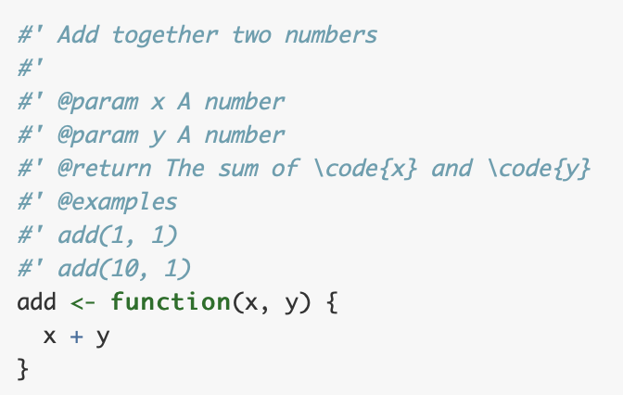
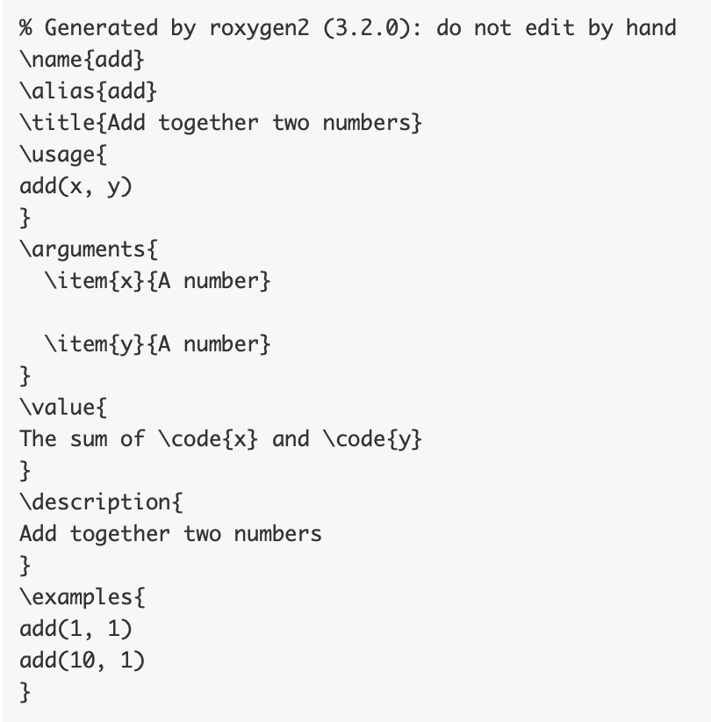
Roxygen comments are converted directly into .Rd documentation files
Roxygen comments in source
project/man/add.Rd

Slide 30
Referencing other packages in your package
It is not recommended to include library() statements in packages.
External functions should be referenced completely, e.g.:
  stats::lm()
  stats::rnorm()
  dplyr::select()
  tidyr::pivot_longer()
This will allow Roxygen (discussed later) to assess dependencies more reliably.

Slide 31
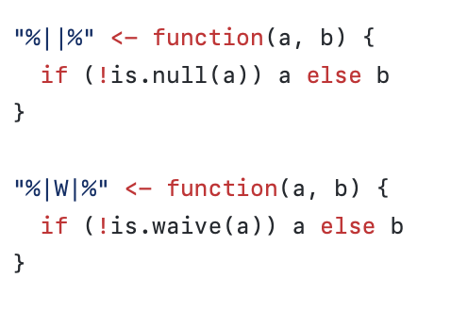
Defining "infix" functions
"Infix" R operators can make code much easier to write (and read)
Many packages include some helper infix functions that are not exported.
These are from ggplot2. What do they do?

Slide 32
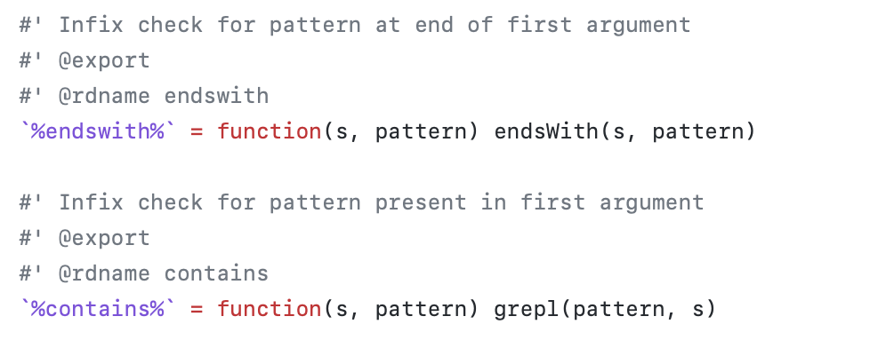
Defining "infix" functions
"Infix" R operators can make code much easier to write (and read)
Many packages include some helper infix functions that are not exported.
These are from the motionTools package. Note that:
  They are exported
  They include the tag @rdname
  This will tell Roxygen what to name the documentation file.

Slide 33

The pipe operator
For several years almost every package had to either replicate or import the Magrittr pipe (%>%) operator, as it was so common.
This was often the only imported function, and because it is an "infix" operator the quotes caused issues.
For your package, it may be worthwhile to:
  Refactor the code to omit the pipe operation (this can be faster)
  Use the new native pipe |>

Slide 34
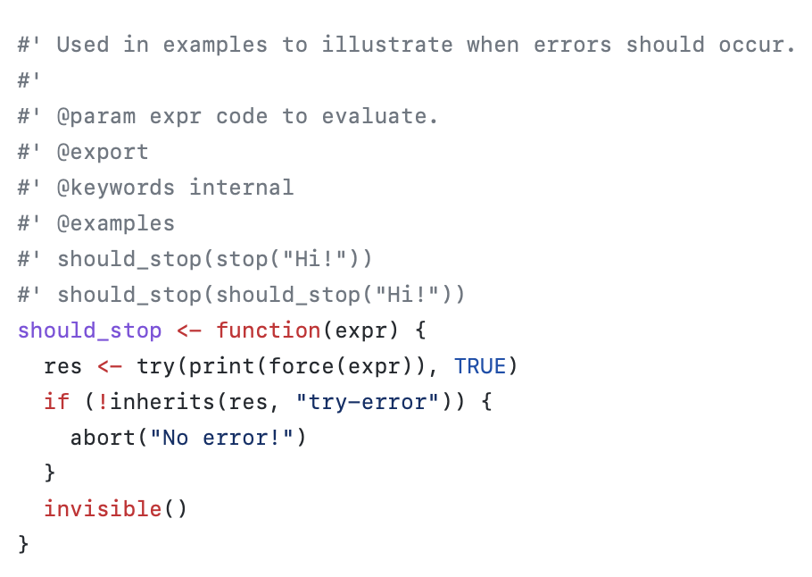
Exported vs. internal functions
The roxygen comment #' @export before a function

Slide 35
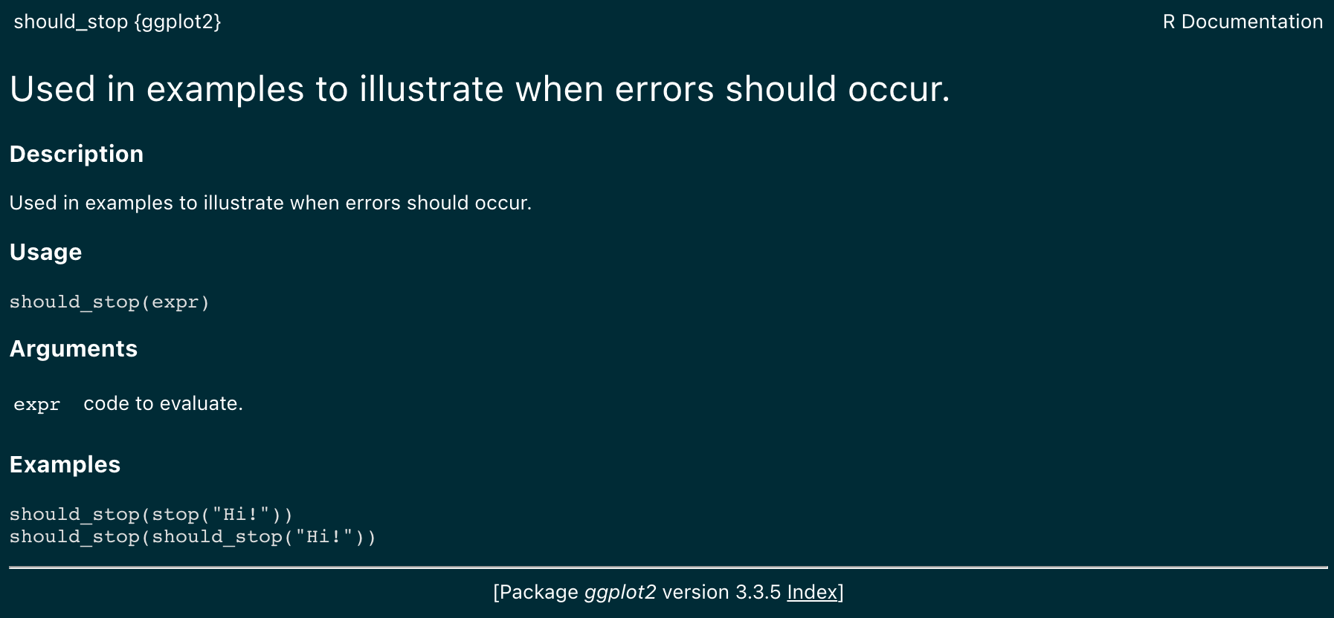
Exported vs. internal functions
Let's have a look at two functions in ggplot2/R/utilities.R

Slide 36
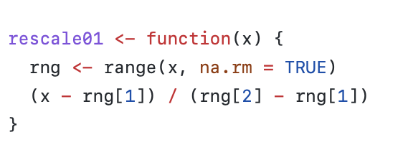
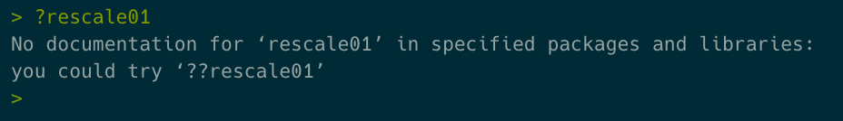
Exported vs. internal functions
Let's have a look at two functions in ggplot2/R/utilities.R

Slide 37
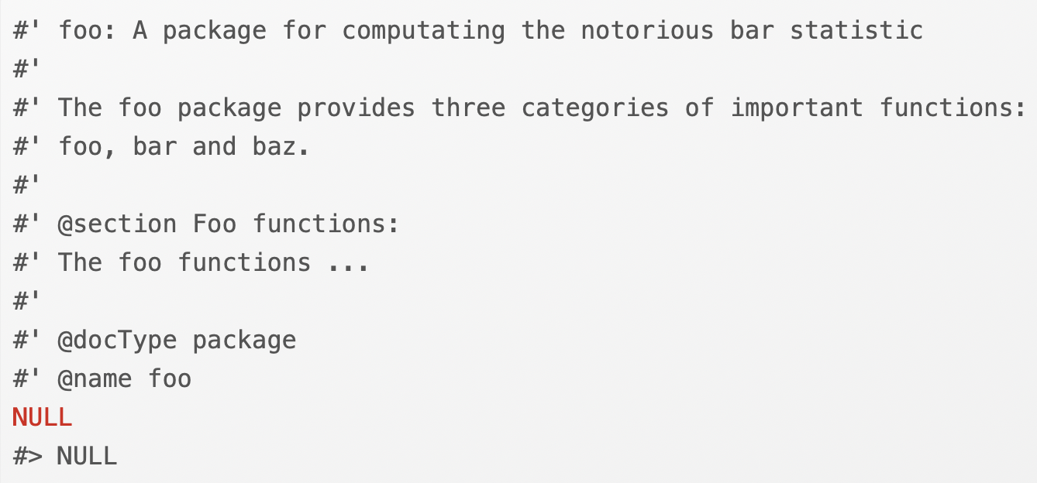
Overall package help
R/packagename.R can be used to document the package and perform any manual imports needed (discouraged).

Slide 38
Outline
Anatomy of an R package
Basic R package creation
R package development workflow
Managing secrets
Final package description
Final Package functions

Slide 39
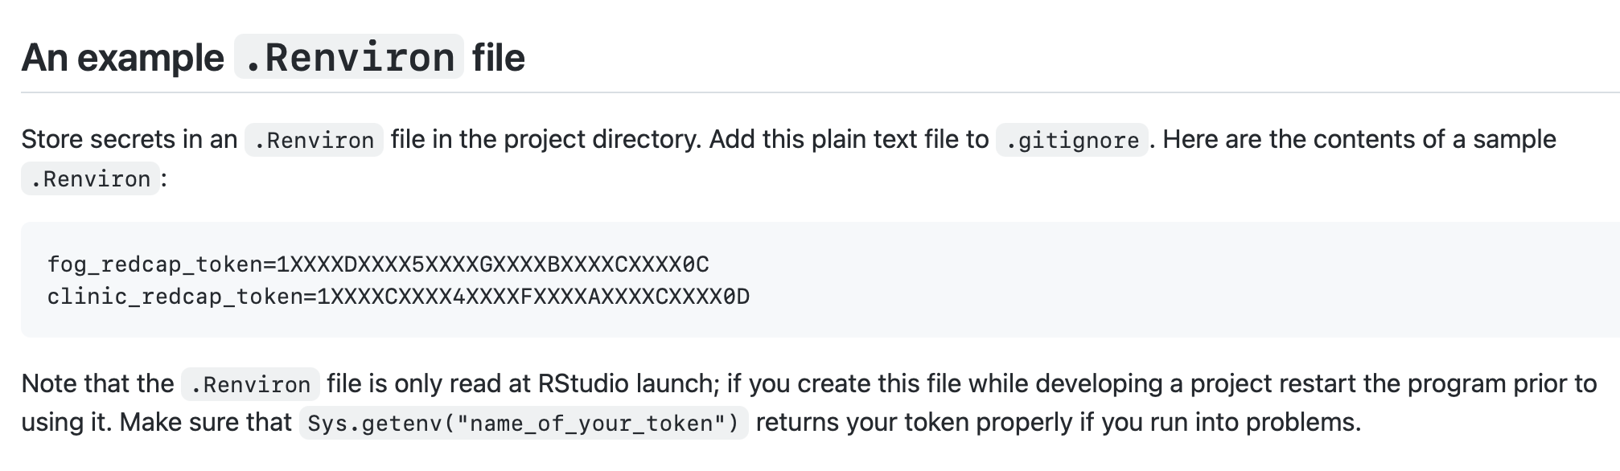
Managing secrets
Secrets like API tokens, etc., should never be stored on github.
The MOST correct place for these is in an .REnviron file within your local copy of the project directory.

Slide 40
Managing secrets
Note about the .REnviron file:
It is read only at startup.
If you change directories during a session it is not re-read.
Be sure to reboot R prior to calling Sys.getenv("your_token").

Slide 41
Managing secrets
Secrets like PHI should never, in any circumstances, be pushed to github.
For this reason I typically suggest including the following lines in .gitignore:
*.xlsx
*.csv
This will (mostly) ensure that data files are not pushed to github; in addition to security problems these files can disrupt your pushes if they are large.

Slide 42
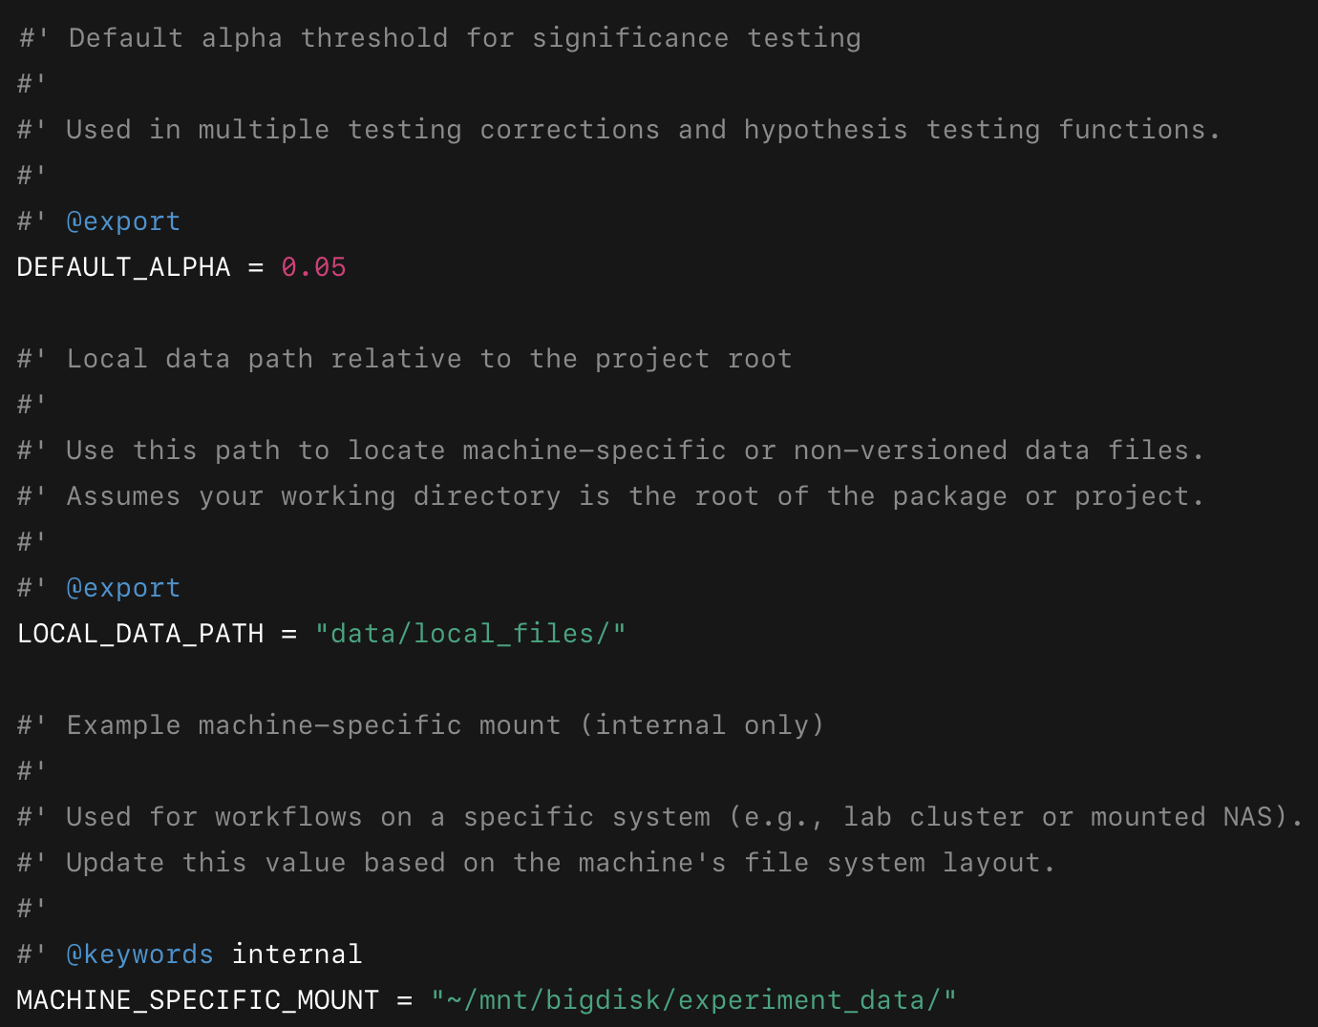
Managing secrets – slightly less secure
The most secure way to manage secrets is within .Renviron; sometimes this is not all the way necessary.
An alternative is to use a constants.R file in your R directory; this can include machine-specific information like paths and control logic.

Slide 43
Outline
Anatomy of an R package
Basic R package creation
R package development workflow
Managing secrets
Final package description
Final Package functions

Slide 44
Final project concept
So, for your final project, you will assemble some functions into a simple R package.
You will assemble appropriate documentation for each of them that can be queried with ?.
You will post the package as a private repository on github to enable version control.
Online resources and CoPilot/etc. are fine, but please do not discuss with each other.
Masoud will send out a survey that will include:
The person to add to your repo
A place to upload the location of your repo
Due 5 PM Thursday 8 May 2025
ABSOLUTELY NO EXTENSIONS

Slide 45

Final project grading
Each of the following 12 functions will be graded as:
Complete documentation queryable with ? (1 point)
Works on test data (1 point)
There are 12 total functions, for 24 total points on the final project.

Slide 46

FINAL PROJECT FUNCTIONS

Slide 47
add4_or(exposure, outcome)
Computes the add-4 odds ratio.
Inputs: Two logical vectors of equal length.
Output: Numeric odds ratio value.

Slide 48
adjust_and_filter_p(p_values, method = "holm", alpha = 0.05)
Adjusts and filters p-values for multiple comparisons.
Inputs: Numeric vector, method, and alpha.
Output: Numeric vector with adjusted p-values or NA.

Slide 49
coalesce_nonempty(x)
Returns the first non-missing, non-empty string.
Inputs: Character vector.
Output: A single character value or NA.

Slide 50
fit_bernoulli(x)
Estimates the success probability using MLE.
Inputs: Logical or binary numeric vector.
Output: List with estimated probability.

Slide 51
fit_gaussian(x)
Computes MLE estimates of mean and variance.
Inputs: Numeric vector.
Output: List with mean and variance.

Slide 52
gt_zero(x)
Truncates values below zero.
Inputs: Numeric value or vector.
Output: Numeric value with negatives set to zero.

Slide 53
make_flat_case(var_names)
Converts names to flat lowercase with no separators.
Inputs: Character vector of variable names.
Output: Cleaned character vector.

Slide 54
print_colnames(df)
Prints each column name on a new line.
Inputs: Data frame or tibble.
Output: Invisibly returns column names.

Slide 55
fair_accuracy(truth, pred, group)
Calculates classification accuracy by group.
Inputs: Binary truth, pred, and group vectors.
Output: Named vector of group-wise accuracy.

Slide 56
confusion_metrics(truth, pred)
Computes accuracy, sensitivity, and specificity.
Inputs: Binary truth and prediction vectors.
Output: List with accuracy, sensitivity, specificity.

Slide 57
is_binary(x, strict = FALSE)
Checks whether a vector is binary.
Inputs: Any vector, optional strict check.
Output: Logical TRUE or FALSE.

Slide 58
majority_label(x, na.rm = TRUE)
Returns the most frequent non-NA value.
Inputs: Any vector, na.rm to exclude NAs.
Output: Most frequent value or NA.

