Slide 1
BMI 510: One- and Two-Sample Tests
J. Lucas McKay, Ph.D., M.S.C.R.
Departments of Biomedical Informatics and Neurology, Emory University, Atlanta, GA USA
Department of Biomedical Engineering, Georgia Institute of Technology, Atlanta, GA, USA

Slide 2
Outline
Key definitions
The sample mean
One-sample hypothesis tests
Two-sample hypothesis tests
Additional topics

Slide 3
Key definitions

Slide 4
Key definitions
Null hypothesis
The conditions under which an analyst proposes chance alone might generate (or have generated) a group of observations
Alternative hypothesis
Usually all conditions other than those specified by the null hypothesis
Statistical test
A tool used to help make a decision about a null hypothesis
$t$, $χ^{2}$, $F$, likelihood ratio, Wald
Probability
A numerical parameter signifying the degree of belief in a given proposition under some body of knowledge
P value
The probability of that chance alone may have generated a group of observations under conditions described by a null hypothesis

Slide 5
Z scores
We often normalize variables prior to analysis. One way to do this is to subtract off the mean value and divide by the standard deviation:
$$Z=\frac{Y−μ_{Y}}{σ_{Y}}$$
This gives you a variable that - if it follows a normal distribution already - is distributed as a standard normal variable:
$$Z∼N(0,1)$$
Note that the variance is 1 and the standard deviation is 1. We refer to these variables as z-scores because if the variable itself follows a normal density, $P(Z≤z)=$pnorm(z).

Slide 6
The sample mean

Slide 7
The sample mean
We are typically going to be interested in how far the expected value of the mean is from some potential value. Therefore we will be interested in the expected value and variance of the sample mean.
If $X_{1},X_{2},...,X_{n},$ are independent $N(μ,σ^{2})$ random variables representing a sample of some normally distributed random variable, then sample mean is given by the familiar formula:
$$\overline{X}=\frac{1}{n}\sum_{i=1}^{n}{X_{i}}$$

Slide 8
The expected value and variance of the sample mean
The sample mean $\overline{X}$ itself is another random variable related to all of the $X_{i}$'s.
The expected value of the sample mean $\overline{X}$ is the population mean $μ$, and the variance of the sample mean is related to the population variance $σ^{2}$:
$$E(\overline{X})=μ$$
$$Var(\overline{X})=\frac{σ^{2}}{n}$$
Note that we do not usually know $σ$, so we do not have a firm estimate of $Var(\overline{X})$. This piece of information will lead us from using the normal distribution to the $t$ distribution.

Slide 9
The expected value of the sample mean
If we consider some random variable $Z=Y_{1}+Y_{2}+…+Y_{n}$, then by linearity:
$$E\left(Z\right)=E\left(Y_{1}\right)+E\left(Y_{2}\right)+…+E(Y_{n})$$
Therefore, if $X_{1},X_{2},...,X_{n},$ are independent $N(μ,σ^{2})$ random variables each representing a sample of some random variable, then the expected value of the sample mean is
$$E\left(\overline{X}\right)=E\left[\frac{1}{n}\left(X_{1}+X_{2}+…+X_{n}\right)\right]=$$
$$\frac{1}{n}\left(E\left(X_{1}\right)+E\left(X_{2}\right)+…+E\left(X_{n}\right)\right) =\frac{1}{n}(μ+μ+...+μ)=μ$$

Slide 10
The variance of the sample mean
If we consider some random variable $Z=Y_{1}+Y_{2}+…+Y_{n}$, then, if the $Y_{i}$’s are independent,
$$Var\left(Z\right)=Var\left(Y_{1}\right)+Var\left(Y_{2}\right)…+Var(Y_{n})$$
and, recall that
$$Var\left(\frac{1}{a}Y\right)=\frac{1}{a^{2}}Var\left(Y\right)$$
Therefore, the variance of the sample mean is
$$Var(\overline{X})=Var(\frac{1}{n}(X_{1}+X_{2}+…+X_{n}))=\frac{1}{n^{2}}Var(X_{1}+X_{2}+…+X_{n})$$
$$Var(\overline{X})=\frac{1}{n^{2}}(σ^{2}+σ^{2}+…+σ^{2})=\frac{σ^{2}}{n}$$

Slide 11
The standard deviation (or standard error) of the sample mean
It is common to refer to the standard deviation of the sample mean $Std(\overline{X})$ as the standard error of the mean to avoid confusion with the standard deviation of the random variable $X$.
We saw the equation for the variance of $\overline{X}$ - the standard error of $\overline{X}$ is simply the square root of the variance of $\overline{X}$:
$$Std(\overline{X})=\sqrt{Var(\overline{X})}=\sqrt{\frac{σ^{2}}{n}}=\frac{σ}{\sqrt{n}}$$

Slide 12
The sample variance
The sample variance (not the variance of the sample mean!) is also calculated by the familiar formula:
$$S^{2}=\frac{1}{n−1}\sum_{i=1}^{n}{(}X_{i}−\overline{X})^{2}$$
Where the sample standard deviation $S$ is the square root.
Note that the use of $n−1$ instead of $n$ here is called Bessel’s correction: it’s an interesting Wikipedia rabbit hole but in my opinion doesn’t provide a lot of insight.

Slide 13
A test statistic for the sample mean
It is possible to show through a change of variables that the deviation of the sample mean from the population mean – normalized by a measurement of the expected amount of deviation, is distributed as a $t$ distribution:
$$\frac{\overline{X}−μ}{S/\sqrt{n}}∼t_{n−1}$$
We will use this information to test hypotheses about the population parameter $μ$ given sample values $\overline{X}$, $S$, and $n$.
Note that $n$ as used here is the number of independent normal variables in the sample. (And $n−1$ seems like it should be related to Bessel’s correction, but is not…)

Slide 14
The test statistic is a unitless number
Note that any units attached to the test statistic cancel out:
$$\frac{\overline{X}−μ}{S/\sqrt{n}}$$
Because of this, it is the analyst's choice of what distribution to use in order to see how probable values of the test statistic (a number like 2, or 4.5, or 0.05) are.
If the test statistic is 2.0, 10% of the area under the t5 density is located at values of |test statistic|>2.0, but only 5% of the area under the z density is located at these values.

Slide 15
Test statistics at different densities

Slide 16
A more in-depth look
$$\frac{\overline{X}−μ}{S/\sqrt{n}}∼t_{n−1}$$
$\overline{X}$: measured from sample
$μ$: usually hypothesized
$S$: measured from sample
$Std(\overline{X})$: $\frac{σ}{\sqrt{n}}$ $\frac{\overline{X}−μ}{σ/\sqrt{n}}∼Z\sim N\left(0,1\right)$
We would be doing a $Z$ test here, but the population standard deviation $σ$ is unknown. As a result, we'll use the $t$.

Slide 17
One-sample hypothesis tests

Slide 18
We will discuss two fundamental statistical modeling steps
Fit model parameters to data
Make inferences about models

Slide 19
We will discuss two fundamental statistical modeling steps
Fit model parameters to data
Make inferences about models
Measure $\overline{X}$ and $S$, assume
a distribution (t) for $\overline{X}$
Decide how likely it would be for a t distribution with some hypothesized value $μ$to have produced $\overline{X}$and $S$

Slide 20
A paired-sample test
Patient | BP0 | BP1
A | 205 | 190
B | 164 | 162
C | 180 | 178
D | 190 | 192
E | 156 | 156
One of the most common tests we see in practice is very similar to the amlodipine clinical trial we considered in the first lecture.
In this design, we have two numbers for each patient – their blood pressure at study entry, and their blood pressure at the end of the trial.
If we just consider the treatment arm, we can ask whether the average blood pressure was changed after the treatment.
What is n?

Slide 21
A paired-sample test
Patient | BP0 | BP1 | BP Change
A | 205 | 190 | -15
B | 164 | 162 | -2
C | 180 | 178 | -2
D | 190 | 192 | +2
E | 156 | 156 | 0
In this design, the outcome is the difference between BP0 and BP1.
It is fairly natural to use "wide" format data for this design –although if there are drop outs there will be empty cells.
(And there is always at least one unusual patient with >2 measurements for some reason.)

Slide 22
A paired-sample test
Patient | BP0 | BP1 | BP Change
A | 205 | 190 | -15
B | 164 | 162 | -2
C | 180 | 178 | -2
D | 190 | 192 | +2
E | 156 | 156 | 0
$n$: $5$
sample mean $\overline{X}$: $−3.4$
sample sd $S$: $6.7$
standard error of the mean: $S/{\sqrt{n}}$
standard error of the mean: ${6.7}/{\sqrt{5}}$
standard error of the mean: $3.0$

Slide 23
A paired-sample test
Patient | BP0 | BP1 | BP Change
A | 205 | 190 | -15
B | 164 | 162 | -2
C | 180 | 178 | -2
D | 190 | 192 | +2
E | 156 | 156 | 0
How likely are we to observe a sample mean of $\overline{X}=−3.4$ (or one more extreme) due to chance alone, assuming that the drug has no real effect?
To evaluate this, we formulate it as a null hypothesis, and then calculate the probability of the data that we've got.

Slide 24
Key definitions
Null hypothesis
The conditions under which an analyst proposes chance alone might generate (or have generated) a group of observations
Alternative hypothesis
Usually all conditions other than those specified by the null hypothesis
Statistical test
A tool used to help make a decision about a null hypothesis
$t$, $χ^{2}$, $F$, likelihood ratio, Wald
Probability
A numerical parameter signifying the degree of belief in a given proposition under some body of knowledge
P value
The probability of that chance alone may have generated a group of observations under conditions described by a null hypothesis

Slide 25
A paired-sample test
Patient | BP0 | BP1 | BP Change
A | 205 | 190 | -15
B | 164 | 162 | -2
C | 180 | 178 | -2
D | 190 | 192 | +2
E | 156 | 156 | 0
How likely are we to observe a sample mean of $\overline{X}=−3.4$ (or one more extreme) due to chance alone, assuming that the drug has no real effect?
To evaluate this, we formulate it as a null hypothesis, and then calculate the probability of the data that we've got.

Slide 26
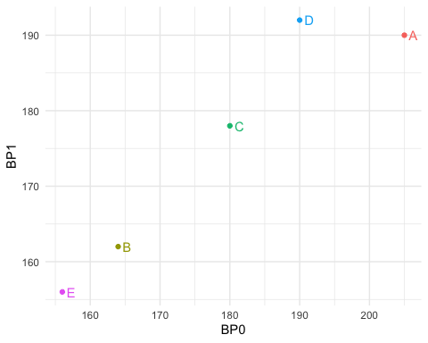
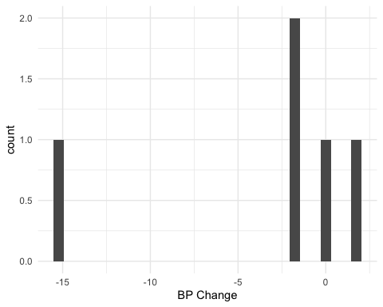
Do the BP data look normal?
At N=5, it is really difficult to make a judgment about this.
It is clear that subject A is exerting a lot of influence on the sample mean. If this was due to a technical equipment error or similar you might be in danger of being led to a very inaccurate conclusion. NB: It is always a good idea to double-check original records for numbers like this. Often a field has been left blank and defaulted to zero.
We will discuss sample size criteria later; but for now, reviewers might take issue with you using a t-test on data with this few samples. (Which is of course just an exercise.)
Often, when the data exhibit a large variance like this the test results will fail to reject the null.
However, if the null is rejected there is a major concern that it is because the normality assumptions were not met, not because the population mean is nonzero.
For now, let's proceed as though normality assumptions are reasonable.

Slide 27
The null hypothesis
We can make the explicit null hypothesis that because the drug has no effect, the data are sampled from a distribution with mean 0.
Specifically, $H_{0}:μ=0$, vs. $H_{A}:μ≠0$.
Then we can calculate a test statistic to evaluate how likely the sample mean we have here would be under the null ($μ=0$):
$\frac{\overline{X}−μ}{S/\sqrt{n}}∼t_{n−1}$
$\frac{−3.4−0}{3.0}=−1.1\sim t_{4}$

Slide 28
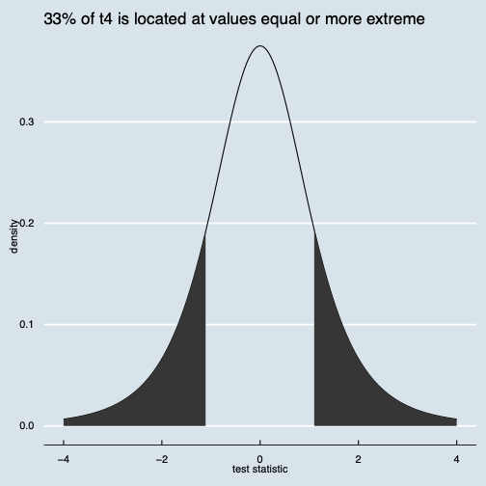
We compare our test statistic to the chosen distribution
Roughly 33% of the t4 density is located at values equal to or more extreme than our test statistic, -1.1.
Note that here we are doing a "two-sided test" – this is always recommended unless you have a strong rationale for one-sided tests.
(Note that I've rounded – the actual number is a little smaller)
t.test(c(-15,-2,-2,2,0))
## ## One Sample t-test ## t = -1.1359, df = 4, p-value = 0.3195 ## alternative hypothesis: true mean is not equal to 0

Slide 29
So did the drug work?
With a P value of 0.31, our observed values are not really surprising at all.
If the P value had been very small, like 0.02, it might have cast doubt on the null hypothesis, because it would mean that the data would be very rare under the null. (Of course, not impossible.)
We often use a cutoff value of alpha = 0.05 for this kind of decision.
So for now, we have no evidence (at alpha = 0.05) that we should reject the null hypothesis that $μ=0$.

Slide 30
Two-sample hypothesis tests

Slide 31
The independent-samples t test
It is much more common to have two samples, $a$ and $b$, of a variable like blood pressure, and to want to know whether the difference in means across the samples is greater than you might expect by chance.
This is typically evaluated with an independent-samples t test.
Note that there are several variants! In fact, the default in R is not the simplest one. We will investigate further.

Slide 32
Entering independent samples data
You will often see data from two groups entered like this:
This is misleading!
It implies that observation 4 in group 1 has something to do with observation 4 in group 2, and this is usually not the case.
Group 1 | Group 2
106 | 98
102 | 104
112 | 104
113 | 108

Slide 33
Entering independent samples data
Especially when used in plots, it can give the sense that these are two separate outcome variables, when in reality the outcome is one variable, and the group is a second variable.
You will note that data organized like this (melted) is ready for plotting in ggplot2 or similar – it is also ready for analysis in any of the main statistical libraries.
Outcome | Group
106 | 1
102 | 1
112 | 1
113 | 1
98 | 2
104 | 2
104 | 2
108 | 2

Slide 34
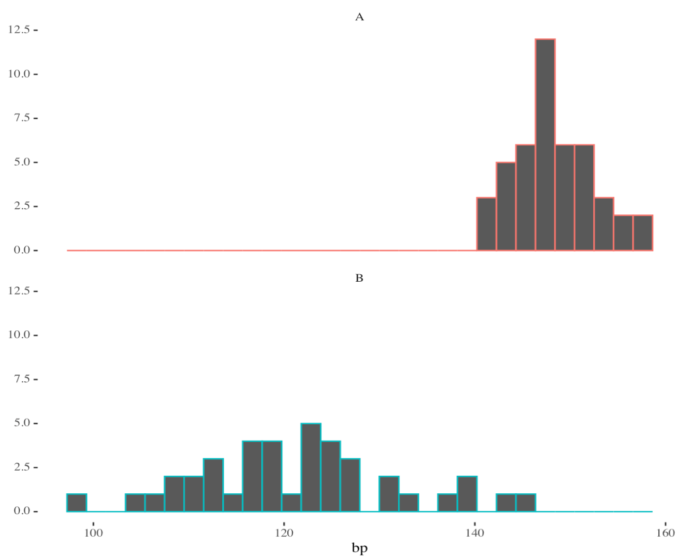
The independent-samples t test
Let's say that we have two samples of blood pressures, with 40 observations of group A and 45 observations of group B.
The traditional t test estimates the difference in means.

Slide 35
The independent-samples t test
In the basic test, under the null $H_{0}:μ_{A}=μ_{B}$ we can evaluate the statistic
$$\frac{\overline{X}−μ}{S/\sqrt{n}}∼t_{n−1}$$
Where the numerator is
$$|μ_{A}−μ_{B}|$$
Under the null, the population standard deviation $σ$ is the same for both groups.

Slide 36
The independent-samples t test
Group | A | B
N | 45 | 40
Mean | 148.3 | 121.4
SD | 4.1 | 10.7
SEM | 0.6 | 1.7
It is clear that we can calculate the difference in means:
$$\overline{X_{A}}−\overline{X_{B}}=26.9$$
Under $H_{0}$, this value should be 0 (on average).
(It is possible to hypothesize other values of $μ_{A}−μ_{B}$, for example, in non-inferiority trials; but 0 is the most common case.)

Slide 37
Methods to estimate variance / SEM
You could be conservative, and just take the larger of the two values of $S$, and the smaller of the two values of $n−1$ for the degrees of freedom in the t distribution.
This is essentially a one-sample test, with the test statistic distributed as $t_{(n_{min}−1)}$.
(Although very conservative, this is a good choice when planning a study.)

Slide 38
Methods to estimate variance / SEM
You could assume the population variances are equal, and pool the sample variances weighted by their sample size:
$$S_{p}^{2}=\frac{\left(n_{A}−1\right)S_{A}^{2}+\left(n_{B}−1\right)S_{B}^{2}}{\left(n_{A}−1\right)+\left(n_{B}−1\right)}$$
The test statistic:
$$T=\frac{\overline{X_{A}}−\overline{X_{B}}}{S_{p}\sqrt{\frac{1}{n_{A}}+\frac{1}{n_{B}}}}$$
Is distributed as $t_{\left(n_{A}−1\right)+\left(n_{B}−1\right)}$. This is called the pooled t test.

Slide 39
Remember the t density: Z over a chi-square
Definition: if $Z$ follows a standard normal density such that $Z∼N(0,1)$
and $U$ follows a chi-square density with $n$ degrees of freedom such that $U∼χ_{n}^{2}$ $∼ Z_{1}^{2}+Z_{2}^{2}+...+Z_{n}^{2}$
then the density $\frac{Z}{\sqrt{U/n}}$ is called the $t$ density with $n$ degrees of freedom.

Slide 40
Methods to estimate variance / SEM
Finally, you could use the typical method that we do in practice, which is to use the "Satterwaithe approximation."
In this approach, we use a test statistic with the standard deviation taken as something similar to the "geometric mean" of the two sample standard deviations.
$$T=\frac{\overline{X_{A}}−\overline{X_{B}}}{\sqrt{\frac{s_{A}^{2}}{n_{A}}+\frac{s_{B}^{2}}{n_{B}}}}$$
Here, the issue is that although the variance of $\overline{X_{A}}$ is distributed as a chi-squared, the variance of the difference of the two means is not.

Slide 41
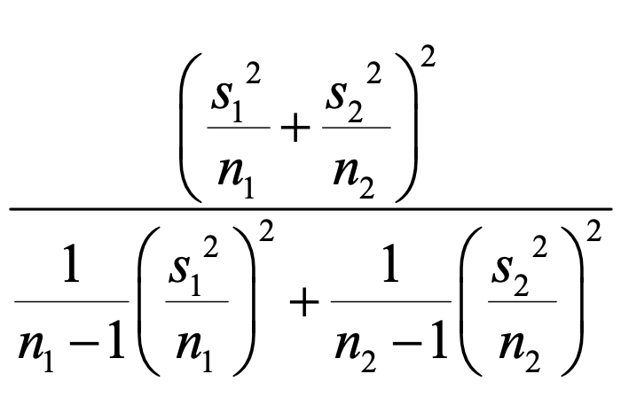
Satterwaithe's formula
Here, the issue is that although the variance of $\overline{X_{A}}$, that shows up in the denominator, is distributed as a chi-squared, the variance of the difference of the two means is not. So the denominator is no longer chi-squared, and the test statistic does not follow a t distribution.
Satterwaithe cleverly figured a way to figure out the "effective" degrees of freedom for the t distribution under which the denominator would be distributed approximately as a chi-squared. This is:

Slide 42
Assessing normality

Slide 43
Assessing normality
Most of the parametric tests derived from the normal distribution ($t$, $χ^{2}$, $F$) assume that the population quantities are normally distributed.
This assumption is very strong, and may not be reasonable for your data. Data visualization is very important to evaluate whether you think the population is normal or not.
There are two schools of thought on assessing normality:
Formal tests
Visual inspection

Slide 44
Assessing normality with formal tests
The Shapiro-Wilk test can be used to assess normality (shapiro.test() in R).
$H_{0}$ is that the data in a given sample are normally distributed; small P-values cast doubt on this.
There is no formal derivation of the test statistic, for which critical values are determined via Monte-Carlo methods.

Slide 45
Visual inspection
Because the sample mean will be normally distributed - even if the data themselves are not - if the sample size is over 30, many statisticians suggest a quick visual inspections to evaluate the assumptions of normality.
Since many of the questions we ask involve changes in mean values, it is often not necessary to go much beyond that.

Slide 46
How to interpret it when the data are not normal
Personally, as a scientist, when I run a statistical test it is much more important to me that the data satisfy independence than actually being very nicely normally distributed.
My reasoning on this is that if the data cause a null hypothesis to be rejected because one group has a bizarre distribution compared to another group, it is as interesting to me as if that particular group had a very normally distributed sample with a clear difference only in means.
Many people think differently about this, which is of course fine. Consider where you want to be (and where your reviewers will be) when you run into this.

Slide 47
Non-parametric alternatives
It is possible to use the Wilcoxon family of tests (wilcox.test() in R) to deal with data for which the mean may not be normally distributed.
This is a test of central tendency based on the difference in ranks of the the groups in the sample once it is sorted, rather than based on the absolute difference in mean values across groups. It is similar but usually less powerful than the parametric alternative.
The multi-group analog is the Kruscal-Wallis tests (kruskal.test).

Slide 48
Two additional notes

Slide 49
Moore and McCabe’s guidelines for sample size
The $t$-distribution formula for the population mean $μ$ is exactly correct when the underlying population is normal.
Whether or not this assumption is reasonable is the decision of the analyst. Data visualization is very important to evaluate whether you think the population is normal or not.
"Moore and McCabe" recommend using the following guidelines for determining whether the $t$ distribution procedure is ok to use in the presence of non-normal populations.
n < 15: use t-distribution only if the data indicate that the population is very close to normal.
15 < n < 39: use t-distribution except in the presence of outliers or strong skewness.
n > 40: use t-distribution regardless of the shape of the population distribution.

Slide 50
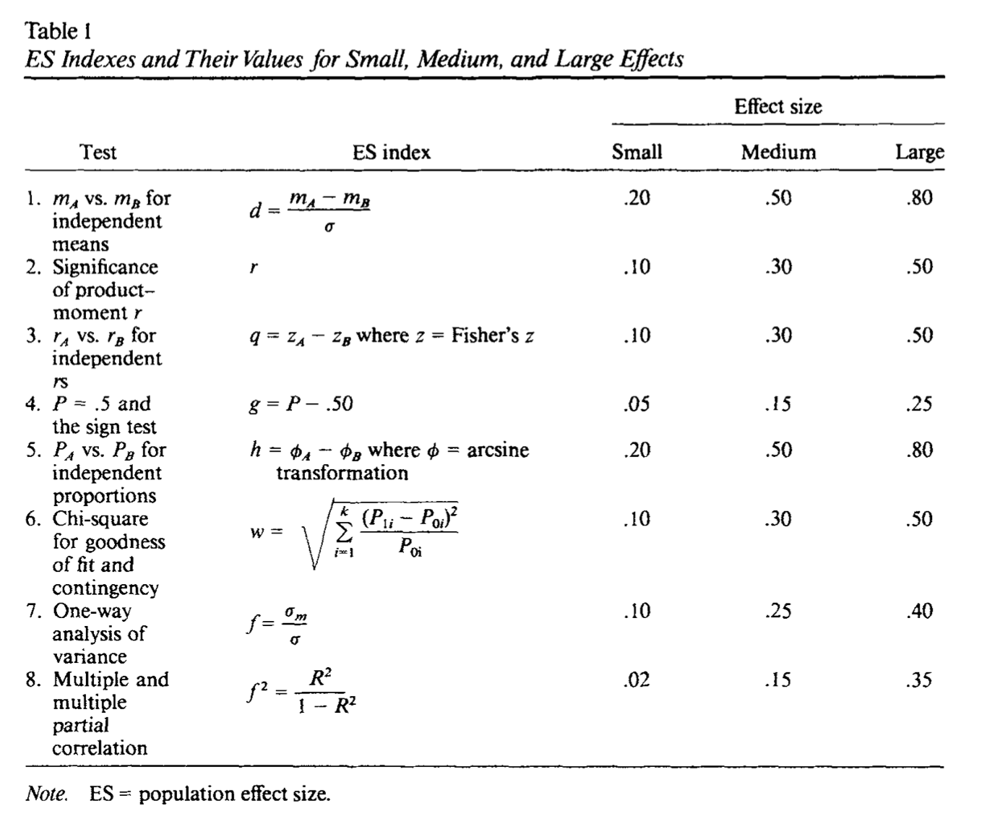
Effect sizes

Slide 51
Outline
Key definitions
The sample mean
One-sample hypothesis tests
Two-sample hypothesis tests
Additional topics

