Slide 1

BMI 510: Multiple comparisons
J. Lucas McKay, Ph.D., M.S.C.R.
Departments of Biomedical Informatics and Neurology, Emory University, Atlanta, GA USA
Department of Biomedical Engineering, Georgia Institute of Technology, Atlanta, GA, USA

Slide 2
Outline
Types of error
Family-wise error rate
  Understanding the underlying null hypothesis
Some methods to control family-wise error rate
  Strict FWER control
  FWER management – False Discovery Rate control
When and when not to adjust for FWER
Implementation of FWER in software

Slide 3
Types of error in a hypothesis test
 |  | H₀
 |  | False | True
Decision | Reject | Correct | Type I
 | Fail to reject | Type II | Correct

Slide 4
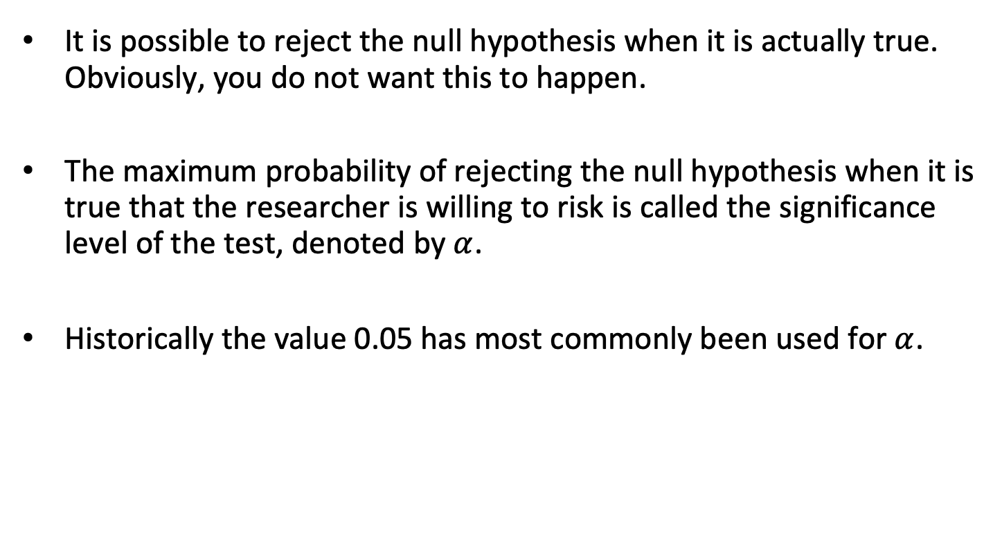

Type I error and $α$
It is possible to reject the null hypothesis when it is actually true. Obviously, you do not want this to happen.
The maximum probability of rejecting the null hypothesis when it is true that the researcher is willing to risk is called the significance level of the test, denoted by $α$.
Historically the value 0.05 has most commonly been used for $α$.

Slide 5
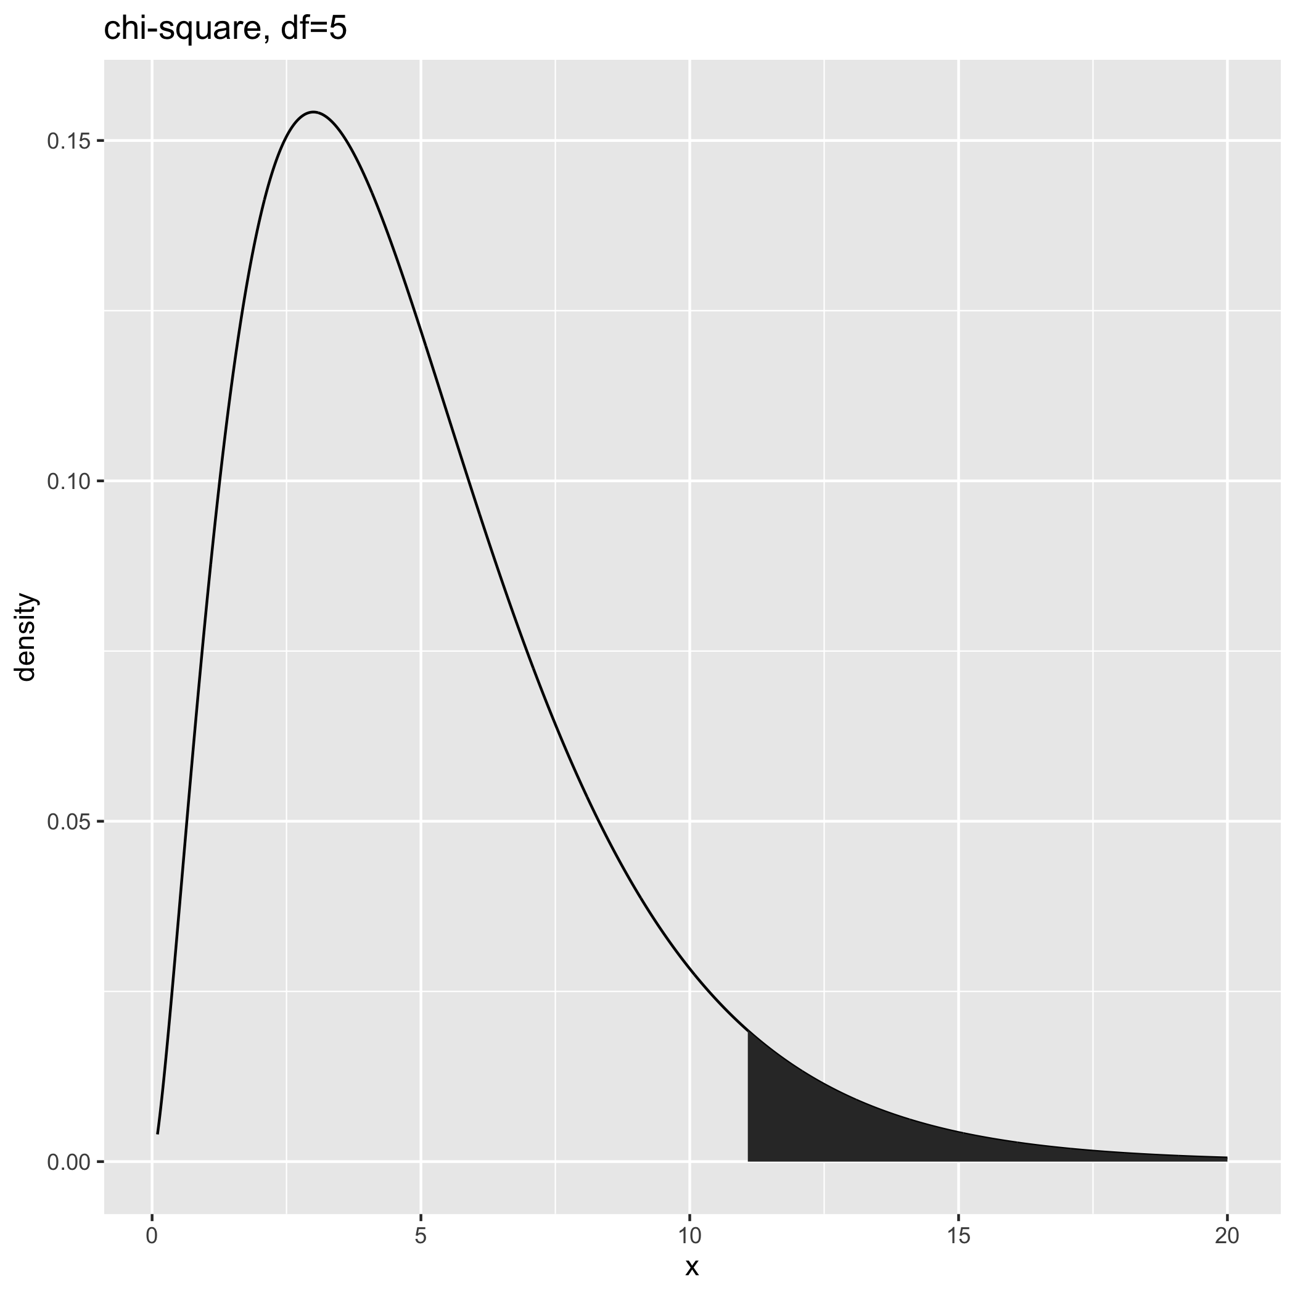
Type I error and $α$
In the hypothesis tests we've discussed, we reject the null when the data are not particularly likely.
That does not mean that the observed data are impossible if the null is true – but we will reject the null for rare events even if it is true.

Slide 6
What happens when you evaluate the null hypothesis in more than one way?
This is a quite prudent thing to do – if you were going to buy a used car, you would certainly test out many different aspects of how well it was maintained.
If, say, the oil happened to be low, you might regard it as a fluke, but if the oil was low, the tires were worn down, and the windshield washer fluid tank was bone dry, you might reject the null hypothesis that "the previous owner took care of the car" in favor of the alternative that "the previous owner did not take care of the car."

Slide 7
Type-I error in the presence of multiple tests
Traditional statistical models, sadly, do not really accommodate this very straightforward application of common sense.
In the reject/accept context of a single statistical test, the incorporation of multiple pieces of evidence causes problems.
In particular, it increases the probability of Type I errors, or false positives – that is, rejecting the null because of one or more extreme test results that we would attribute to chance, given common sense.

Slide 8
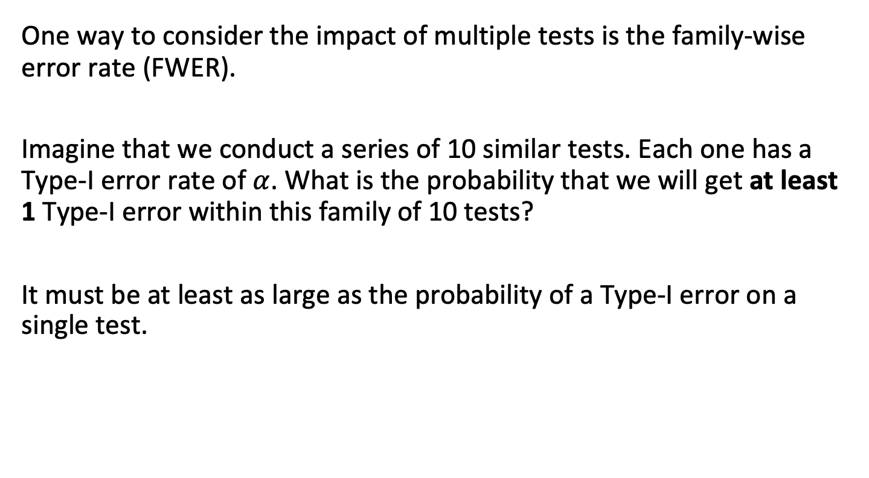
Family-wise error rate
One way to consider the impact of multiple tests is the family-wise error rate (FWER).
Imagine that we conduct a series of 10 similar tests. Each one has a Type-I error rate of $α$. What is the probability that we will get at least 1 Type-I error within this family of 10 tests?
It must be at least as large as the probability of a Type-I error on a single test.

Slide 9
Family-wise error rate
Let’s say you have a group of coins, and Heads is a false positive.
p(0 false positives):
{T H}
0.95
{TT TH HT TT}
0.95*0.95
{TTT TTH THT THH HTT HTH HHT HHH}
0.95*0.95*0.95

Slide 10
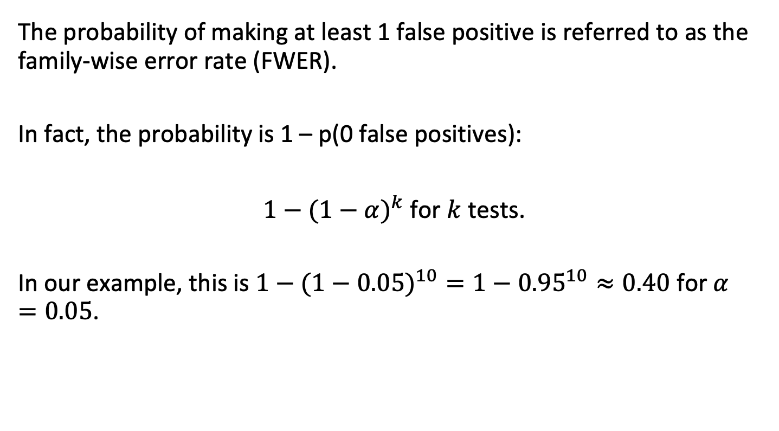
Family-wise error rate
The probability of making at least 1 false positive is referred to as the family-wise error rate (FWER).
In fact, the probability is 1 – p(0 false positives):
$1−(1−α)^{k}$ for $k$ tests.
In our example, this is $1−(1−0.05)^{10}=1−{0.95}^{10}≈0.40$ for $α=0.05$.

Slide 11
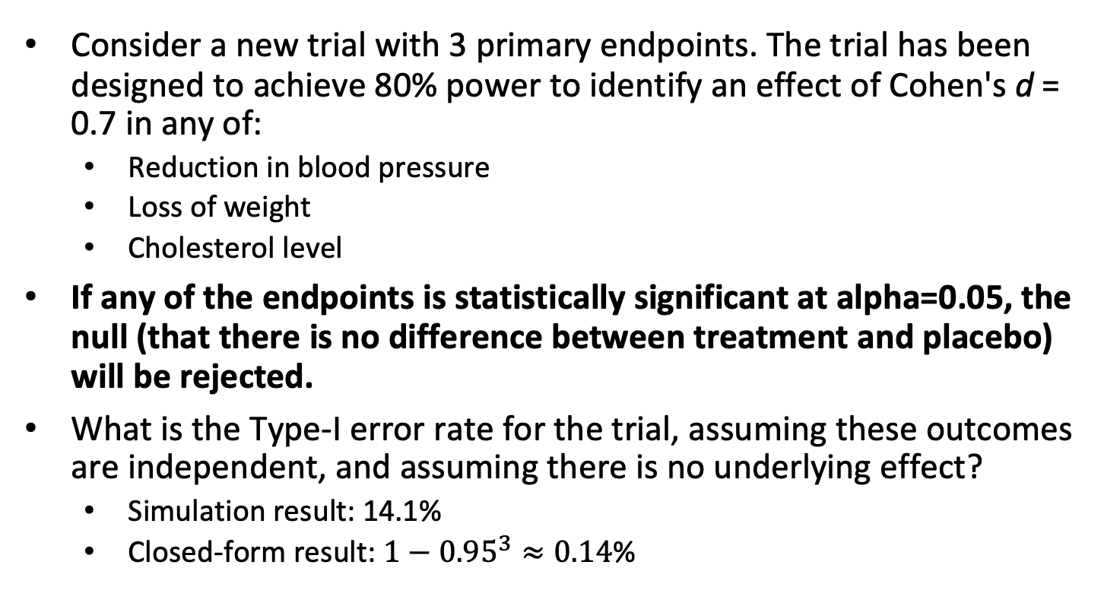
An example of multiple tests assessing the same underlying null hypothesis
Consider a new trial with 3 primary endpoints. The trial has been designed to achieve 80% power to identify an effect of Cohen's d = 0.7 in any of:
  Reduction in blood pressure
  Loss of weight
  Cholesterol level
If any of the endpoints is statistically significant at alpha=0.05, the null (that there is no difference between treatment and placebo) will be rejected.
What is the Type-I error rate for the trial, assuming these outcomes are independent, and assuming there is no underlying effect?
  Simulation result: 14.1%
  Closed-form result: $1−{0.95}^{3}≈0.14$%

Slide 12
Type-I error control methods
Strict FWER control
Bonferroni (instructive)
Holm (preferred in most cases)
There are other related procedures (Tukey, Scheffé, etc.) that we will not go into.
False discovery rate control
Benjamini & Hochberg (most common)
There are other related procedures (Benjamini–Yekutieli) that we will not go into.

Slide 13
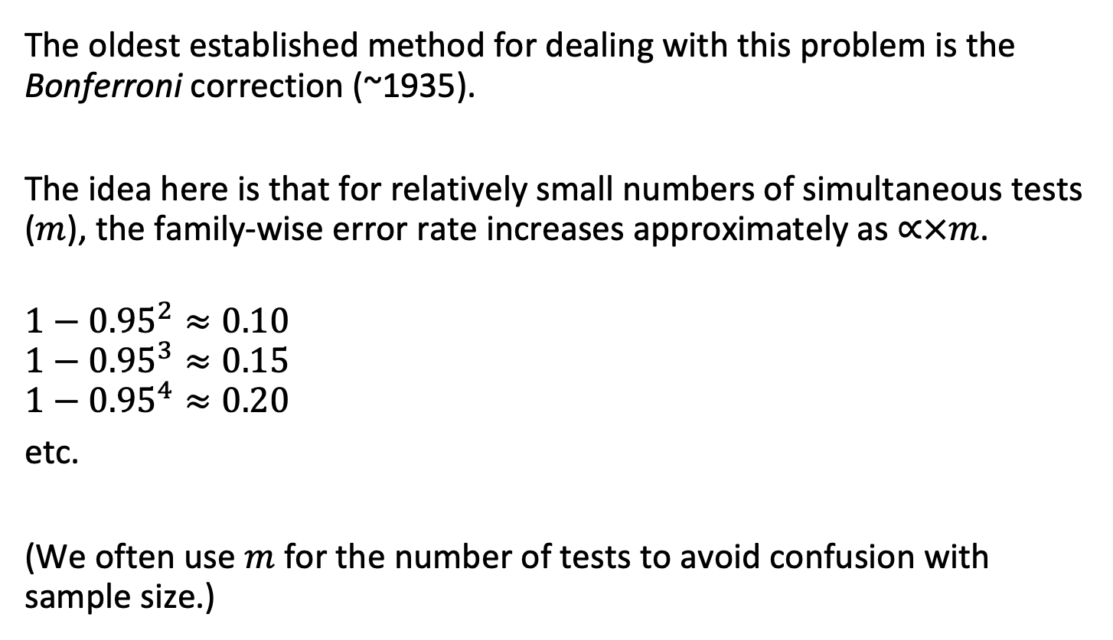
Bonferroni correction
The oldest established method for dealing with this problem is the Bonferroni correction (~1935).
The idea here is that for relatively small numbers of simultaneous tests ($m$), the family-wise error rate increases approximately as $∝×m$.
$$1−{0.95}^{2}≈0.10$$
$$1−{0.95}^{3}≈0.15$$
$$1−{0.95}^{4}≈0.20$$
etc.
(We often use $m$ for the number of tests to avoid confusion with sample size.)

Slide 14
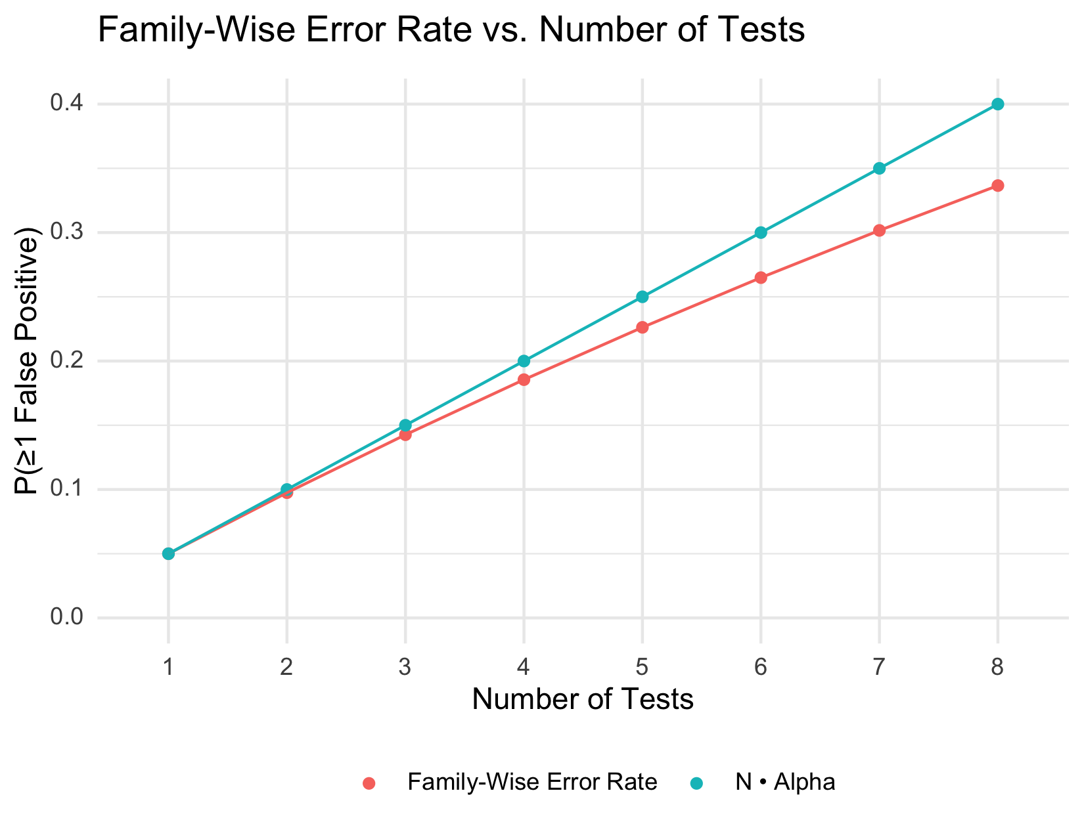

Slide 15
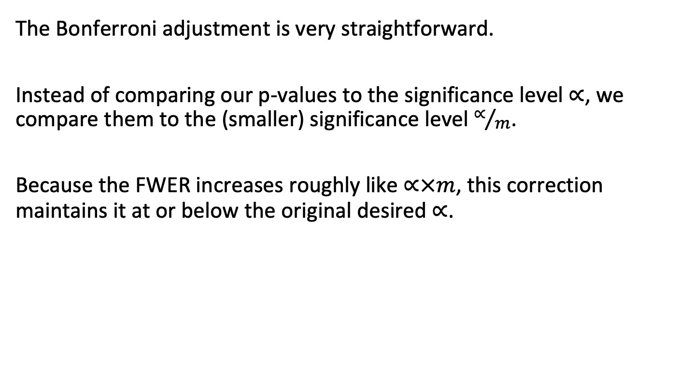
Bonferroni correction
The Bonferroni adjustment is very straightforward.
Instead of comparing our p-values to the significance level $∝$, we compare them to the (smaller) significance level $∝/m$.
Because the FWER increases roughly like $∝×m$, this correction maintains it at or below the original desired $∝$.

Slide 16
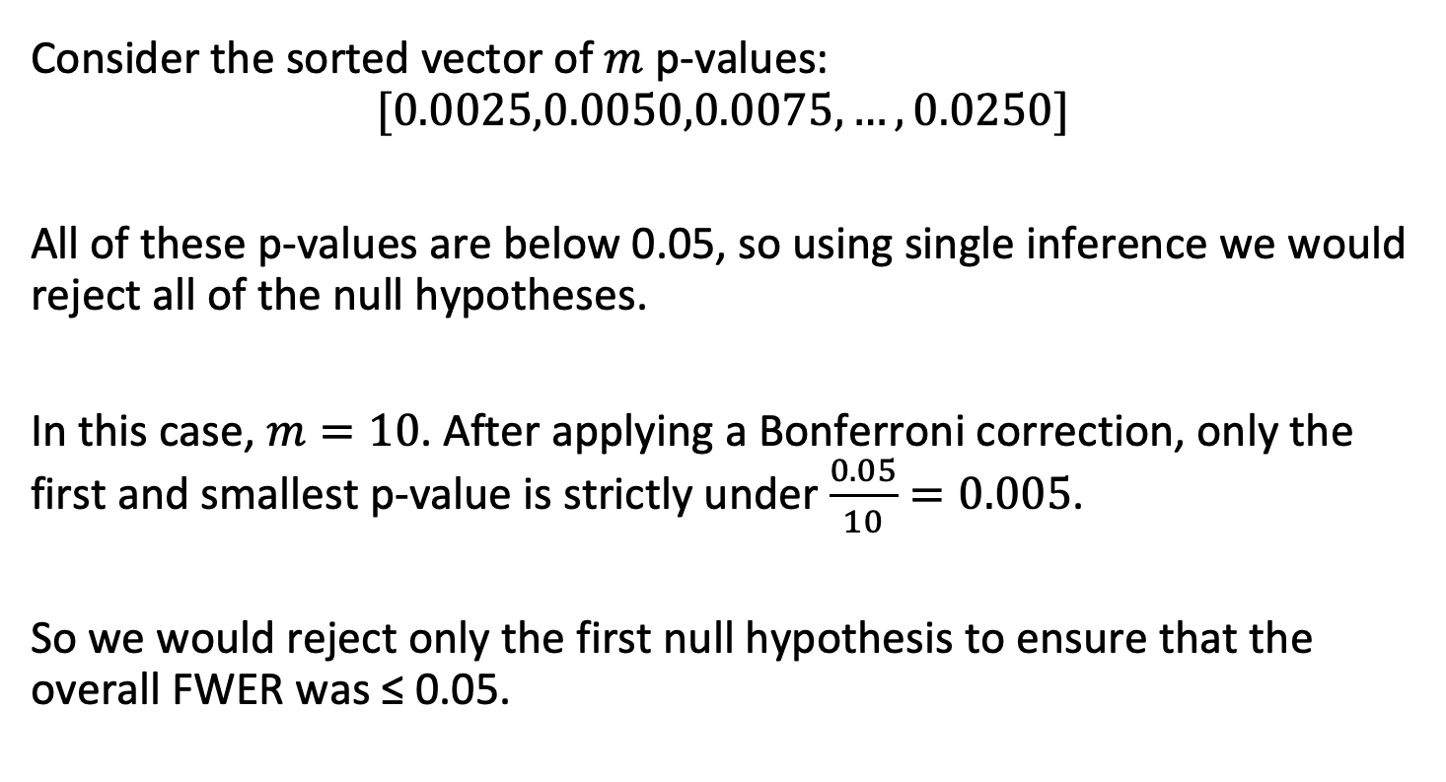
Bonferroni example
Consider the sorted vector of $m$ p-values:
$$[0.0025,0.0050,0.0075,…,0.0250]$$
All of these p-values are below 0.05, so using single inference we would reject all of the null hypotheses.
In this case, $m=10$. After applying a Bonferroni correction, only the first and smallest p-value is strictly under $\frac{0.05}{10}=0.005$.
So we would reject only the first null hypothesis to ensure that the overall FWER was ≤ 0.05.

Slide 17
Drawbacks of Bonferroni
Because it is simple, the Bonferroni adjustment is very common.
However, there are a few main drawbacks:
It is extremely conservative; for large numbers of tests (e.g., 'omics) it sacrifices power.
There are alternative methods with more power for the same assumptions (Holm is most common).
For large numbers tests, a small number of false positives might be perfectly acceptable (FDR is most common).

Slide 18
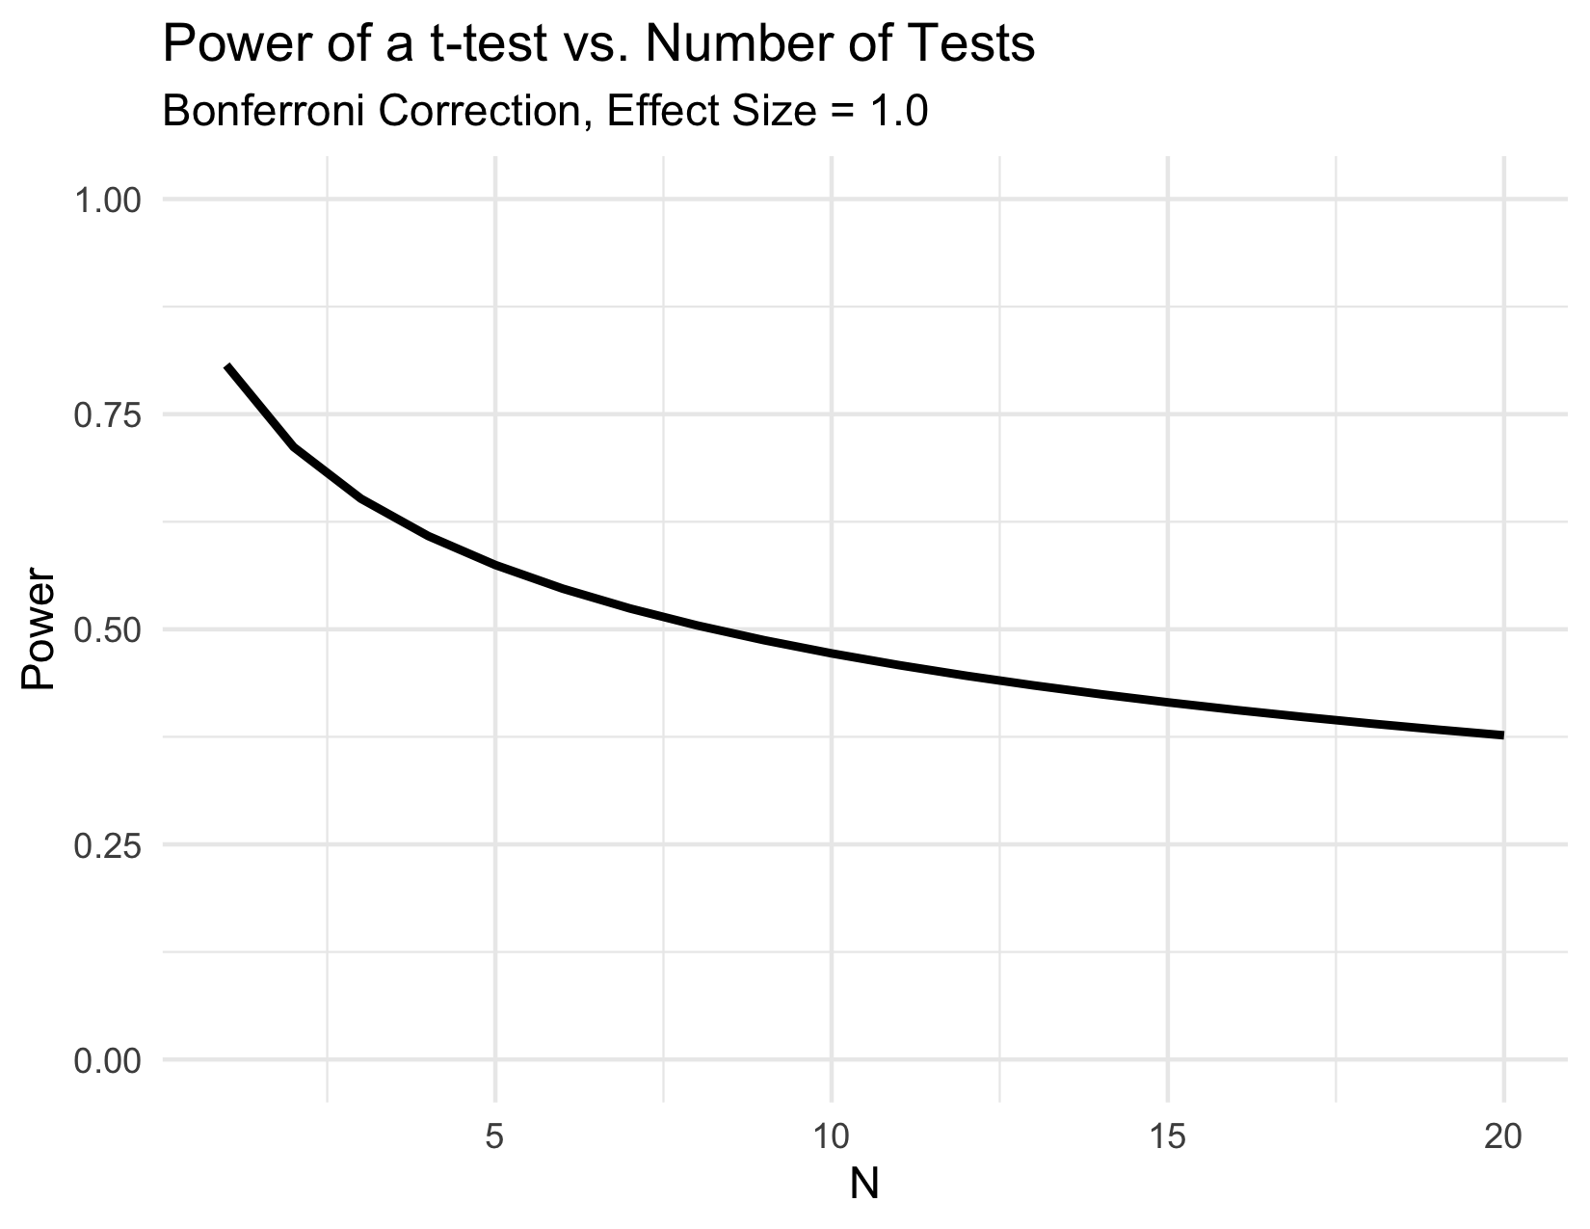

Slide 19
Drawbacks of Bonferroni
Because it is simple, the Bonferroni adjustment is very common.
However, there are a few main drawbacks:
It is extremely conservative; for large numbers of tests (e.g., 'omics) it sacrifices power.
There are alternative methods with more power for the same assumptions (Holm is most common).
For large numbers tests, a small number of false positives might be perfectly acceptable (FDR is most common).

Slide 20
Holm procedure
The first major "sequential testing" modification of the Bonferroni correction was developed by Holm (1979).
Holm showed that this procedure produces much lower Type-II error (much higher power) than the original Bonferroni procedure while maintaining as tight or tighter control on FWER.
For some reason the original Bonferroni procedure remains more common. There is no reason to use the original Bonferroni procedure.

Slide 21
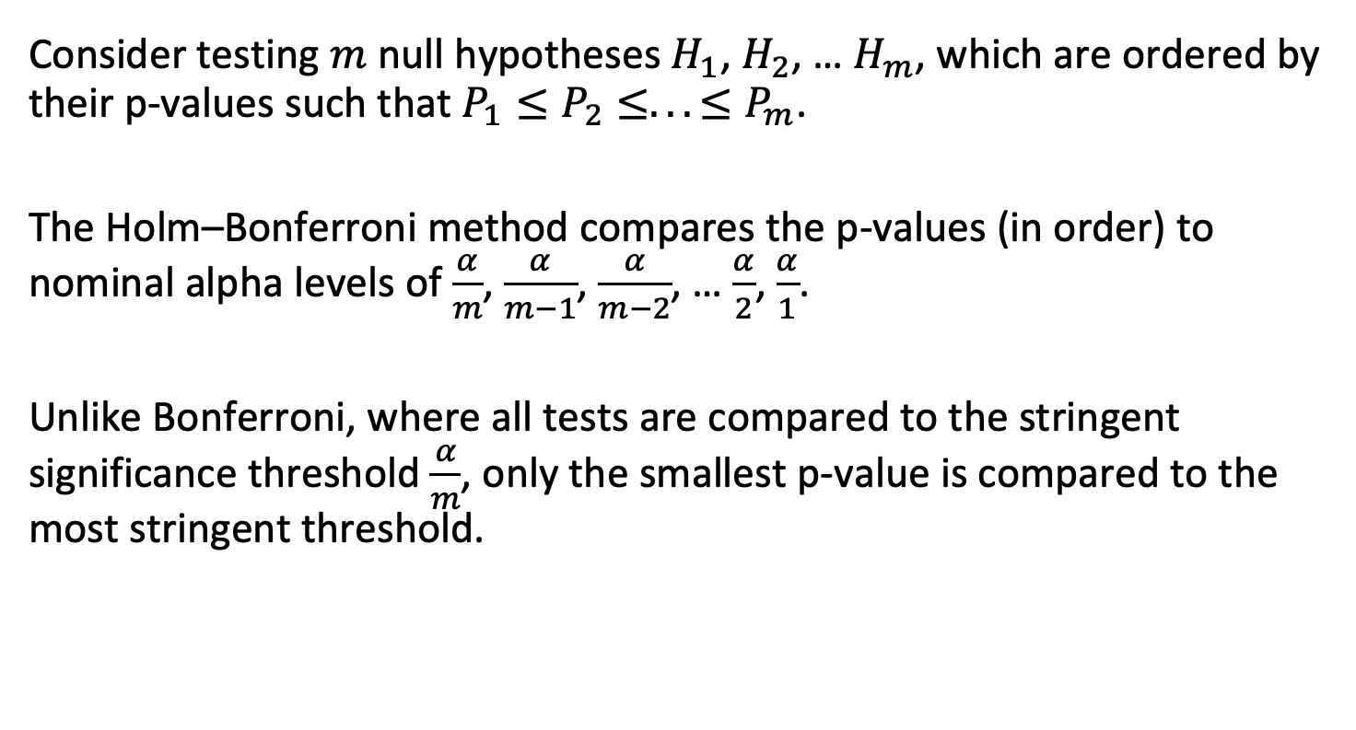
Holm procedure
Consider testing $m$ null hypotheses $H_{1}$, $H_{2}$, … $H_{m}$, which are ordered by their p-values such that $P_{1}≤P_{2}≤...≤P_{m}$.
The Holm–Bonferroni method compares the p-values (in order) to nominal alpha levels of $\frac{α}{m}$, $\frac{α}{m−1}$, $\frac{α}{m−2}$, … $\frac{α}{2}$, $\frac{α}{1}$.
Unlike Bonferroni, where all tests are compared to the stringent significance threshold $\frac{α}{m}$, only the smallest p-value is compared to the most stringent threshold.

Slide 22
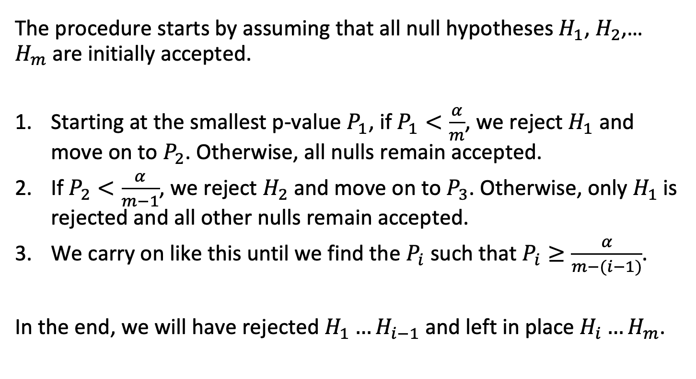
Holm procedure
The procedure starts by assuming that all null hypotheses $H_{1}$, $H_{2}$, … $H_{m}$are initially accepted.
Starting at the smallest p-value $P_{1}$, if $P_{1}<\frac{α}{m}$, we reject $H_{1}$ and move on to $P_{2}$. Otherwise, all nulls remain accepted.
If $P_{2}<\frac{α}{m−1}$, we reject $H_{2}$ and move on to $P_{3}$. Otherwise, only $H_{1}$is rejected and all other nulls remain accepted.
We carry on like this until we find the $P_{i}$ such that $P_{i}≥\frac{α}{m−(i−1)}$.
In the end, we will have rejected $H_{1}…H_{i−1}$ and left in place $H_{i}…H_{m}$.

Slide 23
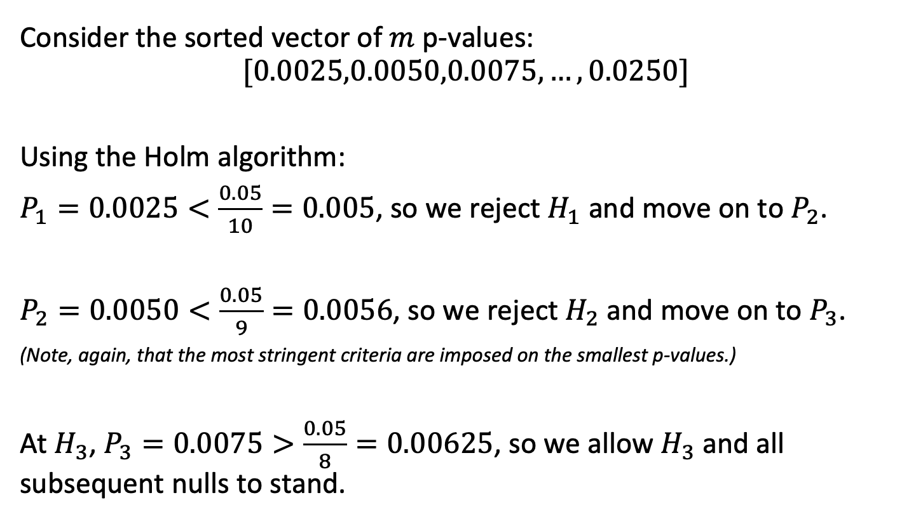
Holm example
Consider the sorted vector of $m$ p-values:
$$[0.0025,0.0050,0.0075,…,0.0250]$$
Using the Holm algorithm:
$P_{1}=0.0025<\frac{0.05}{10}=0.005$, so we reject $H_{1}$ and move on to $P_{2}$.
$P_{2}=0.0050<\frac{0.05}{9}=0.0056$, so we reject $H_{2}$ and move on to $P_{3}$.
(Note, again, that the most stringent criteria are imposed on the smallest p-values.)
At $H_{3}$, $P_{3}=0.0075>\frac{0.05}{8}=0.00625$, so we allow $H_{3}$ and all subsequent nulls to stand.

Slide 24
Outline
Types of error
Family-wise error rate
  Understanding the underlying null hypothesis
Some methods to control family-wise error rate
  Strict FWER control
  FWER management – False Discovery Rate control
When and when not to adjust for FWER
Implementation of FWER in software

Slide 25
The problem with multiple simultaneous tests
"When pursuing multiple inferences, researchers tend to select the (statistically) significant ones for emphasis, discussion and support of conclusions. An unguarded use of single-inference procedures results in a greatly increased false positive (significance) rate. To control this multiplicity (selection) effect, classical multiple comparison procedures (MCPs) aim to control the probability of committing any Type I error in families of comparisons under simultaneous consideration. The control of this familywise error rate (FWER) is usually required in a strong sense, i.e. under all configurations of the true and false hypotheses tested."
Benjamini and Hochberg, 1995

Slide 26
FWER control is needed for linked hypothesis tests
"Often the control of the FWER is not quite needed. The control of the FWER is important when a conclusion from the various individual inferences is likely to be erroneous when at least one of them is. This may be the case, for example, when several new treatments are competing against a standard, and a single treatment is chosen from the set of treatments which are declared significantly better than the standard. However, a treatment group and a control group are often compared by testing various aspects of the effect (different end points in clinical trials terminology). The overall conclusion that the treatment is superior need not be erroneous even if some of the null hypotheses are falsely rejected."
Benjamini and Hochberg, 1995

Slide 27
False discovery rate
As the nature of scientific questions changed, researchers started asking different types of questions.
Among all of these biomarkers, which are differentially expressed in the presence of a disease?
Among all of these fMRI voxels, which are more active during a particular imagined activity?

Slide 28
False discovery rate
There was less interest in identifying individual statistical outcomes and more interest in identifying groups of outcomes associated with a particular condition.
In this case, the requirement of having absolutely no false positives was less important than having better power to identify true positives.
Benjamini and Hochberg (1995) really captured this idea with the concept of false discovery rate (FDR).
In an FDR design, among a group of multiple statistically-significant results, the analysis is controlled such that, say, false positives make up 5% or fewer of the "discoveries."

Slide 29
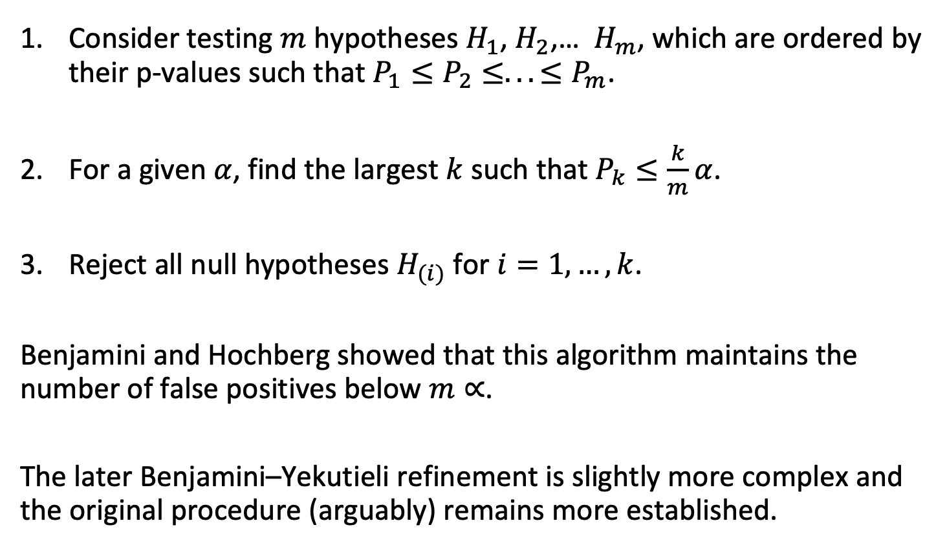
The Benjamini-Hochberg ("BH", "FDR") procedure
Consider testing $m$ hypotheses $H_{1}$, $H_{2}$, … $H_{m}$, which are ordered by their p-values such that $P_{1}≤P_{2}≤...≤P_{m}$.
For a given $α$, find the largest $k$ such that $P_{k}≤\frac{k}{m}α$.
Reject all null hypotheses $H_{(i)}$ for $i=1,…,k$.
Benjamini and Hochberg showed that this algorithm maintains the number of false positives below $m∝$.
The later Benjamini–Yekutieli refinement is slightly more complex and the original procedure (arguably) remains more established.

Slide 30
Outline
Types of error
Family-wise error rate
  Understanding the underlying null hypothesis
Some methods to control family-wise error rate
  Strict FWER control
  FWER management – False Discovery Rate control
When and when not to adjust for FWER
Implementation of FWER in software

Slide 31
When and when not to adjust for FWER
Yes:
If a statistically-significant result among any of a group of tests will cause you to reject an overall null hypothesis, you should certainly use a Type-I error control procedure. These cases are not as common as you might think in designed experiments. (Strict FWER control.)
No:
In clinical studies with primary and secondary endpoints, the primary and secondary endpoints represent independent null hypotheses with no real linked null. An example might be a clinical trial with primary endpoint all-cause mortality and secondary endpoint self-reported quality of life.

Slide 32
When and when not to adjust for FWER
Yes:
In situations where you are using all possible combinations among groups of factors. This is a common procedure in Analysis of Variance (ANOVA) – many statisticians do not recommend this anyway, as a well-formulated model will save you from doing a large number of linked tests. (Strict FWER control.)
Yes:
In studies like fMRI or GWAS where the number of tests is likely to generate a large number of statistically-significant results and therefore a large number of false positives. In this case some sort of Type-I control is always needed; often this is of an FDR type but you may see even traditional Bonferroni depending on the field.

Slide 33
When and when not to adjust for FWER
No:
When you do more than one test in a single paper. They are independent hypotheses.
Do both:
When a large number of clinical outcomes are reported for a treatment, it is usually instructive to report the single inference P values and then highlight those that remain statistically-significant after Type-I control.

Slide 34

Type-I error rate control can assist in the interpretation of multiple outcomes
This p-value would have to be <0.003 to survive a Holm procedure.
Follett et al., NEJM 2010

Slide 35
Outline
Types of error
Family-wise error rate
  Understanding the underlying null hypothesis
Some methods to control family-wise error rate
  Strict FWER control
  FWER management – False Discovery Rate control
When and when not to adjust for FWER
Implementation of FWER in software

Slide 36
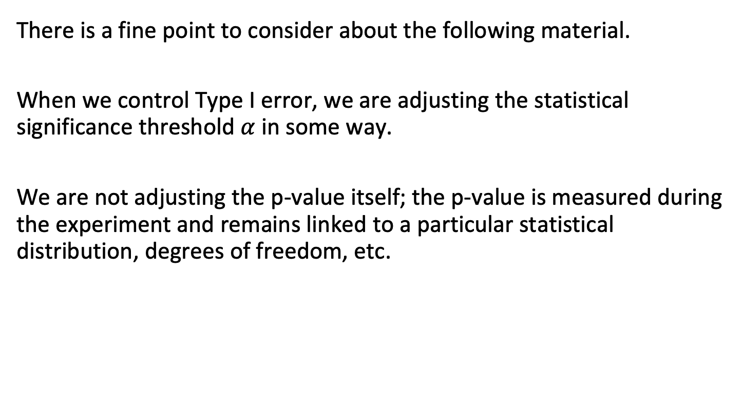
In software, we usually "adjust" p-values to control FWER
There is a fine point to consider about the following material.
When we control Type I error, we are adjusting the statistical significance threshold $α$ in some way.
We are not adjusting the p-value itself; the p-value is measured during the experiment and remains linked to a particular statistical distribution, degrees of freedom, etc.

Slide 37
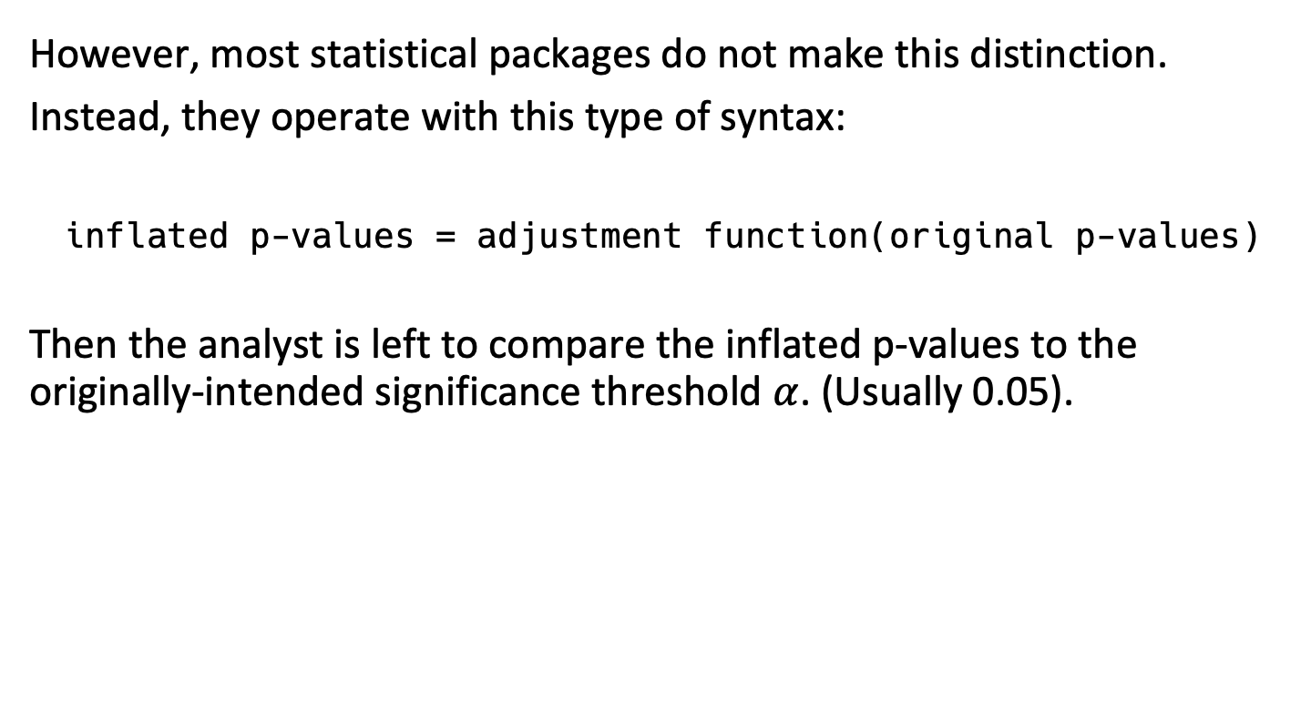
In software, we usually "adjust" p-values to control FWER
However, most statistical packages do not make this distinction.
Instead, they operate with this type of syntax:
inflated p-values = adjustment function(original p-values)
Then the analyst is left to compare the inflated p-values to the originally-intended significance threshold $α$. (Usually 0.05).

Slide 38
Common software implementations for Type-I error control
p.adjust in R
statsmodels.stats.multitest.multipletests in python

Slide 39
Outline
Types of error
Family-wise error rate
  Understanding the underlying null hypothesis
Some methods to control family-wise error rate
  Strict FWER control
  FWER management – False Discovery Rate control
When and when not to adjust for FWER
Implementation of FWER in software

