Slide 1

BMI 510:
Linear Mixed Models
J. Lucas McKay, Ph.D., M.S.C.R.
Departments of Biomedical Informatics and Neurology, Emory University, Atlanta, GA USA
Department of Biomedical Engineering, Georgia Institute of Technology, Atlanta, GA, USA

Slide 2
Outline
Statistical independence and repeated measures
Fixed vs. random effects
Correlated data
Estimation and testing
Sums of Squares

Slide 3
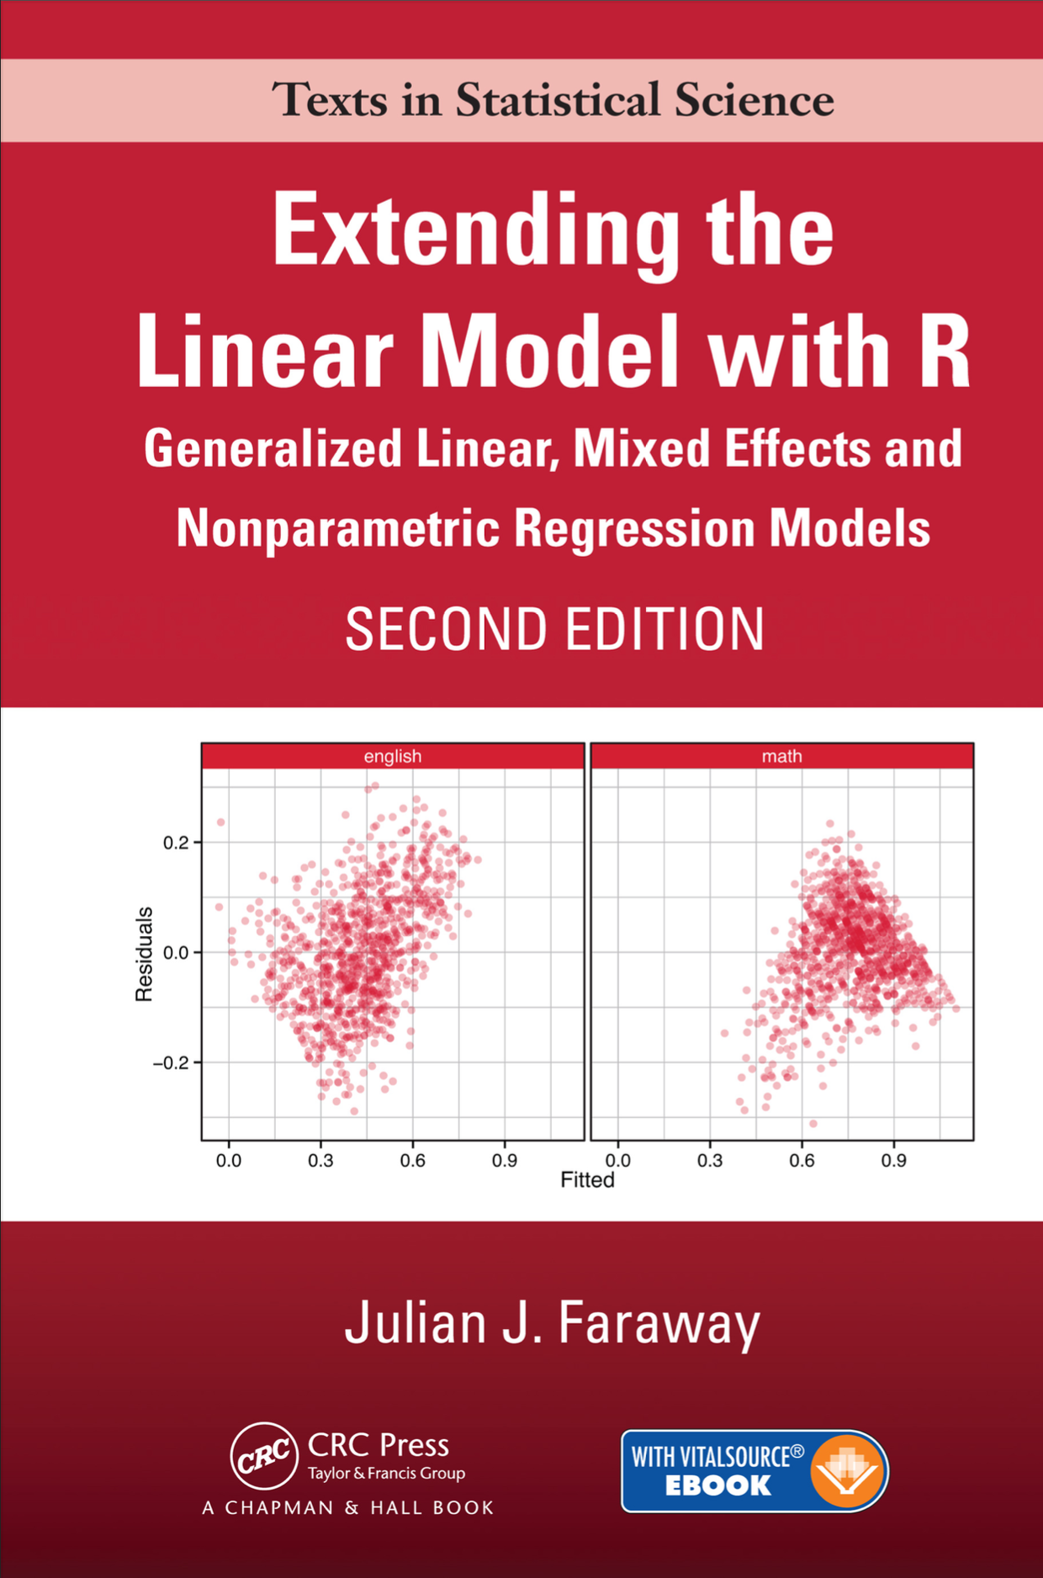
Reference work
This material does not appear in the James text. Some of it is adapted from this reference:

Slide 4
Acknowledgment
Some of this material is adapted from course notes for an Epidemiology course taught by Mitch Klein, Ph.D.

Slide 5
Independence
Almost everything we have considered now has required the assumption that observations were independent.
We recall that this is a fundamental assumption - any test using the chi-square, t, and F distributions will require this.
Unfortunately, real-world data very rarely fit this assumption.

Slide 6
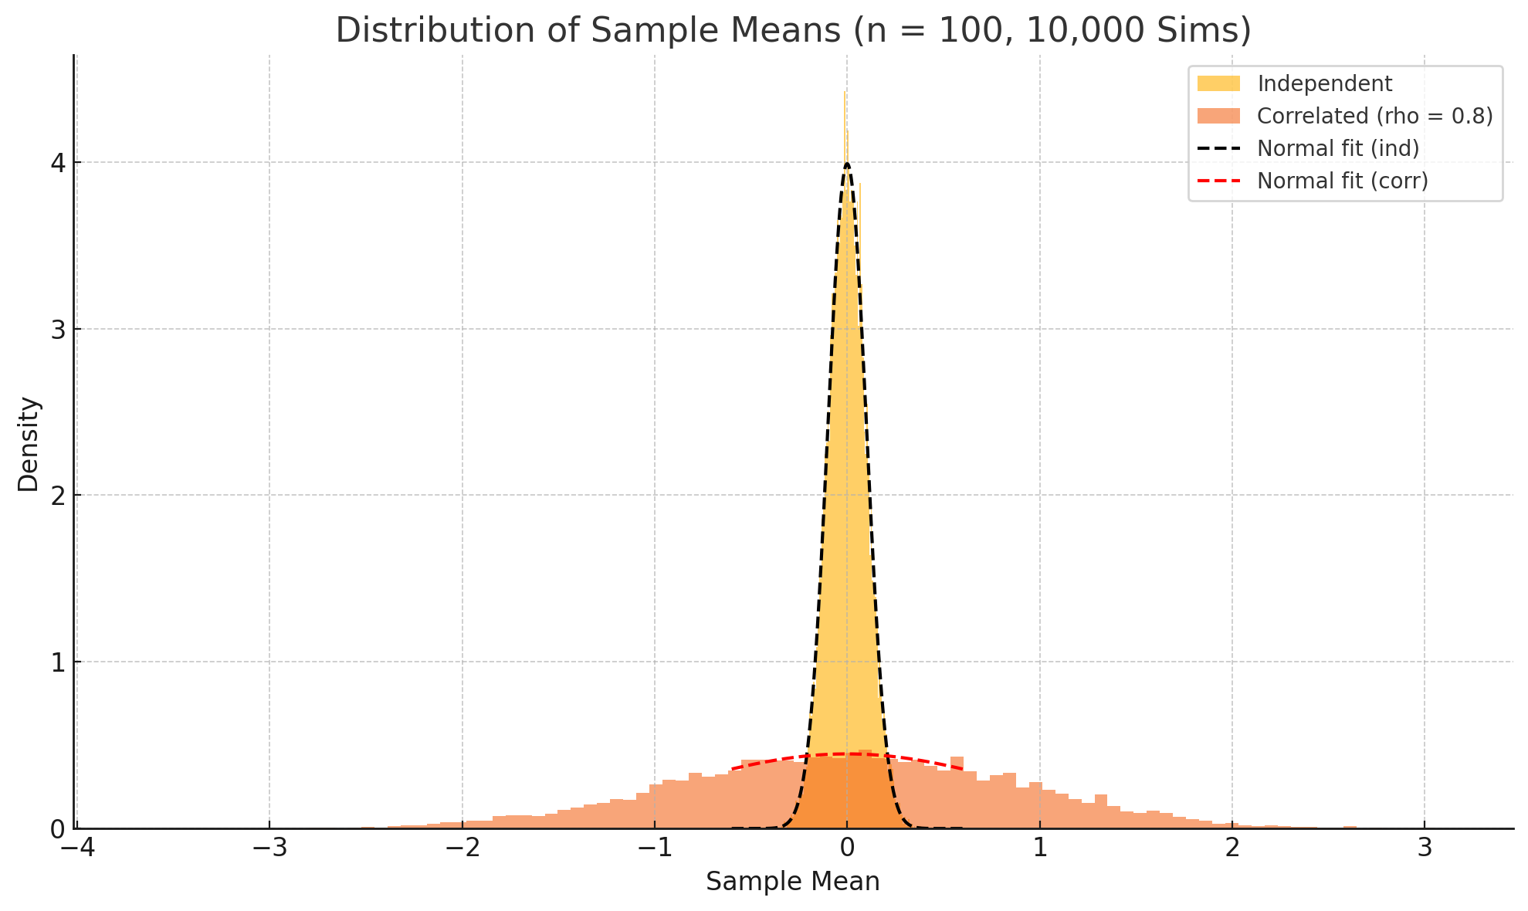
Non-independence leads to overly narrow confidence intervals
This is a simulation of the variation in errors of the mean with independent and correlated data.
The width of this density is what you would use to make a confidence interval or do a z-test.
Correlation between the samples typically increases the width of the density.
This means that a z-score of, say, 3 will be much more likely to happen when the data are correlated than when the data are independent.
Notes:
This is a simulation of the variation in ”errors of the mean” with independent and correlated data.
The width of this density is what you would use to make a confidence interval or do a z-test.
Correlation between the samples typically increases the width of the density, meaning that a z-score of, say, 3 will be much more likely to happen when the data are correlated than when the data are independent.

Slide 7

Independence
Most real-world data share the common feature that there are multiple observations of an individual patient or subject. We might have multiple variables taken from one person, or the same variable measured several times in a longitudinal study.
1
Analyses that assume independence of the observations will be inappropriate.
2
The use of random effects is one common and convenient way to model such grouping structure. (We’ll discuss later.)
3

Slide 8
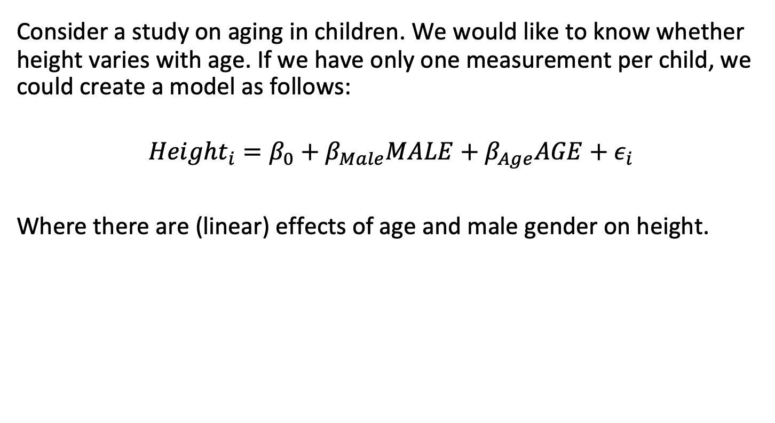
A growth study
Consider a study on aging in children. We would like to know whether height varies with age. If we have only one measurement per child, we could create a model as follows:
$$Height_{i}=β_{0}+β_{Male}MALE+β_{Age}AGE+ε_{i}$$
Where there are (linear) effects of age and male gender on height.

Slide 9

A growth study
The data for this study might be laid out something like this:
$$\left[\begin{matrix}ID & MALE & AGE & HEIGHT \\ 795 & 1 & 7.5 & 120 \\ 401 & 0 & 7.0 & 112 \\ 203 & 1 & 5.6 & 88\end{matrix}\right]$$

Slide 10
A growth study
Note that in this dataset, there is only one row per individual. Each observation can be assumed to be statistically independent.
However, what if the data were grouped in some way - for example, if (some) siblings were included in the study?
Then the assumption of statistical independence might be a little more questionable; children with the same households would have dietary and other factors in common.
How would we represent this clustering in the dataset?

Slide 11
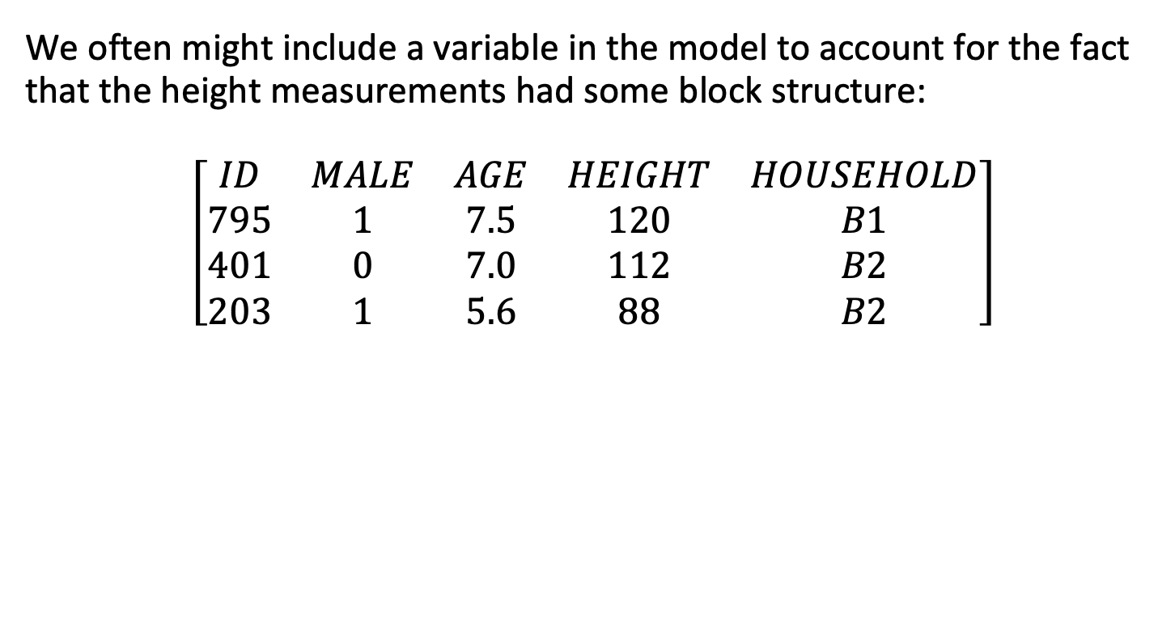
A growth study
We often might include a variable in the model to account for the fact that the height measurements had some block structure:
$$\left[\begin{matrix}ID & MALE & AGE & HEIGHT & HOUSEHOLD \\ 795 & 1 & 7.5 & 120 & B1 \\ 401 & 0 & 7.0 & 112 & B2 \\ 203 & 1 & 5.6 & 88 & B2\end{matrix}\right]$$

Slide 12

A growth study
How would we accommodate this in the model design? We could take household $B1$ as the reference household, and include an effect for being in household $B2$:
$$Height_{i}=β_{0}+β_{Male}MALE+β_{Age}AGE+β_{B2}B2+ε_{i}$$

Slide 13


A growth study
Would we necessarily be interested in whether there was a “statistically significant” effect of being in one household or the other?
If we repeated the study, would we have a better estimate of $β_{Age}$? What about $β_{B2}$?

Slide 14

A growth study
Suddenly this effect $β_{B2}$ seems to play a very different role than the regression coefficients we have considered previously.
This is because the clustering effect of household should be considered a random effect.

Slide 15
Outline
Statistical independence and repeated measures
Fixed vs. random effects
Correlated data
Estimation and testing
Sums of Squares

Slide 16
Fixed vs. random effects
A fixed effect is an unknown constant that we try to estimate from the data. Essentially, all the parameters used in the linear and generalized linear models are fixed effects.
In contrast, a random effect is a random variable. It does not make sense to estimate a random effect; instead, we try to estimate the parameters that describe the distribution of this random effect.

Slide 17
Fixed vs. random effects
One way to discern fixed from random effects is how they vary over replication.
Fixed effect: the estimate of the effect becomes more precise as the experiment is replicated.
For example, if we repeated a randomized drug trial with identical sample size, dosage, etc., over and over again, we would be able to produce a more precise estimate of treatment.

Slide 18
Fixed vs. random effects
One way to discern fixed from random effects is how they vary over replication.
Random effect: the estimate of the effect does not become more precise as the experiment is replicated. For example, if we repeated our height study with a different group of children, there would presumably be no effect of “household” that was held over from one iteration to the next.

Slide 19
A growth study
Consider two studies, each of which contains a hundred height measurements from children aged one through ten years old.
Study 1: Heights are measured on a cross section of 100 children. There are 10 children represented from each year of age (ages 1-10).
Study 2: Ten children each 1-year old are followed for 10 years. Each year their height is measured and recorded. So each child contributes 10 measurements yielding 100 data points in all. This is an example of a longitudinal repeated measure study.

Slide 20

A growth study
Question: If the goal of the study is to estimate the average height of a 7-year old, then which of the study designs would you prefer?
Question: If the goal of the study was to evaluate the way children grow (i.e., growth curves), then which of the study designs would you prefer?

Slide 21
Outline
Statistical independence and repeated measures
Fixed vs. random effects
Correlated data
Estimation and testing
Sums of Squares

Slide 22
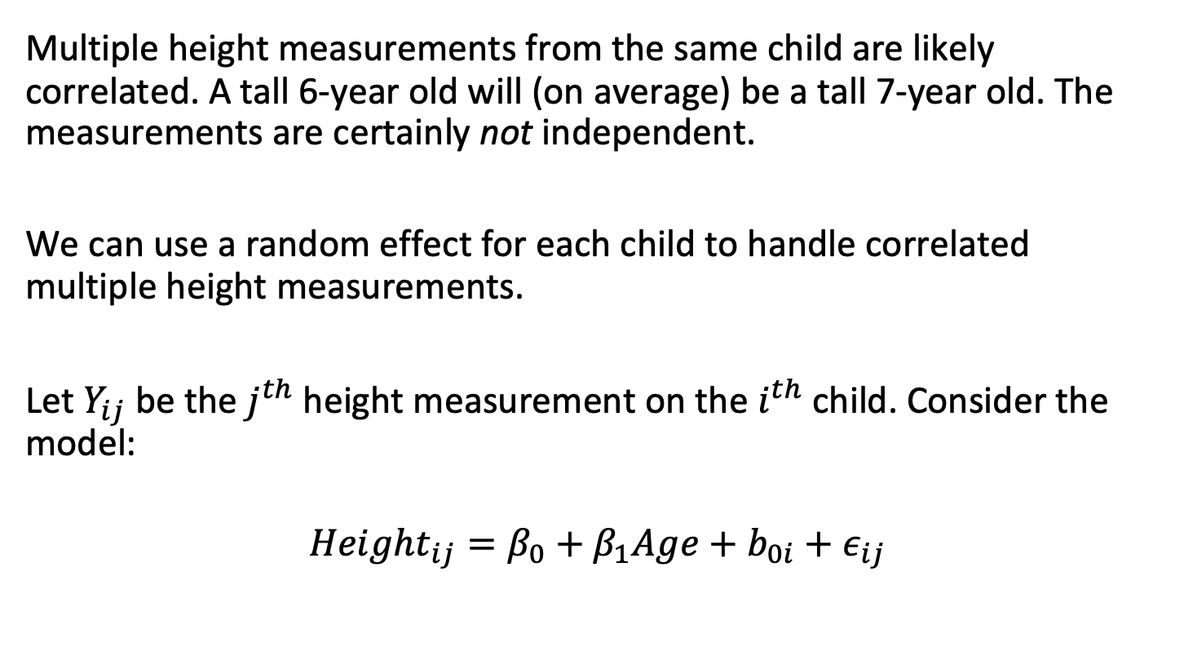
Correlated data
Multiple height measurements from the same child are likely correlated. A tall 6-year old will (on average) be a tall 7-year old. The measurements are certainly not independent.
We can use a random effect for each child to handle correlated multiple height measurements.
Let $Y_{ij}$ be the $j^{th}$ height measurement on the $i^{th}$ child. Consider the model:
$$Height_{ij}=β_{0}+β_{1}Age+b_{0i}+ε_{ij}$$

Slide 23
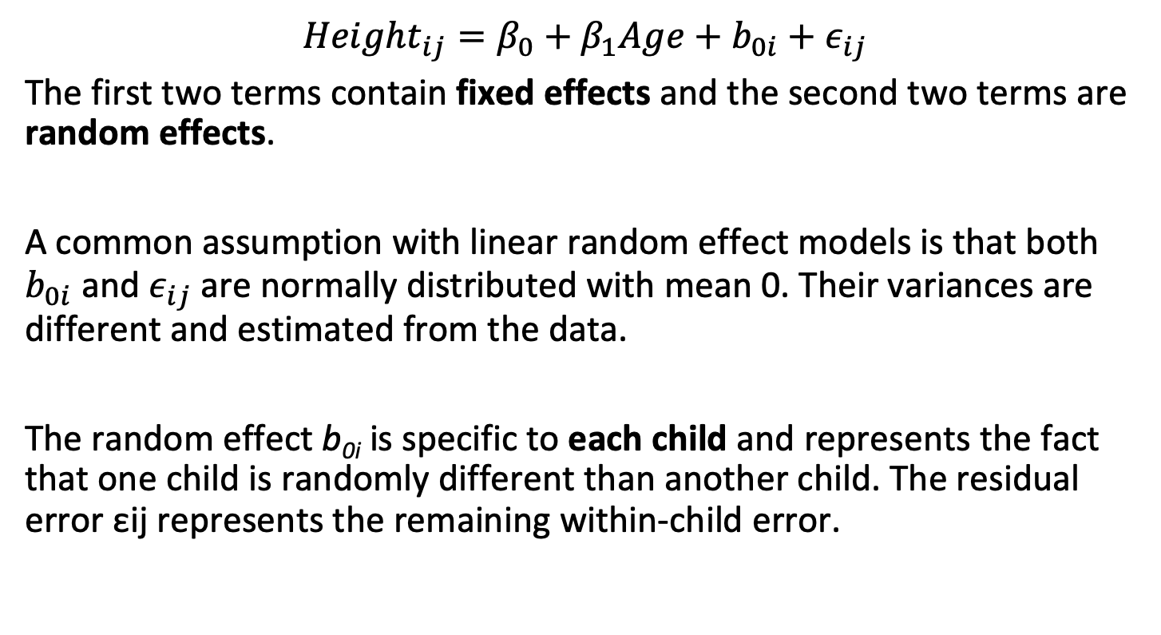
Correlated data
$$Height_{ij}=β_{0}+β_{1}Age+b_{0i}+ε_{ij}$$
The first two terms contain fixed effects and the second two terms are random effects.
A common assumption with linear random effect models is that both $b_{0i}$ and $ε_{ij}$ are normally distributed with mean 0. Their variances are different and estimated from the data.
The random effect b_{0i} is specific to each child and represents the fact that one child is randomly different than another child. The residual error εij represents the remaining within-child error.

Slide 24
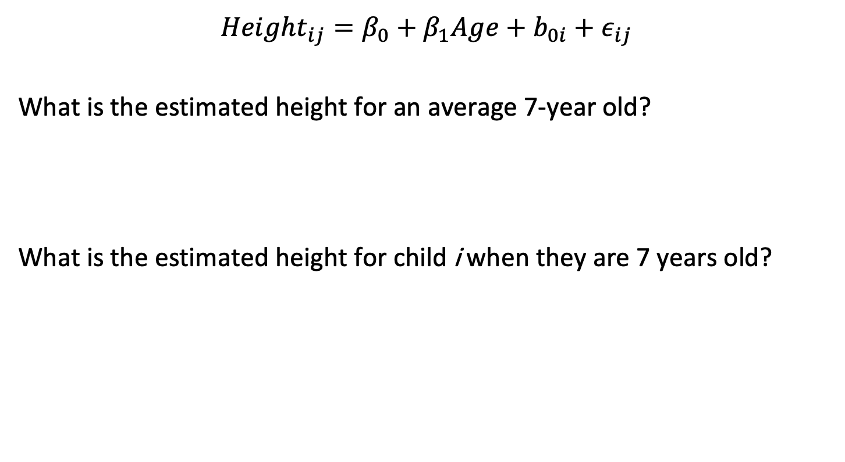
Correlated data
$$Height_{ij}=β_{0}+β_{1}Age+b_{0i}+ε_{ij}$$
What is the estimated height for an average 7-year old?
$$β_{0}+7β_{1}$$
What is the estimated height for child i when they are 7 years old?
$$β_{0}+b_{0i}+7β_{1}$$

Slide 25
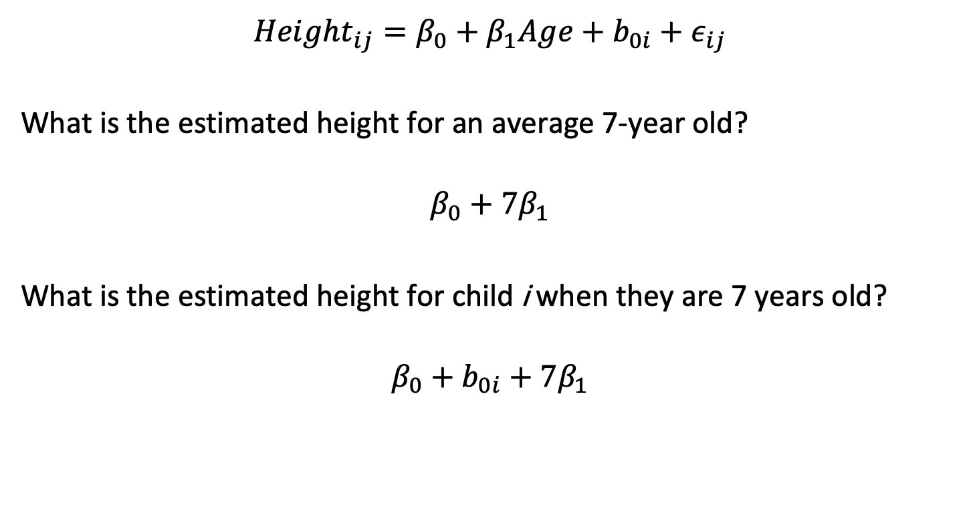
Correlated data
$$Height_{ij}=β_{0}+β_{1}Age+b_{0i}+ε_{ij}$$
What is the estimated height for an average 7-year old?
$$β_{0}+7β_{1}$$
What is the estimated height for child i when they are 7 years old?
$$β_{0}+b_{0i}+7β_{1}$$

Slide 26

Correlated data
$$Height_{ij}=β_{0}+β_{1}Age+b_{0i}+ε_{ij}$$
Does each child have the same intercept in this model?
No
Does each child have the same slope in this model?
Yes

Slide 27

Correlated data
$$Height_{ij}=β_{0}+β_{1}Age+b_{0i}+ε_{ij}$$
Does each child have the same intercept in this model?
No
Does each child have the same slope in this model?
Yes

Slide 28

Correlated data
$$Height_{ij}=β_{0}+β_{1}Age+b_{0i}+ε_{ij}$$
If there are 10 children in the study, how many $b_{0i}$ coefficients do we need to estimate from the data (if these coefficients are treated as fixed effects)?
9

Slide 29
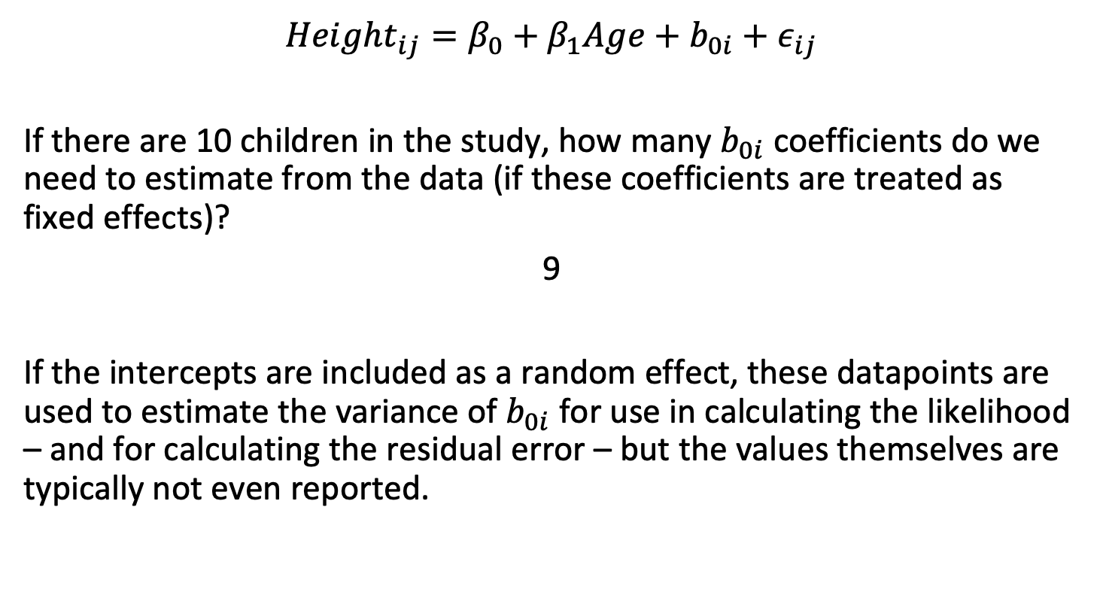
Correlated data
$$Height_{ij}=β_{0}+β_{1}Age+b_{0i}+ε_{ij}$$
If there are 10 children in the study, how many $b_{0i}$ coefficients do we need to estimate from the data (if these coefficients are treated as fixed effects)?
9
If the intercepts are included as a random effect, these datapoints are used to estimate the variance of $b_{0i}$ for use in calculating the likelihood – and for calculating the residual error – but the values themselves are typically not even reported.

Slide 30
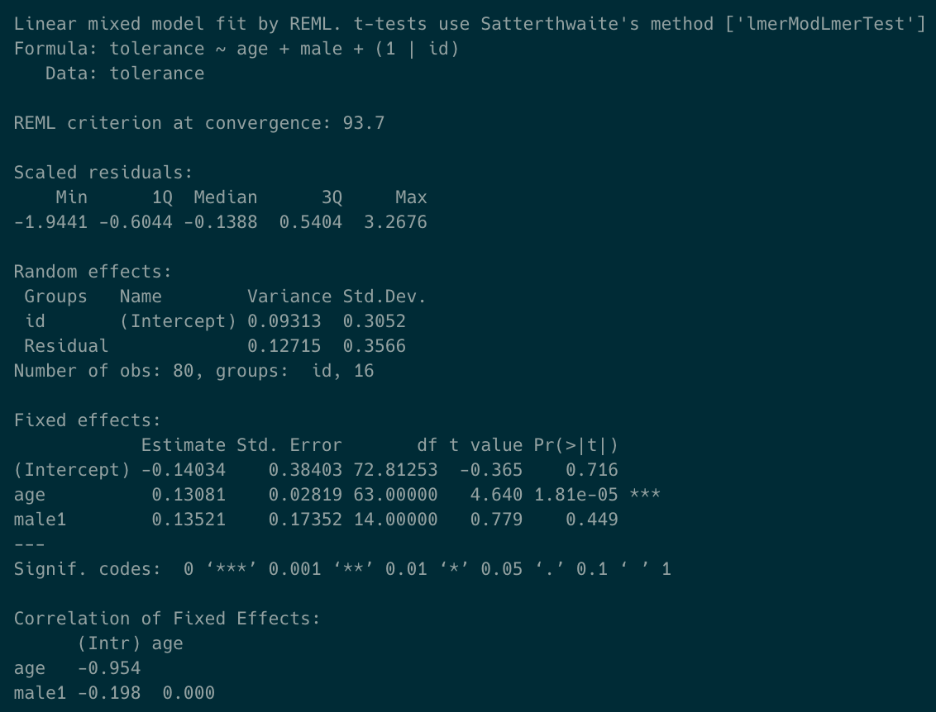
Correlated data

Slide 31
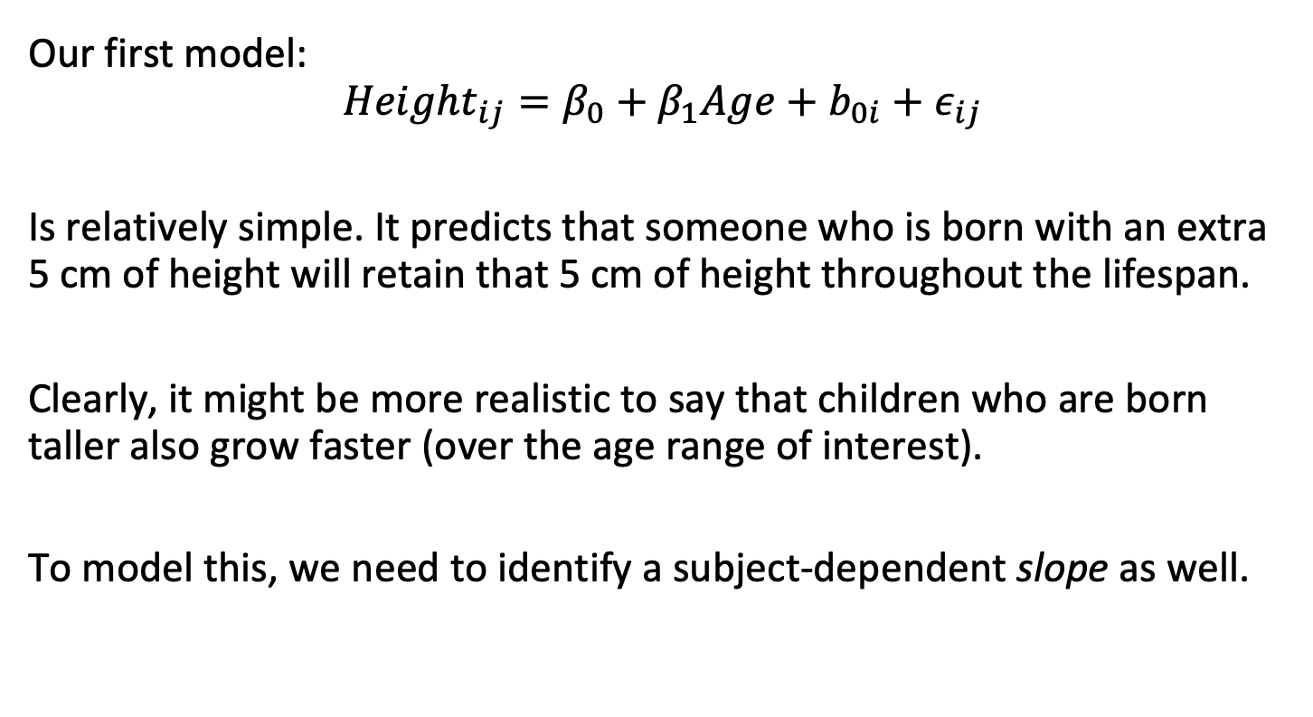
Partitioning of models into fixed and random terms
Our first model:
$$Height_{ij}=β_{0}+β_{1}Age+b_{0i}+ε_{ij}$$
Is relatively simple. It predicts that someone who is born with an extra 5 cm of height will retain that 5 cm of height throughout the lifespan.
Clearly, it might be more realistic to say that children who are born taller also grow faster (over the age range of interest).
To model this, we need to identify a subject-dependent slope as well.

Slide 32
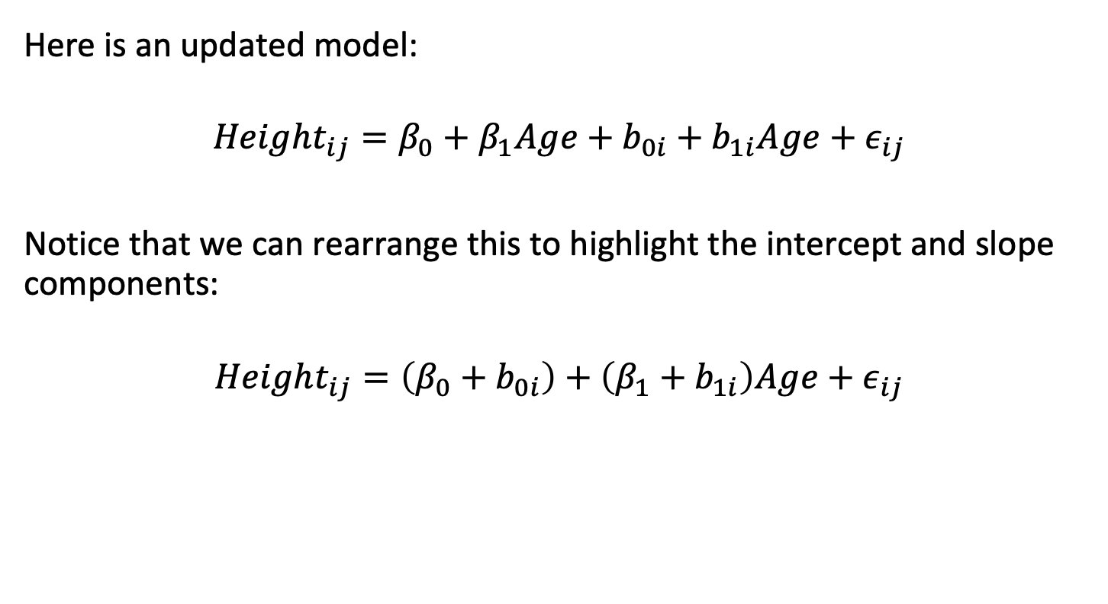
Partitioning of models into fixed and random terms
Here is an updated model:
$$Height_{ij}=β_{0}+β_{1}Age+b_{0i}+b_{1i}Age+ε_{ij}$$
Notice that we can rearrange this to highlight the intercept and slope components:
$$Height_{ij}=\left(β_{0}+b_{0i}\right)+\left(β_{1}+b_{1i}\right)Age+ε_{ij}$$

Slide 33
Partitioning of models into fixed and random terms
Here is an updated model:
$$Height_{ij}=β_{0}+β_{1}Age+b_{0i}+b_{1i}Age+ε_{ij}$$
Notice that we can rearrange this to highlight the intercept and slope components:
$$Height_{ij}=\left(β_{0}+b_{0i}\right)+\left(β_{1}+b_{1i}\right)Age+ε_{ij}$$

Slide 34
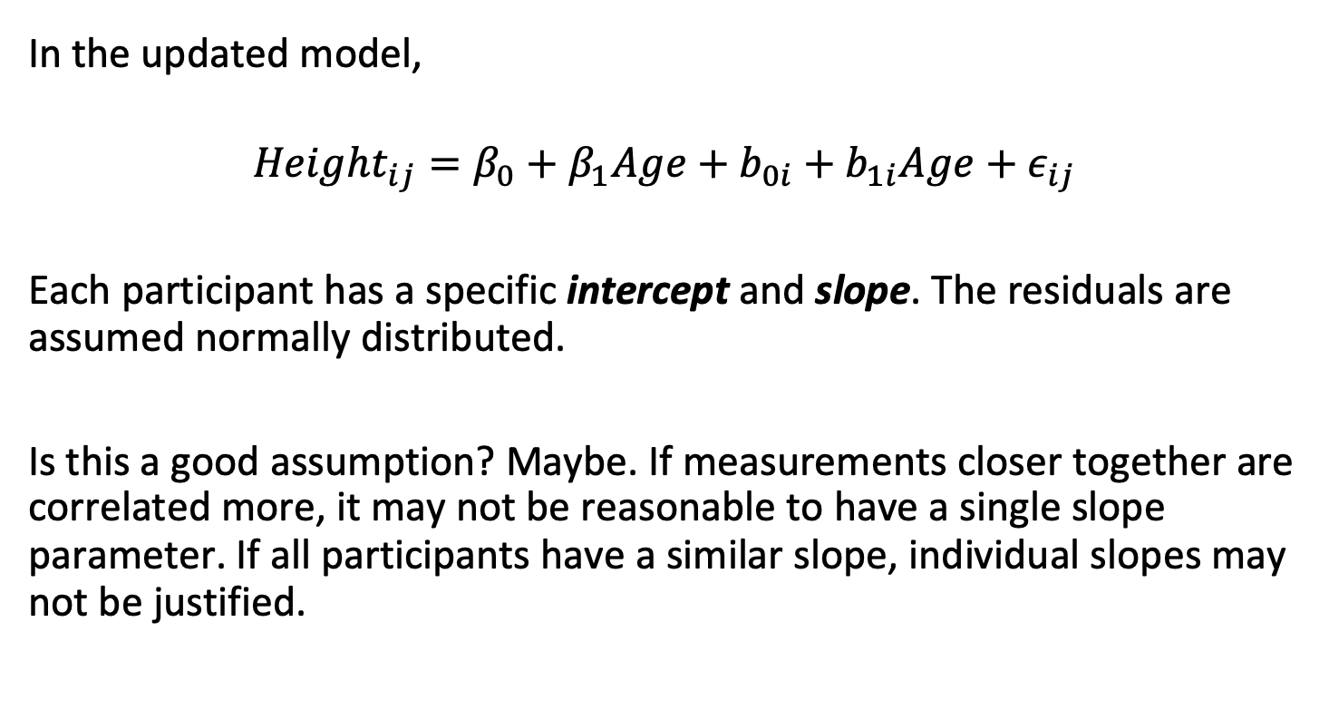
Random intercepts and slopes
In the updated model,
$$Height_{ij}=β_{0}+β_{1}Age+b_{0i}+b_{1i}Age+ε_{ij}$$
Each participant has a specific intercept and slope. The residuals are assumed normally distributed.
Is this a good assumption? Maybe. If measurements closer together are correlated more, it may not be reasonable to have a single slope parameter. If all participants have a similar slope, individual slopes may not be justified.

Slide 35
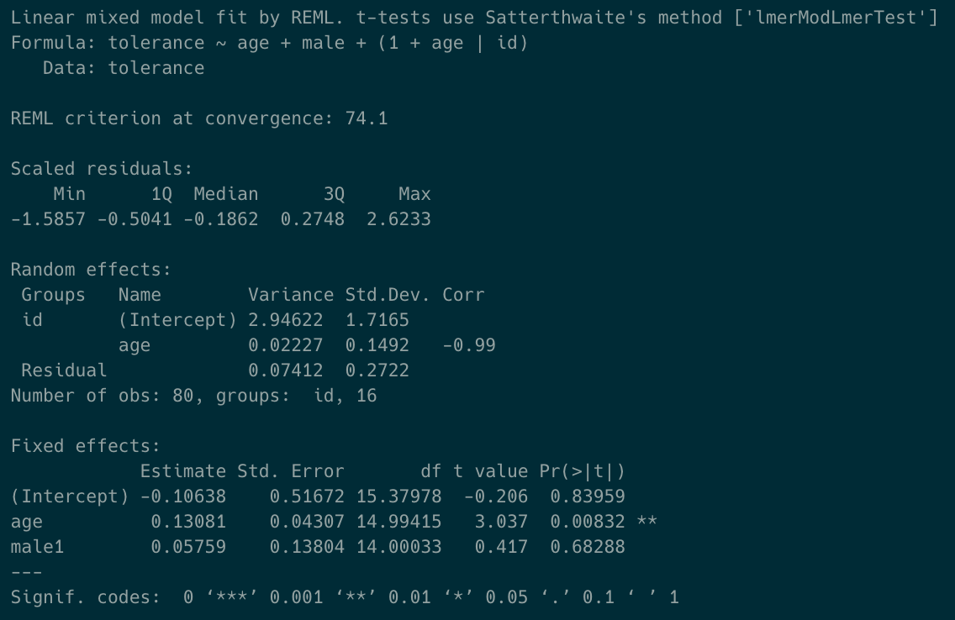
Random intercepts and slopes

Slide 36
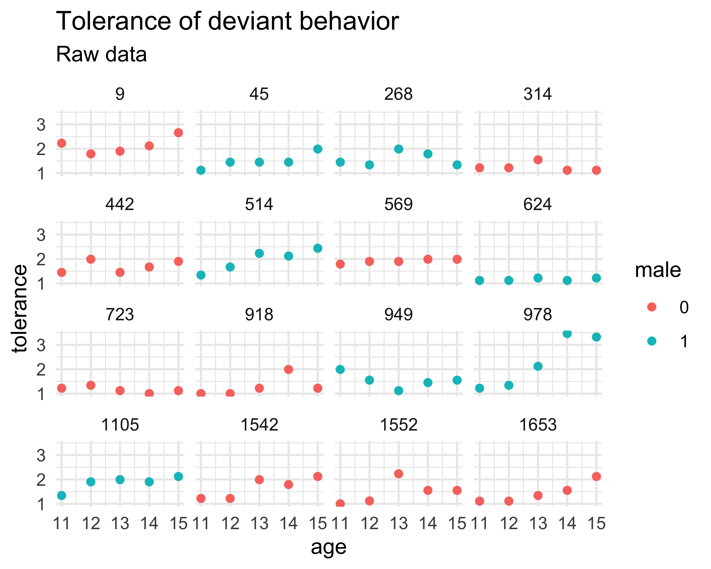
Random intercepts and slopes: tolerance data

Slide 37
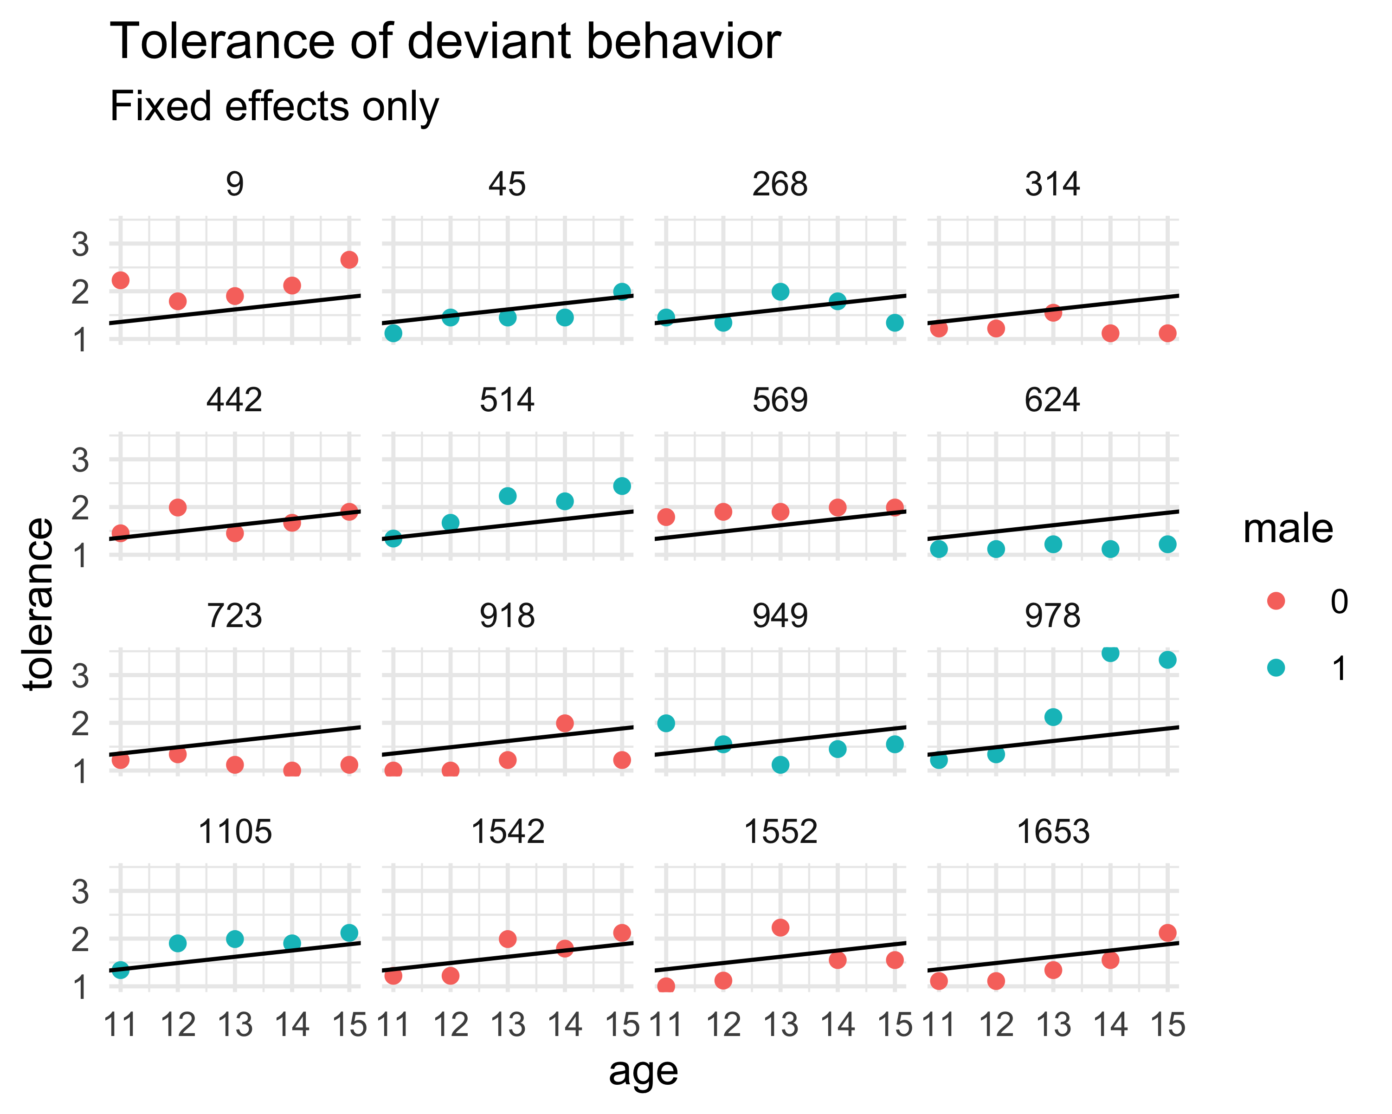

Equation:
$${Tolerance}_{i}=β_{0}+$$
$$β_{1}{Age}_{i}+ε_{i}$$
Wilkinson notation:
tolerance~age

Slide 38
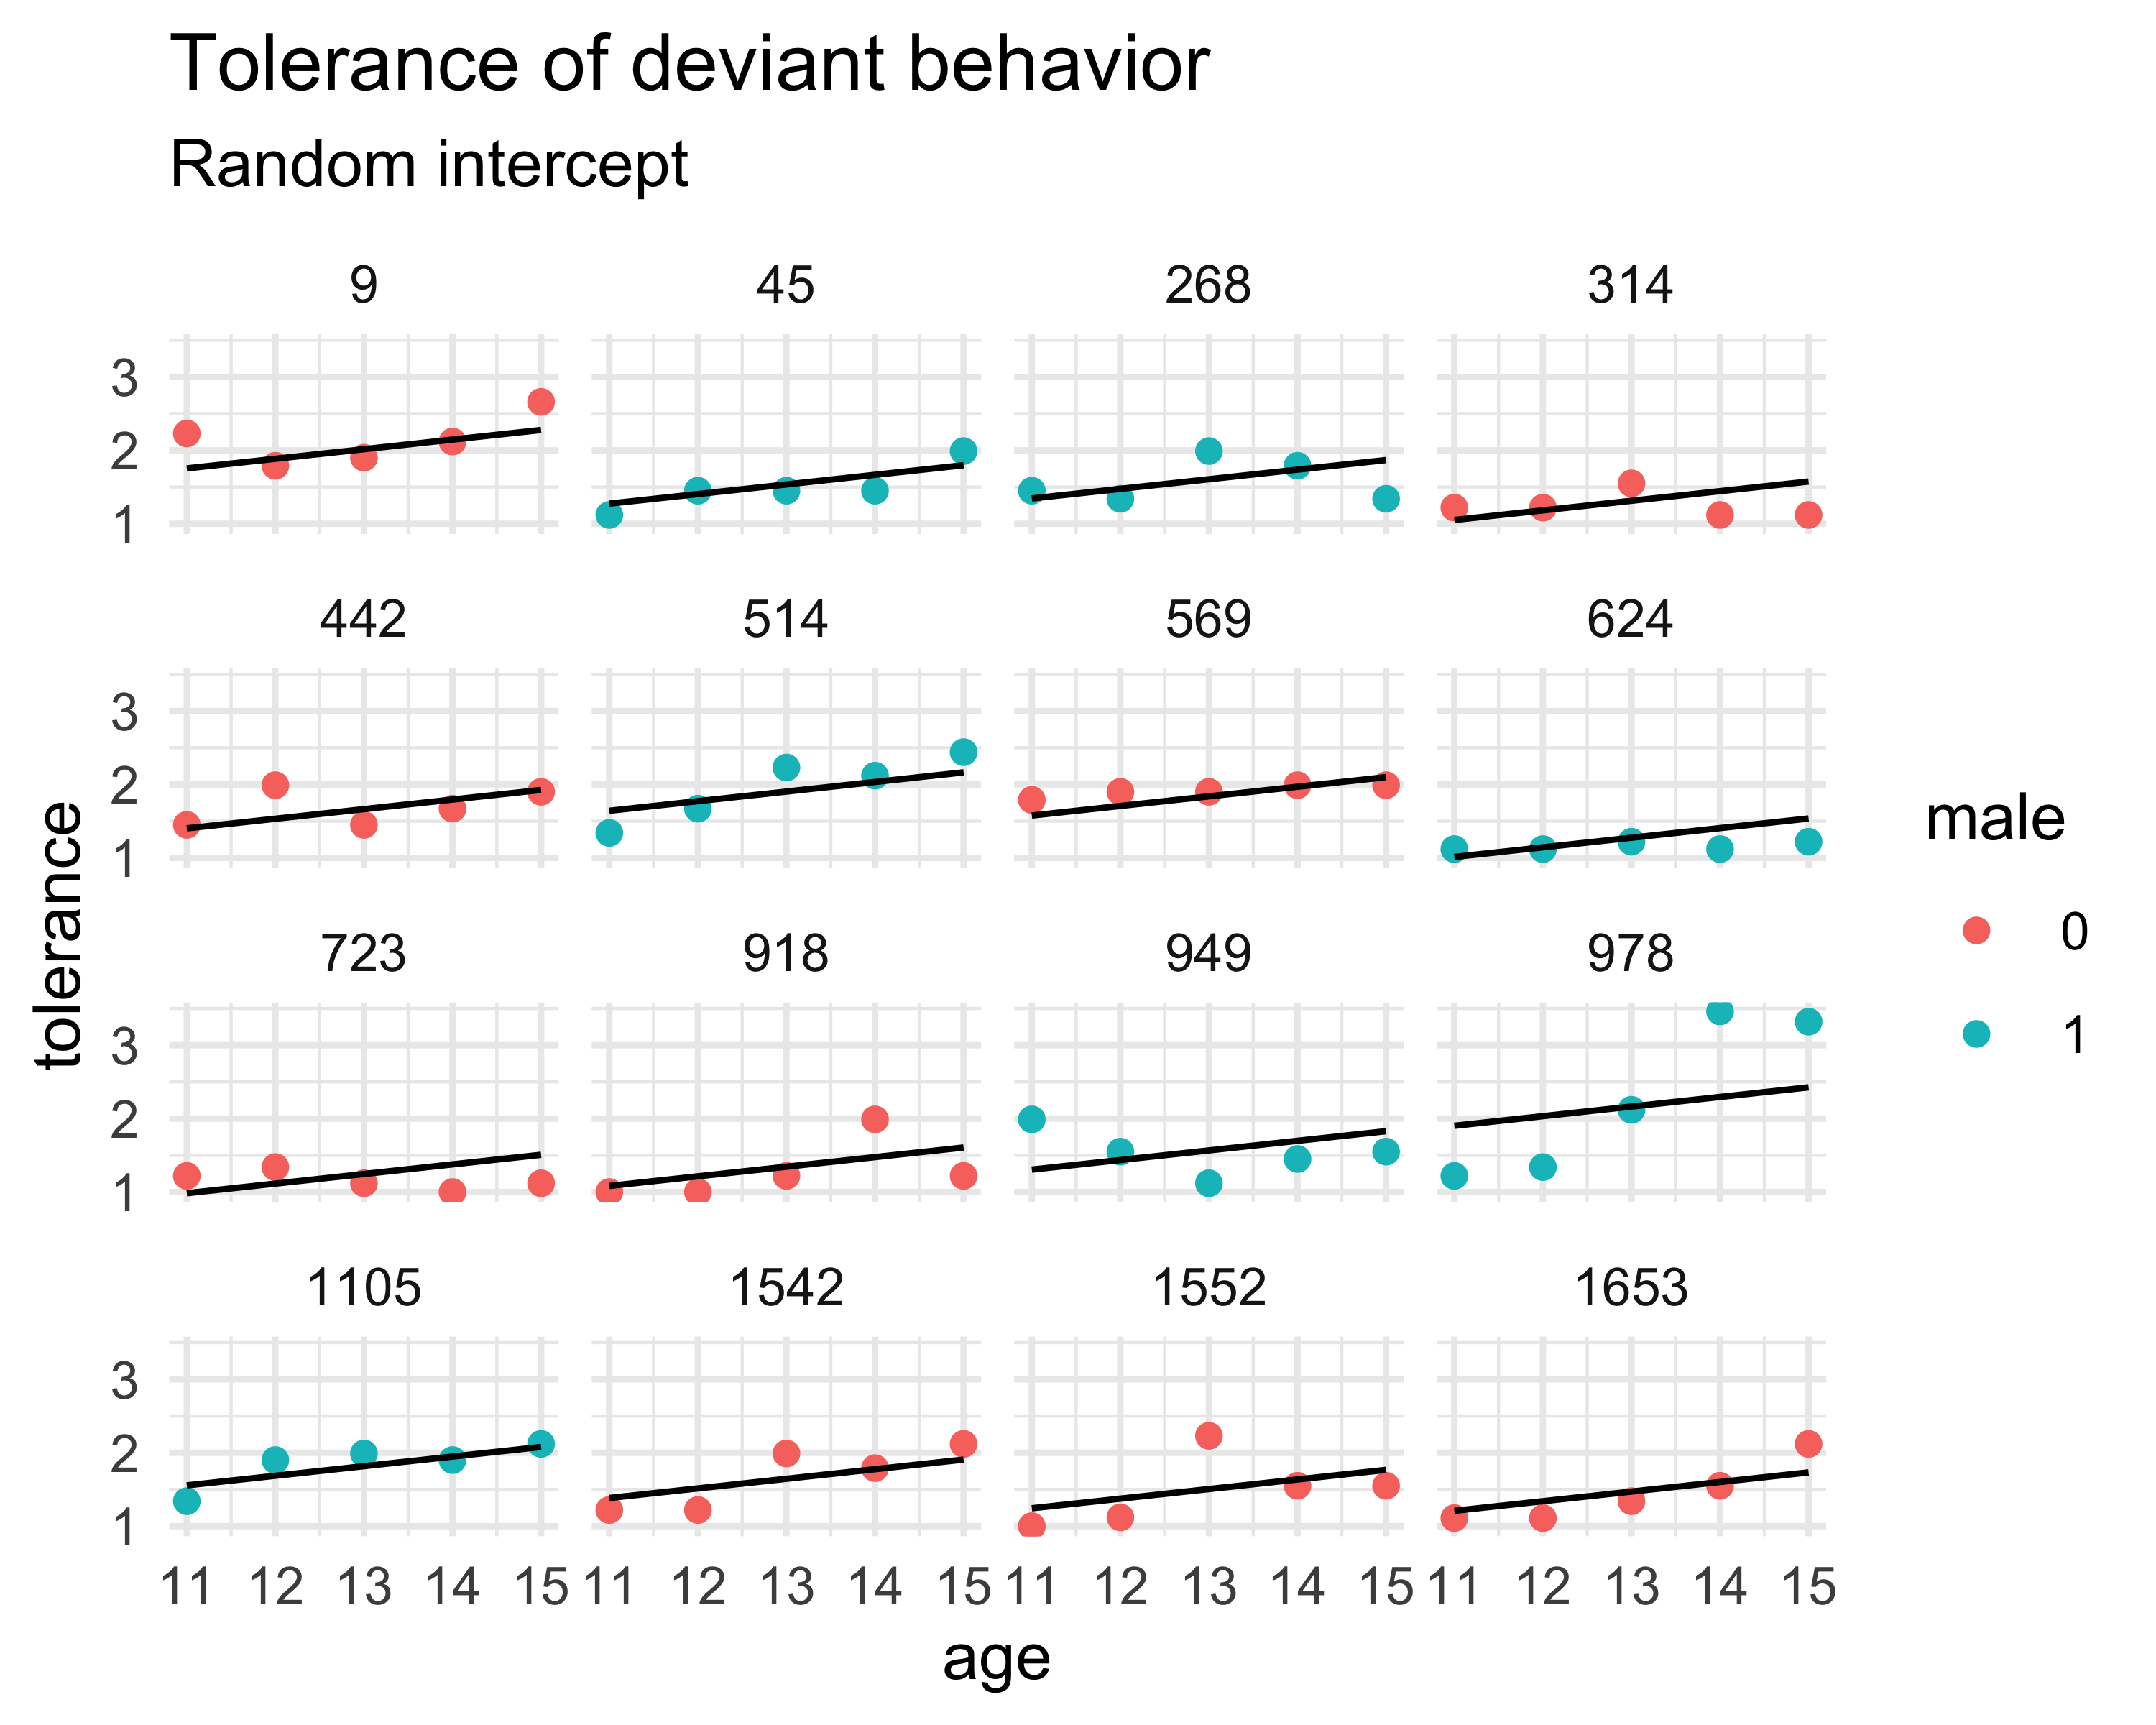

Equation:
$${Tolerance}_{ij}=β_{0}+b_{0i}+$$
$$β_{1}{Age}_{ij}+ε_{ij}$$
Wilkinson notation:
tolerance~age+(1|id)

Slide 39
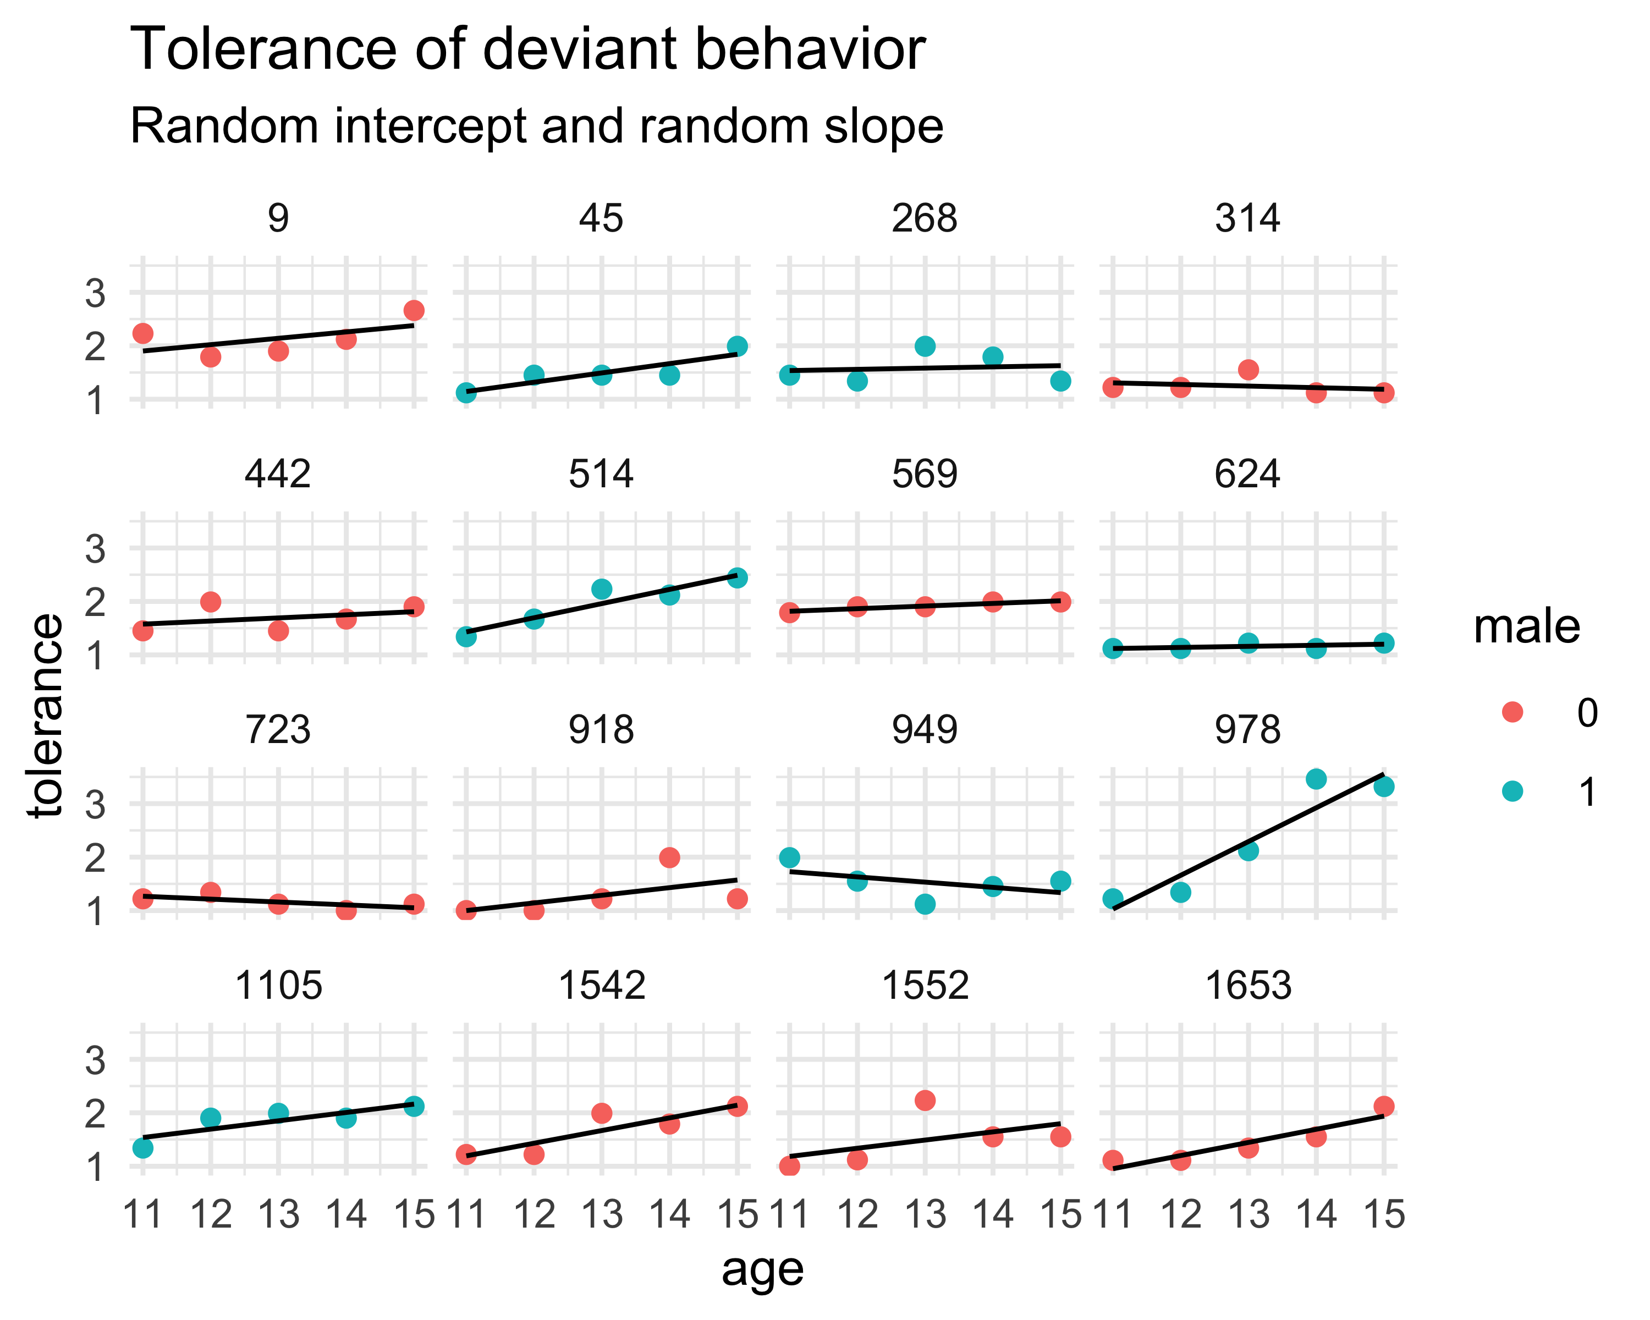

Equation:
$${Tolerance}_{ij}=β_{0}+b_{0i}+$$
$${(β_{1}+b_{01})Age}_{ij}+ε_{ij}$$
Wilkinson notation:
tolerance~age+(1+age|id)

Slide 40
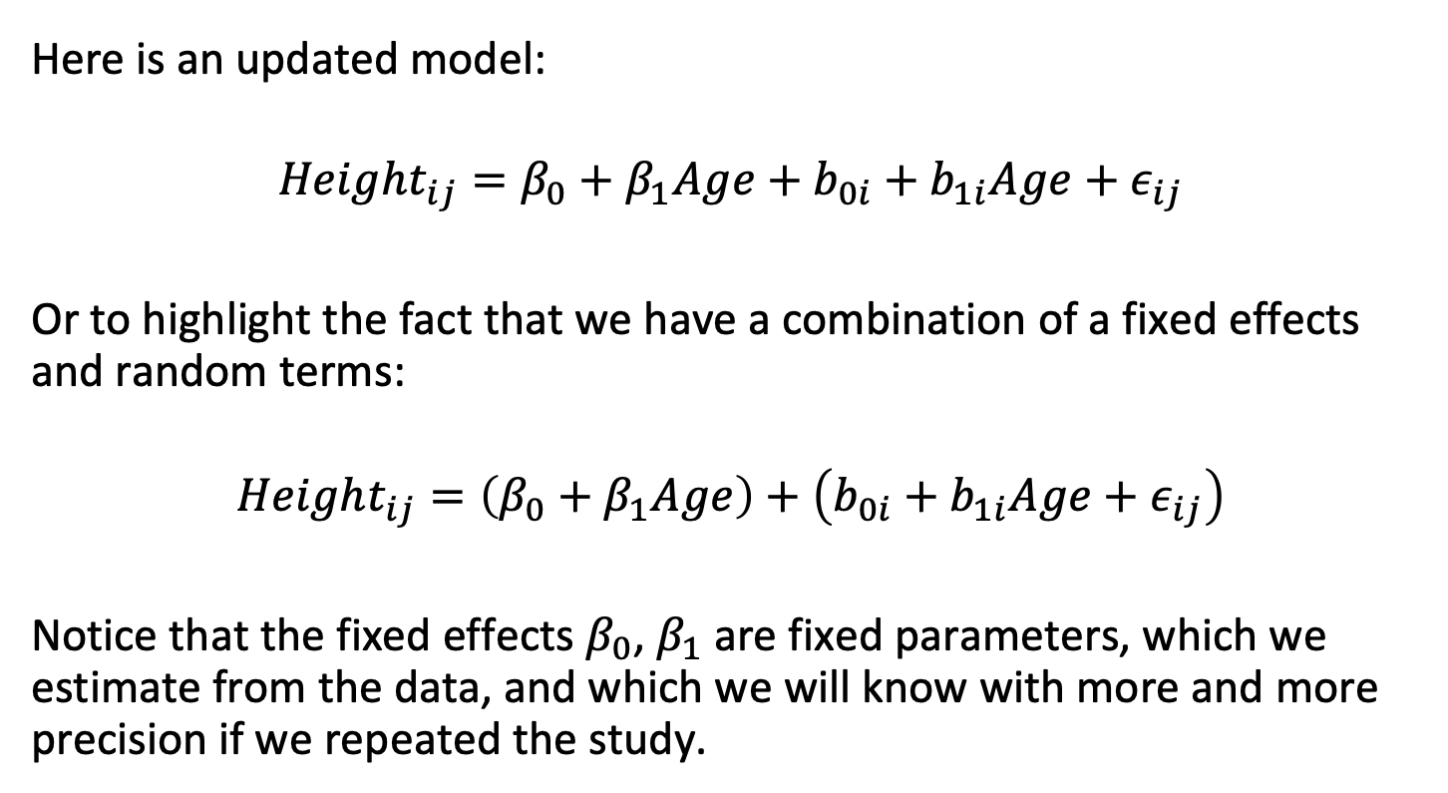
Partitioning of models into fixed and random terms
Here is an updated model:
$$Height_{ij}=β_{0}+β_{1}Age+b_{0i}+b_{1i}Age+ε_{ij}$$
Or to highlight the fact that we have a combination of a fixed effects and random terms:
$$Height_{ij}=\left(β_{0}+β_{1}Age\right)+\left(b_{0i}+b_{1i}Age+ε_{ij}\right)$$
Notice that the fixed effects $β_{0}$, $β_{1}$ are fixed parameters, which we estimate from the data, and which we will know with more and more precision if we repeated the study.

Slide 41
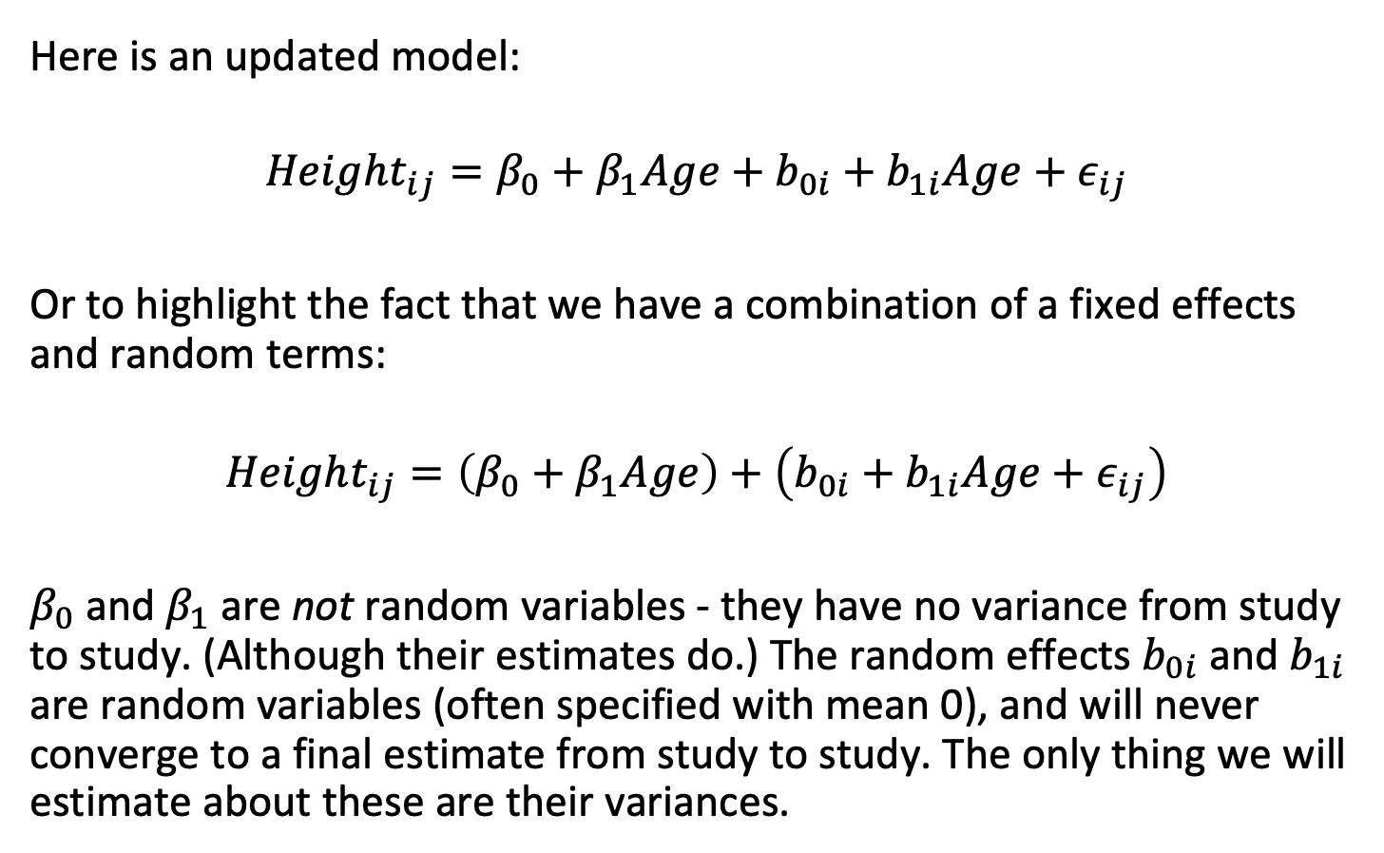
Partitioning of models into fixed and random terms
Here is an updated model:
$$Height_{ij}=β_{0}+β_{1}Age+b_{0i}+b_{1i}Age+ε_{ij}$$
Or to highlight the fact that we have a combination of a fixed effects and random terms:
$$Height_{ij}=\left(β_{0}+β_{1}Age\right)+\left(b_{0i}+b_{1i}Age+ε_{ij}\right)$$
$β_{0}$ and $β_{1}$ are not random variables - they have no variance from study to study. (Although their estimates do.) The random effects $b_{0i}$ and $b_{1i}$ are random variables (often specified with mean 0), and will never converge to a final estimate from study to study. The only thing we will estimate about these are their variances.

Slide 42
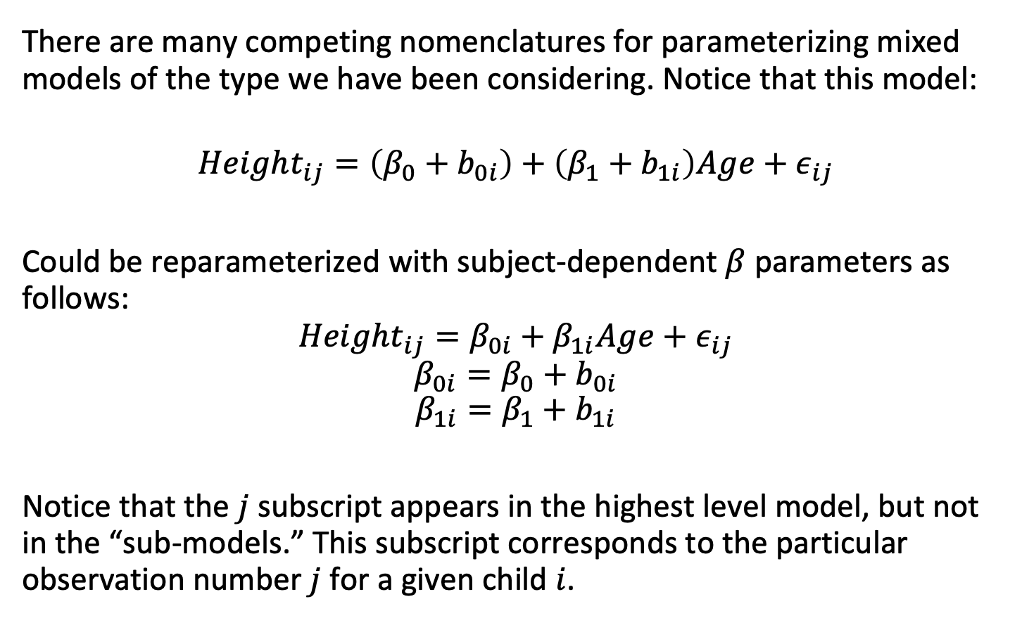
Hierarchical linear models
There are many competing nomenclatures for parameterizing mixed models of the type we have been considering. Notice that this model:
$$Height_{ij}=\left(β_{0}+b_{0i}\right)+\left(β_{1}+b_{1i}\right)Age+ε_{ij}$$
Could be reparameterized with subject-dependent $β$ parameters as follows:
$$Height_{ij}=β_{0i}+β_{1i}Age+ε_{ij}$$
$$β_{0i}=β_{0}+b_{0i}$$
$$β_{1i}=β_{1}+b_{1i}$$
Notice that the $j$ subscript appears in the highest level model, but not in the “sub-models.” This subscript corresponds to the particular observation number $j$ for a given child $i$.

Slide 43
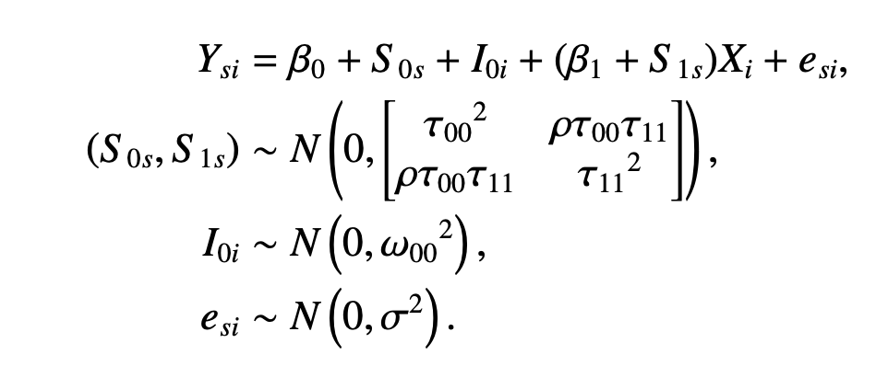
Hierarchical linear models
Different texts use different combinations of letters to represent models and sub-models; please be aware of this.
I do not recommend any particular coding scheme at the level we are working at.

Slide 44
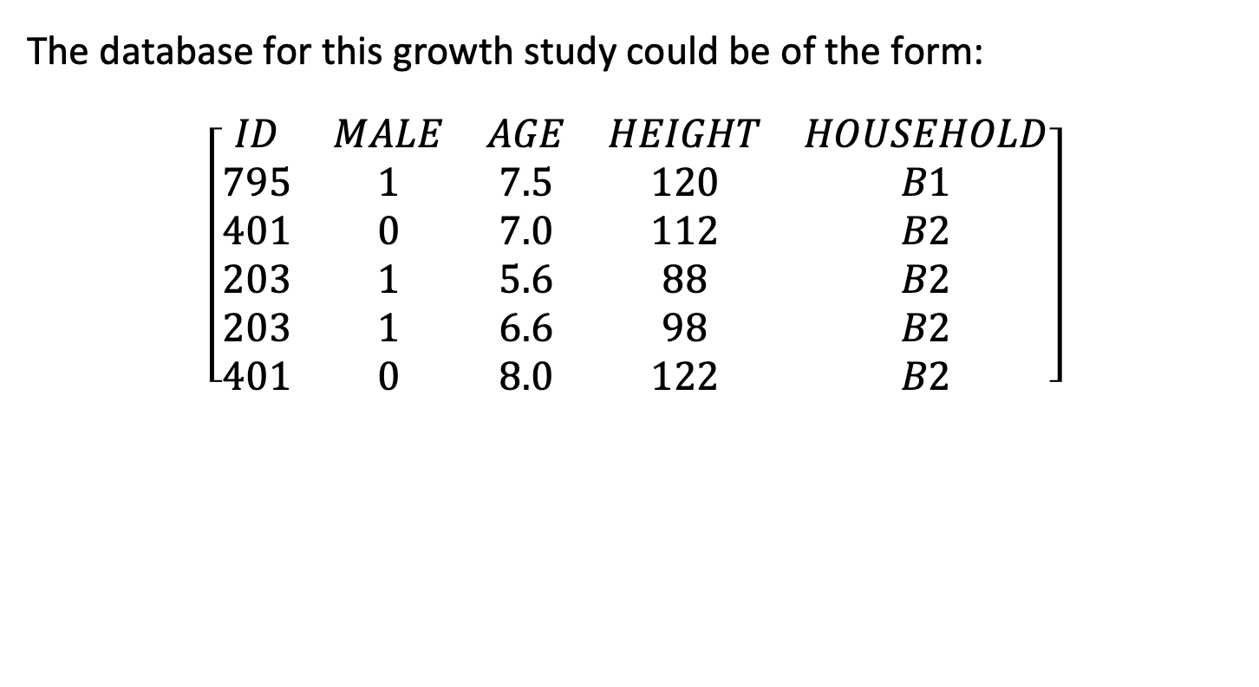
Time-varying covariates: a growth study
The database for this growth study could be of the form:
$$\left[\begin{matrix}ID & MALE & AGE & HEIGHT & HOUSEHOLD \\ 795 & 1 & 7.5 & 120 & B1 \\ 401 & 0 & 7.0 & 112 & B2 \\ 203 & 1 & 5.6 & 88 & B2 \\ 203 & 1 & 6.6 & 98 & B2 \\ 401 & 0 & 8.0 & 122 & B2\end{matrix}\right]$$

Slide 45
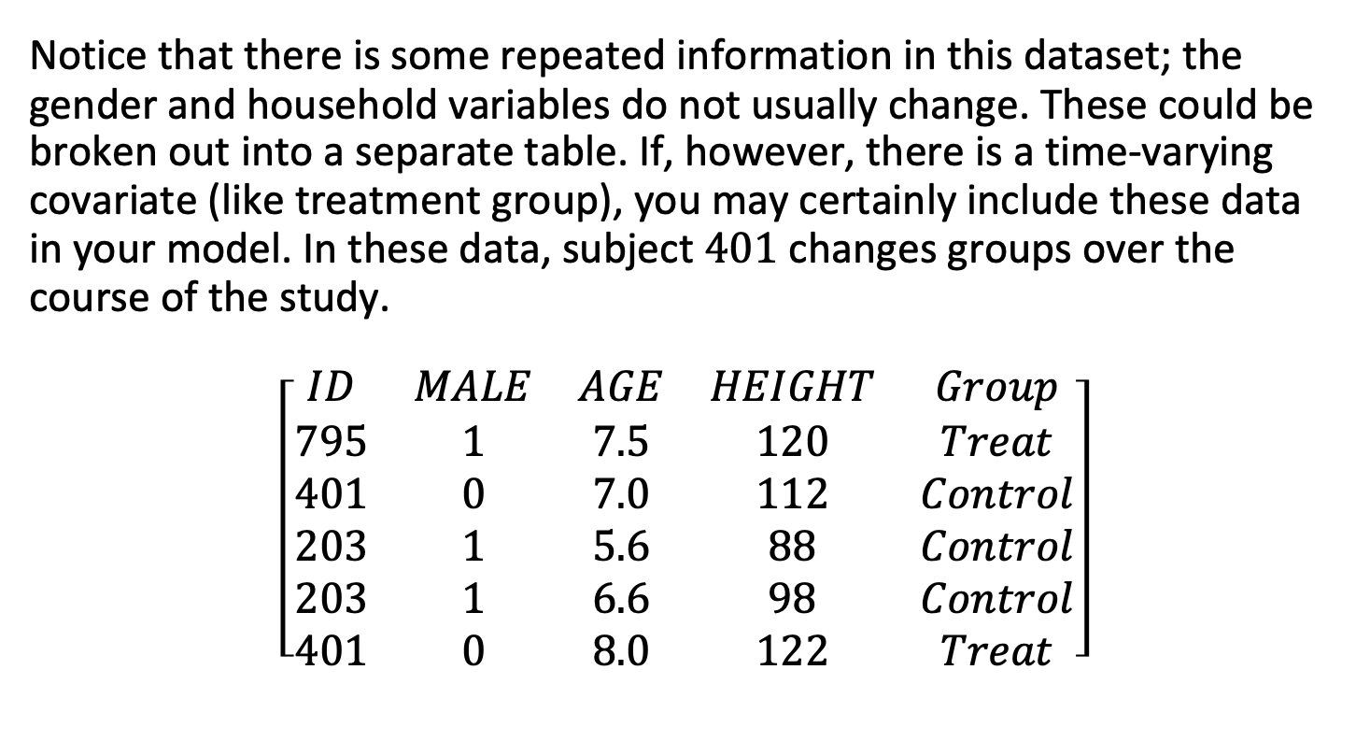
Time-varying covariates: a growth study
Notice that there is some repeated information in this dataset; the gender and household variables do not usually change. These could be broken out into a separate table. If, however, there is a time-varying covariate (like treatment group), you may certainly include these data in your model. In these data, subject $401$ changes groups over the course of the study.
$$\left[\begin{matrix}ID & MALE & AGE & HEIGHT & Group \\ 795 & 1 & 7.5 & 120 & Treat \\ 401 & 0 & 7.0 & 112 & Control \\ 203 & 1 & 5.6 & 88 & Control \\ 203 & 1 & 6.6 & 98 & Control \\ 401 & 0 & 8.0 & 122 & Treat\end{matrix}\right]$$

Slide 46

How many random effects are we estimating?
Let’s return to our growth study. If we had, say, three total households $B1$, $B2$, and $B3$, how many parameters would we need to add to the model to estimate the effects of “household” if it was a fixed effect?

Slide 47
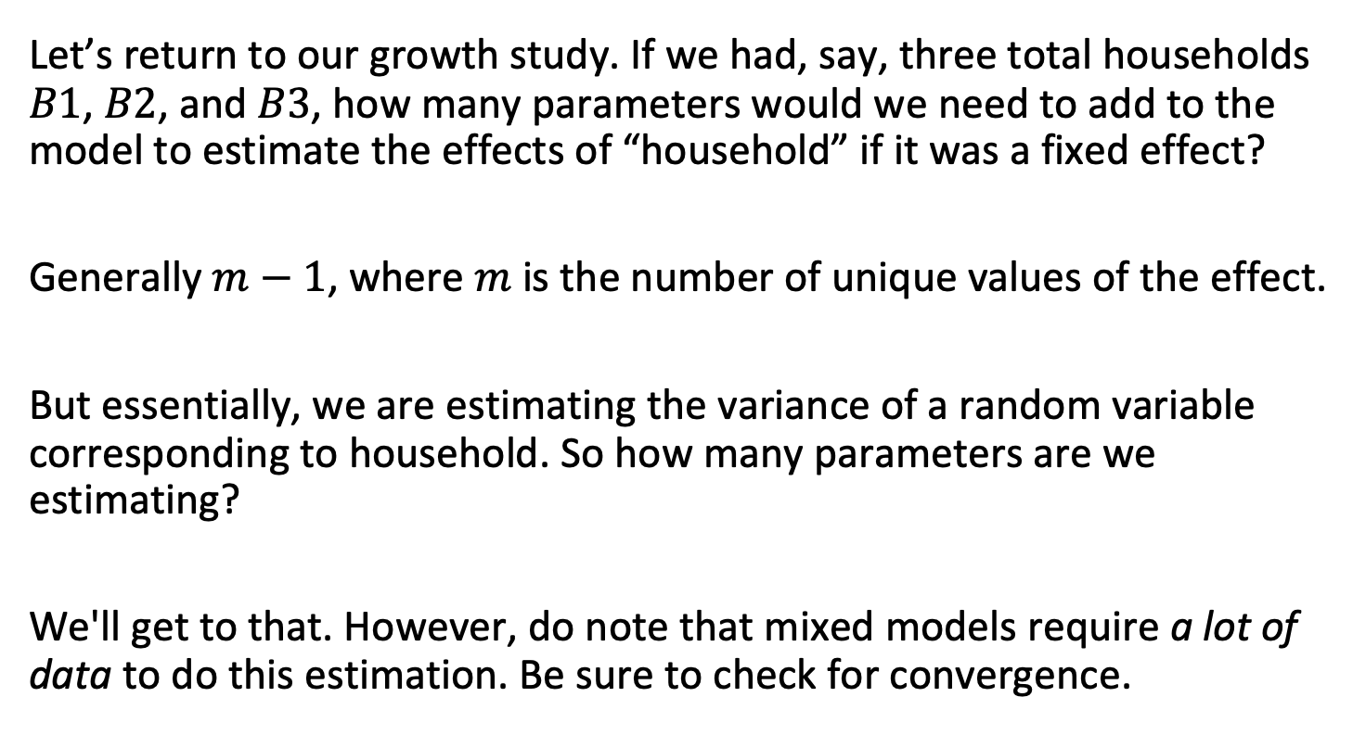
How many random effects are we estimating?
Let’s return to our growth study. If we had, say, three total households $B1$, $B2$, and $B3$, how many parameters would we need to add to the model to estimate the effects of “household” if it was a fixed effect?
Generally $m−1$, where $m$ is the number of unique values of the effect.
But essentially, we are estimating the variance of a random variable corresponding to household. So how many parameters are we estimating?
We'll get to that. However, do note that mixed models require a lot of data to do this estimation. Be sure to check for convergence.

Slide 48
Outline
Statistical independence and repeated measures
Fixed vs. random effects
Correlated data
Estimation and testing
Sums of Squares

Slide 49

We typically use “Restricted Maximum Likelihood” to estimate parameters
Ordinary least squares estimates are not appropriate for mixed effects models.
Typically, these models are fit using either:
Maximum likelihood
Restricted maximum likelihood (REML)
We have discussed maximum likelihood a great deal – the relationship to REML is essentially that the REML calculation is performed on the residuals after the fixed terms are identified using OLS or similar.
For most purposes, restricted maximum likelihood is appropriate, and is the default in most packages.
You must report whether you use ML or REML in your papers, as the answers will differ slightly.

Slide 50
P Values in Linear Mixed Models
Inferences regarding the fixed-effects parameters are more complicated in a linear mixed-effects model than in a linear model with fixed effects only.
In a model with only fixed effects we estimate these parameters and one other parameter which is the variance of the noise that infects each observation and that we assume to be [iid Gaussian].
Baayen et al., 2007

Slide 51
P Values in Linear Mixed Models
The temptation to perform hypothesis tests using-distributions or F-distributions based on certain approximations of the degrees of freedom in these distributions persists.
An exact calculation can be derived for certain models with a comparatively simple structure applied to exactly balanced data sets, such as occur in text books. In real-world studies the data often end up unbalanced, especially in observational studies but even in designed experiments where missing data can and do occur, and the models can be quite complicated.
Baayen et al., 2007

Slide 52
P Values in Linear Mixed Models
There are many approximations in use for hypothesis tests in mixed models; the MIXED procedure in SAS offers 6 different calculations of degrees of freedom in certain tests, each leading to different p-values, but none of them is "correct".
Baayen et al., 2007

Slide 53
P Values in Linear Mixed Models
It is not even obvious how to count the number of parameters in a mixed-effects model. Suppose we have 1000 subjects, each exposed to 200 items chosen from a pool of 10000 potential items. If we model the effect of subject and item as independent random effects we add two variance components to the model. At the estimated parameter values we can evaluate 1000 predictors of the random effects for subject and 10000 predictors of the random effects for item.
Did we only add two parameters to the model when we incorporated these random effects? Or should we say that we added several thousand parameters that are adjusted to help explain the observed variation in the data?
It is overly simplistic to say that thousands of random effects amount to only two parameters.
Baayen et al., 2007

Slide 54
LmerTest will calculate P Values for you
Performing hypothesis tests in linear mixed models remains an active area of research, especially regarding denominator degrees of freedom.
The commonly used `lme4` package does not report p-values.
The `lmerTest` package extends `lme4` and provides approximate p-values using a Satterthwaite method for degrees of freedom.
`lmerTest` has been stable since 2017, with results broadly consistent with other statistical software—even if the exact correctness remains debated.
Once again I have no idea how MS chose these random symbols

Slide 55
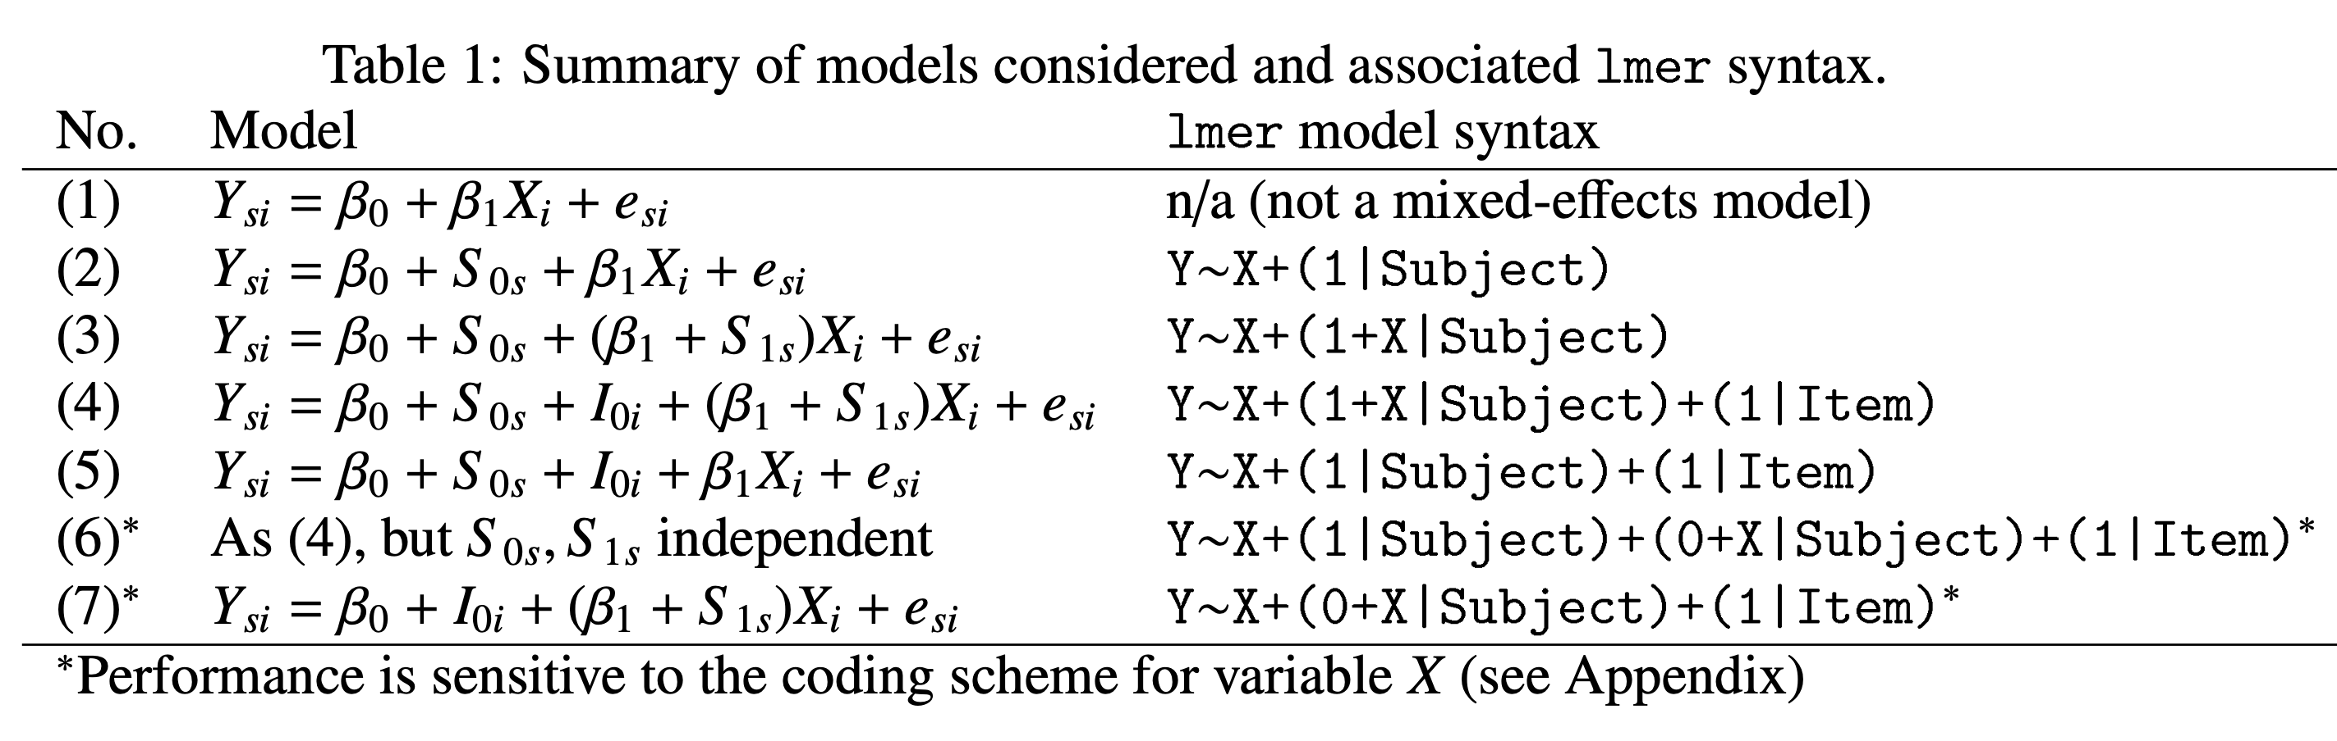
Estimation and hypothesis testing: Wilkinson notation
Barr et al., 2012

Slide 56
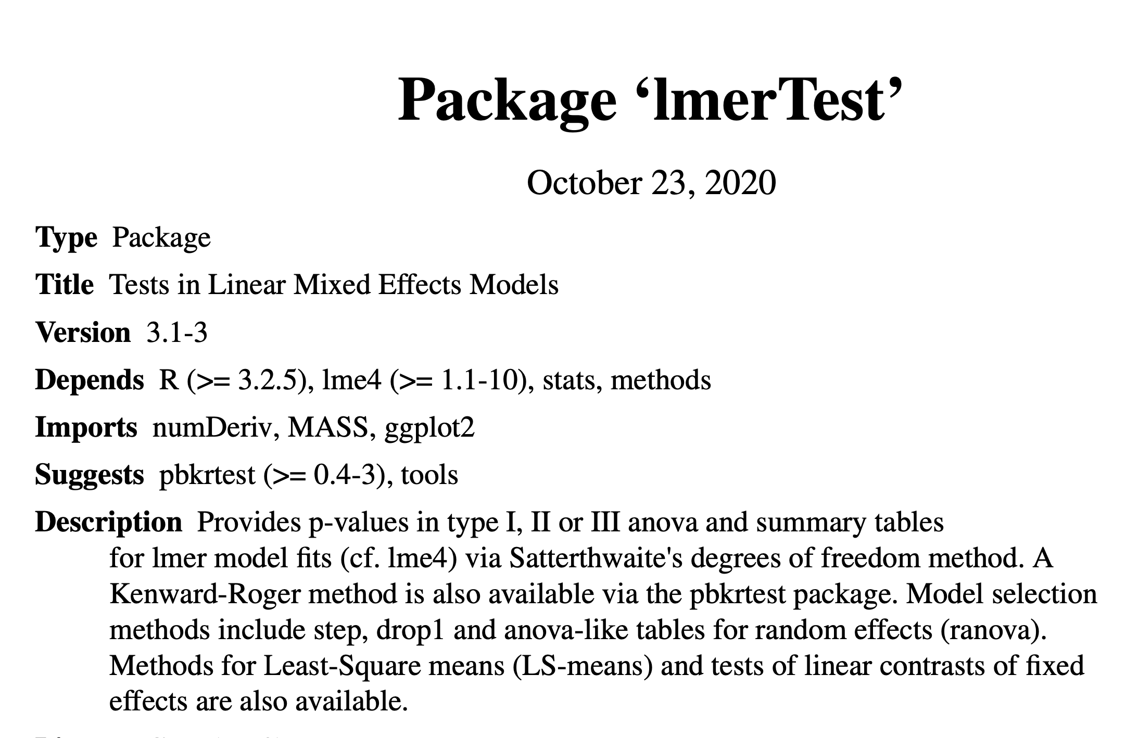
Estimation and hypothesis testing

Slide 57
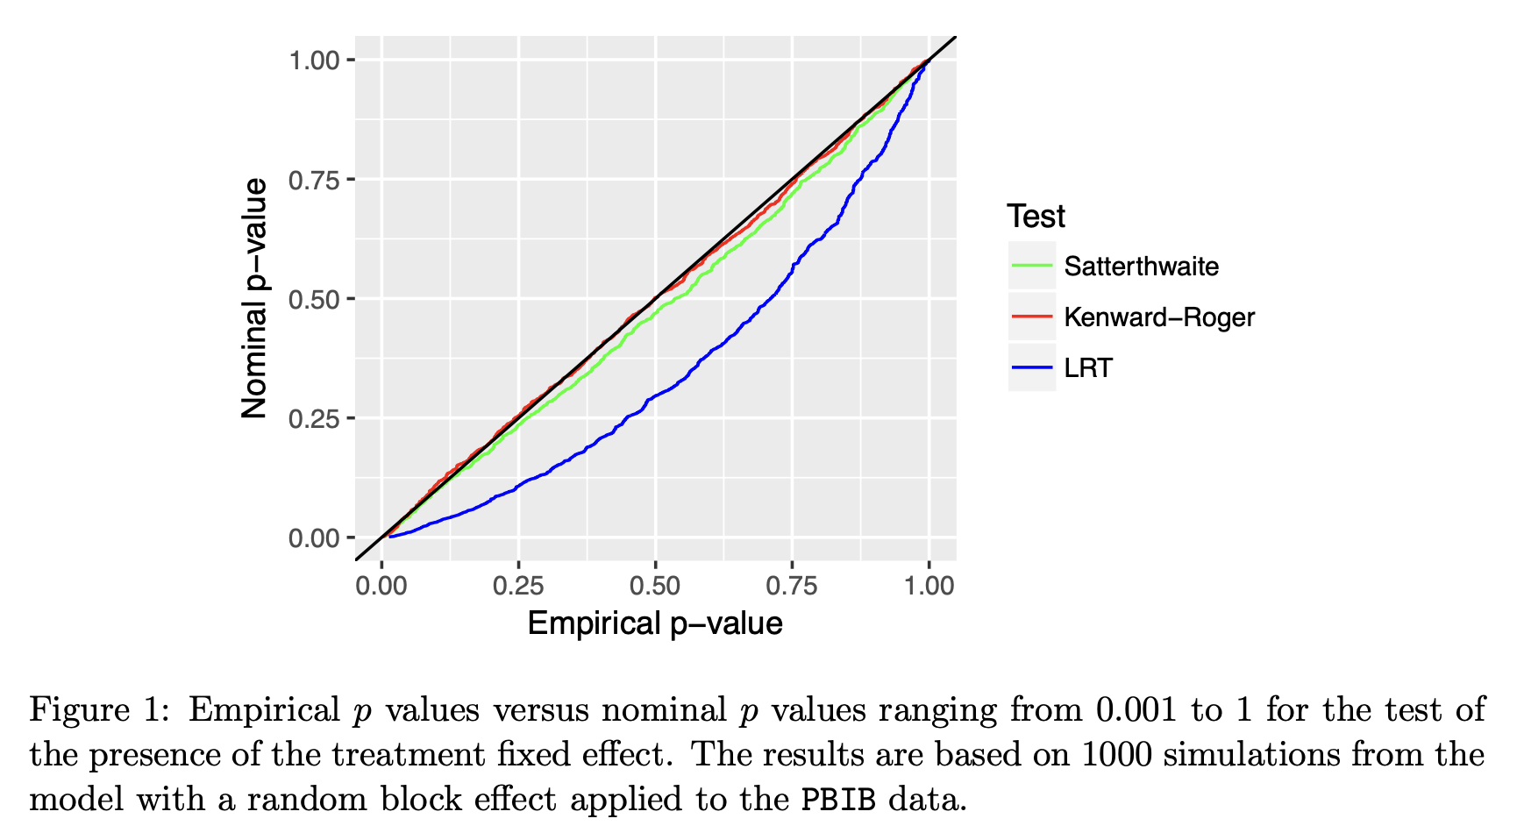
Estimation and hypothesis testing
Kuznetsova et al., 2017

Slide 58
Satterwaithe and Kenward-Roger degrees of freedom approximations
We remember from t-tests that when sample sizes are unbalanced, test statistics can deviate from their ideal distributions, and complex formulas are required to calculate "estimated" degrees of freedom such that the calculated test statistics perform as closely as possible to known distributions.
This problem shows up in both single parameter t-type tests and in ANOVA F-type-tests in mixed models.
There are two main approaches to estimation: Satterwaithe and Kenward-Roger.
Kuznetsova et al., 2017

Slide 59
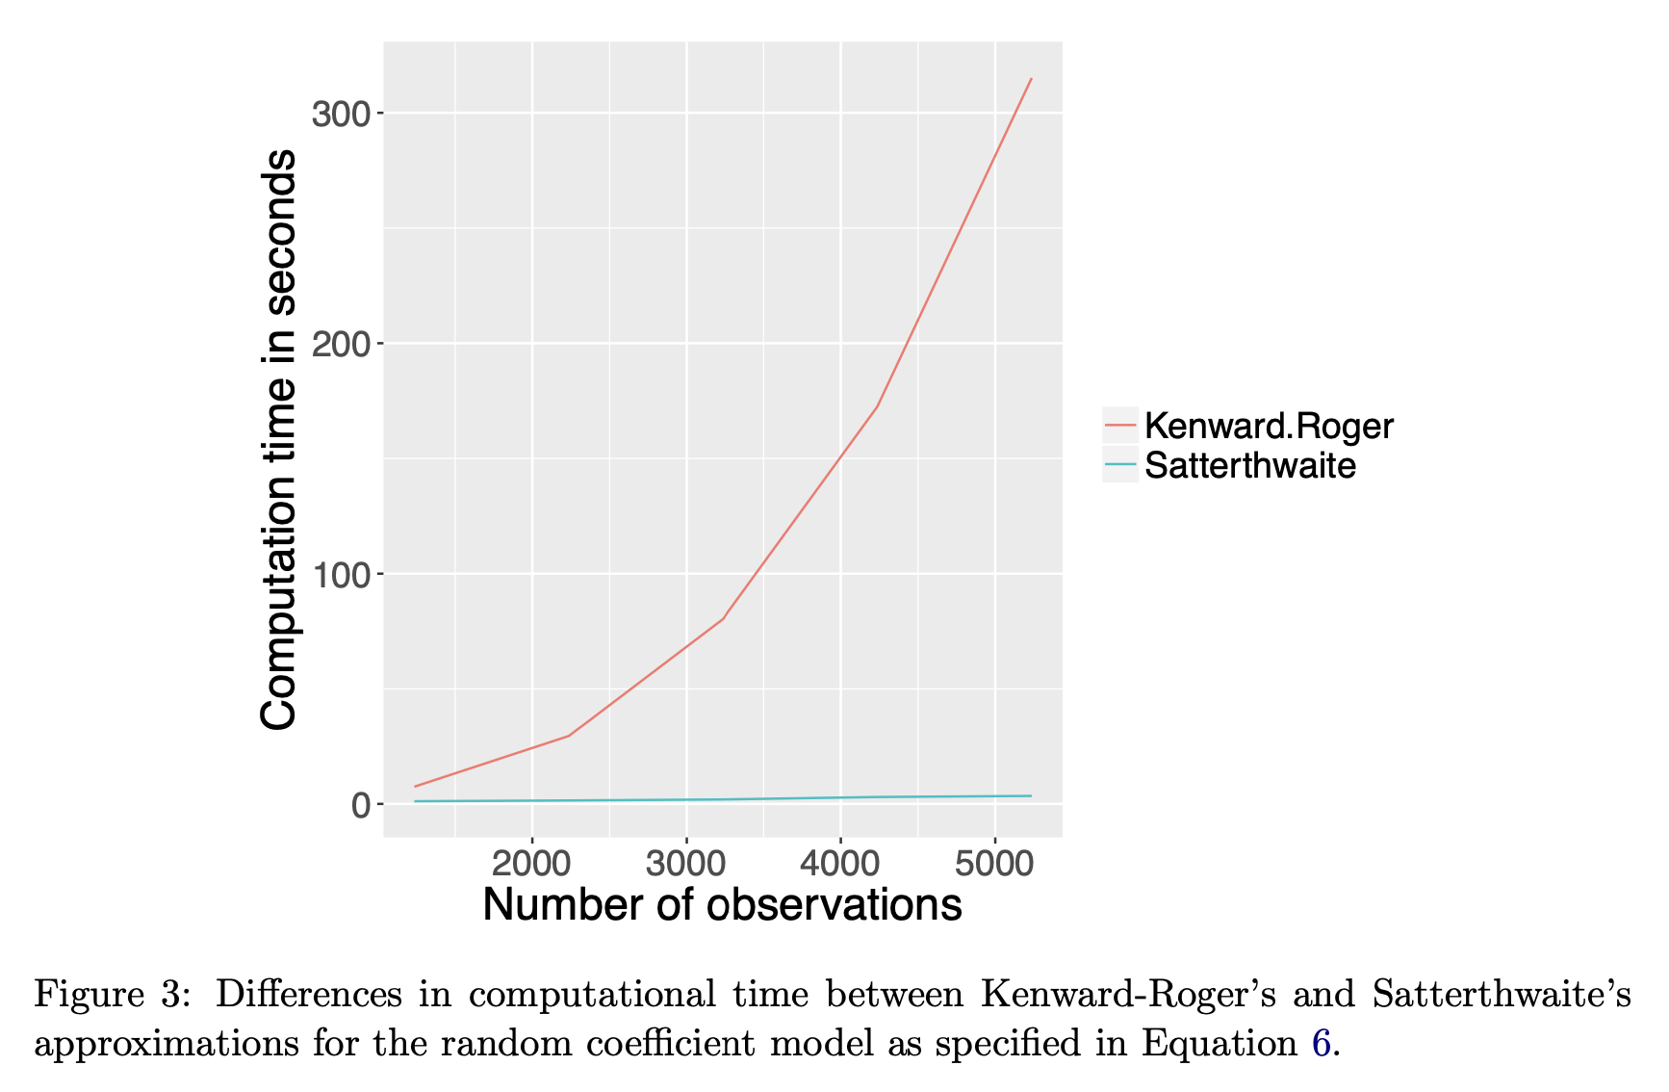
Satterwaithe and Kenward-Roger degrees of freedom approximation
Kuznetsova et al., 2017

Slide 60
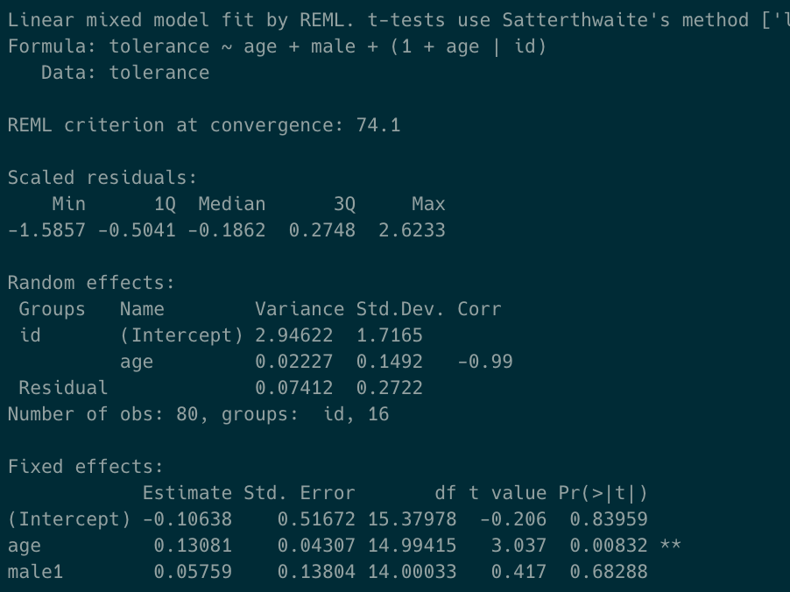
Satterwaithe degrees of freedom approximation

Slide 61
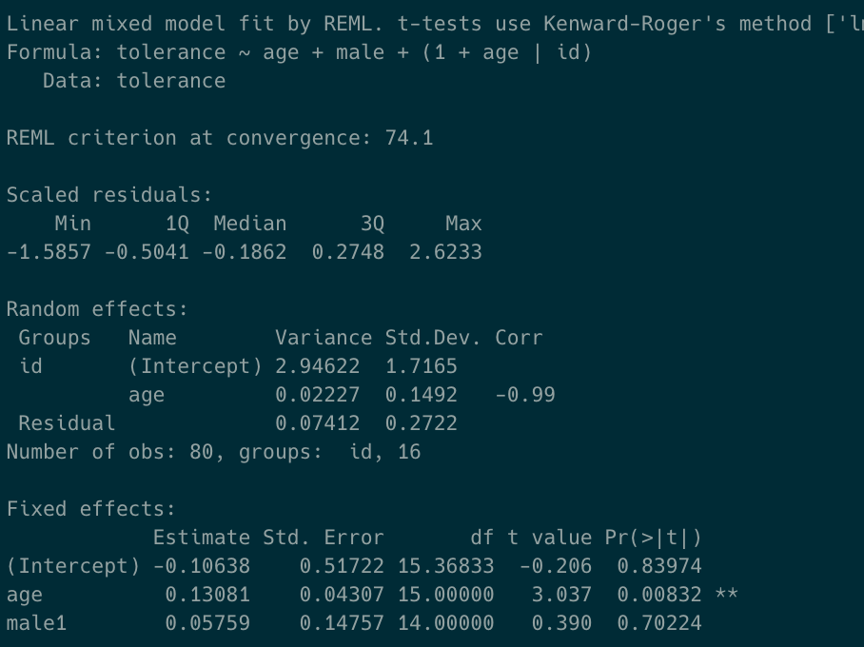
Kenward-Roger degrees of freedom approximation

Slide 62
Estimation and hypothesis testing
In general, the testing of fixed effects proceeds as in standard linear models.
It is critical to document your procedures, preferably supplying the actual call to the function in supplementary information.
In most practical applications, there is no need to apply statistical testing to random effects. These effects are (usually) there to explain variation, rather than to evaluate statistical significance of same.
Cluster-randomized and other designs may offer some exceptions to this.

Slide 63
Outline
Statistical independence and repeated measures
Fixed vs. random effects
Correlated data
Estimation and testing
Sums of Squares

Slide 64
ANOVA in linear mixed models
With a well-formulated model you can typically perform inference on one parameter at a time using Wald-type tests.
It still might be necessary to evaluate groups of parameters with an F-type ANOVA test.
This becomes complicated when data are unbalanced.

Slide 65
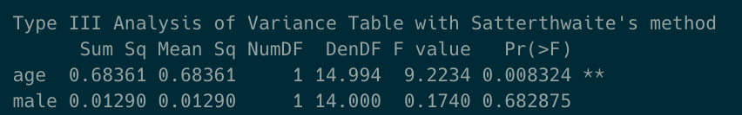
ANOVA in linear mixed models

Slide 66
Sum of squares types
When datasets are unbalanced (almost always the case in observational studies) the calculation of F statistics (e.g., for ANOVA) becomes more complex.
The overall idea is to calculate some sort of construction like:
sum of squares explained by factor of interest / error sum of squares
However, how to count up the sum of squares explained by a single factor is ambiguous when the cell counts are unequal.

Slide 67
Sum of squares types
Sequential / Type I:
  The SS for each factor is the incremental improvement in the error SS as each factor effect is added to the regression model, in order of listing in the model statement.
  e.g., Height~Age+Sex+error will use the improvement in explained variance associated with the "Sex" variable with Age in the model to estimate the appropriate F statistic.
  Pro:
    The sum of squares explained by each factor add up.
    Intuitive for model building.
  Con:
    Order of entry of terms matters. The model above will have different sums of squares (and P-values) for Age and Sex, rather than Sex and Age.
  Default in R

Slide 68
Sequential / Type I
Height~Age+Sex+error
Age: The SS explained by Age and the intercept is compared to the SS explained by the intercept.
Sex: The SS explained by Age, Sex, and the intercept is compared to the SS explained by Age and the intercept.

Slide 69
Sum of squares types
Marginal / Orthogonal / Type III:
  The SS for each factor is the incremental improvement in the error SS as each factor effect is added to the regression model including all other terms.
  Conceptually equivalent to doing Type I with each term entered "last."
  Pro
    Order of entry does not matter
  Con
    If factors are correlated the SS does not necessarily add up to the total SS.
    If interactions are present, main effects are compared to models with interaction terms but without main effects.
  Default in SAS, SPSS, some other packages

Slide 70
Marginal / Orthogonal / Type III
Height~Age+Sex+error
Age: The SS explained by Age, Sex, and the intercept is compared to the SS explained by the intercept and Sex.
Sex: The SS explained by Age, Sex, and the intercept is compared to the SS explained by the intercept and Age.

Slide 71
Marginal / Orthogonal / Type III
Height~Age+Sex+Age*Sex+error
Age: The SS explained by the intercept, Age, Sex, and the interaction term is compared to the SS explained by the intercept, Sex, and the interaction term.
Because this comparison model is not really a valid alternative the incremental improvement in SS is probably underestimated.

Slide 72
Sum of squares types
Type II:
  The SS for each factor is the incremental improvement in the error SS as each factor effect is added to the regression model including all other terms that do not contain the factor.
  e.g., Height~Age+Sex+Age*Sex+error will use the improvement in explained variance associated with the "Sex" variable with Age in the model (but not the interaction term) to estimate the appropriate F statistic.
  Pro:
    Order of entry of terms does not matter.
    Nonsensical models avoided
  Con:
    Factor SS do not add to total SS
    No agreed-upon name
  Increasingly recommended, still uncommon in practice

Slide 73
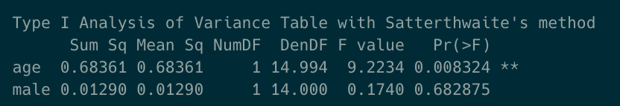
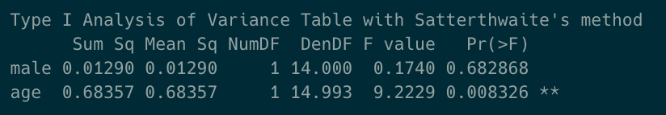
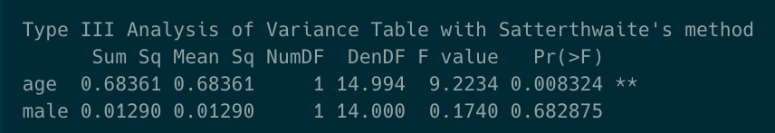
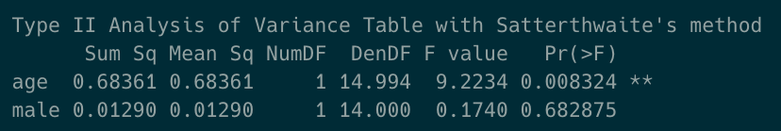
Comparison of sum of squares results

Slide 74
Outline
Statistical independence and repeated measures
Fixed vs. random effects
Correlated data
Estimation and testing
Sums of Squares

