Slide 1

BMI 510:
Logistic Regression
J. Lucas McKay, Ph.D., M.S.C.R.
Departments of Biomedical Informatics and Neurology, Emory University, Atlanta, GA USA
Department of Biomedical Engineering, Georgia Institute of Technology, Atlanta, GA, USA

Slide 2
Outline
Introduction to logistic regression
Modeling probabilities
Details of the log odds / logit equation
Examples
The odds ratio
Link functions and generalized linear models
Hypothesis tests
Parameter identification

Slide 3
Logistic regression as part of classification
Classification problems are common in clinical and operational settings. For example:
A patient presents with symptoms consistent with COVID-19, influenza, or the common cold. Which diagnosis is most likely?
An online banking system must determine whether a transaction is fraudulent based on IP address and history.
Both involve training a classifier to guide decisions on new cases.
Logistic regression is a foundational method for estimating classifier weights.
Logistic regression can be competitive with boosting/DL, particularly when features are well-designed.

Slide 4
Logistic regression to investigate possible causal relationships
In clinical and epidemiological research, logistic regression is commonly used to test hypothesized causal relationships. For example:
Given DNA sequence data from patients with and without a disease, which mutations are associated with disease status?
Given smoking histories of individuals with and without lung cancer, is smoking associated with cancer?
Both involve hypothesis testing within observational data, where logistic regression provides a standard analytic approach.
Note that in both cases the outcome is a yes/no variable!

Slide 5
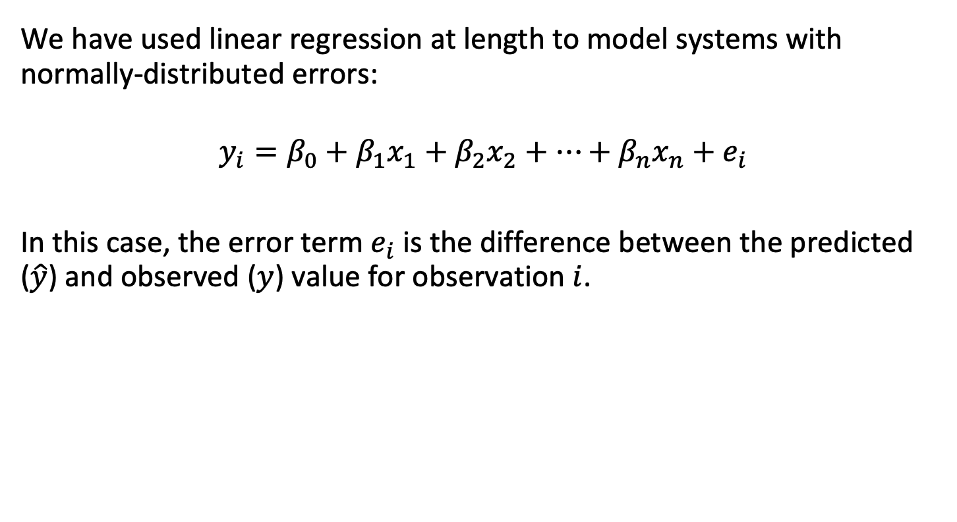
Modeling probabilities
We have used linear regression at length to model systems with normally-distributed errors:
$$y_{i}=β_{0}+β_{1}x_{1}+β_{2}x_{2}+…+β_{n}x_{n}+e_{i}$$
In this case, the error term $e_{i}$ is the difference between the predicted ($\hat{y}$) and observed ($y$) value for observation $i$.

Slide 6

Modeling probabilities
In linear regression, the data are set up something like this:
$$\left[\begin{matrix}y_{1} & x_{11} & x_{21} & x_{31} \\ y_{2} & x_{12} & x_{22} & x_{32} \\ ⋮ & ⋮ & ⋮ & ⋮ \\ y_{n} & x_{1n} & x_{2n} & x_{3n}\end{matrix}\right]$$
outcome
predictors

Slide 7

Modeling probabilities
If we plug in some numbers for the outcome variable, we might see something like the following:
$$\left[\begin{matrix}14 & x_{11} & x_{21} & x_{31} \\ 34 & x_{12} & x_{22} & x_{32} \\ ⋮ & ⋮ & ⋮ & ⋮ \\ 22 & x_{1n} & x_{2n} & x_{3n}\end{matrix}\right]$$
outcome:
continuous
numerical values
predictors

Slide 8
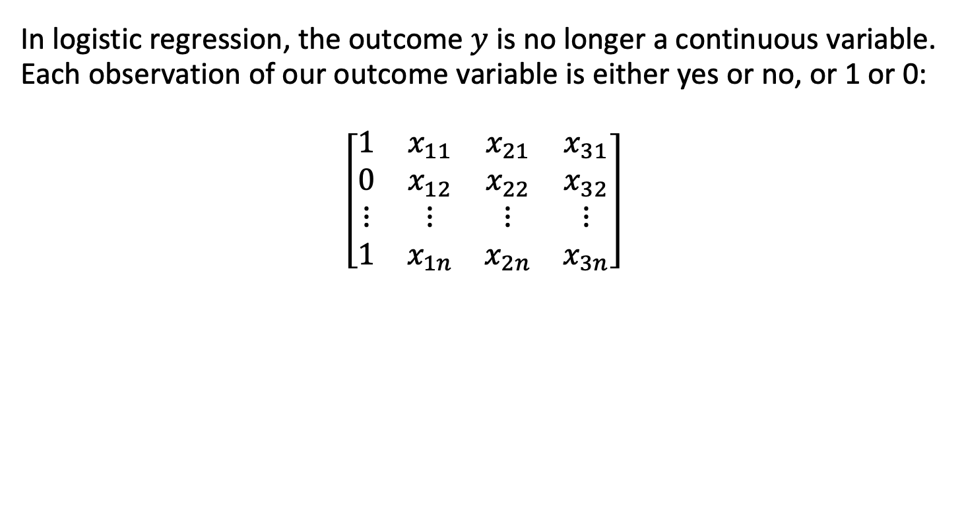
Modeling probabilities
In logistic regression, the outcome $y$ is no longer a continuous variable. Each observation of our outcome variable is either yes or no, or 1 or 0:
$$\left[\begin{matrix}1 & x_{11} & x_{21} & x_{31} \\ 0 & x_{12} & x_{22} & x_{32} \\ ⋮ & ⋮ & ⋮ & ⋮ \\ 1 & x_{1n} & x_{2n} & x_{3n}\end{matrix}\right]$$
outcome:
yes/no
encoding
predictors

Slide 9
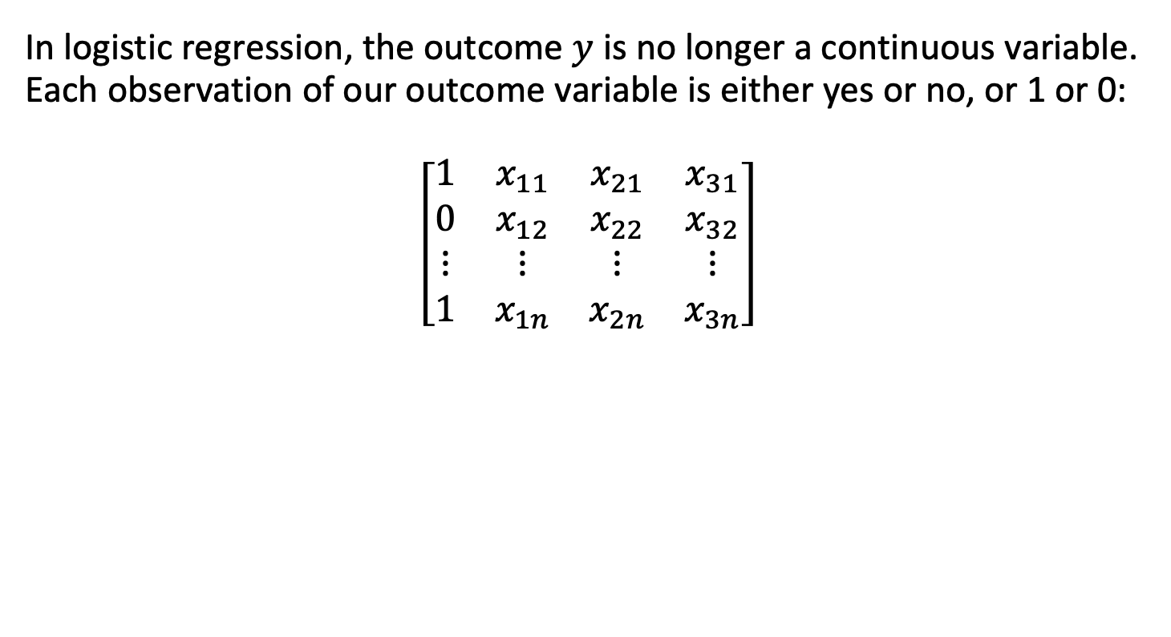
Modeling probabilities
In logistic regression, the outcome $y$ is no longer a continuous variable. Each observation of our outcome variable is either yes or no, or 1 or 0:
$$\left[\begin{matrix}1 & x_{11} & x_{21} & x_{31} \\ 0 & x_{12} & x_{22} & x_{32} \\ ⋮ & ⋮ & ⋮ & ⋮ \\ 1 & x_{1n} & x_{2n} & x_{3n}\end{matrix}\right]$$
outcome:
yes/no
encoding
predictors
Note: You can apply logistic regression with multi-level outcomes 0 vs. 1 vs. 2, etc., but the dichotomous case can be discussed essentially without loss of generality.

Slide 10


Modeling probabilities
What we would really like is some sort of equation like:
$$P\left(y_{i}==1\right)$$
$$=β_{0}+β_{1}x_{1}+β_{2}x_{2}+…+β_{n}x_{n}+e_{i}$$
Do you see any potential problems with this?
I wish I knew why microsoft office thinks this slide
has something to do with dragonflies

Slide 11
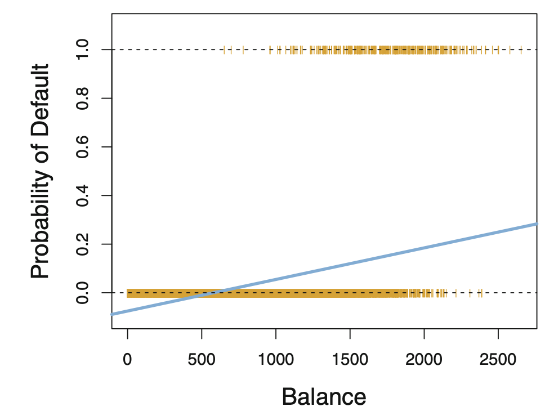
Modeling probabilities: linear regression
Because probabilities are bounded between 0 and 1, we see that many predictions would be nonsensical.
Here's an example from the James text. Note:
There are negative predicted probabilities.
No predicted datapoint has p>0.5.

Slide 12
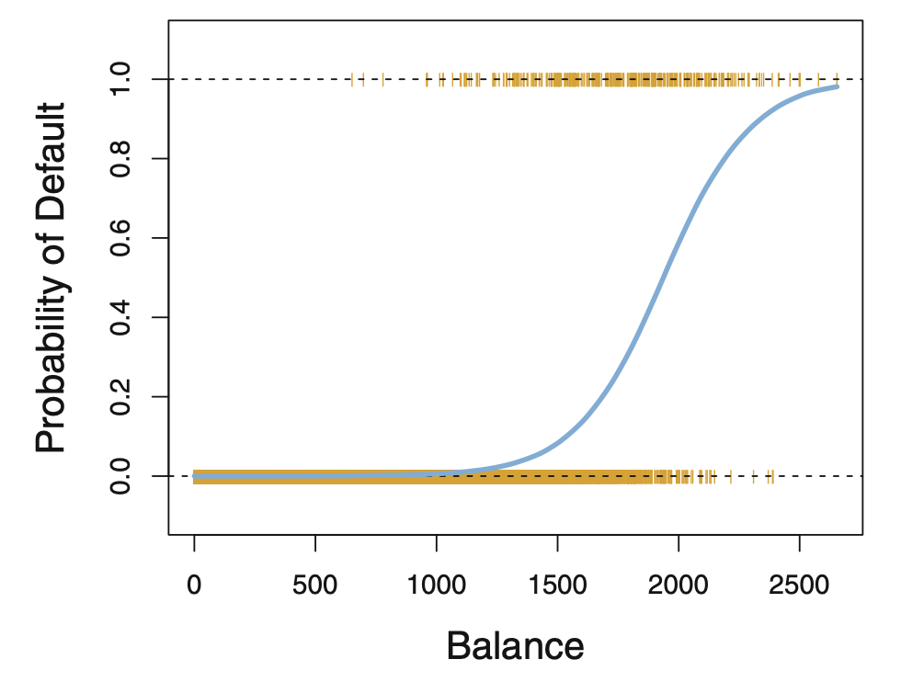
Modeling probabilities: logistic regression
Logistic regression offers us the ability to model probabilities compactly - while still being able to perform hypothesis tests as in linear regression.

Slide 13

The logistic model!
We have seen that this type of formulation:
$$p\left(Y==1\right)≈β_{0}+β_{1}X$$
Has some fundamental problems.
For low values of $X$ we predict negative probabilities
For very large values of $X$ we would get probabilities greater than 1
The notion of “error” as in a Gaussian error is strange. The probability itself is a random process; should the probability have error?

Slide 14

The logistic model
Let’s introduce the logistic regression model and then break down the parts. Here is the basic model:
$$log\left(\frac{p\left(Y\right)}{1−p\left(Y\right)}\right)=β_{0}+β_{1}x_{1}+β_{2}x_{2}+…+β_{n}x_{n}$$

Slide 15
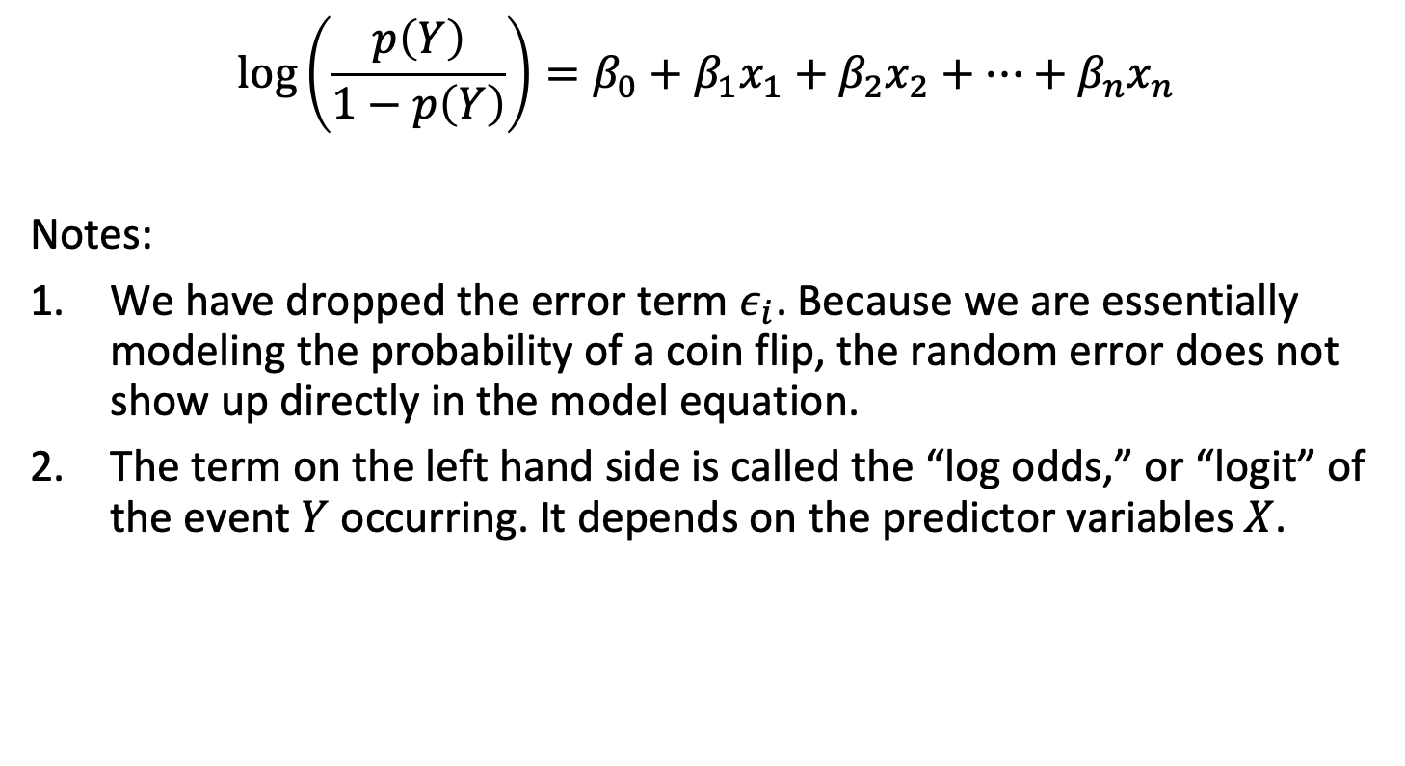
The logistic model
$$log\left(\frac{p\left(Y\right)}{1−p\left(Y\right)}\right)=β_{0}+β_{1}x_{1}+β_{2}x_{2}+…+β_{n}x_{n}$$
Notes:
We have dropped the error term $ε_{i}$. Because we are essentially modeling the probability of a coin flip, the random error does not show up directly in the model equation.
The term on the left hand side is called the “log odds,” or “logit” of the event $Y$ occurring. It depends on the predictor variables $X$.

Slide 16
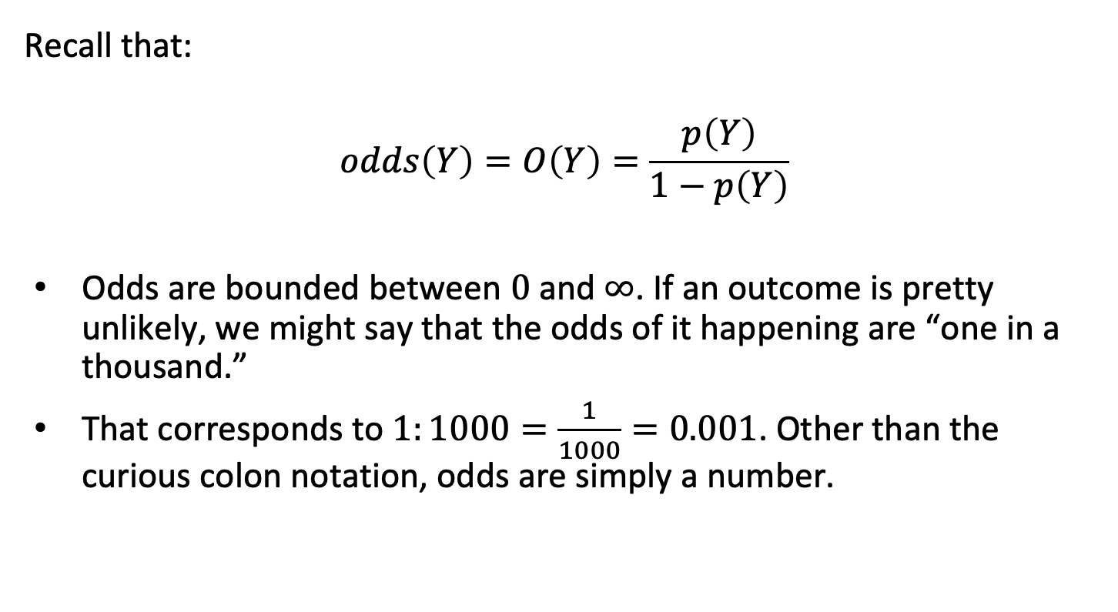
The logistic model
Recall that:
$$odds\left(Y\right)=O\left(Y\right)=\frac{p\left(Y\right)}{1−p\left(Y\right)}$$
Odds are bounded between $0$ and $∞$. If an outcome is pretty unlikely, we might say that the odds of it happening are “one in a thousand.”
That corresponds to $1:1000=\frac{1}{1000}=0.001$. Other than the curious colon notation, odds are simply a number.

Slide 17
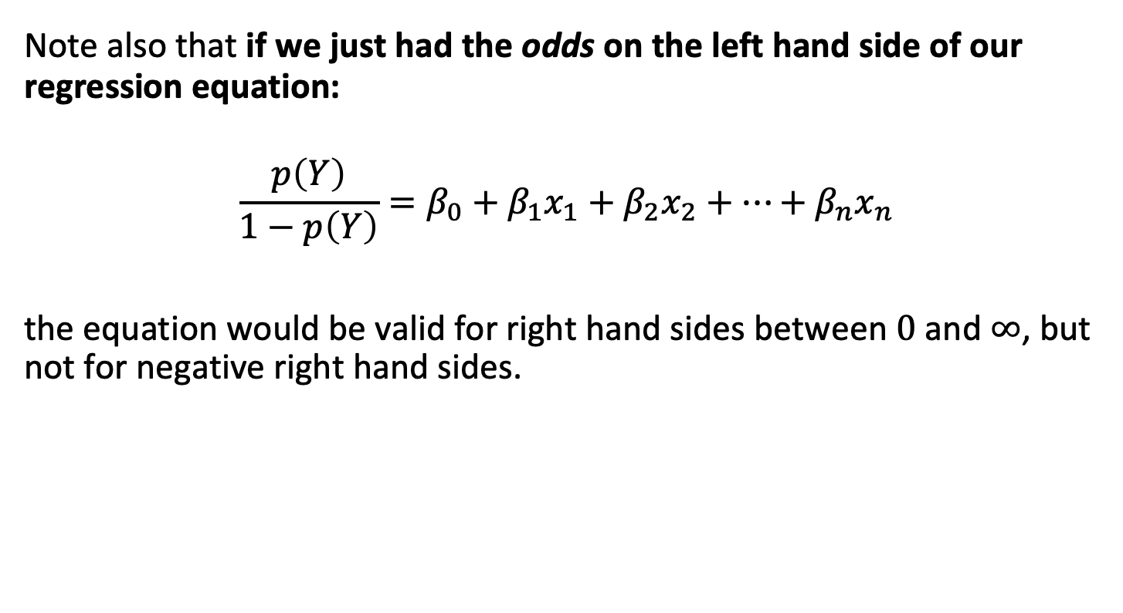
The logistic model
Note also that if we just had the odds on the left hand side of our regression equation:
$$\frac{p\left(Y\right)}{1−p\left(Y\right)}=β_{0}+β_{1}x_{1}+β_{2}x_{2}+…+β_{n}x_{n}$$
the equation would be valid for right hand sides between $0$ and $∞$, but not for negative right hand sides.

Slide 18
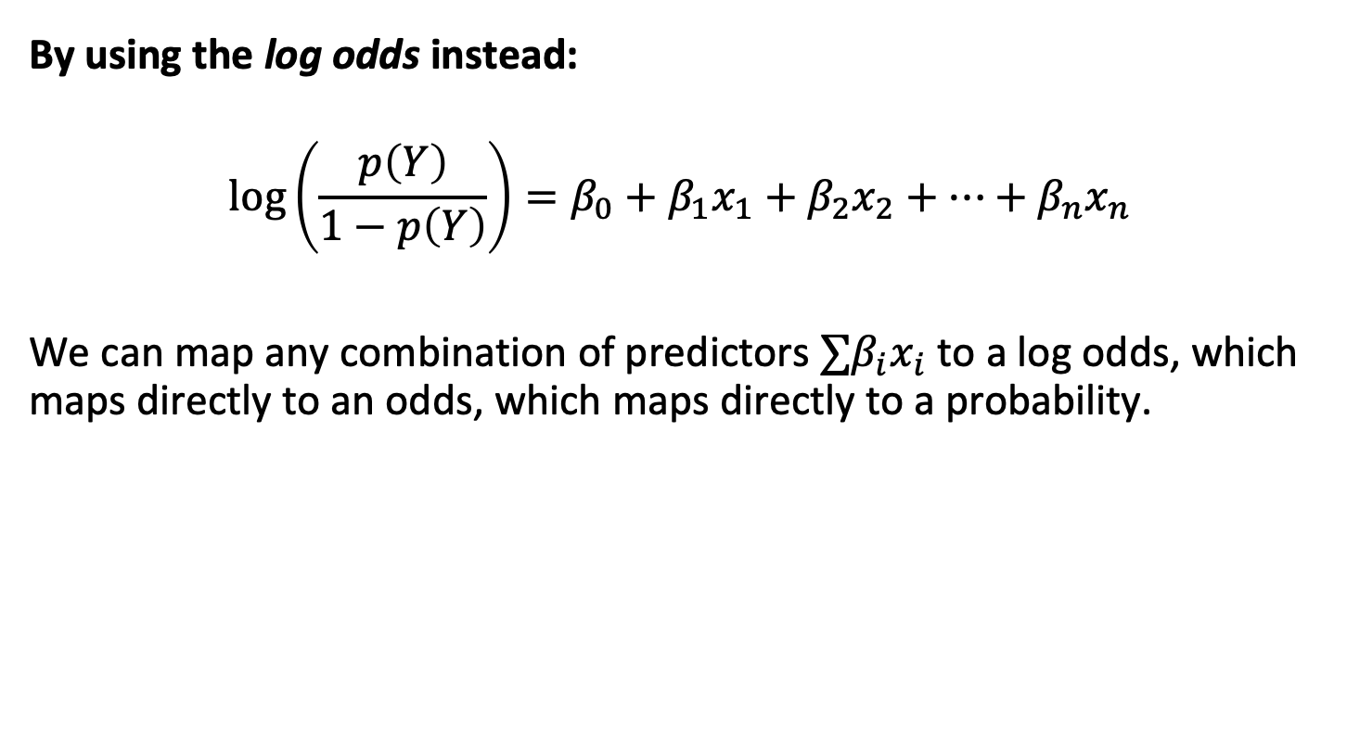
The logistic model
By using the log odds instead:
$$log\left(\frac{p\left(Y\right)}{1−p\left(Y\right)}\right)=β_{0}+β_{1}x_{1}+β_{2}x_{2}+…+β_{n}x_{n}$$
We can map any combination of predictors $∑β_{i}x_{i}$ to a log odds, which maps directly to an odds, which maps directly to a probability.

Slide 19

Transforming odds to probabilities and back
$$odds=\frac{probability}{1−probability}$$
$$probability=\frac{odds}{1+odds}$$

Slide 20
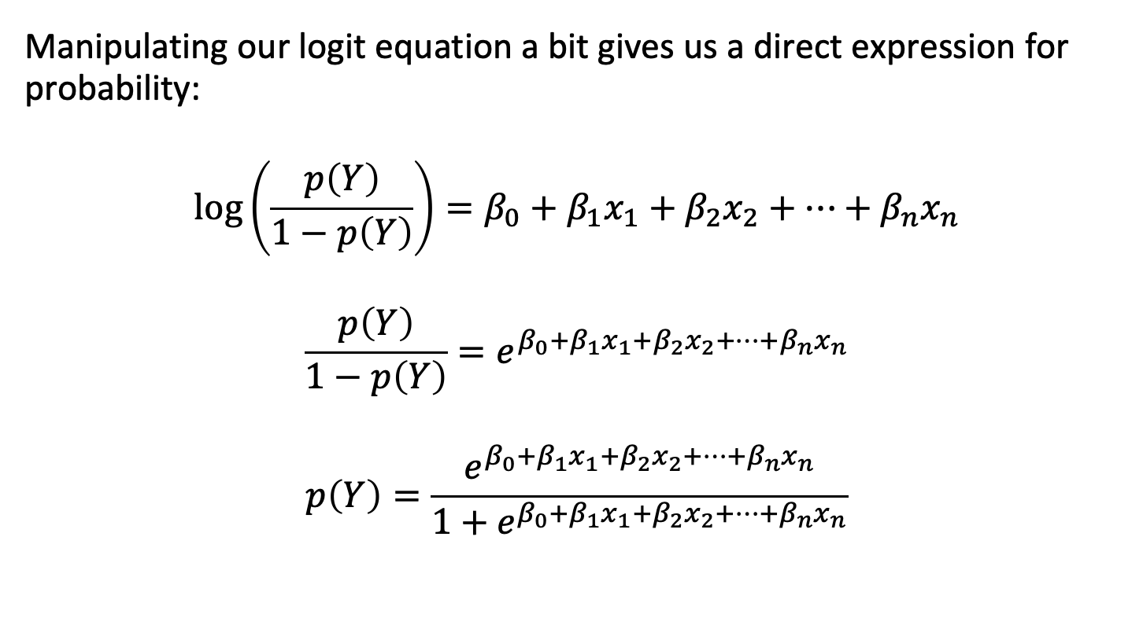
The logistic function
Manipulating our logit equation a bit gives us a direct expression for probability:
$$log\left(\frac{p\left(Y\right)}{1−p\left(Y\right)}\right)=β_{0}+β_{1}x_{1}+β_{2}x_{2}+…+β_{n}x_{n}$$
$$\frac{p\left(Y\right)}{1−p\left(Y\right)}=e^{β_{0}+β_{1}x_{1}+β_{2}x_{2}+…+β_{n}x_{n}}$$
$$p\left(Y\right)=\frac{e^{β_{0}+β_{1}x_{1}+β_{2}x_{2}+…+β_{n}x_{n}}}{1+e^{β_{0}+β_{1}x_{1}+β_{2}x_{2}+…+β_{n}x_{n}}}$$

Slide 21

The logistic function
Or, in the simpler case with just one predictor:
$$p\left(Y\right)=\frac{e^{β_{0}+β_{1}X}}{1+e^{β_{0}+β_{1}X}}$$

Slide 22
Outline
Introduction to logistic regression
Modeling probabilities
Details of the log odds / logit equation
Examples
The odds ratio
Link functions and generalized linear models
Hypothesis tests
Parameter identification

Slide 23

Some examples
Let’s say we had the following model:
$$log\left(\frac{p\left(Cancer\right)}{1−p\left(Cancer\right)}\right)=β_{0}+β_{S}SMOKE$$
Where the outcome was the log odds of developing cancer within 1 year and $β_{S}$ is the regression coefficient for smoking.

Slide 24

Some examples
What are the log odds of developing cancer for non-smokers?
$$log(\frac{p\left(Cancer\right)}{1−p\left(Cancer\right)})=β_{0}$$
What are the log odds of developing cancer for smokers?
$$log(\frac{p\left(Cancer\right)}{1−p\left(Cancer\right)})=β_{0}+β_{S}SMOKE$$

Slide 25
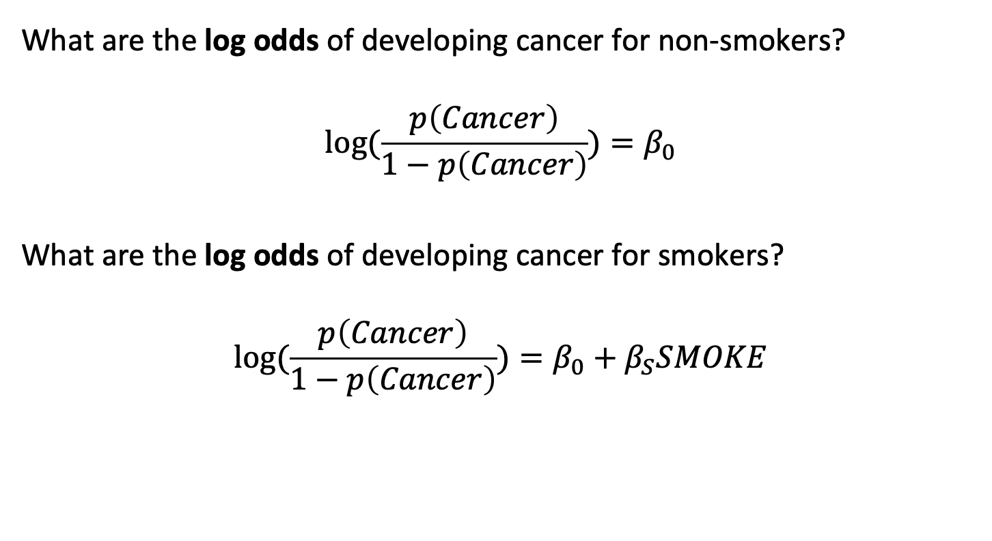
Some examples
What are the log odds of developing cancer for non-smokers?
$$log(\frac{p\left(Cancer\right)}{1−p\left(Cancer\right)})=β_{0}$$
What are the log odds of developing cancer for smokers?
$$log(\frac{p\left(Cancer\right)}{1−p\left(Cancer\right)})=β_{0}+β_{S}SMOKE$$

Slide 26

Some examples
What are the odds of developing cancer, for non-smokers?
$$\frac{p\left(Cancer\right)}{1−p\left(Cancer\right)}=e^{β_{0}}$$

Slide 27

Some examples
What are the odds of developing cancer, for non-smokers?
$$\frac{p\left(Cancer\right)}{1−p\left(Cancer\right)}=e^{β_{0}}$$

Slide 28

Some examples
What is the probability of developing cancer, for non-smokers?
$$\frac{p\left(Cancer\right)}{1−p\left(Cancer\right)}=e^{β_{0}}$$
$$probability=\frac{odds}{1+odds}$$
$$p\left(Cancer\right)=\frac{e^{β_{0}}}{1+e^{β_{0}}}$$

Slide 29
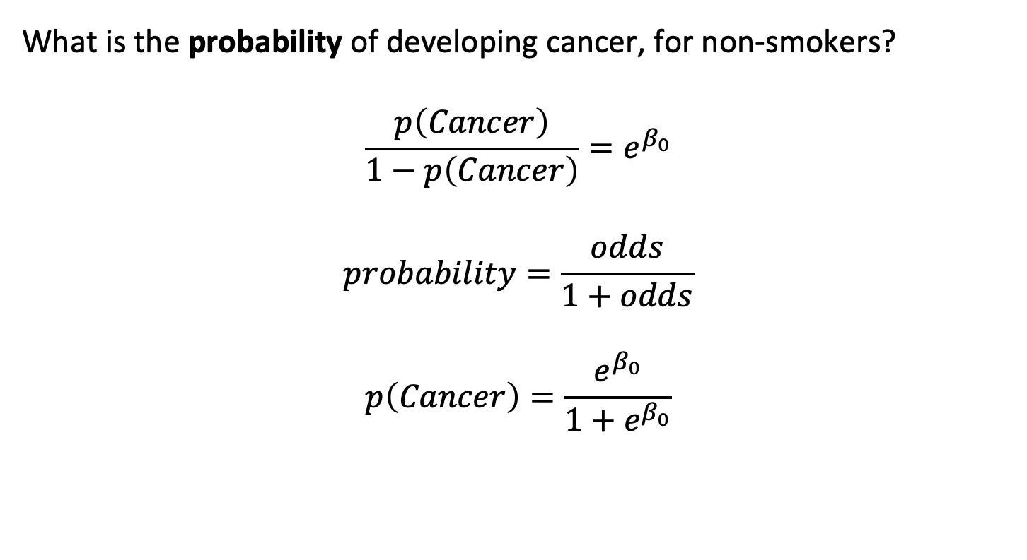
Some examples
What is the probability of developing cancer, for non-smokers?
$$\frac{p\left(Cancer\right)}{1−p\left(Cancer\right)}=e^{β_{0}}$$
$$probability=\frac{odds}{1+odds}$$
$$p\left(Cancer\right)=\frac{e^{β_{0}}}{1+e^{β_{0}}}$$

Slide 30
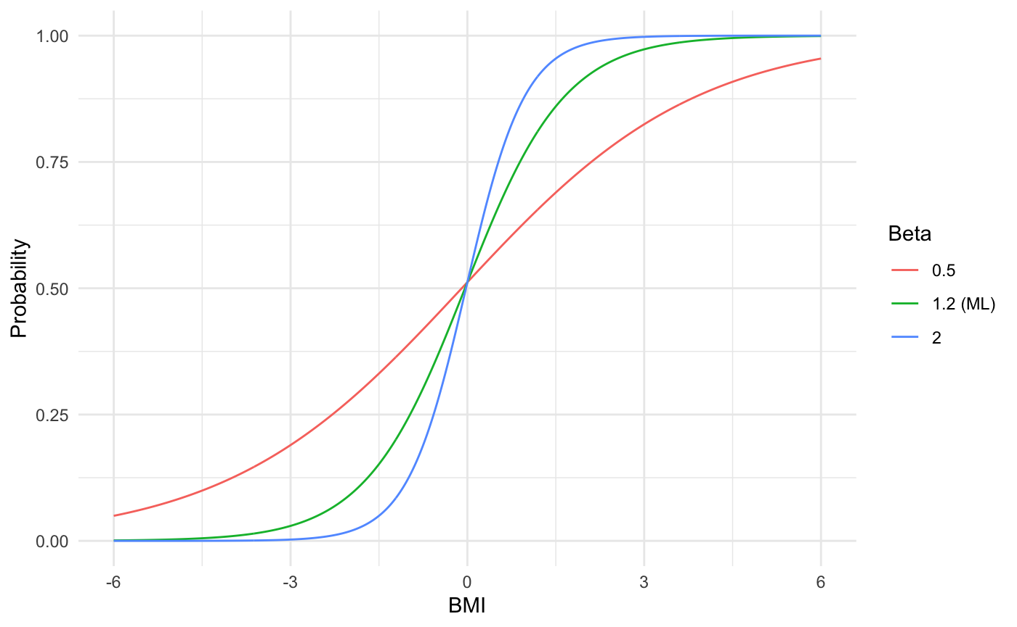
Variation in predicted probability with beta

Slide 31
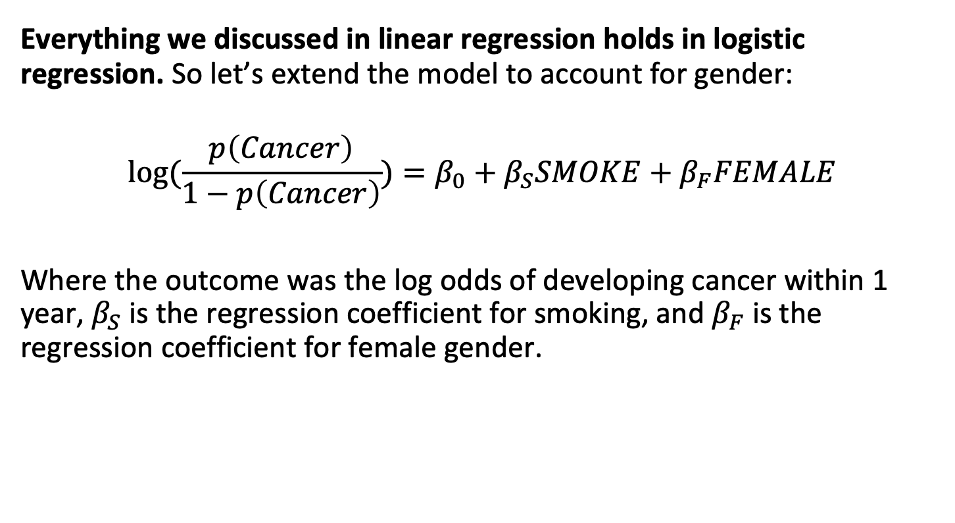
Some examples
Everything we discussed in linear regression holds in logistic regression. So let’s extend the model to account for gender:
$$log(\frac{p\left(Cancer\right)}{1−p\left(Cancer\right)})=β_{0}+β_{S}SMOKE+β_{F}FEMALE$$
Where the outcome was the log odds of developing cancer within 1 year, $β_{S}$ is the regression coefficient for smoking, and $β_{F}$ is the regression coefficient for female gender.

Slide 32

Some examples
What is the probability of developing cancer, for a female non-smoker?
$$p\left(Cancer\right)=\frac{e^{β_{0}+β_{F}}}{1+e^{β_{0}+β_{F}}}$$

Slide 33
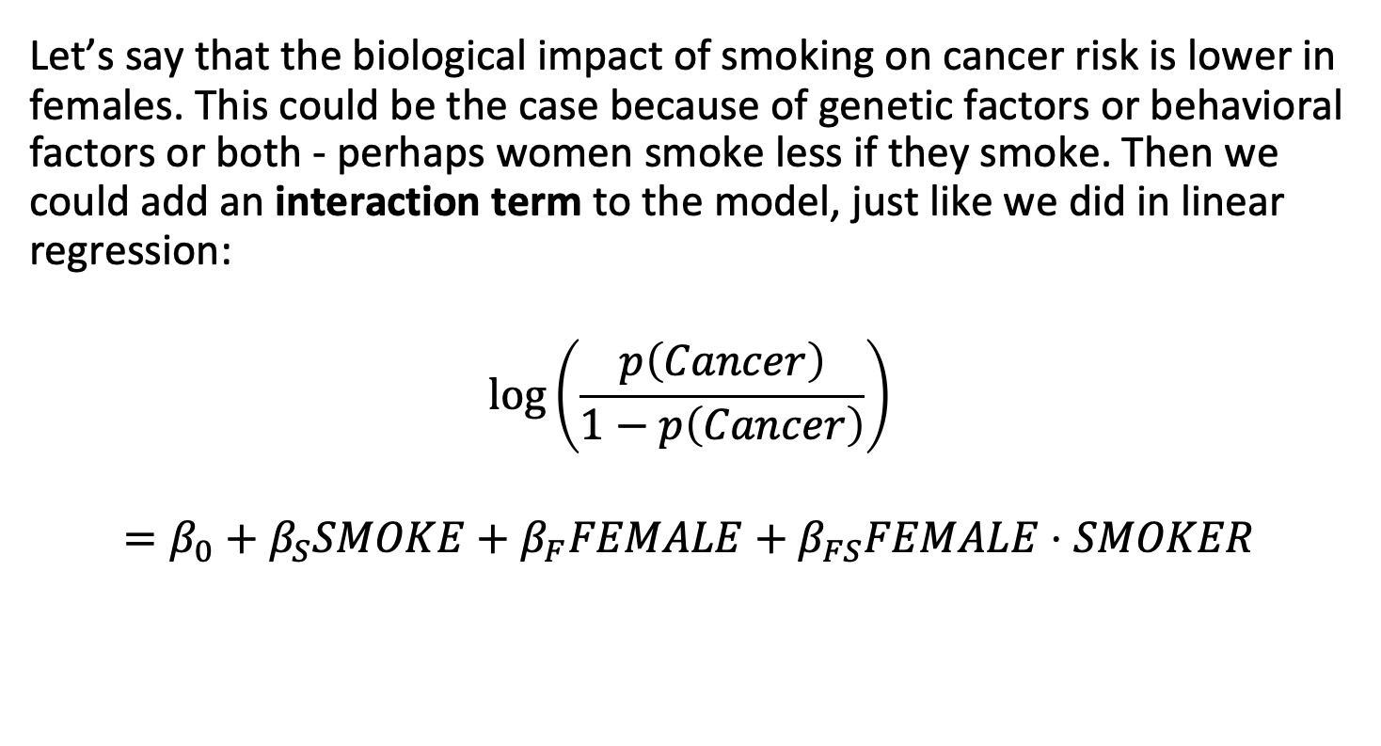
Some examples
Let’s say that the biological impact of smoking on cancer risk is lower in females. This could be the case because of genetic factors or behavioral factors or both - perhaps women smoke less if they smoke. Then we could add an interaction term to the model, just like we did in linear regression:
$$log\left(\frac{p\left(Cancer\right)}{1−p\left(Cancer\right)}\right)$$
$$=β_{0}+β_{S}SMOKE+β_{F}FEMALE+β_{FS}FEMALE⋅SMOKER$$

Slide 34

Some examples
Now what is the probability of developing cancer, for a female smoker?
$$p\left(Cancer\right)=\frac{e^{β_{0}+β_{F}+β_{S}+β_{FS}}}{1+e^{β_{0}+β_{F}+β_{S}+β_{FS}}}$$

Slide 35
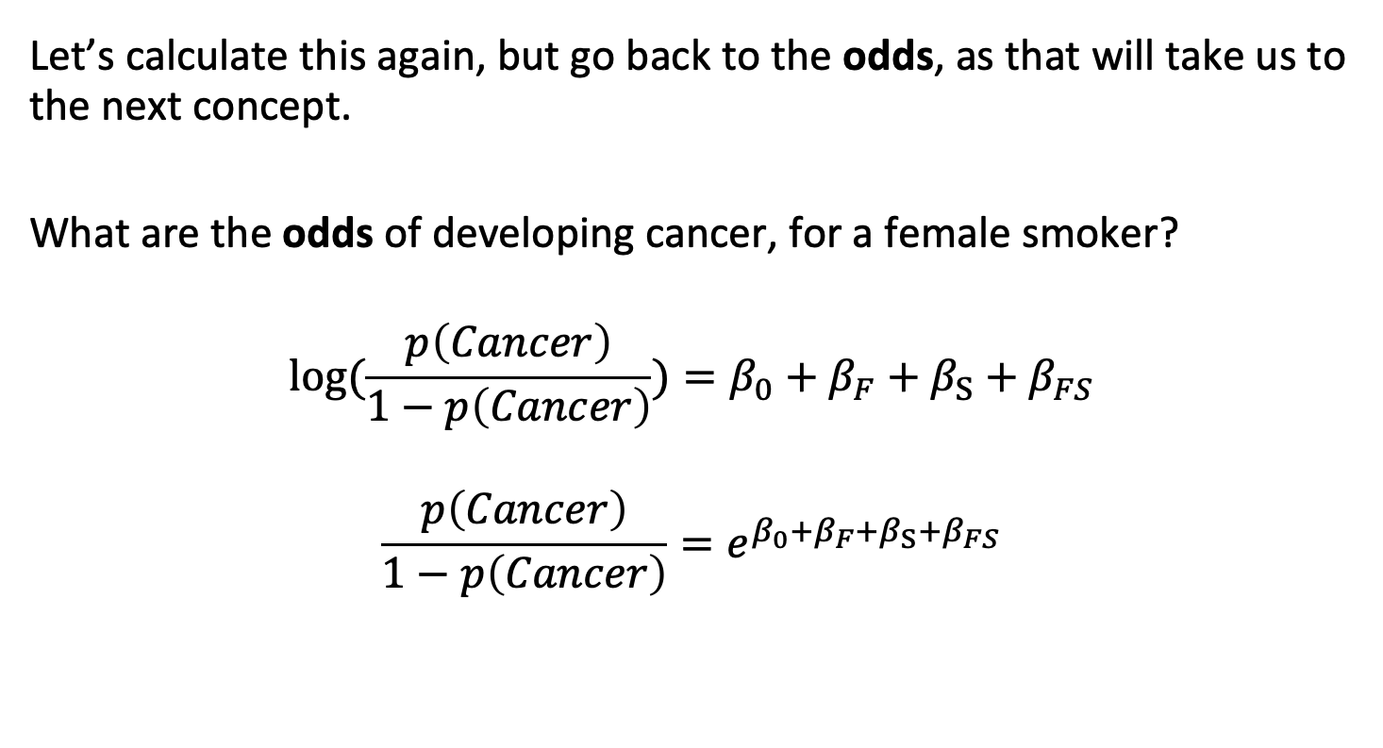
Some examples: towards the odds ratio
Let’s calculate this again, but go back to the odds, as that will take us to the next concept.
What are the odds of developing cancer, for a female smoker?
$$log(\frac{p\left(Cancer\right)}{1−p\left(Cancer\right)})=β_{0}+β_{F}+β_{S}+β_{FS}$$
$$\frac{p\left(Cancer\right)}{1−p\left(Cancer\right)}=e^{β_{0}+β_{F}+β_{S}+β_{FS}}$$

Slide 36
Outline
Introduction to logistic regression
Modeling probabilities
Details of the log odds / logit equation
Examples
The odds ratio
Link functions and generalized linear models
Hypothesis tests
Parameter identification

Slide 37

The Odds Ratio
The Odds Ratio is extremely useful in clinical / epidemiological research. Let’s return to our earlier model to explore this concept. We can model the log odds of cancer as a function of smoking status and sex.
$$log(\frac{p\left(Cancer\right)}{1−p\left(Cancer\right)})=β_{0}+β_{S}SMOKE+β_{F}FEMALE$$
Or equivalently, expressed as odds:
$$\frac{p\left(Cancer\right)}{1−p\left(Cancer\right)}=e^{β_{0}+β_{S}SMOKE+β_{F}FEMALE}$$

Slide 38
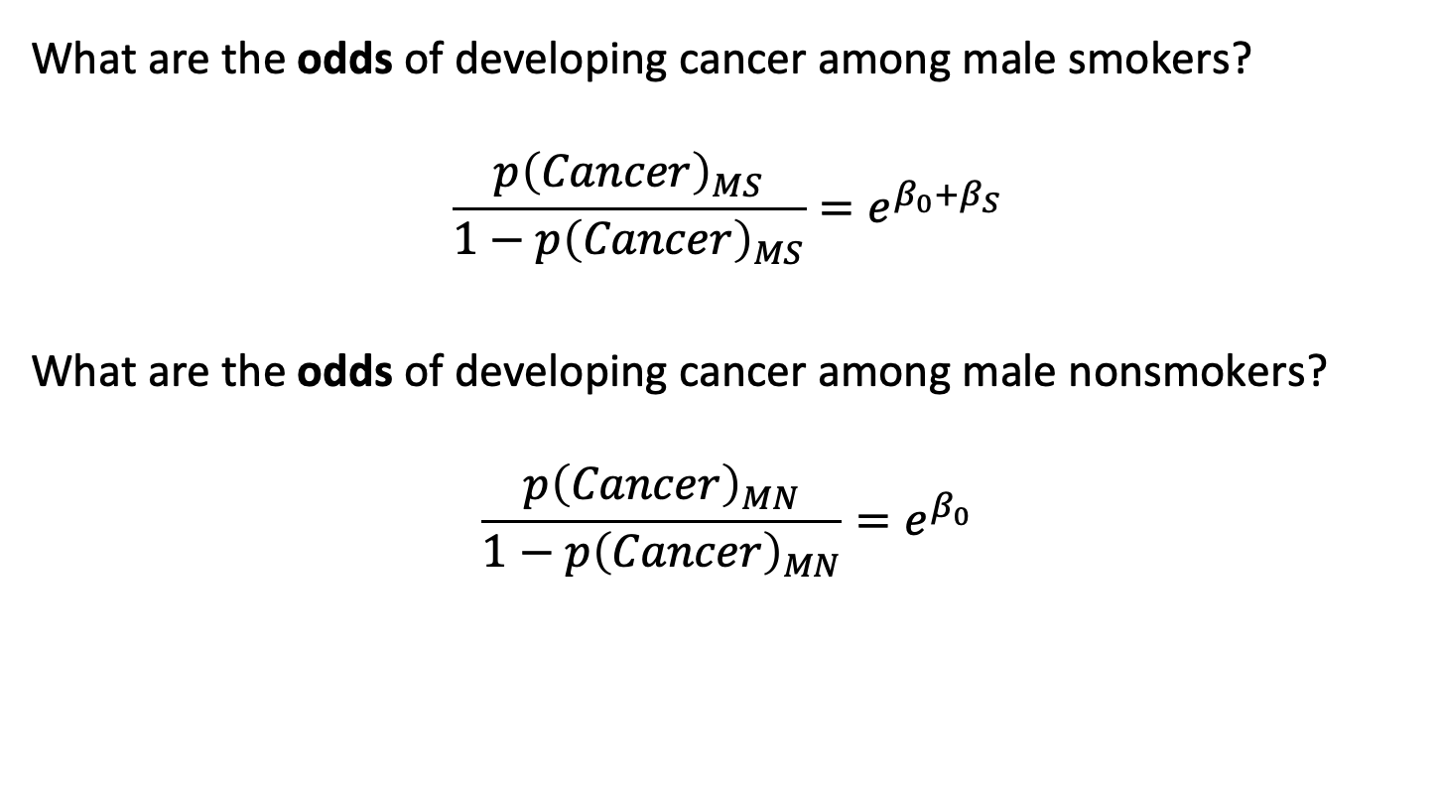
The Odds Ratio
What are the odds of developing cancer among male smokers?
$$\frac{p{\left(Cancer\right)}_{MS}}{1−p{\left(Cancer\right)}_{MS}}=e^{β_{0}+β_{S}}$$
What are the odds of developing cancer among male nonsmokers?
$$\frac{p{\left(Cancer\right)}_{MN}}{1−p{\left(Cancer\right)}_{MN}}=e^{β_{0}}$$

Slide 39
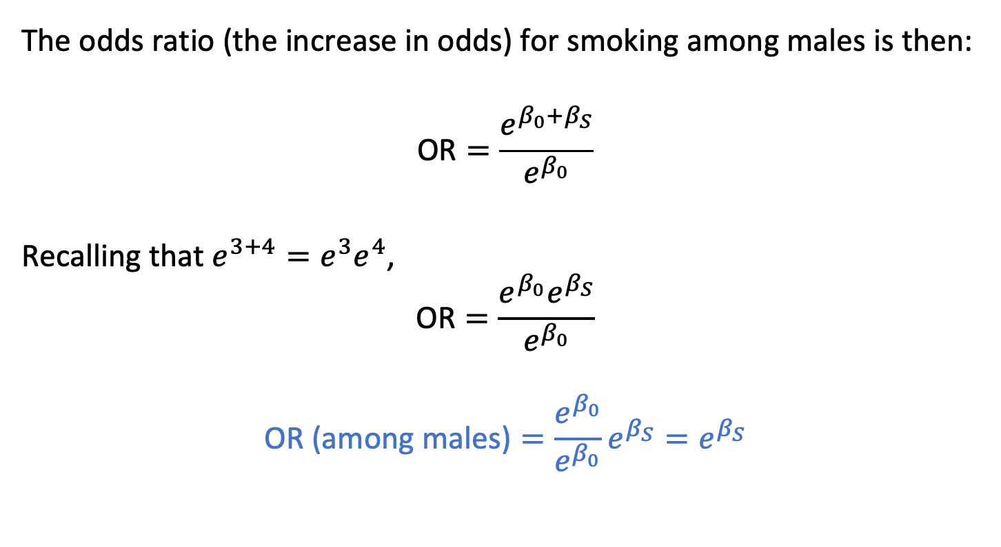
The Odds Ratio
The odds ratio (the increase in odds) for smoking among males is then:
$$\text{OR}=\frac{e^{β_{0}+β_{S}}}{e^{β_{0}}}$$
Recalling that $e^{3+4}=e^{3}e^{4}$,
$$\text{OR}=\frac{e^{β_{0}}e^{β_{S}}}{e^{β_{0}}}$$
$$\text{OR}\text{ (}\text{among} \text{males}\text{)}=\frac{e^{β_{0}}}{e^{β_{0}}}e^{β_{S}}=e^{β_{S}}$$

Slide 40
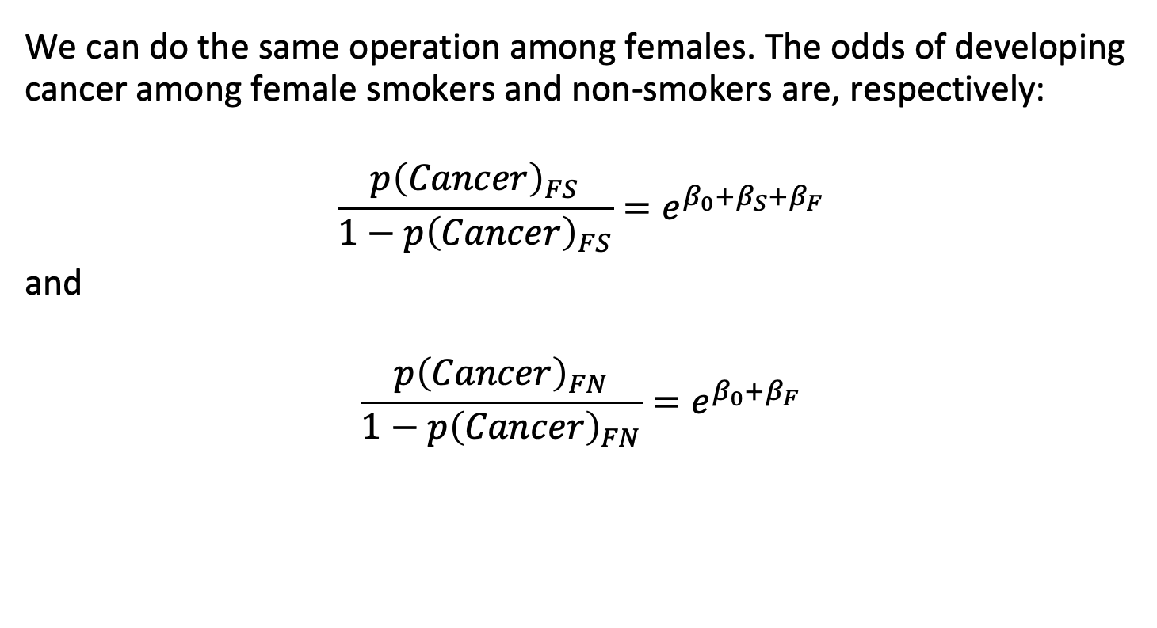
The Odds Ratio
We can do the same operation among females. The odds of developing cancer among female smokers and non-smokers are, respectively:
$$\frac{p{\left(Cancer\right)}_{FS}}{1−p{\left(Cancer\right)}_{FS}}=e^{β_{0}+β_{S}+β_{F}}$$
and
$$\frac{p{\left(Cancer\right)}_{FN}}{1−p{\left(Cancer\right)}_{FN}}=e^{β_{0}+β_{F}}$$

Slide 41

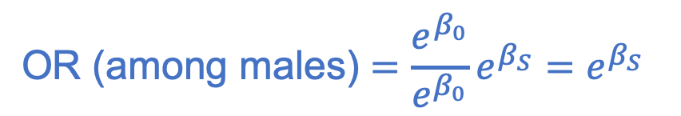
The Odds Ratio
Note that when we calculate the odds ratio among females, we get:
This is a pretty surprising result. The probability of developing cancer depends on gender, but the odds ratio does not:
$$\text{OR}\text{ (}\text{among} \text{fe}males)=\frac{e^{β_{0}+β_{F}}}{e^{β_{0}+β_{F}}}e^{β_{S}}=e^{β_{S}}$$
$$\text{OR}\text{ (}\text{among} \text{males}\text{)}=\frac{e^{β_{0}}}{e^{β_{0}}}e^{β_{S}}=e^{β_{S}}$$

Slide 42

The Odds Ratio
This is a pretty surprising result. The probability of developing cancer depends on gender, but the odds ratio does not.
That is why it is so useful: the odds ratio associated with a particular exposure is the same across all other covariate profiles, and it comes straight out of logistic regression.
So although I am older than you, and my cancer risk is increased due to age, if you or I were to start smoking today our odds of developing cancer would increase by the same multiplier.

Slide 43
Outline
Introduction to logistic regression
Modeling probabilities
Details of the log odds / logit equation
Examples
The odds ratio
Link functions and generalized linear models
Hypothesis tests
Parameter identification

Slide 44
Generalized linear models and the “link function”
Generalized linear models (GLMs), including logistic regression, extend ordinary linear regression by allowing the response variable to follow distributions beyond the normal. GLMs use a link function to relate the linear predictor to the mean of the response variable.
Maximum likelihood estimation, the most common method for fitting GLMs, is the default in many statistical software packages.
GLMs provide flexibility by allowing both non-normal response distributions and non-identity link functions, enabling broader modeling of real-world data.

Slide 45


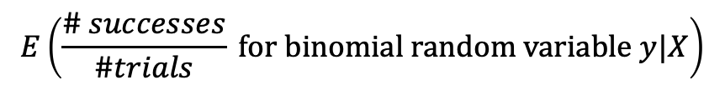
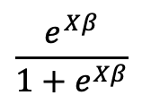
Generalized linear models and the “link function”
Linear
Regression
$$E(\text{normal} \text{random} \text{variable} y|X)$$
$$Xβ$$
Logistic
Regression
$$E\left(\frac{\# successes}{\#trials} \text{for} \text{binomial} \text{random} \text{variable} y|X\right)$$
$$\frac{e^{Xβ}}{1+e^{Xβ}}$$

Slide 46
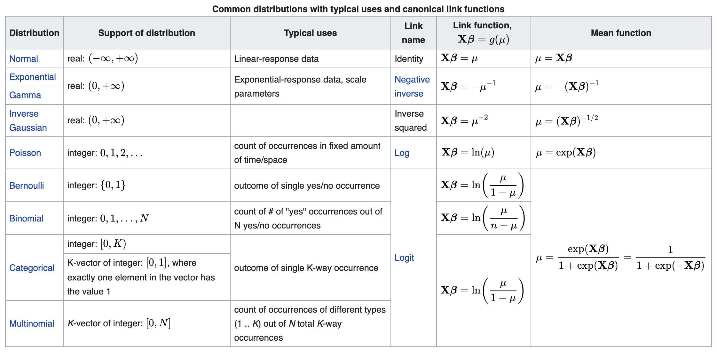
Generalized linear models and the “link function”

Slide 47
Outline
Introduction to logistic regression
Modeling probabilities
Details of the log odds / logit equation
Examples
The odds ratio
Link functions and generalized linear models
Hypothesis tests
Parameter identification

Slide 48
Hypothesis tests
Hypothesis tests of individual parameters or groups of parameters are performed in logistic regression analogously to linear regression.
We will not discuss them in depth, but individual parameter tests can be obtained from the glm output. These tests are derived from estimates of the betas and their standard errors.
The null hypotheses are that each beta coefficient is zero vs. nonzero.

Slide 49
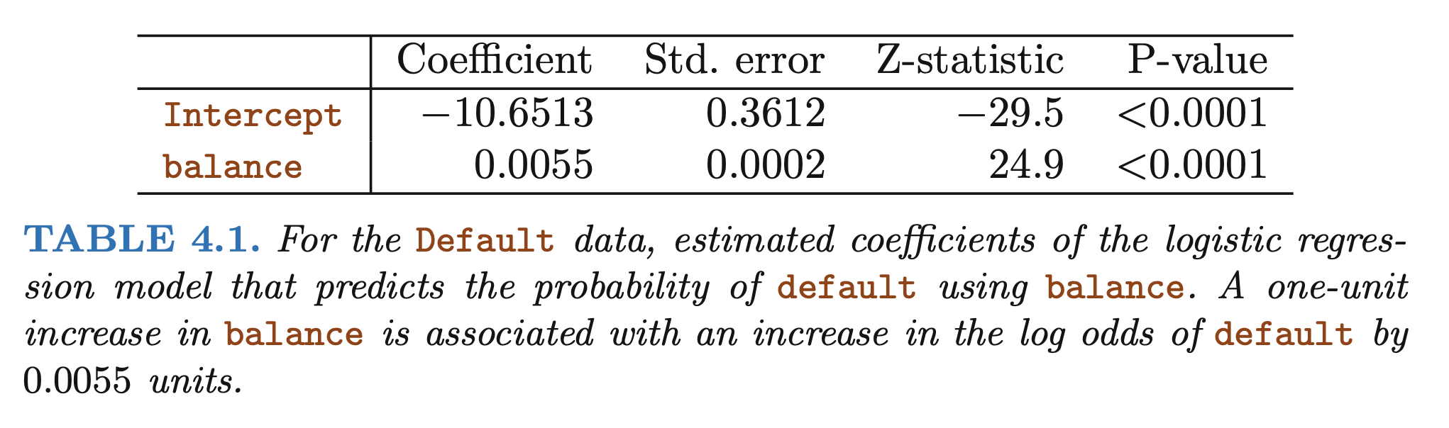
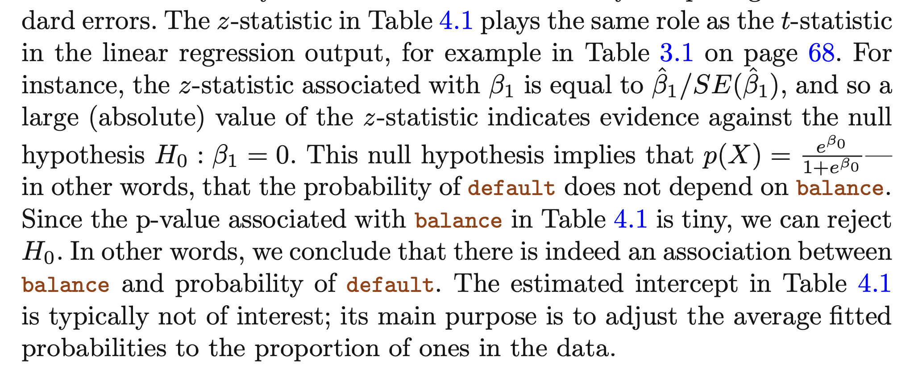
Hypothesis tests

Slide 50
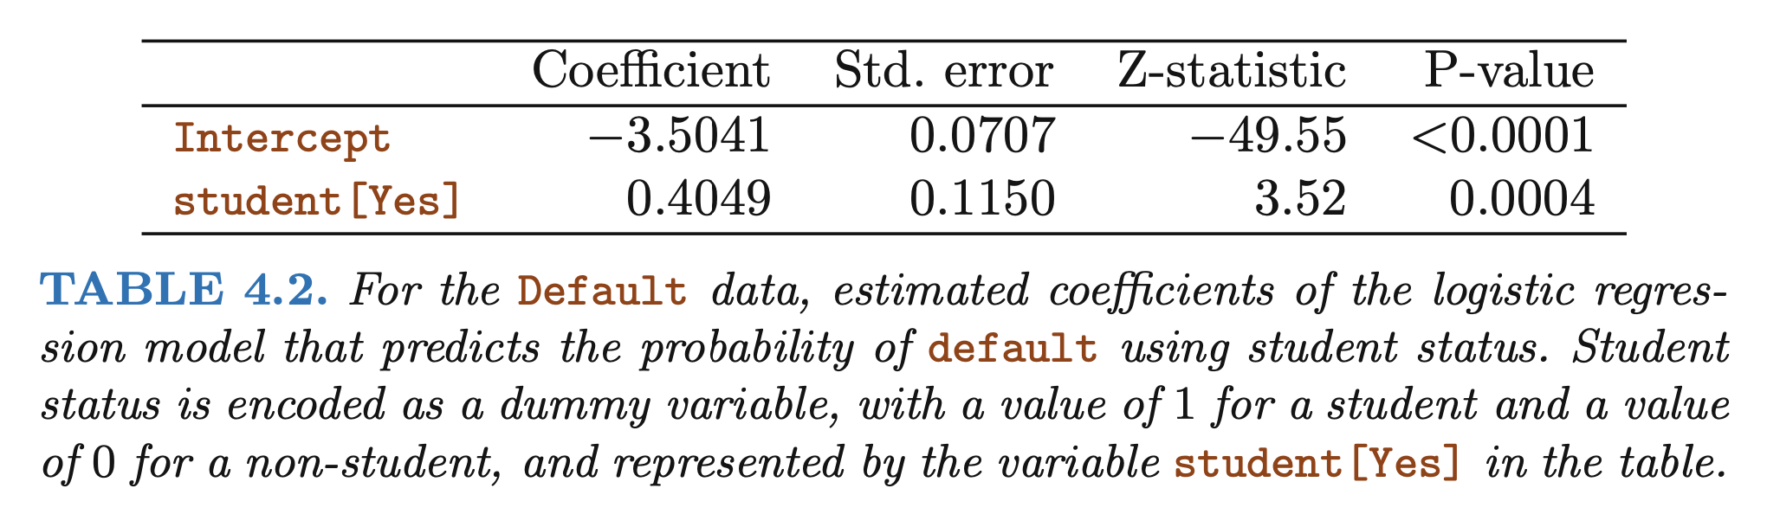
Confounding

Slide 51
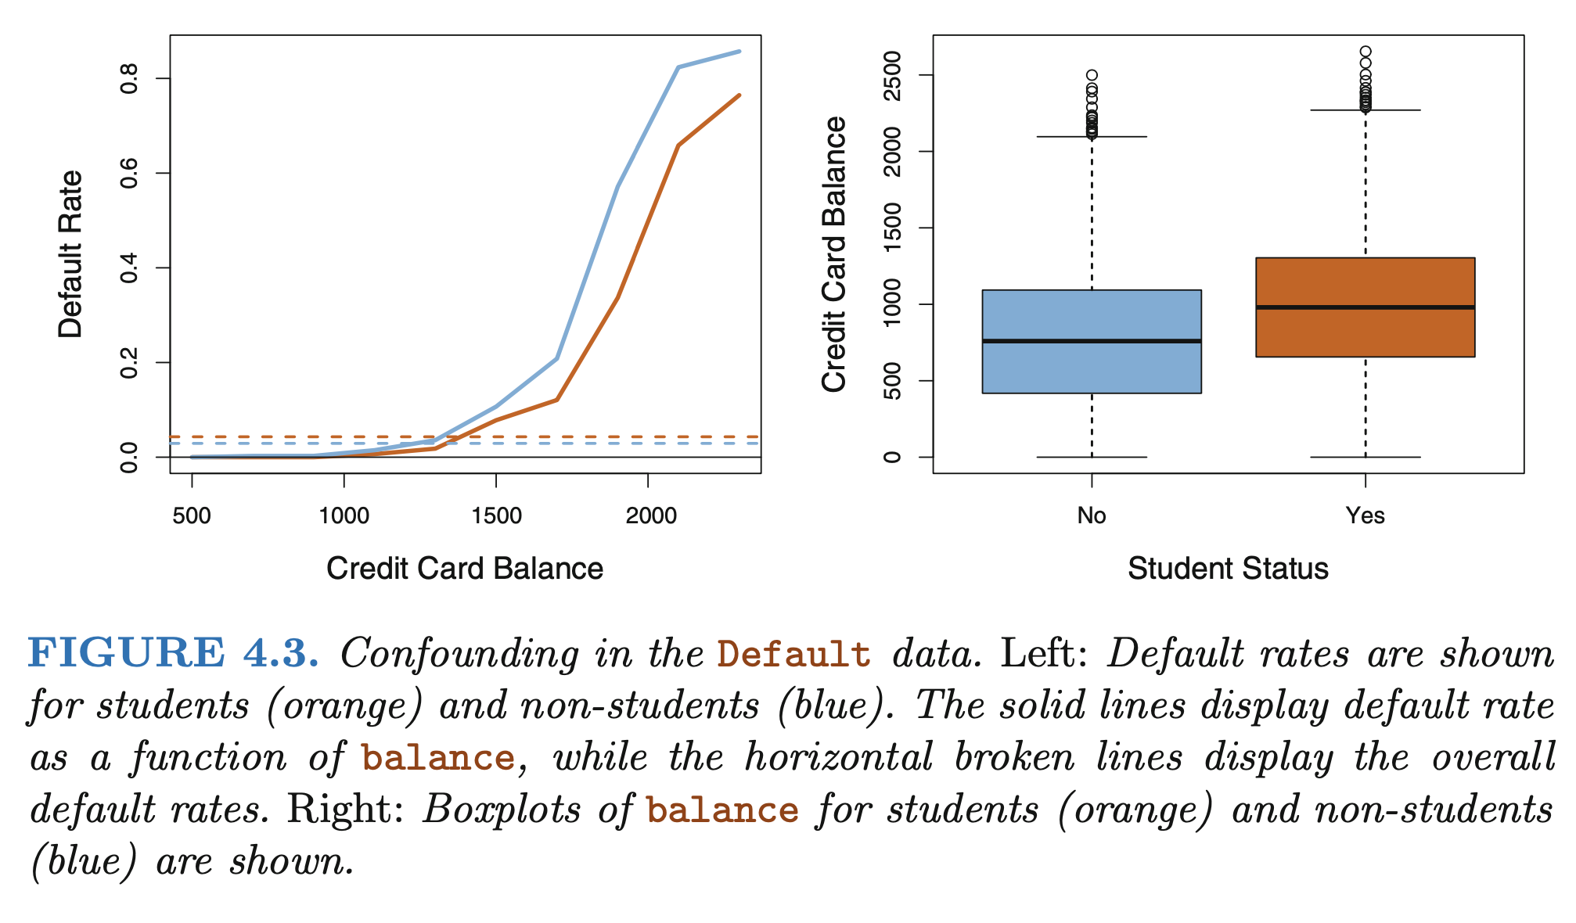
Confounding

Slide 52
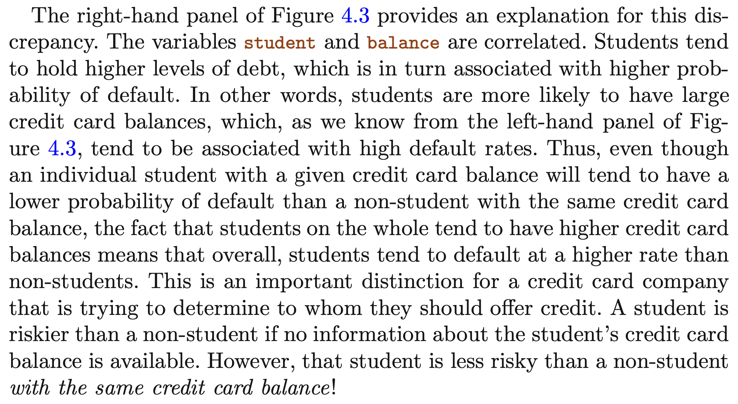
Confounding

Slide 53
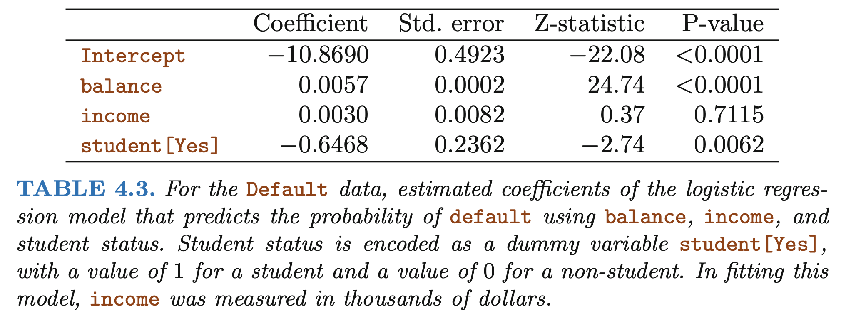
Confounding

Slide 54
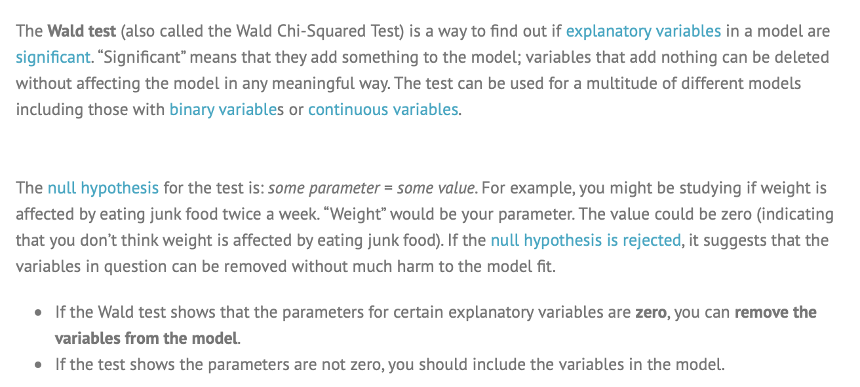
Bad advice from the internet: using p-values (exclusively) to identify models
This is incorrect.
https://www.statisticshowto.com/wald-test/

Slide 55
Definition of a statistical test
A statistical test is a tool used to help make a decision about a null hypothesis.
Due to confounding, Simpson's paradox, all of the topics we've discussed, variables might go from highly significant to not (or vice-versa) in the presence of other variables.
Visualization and judgment are key. p-values can help, but they are not a substitute for critical reasoning.

Slide 56
Confounding
Why do you think additional income would increase log odds of default?

Slide 57
Outline
Introduction to logistic regression
Modeling probabilities
Details of the log odds / logit equation
Examples
The odds ratio
Link functions and generalized linear models
Hypothesis tests
Parameter identification

Slide 58
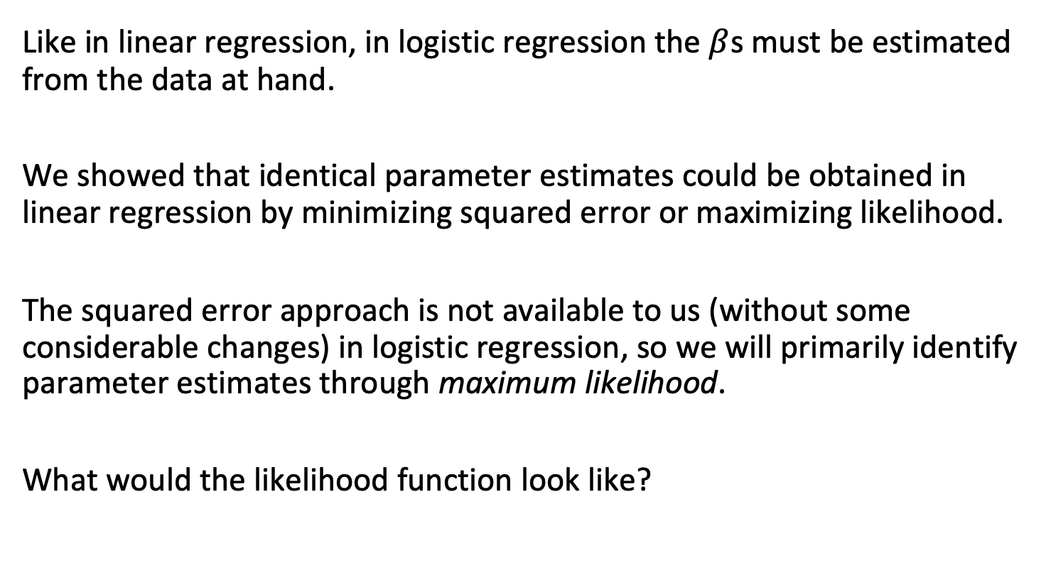
Estimating parameters
Like in linear regression, in logistic regression the $β$s must be estimated from the data at hand.
We showed that identical parameter estimates could be obtained in linear regression by minimizing squared error or maximizing likelihood.
The squared error approach is not available to us (without some considerable changes) in logistic regression, so we will primarily identify parameter estimates through maximum likelihood.
What would the likelihood function look like?

Slide 59
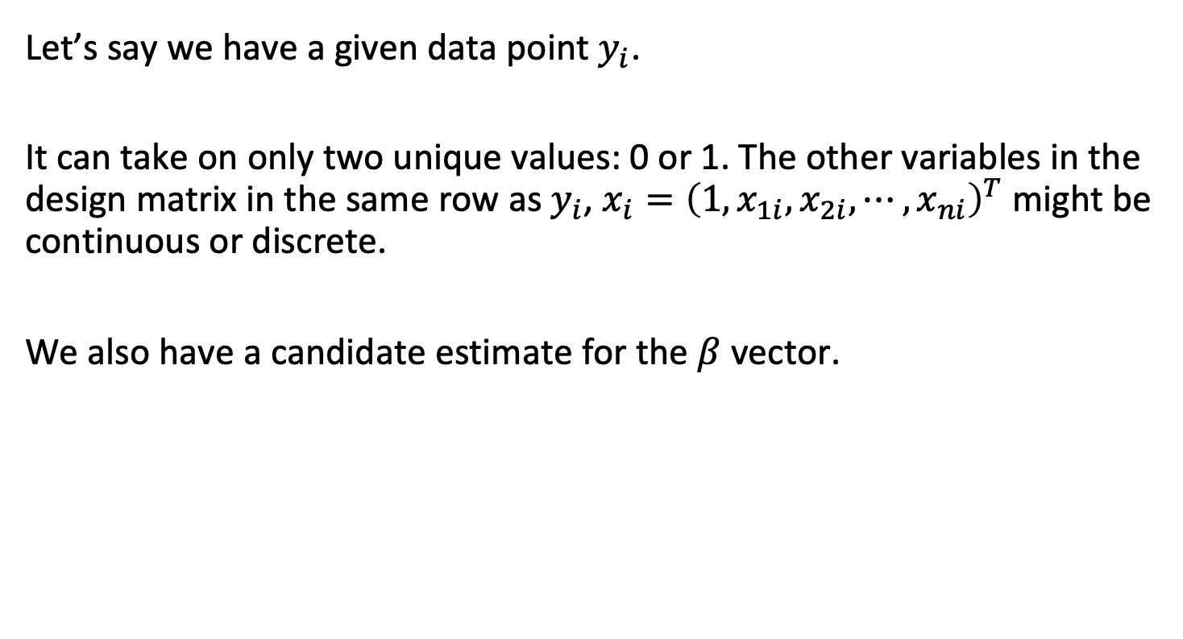
Maximum likelihood
Let’s say we have a given data point $y_{i}$.
It can take on only two unique values: 0 or 1. The other variables in the design matrix in the same row as $y_{i}$, $x_{i}={\left(1,x_{1i},x_{2i},⋯,x_{ni}\right)}^{T}$ might be continuous or discrete.
We also have a candidate estimate for the $β$ vector.

Slide 60

Maximum likelihood
The predicted probability of $y_{i}$ being a success (equaling 1) given what we know about the other predictors $x_{i}$ and our estimate of the betas is:
$$p\left(y_{i}==1|x_{i}\right)=\frac{e^{Xβ}}{1+e^{Xβ}}$$

Slide 61
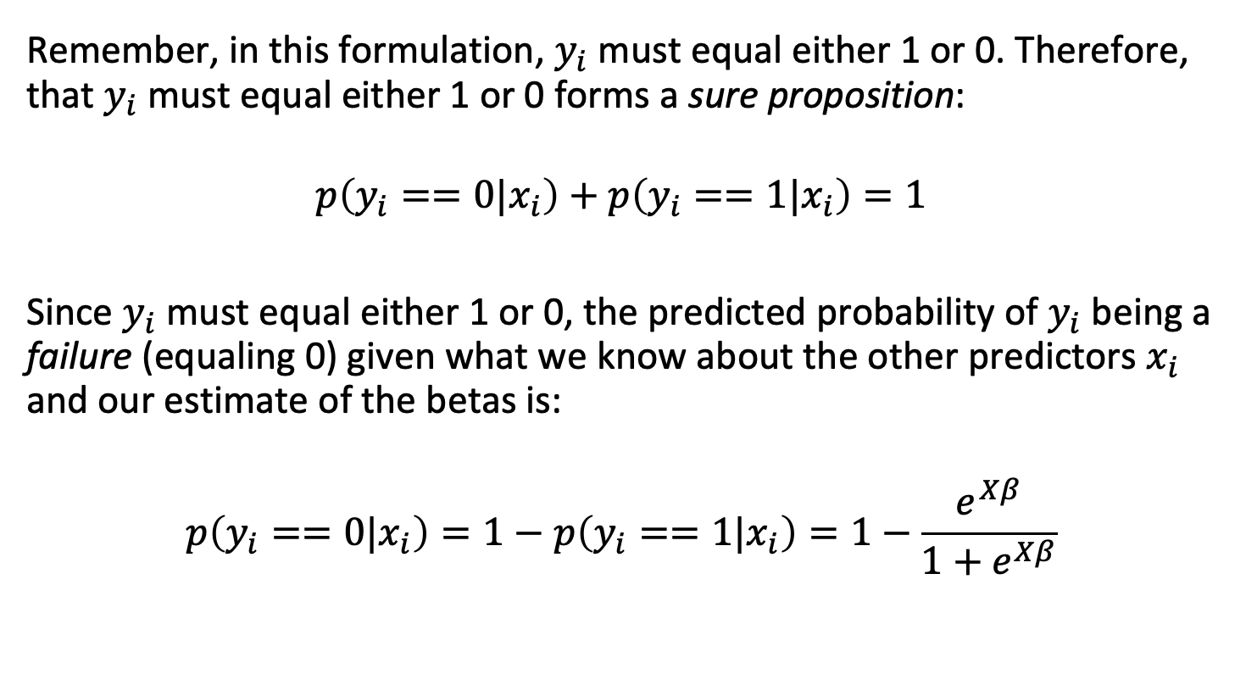
Maximum likelihood
Remember, in this formulation, $y_{i}$ must equal either 1 or 0. Therefore, that $y_{i}$ must equal either 1 or 0 forms a sure proposition:
$$p\left(y_{i}==0|x_{i}\right)+p\left(y_{i}==1|x_{i}\right)=1$$
Since $y_{i}$ must equal either 1 or 0, the predicted probability of $y_{i}$ being a failure (equaling 0) given what we know about the other predictors $x_{i}$ and our estimate of the betas is:
$$p\left(y_{i}==0|x_{i}\right)=1−p\left(y_{i}==1|x_{i}\right)=1−\frac{e^{Xβ}}{1+e^{Xβ}}$$

Slide 62

Maximum likelihood
We recall that the likelihood of the data under the model is the product of the probabilities of each data point under the model.
In the Gaussian noise case, the probability depended on the actual value of the residual, with some construction like $dnorm\left(y_{i},0,sd_{est}\right)$.

Slide 63
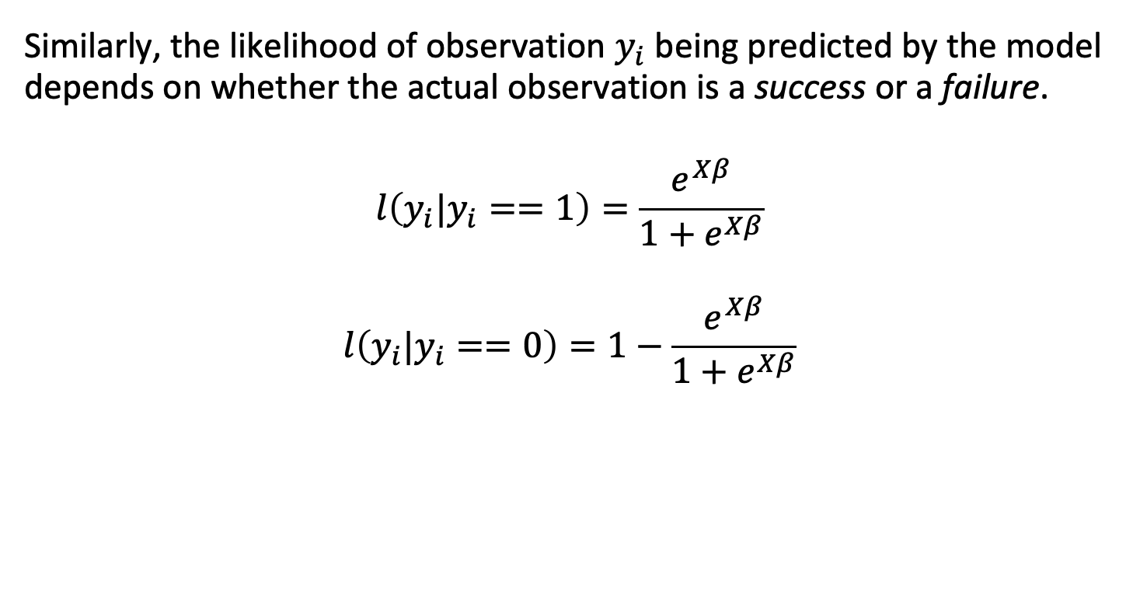
Maximum likelihood
Similarly, the likelihood of observation $y_{i}$ being predicted by the model depends on whether the actual observation is a success or a failure.
$$l\left(y_{i}|y_{i}==1\right)=\frac{e^{Xβ}}{1+e^{Xβ}}$$
$$l\left(y_{i}|y_{i}==0\right)=1−\frac{e^{Xβ}}{1+e^{Xβ}}$$

Slide 64

Likelihood function
Since the likelihood of the data is the product of the likelihood of each point, the likelihood function has a two-part structure:
$$l\left(data|model\right)=\prod_{successes}^{​}{\frac{e^{x_{i}β}}{1+e^{x_{i}β}}}×\prod_{failures}^{​}{1}−\frac{e^{x_{i}β}}{1+e^{x_{i}β}}$$
$$l\left(data|model\right)=\prod_{successes}^{​}{p}\left(x_{i}\right)\prod_{failures}^{​}{1}−p\left(x_{i}\right)$$

Slide 65

Likelihood function
The James text uses the following notation for this:
Let $i$ represent all of the observations $x_{i}$ that are successes, and $i^{′}$ represent all of the observations $x_{i^{′}}$ that are failures. Then:
$$l\left(data|β\right)=\prod_{i}^{​}{\frac{e^{x_{i}β}}{1+e^{x_{i}β}}}×\prod_{i^{′}}^{​}{1}−\frac{e^{x_{i^{′}}β}}{1+e^{x_{i^{′}}β}}$$
$$l\left(data|β\right)=\prod_{i}^{​}{p}\left(x_{i}\right)\prod_{i^{′}}^{​}{1}−p\left(x_{i^{′}}\right)$$

Slide 66

Maximum likelihood
Much like linear regression, our estimates of the beta parameters in logistic regression are usually selected to maximize the (log) likelihood function.
There are various numerical methods to identify the beta that maximizes this curve.

Slide 67
Another note on maximum likelihood
In practical settings, this does not come up frequently, but it is important to note that there may be no unique maximum likelihood estimate for problems of this type.
If the log likelihood function has many peaks and valleys – or flat regions – ML estimates may reflect local maxima or just not exist.

Slide 68
Deviance
Deviance is a measure that plays the role of the RSS in linear regressions, but for a broader class of models. The deviance is negative two times the maximized log-likelihood; the smaller the deviance, the better the fit.
In the context of logistic regression, deviance is a measure of the difference between the fit of the model and the fit of a “saturated model” – that is, a model with one parameter per observation that fits perfectly.
It is calculated by comparing the log-likelihood of the model being tested to the log-likelihood of the "saturated model," which is a model with a separate parameter for each observation.

Slide 69

Deviance

Slide 70
Calculating deviance
To calculate deviance in a logistic regression, follow these steps:
Fit the logistic regression model to the data.
Calculate the log-likelihood of the fitted model.
Fit a "saturated model" to the same data, which is a model with a separate parameter for each observation. Calculate the log-likelihood of the saturated model.
Subtract the log-likelihood of the fitted model from the log-likelihood of the saturated model.
Multiply the result by -2 to obtain the deviance value.
Deviance = -2 * (Log-likelihood of fitted model - Log-likelihood of saturated model)

Slide 71
Outline
Introduction to logistic regression
Modeling probabilities
Details of the log odds / logit equation
Examples
The odds ratio
Link functions and generalized linear models
Hypothesis tests
Parameter identification

