Slide 1
BMI 510: Regression IV
J. Lucas McKay, Ph.D., M.S.C.R.
Departments of Biomedical Informatics and Neurology, Emory University, Atlanta, GA USA
Department of Biomedical Engineering, Georgia Institute of Technology, Atlanta, GA, USA

Slide 2
Outline
Concept of model selection
Measures of model fit
Model selection methods
Domain knowledge assessment of causality
Stepwise procedures for best subset selection
Regularized regression for constraining or eliminating coefficients
Drawbacks of automated model selection procedures

Slide 3
Back to regression
The typical model is:
$$y_{i}=β_{0}+\sum_{j=1}^{p}{β_{j}}x_{ji}+e_{i}$$
Or, without error,
$$\hat{y_{i}}=β_{0}+\sum_{j=1}^{p}{β_{j}}x_{ji}$$
And our objective is to identify the set of $β$s that minimize some function of $y−\hat{y}$.

Slide 4
Inverting a matrix
We have solved a $2×2$ system of equations by hand previously.
In general, any $n×n$ invertible matrix can be inverted through various computation procedures (Gaussian elimination, Gauss—Jordan, LU decomposition) that are algorithmic applications of that process.
For the $2×2$ case:
$$A≡\left[\begin{matrix}a & b \\ c & d\end{matrix}\right]$$
$$A^{−1}≡\frac{1}{ad−bc}\left[\begin{matrix}d & −b \\ −c & a\end{matrix}\right]$$
Where the term $ad−bc$ is the matrix determinant. The matrix is invertible if and only if the determinant is non-zero.

Slide 5
What does it mean when the determinant is zero?
For the $2×2$ case:
$$A^{−1}≡\frac{1}{ad−bc}\left[\begin{matrix}d & −b \\ −c & a\end{matrix}\right]$$
If the determinant is zero, then we cannot invert the matrix. What is the determinant of this matrix?
$$\left[\begin{matrix}1 & 2 \\ 2 & 4\end{matrix}\right]$$

Slide 6
An example
Let’s start with this simple design matrix.
$$X=\left[\begin{matrix}1 & 2 \\ 1 & 7\end{matrix}\right]$$
We can invert it:
$$X^{−1}=\frac{1}{7−2}\left[\begin{matrix}7 & −2 \\ −1 & 1\end{matrix}\right]$$
$$X^{−1}=\frac{1}{5}\left[\begin{matrix}7 & −2 \\ −1 & 1\end{matrix}\right]=\left[\begin{matrix}\frac{7}{5} & −\frac{2}{5} \\ −\frac{1}{5} & \frac{1}{5}\end{matrix}\right]=\left[\begin{matrix}1.4 & −0.4 \\ −0.2 & 0.2\end{matrix}\right]$$

Slide 7
An example
Now let’s use it in a regression equation.
$$\left[\begin{matrix}6 \\ 22\end{matrix}\right]≈\left[\begin{matrix}1 & 2 \\ 1 & 7\end{matrix}\right]β$$

Slide 8
An example
We can actually solve this directly, since it has a unique solution.
If $X=\left[\begin{matrix}1 & 2 \\ 1 & 7\end{matrix}\right]$, then:
$$X^{−1}\left[\begin{matrix}6 \\ 22\end{matrix}\right]=\left[\begin{matrix}1.4 & −0.4 \\ −0.2 & 0.2\end{matrix}\right]\left[\begin{matrix}6 \\ 22\end{matrix}\right]=β=\left[\begin{matrix}−0.4 \\ 3.2\end{matrix}\right]$$
$$X^{−1}$$

Slide 9
An example
We can actually solve this directly, since it has a unique solution.
If $X=\left[\begin{matrix}1 & 2 \\ 1 & 7\end{matrix}\right]$, then:
$$X^{−1}\left[\begin{matrix}6 \\ 22\end{matrix}\right]=\left[\begin{matrix}1.4 & −0.4 \\ −0.2 & 0.2\end{matrix}\right]\left[\begin{matrix}6 \\ 22\end{matrix}\right]=β=\left[\begin{matrix}−0.4 \\ 3.2\end{matrix}\right]$$
Or, using the OLS approach, you actually get the same answer when the system is unique:
$$(X^{T}X)^{−1}X^{T}\left[\begin{matrix}6 \\ 22\end{matrix}\right]=(X^{T}X)^{−1}X^{T}Xβ$$
$$β=\left[\begin{matrix}−0.4 \\ 3.2\end{matrix}\right]$$

Slide 10
When the number of predictors exceeds the number of equations
Last time, we added an equation to the bottom of this system and found that we had to use OLS to estimate the $β$s.
What if we add an additional predictor?
$$\left[\begin{matrix}6 \\ 22\end{matrix}\right]≈\left[\begin{matrix}1 & 2 & 1 \\ 1 & 7 & 2\end{matrix}\right]β$$
It’s clear from this expression that things have gotten more difficult.
In fact, our OLS workaround of pre-multiplying both sides by $X^{T}$ won’t apply here, because ${\left(X^{T}X\right)}^{−1}$is $3×3$ and non-conformable with $\hat{y}$.
OLS is unsolvable.

Slide 11
Model selection

Slide 12
Alternatives to ordinary least squares
Why might we want to use another fitting procedure instead of least squares? Alternative fitting procedures can yield better (out of sample) prediction accuracy and may aid model interpretability.

Slide 13
Alternatives to ordinary least squares
Why might we want to use another fitting procedure instead of least squares? Alternative fitting procedures can yield better (out of sample) prediction accuracy and may aid model interpretability.
Prediction Accuracy: if there really is an underlying linear relationship, and n > p (that is, if n, the number of observations, is much larger than p, the number of predictor variables) then the least squares estimates will perform well on test observations.
However, if n ≈ p, then we are in danger of overfitting and consequently poor predictions on future observations not used in model training.
And if n < p, then there is no longer a unique OLS solution for the coefficient estimates, and we simply cannot use OLS.

Slide 14
Alternatives to ordinary least squares
Why might we want to use another fitting procedure instead of least squares? Alternative fitting procedures can yield better (out of sample) prediction accuracy and may aid model interpretability.
By constraining or shrinking the model parameters, we may be able to identify more stable (in the sense of less variable) parameter estimates at the cost of a negligible increase in bias.
This can lead to substantial improvements in the accuracy with which we can predict the response for observations not used in model training.

Slide 15
Alternatives to ordinary least squares
Why might we want to use another fitting procedure instead of least squares? Alternative fitting procedures can yield better (out of sample) prediction accuracy and may aid model interpretability.
Model interpretability. In many observational contexts, many variables are measured that have no underlying association with the response. But – if you have enough observations – OLS will happily identify coefficients for all of them. By pruning these variables – that is, by setting the corresponding coefficient estimates to zero – we may have a more sensible model.

Slide 16
Assessing model fit

Slide 17
A brief mention of cross-validation
Cross-validation is somewhat rare in clinical / epidemiological studies but an essential part of most machine learning pipelines. We will not go into it in detail – as it isn't really a statistical concept in the original sense, and best practices will depend on the literature in your field.
The basic concept is simple; (randomly) split your data into a training set and a test set, and report the fit on the test set.

Slide 18
Assessing model fit
We have covered several outcomes for assessing model fit.

Slide 19
Assessing model fit
The main way we explain the quality of a linear regression model fit is the $R^{2}$ statistic:
$$R^{2}=\frac{TSS−RSS}{TSS}=1−\frac{RSS}{TSS}$$

Slide 20
Assessing model fit
A variant of the $R^{2}$ statistic that is often very useful is the "adjusted" $R^{2}$, which penalizes the number of predictor variables d.
As additional predictors are added, the proportion of the total variance that is explained is decremented by the number of predictor variables d:
Adjusted $R^{2}=1−\frac{RSS/(n−d−1)}{TSS/(n−1)}$

Slide 21
Assessing model fit
We discussed the Akaike Information Criterion (AIC):
$$AIC=−2\ln\left(L\right)+2k$$
Where L is the likelihood and 2k is the number of parameters. Note that the likelihood here is, again, $\sum{ln(P(data|parameters)\text{)}}$, or, equivalently, $\prod{P(data|parameters)}$.
The James text provides the alternative formula that equals the AIC to within a constant, and depends on the $RSS$ rather than the likelihood:
$$AIC≈\frac{1}{n{\hat{σ}}^{2}}(RSS+2d{\hat{σ}}^{2})$$

Slide 22
Assessing model fit
A very similar approach is the Bayesian Information Criterion:
$$BIC=kln\left(n\right)−2ln⁡(L)$$
Similarly, we have the alternative expression that depends on the $RSS$ rather than the likelihood:
$$BIC≈\frac{1}{n{\hat{σ}}^{2}}(RSS+\text{log}(n)d{\hat{σ}}^{2})$$
NB: In my experience $\frac{RSS}{n{\hat{σ}}^{2}}$ dwarfs these equations for low values of d.

Slide 23
AIC vs. BIC
The two most common information criteria are AIC and BIC; they perform generally similarly.
In both cases, small values of AIC/BIC are desirable (large values of R²/Adjusted R² are desirable).

Slide 24
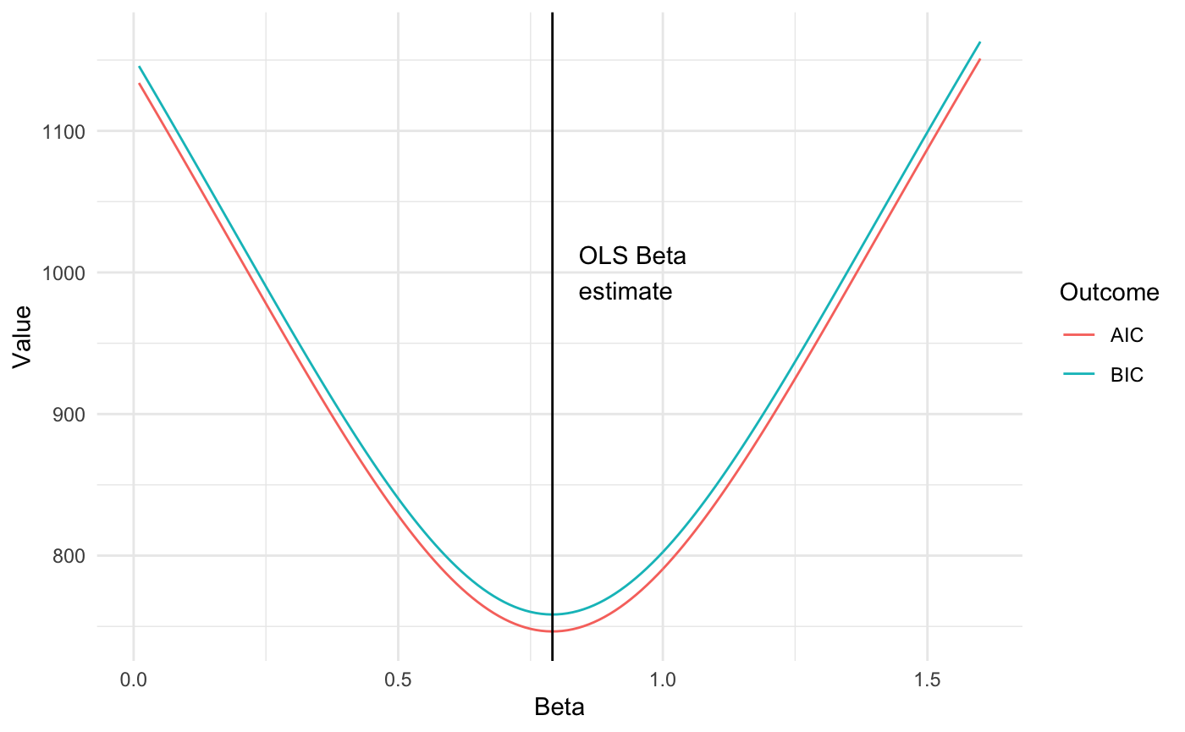
AIC vs. BIC

Slide 25
Mallow's C_{p}
You may also see Mallow's C_{p}; in Gaussian models it is essentially equivalent to AIC for purposes of model selection, so we will not consider it at length.

Slide 26
Four primary measures of model fit:
Outcome | Units | Better values | Penalizes additional terms
R² | 0-1 | Higher | No
Adjusted R² | 0-1 | Higher | Yes
AIC | Arbitrary | Lower | Yes
BIC | Arbitrary | Lower | Yes

Slide 27
Model selection methods

Slide 28
Model selection methods
Domain knowledge assessment of causality
Stepwise procedures
Best subset
Sequential/stepwise
Regularized regression
Lasso
Ridge

Slide 29
Domain knowledge
Next, we will discuss automated variable selection procedures.
This is a very contentious topic among biostatisticians and epidemiologists, and many would argue that subject matter experts are critical in this stage.
Consider the dangers associated with identifying reversed causality or biased (in the sense of sex or race) predictors.
Here are some anonymized quotes from a biostatistics listserv on this topic.

Slide 30
Domain knowledge
"Stepwise, forward, and backward are all demonstrably bad"
"I have no issue with using stepwise as part of an overall strategy but never use automated procedures. For example, I was doing a stepwise procedure yesterday but before I even did it I removed several variables from consideration based on the talking with the SME. I removed a couple of other variables that didn’t make sense to have in the model along with the outcome."

Slide 31
Domain knowledge
"for a data analyst to use stepwise methods is equivalent to telling his or her boss that his or her salary should be cut."
"I still see people using univariable selection/bivariate screening (including only “significant” variables from univariable models in the multivariable model), which I advise against!"

Slide 32
Domain knowledge
“In most situations, subject matter expertise not only provides precedents for regression predictors, but also more importantly a conceptual basis for selection of predictors available in a given dataset.
Automated selection, on the other hand, becomes relevant when a much more agnostic approach is required and there is little to distinguish the value of one candidate predictor from another.
In your situation, are you building a hypothesis-driven regression model or searching with little presumption for a set of predictors?”

Slide 33
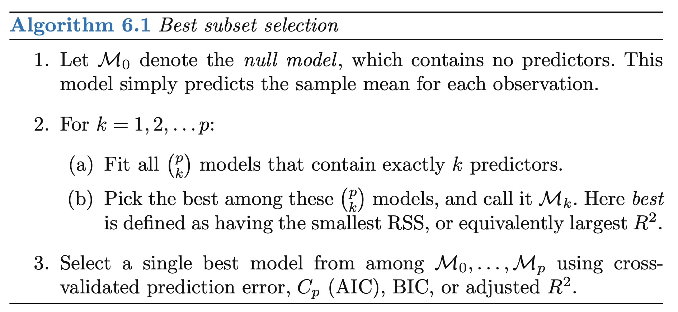
Best subset selection
In best subset selection, separate least squares regressions are identified for each possible combination of the p predictors, and the model with the best performance is chosen.

Slide 34
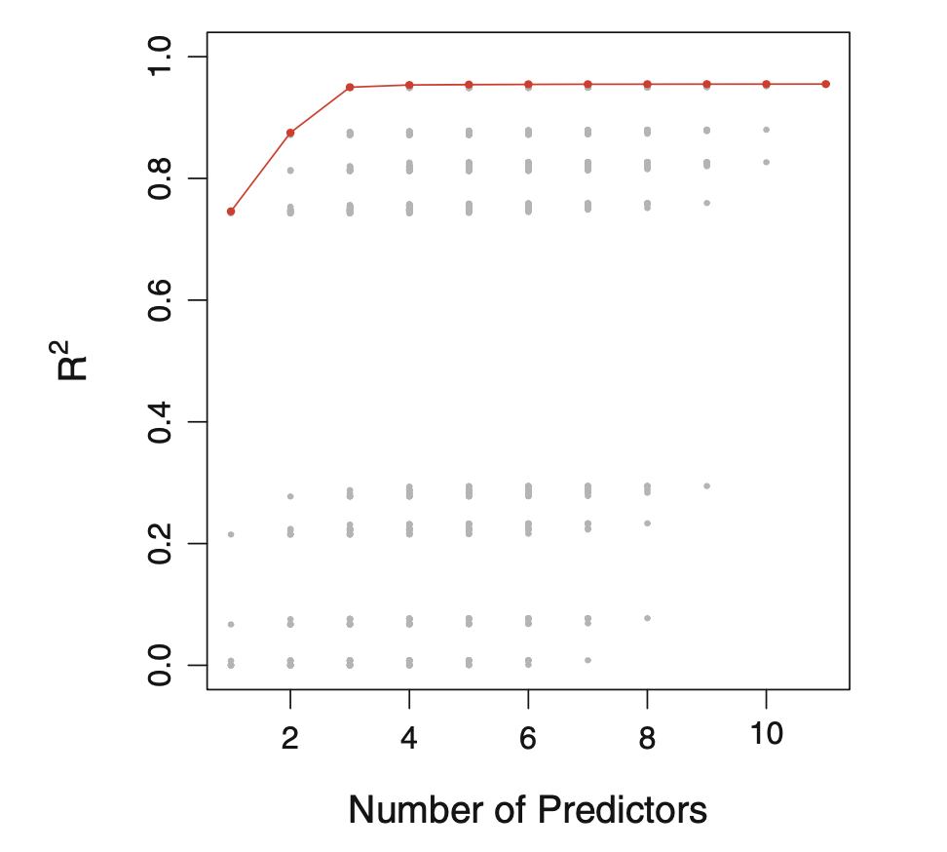
Best subset selection
In best subset selection, separate least squares regressions are identified for each possible combination of the p predictors, and the model with the best performance is chosen.
Here it is clear that most of the insight has been
achieved with a set of 3 predictors.
In interest of parsimony, we probably would not
want to include additional terms.

Slide 35
Best subset selection
In best subset selection, separate least squares regressions are identified for each possible combination of the p predictors, and the model with the best performance is chosen.
What happens when one of the "predictors"
is a set of 3 dummy variables based on race?
Should they be included in an all-or-none fashion?
This is an important choice to make that may
require domain expertise.

Slide 36
Sequential/stepwise selection
If the number of potential predictor variables is large (over 30-40), the combinatorial expansion of predictors can prohibit the best subset procedure even with modern computers.
For a long period "stepwise" approaches were the dominant technique for model selection.
These approaches algorithmically approximate what a naïve analyst might do, given a set of data and told to produce the "best" model.

Slide 37
Forward stepwise selection
Forward stepwise selection is an efficient alternative to best subset selection.
Instead of the 2^{p} candidate models considered in best subset selection, forward stepwise begins with a model containing no predictors, and then adds predictors to the model, one-at-a-time, until all of the predictors are in the model.
In particular, at each step the variable that gives the greatest additional improvement to the fit is added to the model.

Slide 38
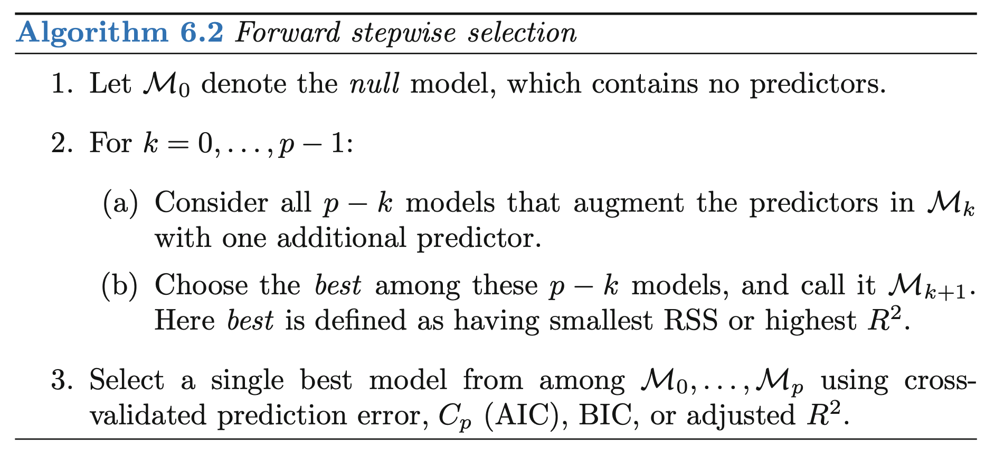
Forward stepwise selection

Slide 39
Forward stepwise selection
In many implementations of stepwise procedures, the analyst sets formal "entry/exit" p-value levels for t-tests on individual parameters.
A common value is alpha=0.15; for example, in step 1, we would regress the dependent variable onto all independent variables one at a time, and then discard any independent variables with p-values greater than the removal level.
If no independent variables survive, we would stop; otherwise we would perform an analogous procedure to step 1 among the remaining variables.

Slide 40
Backward stepwise selection
Backward stepwise selection proceeds in a similar manner; however, we begin with a model containing all predictors and iteratively removes the least useful predictors one-by-one.

Slide 41
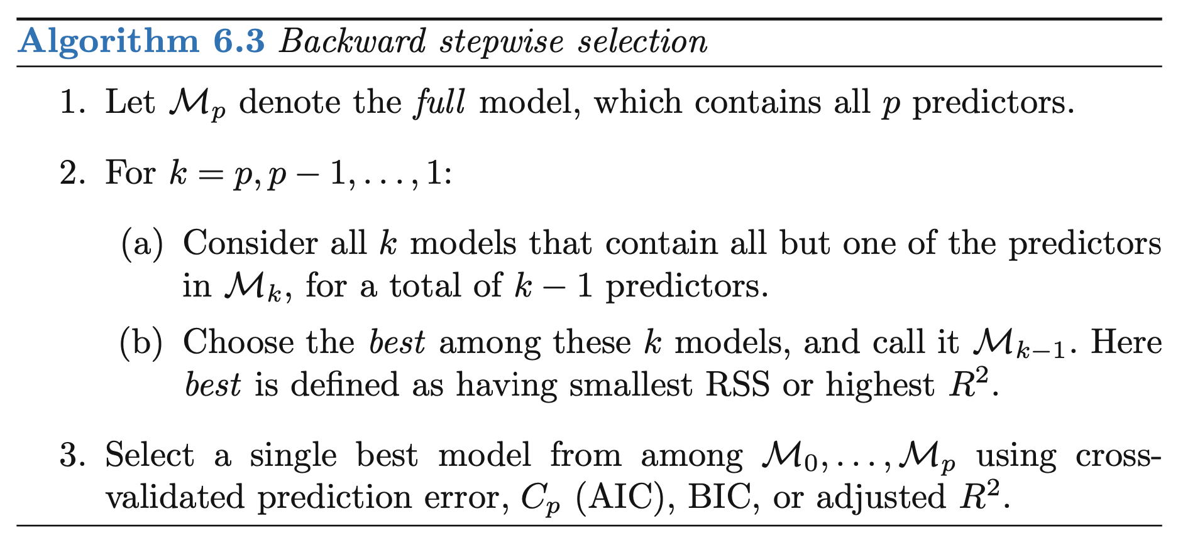
Backward stepwise selection

Slide 42
Regularized regression

Slide 43
Regularized regression
Subset selection methods involve using comparing least squares fits among linear models that contain subsets of candidate predictors.
Alternatively, we could fit a model containing all predictors with a technique that constrains or regularizes the coefficient estimates. This is sometimes called "shrinkage", because it shrinks the coefficient estimates towards zero.
The two best-known techniques for shrinking the regression coefficients towards zero are the lasso and ridge regression.

Slide 44
The 2-norm
Before we go on, let's talk about "norms."
When we minimize the sum of squares of the residuals:
$$RSS=\sum_{i=1}^{n}{{\left(y−\hat{y}\right)}^{2}}$$
We can also be said to be minimizing the "2-norm", sometimes written as:
$$||y−\hat{y}||_{2}$$

Slide 45
The 2-norm
A little detail here: technically the "2-norm" is:
$$||y−\hat{y}||_{2}=\sqrt{\sum_{i=1}^{n}{{\left(y−\hat{y}\right)}^{2}}}$$
Because "norms" must be in the original units of the data. However, in terms of minimization, any choice of parameters, etc. that minimizes the square of the 2-norm will minimize the norm itself, since squaring is a monotonic function.

Slide 46
The 1-norm
So, let’s consider an alternative to the “2-norm” of a vector, the “1-norm”.
Let’s say the 2-norm of some vector $z$ is:
$$||z||_{2}=(z^{T}z)^{\frac{1}{2}}=(z_{1}^{2}+z_{2}^{2}+…+z_{n}^{2})^{\frac{1}{2}}$$
We have used this construction often. The 1-norm is defined as:
$$||z||_{1}=|z_{1}|+|z_{2}|+…+|z_{n}|$$
where $|⋅|$ designates the absolute value. (Or, $|z_{i}|=(z_{i}^{2})^{\frac{1}{2}}$).

Slide 47
Comparing norms
2-norm of the vector $[2,−2,2]^{T}$:
$$(2^{2}+(−2)^{2}+2^{2})^{\frac{1}{2}}={12}^{\frac{1}{2}}≈3.5$$
1-norm of the vector $[2,−2,2]^{T}$:
$$(|2|+|−2|+|2|)=6$$
2-norm of the vector $[\sqrt{6},\sqrt{6},0]^{T}$:
$$({\sqrt{6}}^{2}+{\sqrt{6}}^{2}+0^{2})^{\frac{1}{2}}={12}^{\frac{1}{2}}≈3.5$$
1-norm of the vector $[\sqrt{6},\sqrt{6},0]^{T}$:
$$(|\sqrt{6}|+|\sqrt{6}|+|0|)≈4.9$$

Slide 48
Relation to distances
The 2-norm is also referred to as a "Euclidean" norm, since it is the length of a vector like you might have seen in high school geometry.
The 1-norm is also referred to as a "Manhattan" distance, since it is how you might measure distance if you were walking city blocks.
1-norm = a+b+c
2-norm = d
c
d
b
a

Slide 49
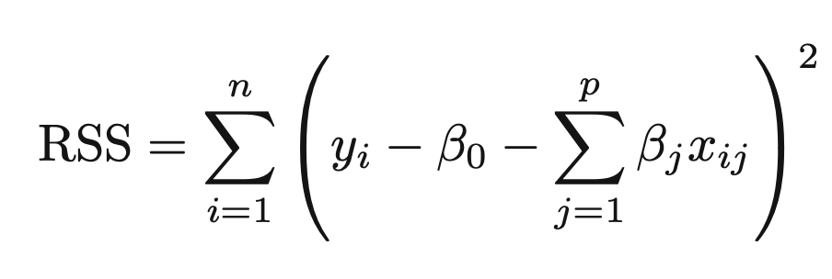
Ridge regression
In typical OLS regression, we minimize:
In Ridge regression, we minimize:

Slide 50
Ridge regression
Note that in the ridge regression equation:
The last term includes a "tuning parameter" $λ$. This is usually determined by sweeping potential values over a range until the resulting model performs in some desired way.
The larger $λ$ is, the higher the penalty on the 2-norm of the vector of regression coefficients. (And so the smaller the betas.)

Slide 51
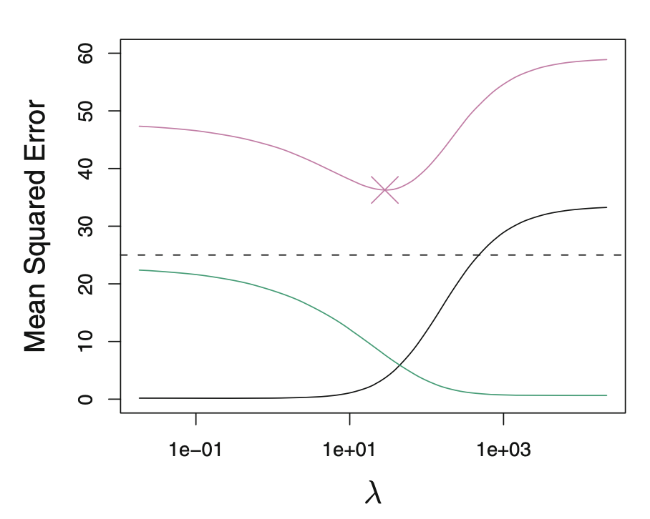
Ridge regression
Why would we want to do this?
When you fit a linear regression to a set of training data, the parameters are biased to fit that particular set of training data.
Penalizing the magnitude of the regression parameters can decrease overfitting and increase out-of-sample performance.
This simulated data from the James text shows the minimum possible out-of-sample mean squared error in the dashed line, and model performance in pink.
It's clear that the best out of sample performance is for lambda around 10-100.
The black and green lines show the bias and the variance of the model parameters, which we'll discuss in a bit.

Slide 52
Lasso regression
In typical OLS regression, we minimize:
In Lasso regression, we minimize:

Slide 53
Lasso regression
Tibshirani and colleagues introduced "Lasso" (Least Absolute Shrinkage and Selection Operator) regression as an approach for model selection when the number of potential predictors was large, and potentially larger than the number of observations.
The Lasso procedure is very popular because it drives many of the coefficients in a regression model to zero.

Slide 54
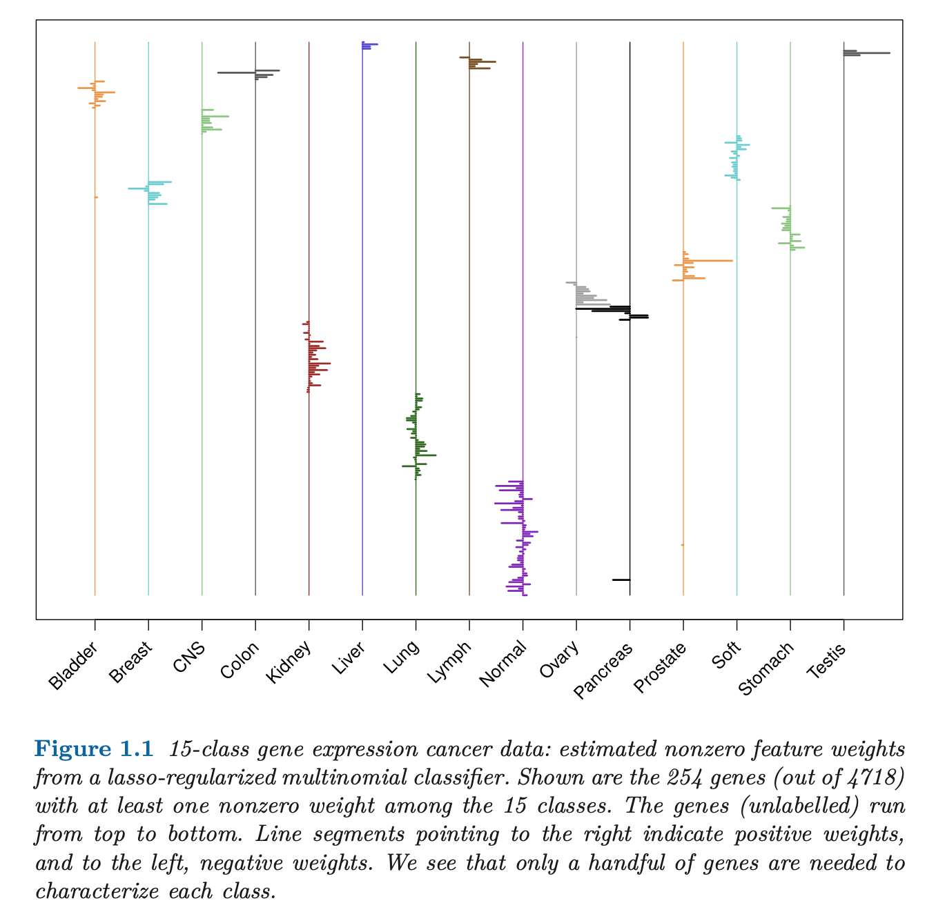
Benefits of the sparsity constraint in the Lasso

Slide 55
The Lagrangian vs. constrained optimization forms of the Lasso
In a constrained optimization context, we often use the method of Lagrange multipliers.
The basic idea is that to enforce constraints on a solution, you express the constraint as an additional equation that must equal 0 to be satisfied. Then you append the constraint to the cost function multiplied by a small (unknown) Lagrange multiplier $λ$. This is quite elegant – at the optimum, the term multiplying the Lagrange multiplier is 0, but it is non-zero during your search. (Or calculation of derivatives.)
$${\text{minimize}}_{β_{0},β}\{\frac{1}{2N}||y−Xβ||_{2}^{2}+λ||β||_{1}\}$$

Slide 56
The Lagrangian vs. constrained optimization forms of the Lasso
In the lasso, or $l_{1}$-regularized regression, we add a constraint on our estimated $β$s during our search. The problem changes from:
$${\text{minimize}}_{β_{0},β}\sum_{i=1}^{N}{(}y_{i}−β_{0}−\sum_{j=1}^{p}{β_{p}}x_{ji})^{2}$$
to:
$${\text{minimize}}_{β_{0},β}\sum_{i=1}^{N}{(}y_{i}−β_{0}−\sum_{j=1}^{p}{β_{p}}x_{ji})^{2}$$
$$\text{such} \text{that}\sum{\left|β_{j}\right|}≤t$$
Where $t$ is a parameter that depends on the problem at hand. This small change may affect our answers a little, or a lot.

Slide 57
Constrained optimization and Lagrangian forms: Ridge
$${\text{minimize}}_{β_{0},β}\{\frac{1}{2N}\sum_{i=1}^{N}{(}y_{i}−β_{0}−\sum_{j=1}^{p}{β_{j}}x_{ij})^{2}\}$$
$$\text{such} \text{that}\sqrt{\sum{β^{2}}}≤t$$
$${\text{minimize}}_{β_{0},β}\{\frac{1}{2N}||y−Xβ||_{2}^{2}+λ||β||_{2}\}$$

Slide 58
The Lagrangian vs. constrained optimization forms of the Lasso
There is a 1:1 correspondence between the constrained optimization formulation of the Lasso equation and the Lagrangian formulation.
For this reason, you will often see the Lasso (and Ridge) formulations presented both ways: as a penalty on the 1-norm ($λ$) or as a maximum value for the 1-norm ($t$).
These are duals and express the same concept. The nice thing about the constrained optimization formulation is that it allows us to draw this picture:

Slide 59
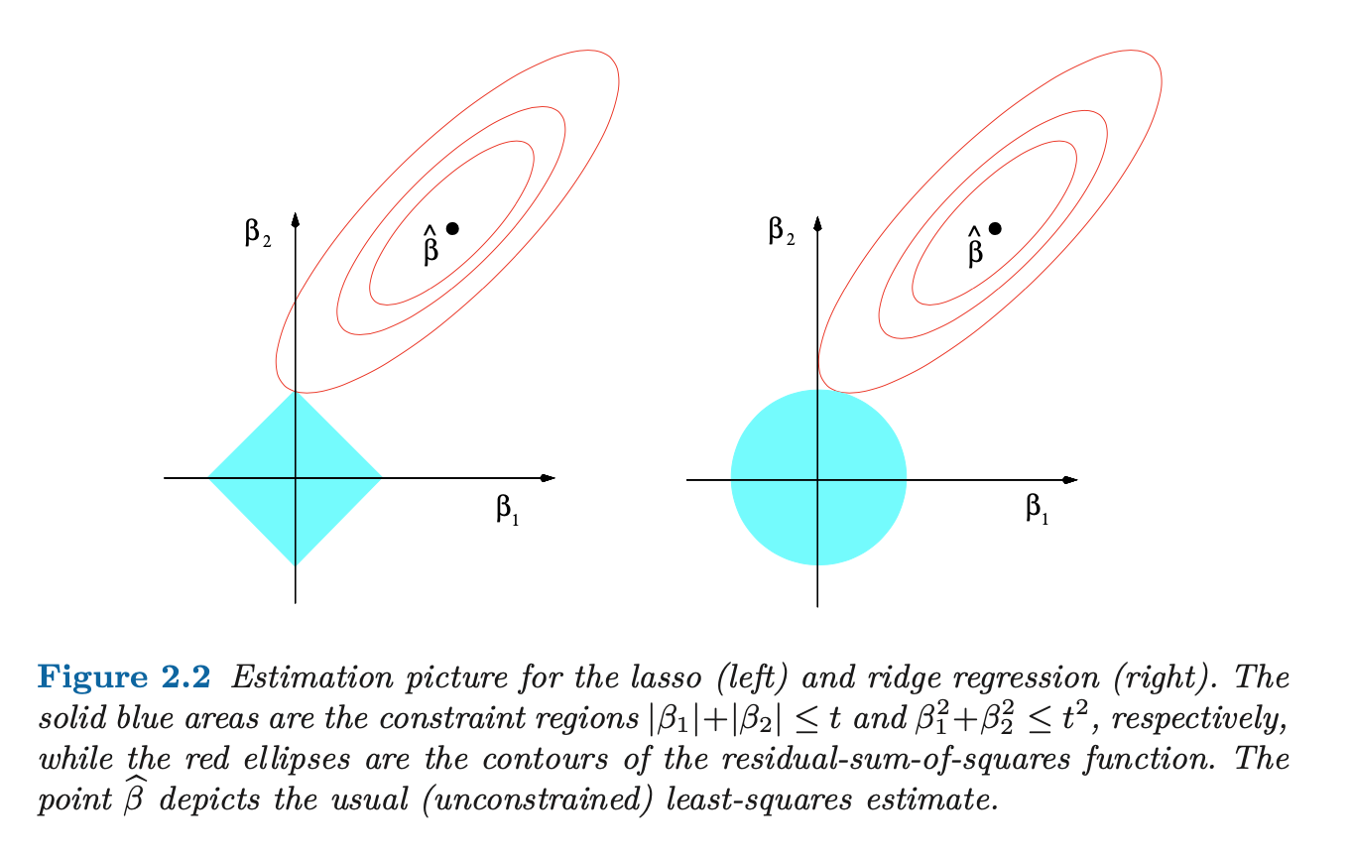
Ridge regression vs. Lasso regression
increasing RSS
increasing RSS
region satisfying
constraint t
region satisfying
constraint t

Slide 60
Ridge regression vs. Lasso regression
increasing RSS
increasing RSS
region satisfying
constraint t
region satisfying
constraint t

Slide 61
A note on units
If, say, the dependent variable was height and the independent variable was age, what units would these two terms be in?
$${\text{minimize}}_{β_{0},β}\{\frac{1}{2N}||y−Xβ||_{2}^{2}+λ||β||_{1}\}$$

Slide 62
A note on units
If, say, the dependent variable was height and the independent variable was age, what units would these two terms be in?
$${\text{minimize}}_{β_{0},β}\{\frac{1}{2N}||y−Xβ||_{2}^{2}+λ||β||_{1}\}$$
What if the different predictors, were, say, age, weight at birth, and paternal height? What units would $λ||β||_{1}$ be in?

Slide 63
A note on units
If, say, the dependent variable was height and the independent variable was age, what units would these two terms be in?
$${\text{minimize}}_{β_{0},β}\{\frac{1}{2N}||y−Xβ||_{2}^{2}+λ||β||_{1}\}$$
What if the different predictors, were, say, age, weight at birth, and paternal height? What units would $λ||β||_{1}$ be in?
Conceptually, mixing units does not make sense. Practically, they are just number variables being manipulated – but if one of the betas dwarfs the other ones, this will dominate the solution!

Slide 64
Always standardize units prior to penalized regression
Both the outcome and predictor variables should be standardized (centered and scaled) prior to doing any of these searches.
Ideally, the centering procedure will allow you to neglect the overall intercept, allowing you to estimate one fewer parameter.

Slide 65
A note on bias
We mentioned that as the lambda parameter is increased, the parameter estimates can become biased. What does that mean exactly?
As the penalty is increased in magnitude, the parameter estimates become more and more strongly biased towards zero.
If the lambda is sufficiently large, the "optimal" solution will be to have all zero coefficients.
This simulated data from the James text shows the minimum possible out-of-sample mean squared error in the dashed line, and model performance in pink.
It's clear that the best out of sample performance is for lambda around 10-100.
The black line shows the bias of the model parameters, which we'll discuss in a bit.

Slide 66
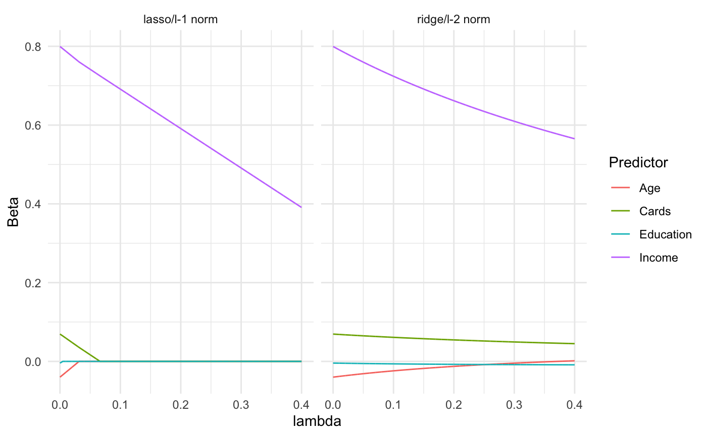
Regularization biases coefficients towards zero

Slide 67
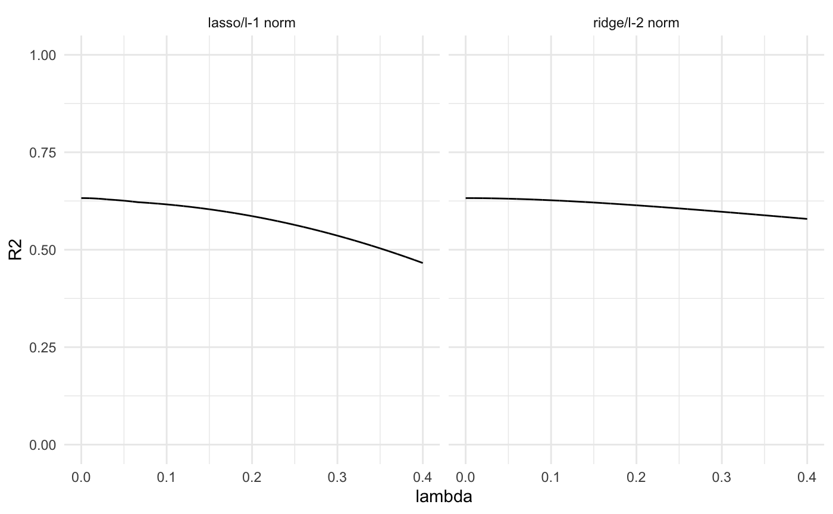
Regularization may exert a weaker effect on R²

Slide 68
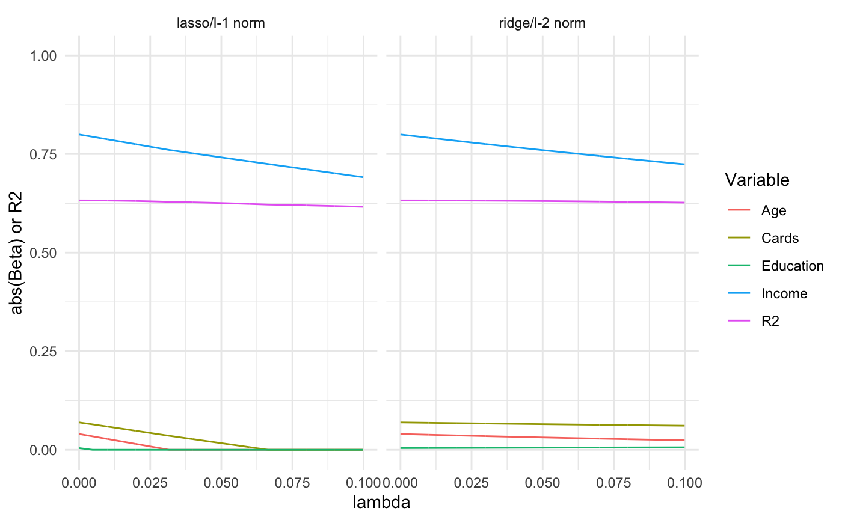
Comparison of coefficient bias and R² with regularization in credit dataset

Slide 69
Regularized regression with categorical predictor variables
Regularized regression with categorical / dummy predictor variables is very problematic, and an active area of research.
Packages like glmnet and LassoCV in Scikit-Learn will create model matrices for you; the details of this are out of scope.
With that said, in pure ML contexts, crude one-hot encoding is used all the time in penalized regression problems with often satisfactory results. Depending on the problem at hand, this may be a solution for you.

Slide 70
Drawbacks of automated model selection procedures

Slide 71
The big picture: two fundamental statistical modeling steps
Fit model parameters to data
Make inferences about models

Slide 72
Drawbacks of automated model selection procedures
Although the stepwise procedures discussed here provide p-values, the lasso and ridge do not. From Dr. Tibshirani:
https://statweb.stanford.edu/~tibs/ftp/covtest.pdf

Slide 73
Drawbacks of automated model selection procedures
Although one could apply statistical tests to the individual predictors identified through lasso/ridge procedures, the fact that the individual predictors have been chosen through some adaptive / greedy process violates the underlying null hypotheses.
For this reason lasso/ridge procedures are uncommon in clinical/epidemiological work where inferences are based on p-values or hypothesis tests; packages like glmnet do not provide p-values.
This is a major consideration when evaluating these techniques as part of your analytical plan.

Slide 74
Outline
Concept of model selection
Measures of model fit
Model selection methods
Domain knowledge assessment of causality
Stepwise procedures for best subset selection
Regularized regression for constraining or eliminating coefficients
Drawbacks of automated model selection procedures

Slide 75
Acknowledgment
Some of this material is adapted from Statistical Learning with Sparsity by Hastie et al. (Available here)

Slide 77
Comparing models
There are other methods of assessing model fit – but they are generally used to compare models, or equivalently, to select among models with a different number of variables.
One is the Akaike Information Criterion (AIC):
$$AIC=−2\ln\left(L\right)+2k$$
Where L is the likelihood and 2k is the number of parameters. Note that the likelihood here is, again, $\sum{ln(P(data|parameters)\text{)}}$, or, equivalently, $\prod{P(data|parameters)}$.

Slide 78
Comparing models
A very similar approach is the Bayesian Information Criterion:
$$BIC=kln\left(n\right)−2ln⁡(L)$$
Both of these can be calculated directly and compared across models. The model that minimizes these (of those hypothesized) is the "best" model, in the sense of the variability captured per parameter.

Slide 79
The role of sparsity in regression
A “sparse” statistical model is one in which a small number of predictors (compared to the number of possible predictors) play an important role.
In linear regression, we observe $N$ observations of an outcome variable $y_{i}$; and p predictors (or features):
$$x_{i}=(x_{i1},x_{i2},⋯,x_{ip})^{T}$$

Slide 80
The role of sparsity in regression
Note:
If the number of samples (or equations) $N$ equals the number of predictors $p$, we have a directly invertible system with one solution vector $β$.
If $N>p$, there is one unique solution that minimizes the squared error $\sum_{i}^{​}{(}y_{i}−\hat{y_{i}})^{2}$, referred to as the “2-norm” $||y−\hat{y}||_{2}$.
If $p>N$, we have a problem of a different nature. There are no unique least-squares estimates of the $β$s.

Slide 81
What the Lasso does
We can see from this equation that the 1-norm of the betas adds to the error that we are trying to minimize.
So, between two sets of betas with the exact same residuals, the one with the smaller 1-norm will win out.
Often this is the sparsest solution, e.g., the one with the fewest nonzero elements.
$${\text{minimize}}_{β_{0},β}\{\frac{1}{2N}||y−Xβ||_{2}^{2}+λ||β||_{1}\}$$

