Slide 1
BMI 510: Linear Regression III
J. Lucas McKay, Ph.D., M.S.C.R.
Departments of Biomedical Informatics and Neurology, Emory University, Atlanta, GA USA
Department of Biomedical Engineering, Georgia Institute of Technology, Atlanta, GA, USA

Slide 2
Outline
More examples of fitting model parameters to the design matrix X
Review of methods of testing
Additional terms: multiple linear regression
Categorical variables
Interaction terms

Slide 3
The big picture: two fundamental statistical modeling steps
Fit model parameters to data
Make inferences about models

Slide 4
Sales vs. advertising
Simple linear regression lives up to its name: it is a very straightforward approach for predicting a quantitative response $Y$ on the basis of a single predictor variable $X$. It assumes that there is approximately a linear relationship between $X$ and $Y$. Mathematically, we can write this linear relationship as:
$$Y≈β_{0}+β_{i}X$$
You might read $≈$ as “is approximately modeled as”. We can describe this relationship by saying that we are regressing $Y$ onto $X$.
For example, $X$ may represent TV advertising budget and $Y$ may represent sales. Then we can regress $sales$ onto $TV$ by fitting the model $sales≈β_{0}+β_{1}TV$.

Slide 5
Sales vs. advertising
$$Y≈β_{0}+β_{i}X$$
In this equation, $β_{0}$ and $β_{1}$ are two unknown constants that represent the intercept and slope terms in the linear model.
Together, $β_{0}$ and $β_{1}$ are known as the model parameters. Once we have used our training data to produce estimates ${\hat{β}}_{0}$ and ${\hat{β}}_{1}$ for the model parameters, we can predict future sales on the basis of a particular value of TV advertising by computing $\hat{y}={\hat{β}}_{0}+{\hat{β}}_{1}x$.
Here we use a hat symbol to denote the estimated value for an unknown parameter or coefficient, or to denote the predicted value of the response.

Slide 6
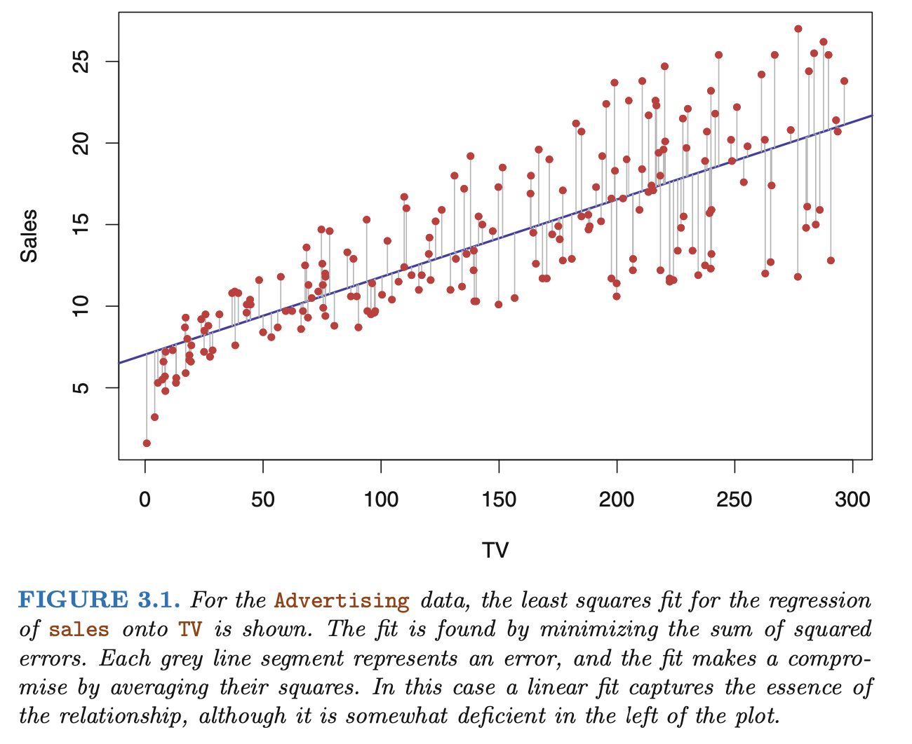
An Introduction to Statistical Learning - James

Slide 7
Fitting the parameters
In linear regression, we can typically identify estimates of the model parameters using a set of training data and the "normal equations," which we went through at some length.

Slide 8
The design matrix
$$Y≈β_{0}+β_{i}X$$
In order to solve this equation in matrix form, we will create a “design matrix” by pre-pending a column of ones to the $X$ vector.
$$Y≈\left[\begin{matrix}1 & x_{1} \\ 1 & x_{2} \\ ⋮ & ⋮ \\ 1 & x_{i}\end{matrix}\right]\left[\begin{matrix}β_{0} \\ β_{1}\end{matrix}\right]$$
We will often just refer to the design matrix as $X$, which, although a little imprecise, will make sense later.
$$Y≈Xβ$$

Slide 9
A very small (invertible) example
Let’s consider the following system of equations:
$$\left[\begin{matrix}7 \\ 11\end{matrix}\right]≈\left[\begin{matrix}1 & 1 \\ 1 & 2\end{matrix}\right]\left[\begin{matrix}β_{0} \\ β_{1}\end{matrix}\right]$$
What are the parameters of this model? It corresponds to the following system of equations, which has two equations and two unknowns. This is, of course, a nonsingular (invertible) matrix.
$$\left[\begin{matrix}7 \\ 11\end{matrix}\right]≈\begin{matrix}1⋅β_{0} & + & 1⋅β_{1} \\ 1⋅β_{0} & + & 2⋅β_{1}\end{matrix}$$

Slide 10
A very small (invertible) example
$$\left[\begin{matrix}7 \\ 11\end{matrix}\right]=\left[\begin{matrix}1 & 1 \\ 1 & 2\end{matrix}\right]\left[\begin{matrix}β_{0} \\ β_{1}\end{matrix}\right]$$
$$\left[\begin{matrix}7 \\ 11\end{matrix}\right]=X\left[\begin{matrix}β_{0} \\ β_{1}\end{matrix}\right]$$
$$X^{−1}\left[\begin{matrix}7 \\ 11\end{matrix}\right]=X^{−1}X\left[\begin{matrix}β_{0} \\ β_{1}\end{matrix}\right]$$
$$\left[\begin{matrix}2 & −1 \\ −1 & 1\end{matrix}\right]\left[\begin{matrix}7 \\ 11\end{matrix}\right]=\left[\begin{matrix}β_{0} \\ β_{1}\end{matrix}\right]=\left[\begin{matrix}3 \\ 4\end{matrix}\right]$$
$$\left[\begin{matrix}β_{0} \\ β_{1}\end{matrix}\right]=\left[\begin{matrix}3 \\ 4\end{matrix}\right]$$

Slide 11
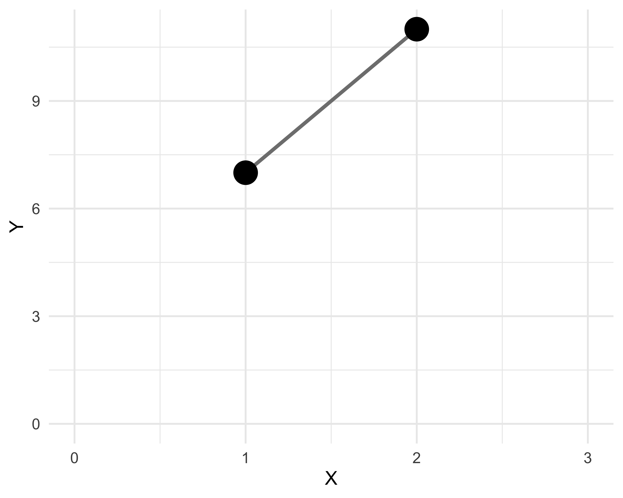
Our answer

Slide 12
Predicting new values
We can use our new regression model to predict new $Y$ values $Y_{new}$ that would correspond to new $X$ values $X_{new}$:
$$Y_{new}=X_{new}β$$

Slide 13
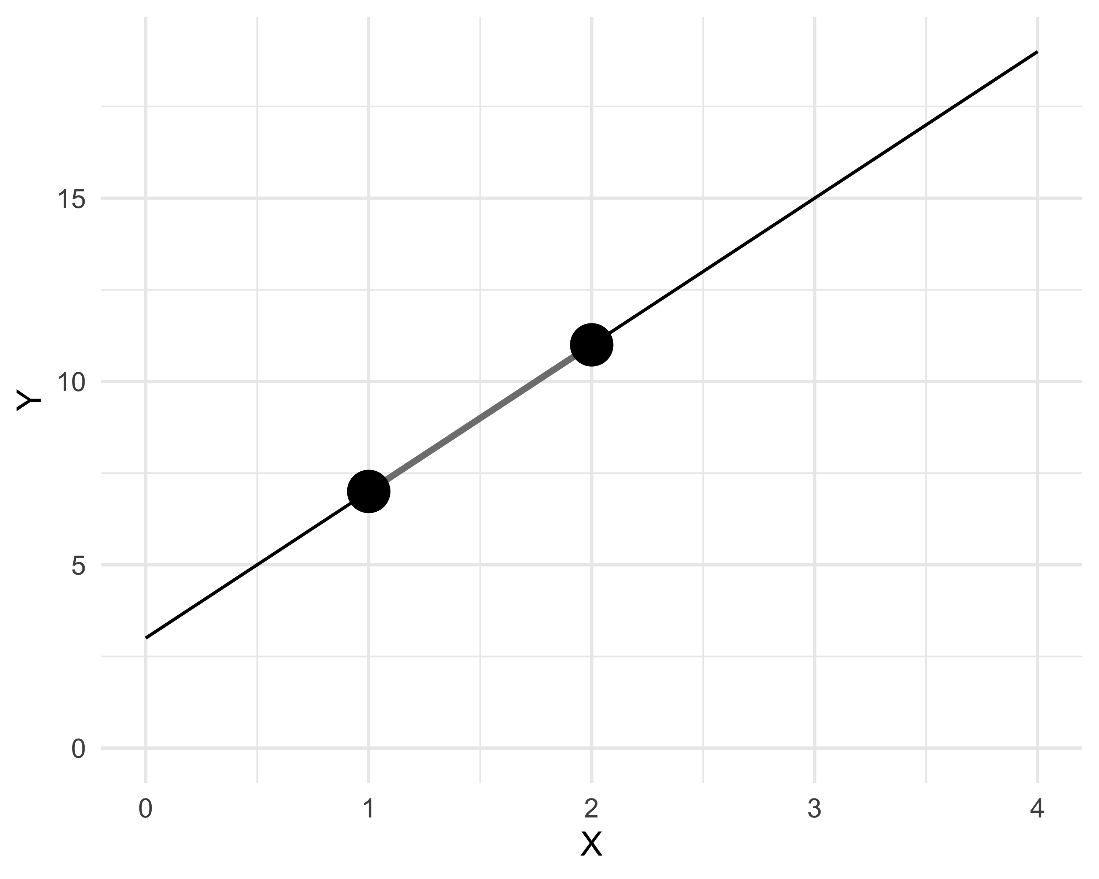
Predicting new values

Slide 14
A differently-shaped example
However, in most cases, the number of equations does not match the number of unknowns, we are unable to directly invert $X$ to create $X^{−1}$.
So we rely on the fact that - for any full-rank matrix $X$, the crosspoduct matrix $X^{T}X$ is symmetric and invertible. Let’s consider this system:
$$\left[\begin{matrix}7 \\ 11 \\ 14\end{matrix}\right]=\left[\begin{matrix}1 & 1 \\ 1 & 2 \\ 1 & 3\end{matrix}\right]\left[\begin{matrix}β_{0} \\ β_{1}\end{matrix}\right]$$
It is clear that we cannot premultiply both sides by $X^{−1}$, because the matrix is not square, and $X^{−1}$ does not exist!

Slide 15
A differently-shaped example
There is a wide range of research into generalized inverses if you are interested, but the ordinary least squares equations represent the simplest and most common one.
$$X^{T}\left[\begin{matrix}7 \\ 11 \\ 14\end{matrix}\right]=X^{T}X\left[\begin{matrix}β_{0} \\ β_{1}\end{matrix}\right]$$
Note that here, the crossproduct matrix $X^{T}X$ is square and invertible:
$$X^{T}X=\left[\begin{matrix}3 & 6 \\ 6 & 14\end{matrix}\right]$$

Slide 16
A differently-shaped example
So we can premultiply both sides by the inverse of the crossproduct matrix:
$$(X^{T}X)^{−1}X^{T}\left[\begin{matrix}7 \\ 11 \\ 14\end{matrix}\right]=(X^{T}X)^{−1}X^{T}X\left[\begin{matrix}β_{0} \\ β_{1}\end{matrix}\right]$$
What does $(X^{T}X)^{−1}X^{T}X$ equal?
$$(X^{T}X)^{−1}X^{T}\left[\begin{matrix}7 \\ 11 \\ 14\end{matrix}\right]=\left[\begin{matrix}β_{0} \\ β_{1}\end{matrix}\right]$$

Slide 17
A differently-shaped example
$$(X^{T}X)^{−1}X^{T}\left[\begin{matrix}7 \\ 11 \\ 14\end{matrix}\right]=\left[\begin{matrix}β_{0} \\ β_{1}\end{matrix}\right]$$
$$\left[\begin{matrix}1.33 & 0.33 & −0.67 \\ −0.5 & 0.0 & 0.5\end{matrix}\right]\left[\begin{matrix}7 \\ 11 \\ 14\end{matrix}\right]=\left[\begin{matrix}β_{0} \\ β_{1}\end{matrix}\right]$$
$$\left[\begin{matrix}β_{0} \\ β_{1}\end{matrix}\right]=\left[\begin{matrix}3.67 \\ 3.50\end{matrix}\right]$$

Slide 18
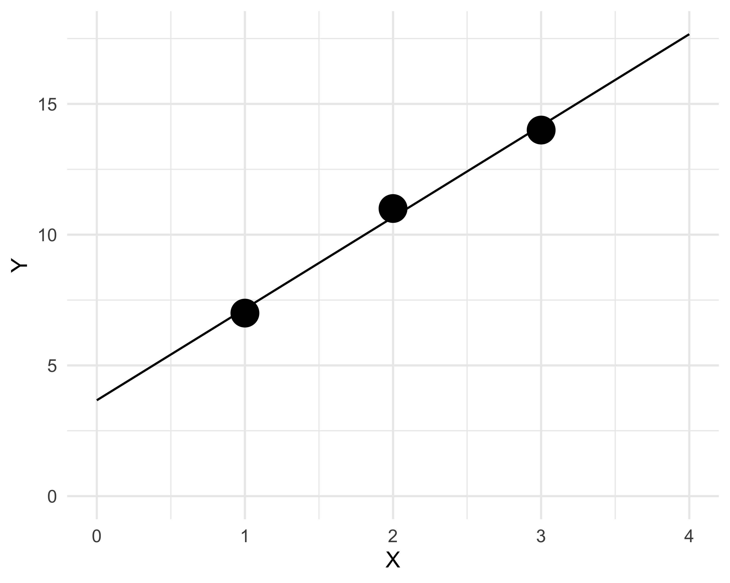
A differently-shaped example
Note that in this case, the predicted values $\hat{y}$ no longer directly lie on the best-fit line. This is because there is no set of parameters $β_{0}$,$β_{1}$ that will satisfy all three equations.

Slide 19
Outline
More examples of fitting model parameters to the design matrix X
Review of methods of testing
Additional terms: multiple linear regression
Categorical variables
Interaction terms

Slide 20
The (potential) need to test
Note that everything we have done so far has just involved fitting / estimating the regression parameters. There were no statistics involved!
However, even if the least squares point estimates are not equal to 0, that does not mean that the population values of the slope and y-intercept are not 0.
After obtaining the point estimates of the true slope and y-intercept, we may need to perform hypothesis tests to determine whether the population slope and y intercept are significantly different from 0.

Slide 21
The (potential) need to test
To do these tests, we could ask:
Whether the two parameters in the model explain more of the sum of squares than would be expected by chance, given an additional estimate of the error variance (an F test on the whole model)
How likely it would be to obtain an observation of either of the parameters ≥ the value of our point estimates, given an additional estimate of the parameter standard errors (t tests on the parameters)

Slide 22
Methods of testing
Assuming that the number of observations is $n$ and the number of parameters (in this case, 2) is $p$, and the residual sum of squares is:
$$RSS=∑(y_{i}−\hat{y_{i}})^{2}$$
There are two ways to calculate p-values for the model.

Slide 23
Methods of testing
Method 1: Calculate an F statistic:
$$F=\frac{{Model Sum of Squares}/{p−1}}{{Residual Sum of Squares}/{n−p}}$$
This will be a unitless number distributed as an F with p-1 and n-p degrees of freedom.

Slide 24
Methods of testing
Method 1: Calculate an F statistic:
$$F=\frac{{Model Sum of Squares}/{p−1}}{{Residual Sum of Squares}/{n−p}}$$
Note that this depends very strongly on the Residuals!
$$F=\frac{{Total Sum of Squares −Residual Sum of Squares}/{p−1}}{{Residual Sum of Squares}/{n−p}}$$

Slide 25
Methods of testing
Method 2: Calculate a t statistic for the slope.
$$t=\frac{\hat{β_{i}}}{s\sqrt{c_{ii}}}$$
Will be a unitless number distributed as a t with n-p degrees of freedom.

Slide 26
Methods of testing
Method 2: Calculate a t statistic for the slope.
$$t=\frac{\hat{β_{i}}}{s\sqrt{c_{ii}}}$$
Will be a unitless number distributed as a t with n-p degrees of freedom.
Note that $c_{ii}$ is the $i^{th}$ diagonal element of $C=(X^{T}X)^{−1}$.

Slide 27
Methods of testing
Method 2: Calculate a t statistic for the slope.
$$t=\frac{\hat{β_{i}}}{s\sqrt{c_{ii}}}$$
Will be a unitless number distributed as a t with n-p degrees of freedom.
Note that this test also depends very strongly on the Residuals! This is because $s=\sqrt{\frac{RSS}{n−p}}$.

Slide 28
Methods of testing
A note on nomenclature:
Throughout the class we have used p to indicate the number of parameters, e.g., a slope and intercept is 2 parameters.
The James text uses p as the number of predictor variables, e.g., a slope and intercept is 1 predictor variable.
Be careful with this!

Slide 29
Outline
More examples of fitting model parameters to the design matrix X
Review of methods of testing
Additional terms: multiple linear regression
Categorical variables
Interaction terms

Slide 30
Additional terms: multiple regression
Simple linear regression is a useful approach for predicting a response on the a basis of a single predictor variable. However, in practice we often have more than one predictor. For example, in the advertising data, we found a relationship between sales and TV advertising budget.
We also have data for the amount of money spent advertising on the radio and in newspapers, and we may want to know whether either of these two media is associated with sales. How can we extend our analysis of the advertising data in order to accommodate these two additional predictors?

Slide 31
Additional terms: multiple regression
One option is to run three separate simple linear regressions, each of which uses a different advertising medium as a predictor. For instance, we can fit a simple linear regression to predict sales on the basis of the amount spent on radio advertisements.
We find that the return on investment for radio is ≈200 units / $1k advertising dollars, and the return on investment for newspaper is ≈ 55 units / $1k advertising dollars.

Slide 32
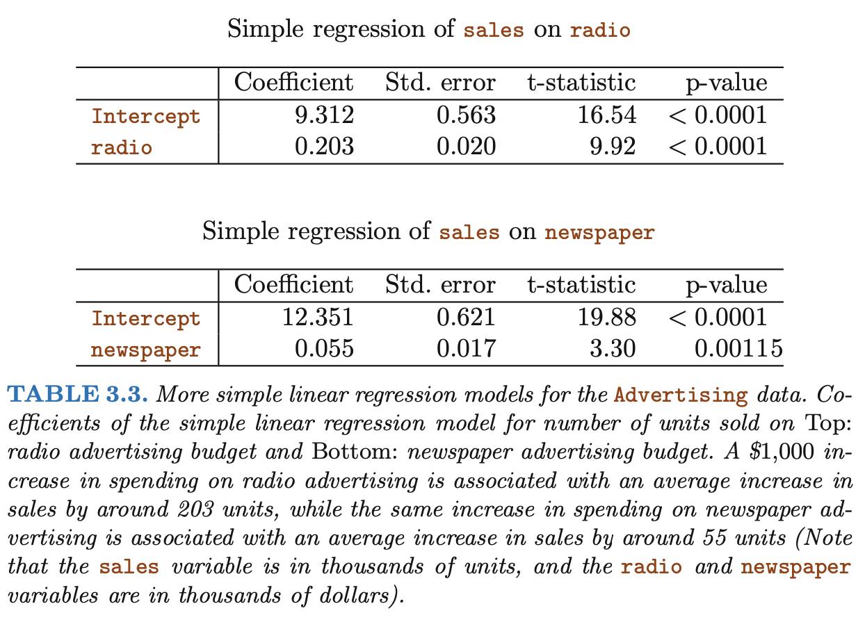
Additional terms: multiple regression

Slide 33
Multiple regression
The approach of fitting a separate simple linear regression model for each predictor is not entirely satisfactory, because:
It is unclear how to make a single prediction of sales given levels of the three advertising media budgets, since each of the budgets is associated with a separate regression equation.
Each of the three regression equations ignores the other two media in forming estimates for the regression coefficients. This can lead to very misleading estimates of the individual media effects on sales.

Slide 34
Multiple regression
Instead of fitting a separate simple linear regression model for each predictor, a better approach is to extend the simple linear regression model so that it can directly accommodate multiple predictors.
We can do this by giving each predictor a separate slope coefficient in a single model:
$$sales=β_{0}+β_{TV}TV+β_{Radio}Radio+β_{Newspaper}Newspaper+ε$$

Slide 35
Multiple regression
Although the model has additional terms, the procedure for identifying the beta hats and performing tests is exactly the same as in the simple linear regression case.
$$sales=β_{0}+β_{TV}TV+β_{Radio}Radio+β_{Newspaper}Newspaper+ε$$
How many columns will the design matrix have?

Slide 36
Multiple regression
Although the model has additional terms, the procedure for identifying the beta hats and performing tests is exactly the same as in the simple linear regression case.
$$sales=β_{0}+β_{TV}TV+β_{Radio}Radio+β_{Newspaper}Newspaper+ε$$
Will the slope estimates be the same as the estimates from separate linear regressions?

Slide 37
Multiple regression
Simple regression of Sales onto Newspaper Budget
Multiple regression of Sales onto all budget domains

Slide 38
Multiple regression
Note that including the other variables in the regression has completely eliminated the estimated effect of newspaper advertising on sales.
The slope goes from a small positive number to essentially 0, and the t-test p-value goes from highly statistically-significant to negligible (P=0.86).
In the simple linear regression case, the slope term represents the average effect of a $1,000 increase in newspaper advertising, ignoring other predictors such as TV and radio, but, in the multiple regression setting, the coefficient for newspaper represents the average effect of increasing newspaper spending by $1,000 while holding TV and radio fixed.

Slide 39
Multiple regression
Does it make sense for the multiple regression to suggest no relationship between sales and newspaper while the simple linear regression implies the opposite? In fact it does.
The correlation between radio and newspaper is 0.35; we spend more on newspaper advertising in markets where more is spent on radio advertising.

Slide 40
Multiple regression
Does it make sense for the multiple regression to suggest no relationship between sales and newspaper while the simple linear regression implies the opposite? In fact it does.
In a simple linear regression which only examines sales versus newspaper, we will observe that higher values of newspaper tend to be associated with higher values of sales, even though newspaper advertising does not actually affect sales.
So newspaper sales are a surrogate for radio advertising; newspaper gets "credit" for the effect of radio on sales.
In other words, the association between sales and newspaper advertising is confounded by radio advertising.

Slide 41
Key definitions
Null hypothesis
The conditions under which an analyst proposes chance alone might generate (or have generated) a group of observations
Statistical test
A tool used to help make a decision about a null hypothesis
t, chi-squared, F, likelihood ratio, Wald
Confound
A variable that is associated with the exposure and the outcome that is not a consequence of the outcome

Slide 42
Overall F test for multiple regression
The overall F test evaluates the null hypothesis that all of the model coefficients (barring the intercept) are zero. It is assembled analogously to the simple linear regression case.
With k predictor variables and n samples:
Source of Variation | Degrees of freedom | Sum of Squares | Mean Square | F
Model | k | TOTSS-RSS | Divide by k | Divide
Residuals | n-k-1 | RSS = $\sum{{\left(y_{i}−\hat{y_{i}}\right)}^{2}}$ | Divide by n-k-1
Total | n-1 | TOTSS = $\sum{{\left(y_{i}−\overline{y}\right)}^{2}}$

Slide 43
Partial tests in multiple regression
As in the simple linear regression, each slope can be compared to zero with a t-test where the standard error is as we have described.
We will do a few examples, but this is often left to software, especially for more complex models.

Slide 44
Tests of subsets of parameters
Often, predictor variables can be linked in some way to aid in decision making. For example, in the advertising data you might want to test the hypothesis that all of the advertising types other than TV were unassociated with Sales.
To assess this, you can create a second (sub) model with only the terms you want to keep and compare the residual sum of squares.

Slide 45
Tests of subsets of parameters
Which model will have the higher amount of explained variation TOTSS-RSS?
Full
Reduced
Which model will have the higher RSS?
Full
Reduced

Slide 46
Tests of subsets of parameters
Which model will have the higher amount of explained variation TOTSS-RSS?
Full
Reduced
Which model will have the higher RSS?
Full
Reduced

Slide 47
Tests of subsets of parameters
So, if you would like to test the impact of, say, a set of q variables on the overall explained variation, you could calculate an F-statistic as follows:
$$F=\frac{{({RSS}_{reduced}−{RSS}_{full})}/q}{{{RSS}_{full}}/{(n−p)}}$$
Where p is the number of parameters in the full model.

Slide 48
Tests of subsets of parameters
Equivalently to the F test, we can use a "Likelihood Ratio Test" to compare reduced and full models.
$$LR=−2\ln\left(\frac{L\left(m_{reduced}\right)}{L\left(m_{full}\right)}\right)=2\left(ln\left(L(m_{full})\right)−ln\left(L(m_{reduced})\right)\right)$$
This statistic is distributed as a chi-squared with degrees of freedom equal to the reduction in parameters from the full to the reduced model.

Slide 49
Calculating likelihood
To calculate the (log) likelihood of the test data given the parameters of the model, we need only consider the residuals.
Remember that the error term is normally distributed with mean zero and constant standard deviation:
$$s=\sqrt{\frac{RSS}{n−p}}$$
Where p is the number of betas (including the intercept). Once this parameter is fit we can calculate the likelihood of the residuals as though we were parameterizing a normal distribution.

Slide 50
Assessing model fit
The main way we explain the quality of a linear regression model fit is the $R^{2}$ statistic:
$$R^{2}=\frac{TSS−RSS}{TSS}$$
Where $TSS$ is the total sum of squares, and $RSS$ is the residual sum of squares.
There are a lot of caveats to using the coefficient of determination, as discussed. One nice enhancement is the adjusted $R^{2}$, which includes a correction for the number of regressors.

Slide 51
Assessing model fit
The main way we explain the quality of a linear regression model fit is the $R^{2}$ statistic:
$$R^{2}=\frac{TSS−RSS}{TSS}$$
With many clinical/epidemiological studies, the objective is not necessarily to explain all of the variance in the data, but to ask if individual predictors explain more variance than might be expected by chance.
If your study question seems to hinge on a goodness of fit metric, see if you can reformulate it to a hypothesis test.

Slide 52
Assessing model fit
The main way we explain the quality of a linear regression model fit is the $R^{2}$ statistic:
$$R^{2}=\frac{TSS−RSS}{TSS}$$
Alternatively, if you are building some sort of predictive system, if the goodness of fit is low the predictions will be inaccurate.
So it is important to consider goodness of fit in the context of the scientific question.

Slide 53
Comparing models
There are other methods of assessing model fit – but they are generally used to compare models, or equivalently, to select among models with a different number of variables.
One is the Akaike Information Criterion (AIC):
$$AIC=−2\ln\left(L\right)+2k$$
Where L is the likelihood and 2k is the number of parameters. Note that the likelihood here is, again, $\sum{ln(P(data|parameters)\text{)}}$, or, equivalently, $\prod{P(data|parameters)}$.

Slide 54
Comparing models
A very similar approach is the Bayesian Information Criterion:
$$BIC=−2\ln\left(L\right)+kln\left(n\right)$$
Both of these can be calculated directly and compared across models. The model that minimizes these (of those hypothesized) is the "best" model, in the sense of the variability captured per parameter.

Slide 55
A note on In- and Out- of sample variability
When we fit a regression model to a set of (training) data, the fit will almost always be lower on test data.
While maximizing $R^{2}$ maximizes the fit to the training data – which may lead to overfitting – the information criteria just described are intended to represent out of sample performance.

Slide 56
A drawback of AIC / BIC criteria
You will remember from likelihood calculations that we have done that the numbers that result are not particularly intuitive.
For this reason, R² remains probably the most intuitive description of model fit - it varies between 0 and 1.

Slide 57
Outline
More examples of fitting model parameters to the design matrix X
Review of methods of testing
Additional terms: multiple linear regression
Categorical variables
Interaction terms

Slide 58
Polynomial and other terms
You may include whatever terms you like in the design matrix. For parsimony, linear terms are by far the most common.
You may do this by building a design matrix as follows:
$$y=\left[\begin{matrix}1 & x_{1} & x_{1}^{2} \\ 1 & x_{2} & x_{2}^{2} \\ 1 & x_{3} & x_{3}^{2} \\ ⋮ & ⋮ & ⋮ \\ 1 & x_{n} & x_{n}^{2}\end{matrix}\right]β+ε$$
Although the outcome variable now depends on the square of x, this remains a linear model with three parameters.

Slide 59
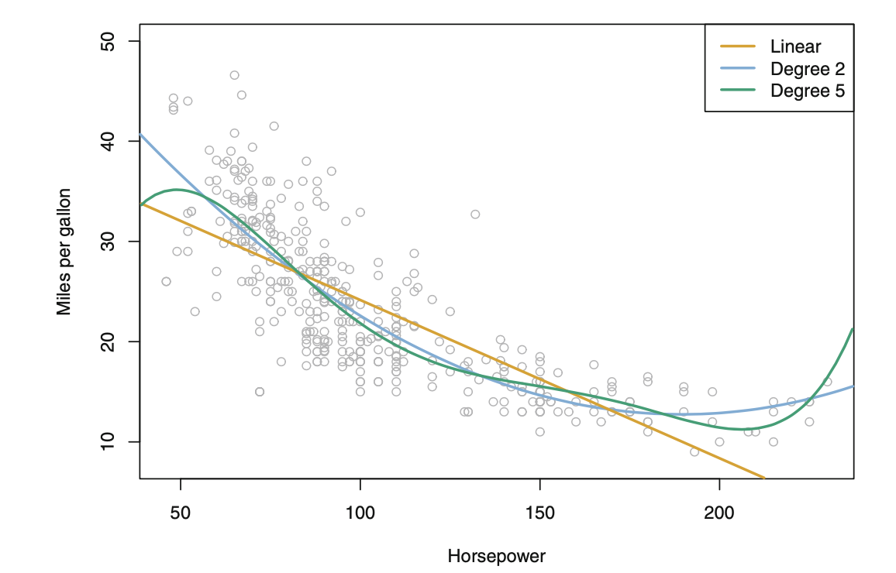
Polynomial and other terms

Slide 60
Categorical variables
Categorical variables can be included in the design matrix easily.
Consider a pediatric study of growth rates in male and female children with variables height, age, and sex. We might fit the following model:
$$height=β_{0}+β_{1}Age+β_{Male}Male+ε$$
What does $β_{0}$ represent?
What does $β_{1}$ represent?
What does $β_{Male}$ represent?

Slide 61
Categorical variables
Let’s say that we found that our study, which considered a very narrow age range, was such that the term $β_{1}$ was not statistically significant. We would fit the following model:
$$height=β_{0}+β_{Male}Male+ε$$
What does $β_{0}$ represent? Is it the same as before?

Slide 62
Categorical variables
Let’s say we had the previous model and the following design matrix:
$$\left[\begin{matrix}1 & 4 & 1 \\ 1 & 4.5 & 1 \\ 1 & 2 & 0 \\ 1 & 2.5 & 0 \\ 1 & 3 & 1\end{matrix}\right]$$
Who are the participants?

Slide 63
Categorical variables
Let’s say we had the previous model and the following design matrix:
$$\left[\begin{matrix}1 & 4 & 1 \\ 1 & 4.5 & 1 \\ 1 & 2 & 0 \\ 1 & 2.5 & 0 \\ 1 & 3 & 1\end{matrix}\right]$$
Who are the participants?
$$\left[\begin{matrix}\text{4 }\text{year} \text{old} \text{male} \\ \text{4.5 }\text{year} \text{old} \text{male} \\ \text{2 }\text{year} \text{old} \text{female} \\ \text{2.5 }\text{year} \text{old} \text{female} \\ \text{3 }\text{year} \text{old} \text{male}\end{matrix}\right]$$

Slide 64
Categorical variables
Let’s say that instead of aging we were studying time to death in a cancer study with stage at diagnosis (I-IV) as a covariate.
For this, we might consider stage I to be the reference group, and then create dummy variables to indicate the other stages.
The model might be:
$$\text{longevity}=β_{0}+β_{1}\text{Age} \text{at} \text{diagnosis}$$
$$+β_{II}\text{Stage} \text{II}+β_{III}\text{Stage} \text{III}+β_{IV}\text{Stage} \text{IV}+ε$$

Slide 65
Categorical variables
And the design matrix might look like:
$$\left[\begin{matrix}1 & 76 & 0 & 0 & 0 \\ 1 & 56 & 0 & 1 & 0 \\ 1 & 45 & 1 & 0 & 0 \\ & & \text{etc}\text{.} & & \end{matrix}\right]$$
Which would be
$$\left[\begin{matrix}\text{76} \text{year} \text{old} \text{Stage} \text{I} \\ \text{56} \text{year} \text{old} \text{Stage} \text{III} \\ \text{45} \text{year} \text{old} \text{Stage} \text{II}\end{matrix}\right]$$

Slide 66
Interaction terms
The last and most interesting topic we’ll discuss is interaction terms. Interaction terms are a very natural way to evaluate scientific hypotheses. Say, for example, we return to our aging study.
$$height=β_{0}+β_{1}Age+β_{Male}Male+ε$$
What is the rate of change of height, in cm/years or similar units?
Is the average height the same in males and females (assuming $β_{Male}$ is statistically-significant)?
Is the rate of change in height the same in males and females (assuming $β_{Male}$ is statistically-significant)?

Slide 67
Interaction terms
What about this model:
$$height=β_{0}+β_{1}Age+β_{Male}Male+β_{MA}Male⋅Age+ε$$
Assuming that all of the terms are statistically-significant,
Is the rate of change in height the same in males and females?
By comparing $β_{MA}$ to zero we can test the hypothesis that the rate of change in height differs between males and females.

Slide 68
Outline
More examples of fitting model parameters to the design matrix X
Review of methods of testing
Additional terms: multiple linear regression
Categorical variables
Interaction terms

Slide 69
Acknowledgment
Some of the figures in this presentation are taken from “An Introduction to Statistical Learning, with applications in R” (Springer, 2013) with permission from the authors: G. James, D. Witten, T. Hastie and R. Tibshirani.

