Slide 1
BMI 510: Linear Regression II
J. Lucas McKay, Ph.D., M.S.C.R.
Departments of Biomedical Informatics and Neurology, Emory University, Atlanta, GA USA
Department of Biomedical Engineering, Georgia Institute of Technology, Atlanta, GA, USA

Slide 2
Outline
Resuming where we left off
Additional formulae for standard errors for the betas
Confidence intervals for the betas
Model accuracy
Confidence and prediction intervals for the y variable
Variance normalizing transformations
Regression lab

Slide 3
Resuming where we left off
In software, once we fit a least-squares model the identified coefficients are usually displayed in a table with corresponding t statistics and p-values.
An Introduction to Statistical Learning - James

Slide 4
Alternative formulae for the standard errors of the coefficients
In the previous class, we used the following formulae for the standard errors of the $β$s:
$$RSS=|\left|\text{Y}−\text{X}β\right||^{2}=|\left|\text{Y}−\hat{Y}\right||^{2}$$
$$s^{2}=\frac{RSS}{n−p}$$
$$s_{β_{i}}=s\sqrt{c_{ii}}$$
Where $c_{i}i$ is the $i^{t}h$ diagonal element of $C=(X^{T}X)^{−1}$.

Slide 5
An aside: the regression error term also comes from the residuals
In the previous class, we used the following formulae for the standard errors of the $β$s:
$$RSS=|\left|\text{Y}−\text{X}β\right||^{2}=|\left|\text{Y}−\hat{Y}\right||^{2}$$
$$s^{2}=\frac{RSS}{n−p}$$
Note that $s^{2}$ here is the variance of the error term $Ν(0,s^{2})$in:
$$\text{Y}≈\text{X}β$$
$$\text{Y}=\text{X}β+Ν(0,s^{2})$$

Slide 6
Alternative formulae for the standard errors of the coefficients
We can also use the alternative formulae for the standard errors of the $β$s:
$$SE(β_{0})^{2}=σ^{2}\left(\frac{1}{n}+\frac{{\overline{x}}^{2}}{∑(x_{i}−\overline{x})^{2}}\right)$$
$$SE(β_{1})^{2}=σ^{2}\left(\frac{1}{∑(x_{i}−\overline{x})^{2}}\right)$$
Where the residual variance $σ^{2}$ is estimated by $s^{2}$ from the last slide.

Slide 7
Confidence intervals for the coefficients
Similarly to the case of estimating a confidence interval for parameters like the population mean or population proportion based on data we have sampled, we can estimate confidence intervals for the regression coefficients.
Using a hat to estimate that the $\hat{β_{i}}$ we have is an estimate, the confidence interval
$$\hat{β_{i}}±t_{crit}SE(\hat{β_{i}})$$
Will contain the true underlying value of $β_{i}$ at least 95% of the time. Note here that $t_{crit}$ is the critical value of $t$ for whatever $n$ and $α$ you are using - in R this would be qt(0.975,98) $≈$ 1.98 if $n$ = 100 and $α$ = 0.05. For short, some authors just approximate the critical value with the number 2 in all cases.

Slide 8
Assessing the accuracy of the model
Once we have rejected the null hypothesis $β_{i}=0$ in favor of the alternative hypothesis $β_{i}≠0$, it is natural to want to quantify the extent to which the model fits the data.
The quality of a linear regression fit is typically assessed using two closely related quantities: the residual standard error $RSE$ and the $R^{2}$ statistic.

Slide 9
Assessing the accuracy of the model
Recall that associated with each observation is an error term $ε$. Due to the presence of these error terms, even if we knew the true regression line (i.e. even if $β_{0}$ and $β_{1}$ were known), we would not be able to perfectly predict $y$ from $x$.
This error represents the fundamental, irreducible biological variability in the data. (Even after accounting for gender, for example, there remains some variance in height in our data from last class.)
The $RSE$ is an estimate of the standard deviation of this error or noise process.

Slide 10
Assessing the accuracy of the model
The $RSE$ is an estimate of the standard deviation of this error or noise process. As the residual variance is:
$$s^{2}=\frac{RSS}{n−p}$$
The residual standard error is:
$$RSE=s=\sqrt{\frac{RSS}{n−p}}$$

Slide 11
The R² statistic
The $RSE$ is in units of the $y$ variable, which is not always interpretable.
Therefore, we often express this variation as a fraction of the total sum of squares:
$$TSS=\sum_{i}^{​}{{\left(y_{i}−\overline{y}\right)}^{2}}$$
$$R^{2}=\frac{TSS−RSS}{TSS}=1−\frac{RSS}{TSS}$$
Note that the quantity $TSS−RSS$ is the “sum of squares due to groups” or otherwise explained by the model.

Slide 12
Relationship to the correlation coefficient
In simple linear regression, the $R^{2}$ statistic is exactly equal to $r^{2}$, the square of Pearson’s correlation coefficient between $y$ and $x$. When the conditions for correlation are met - e.g., both $y$ and $x$ are normally distributed and there are no other terms in the model, both the $R^{2}$ and $r^{2}$ are bounded between 0 (no variation of $y$ is explained at all by $x$) and 1 (all of the variation in $y$ is explained by $x$).
In almost all practical situations this relationship does not hold.
In particular, note that if we calculate $RSS$ based on model residuals: $RSS=∑(y_{i}−\hat{y_{i}})^{2}$, if the predictions are created by a complex model the residual sum of squares might exceed the total sum of squares, creating negative values for $R^{2}$.

Slide 13
Confidence intervals and prediction intervals for fitted values
There are two common measures of sampling variability in a linear regression context: confidence intervals and prediction intervals.
Due to random sampling, if we repeated the study over and over, we would get slightly different estimates of $β_{0}$ and $β_{1}$ each time.
A confidence interval for the predicted value $\hat{y}=β_{0}+β_{i}x$ (notice there is no error term for the predicted value) describes a range of $y$ that, for a given value $x$, would contain the average value of $\hat{y}$ 95% of the time if the study were repeated over and over.
The confidence interval varies with $x$.

Slide 14
Confidence intervals and prediction intervals for fitted values
The prediction interval in a linear regression is very similar to the idea of a confidence interval.
However, rather than creating an interval for the predicted average value $\hat{y}=β_{0}+β_{i}x$, we would like to create an interval that would contain any particular observation of $\hat{y}$ 95% of the time, if the study were repeated over and over, given the random variability $σ_{i}$.
Meaning, we would be fairly surprised to see an individual datum outside of the prediction interval.

Slide 15
Confidence intervals and prediction intervals for fitted values
Confidence interval for average value of y at given value of x
Confidence interval for predicted value of y at given value of x
Notice - they are symmetric
Where will the interval be the narrowest?

Slide 16
Variance-normalizing transformations
There are several ways you can transform your data if they appear non-normal, in order to make the residuals better accommodate the assumptions of linear regression.
Any monotonic mathematical function can be applied to your data prior to linear modeling. (Perhaps applied for the purposes of p-value calculation and then reversed.)
If data have heavy right tails, you might take the square root or log.
If data have heavy left tails, you might square the variable.
If data are limited to the unit interval, you might use the logit transformation, which we will discuss later.

Slide 17
Variance-normalizing transformations
These approaches may be more or less common given the field you are working in and the application at hand.
In many applications it may not make sense, from a causal reasoning standpoint, to apply variance normalization; you went to great lengths to get the data and now you proceed by manipulating it.
In this case, it is recommended to fit a linear regression model using the data in original units, and verify that the results still hold in data transformed appropriately. (In a supplement or similar.)

Slide 18
The Box-Cox transformation
One approach that manages to avoid the seeming arbitrariness of the transformations described previously is the Box-Cox approach (1964).
This approach has one free parameter $λ$ that covers a range of transforms.
The transformation is defined as follows:
$$y_{i}^{(λ)}=\left\{\begin{matrix}\frac{y_{i}^{λ}−1}{λ} & \text{if} λ≠0, \\ \text{ln}y_{i} & \text{if} λ=0\end{matrix}\right.$$

Slide 19
The Box-Cox transformation
Typically, a value of $λ$ is chosen that (approximately) maximizes the log-likelihood of the model being evaluated:
$$y(λ)∼N(Xβ,σ^{2}I)$$
Because the specific value of $λ$ chosen depends on the current sample, rather than on some population parameter, a $λ$ value is often chosen that is a “nice” number (like, say, 1.5) that is near the ML value for $λ$.

Slide 20
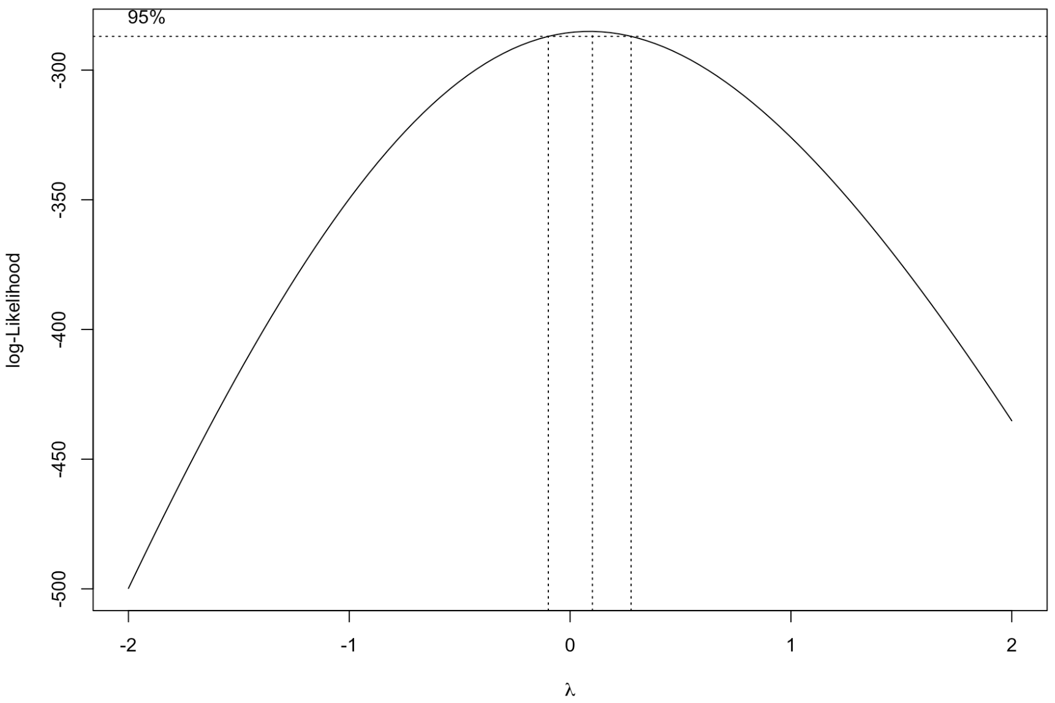
The Box-Cox transformation
In the case of our data here, a 95% confidence interval about the maximum likelihood estimator of $λ$ contains 0, so we might just go with the log for parsimony.

Slide 21
Outline
Resuming where we left off
Additional formulae for standard errors for the betas
Confidence intervals for the betas
Model accuracy
Confidence and prediction intervals for the y variable
Variance normalizing transformations
Regression lab

