Slide 1
BMI 510: Linear Regression I
J. Lucas McKay, Ph.D., M.S.C.R.
Departments of Biomedical Informatics and Neurology, Emory University, Atlanta, GA USA
Department of Biomedical Engineering, Georgia Institute of Technology, Atlanta, GA, USA

Slide 2
Outline
Introduction to part II of the class
A motivating example
Introduction to linear regression
Solving a regression problem with an ANOVA
Parameterization and coefficient interpretation
Linear least squares
Inference on regression coefficients
Implementation in software

Slide 3
Biostatistics for Machine Learning: Part II
We have covered basic probability, simple tests, and ANOVA. (Along with a lot of data management and practicing coding.)
Now that we have the basics of a statistical test, we can move on to the general purpose approach applied in the majority of clinical / epidemiological papers – regression. This is sometimes referred to just as "modeling."
We have discussed linear regression before in the context of simple problems like y=mx+b, where x is a continuous numerical variable.
We will see that that regression is not usually applied that way in clinical / epi work, and that it will be able to answer a much wider range of scientific questions.

Slide 4
Outline
Introduction to part II of the class
A motivating example
Introduction to linear regression
Solving a regression problem with an ANOVA
Parameterization and coefficient interpretation
Linear least squares
Inference on regression coefficients
Implementation in software

Slide 5
Question (adapted from Dr. Mitch Klein)
Multiple choice. Consider a dataset containing the heights of 100 adult individuals of the same ethnic origin.
Among which of the following sets of measurements would you expect the greatest variance?
All 100 individuals are male
All 100 individuals are female
50 individuals are male and 50 are females

Slide 6
Some points concerning the question
There is variation in height among men
There is variation in height among women
However, there is probably more variation in height when we combine the height measurements of men and women into one variable
Gender explains some of the overall variation in height, but there is still some unexplained (“residual,” “within-group,” “error”) variation remaining within each stratum of gender.
Imagine that all men were the same height and all women were the same height (but women’s height were different than men), then gender would explain all (100%) of the overall variation in height.
In our ANOVA example, ${SS}_{TOT}={SS}_{Gender}$ in this imaginary example.

Slide 7
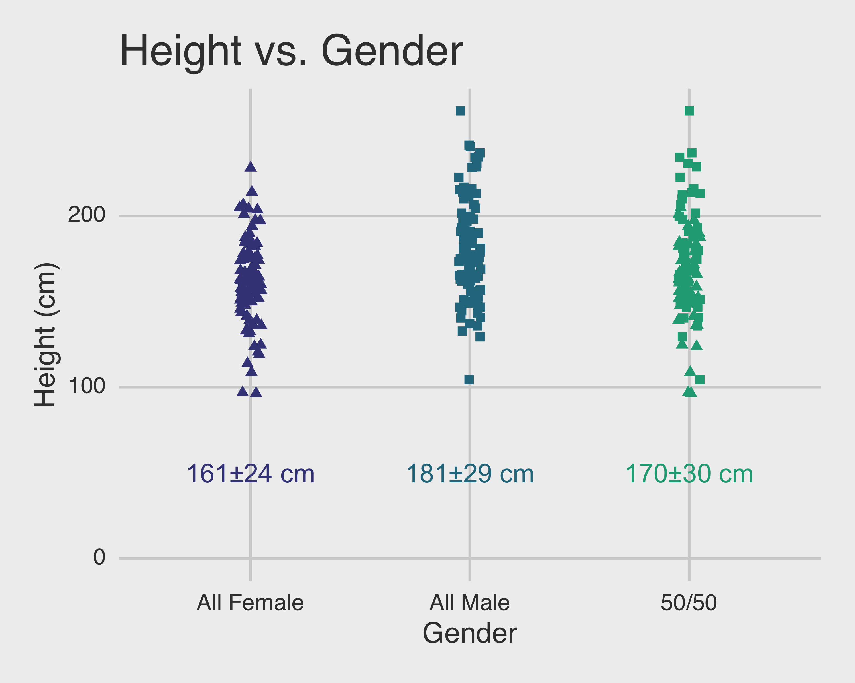
Height distribution

Slide 8
There is always some systematic and random variation in real-world problems
In ANOVA, the residual variation ends up as the term ${SS}_{RESID}$ or similar.
The variation explained by the model ends up as the term ${SS}_{MODEL}$ or similar.
We normalize ${SS}_{MODEL}$ and ${SS}_{RESID}$ by degrees of freedom (the number of groups minus one and the number of samples minus the number of groups), and calculate a ratio that is distributed as an $F$.
As we discussed, basic ANOVA has some limitations in medical research because imbalances and similar concerns are so common, among other reasons.

Slide 9
A regression formulation
Because of this, it is more common to use a regression framework, which in its most broad application is referred to as Generalized Linear Modeling.
Where ANOVA uses categorical grouping variables to compare means, regression uses continuous grouping variables to compare slopes.
Very often, the slopes we consider describe changes in the outcome variable for a 1 unit change (a dummy variable) in the grouping variable.
These two techniques are very closely related.

Slide 10
A regression formulation
We will use a simple regression formula familiar from algebra:
$$y_{ij}=β_{0}+β_{1}x_{i}+ε_{ij}$$
$y_{ij}$ is the j^{th} observation of group i
$β_{0}$ is the mean of the reference group (remember in ANOVA it was the overall mean)
$β_{1}$ is the slope, or change in the dependent variable associated with a 1-unit change in the independent variable
$ε_{ij}$ is a random additive error.

Slide 11
A regression formulation
We will use a simple regression formula familiar from algebra:
$$y_{ij}=β_{0}+β_{1}x_{i}+ε_{ij}$$
Note that in many cases, $x_{i}$ will only take on a value of 0 or 1. $x_{i}$
will take a value 0 if observation $y_{ij}$ is in the "reference group," and a value 1 if observation $y_{ij}$ is in another group.

Slide 12
One-hot / dummy encoding
If the grouping variable has, say, three levels, like control/ parkinsons/ essential tremor, we might use the following scheme with two dummy variables, and with "control" as the reference group:
$$y_{j}=β_{0}+β_{PD}PD+β_{ET}ET+ε_{j}$$
In this case, the variable PD would be 1 if observation j was in the PD group, and 0 otherwise, and the variable ET would be 1 if observation j was in the ET group, and 0 otherwise.
Note that here we've dropped the group variable i. Once there are multiple terms, the grouping might not be as clear as in ANOVA.

Slide 13
A simpler model
Let's consider a simpler model with only 1 degree of freedom, expected lifetimes in men and women.
First let's do an ANOVA.

Slide 14
A simpler model
 | df | SS | MS | F | P
Groups | 1
Error
Total | 99

Slide 15
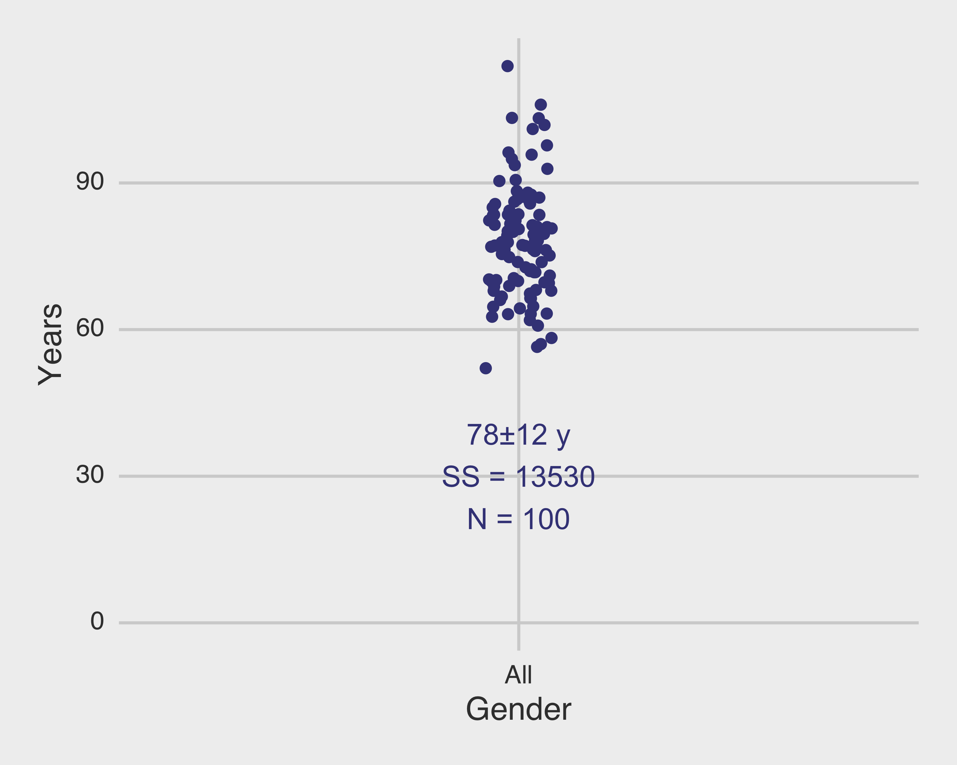
A simpler model

Slide 16
A simpler model
$$SS=\sum{{\left(x_{i}−\overline{x}\right)}^{2}}$$

Slide 17
A simpler model
 | df | SS | MS | F | P
Groups | 1
Error
Total | 99 | 13530

Slide 18
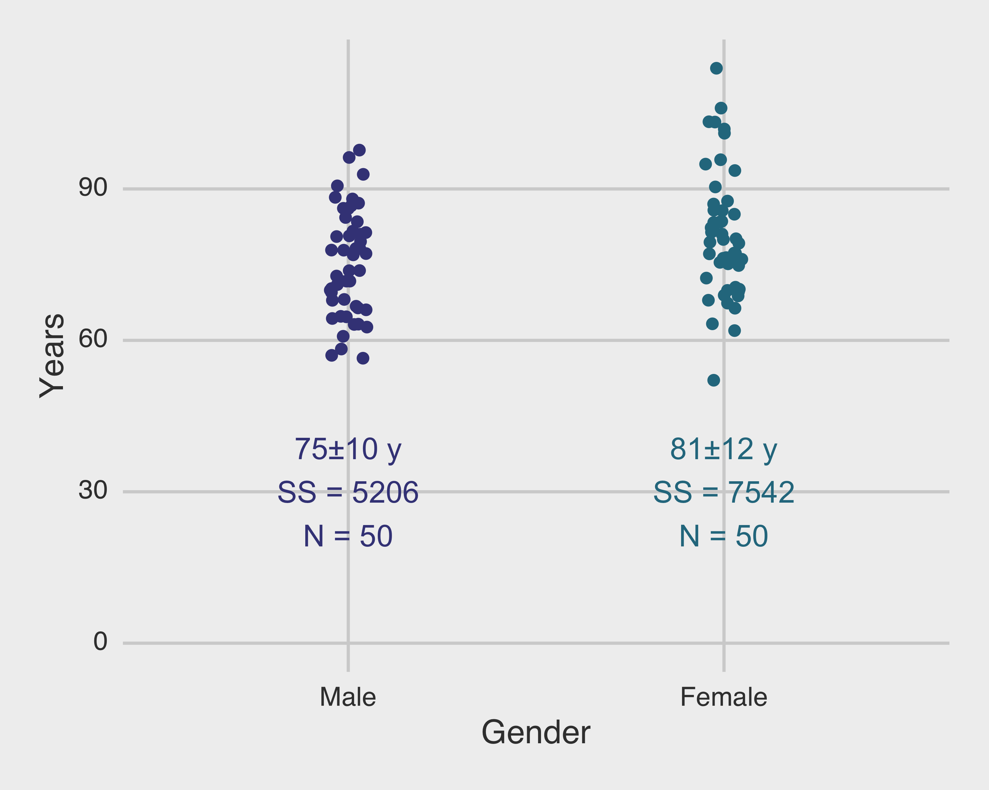
A simpler model
$$SS=\sum{{\left(x_{i}−\overline{x}\right)}^{2}}$$

Slide 19
A simpler model
 | df | SS | MS | F | P
Groups | 1
Error |  | 5206.5+7542.5= 12749
Total | 99 | 13530

Slide 20
A simpler model
 | df | SS | MS | F | P
Groups | 1 | 781
Error | 98 | 12749
Total | 99 | 13530

Slide 21
A simpler model
 | df | SS | MS | F | P
Groups | 1 | 781 | 781
Error | 98 | 12749 | 130
Total | 99 | 13530

Slide 22
A simpler model
 | df | SS | MS | F | P
Groups | 1 | 781 | 781 | 6.00
Error | 98 | 12749 | 130
Total | 99 | 13530

Slide 23
A simpler model
 | df | SS | MS | F | P
Groups | 1 | 781 | 781 | 6.00 | 0.016
Error | 98 | 12749 | 130
Total | 99 | 13530

Slide 24
A simpler model – regression approach

Slide 25
A simpler model – regression approach
Since women are living longer, let's treat men as the reference group here. Then an appropriate model might be:
$$y_{i}=β_{0}+β_{M}Male+ε_{i}$$
Before we fit the model, let's interpret the coefficients.

Slide 26
Coefficient interpretation
$$y_{i}=β_{0}+β_{M}Male+ε_{i}$$
Average lifespan among women:
Average lifespan among men:
Term that would be zero if men and women lived the same number of years (the null):

Slide 27
Coefficient interpretation
$$y_{i}=β_{0}+β_{M}Male+ε_{i}$$
Average lifespan among women: $β_{0}$
Average lifespan among men: $β_{0}+β_{M}$
Term that would be zero if men and women lived the same number of years (the null): $β_{M}$

Slide 28
Fitting the coefficients: linear least squares
In order to fit a straight line to a plot of points $(x_{i},y_{i})$, the slope and intercept of the line $y=β_{0}+β_{1}x$ must be found from the data in some manner.
(Similarly, in order to fit a $p^{th}$-order polynomial, $p+1$ coefficients must be determined; we often use straight line fits for reasons of parsimony.)
The most common method for determining the parameters in curve-fitting problems is the method of least squares.
Rice

Slide 29
Fitting the coefficients: linear least squares
The principle underlying this method is to minimize the sum of squared deviations of the predicted, or fitted, values (given by the curve) from the actual observations.
For example, suppose that a straight line is to be fit to the points $(x_{i},y_{i})$; $y$ is called the dependent variable and $x$ is called the independent variable, and we want to predict $y$ from $x$. (This usage of the terms independent and dependent is different from their probabilistic meaning.)
Sometimes $x$ and $y$ are called the predictor variable and the response variable, respectively.
Rice

Slide 30
Fitting the coefficients: linear least squares
Applying the method of least squares, we choose the slope and intercept of the straight line to minimize
$$S(β_{0},β_{1})=\sum_{i}^{​}{(}y_{i}−\hat{y_{i}})^{2}$$
Where the $\hat{y_{i}}$ values are the predicted, or fitted, values and the terms $(y_{i}−\hat{y_{i}})^{2}$ are the squared residuals of the fit - that is, what is left over after all of the variance that can be explained by the curve.
Rice

Slide 31
Fitting the coefficients: linear least squares
If we sub in our original formula:
$$\hat{y_{i}}=β_{0}+β_{1}x_{i}$$
$$S(β_{0},β_{1})=\sum_{i}^{​}{(}y_{i}−β_{0}−β_{1}x_{i})^{2}$$
Rice

Slide 32
Fitting the coefficients: linear least squares
There are several primary ways to identify values for $β_{0}$ and $β_{1}$.
You could find expressions for $\frac{∂S}{∂β_{0}}$ and $\frac{∂S}{∂β_{1}}$ and identify the unique values of $β_{0}$ and $β_{1}$ for which these expressions equal 0. This is the way most textbooks proceed.
You could use the normal equation approach, which we discussed in the first lecture. (This is actually directly equivalent to the calculus-based approach.)
You could use a numerical optimization procedure to minimize the error.

Slide 33
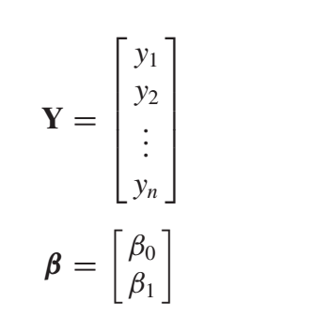
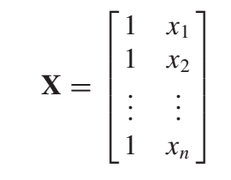
Fitting the coefficients: linear least squares
Let’s say, for sake of argument, we take the second approach.
≈
×
Rice

Slide 34
Fitting the coefficients: linear least squares
Let’s say, for sake of argument, we take the second approach. We use use the following transformations to get our best estimates of $β$.
$$Y≈Xβ$$
$$X^{T}Y≈X^{T}Xβ$$
$$(X^{T}X)^{−1}X^{T}Y≈{(X^{T}X)^{−1}X}^{T}Xβ$$
$$(X^{T}X)^{−1}X^{T}Y=β$$

Slide 35
Fitting the coefficients: linear least squares
For the problem at hand, remember the model was:
$$y_{i}=β_{0}+β_{M}Male+ε_{i}$$
The normal equations approach gives us the following numerical values:
$$β_{0}=81.0$$
$$β_{M}=−5.6$$
What units are these in?

Slide 36
Assumptions necessary for linear regression
The ordinary least squares estimates of the $β$s are unbiased under a broad range of conditions. To do hypothesis tests on the $β$s, we will have to estimate their standard errors. We should consider the assumptions necessary for this, which can really be read off of the equation itself:
$$y_{i}=β_{o}+β_{1}x+ε_{i}$$

Slide 37
Assumptions necessary for linear regression
$$y_{i}=β_{o}+β_{1}x+ε_{i}$$
The response variable $y$ must be comprised of independent observations. This is required for various reasons, in particular for the $t$ distribution we will see later to hold.
The residuals $ε_{i}$ must be normally distributed with constant variance $σ^{2}$. Most regression diagnostics examine the extent to which this assumption holds. If, for example, there are larger errors for certain values of $x$, remediation measures are needed. The residuals must also be uncorrelated to estimate the error variance, which relies on the trace of several intermediate matrices.
There are no constraints on the distribution of the predictor variable(s). This is why we are able to use dummy variables as predictors.
The number of observations must be greater than the number of parameters in order for various intermediate matrices to be invertible. In practice, you need ~5-10 times the number of observations to the number of parameters.

Slide 38
Statistical properties of the coefficients
In our ANOVA design, we considered an overall $F$ test. We found that the ANOVA formulation gave us limited ability to drill down between groups.
This is not the case with regression; if we formulate our model in a way that the coefficients are interpretable, we can compare each of them to zero.

Slide 39
Statistical properties of the coefficients
Assuming that the number of observations is $n$ and the number of parameters (in this case, 2) is $p$, we can calculate:
Residual sum of squares (RSS): $RSS=||Y−Xβ||^{2}$
Estimator of residual variance $σ^{2}$: $s^{2}=\frac{RSS}{n−p}$
Standard error of the regression coefficient $β_{i}$: $s_{β_{i}}=s\sqrt{c_{ii}}$, where $c_{ii}$ is the $i^{th}$ diagonal element of $C=(X^{T}X)^{−1}$.
Since we have a standard error for each coefficient, we can test each coefficient vs. 0.

Slide 40
Fitting the coefficients: linear least squares
For the problem at hand, remember the model was:
$$y_{i}=β_{0}+β_{M}Male+ε_{i}$$
The normal equations approach gives us the following numerical values:
$$β_{0}=81.0$$
$$β_{M}=−5.6$$

Slide 41
A simpler model – regression approach

Slide 42
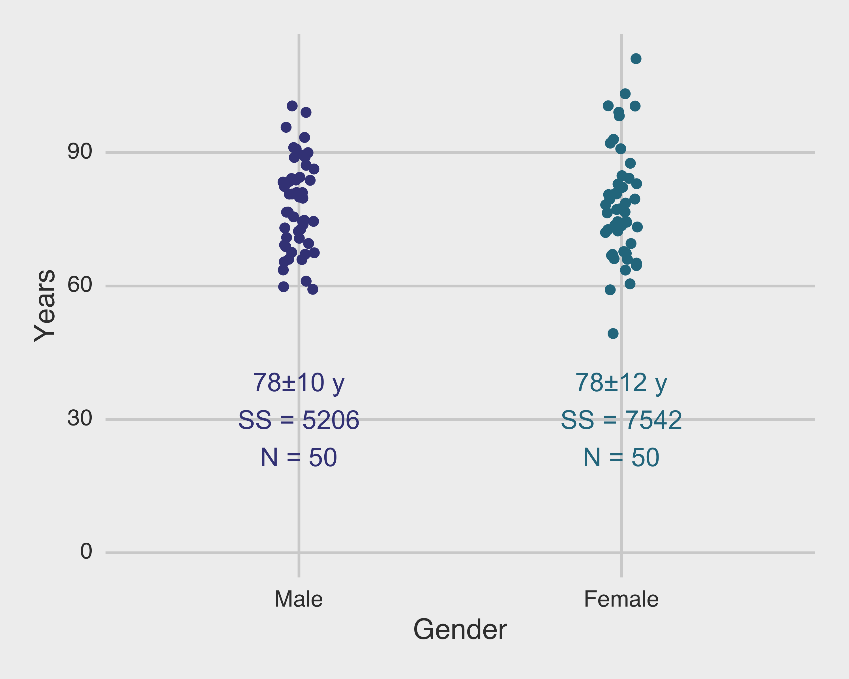
Plot of residuals

Slide 43
Fitting the coefficients: linear least squares
For the problem at hand, remember the model was:
$$y_{i}=β_{0}+β_{M}Male+ε_{i}$$
$$β_{0}=81.0$$
$$β_{M}=−5.6$$
$$RSS=5206+7542=12748$$
$$n=100$$
$$p=2$$
$$s^{2}=\frac{RSS}{n−p}=130$$

Slide 44
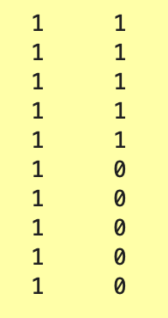
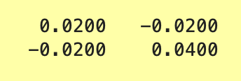
Fitting the coefficients: linear least squares
The design matrix X was:
$$C=(X^{T}X)^{−1}=$$
(should be 100 rows)

Slide 45
Fitting the coefficients: linear least squares
For the problem at hand, remember the model was:
$$y_{i}=β_{0}+β_{M}Male+ε_{i}$$
$C={(X^{T}X)}^{−1}$ = $\left[\begin{matrix}0.02 & ∙ \\ ∙ & 0.04\end{matrix}\right]$ = $\left[\begin{matrix}c_{11} & ∙ \\ ∙ & c_{22}\end{matrix}\right]$

Slide 46
Fitting the coefficients: linear least squares
For the problem at hand, remember the model was:
$$y_{i}=β_{0}+β_{M}Male+ε_{i}$$
$$β_{0}=81.0$$
$$β_{M}=−5.6$$
$$RSS=5206+7542=12748$$
$$n=100$$
$$p=2$$
$$s^{2}=\frac{RSS}{n−p}=130$$
$$s=11.4$$
$$s_{β0}=s\sqrt{c_{11}}=1.6$$
$$s_{βM}=s\sqrt{c_{22}}=2.3$$

Slide 47
Outline
Introduction to part II of the class
A motivating example
Introduction to linear regression
Solving a regression problem with an ANOVA
Parameterization and coefficient interpretation
Linear least squares
Inference on regression coefficients
Implementation in software

Slide 48
Hypothesis tests on coefficients
Now that we have an expression for the standard error of each of the $β$s, we can perform hypothesis tests on them.
In particular, in regression models we often construct the coefficients in such a way so that tests of individual coefficients allow us to assess particular null hypotheses.
In this model, under the null, $μ_{F}=μ_{M}$, where the $μ$s designate the average age at death among women and men, respectively.
Recall we said:

Slide 49
Hypothesis tests on coefficients
$$y_{i}=β_{0}+β_{M}Male+ε_{i}$$
Average lifespan among women: $β_{0}$
Average lifespan among men: $β_{0}+β_{M}$
Term that would be zero if men and women lived the same number of years (the null): $β_{M}$

Slide 50
Hypothesis tests on coefficients
Therefore, to assess the probability of observing these data under the null that $μ_{F}=μ_{M}$, we can perform a hypothesis test on $β_{M}$.
Specifically, let's test:
$$H_{0}:β_{M}=0$$
against:
$$H_{A}:β_{M}≠0$$

Slide 51
Hypothesis tests on coefficients
To do this, we can calculate the test statistic:
$$t=\frac{β_{M}}{s_{βM}}=−2.45$$
This follows a t distribution with $n−p=98$ degrees of freedom.

Slide 52
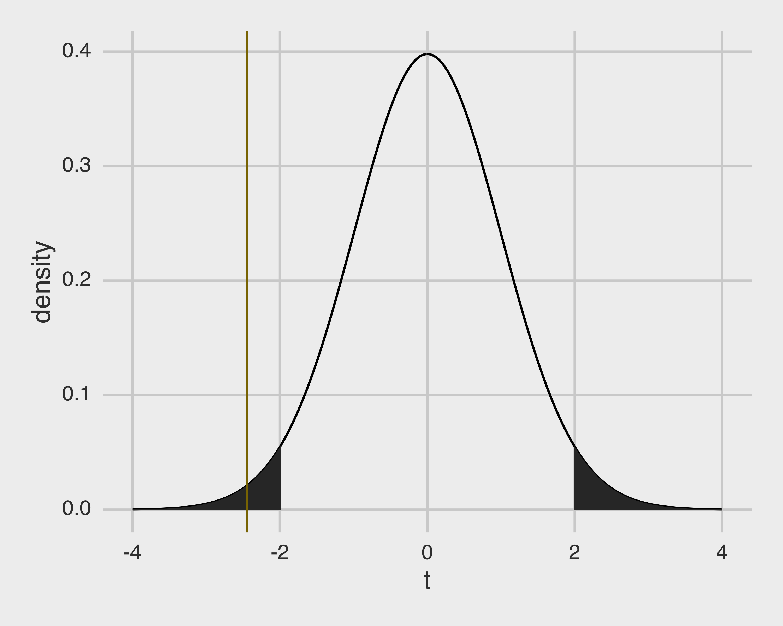
Hypothesis tests on coefficients

Slide 53
Hypothesis tests on coefficients
Since the two-sided p-value for a $t_{98}$ of $−2.45$ is $0.016$, we can reject the null hypothesis that women and men live equally long given these data.

Slide 54
Recall: ANOVA result
 | df | SS | MS | F | P
Groups | 1 | 781 | 781 | 6.00 | 0.016
Error | 98 | 12749 | 130
Total | 99 | 13530
In this case, the design is balanced and all of the ANOVA assumptions are met.
As a result, the regression t-test and ANOVA F-test P values are identical.
In general the regression approach is much more flexible but will give the same results as ANOVA if the assumptions are met. So you will probably not need ANOVA very often.

Slide 55
Outline
Introduction to part II of the class
A motivating example
Introduction to linear regression
Solving a regression problem with an ANOVA
Parameterization and coefficient interpretation
Linear least squares
Inference on regression coefficients
Implementation in software

Slide 56
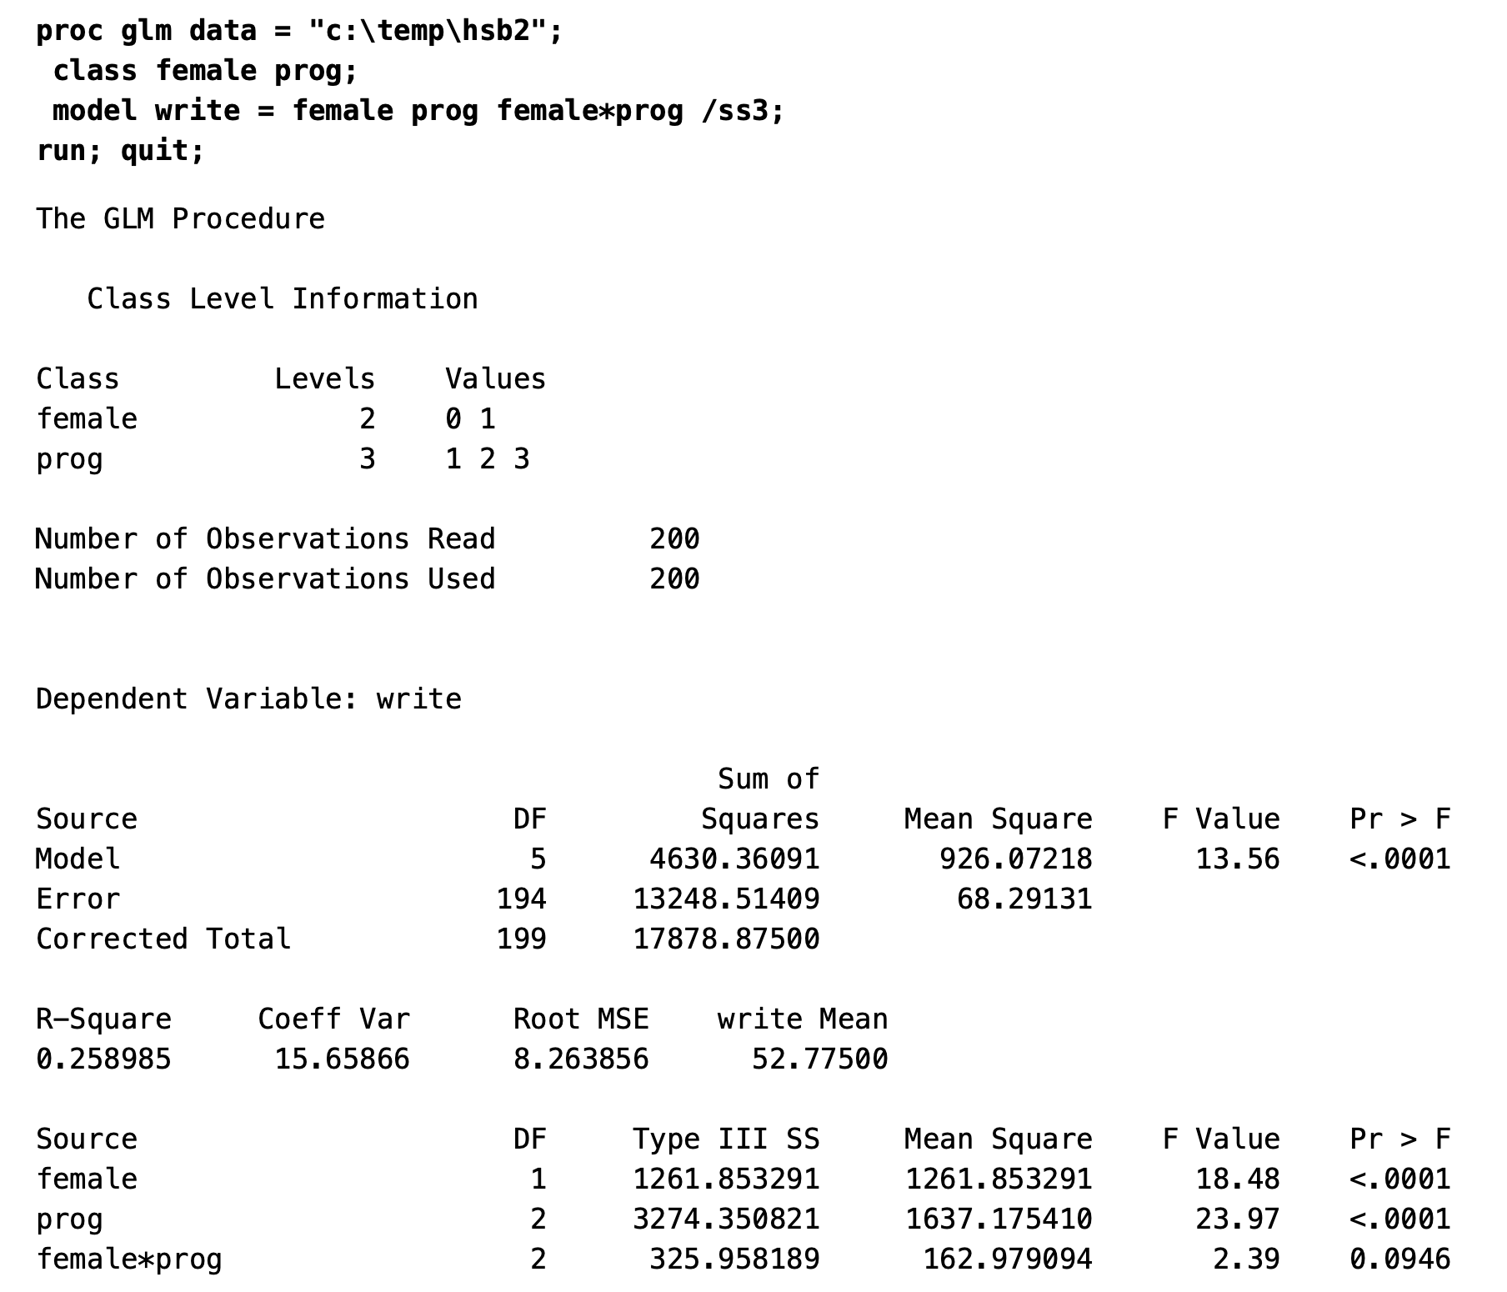
How this is implemented in software
In dedicated statistics software like SAS, the fitted model coefficients are supplied with estimates of their standard errors and p-values from hypothesis tests comparing the values to zero.
Depending on the type of model used, these tests may be presented as F, t, Wald, or other types.
The broom package in R will produce this type of behavior for you.
https://stats.idre.ucla.edu/sas/output/glm/

Slide 57
How this is implemented in software
Because in general the test formulations are asymptotically equivalent, it is often fine to keep the default behavior.
Once the coefficients are fit with lm, anova and broom::tidy produce the same p-value to several decimal places.

Slide 58
Outline
Introduction to part II of the class
A motivating example
Introduction to linear regression
Solving a regression problem with an ANOVA
Parameterization and coefficient interpretation
Linear least squares
Inference on regression coefficients
Implementation in software

