Slide 1
BMI 510: Fairness
J. Lucas McKay, Ph.D., M.S.C.R.
Departments of Biomedical Informatics and Neurology, Emory University, Atlanta, GA USA
Department of Biomedical Engineering, Georgia Institute of Technology, Atlanta, GA, USA

Slide 2
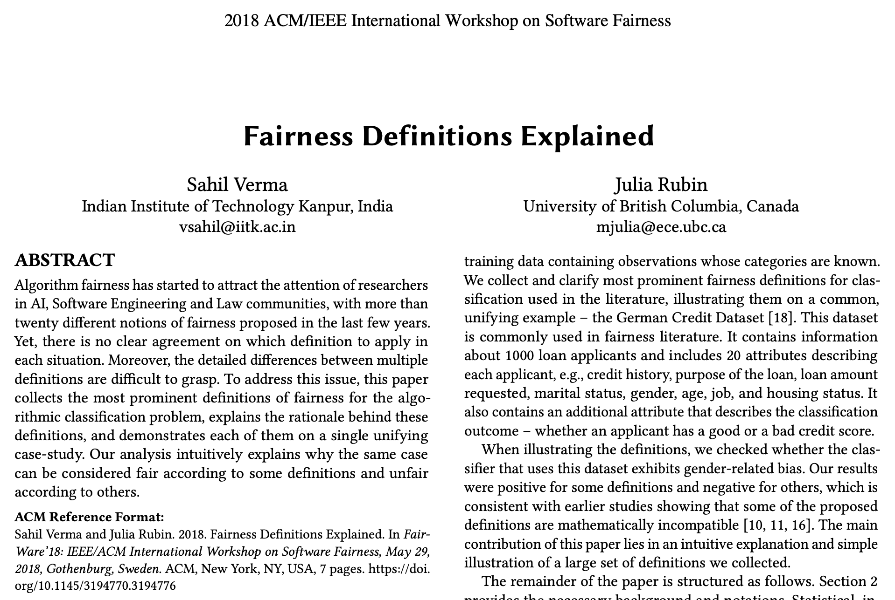

Slide 3
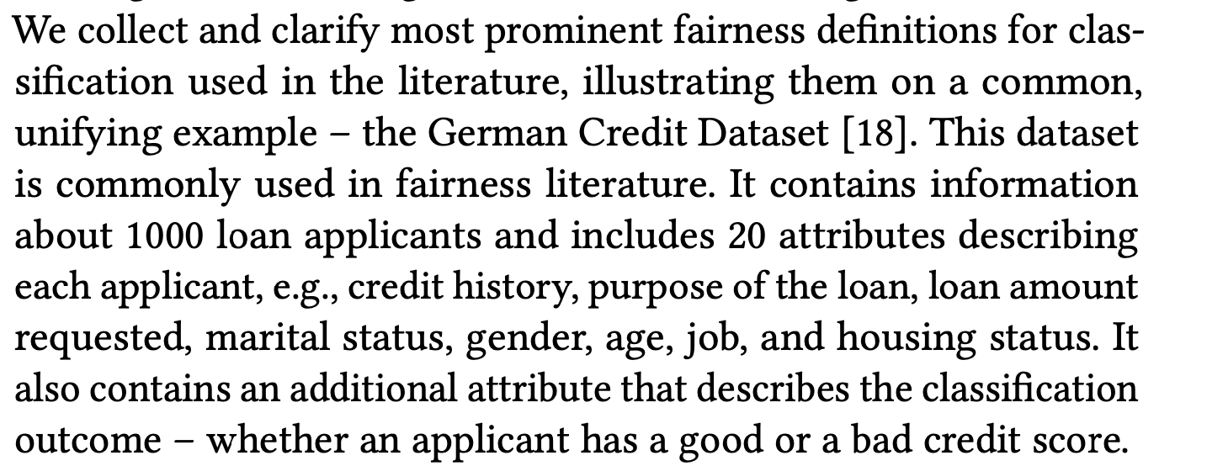

Slide 5
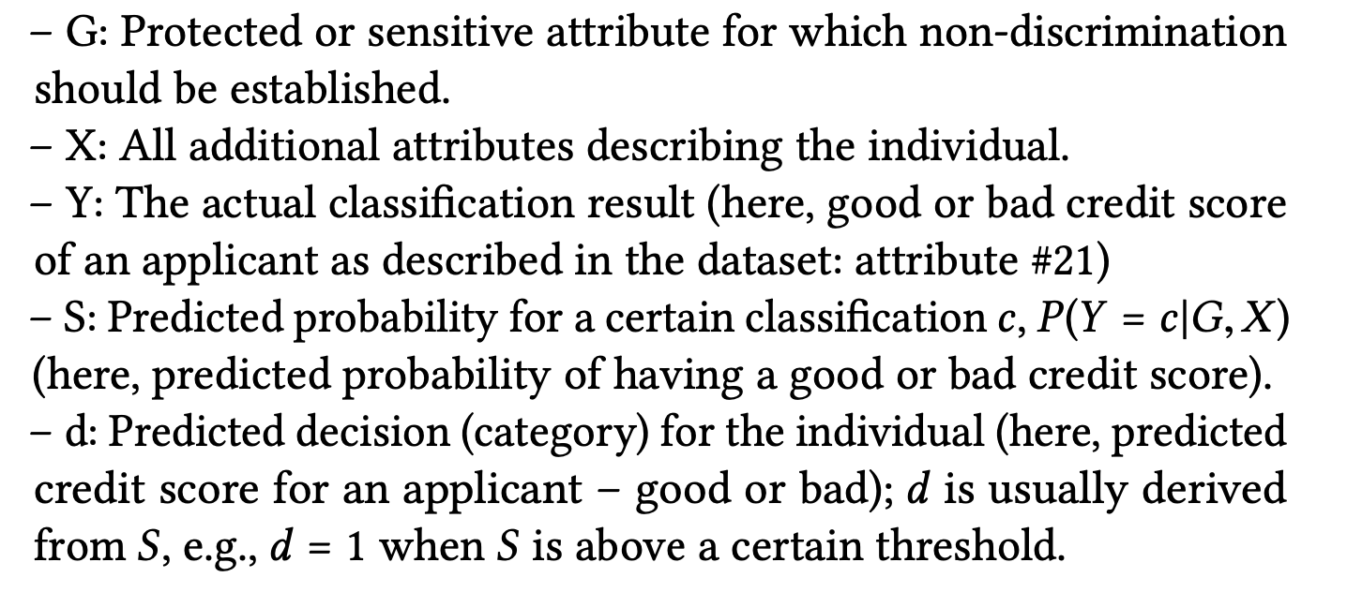
Notations

Slide 6
A note on gender in the data
The authors use “gender” throughout the manuscript, as it was used in the 1970s, essentially as a synonym for biological sex
Gender and sex are not the same thing, neither are binary, and each has distinct patterns of influence on the biological and social determinants of health
For this reason, modern EMR (Like Epic) use terminology like “legal sex” and other more precise indicators of sex and gender
We note that single women do not exist in this dataset, which:
Is arguably a concrete example of intersectionality between class and gender marginalizing a large group of people
Would be unheard of now, in the USA at least, partially because
The bank is clearly missing out on making loans to roughly half the population

Slide 7
Definitions
Definitions Based on Predicted Outcome
Definitions Based on Predicted and Actual Outcomes
Definitions Based on Predicted Probabilities and Actual Outcome
Similarity-Based Measures
Causal Reasoning
Skip for today

Slide 8
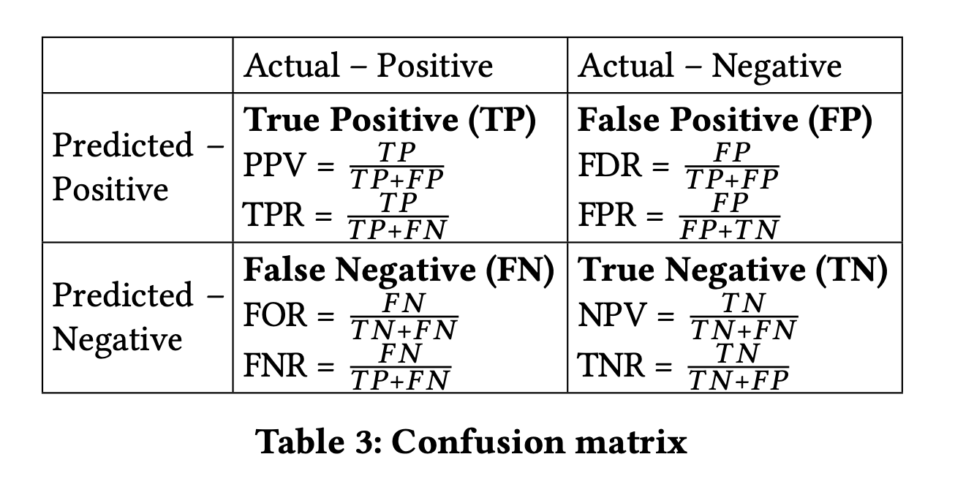

Slide 9
Definitions Based on Predicted Outcome

Slide 10
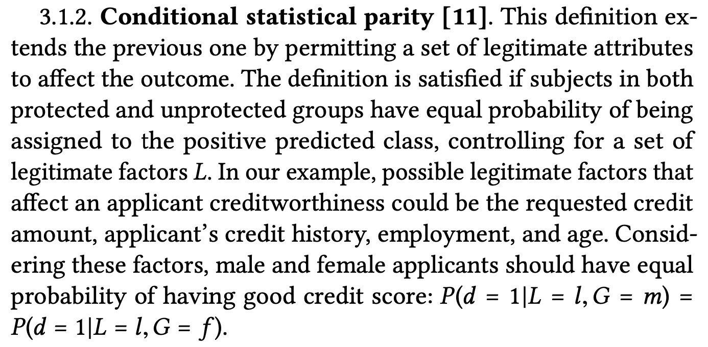
Definitions Based on Predicted Outcome

Slide 11
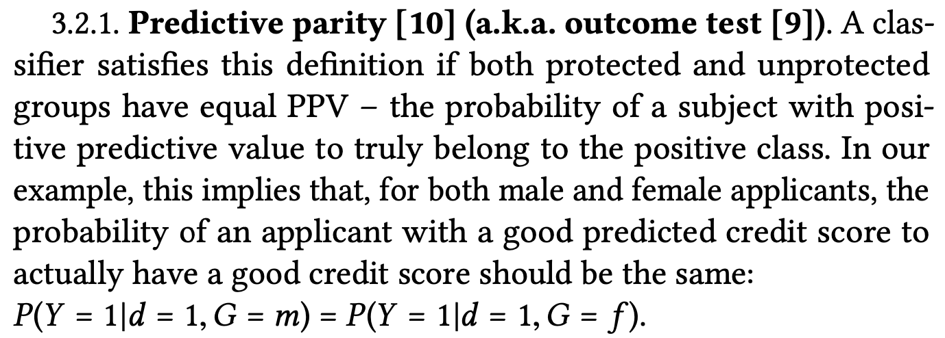
Definitions Based on Predicted and Actual Outcomes

Slide 12
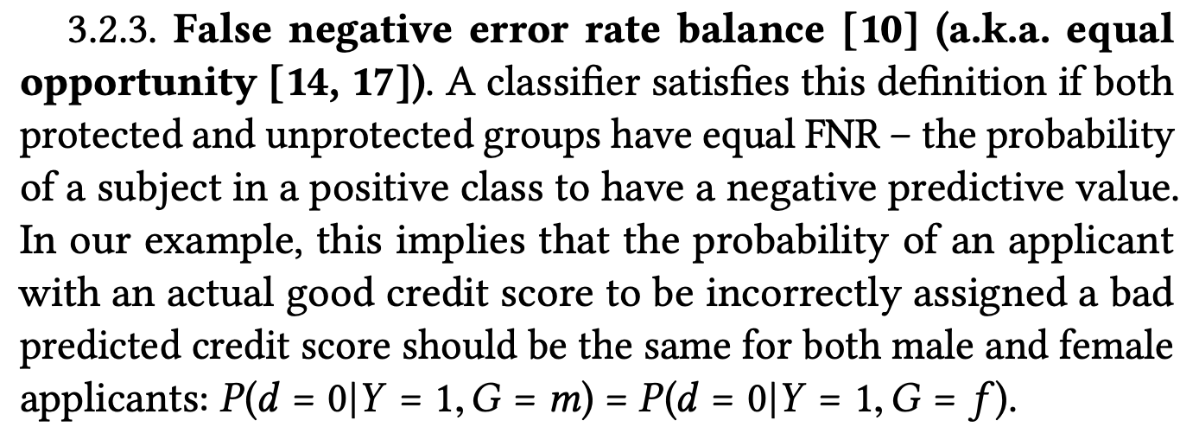
Definitions Based on Predicted and Actual Outcomes

Slide 13
Definitions Based on Predicted and Actual Outcomes
$$P\left(d=1 | Y=i,G=m\right)=P\left(d=1 | Y=i,G=f\right),i∈0,1$$

Slide 14
Definitions Based on Predicted and Actual Outcomes
$$P\left(d=1 | Y=i,G=m\right)=P\left(d=1 | Y=i,G=f\right),i∈0,1$$
$\left(P\left(Y=1 | d=1,G=m\right)=P\left(Y=1 | d=1,G=f\right)\right)$^ $\left(P\left(0=1 | d=0,G=m\right)=P\left(Y=0 | d=0,G=f\right)\right)$
$$P(d=Y,G=m)=P(d=Y,G=f)$$

Slide 15
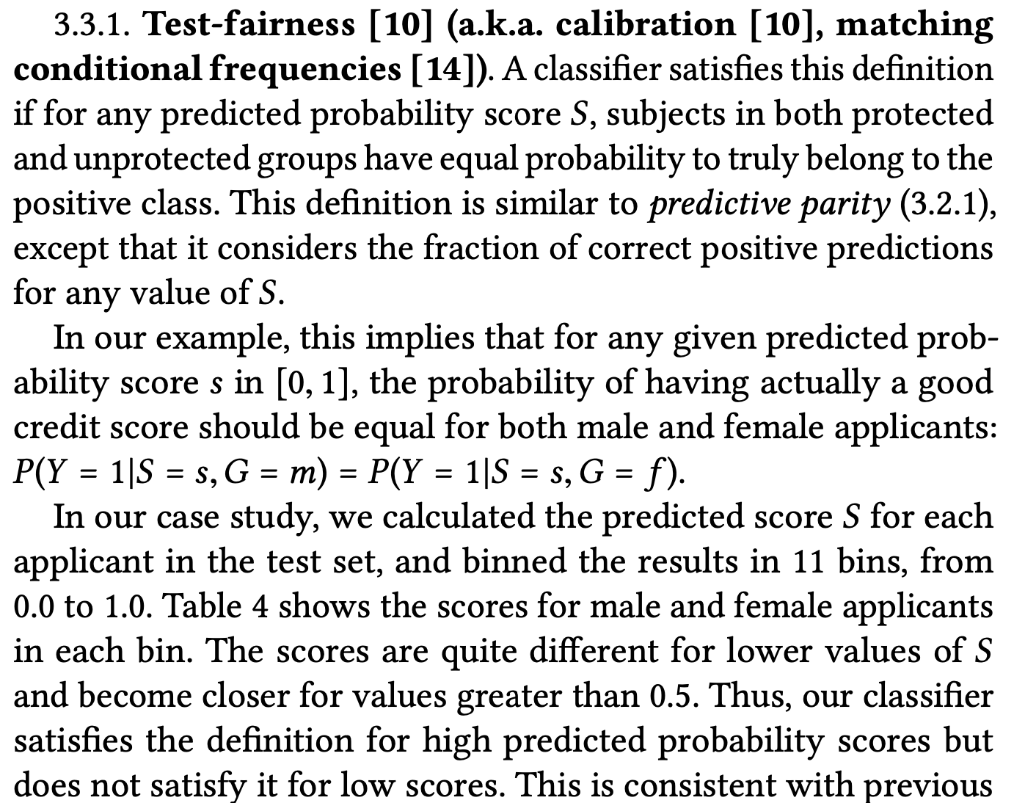
Definitions Based on Predicted Probabilities and Actual Outcome

Slide 16
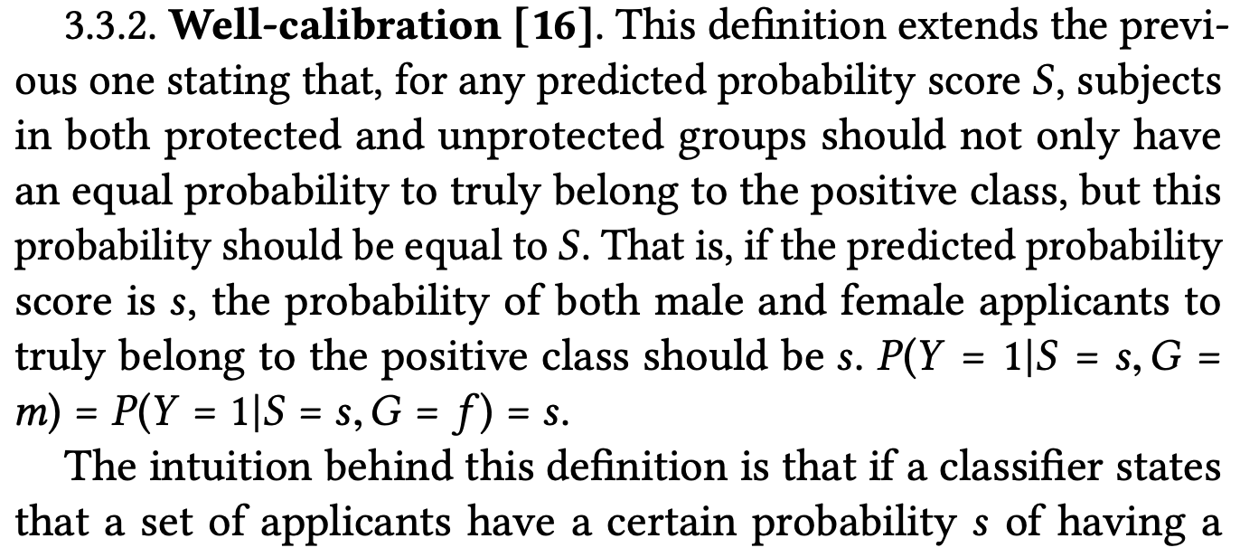
Definitions Based on Predicted Probabilities and Actual Outcome

Slide 17
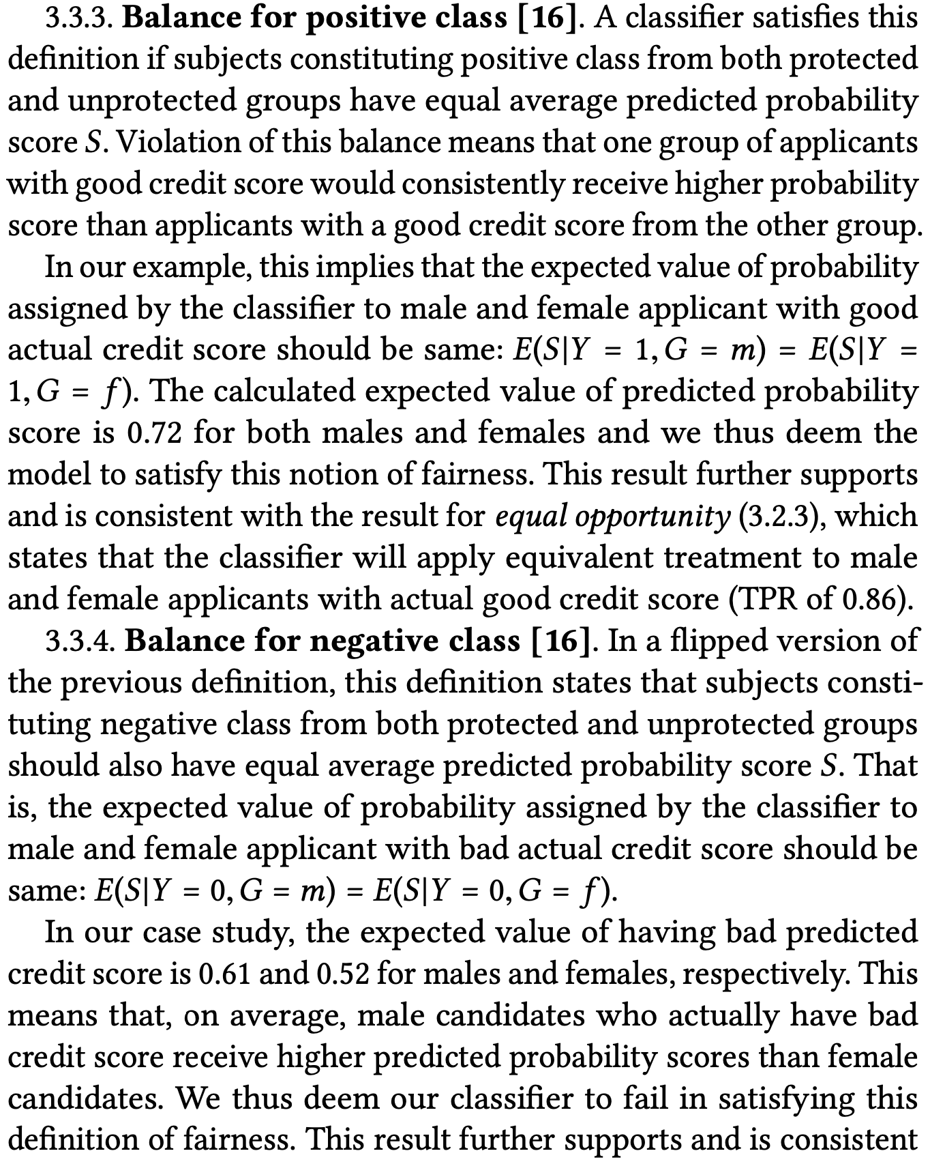
Definitions Based on Predicted Probabilities and Actual Outcome

Slide 18
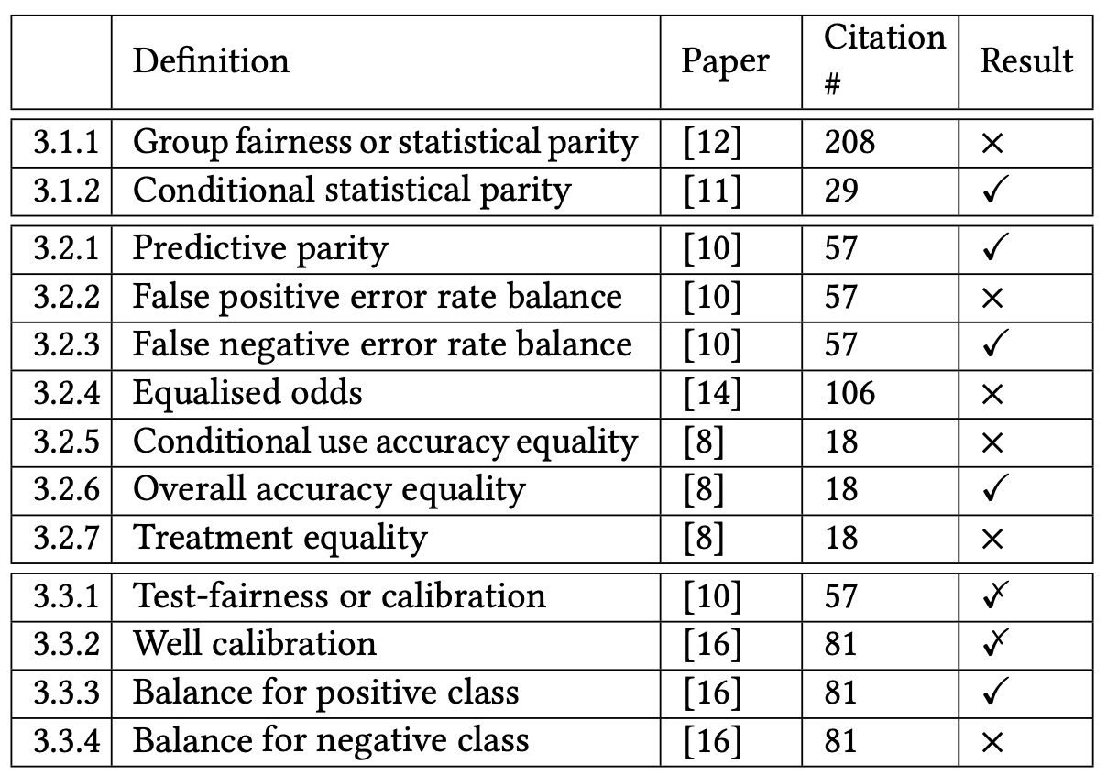
Overall performance
$$5/{13}$$

Slide 19
Gender-related feature weights

Slide 20
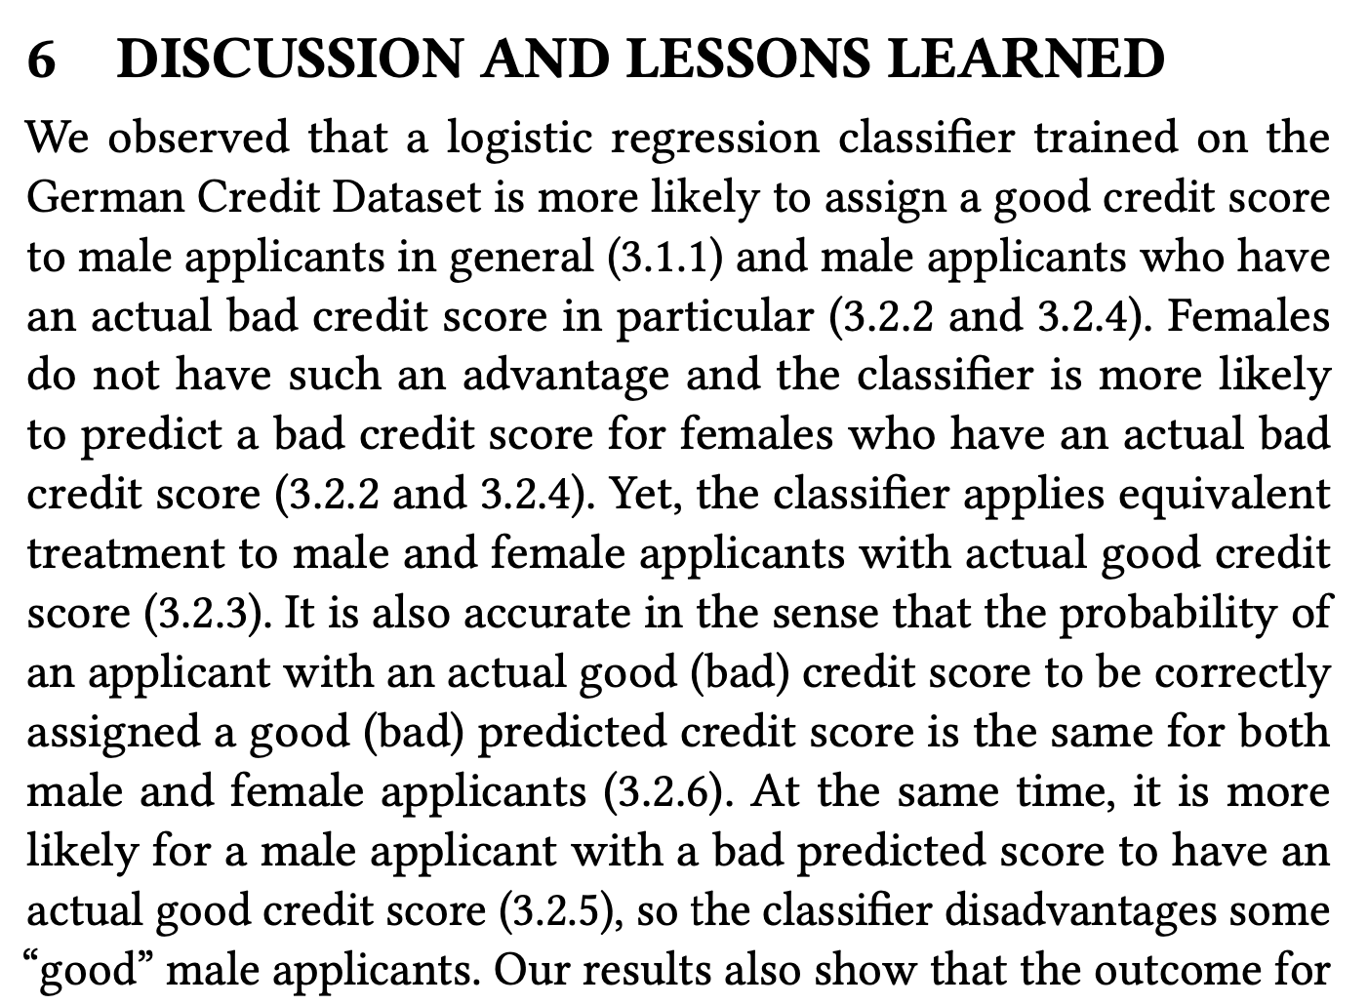

Slide 21
Discussion questions
Did the authors ever evaluate whether the underlying data were fair? How would you do this?
Given that you have built a classifier based on these data, how would you go about adding a class for unmarried women?
When investigating sex/gender bias, do you think it is valid to consider previous credit history as a "legitimate attribute" for evaluating conditional statistical parity?
Can you think of a way the authors could have made stronger statements about which aspects of fairness did and did not pass?

Slide 22
Discussion plan
We will divide the class into four breakout groups. Please:
Introduce yourselves briefly
Choose a group name
Discuss the questions above for ≈20 minutes.
Make some notes regarding your answers – when we return to the main session we will discuss all questions as a group.
At the end of the class, please edit your answers as you like and record them in the online survey.
Everyone must enter a group name, but only one person per group needs to enter the answers

