Slide 1
BMI 510: Distributions derived from the normal
J. Lucas McKay, Ph.D., M.S.C.R.
Departments of Biomedical Informatics and Neurology, Emory University, Atlanta, GA USA
Department of Biomedical Engineering, Georgia Institute of Technology, Atlanta, GA, USA

Slide 2
The big picture: two fundamental statistical modeling steps
Fit model parameters to data
Make inferences about models

Slide 3
Distributions derived from the normal density

Slide 4
These distributions show up all the time
The chi-square density shows up all the time in tests of frequency tables and logistic regression
The t density shows up all the time when comparing sample means
The F density shows up all the time in ANOVA procedures

Slide 5
The chi-square density: sum of Z²
Definition: if $Z$ is ONE standard normal random variable, the Density of $U$ = $Z^{2}$ is called the chi-square Density with 1 degree of freedom.
This is often written as $χ_{1}^{2}$.

Slide 6
The chi-square density: sum of Z²
Definition: if $U_{1},U_{2},...,U_{n}$ are $n$ independent chi-square variables with 1 degree of freedom – meaning that each variable is $U$ = $Z^{2}$ – the Density of $V=U_{1}+U_{2}+...+U_{n}$ is called the chi-square Density with $n$ degrees of freedom.
This is often written as $χ_{n}^{2}$. So if you have a quantity that represents the sum of n squared normal variables, it will be distributed as $χ_{n}^{2}$.

Slide 7
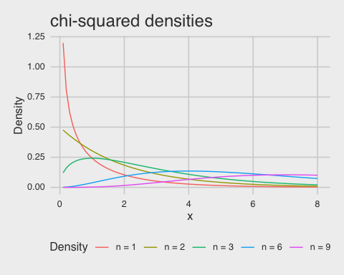
The chi-square density: sum of Z²

Slide 8
The chi-square density: sum of Z²
Recall that $χ^{2}$ is the distribution of the sum of squared normal variables $Z_{1}^{2}+Z_{2}^{2}+...+Z_{n}^{2}$.
So for $n=1$, there is non-zero probability of obtaining a value of 0; but this drops off steeply.
For $n=6$, you are most likely to get a sum around 4.

Slide 9
The t density: Z over a chi-square
Definition: if $Z$ follows a standard normal density such that $Z∼N(0,1)$
and $U$ follows a chi-square density with $n$ degrees of freedom such that $U∼χ_{n}^{2}$
then the density $\frac{Z}{\sqrt{U/n}}$ is called the $t$ density with $n$ degrees of freedom.

Slide 10
The t density: Z over a chi-square
Why would we want to know the Density of $\frac{Z}{\sqrt{U/n}}$?
The denominator $\sqrt{Z_{1}^{2}+Z_{2}^{2}+...+Z_{n}^{2}/n}$ may remind you of the “standard error of the mean” from the first lecture:
$$σ/{\sqrt{N}}=\sqrt{{σ^{2}}/N}$$
So this density is useful for one- and two- sample tests, which we will discuss next.

Slide 11
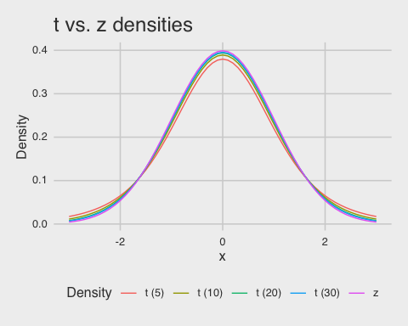
The t density: Z over a chi-square

Slide 12
The t density: Z over a chi-square
Note the heavier tails for smaller degrees of freedom.
After around 30, the $t$ and $z$ densities are quite close.
One way to remember this (completely non mathematically) is that for smaller samples, our (sampled) estimate of the population variance tends to be biased downward, so extreme values are more likely than with the $z$.

Slide 13
The F density: ratio of chi-squares
Definition: if $U$ and $V$ are independent $χ^{2}$ variables with $m$ and $n$ degrees of freedom,
the distribution of the ratio
$$W=\frac{U/m}{V/n}$$
is called the $F$ distribution with $m$ and $n$ degrees of freedom: $F_{m,n}$.

Slide 14
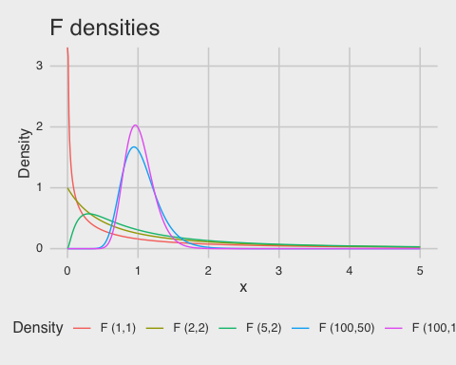
The F density: ratio of chi-squares

Slide 15
The F density: ratio of chi-squares
This comes into play when we get into ANOVA, in which case we can compare the ratio of expected differences due to the groups to the expected differences due to random variation.
Note that, for $df1=df2=2$, it is very unlikely that a ratio like $\frac{Z_{1}^{2}+Z_{2}^{2}}{Z_{3}^{2}+Z_{4}^{2}}$ takes on a value of, say, 5. Expected value of the top is around 2, expected value of the bottom is around 2.
Note that once the number of random variables included in the averages in the numerator and denominator get high enough, we are very likely to get an answer around 1.

