Slide 1
BMI 510: Dimensionality
J. Lucas McKay, Ph.D., M.S.C.R.
Departments of Biomedical Informatics and Neurology, Emory University, Atlanta, GA USA
Department of Biomedical Engineering, Georgia Institute of Technology, Atlanta, GA, USA

Slide 2
Outline
Concepts of dimensionality and dimensionality reduction
Calculating PCs and choosing PC number
Scree plots and biplots
Including labels: discriminant analysis
Constrained alternatives: non-negative matrix factorization

Slide 3
Concepts of dimensionality and dimensionality reduction
A lot of the material we discuss relates to statistical modeling situations in which we have a set of $p$ independent variables or covariates $X_{1}$, $X_{2}$, $…,X_{p}$, measured on $n$ observations.
We usually have a dependent or response variable $Y$ also measured on those same $n$ observations. The goals are then to:
Assess the extent to which $Y$ depends on any of $X_{1}$, $X_{2}$, $…,X_{p}$, or,
Predict $Y$ using $X_{1}$, $X_{2}$, $…,X_{p}$
In this case, $Y$ could be either a continuous variable, in which we might use linear regression (later), or a discrete variable, in which we might use logistic regression (later).

Slide 4
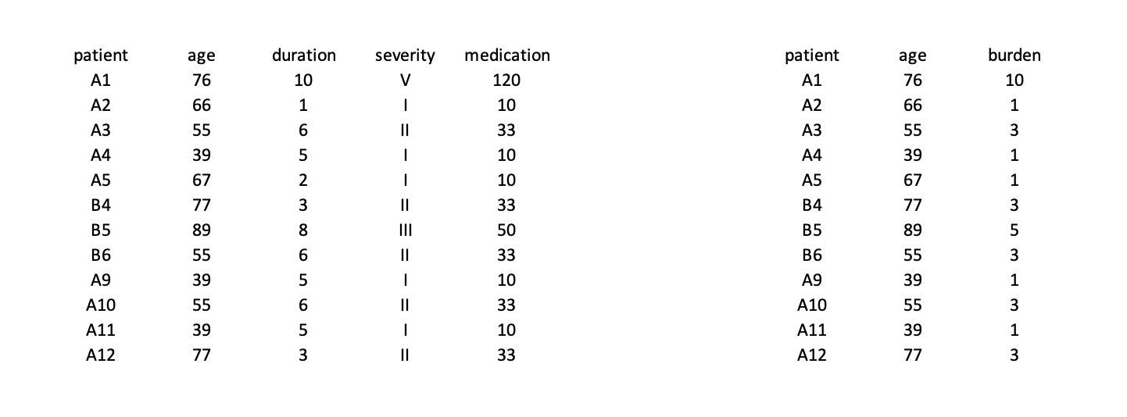
Concepts of dimensionality and dimensionality reduction
If the number of variables is quite large, and particularly if they provide information that is overlapping in some way, we often want to simplify the data prior to analysis.

Slide 5
Concepts of dimensionality and dimensionality reduction
If the number of variables is quite large, and particularly if they provide information that is overlapping in some way, we often want to simplify the data prior to analysis.

Slide 6
Fewer variables makes parameter estimation easier and can provide insight
one column
of label or outcome
p columns of
recorded variables
y
X
n rows of
independent observations
≈
n rows of
independent observations

Slide 7
Fewer variables makes parameter estimation easier and can provide insight
one column
of label or outcome
m<p columns of
derived variables
y
X’
n rows of
independent observations
≈
n rows of
independent observations

Slide 8
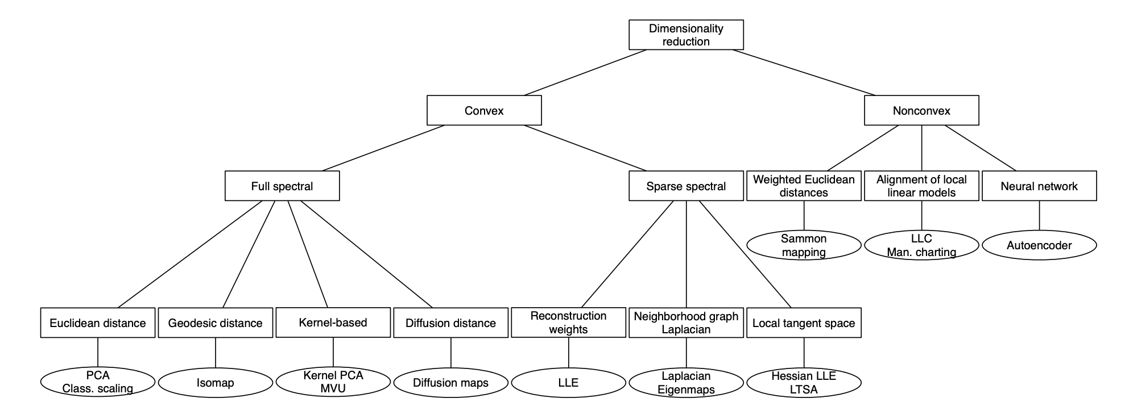
There are many, many approaches
Dimensionality Reduction: A Comparative Review. Laurens van der Maaten et al.

Slide 9
Methods we will touch on
Unsupervised: principal component analysis
Supervised: discriminant analysis
Constrained alternatives: non-negative matrix factorization

Slide 10
Motivation for PCA
Suppose that we wish to visualize $n$ observations with measurements on a set of $p$ features or covariates $X_{1}$, $X_{2}$, $…,X_{p}$ as part of an exploratory data analysis.
Or, for example, suppose that we wish to visualize patterns of association between the covariates.
We could do this by examining two-dimensional scatterplots of the data, each of which contains the $n$ observations' measurements on two of the features.

Slide 11
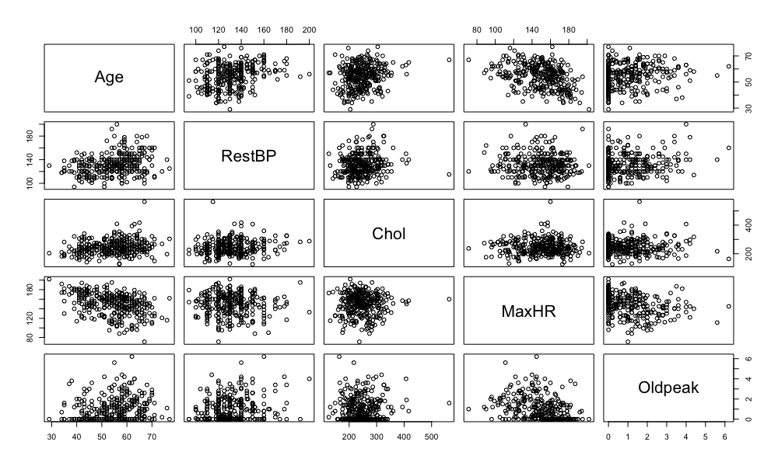
Visualization of 5 variables: original data

Slide 12
Motivation for PCA
Clearly, a better method is required to visualize the n observations when p is large.
The number of plots increases rapidly, and each pair of variables contains only a small amount of variance in the dataset.
In particular, we would often like to find a low-dimensional representation of the data that captures as much of the information as possible.
For instance, if we can obtain a two-dimensional representation of the data that captures most of the information, then we can plot the observations in this "low-dimensional" space.

Slide 13
Motivation for PCA
PCA is a technique for reducing the dimension of a n x p data matrix X. The first principal component direction of the data is that along which the observations vary the most; the second principal component direction of the data is that along which the observations vary the second most, and so on.

Slide 14
Motivation for PCA
In general, the idea of PCA is to express the data matrix X as:
$$X=SP^{T}$$
Where P is an orthonormal matrix. (The columns are orthogonal to each other and of unit length.) (Note this equation is for centered data.)
Note the structure of this: the matrix P is simply a rotation matrix like you would use when performing a change of coordinates.

Slide 15
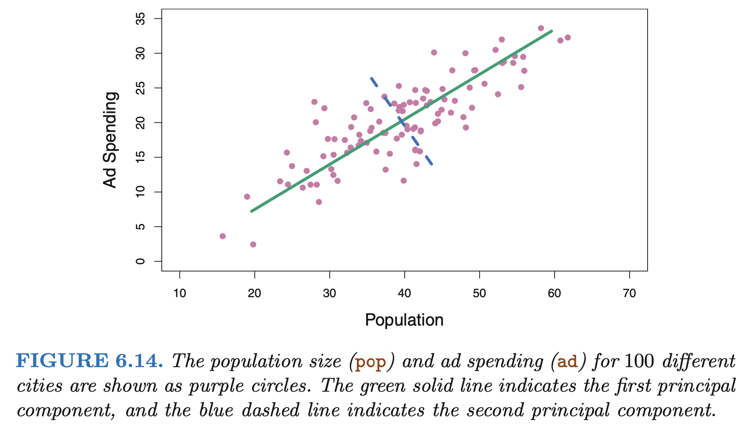
Motivation for PCA

Slide 16
Motivation for PCA
PCA is a technique for reducing the dimension of a n x p data matrix X. The first principal component direction of the data is that along which the observations vary the most; the second principal component direction of the data is that along which the observations vary the second most, and so on.
The green solid line represents the first principal component direction of the data, the direction along which there is the greatest variability in the data. That is, if we projected the 100 observations onto this line, then the resulting projected observations would have the largest possible variance.

Slide 17
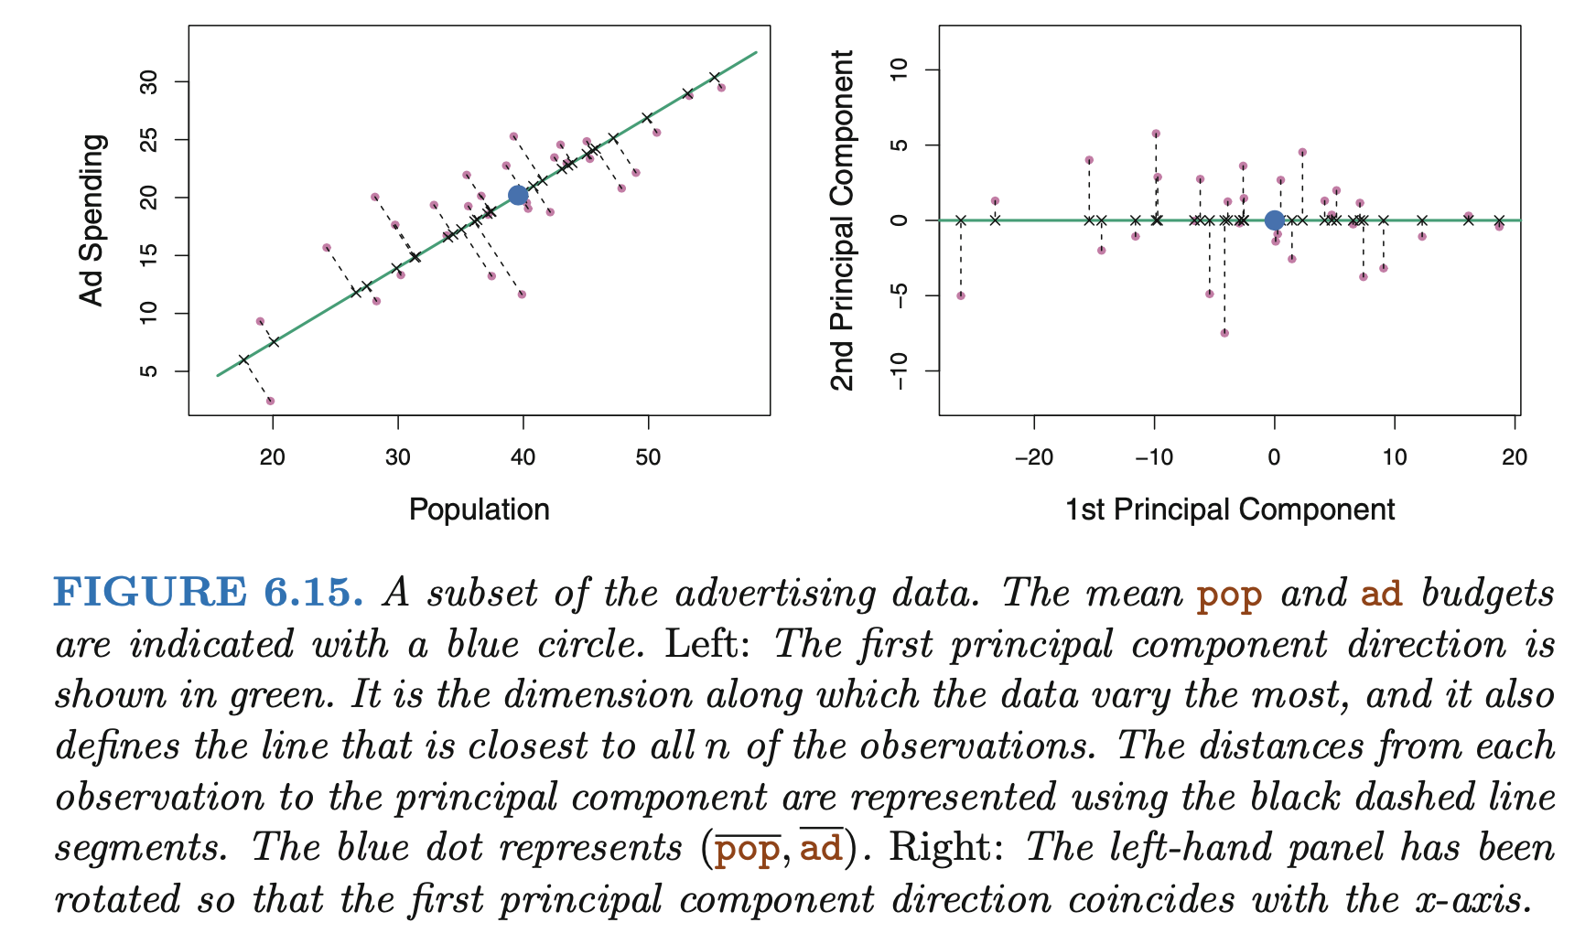
Motivation for PCA

Slide 18
Supervised vs. unsupervised learning
It is important to note that PCA is an example of unsupervised learning. When we consider only the covariates $X_{1}$, $X_{2}$, $…,X_{p}$, we are not including any class labels (or independent variables).
This is quite different from our previous approaches, which almost always included a label / class variable of some type.
Because of this difference, configuring PCA (and related dimensionality reduction techniques) is less algorithmic in some ways.
For example, statistical tests for the number of factors have been proposed since the 1960's-70's remain relatively uncommon due to shaky statistical foundations and questionable empirical performance.

Slide 19
PCA as a matrix decomposition
There are many different routes to arrive at PCA, as it is so closely related to eigenvalue/vector analysis.
The James text uses the following (informal) explanation for how to identify the principal components. If the PCA decomposition is:
$$X=SP^{T}$$
We identify the elements of each column of P (in order) such that the variance of $SP^{T}$ is maximized.

Slide 20
PCA as a matrix decomposition
one column
of label or outcome
p columns of
recorded variables
y
X
n rows of
independent observations
≈
n rows of
independent observations

Slide 21
PCA as a matrix decomposition
p columns of
recorded variables
M columns of
"scores"
M x M
"loadings"
X
S
P^{T}
n rows of
independent observations
=

Slide 22
PCA as a matrix decomposition
M columns of
"scores"
M x M
"loadings"
S
P^{T}
n rows of
independent observations

Slide 23
PCA as a matrix decomposition
M x M
"loadings"
M x M
"loadings"
P^{T}
P
X
= An identity matrix
M x M
"loadings"
M x M
"loadings"
P
P^{T}
X
= An identity matrix

Slide 24
PCA as a matrix decomposition
Because of the nature of the PC vectors in the following decomposition:
$$X=SP^{T}$$
$P^{T}P=I$
$PP^{T}=I$
Therefore, the "scores" can be obtained by postmultiplying the original (centered) data by P.
$$XP=SP^{T}P$$
$$XP=SI$$
$$XP=S$$

Slide 25
PCA as a matrix decomposition
p columns of
recorded variables
M x M
"loadings"
M columns of
"scores"
X
P
S
n rows of
independent observations
=

Slide 26
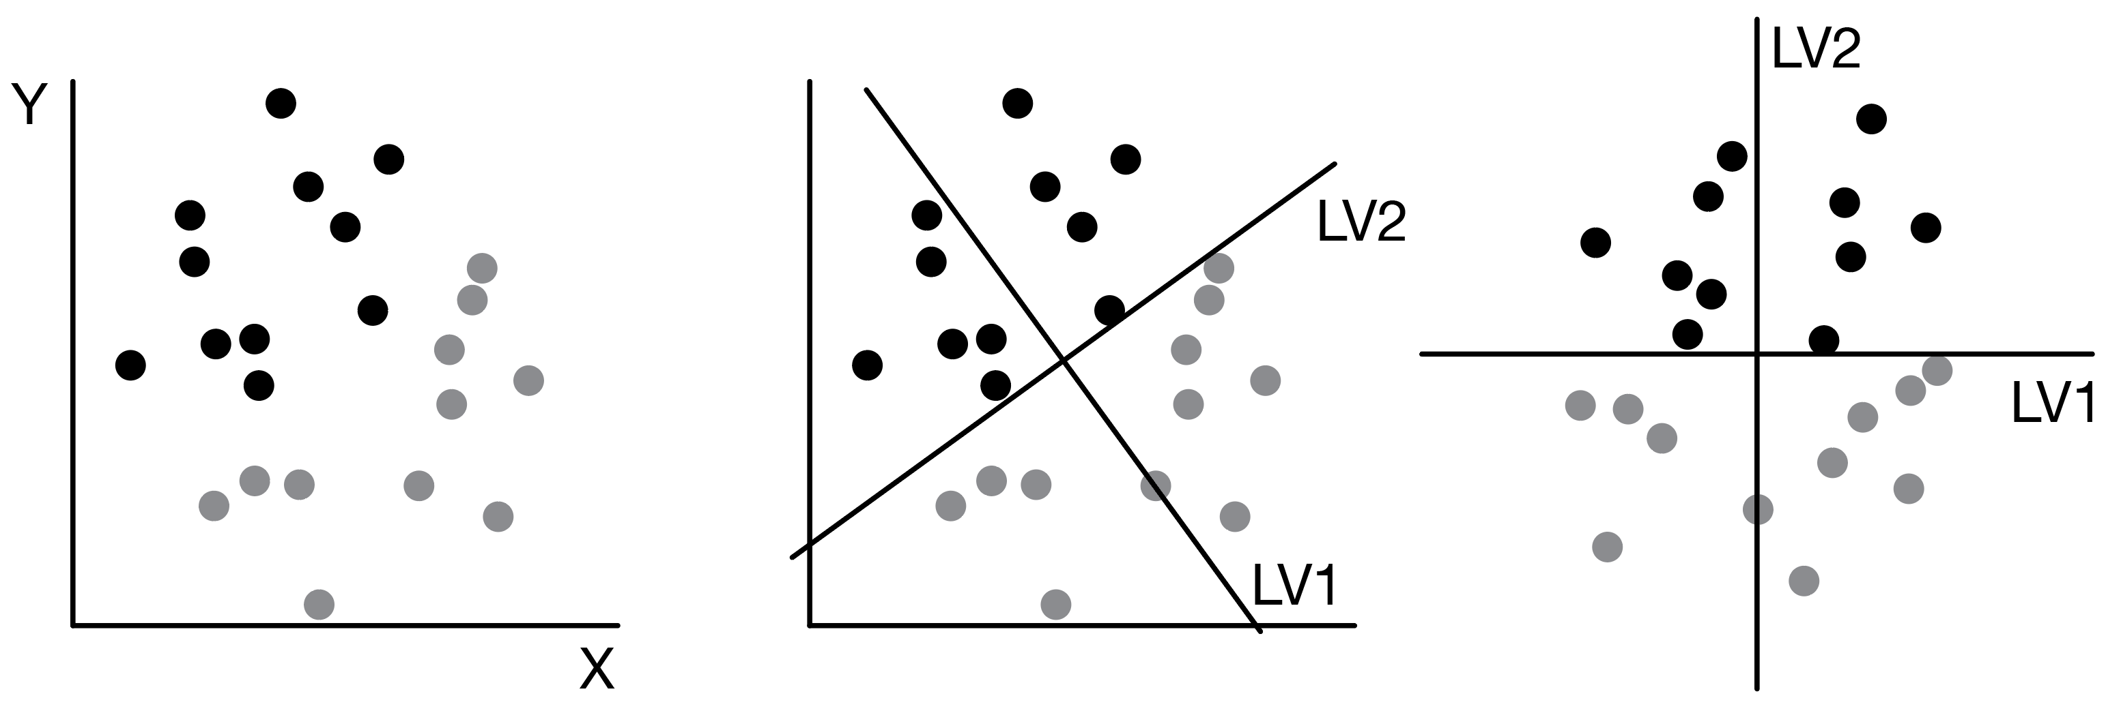
All PCs: PCA is a rotation process
Raw
Data
Coordinate
Transformation
Better
Representation

Slide 27
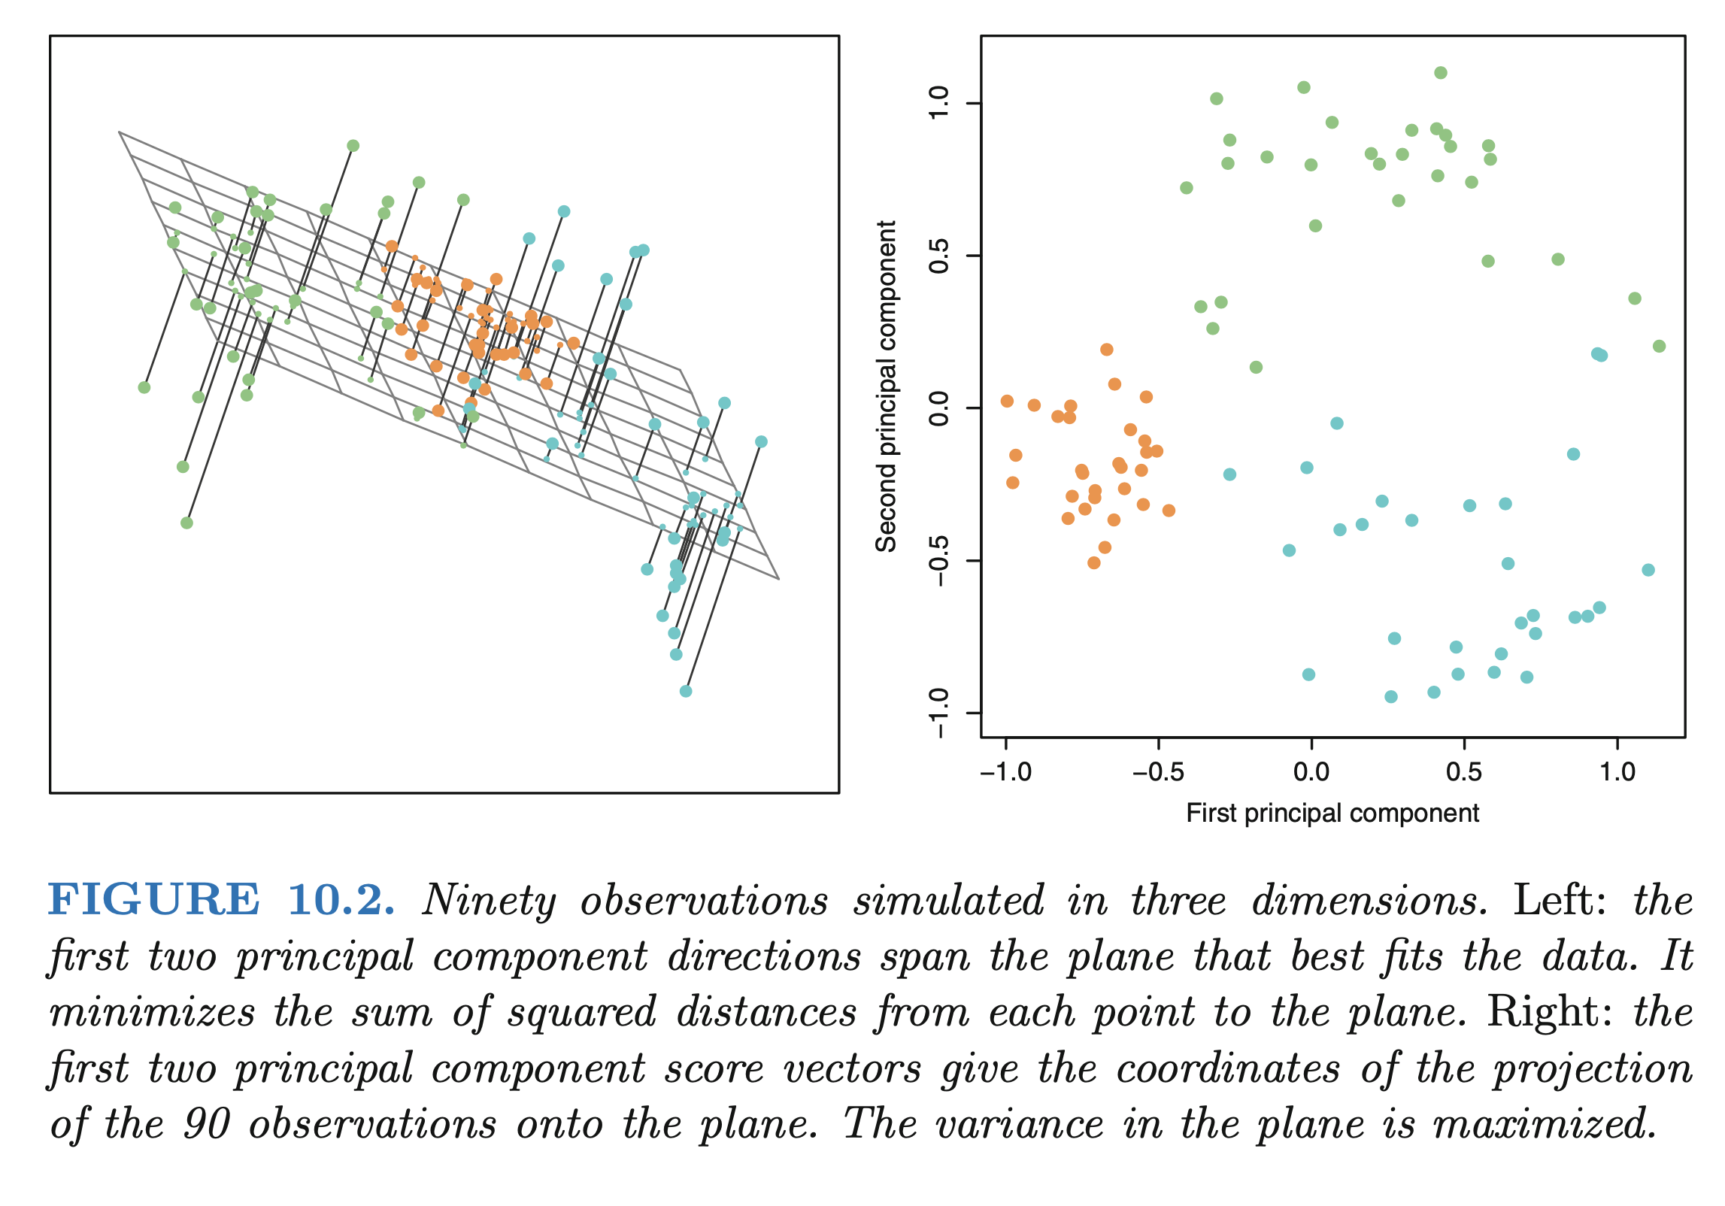
Some PCs: PCA finds the hyperplane that maximizes in-plane variance

Slide 28
PCA as a matrix decomposition: m=M
p columns of
recorded variables
M x M
"loadings"
M columns of
"scores"
X
P
S
n rows of
independent observations
=

Slide 29
PCA as a matrix decomposition: m<M
p columns of
recorded variables
M x m
"loadings"
m columns of
"scores"
X
P
S
n rows of
independent observations
=

Slide 30
PCA as a matrix decomposition: m<M
m columns of
"scores"
m x M
"loadings"
p columns of
recorded variables
S
P^{T}
m-dimensional
approximation to
X
n rows of
independent observations
=

Slide 31
Visualization of 5 variables: 5 PCs

Slide 32
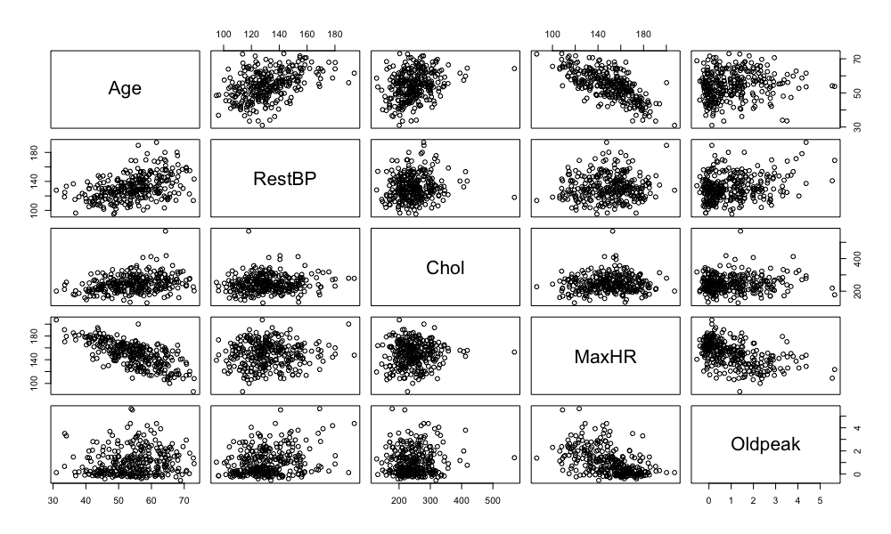
Visualization of 5 variables: 4 PCs

Slide 33
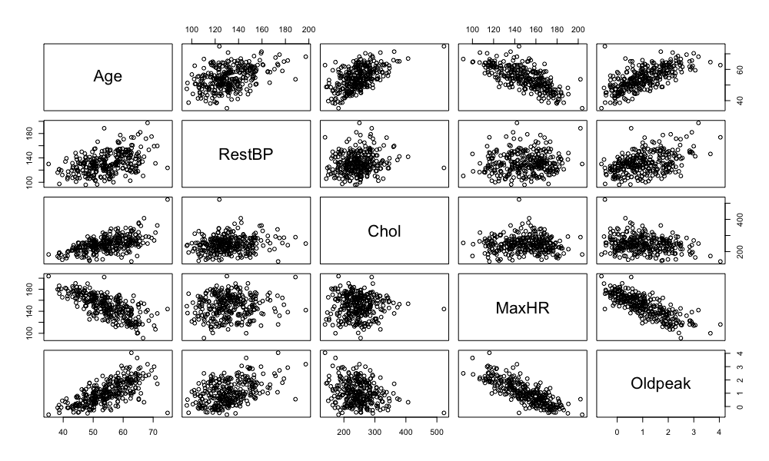
Visualization of 5 variables: 3 PCs

Slide 34
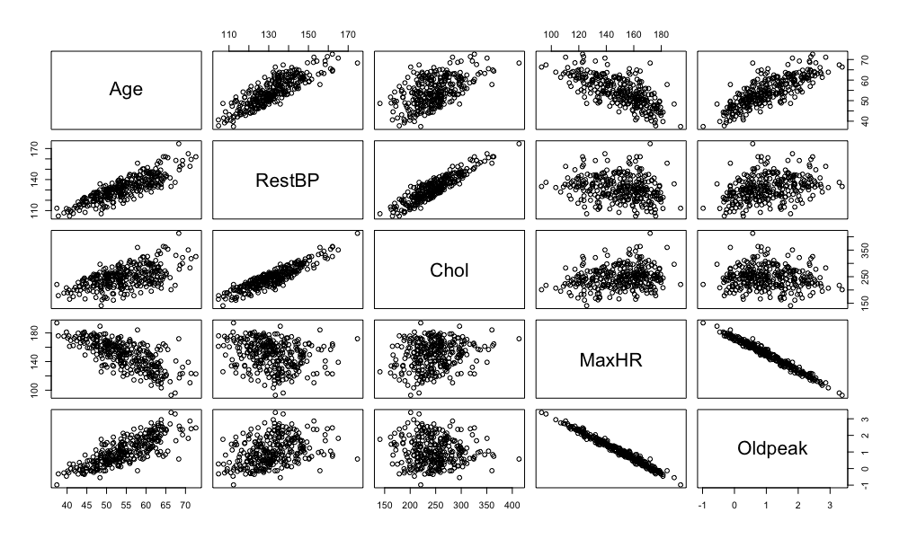
Visualization of 5 variables: 2 PCs

Slide 35
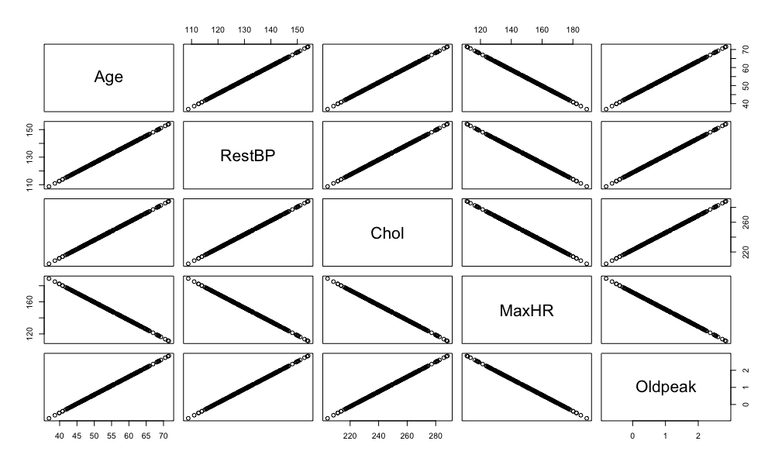
Visualization of 5 variables: 1 PC

Slide 36
Outline
Concepts of dimensionality and dimensionality reduction
Calculating PCs and choosing PC number
Scree plots and biplots
Including labels: discriminant analysis
Constrained alternatives: non-negative matrix factorization

Slide 37
Calculation of principal components
If the columns of $X$ are centered, we can calculate the covariance matrix:
$$X^{T}X/(n−1)$$
The principal components of $X$are the eigenvectors of the covariance matrix. (Note this equation is for centered data.)

Slide 38
Calculation of principal components
In the singular value decomposition:
$$X=UDV^{T}$$
The principal components are the columns of $V$. (Note this equation is for centered data.)

Slide 39
Calculation of principal components
Note the link between the SVD relationship:
$$X=UDV^{T}$$
And the PCA relationship:
$$X=SP^{T}$$
If we allow S=UD then it is clear that the principal components P and singular vectors V are the same.

Slide 40
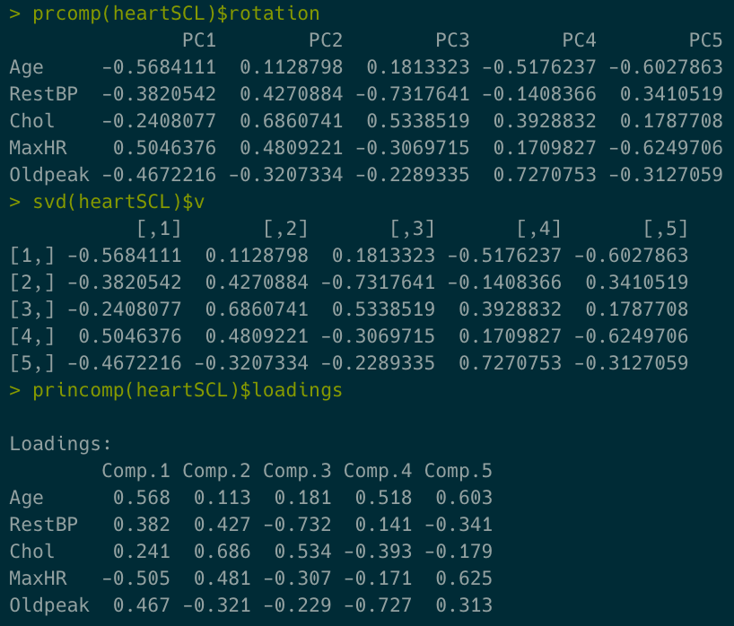
Relationship between PCA and SVD

Slide 41
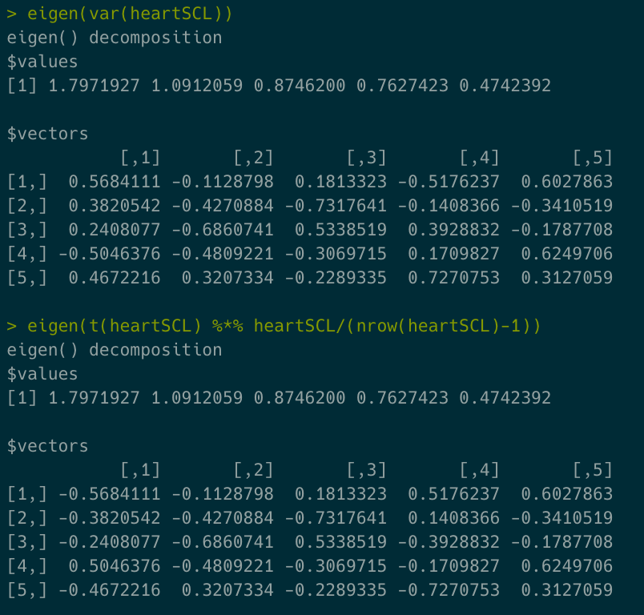
Relationship between eigenvector decomposition of covariance and SVD

Slide 42
A note on centering and scaling
Centering and scaling is assumed to have been performed prior to all of the approaches we will discuss here.
This is to ensure:
That each variable / feature is valued equally in the analysis
Unit conformability (unit standard deviation)
Numerical stability (sometimes required for large n and or p)
Another note:
Omitting the scaling step will probably not cause any problems other than distorting PCs / loadings.
Omitting the centering will typically cause the first PC to include the average and dominate the other PCs

Slide 43
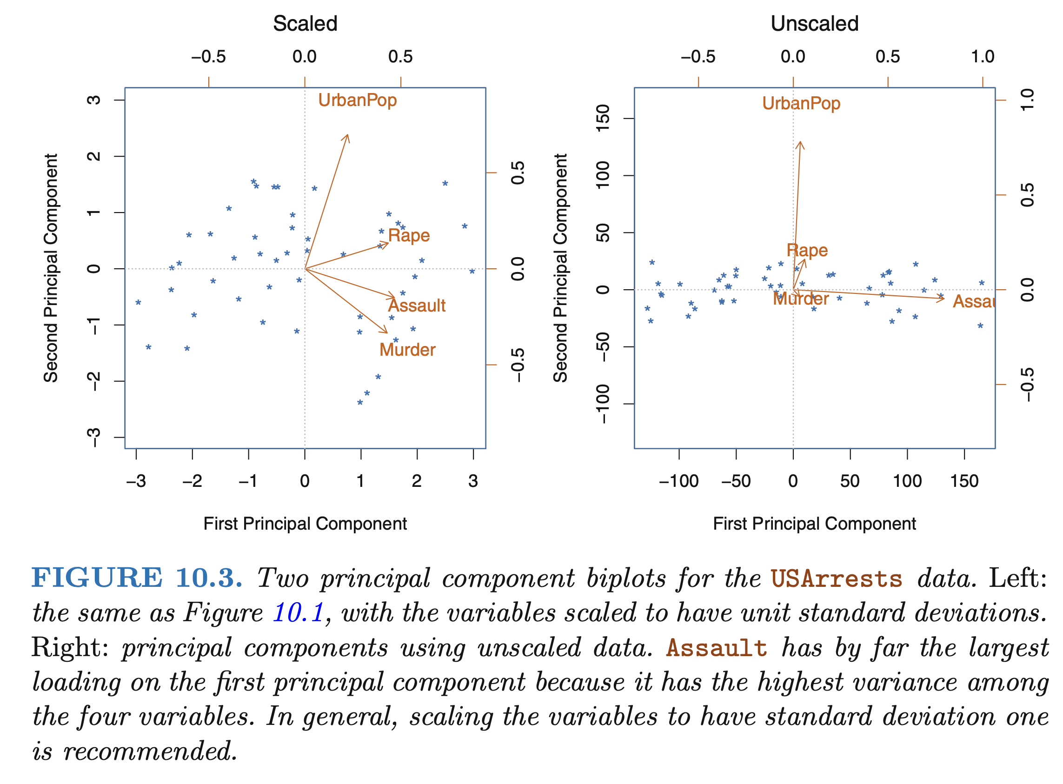
Unlike regression, scaling can substantially alter PCA results

Slide 44
Special cases of scaling
When variables differ in overall scale by orders of magnitude, PCA will favor variables in the largest fundamental units unless scaling is performed.
When dealing with data in the same physical units (e.g., x-y-z kinematic coordinates) it may be less appropriate to scale the each variable; perhaps each set of three columns should contribute a certain amount of variance.
When dealing with GWAS / 'omics / biomarker data with common units, we may not choose to scale columns so that biomarkers with the most variance in expression are represented the strongest.

Slide 45
Choosing the number of PCs
In general, an n x p data matrix (where n>p) has p distinct principal components. However, we usually are not interested in all of them.
We would typically like to use just the first few principal components in order to visualize or interpret the data.
Unfortunately, there is no single answer to how many principal components constitute "a few."
Typically, the process is iterated over a number of candidate values of M until a decision can be made.

Slide 46
Choosing the number of PCs
Methods include:
Choosing the minimum number of PCs required to meet a pre-determined explained variance threshold, such as 80%
Visually examining the scree plot for a "knee"
When data are scaled to unit variance prior to entry, retaining all PCs with variance (or standard deviation) ≥ 1, based on the notion that they explain at least "one variable" worth of variance.
Applying any of the above criteria to a leave-out validation set.

Slide 47
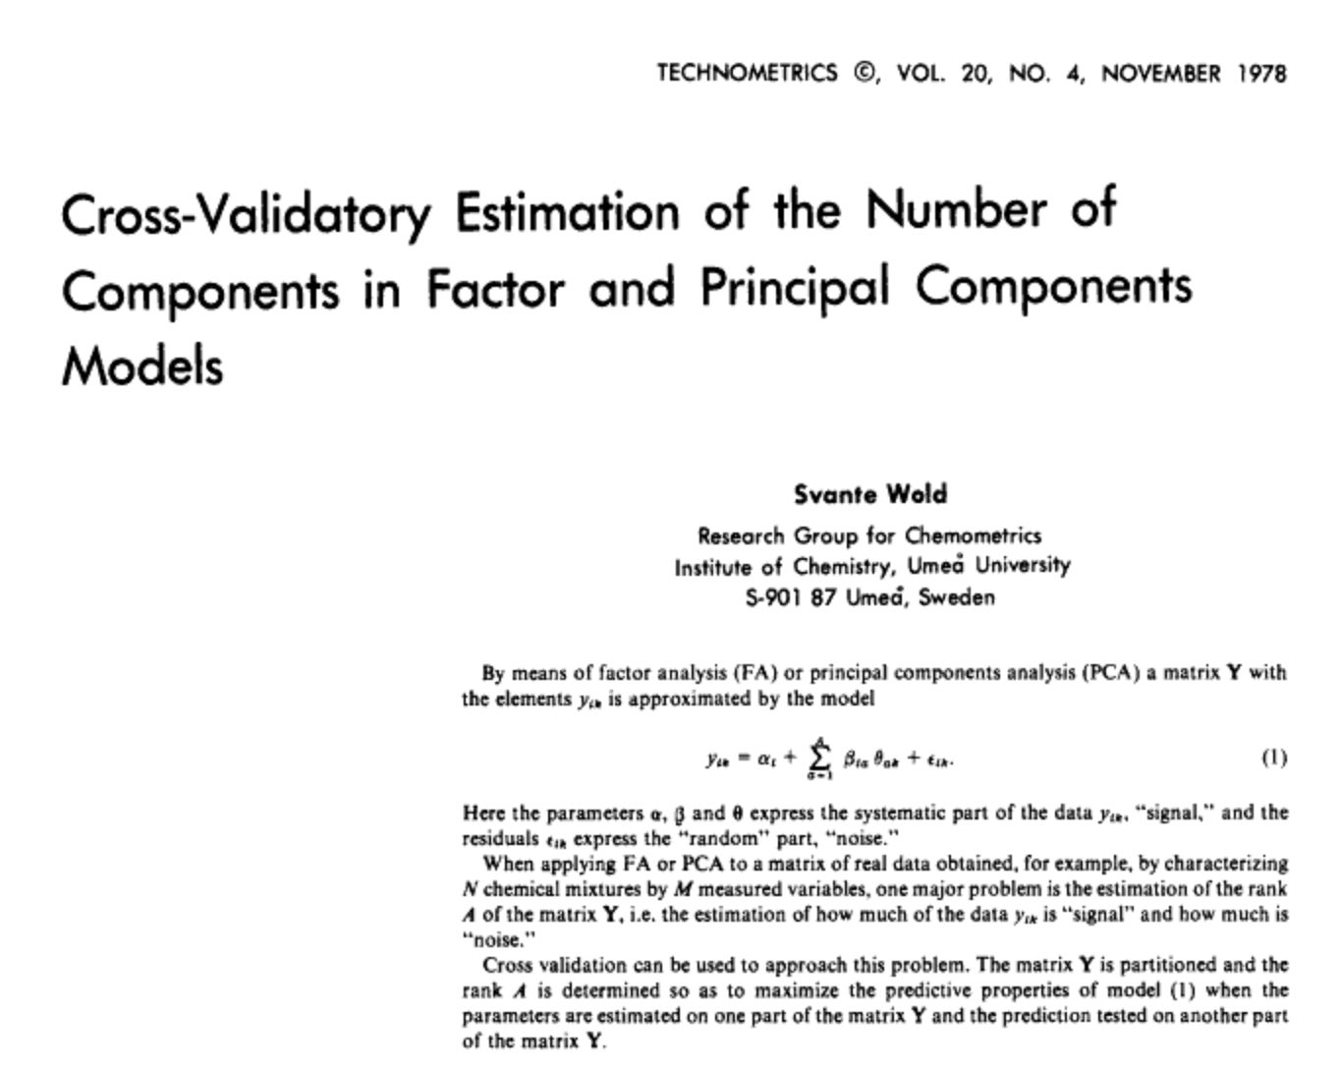
Automated decision making for PC selection remains nonstandardized
Cross-validation approaches exist, but generally suffer from the same pitfalls as step-in/step-out methodologies for regression.

Slide 48
Statistical tests exist but remain in development
There are statistical methods for this question, but they are somewhat uncommon in practical use. For example: the "Sequential Chi-Square Model Test" (EFA.dimensions::SMT)
"The fit of common factor models is often assessed with the likelihood ratio test statistic (Lawley, 1940) using maximum likelihood estimation (ML), which tests whether the model-implied covariance matrix is equal to the population covariance matrix. The associated test statistic asymptotically follows a Chi-Square distribution if the observed variables follow a multivariate normal distribution and other assumptions are met (e.g., Bollen, 1989). This test can be sequentially applied to factor models with increasing numbers of factors, starting with a zero-factor model. If the Chi-Square test statistic is statistically significant (with e.g., p < .05), a model with one additional factor, in this case a unidimensional factor model, is estimated and tested. The procedure continues until a nonsignificant result is obtained, at which point the number of common factors is identified."

Slide 49
Statistical tests exist but remain in development
There are statistical methods for this question, but they are somewhat uncommon in practical use. For example: the "Sequential Chi-Square Model Test" (EFA.dimensions::SMT)
"Simulation studies investigating the performance of [SMTs] have shown conflicting results. Whereas some studies have shown that SMT has a tendency to overextract (e.g., Linn, 1968; Ruscio & Roche, 2012; Schonemann & Wang, 1972), others have indicated that the SMT has a tendency to underextract (e.g., Green et al., 2015; Hakstian et al., 1982; Humphreys & Montanelli, 1975; Zwick & Velicer, 1986). Hayashi, Bentler, and Yuan (2007) demonstrated that overextraction tendencies are due to violations of regularity assumptions if the number of factors for the test exceeds the true number of factors. For example, if a test of three factors is applied to samples from a population with two underlying factors, the likelihood ratio test statistic will no longer follow a Chi-Square distribution. Note that the tests are applied sequentially, so a three-factor test is only employed if the two-factor test was incorrectly significant. Therefore, this violation of regularity assumptions does not decrease the accuracy of SMT, but leads to (further) overextractions if a previous test was erroneously significant. Additionally, this overextraction tendency might be counteracted by the lack of power in simulation studies with smaller sample sizes. The performance of SMT has not yet been assessed for non-normally distributed data or in comparison to most of the other modern techniques presented thus far in a larger simulation design." (p. 475)

Slide 50
Outline
Concepts of dimensionality and dimensionality reduction
Calculating PCs and choosing PC number
Scree plots and biplots
Including labels: discriminant analysis
Constrained alternatives: non-negative matrix factorization

Slide 51
Scree plots
We often decide on the number of principal components required to visualize the data by examining a scree plot.
A scree plot shows the proportion of variance explained by each principal component. Because they are in order of decreasing magnitude, this results in a shape like a hill or mountain.
The idea is that the "real" underlying number of PCs is the base of the hill.

Slide 52
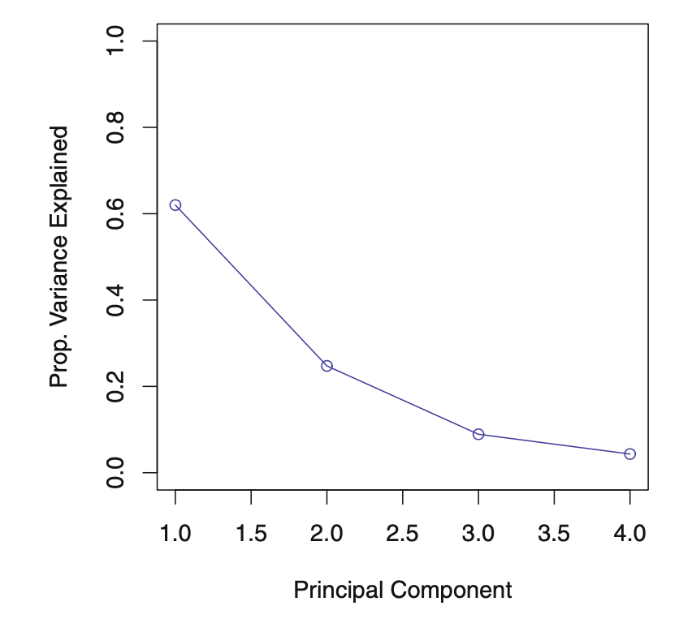
Scree plots
We often decide on the number of principal components required to visualize the data by examining a scree plot.

Slide 53
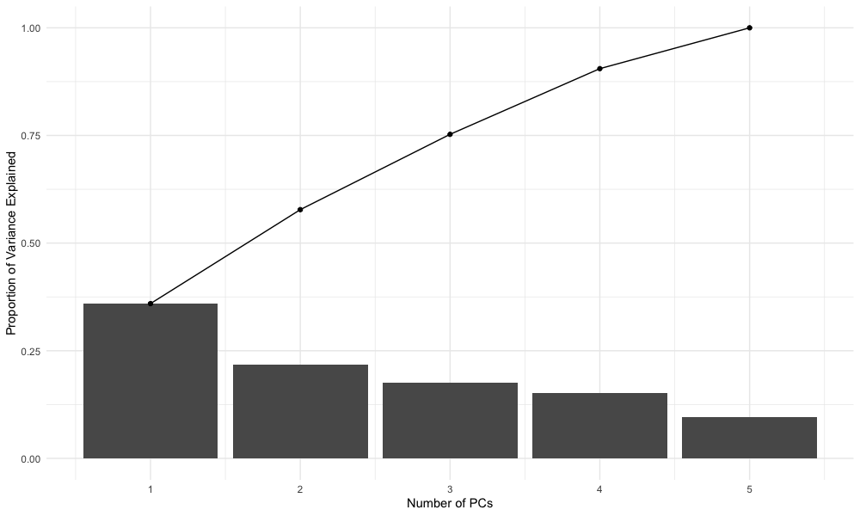
Visualization of 5 PCs: scree plot

Slide 54
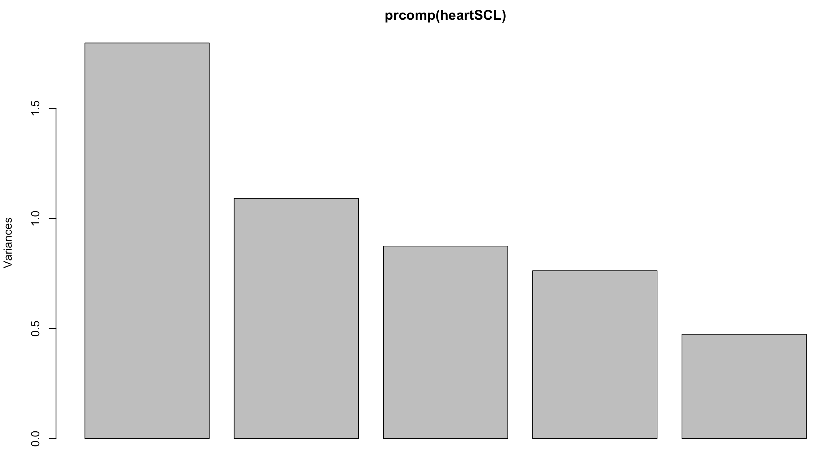
Visualization of 5 PCs: scree plot

Slide 55
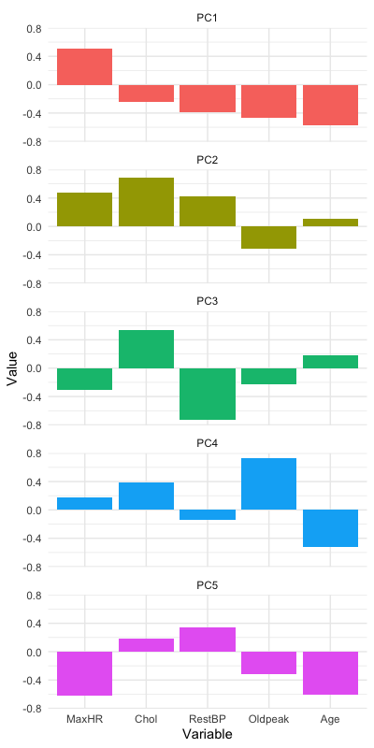
Visualization of PC loadings: bar plot

Slide 56
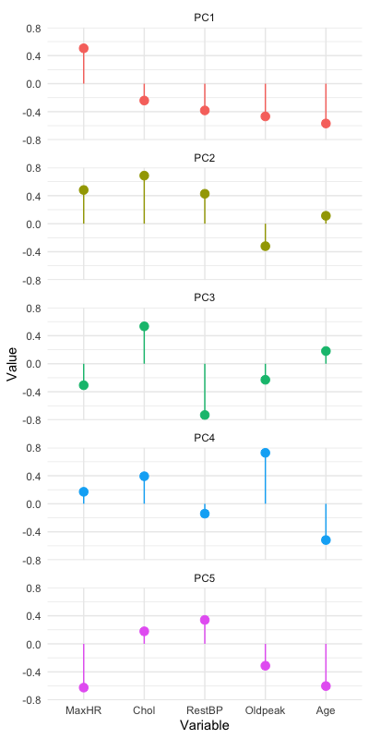
Visualization of PC loadings: lollipop plot

Slide 57
Biplots
Once the data have been transformed to PC space, it is useful to visualize it as a "biplot."
There are many variants of these, but essentially the original variables and the original observations can be visualized on the same axis (although typically with different scaling factors).

Slide 58
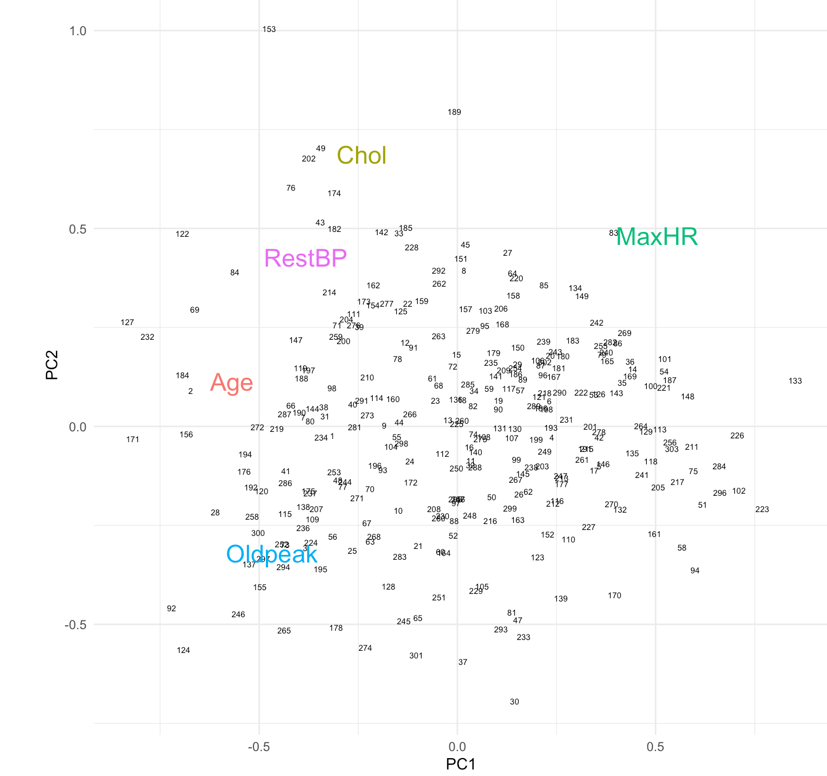
Biplots

Slide 59
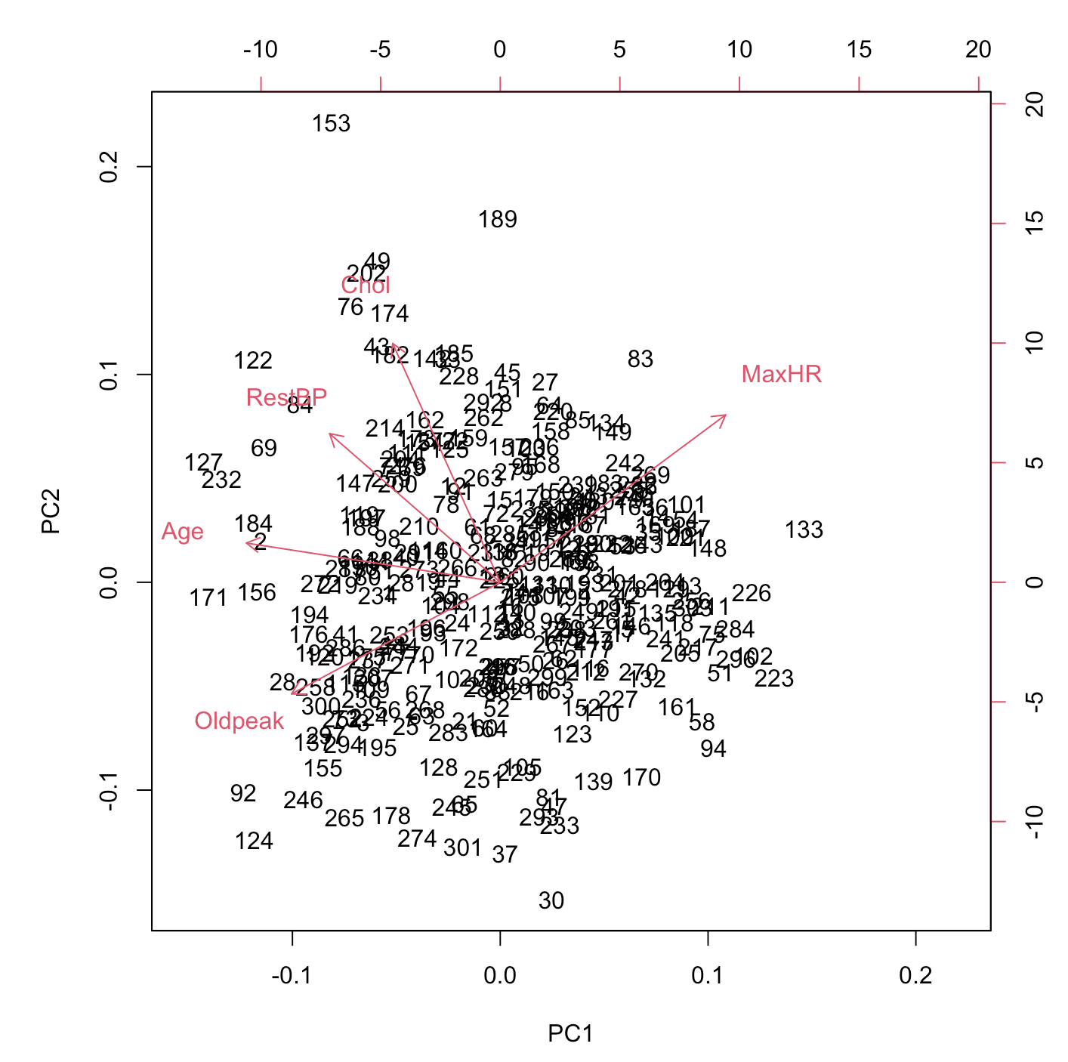
Biplots

Slide 60
Outline
Concepts of dimensionality and dimensionality reduction
Calculating PCs and choosing PC number
Scree plots and biplots
Including labels: discriminant analysis
Constrained alternatives: non-negative matrix factorization

Slide 61
Including labels: discriminant analysis
Up to this point we have considered methods to "discover structure" in the predictor data X.
This is a type of unsupervised learning that may not be appropriate.
In many cases we simply would like to de-noise our Gaussian data prior to some other processing step; however, in other cases we have an idea what the labels should be. Many studies have started by performing a PCA or similar analysis in the (naive?) hope that the algorithm would "discover" an independent variable determined a priori.

Slide 62
Including labels: discriminant analysis
While PCA ignores class labels of input data, discriminant analysis (usually partial least squares discriminant analysis, PLS-DA) is aware of the labels during training.
This is often what we really want in these types of problems.
Some material in this section is adapted from this resource: https://learnche.org/pid/contents

Slide 63
Including labels: discriminant analysis
In PCA the objective is to identify the components/latent variables P that best explains the available variance in X.
It is also possible (in PLS-DA) to identify latent variables, but to identify them so that they best explain X and best explain Y, so that these latent variables have the strongest possible relationship between X and Y.
In other words, there are three simultaneous objectives with PLS:
1. The best explanation of the X-space.
2. The best explanation of the Y-space.
3. The greatest relationship between the X and Y-space.
(Note that there is no requirement that Y be one-dimensional; indeed it is not in many cases.)

Slide 64
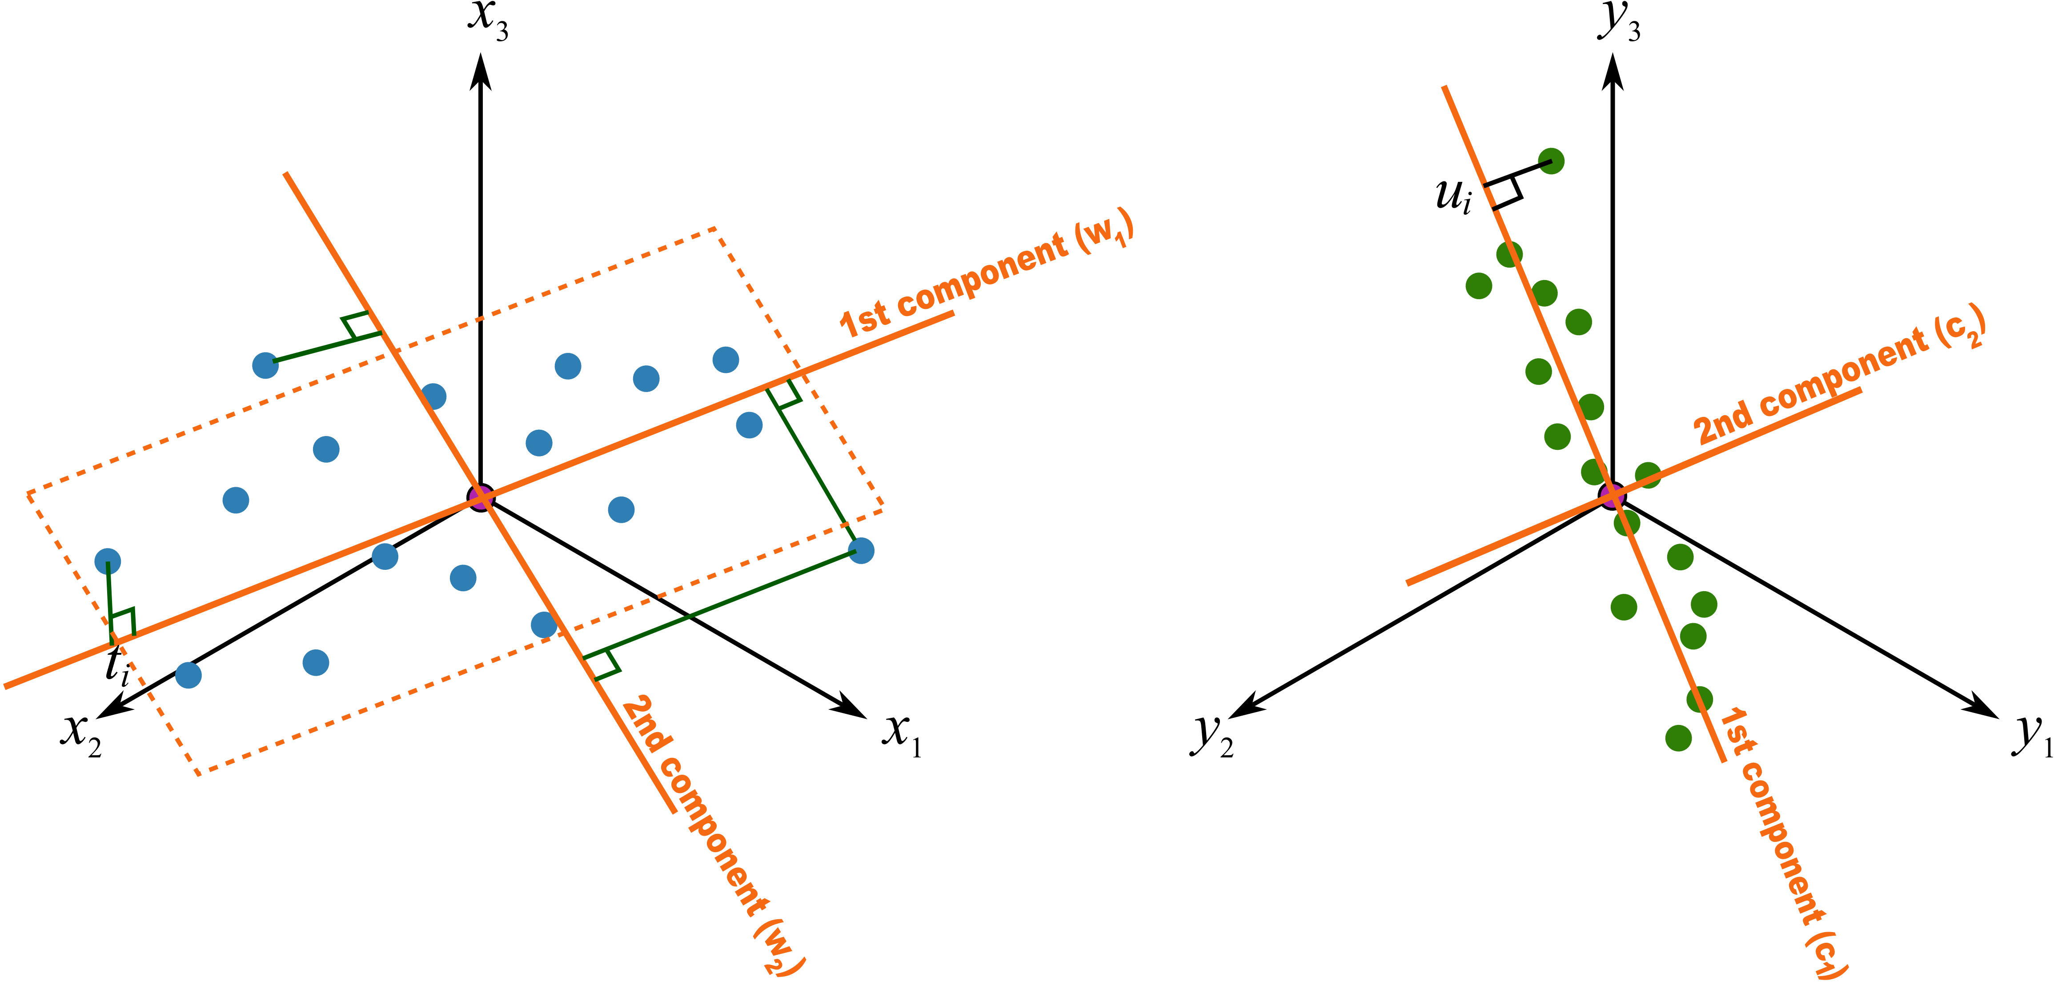
Unsupervised learning
https://learnche.org/pid/latent-variable-modelling/projection-to-latent-structures/conceptual-mathematical-and-geometric-interpretation-of-pls

Slide 65
Supervised learning
https://learnche.org/pid/latent-variable-modelling/projection-to-latent-structures/conceptual-mathematical-and-geometric-interpretation-of-pls

Slide 66
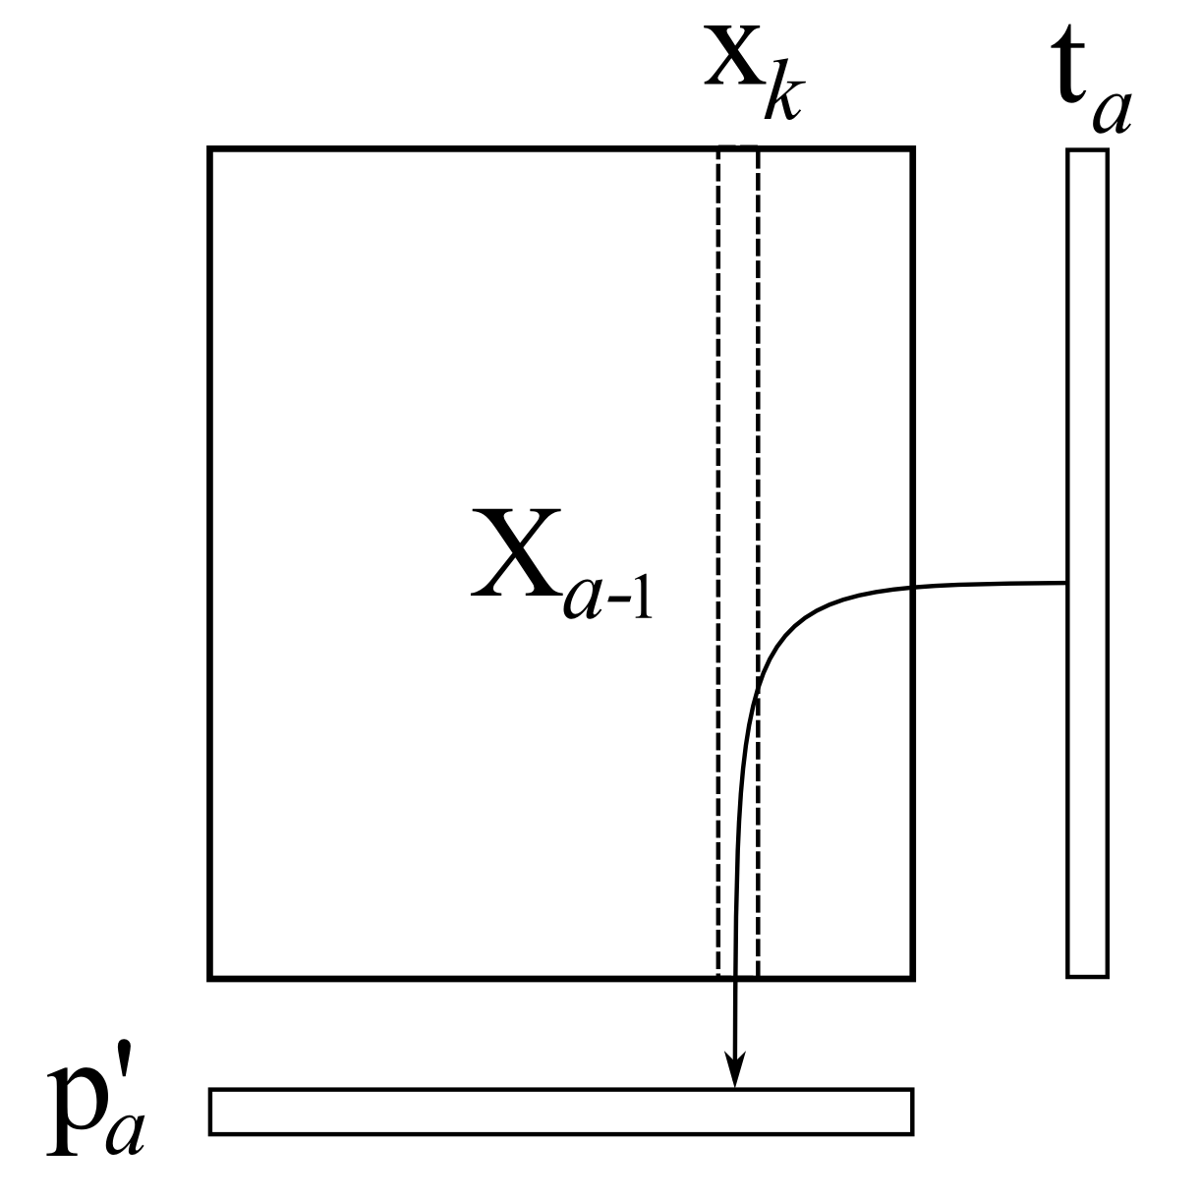
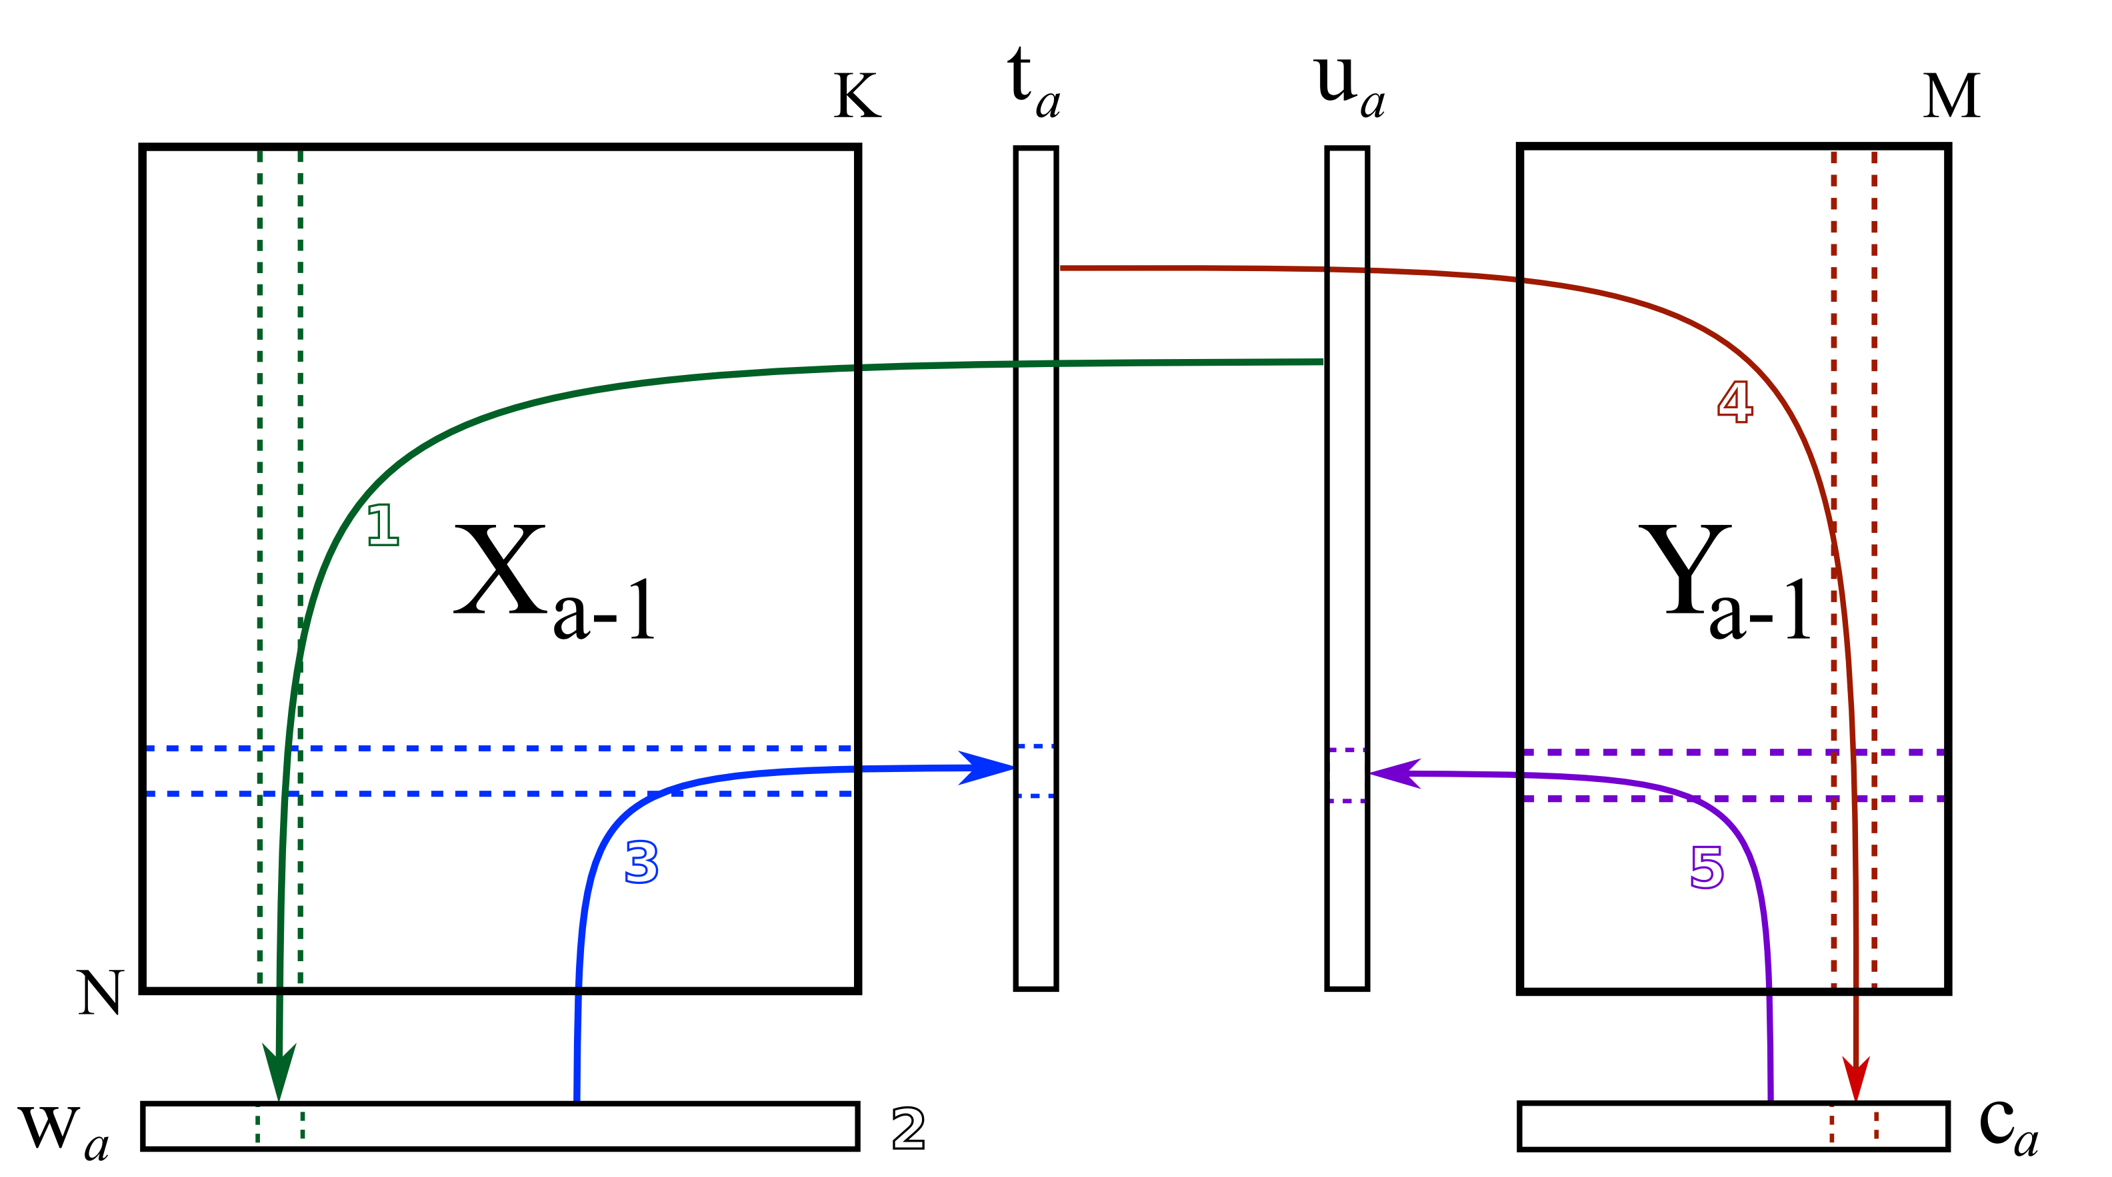
The NIPALS algorithm
Non-linear iterative partial least squares (NIPALS) is a sequential method for computing principal components and "latent variables" in discriminant analysis.
It was originally developed for PCA and later extended to PLS-DA.
It is tolerant of missing data but convergence is based on heuristics.
https://learnche.org/pid/latent-variable-modelling/projection-to-latent-structures/conceptual-mathematical-and-geometric-interpretation-of-pls

Slide 67
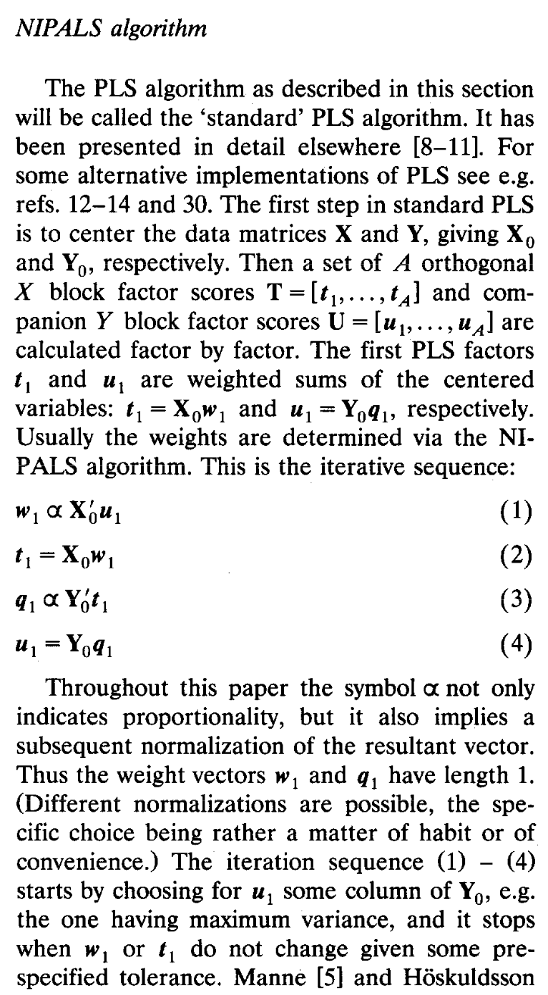
The NIPALS algorithm
Non-linear iterative partial least squares (NIPALS) is a sequential method for computing principal components and "latent variables" in discriminant analysis.
It was originally developed for PCA and later extended to PLS-DA.
It is tolerant of missing data but convergence is based on heuristics.
de Jong 1993

Slide 68
The NIPALS algorithm
Non-linear iterative partial least squares (NIPALS) is a sequential method for computing principal components and "latent variables" in discriminant analysis.
It was originally developed for PCA and later extended to PLS-DA.
It is tolerant of missing data but convergence is based on heuristics.
Subsequent improvements (SIMPLS) have been proposed.
de Jong 1993

Slide 69
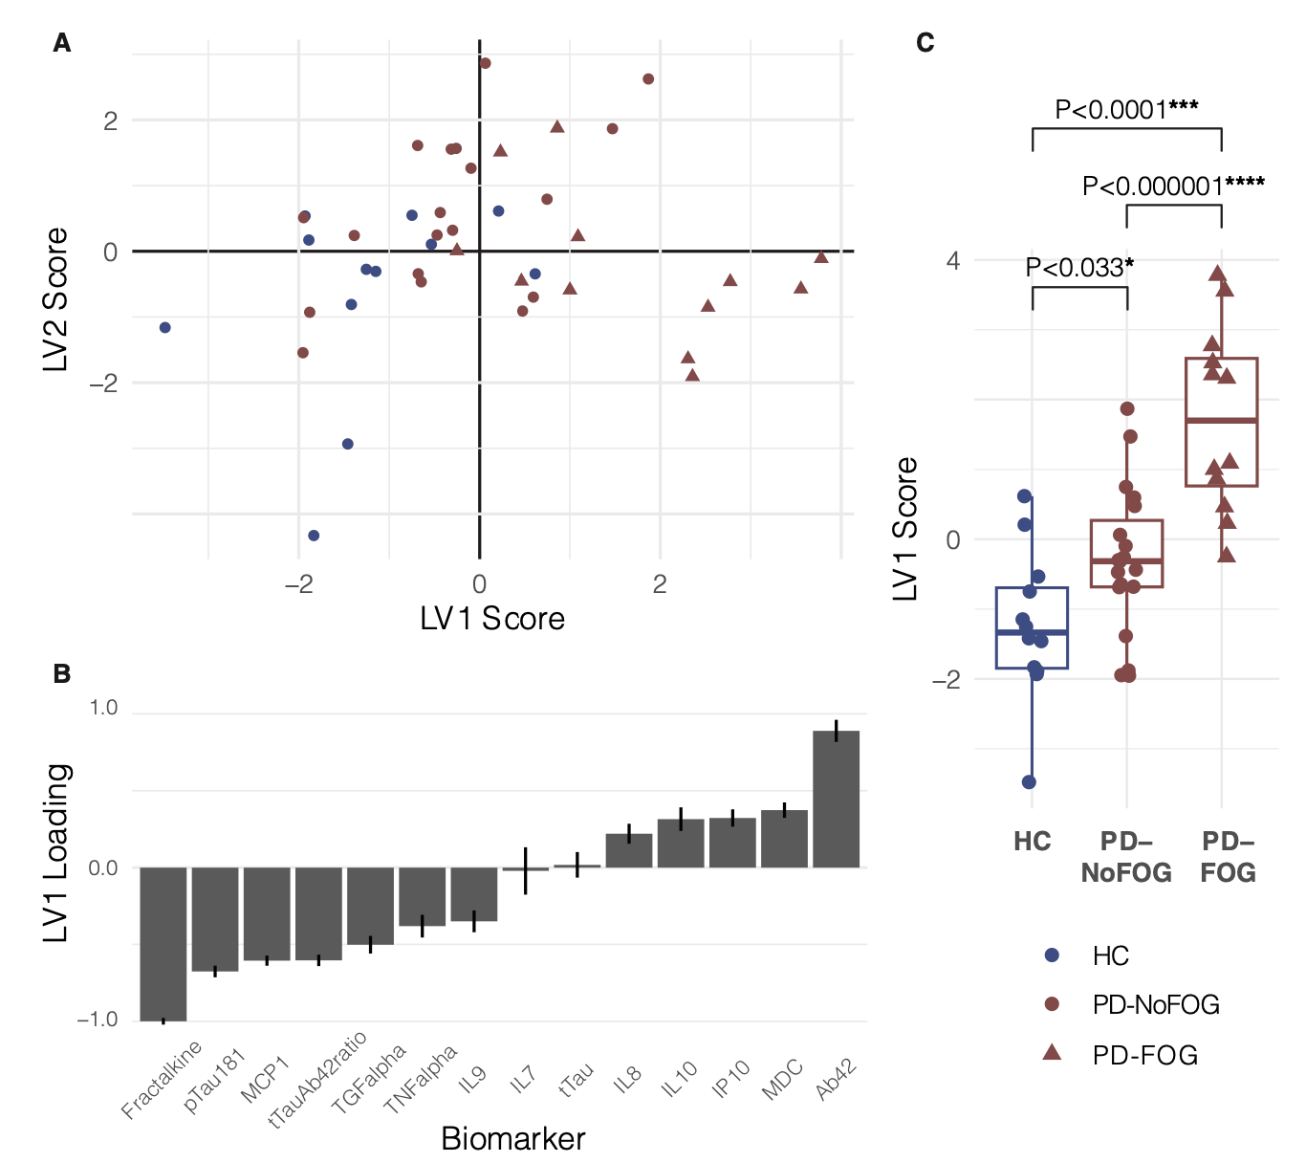
Example PLS-DA results
LV1: tends to discriminate
triangles vs. circles
(main independent variable)
Biomarkers loaded in LV1
(note that the loading of the
labels is not considered)

Slide 70
PLSDA implementations
Implemented on bioconductor (an alternative to CRAN) as mixOmics::plsda
Implemented in Python as PLSRegression in sklearn.cross_decomposition

Slide 71
Outline
Concepts of dimensionality and dimensionality reduction
Calculating PCs and choosing PC number
Scree plots and biplots
Including labels: discriminant analysis
Constrained alternatives: non-negative matrix factorization

Slide 72
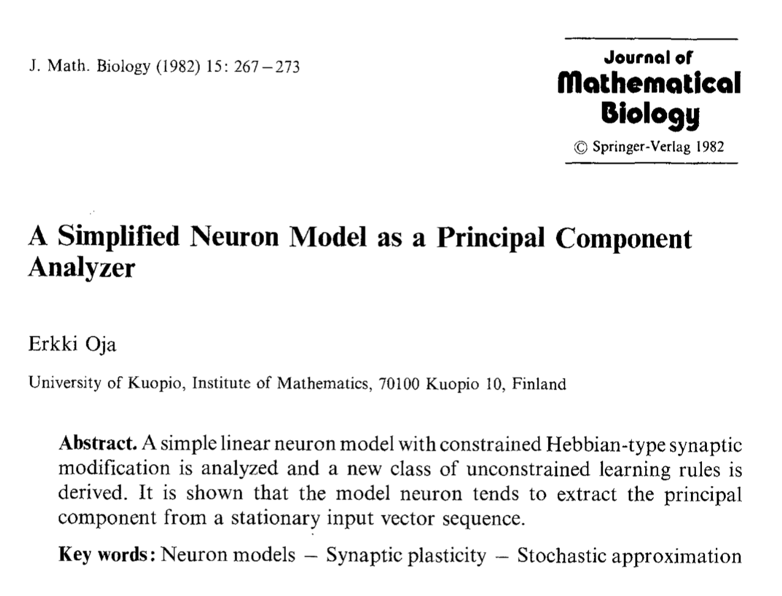
A very brief link to neural processing
It has long been acknowledged that neurons (artificial and living) extract PC-like features via Hebbian learning rules.
PCA is often applied as a preprocessing data reduction step, but the subsequent layers are also doing (meta) PCA.

Slide 73
Constrained alternatives: non-negative matrix factorization
PCA is by far the most common technique for dimensionality reduction, but in some cases the data representation can be exploited to create more compact and interpretable basis vectors.
In particular, non-negative matrix factorization is a technique that is able to exploit the structure of natural images.
This is available in many packages; other alternatives like non-negative PCA are also available and may be suited to your problem.

Slide 74
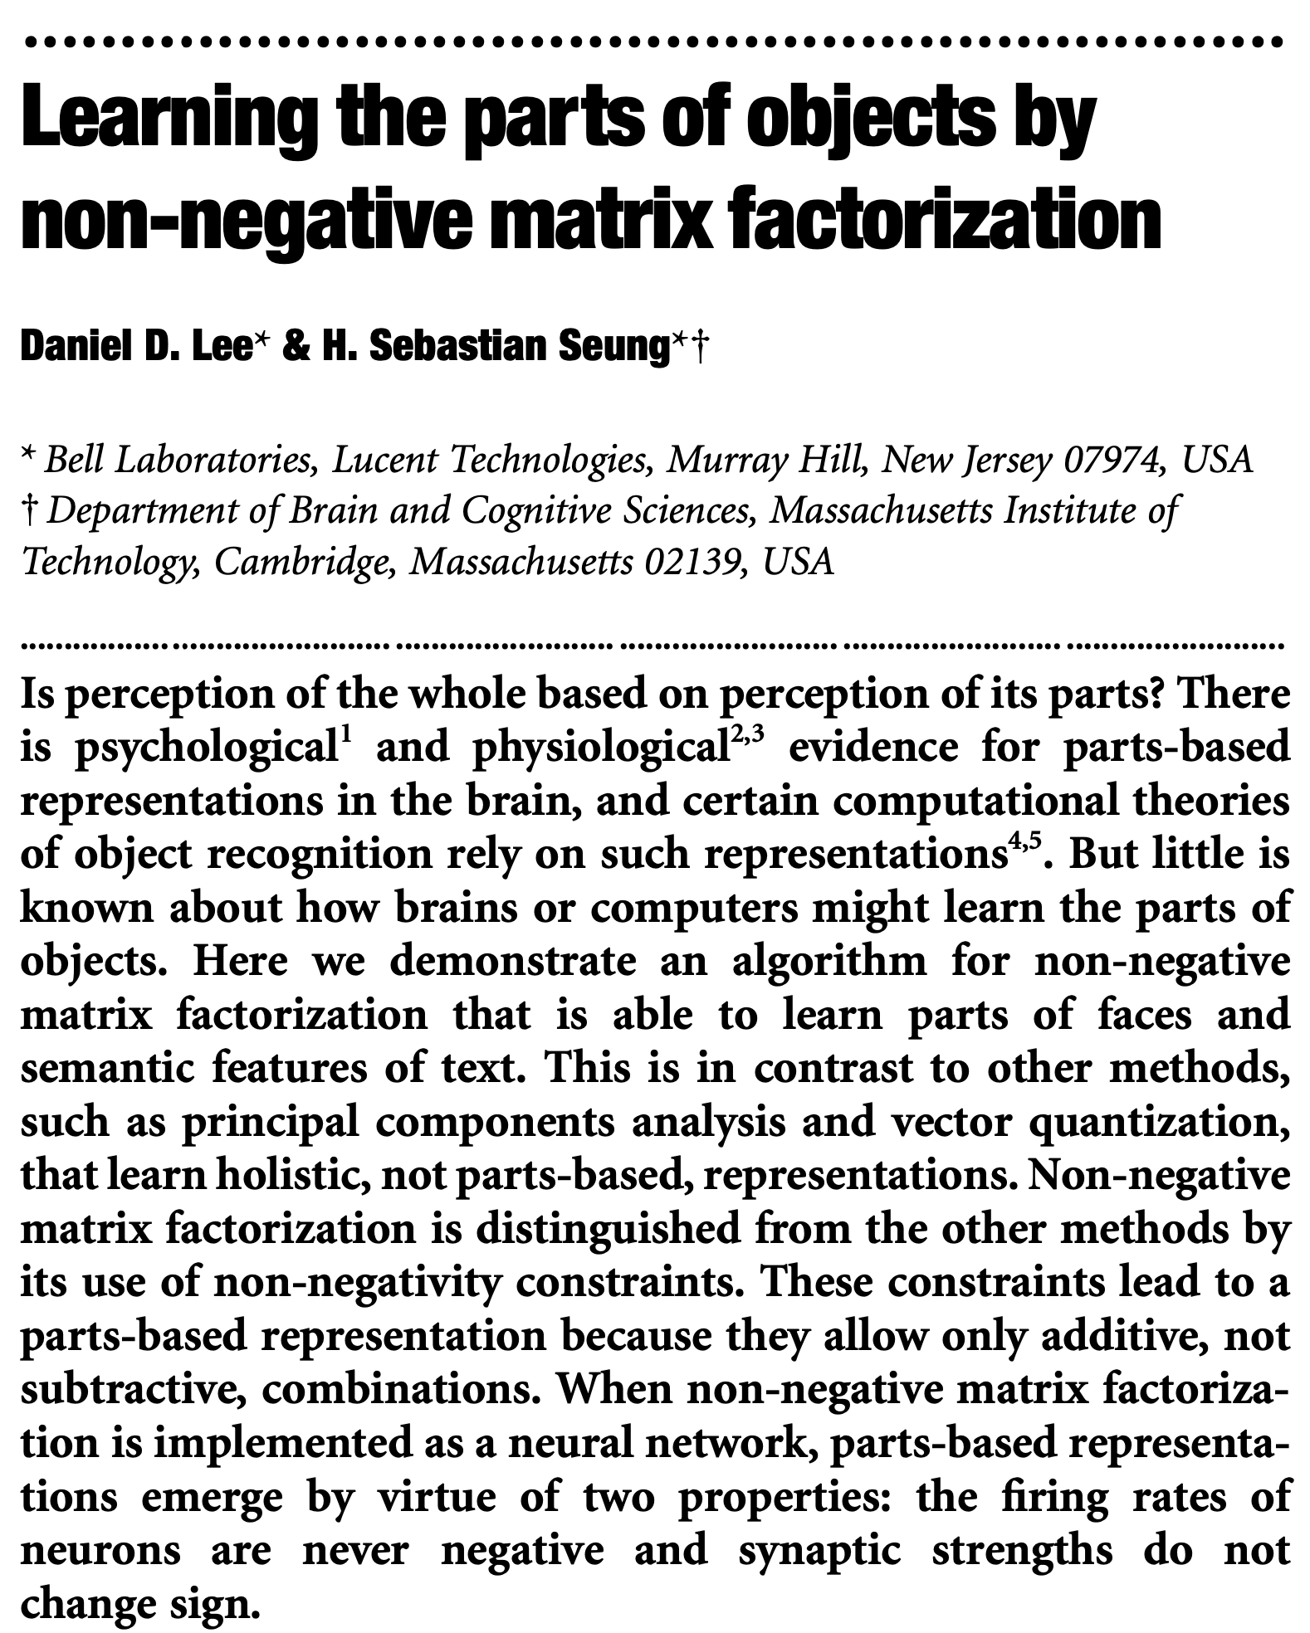
Constrained alternatives: non-negative matrix factorization
Nature, 1999

Slide 75
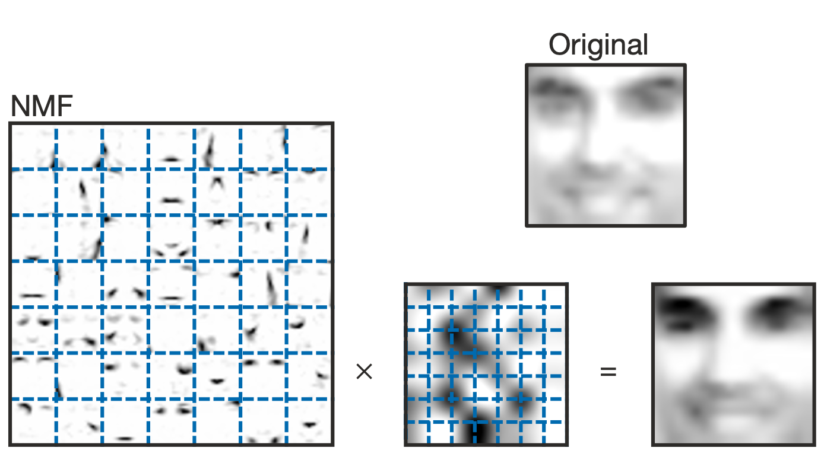
Constrained alternatives: non-negative matrix factorization

Slide 76
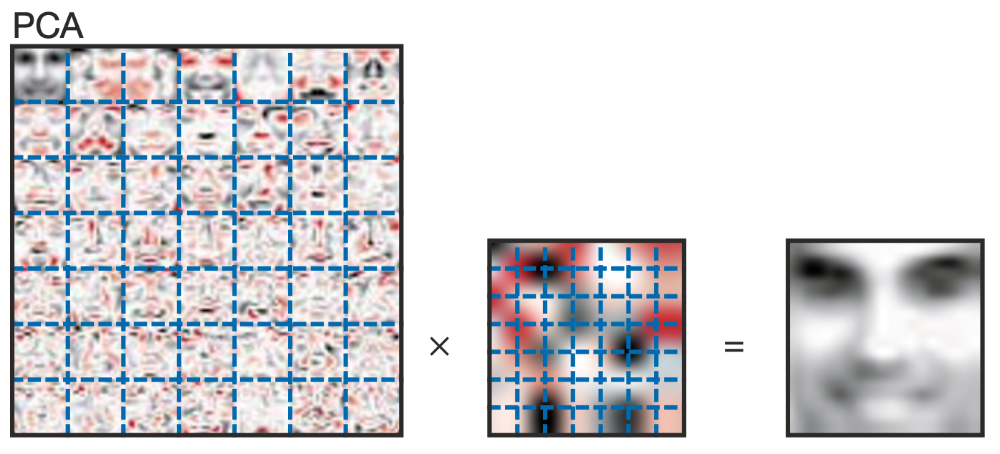
Constrained alternatives: non-negative matrix factorization

Slide 77
Outline
Concepts of dimensionality and dimensionality reduction
Scree plots and biplots
Calculating PCs and choosing PC number
Including labels: discriminant analysis
Constrained alternatives: non-negative matrix factorization

