Slide 1

BMI 510: Analysis of Variance
J. Lucas McKay, Ph.D., M.S.C.R.
Departments of Biomedical Informatics and Neurology, Emory University, Atlanta, GA USA
Department of Biomedical Engineering, Georgia Institute of Technology, Atlanta, GA, USA

Slide 2
Introduction
We often use t-tests and similar procedures to analyze numerical data arising from experimental designs with two samples.
Designed experiments frequently involve more than two samples; they might compare the ability of, say, three different treatments to reduce tumor volume (a continuous numerical variable) in three samples of otherwise nearly identical rats.
Analysis of variance (ANOVA) is a common procedure used for the statistical analysis of such experiments.

Slide 3
Outline
Contexts for ANOVA
Data management
Model formulation and sums of squares
The ANOVA F test
Post-hoc tests

Slide 4
Contexts for ANOVA

Slide 5
Typical contexts for ANOVA
Designed experiments frequently involve more than two samples; they might compare the ability of, say, three different treatments to reduce tumor volume (a continuous numerical variable) in three samples of otherwise nearly identical rats.
Often these are described as "one-way", "two-way," and "n-way" study designs.

Slide 6
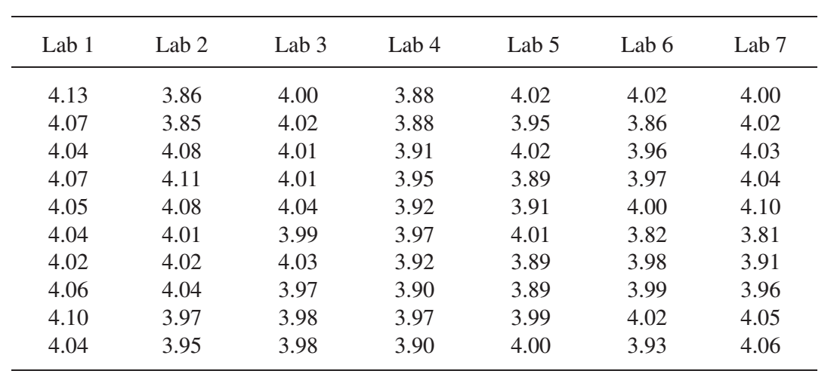
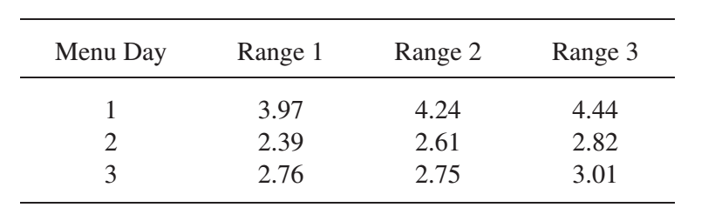
Typical contexts for ANOVA
"One-way"
"Two-way"
Average weights of a drug in tablets synthesized by different laboratories
Energy use by three different restaurant ranges on three different menu days
Each kW measurement is averaged over multiple times during the day
H0A: mean from range 1 = mean 2 = mean 3
H0B: mean from day 1 = day 2 = day3
Only H0A may be of interest!
Each weight is typically averaged over multiple pills from each lab.
H0: mean from lab 1 = mean from lab 2 = etc.

Slide 7
A note about "designed experiments" vs. clinical studies
ANOVA is ubiquitous in "experimental" laboratory science like the previous cases – and is often the only analytic tool needed. (And taught.)
It has fewer applications in clinical /epidemiological research. Why?
Clinical outcomes are often not continuous normal variables.
Participants usually have different balances of covariates that must be accounted for. (Unlike lab rats.)
We often have more than one observation per participant. ANOVA is not designed for this, and the extensions (RM-ANOVA) are cumbersome.
The strict assumptions of ANOVA assume balanced designs; this is rarely possible in clinical studies.
Usually we end up using regression approaches (linear/ logistic/ generalized linear models) to accommodate these.

Slide 8
Data management

Slide 9
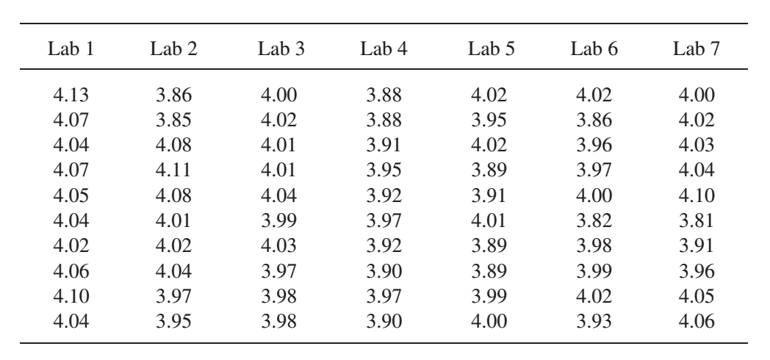
Although you will often see ANOVA data presented in wide format:

Slide 10
Although you will often see ANOVA data presented in wide format:
Lab codes are DATA. Data in variable names is bad form.
Lab codes are also categorical variables. Entering as numbers can lead to errors.

Slide 11
Although you will often see ANOVA data presented in wide format:
Lab codes are DATA. Data in variable names is bad form.
Lab codes are also categorical variables. Entering as numbers can lead to errors.
*Graphpad PRISM software requires entry this way, your collaborators might do this.

Slide 12
Please use melted/tall. There is only one outcome variable!
Lab | Level
A | 6.0
A | 6.1
A | 5.0
B | 10.3
B | 10.9
B | 9.2
C | 12.5
C | 11.7
C | 13.3

Slide 13
Model formulation and sum of squares

Slide 14
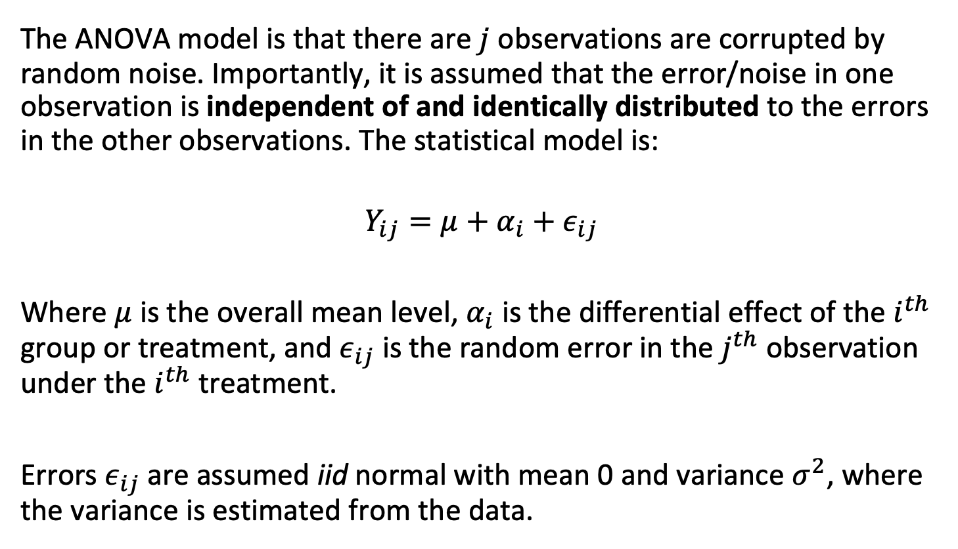
Model formulation
The ANOVA model is that there are $j$ observations are corrupted by random noise. Importantly, it is assumed that the error/noise in one observation is independent of and identically distributed to the errors in the other observations. The statistical model is:
$$Y_{ij}=μ+α_{i}+ε_{ij}$$
Where $μ$ is the overall mean level, $α_{i}$ is the differential effect of the $i^{th}$ group or treatment, and $ε_{ij}$ is the random error in the $j^{th}$ observation under the $i^{th}$ treatment.
Errors $ε_{ij}$are assumed iid normal with mean 0 and variance $σ^{2}$, where the variance is estimated from the data.

Slide 15

Reliance on means
Again, note that in the ANOVA model, each of the $J$ observations of each of the $I$ groups represent a summary for each cell – typically a mean.

Slide 16
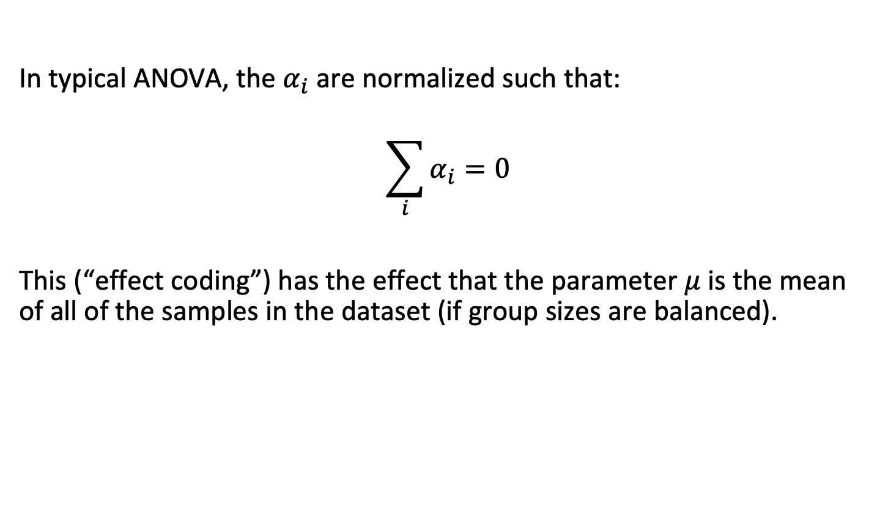
Effect coding
In typical ANOVA, the $α_{i}$ are normalized such that:
$$\sum_{i}^{​}{α_{i}}=0$$
This (“effect coding”) has the effect that the parameter $μ$ is the mean of all of the samples in the dataset (if group sizes are balanced).

Slide 17
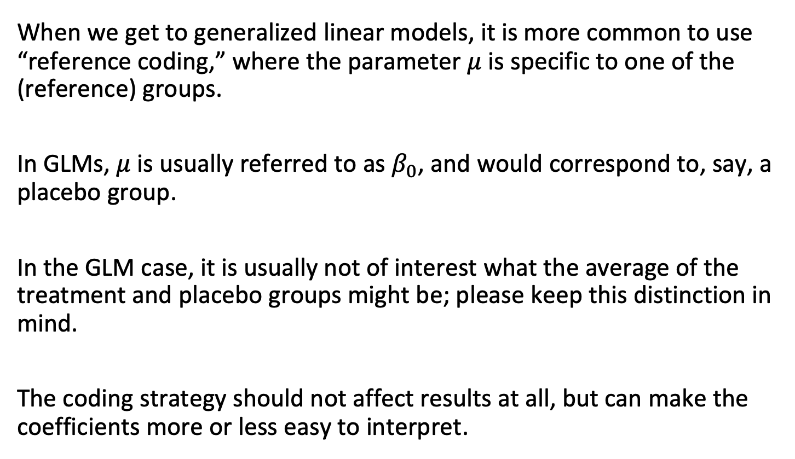
Relationship to reference coding
When we get to generalized linear models, it is more common to use “reference coding,” where the parameter $μ$ is specific to one of the (reference) groups.
In GLMs, $μ$ is usually referred to as $β_{0}$, and would correspond to, say, a placebo group.
In the GLM case, it is usually not of interest what the average of the treatment and placebo groups might be; please keep this distinction in mind.
The coding strategy should not affect results at all, but can make the coefficients more or less easy to interpret.

Slide 18
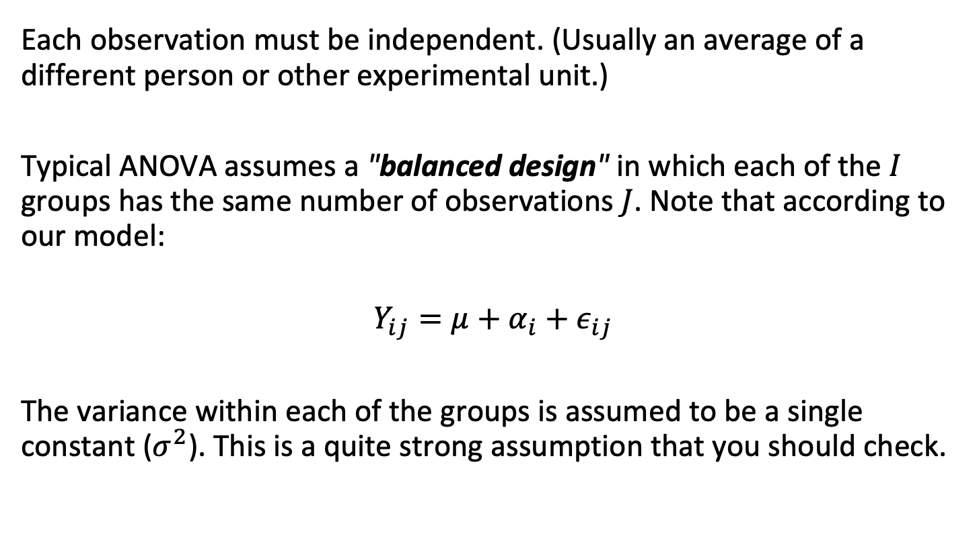
ANOVA assumptions
Each observation must be independent. (Usually an average of a different person or other experimental unit.)
Typical ANOVA assumes a "balanced design" in which each of the $I$ groups has the same number of observations $J$. Note that according to our model:
$$Y_{ij}=μ+α_{i}+ε_{ij}$$
The variance within each of the groups is assumed to be a single constant ($σ^{2}$). This is a quite strong assumption that you should check.

Slide 19
A common case that often gets (mis)treated with ANOVA (and linear models in general)
Although these data look like the tables we have been discussing, these observations are not independent.
If you want to assess whether Models I and II perform differently, these data probably requires a linear mixed model, which we will get to later.
Patient | Model I Result | Model II Result
a | 75 | 78
1 | 84 | 98
alpha | 16 | 42
2 | 100 | 100
carl | 45 | 48

Slide 20

Notation
Where $i$ varies between $1$ and $I$,, and $j$ varies between $1$ and $J$, we will use the following notation to describe summation over all values of $i$ and $j$:
$$\sum_{i,j}^{​}{\text{whatever}}(i,j)=\sum_{i=1}^{i=I}{\sum_{j=1}^{j=J}{\text{whatever}}}(i,j)$$

Slide 21
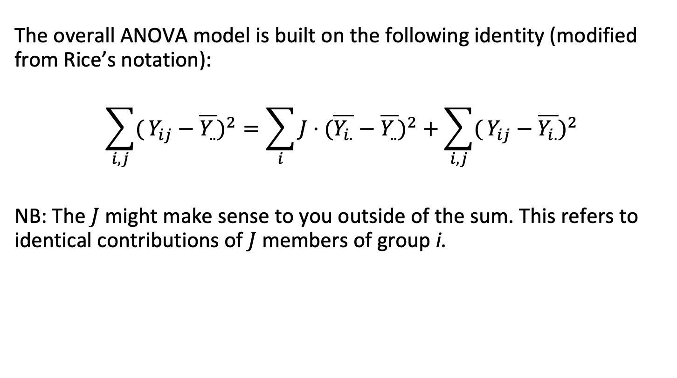
The ANOVA sum of squares
The overall ANOVA model is built on the following identity (modified from Rice’s notation):
$$\sum_{i,j}^{​}{(}Y_{ij}−\overline{Y_{..}})^{2}=\sum_{i}^{​}{J}⋅(\overline{Y_{i.}}−\overline{Y_{..}})^{2}+\sum_{i,j}^{​}{(}Y_{ij}−\overline{Y_{i.}})^{2}$$
NB: The $J$ might make sense to you outside of the sum. This refers to identical contributions of $J$ members of group i.

Slide 22
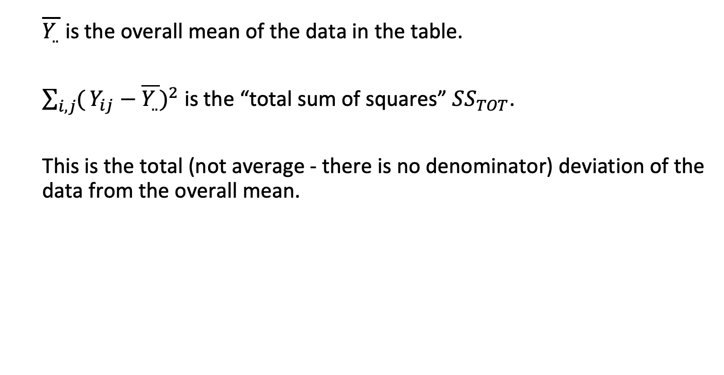
The ANOVA sum of squares
$\overline{Y_{..}}$ is the overall mean of the data in the table.
$\sum_{i,j}^{​}{(}Y_{ij}−\overline{Y_{..}})^{2}$ is the “total sum of squares” $SS_{TOT}$.
This is the total (not average - there is no denominator) deviation of the data from the overall mean.

Slide 23
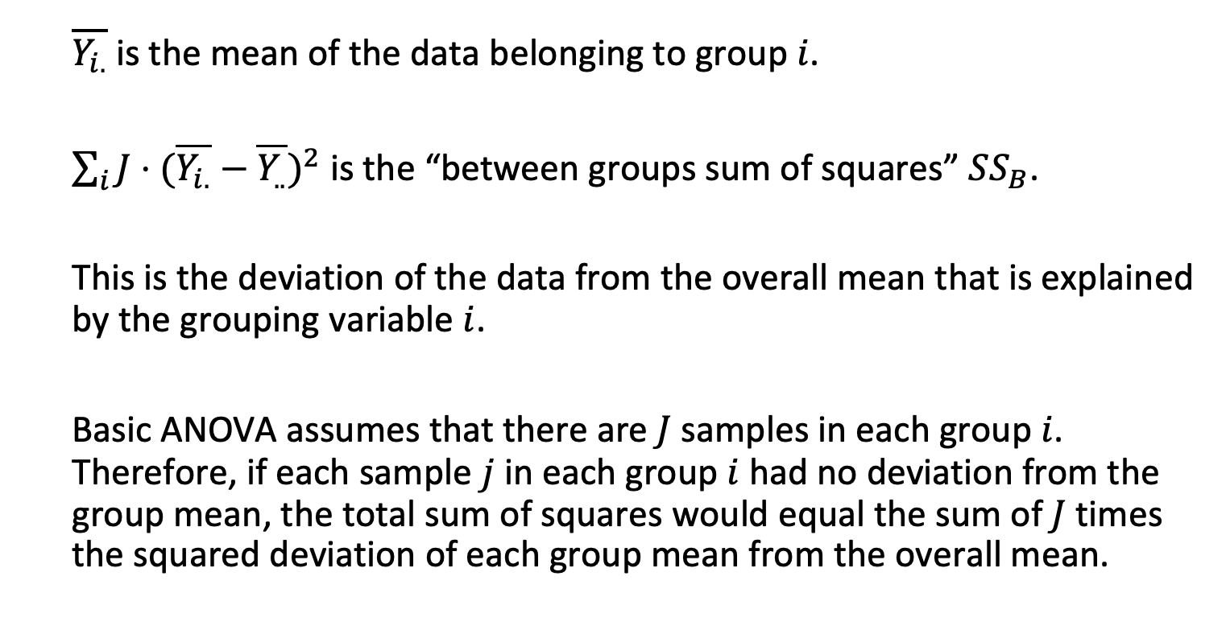
The ANOVA sum of squares
$\overline{Y_{i.}}$ is the mean of the data belonging to group $i$.
$\sum_{i}^{​}{J}⋅(\overline{Y_{i.}}−\overline{Y_{..}})^{2}$ is the “between groups sum of squares” $SS_{B}$.
This is the deviation of the data from the overall mean that is explained by the grouping variable $i$.
Basic ANOVA assumes that there are $J$ samples in each group $i$. Therefore, if each sample $j$ in each group $i$ had no deviation from the group mean, the total sum of squares would equal the sum of $J$ times the squared deviation of each group mean from the overall mean.

Slide 24

The ANOVA sum of squares
$\sum_{i,j}^{​}{(}Y_{ij}−\overline{Y_{i.}})^{2}$ is the total deviation of the data in group $i$ from the mean of group $i$.
If the groups explain all of the deviation (meaning that all samples in each group have the same value), this term goes to zero.

Slide 25

The ANOVA sum of squares
The overall ANOVA model is built on the following identity (modified from Rice’s notation):
$$\sum_{i,j}^{​}{(}Y_{ij}−\overline{Y_{..}})^{2}=\sum_{i}^{​}{J}⋅(\overline{Y_{i.}}−\overline{Y_{..}})^{2}+\sum_{i,j}^{​}{(}Y_{ij}−\overline{Y_{i.}})^{2}$$

Slide 26
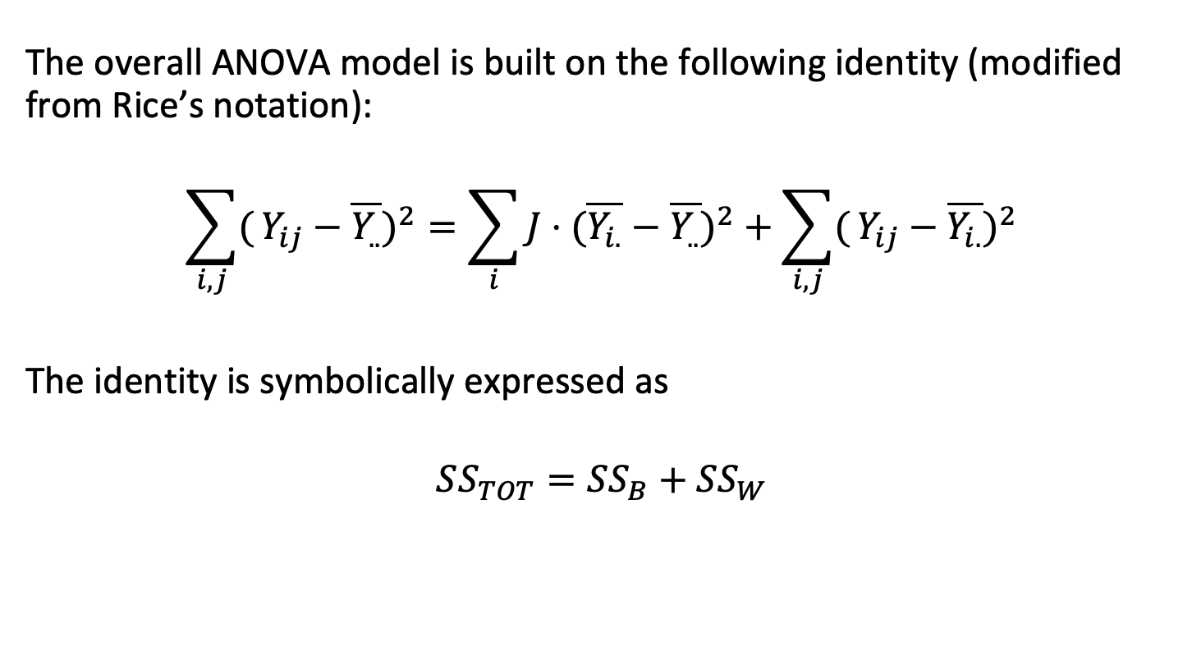
The ANOVA sum of squares
The overall ANOVA model is built on the following identity (modified from Rice’s notation):
$$\sum_{i,j}^{​}{(}Y_{ij}−\overline{Y_{..}})^{2}=\sum_{i}^{​}{J}⋅(\overline{Y_{i.}}−\overline{Y_{..}})^{2}+\sum_{i,j}^{​}{(}Y_{ij}−\overline{Y_{i.}})^{2}$$
The identity is symbolically expressed as
$$SS_{TOT}=SS_{B}+SS_{W}$$

Slide 27
The ANOVA F test

Slide 28
F tests
F tests can be applied in many contexts; they are the primary test used in ANOVA designs.
In ANOVA, the main (or "omnibus") test of the null that the mean values of all groups are equal is performed with an F test.

Slide 29
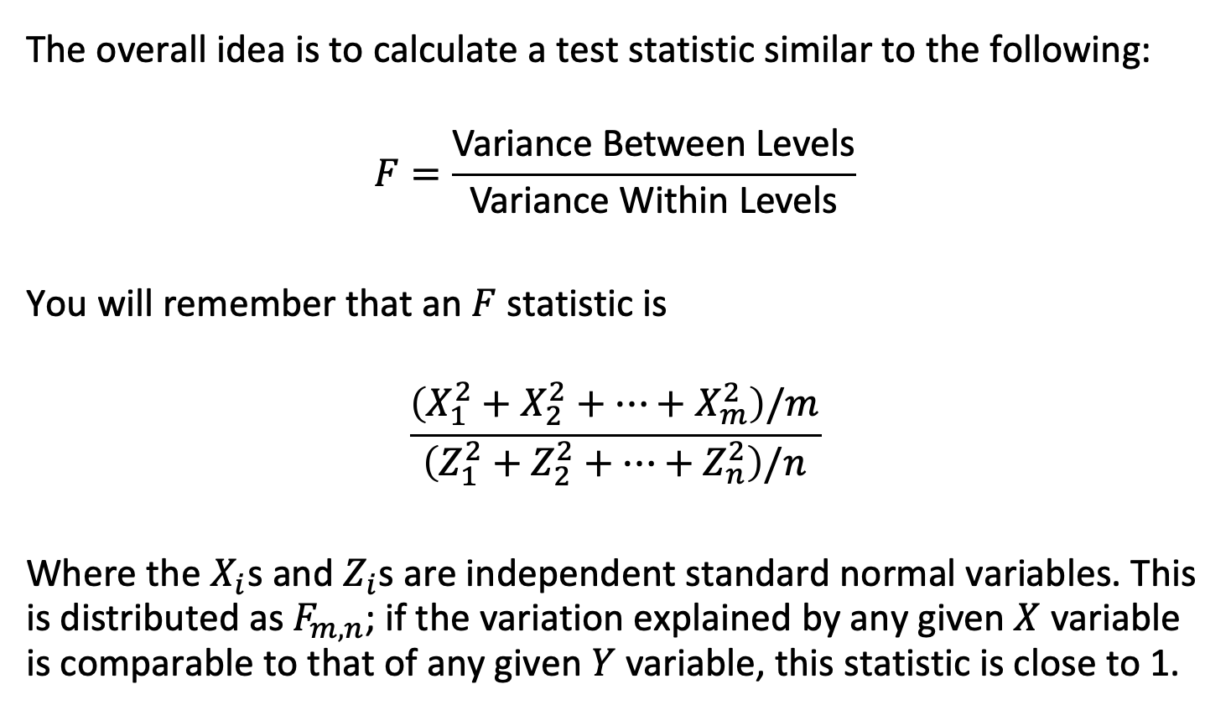
The overall ANOVA idea
The overall idea is to calculate a test statistic similar to the following:
$$F=\frac{\text{Variance} \text{Between} \text{Levels}}{\text{Variance} \text{Within} \text{Levels}}$$
You will remember that an $F$ statistic is
$$\frac{\left(X_{1}^{2}+X_{2}^{2}+…+X_{m}^{2}\right)/m}{\left(Z_{1}^{2}+Z_{2}^{2}+…+Z_{n}^{2}\right)/n}$$
Where the $X_{i}$s and $Z_{i}$s are independent standard normal variables. This is distributed as $F_{m,n}$; if the variation explained by any given $X$ variable is comparable to that of any given $Y$ variable, this statistic is close to 1.

Slide 30
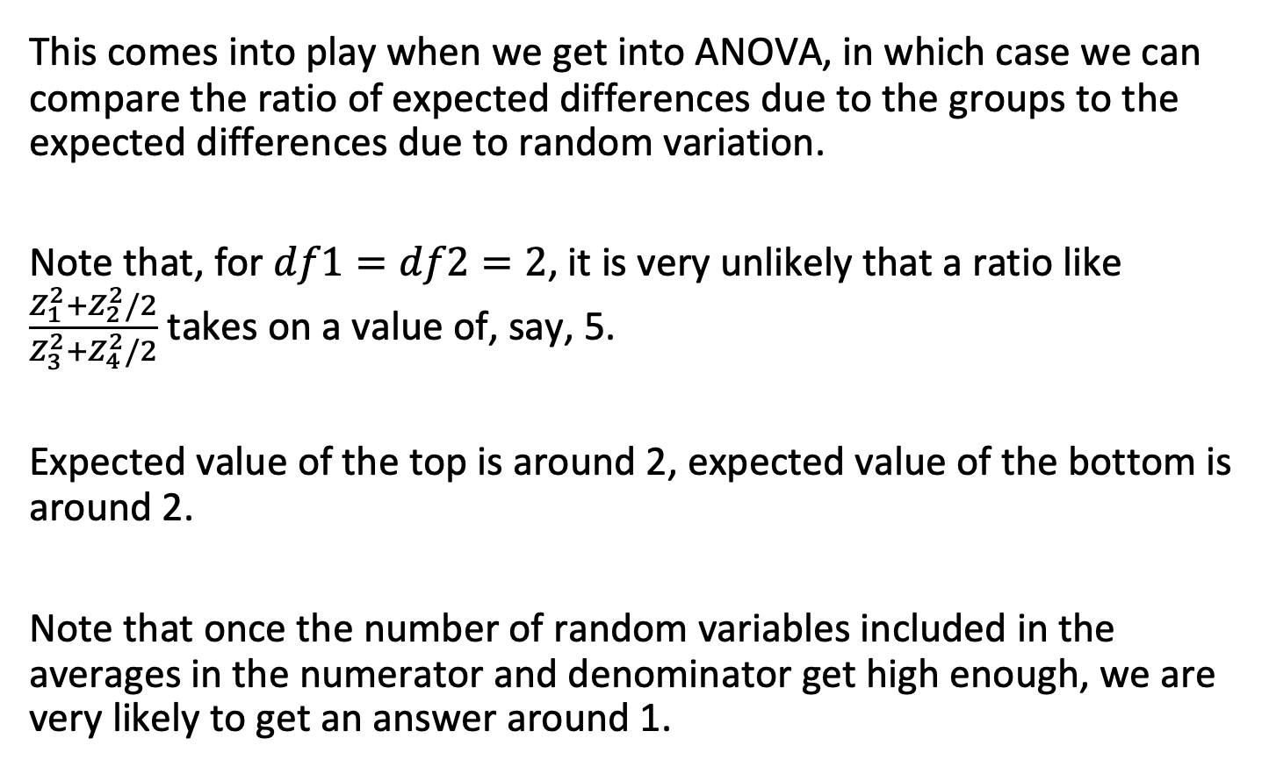
The F density: ratio of chi-squares
This comes into play when we get into ANOVA, in which case we can compare the ratio of expected differences due to the groups to the expected differences due to random variation.
Note that, for $df1=df2=2$, it is very unlikely that a ratio like $\frac{Z_{1}^{2}+Z_{2}^{2}/2}{Z_{3}^{2}+Z_{4}^{2}/2}$ takes on a value of, say, 5.
Expected value of the top is around 2, expected value of the bottom is around 2.
Note that once the number of random variables included in the averages in the numerator and denominator get high enough, we are very likely to get an answer around 1.

Slide 31
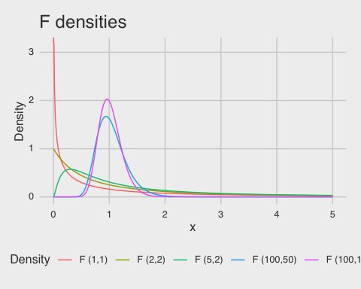
The F density: ratio of chi-squares

Slide 32
The ANOVA sum of squares
The overall ANOVA model is built on the following identity (modified from Rice’s notation):
$$\sum_{i,j}^{​}{(}Y_{ij}−\overline{Y_{..}})^{2}=\sum_{i}^{​}{J}⋅(\overline{Y_{i.}}−\overline{Y_{..}})^{2}+\sum_{i,j}^{​}{(}Y_{ij}−\overline{Y_{i.}})^{2}$$
The identity is symbolically expressed as
$$SS_{TOT}=SS_{B}+SS_{W}$$

Slide 33
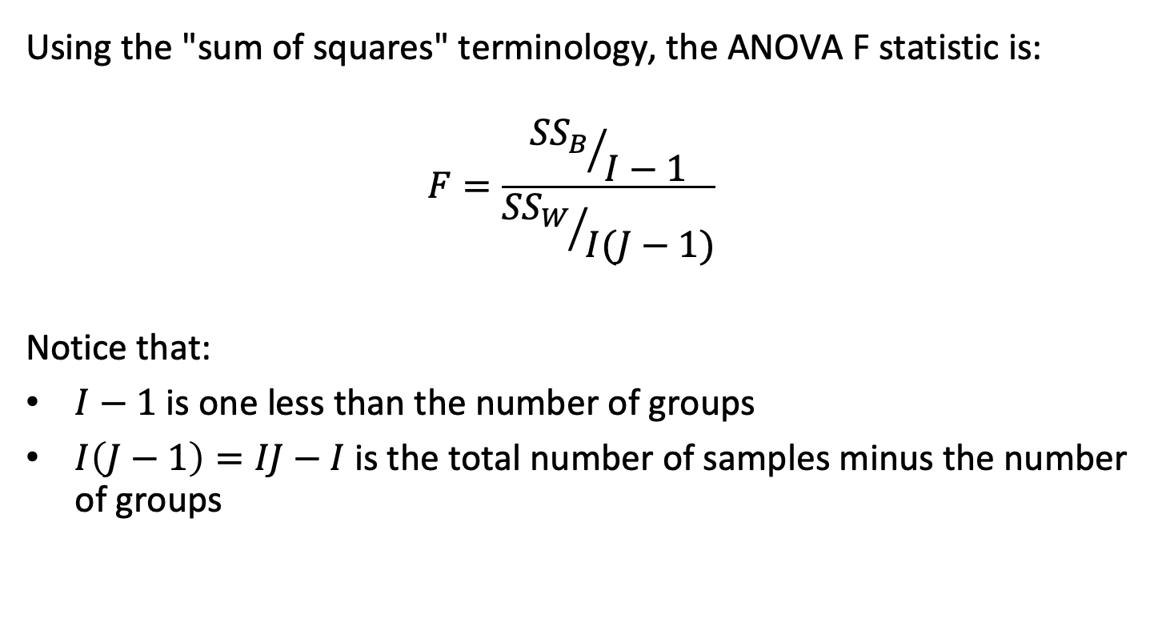
The ANOVA F statistic
Using the "sum of squares" terminology, the ANOVA F statistic is:
$$F=\frac{{{SS}_{B}}/{I−1}}{{{SS}_{W}}/{I(J−1)}}$$
Notice that:
$I−1$ is one less than the number of groups
$I\left(J−1\right)=IJ−I$ is the total number of samples minus the number of groups

Slide 34
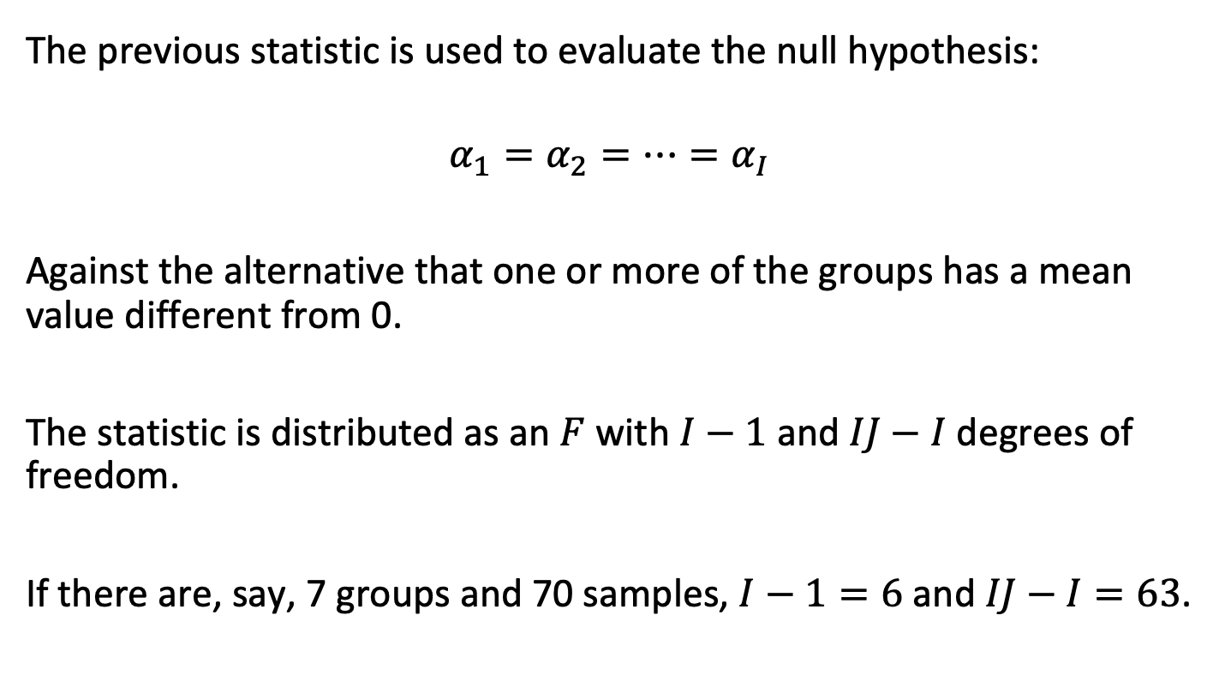
The ANOVA null hypothesis
The previous statistic is used to evaluate the null hypothesis:
$$α_{1}=α_{2}=…=α_{I}$$
Against the alternative that one or more of the groups has a mean value different from 0.
The statistic is distributed as an $F$ with $I−1$ and $IJ−I$ degrees of freedom.
If there are, say, 7 groups and 70 samples, $I−1=6$ and $IJ−I=63$.

Slide 35
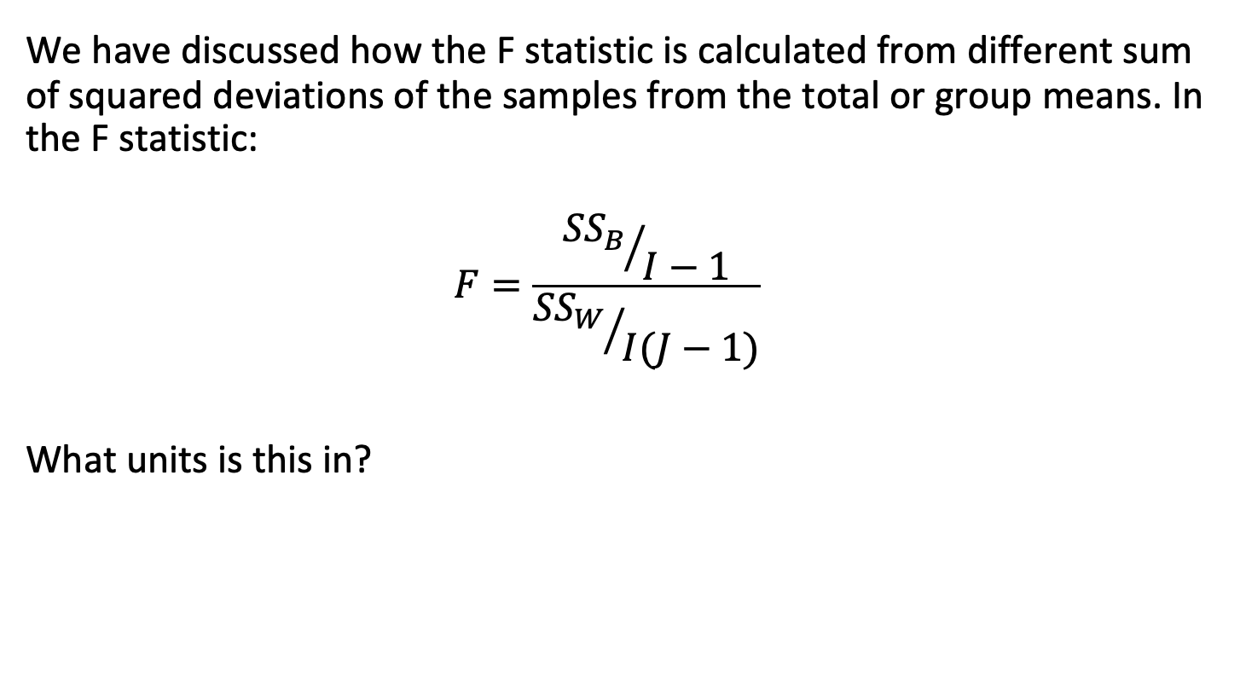
"Mean squares" and the ANOVA table
We have discussed how the F statistic is calculated from different sum of squared deviations of the samples from the total or group means. In the F statistic:
$$F=\frac{{{SS}_{B}}/{I−1}}{{{SS}_{W}}/{I(J−1)}}$$
What units is this in?

Slide 36
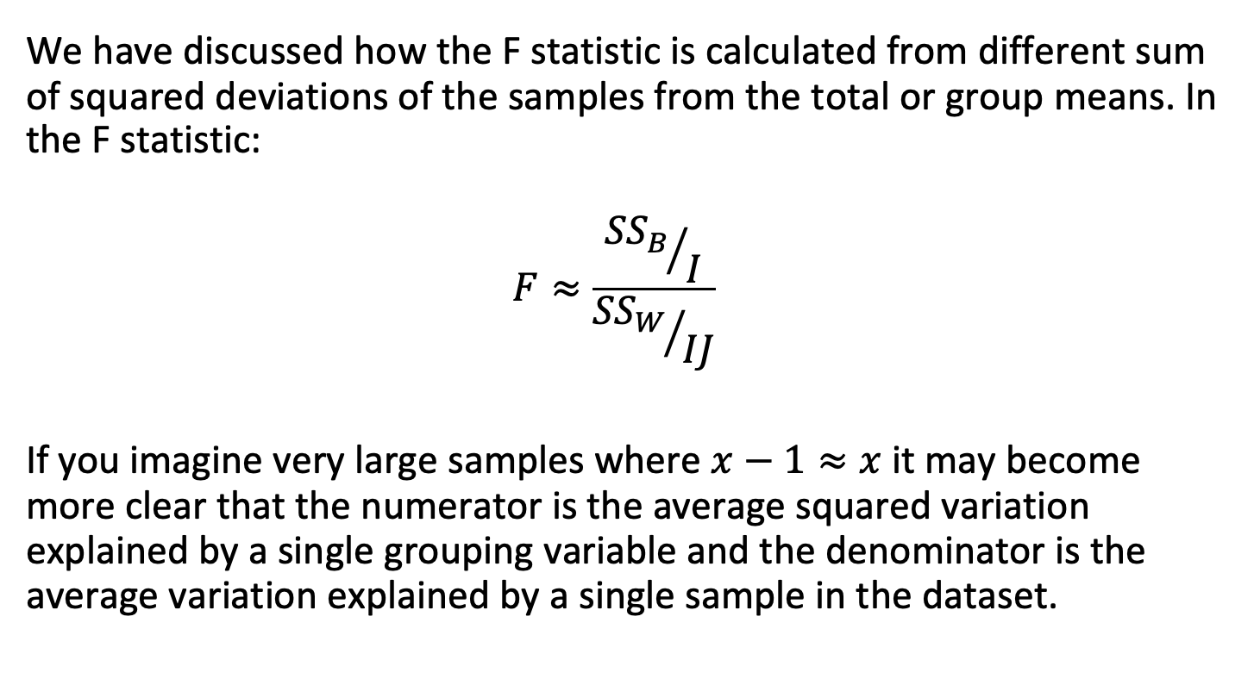
"Mean squares" and the ANOVA table
We have discussed how the F statistic is calculated from different sum of squared deviations of the samples from the total or group means. In the F statistic:
$$F≈\frac{{{SS}_{B}}/I}{{{SS}_{W}}/{IJ}}$$
If you imagine very large samples where $x−1≈x$ it may become more clear that the numerator is the average squared variation explained by a single grouping variable and the denominator is the average variation explained by a single sample in the dataset.

Slide 37
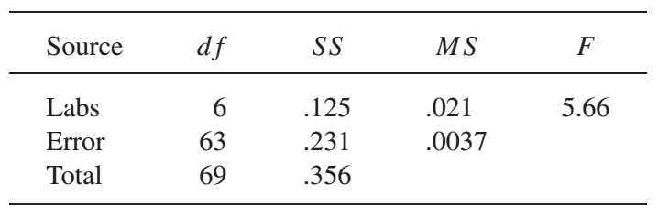
"Mean squares" and the ANOVA table
We typically summarize the results of the ANOVA calculation in a table as follows:
Note that:
69 = 6+63
0.356 = 0.125+0.321
0.21 = 0.125/6
0.0037 = 0.231/63
5.66 = 0.021/0.0037
P(F_{6,63} ≥ 5.66)<0.001

Slide 38
The F test
Once the F statistic has been computed, it can be transformed to a p-value using methods analogous to what we have used previously based on the cumulative density function.

Slide 39
An example
Group | Level
A | 6.0
A | 6.1
A | 5.0
B | 10.3
B | 10.9
B | 9.2
C | 12.5
C | 11.7
C | 13.3

Slide 40

An example
Group | Level
A | 6.0
A | 6.1
A | 5.0
B | 10.3
B | 10.9
B | 9.2
C | 12.5
C | 11.7
C | 13.3
$$H_{0}:μ_{A}=μ_{B}=μ_{C}$$

Slide 41



An example
Group | Level
A | 6.0
A | 6.1
A | 5.0
B | 10.3
B | 10.9
B | 9.2
C | 12.5
C | 11.7
C | 13.3
$$μ=9.4$$
$${SS}_{TOT}=75.0$$
$${df}_{TOT}=9−1=8$$

Slide 42
An example
Group | Level
A | 6.0
A | 6.1
A | 5.0
B | 10.3
B | 10.9
B | 9.2
C | 12.5
C | 11.7
C | 13.3
Group | Mean
A | 5.7
B | 10.1
C | 12.5
Total | 9.4

Slide 43







An example
Group | Level
A | 6.0
A | 6.1
A | 5.0
B | 10.3
B | 10.9
B | 9.2
C | 12.5
C | 11.7
C | 13.3
Group | Mean
A | 5.7
B | 10.1
C | 12.5
Total | 9.4
$${SS}_{GROUPS}:$$
$$3×{\left(5.7−9.4\right)}^{2}$$
$$3×{\left(10.1−9.4\right)}^{2}$$
$$+$$
$$3×{\left(12.5−9.4\right)}^{2}$$
$$71.5$$
$${df}_{GROUPS}=3−1=2$$

Slide 44
An example
Source | df | SS | MS | F | p-value
Groups | 2 | 71.5
Total | 8 | 75.0

Slide 45
An example
Source | df | SS | MS | F | p-value
Groups | 2 | 71.5
Error |  | 3.5
Total | 8 | 75.0

Slide 46
An example
Source | df | SS | MS | F | p-value
Groups | 2 | 71.5
Error | 6 | 3.5
Total | 8 | 75.0

Slide 47
An example
Source | df | SS | MS | F | p-value
Groups | 2 | 71.5 | 35.7
Error | 6 | 3.5 | 0.6
Total | 8 | 75.0

Slide 48
An example
Source | df | SS | MS | F | p-value
Groups | 2 | 71.5 | 35.7 | 61.2
Error | 6 | 3.5 | 0.6
Total | 8 | 75.0

Slide 49

An example
Source | df | SS | MS | F | p-value
Groups | 2 | 71.5 | 35.7 | 61.2 | <0.001
Error | 6 | 3.5 | 0.6
Total | 8 | 75.0
$${Reject H}_{0}:μ_{A}=μ_{B}=μ_{C}$$

Slide 50
Post-hoc tests

Slide 51
Post-hoc tests
In that example, we concluded that the means of measurements from the three groups are not all equal, but the test gives no information about how they differ, in particular about which pairs are significantly different.
Real interest may be focused on comparing pairs or groups of treatments and estimating the treatment means and their differences – often the F test being significant does not give you enough insight to proceed.
One (somewhat antiquated) way to analyze this type of data is to initially conduct an "omnibus" F test. If the omnibus null is rejected, we can go on ("post-hoc") to compare groups.

Slide 52
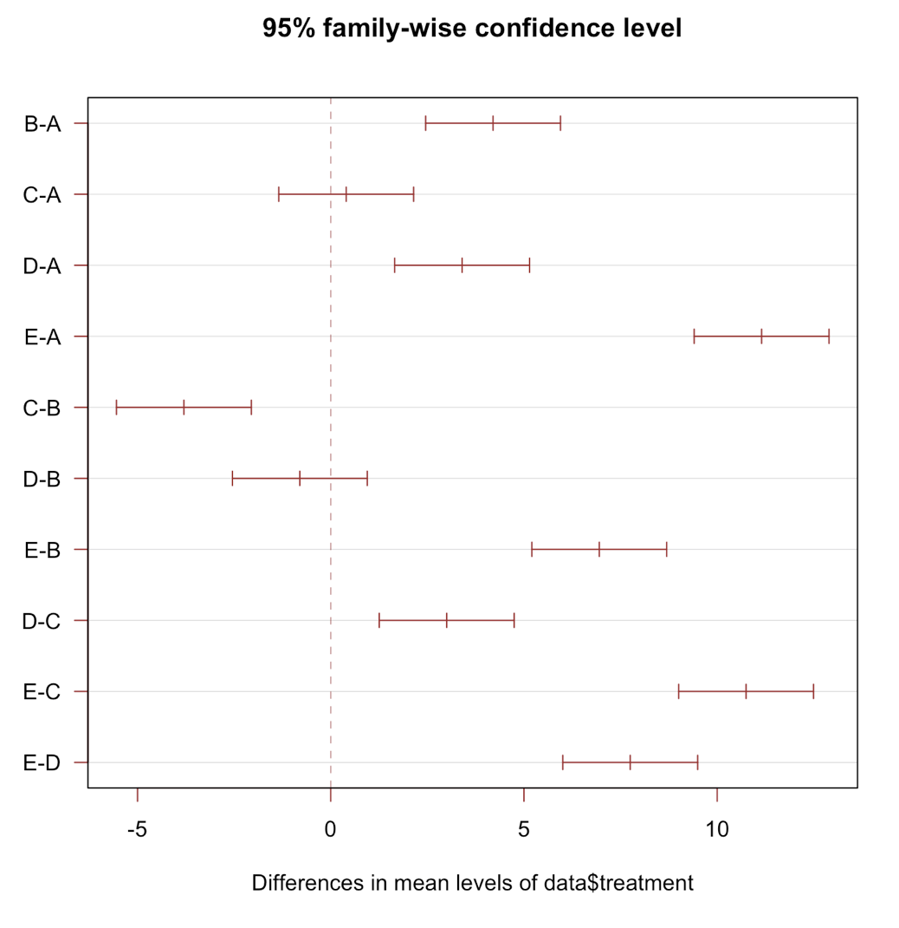
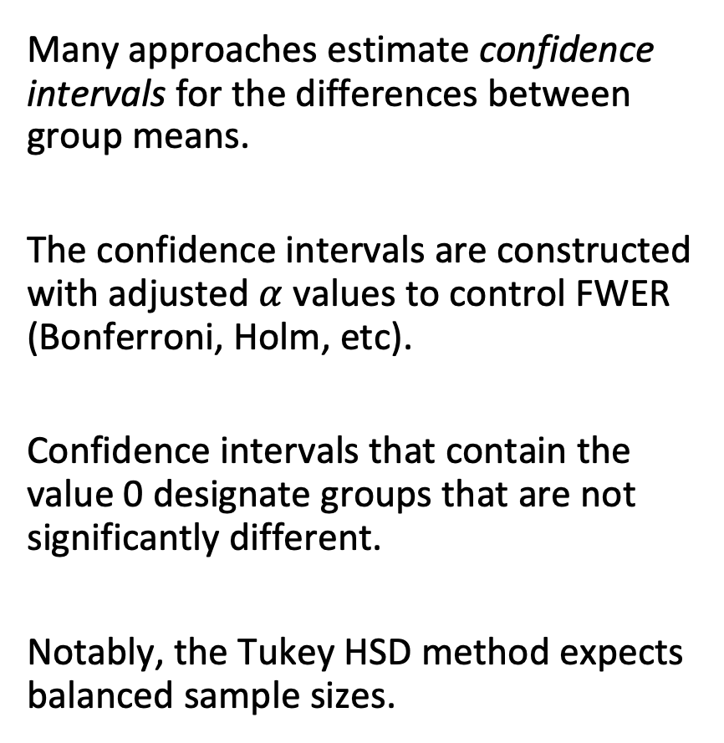
Confidence interval approach to post-hoc testing
Many approaches estimate confidence intervals for the differences between group means.
The confidence intervals are constructed with adjusted $α$ values to control FWER (Bonferroni, Holm, etc).
Confidence intervals that contain the value 0 designate groups that are not significantly different.
Notably, the Tukey HSD method expects balanced sample sizes.
https://www.r-graph-gallery.com/84-tukey-test.html

Slide 53
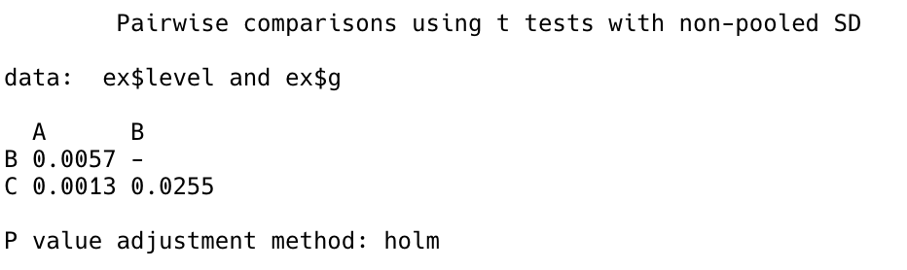
t-test approach to post-hoc testing
Another approach is to compare all pairs of treatment means using t tests. Some Type I control is of course needed.
In R, the pairwise.t.test() function essentially does just this, although it uses a pooled SD estimate to perform the tests. (Similar functionality is available in scikits-posthocs.posthoc_ttest.)

Slide 54
ANOVA vs. the regression approach
We will learn about regression later. However, there are some important considerations about ANOVA.
More modern approaches create a regression style model with terms for each group, often without an overall omnibus test.
If any of the terms are statistically-significant then you would reject the omnibus null; but rejecting the omnibus null is not particularly informative in the first place.
Note that when any one test of a group being statistically-significant would cause the global null to be rejected, you must control the family-wise error rate!

Slide 55
Outline
Contexts for ANOVA
Data management
Model formulation and sums of squares
The ANOVA F test
Post-hoc tests

