Slide 1
BMI 510: Linear Regression I
J. Lucas McKay, Ph.D., M.S.C.R.
Departments of Biomedical Informatics and Neurology, Emory University, Atlanta, GA USA
Department of Biomedical Engineering, Georgia Institute of Technology, Atlanta, GA, USA

Slide 2
Outline
Linear regression model
Solving a regression problem with an ANOVA
Solving a regression problem with regression
Fitting model parameters
Making inferences
Implementation in software
Model fit

Slide 3
A regression formulation
We will use a simple regression formula familiar from algebra:
$$y_{ij}=β_{0}+β_{1}x_{i}+ε_{ij}$$
$y_{ij}$ is the j^{th} observation of group i
$β_{0}$ is the mean of the reference group (remember in ANOVA it was the overall mean)
$β_{1}$ is the slope, or change in the dependent variable associated with a 1-unit change in the independent variable
$ε_{ij}$ is a random additive error.

Slide 4
A regression formulation
We will use a simple regression formula familiar from algebra:
$$y_{ij}=β_{0}+β_{1}x_{i}+ε_{ij}$$
Note that in many cases, $x_{i}$ will only take on a value of 0 or 1. $x_{i}$
will take a value 0 if observation $y_{ij}$ is in the "reference group," and a value 1 if observation $y_{ij}$ is in another group.

Slide 5
One-hot / dummy encoding
If the grouping variable has, say, three levels, like control/ parkinsons/ essential tremor, we might use the following scheme with two dummy variables, and with "control" as the reference group:
$$y_{j}=β_{0}+β_{PD}PD+β_{ET}ET+ε_{j}$$
In this case, the variable PD would be 1 if observation j was in the PD group, and 0 otherwise, and the variable ET would be 1 if observation j was in the ET group, and 0 otherwise.
Note that here we've dropped the group variable i. Once there are multiple terms, the grouping might not be as clear as in ANOVA.

Slide 6
A simpler model – ANOVA approach
Let's consider a simpler model with only 1 degree of freedom, expected lifetimes in men and women.
First let's do an ANOVA.

Slide 7
A simpler model – ANOVA approach
 | df | SS | MS | F | P
Groups | 1
Error
Total | 99

Slide 8
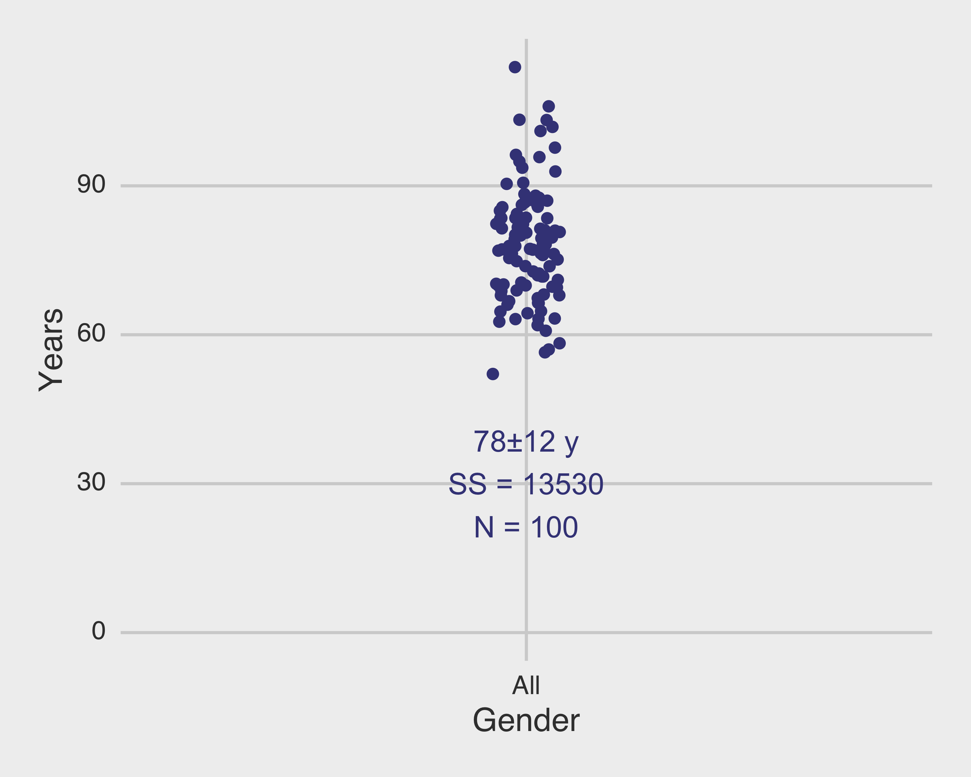
A simpler model – ANOVA approach

Slide 9
A simpler model – ANOVA approach
$$SS=\sum{{\left(x_{i}−\overline{x}\right)}^{2}}$$

Slide 10
A simpler model – ANOVA approach
 | df | SS | MS | F | P
Groups | 1
Error
Total | 99 | 13530

Slide 11
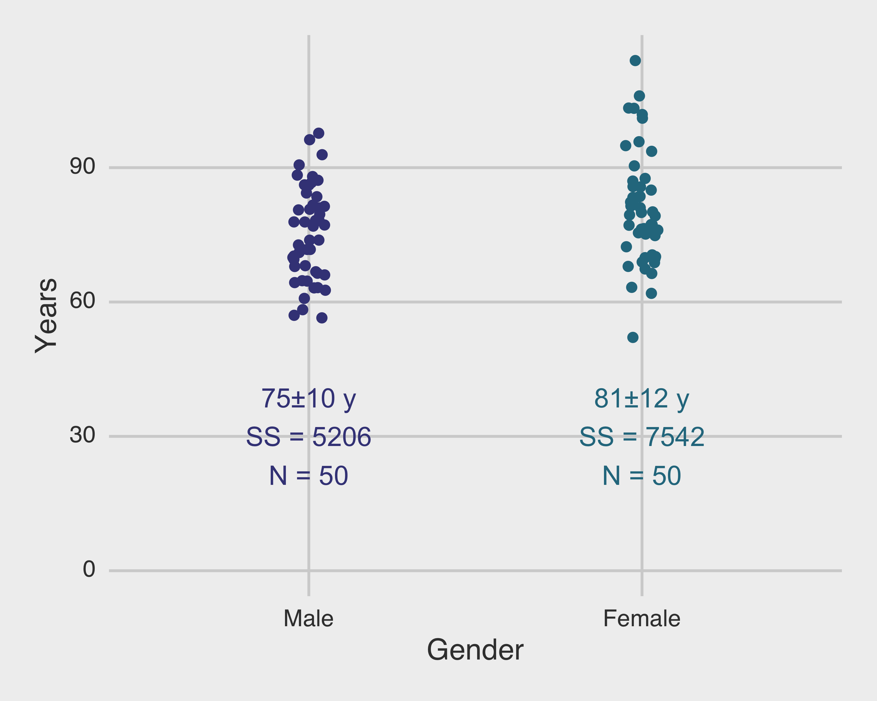
A simpler model – ANOVA approach
$$SS=\sum{{\left(x_{i}−\overline{x}\right)}^{2}}$$

Slide 12
A simpler model – ANOVA approach
 | df | SS | MS | F | P
Groups | 1
Error |  | 5206.5+7542.5= 12749
Total | 99 | 13530

Slide 13
A simpler model – ANOVA approach
 | df | SS | MS | F | P
Groups | 1 | 781
Error | 98 | 12749
Total | 99 | 13530

Slide 14
A simpler model – ANOVA approach
 | df | SS | MS | F | P
Groups | 1 | 781 | 781
Error | 98 | 12749 | 130
Total | 99 | 13530

Slide 15
A simpler model – ANOVA approach
 | df | SS | MS | F | P
Groups | 1 | 781 | 781 | 6.00
Error | 98 | 12749 | 130
Total | 99 | 13530

Slide 16
A simpler model – ANOVA approach
 | df | SS | MS | F | P
Groups | 1 | 781 | 781 | 6.00 | 0.016
Error | 98 | 12749 | 130
Total | 99 | 13530

Slide 17
Outline
Linear regression model
Solving a regression problem with an ANOVA
Solving a regression problem with regression
Fitting model parameters
Making inferences
Implementation in software
Model fit

Slide 18
A simpler model – regression approach

Slide 19
A simpler model – regression approach
Since women are living longer, let's treat men as the reference group here. Then an appropriate model might be:
$$y_{i}=β_{0}+β_{M}Male+ε_{i}$$
Before we fit the model, let's interpret the coefficients.

Slide 20
Coefficient interpretation
$$y_{i}=β_{0}+β_{M}Male+ε_{i}$$
Average lifespan among women:
Average lifespan among men:
Term that would be zero if men and women lived the same number of years (the null):

Slide 21
Coefficient interpretation
$$y_{i}=β_{0}+β_{M}Male+ε_{i}$$
Average lifespan among women: $β_{0}$
Average lifespan among men: $β_{0}+β_{M}$
Term that would be zero if men and women lived the same number of years (the null): $β_{M}$

Slide 22
Outline
Linear regression model
Solving a regression problem with an ANOVA
Solving a regression problem with regression
Fitting model parameters
Making inferences
Implementation in software
Model fit

Slide 23
Fitting the coefficients: linear least squares
In order to fit a straight line to a plot of points $(x_{i},y_{i})$, the slope and intercept of the line $y=β_{0}+β_{1}x$ must be found from the data in some manner.
(Similarly, in order to fit a $p^{th}$-order polynomial, $p+1$ coefficients must be determined; we often use straight line fits for reasons of parsimony.)
The most common method for determining the parameters in curve-fitting problems is the method of least squares.
Rice

Slide 24
Fitting the coefficients: linear least squares
There are several primary ways to identify values for $β_{0}$ and $β_{1}$.
You could find expressions for $\frac{∂S}{∂β_{0}}$ and $\frac{∂S}{∂β_{1}}$ and identify the unique values of $β_{0}$ and $β_{1}$ for which these expressions equal 0. This is the way most textbooks proceed.
You could use a numerical optimization procedure to minimize the error.
You could use the normal equation approach, which we discussed in the first lecture. (This is actually directly equivalent to the calculus-based approach.)

Slide 25
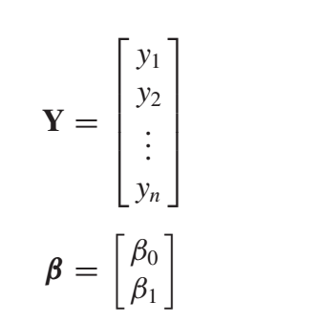
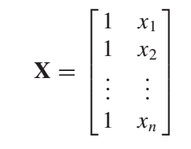
Fitting the coefficients: linear least squares
Let’s say, for sake of argument, we take the second approach.
≈
×
Rice

Slide 26
Fitting the coefficients: linear least squares
Let’s say, for sake of argument, we take the second approach. We use use the following transformations to get our best estimates of $β$.
$$Y≈Xβ$$
$$X^{T}Y≈X^{T}Xβ$$
$$(X^{T}X)^{−1}X^{T}Y≈{(X^{T}X)^{−1}X}^{T}Xβ$$
$$(X^{T}X)^{−1}X^{T}Y=β$$

Slide 27
Fitting the coefficients: linear least squares
For the problem at hand, remember the model was:
$$y_{i}=β_{0}+β_{M}Male+ε_{i}$$
The normal equations approach gives us the following numerical values:
$$β_{0}=81.0$$
$$β_{M}=−5.6$$
What units are these in?

Slide 28
Assumptions necessary for linear regression
The ordinary least squares estimates of the $β$s are unbiased under a broad range of conditions. To do hypothesis tests on the $β$s, we will have to estimate their standard errors. We should consider the assumptions necessary for this, which can really be read off of the equation itself:
$$y_{i}=β_{o}+β_{1}x+ε_{i}$$

Slide 29
Assumptions necessary for linear regression
$$y_{i}=β_{o}+β_{1}x+ε_{i}$$
The response variable $y$ must be comprised of independent observations. This is required for various reasons, in particular for the $t$ distribution we will see later to hold.
The residuals $ε_{i}$ must be normally distributed with constant variance $σ^{2}$. Most regression diagnostics examine the extent to which this assumption holds. If, for example, there are larger errors for certain values of $x$, remediation measures are needed. The residuals must also be uncorrelated to estimate the error variance, which relies on the trace of several intermediate matrices.
There are no constraints on the distribution of the predictor variable(s). This is why we are able to use dummy variables as predictors.
The number of observations must be greater than the number of parameters in order for various intermediate matrices to be invertible. In practice, you need ~5-10 times the number of observations to the number of parameters.

Slide 30
Outline
Linear regression model
Solving a regression problem with an ANOVA
Solving a regression problem with regression
Fitting model parameters
Making inferences
Implementation in software
Model fit

Slide 31
Statistical properties of the coefficients
In our ANOVA design, we considered an overall $F$ test. We found that the ANOVA formulation gave us limited ability to drill down between groups.
This is not the case with regression; if we formulate our model in a way that the coefficients are interpretable, we can compare each of them to the null value zero.
$$H_{0}:β_{AGE}=0$$
$$H_{A}:β_{AGE}≠0$$

Slide 32
Statistical properties of the coefficients
Assuming that the number of observations is $n$ and the number of parameters (in this case, 2) is $p$, we can calculate:
Residual sum of squares (RSS): $RSS=||Y−Xβ||^{2}$
Estimator of residual variance $σ^{2}$: $s^{2}=\frac{RSS}{n−p}$
Standard error of the regression coefficient $β_{i}$: $s_{β_{i}}=s\sqrt{c_{ii}}$, where $c_{ii}$ is the $i^{th}$ diagonal element of $C=(X^{T}X)^{−1}$.
Since we have a standard error for each coefficient, we can test each coefficient vs. 0.

Slide 33
Fitting the coefficients: linear least squares
For the problem at hand, remember the model was:
$$y_{i}=β_{0}+β_{M}Male+ε_{i}$$
The normal equations approach gives us the following numerical values:
$$β_{0}=81.0$$
$$β_{M}=−5.6$$

Slide 34
A simpler model – regression approach

Slide 35
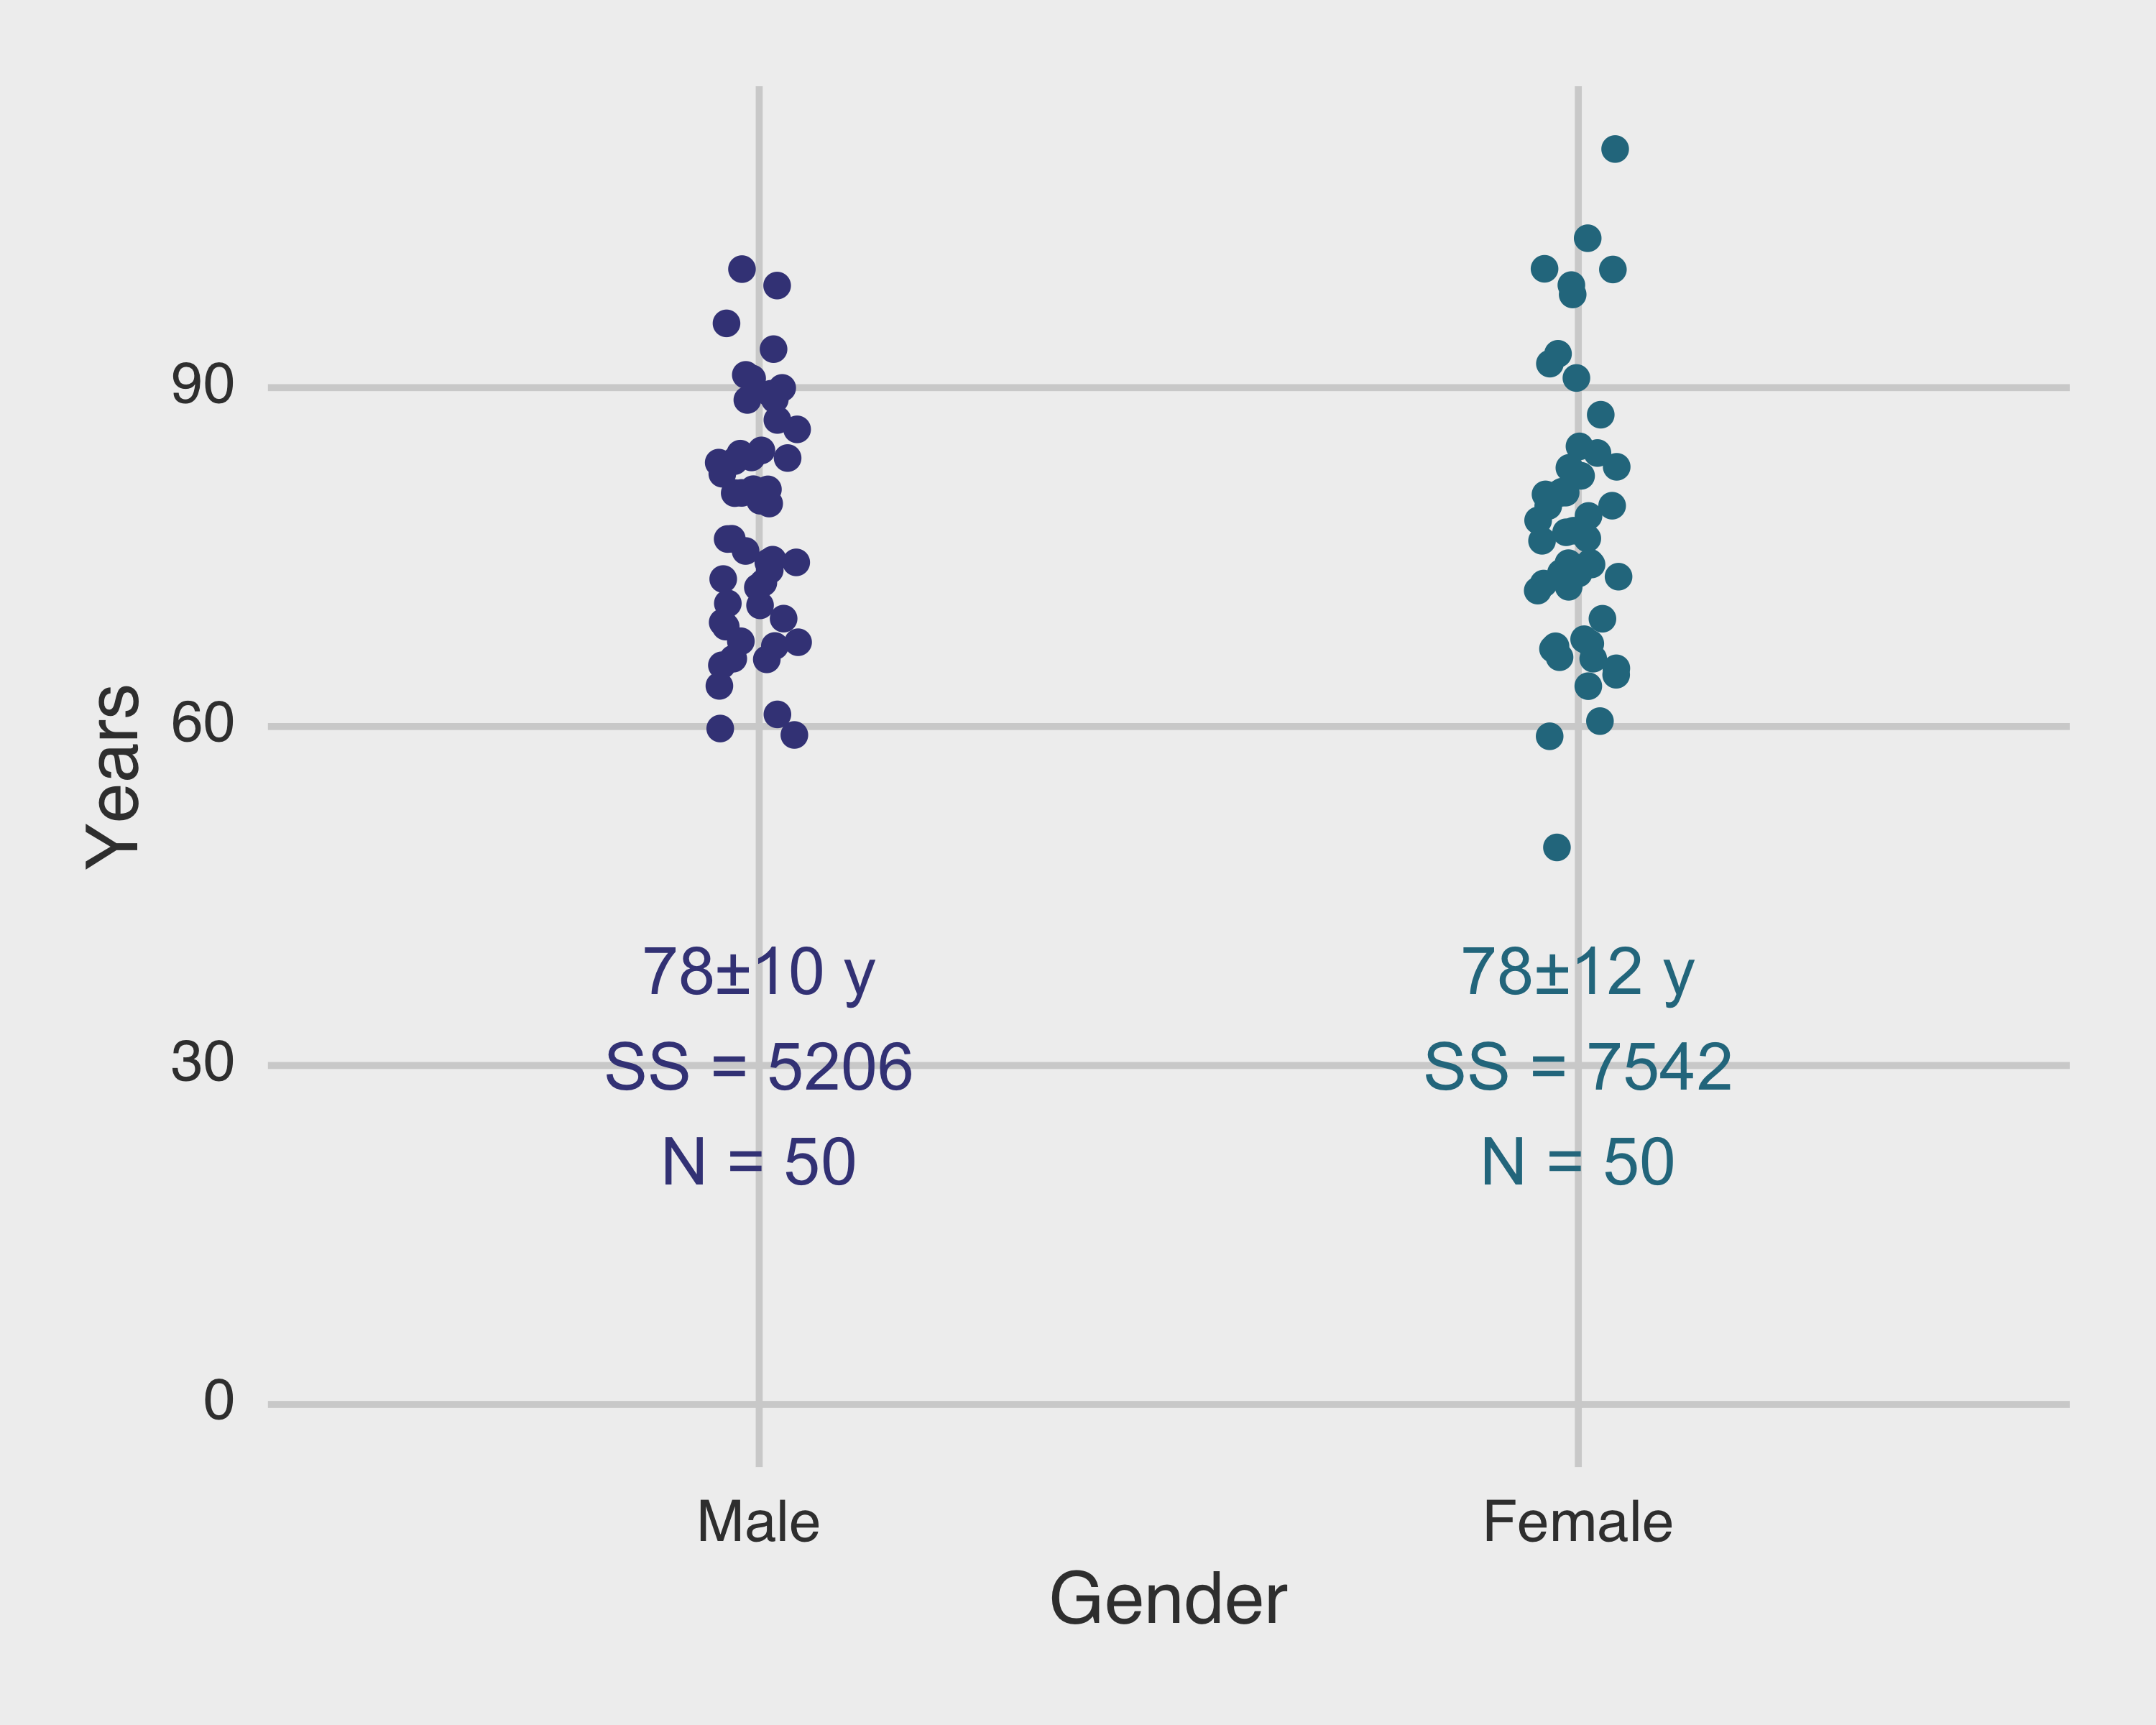
Residuals after controlling for gender

Slide 36
Fitting the coefficients: linear least squares
For the problem at hand, remember the model was:
$$y_{i}=β_{0}+β_{M}Male+ε_{i}$$
$$β_{0}=81.0$$
$$β_{M}=−5.6$$
$$RSS=5206+7542=12748$$
$$n=100$$
$$p=2$$
$$s^{2}=\frac{RSS}{n−p}=130$$

Slide 37
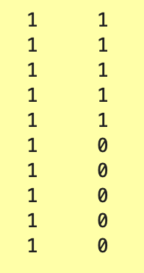
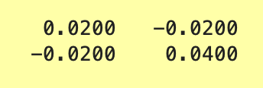
Fitting the coefficients: linear least squares
The design matrix X was:
$$C=(X^{T}X)^{−1}=$$
(should be 100 rows)

Slide 38
Fitting the coefficients: linear least squares
For the problem at hand, remember the model was:
$$y_{i}=β_{0}+β_{M}Male+ε_{i}$$
$C={(X^{T}X)}^{−1}$ = $\left[\begin{matrix}0.02 & ∙ \\ ∙ & 0.04\end{matrix}\right]$ = $\left[\begin{matrix}c_{11} & ∙ \\ ∙ & c_{22}\end{matrix}\right]$

Slide 39
Fitting the coefficients: linear least squares
For the problem at hand, remember the model was:
$$y_{i}=β_{0}+β_{M}Male+ε_{i}$$
$$β_{0}=81.0$$
$$β_{M}=−5.6$$
$$RSS=5206+7542=12748$$
$$n=100$$
$$p=2$$
$$s^{2}=\frac{RSS}{n−p}=130$$
$$s=11.4$$
$$s_{β0}=s\sqrt{c_{11}}=1.6$$
$$s_{βM}=s\sqrt{c_{22}}=2.3$$

Slide 40
Standard errors of the coefficients are calculated directly from the error
We can also use the alternative formulae for the standard errors of the $β$s:
$$SE(β_{0})^{2}=σ^{2}\left(\frac{1}{n}+\frac{{\overline{x}}^{2}}{∑(x_{i}−\overline{x})^{2}}\right)$$
$$SE(β_{1})^{2}=σ^{2}\left(\frac{1}{∑(x_{i}−\overline{x})^{2}}\right)$$
Where the residual variance $σ^{2}$ is estimated by $s^{2}$ from the last slide. Note that the residual variance changes with the model fit, but the rest does not!

Slide 41
Hypothesis tests on coefficients
Now that we have an expression for the standard error of each of the $β$s, we can perform hypothesis tests on them.
In particular, in regression models we often construct the coefficients in such a way so that tests of individual coefficients allow us to assess particular null hypotheses.
In this model, under the null, $μ_{F}=μ_{M}$, where the $μ$s designate the average age at death among women and men, respectively.
Recall we said:

Slide 42
Hypothesis tests on coefficients
$$y_{i}=β_{0}+β_{M}Male+ε_{i}$$
Average lifespan among women: $β_{0}$
Average lifespan among men: $β_{0}+β_{M}$
Term that would be zero if men and women lived the same number of years (the null): $β_{M}$

Slide 43
Hypothesis tests on coefficients
Therefore, to assess the probability of observing these data under the null that $μ_{F}=μ_{M}$, we can perform a hypothesis test on $β_{M}$.
Specifically, let's test:
$$H_{0}:β_{M}=0$$
against:
$$H_{A}:β_{M}≠0$$

Slide 44
Hypothesis tests on coefficients
To do this, we can calculate the test statistic:
$$t=\frac{β_{M}}{s_{βM}}=−2.45$$
This follows a t distribution with $n−p=98$ degrees of freedom.

Slide 45
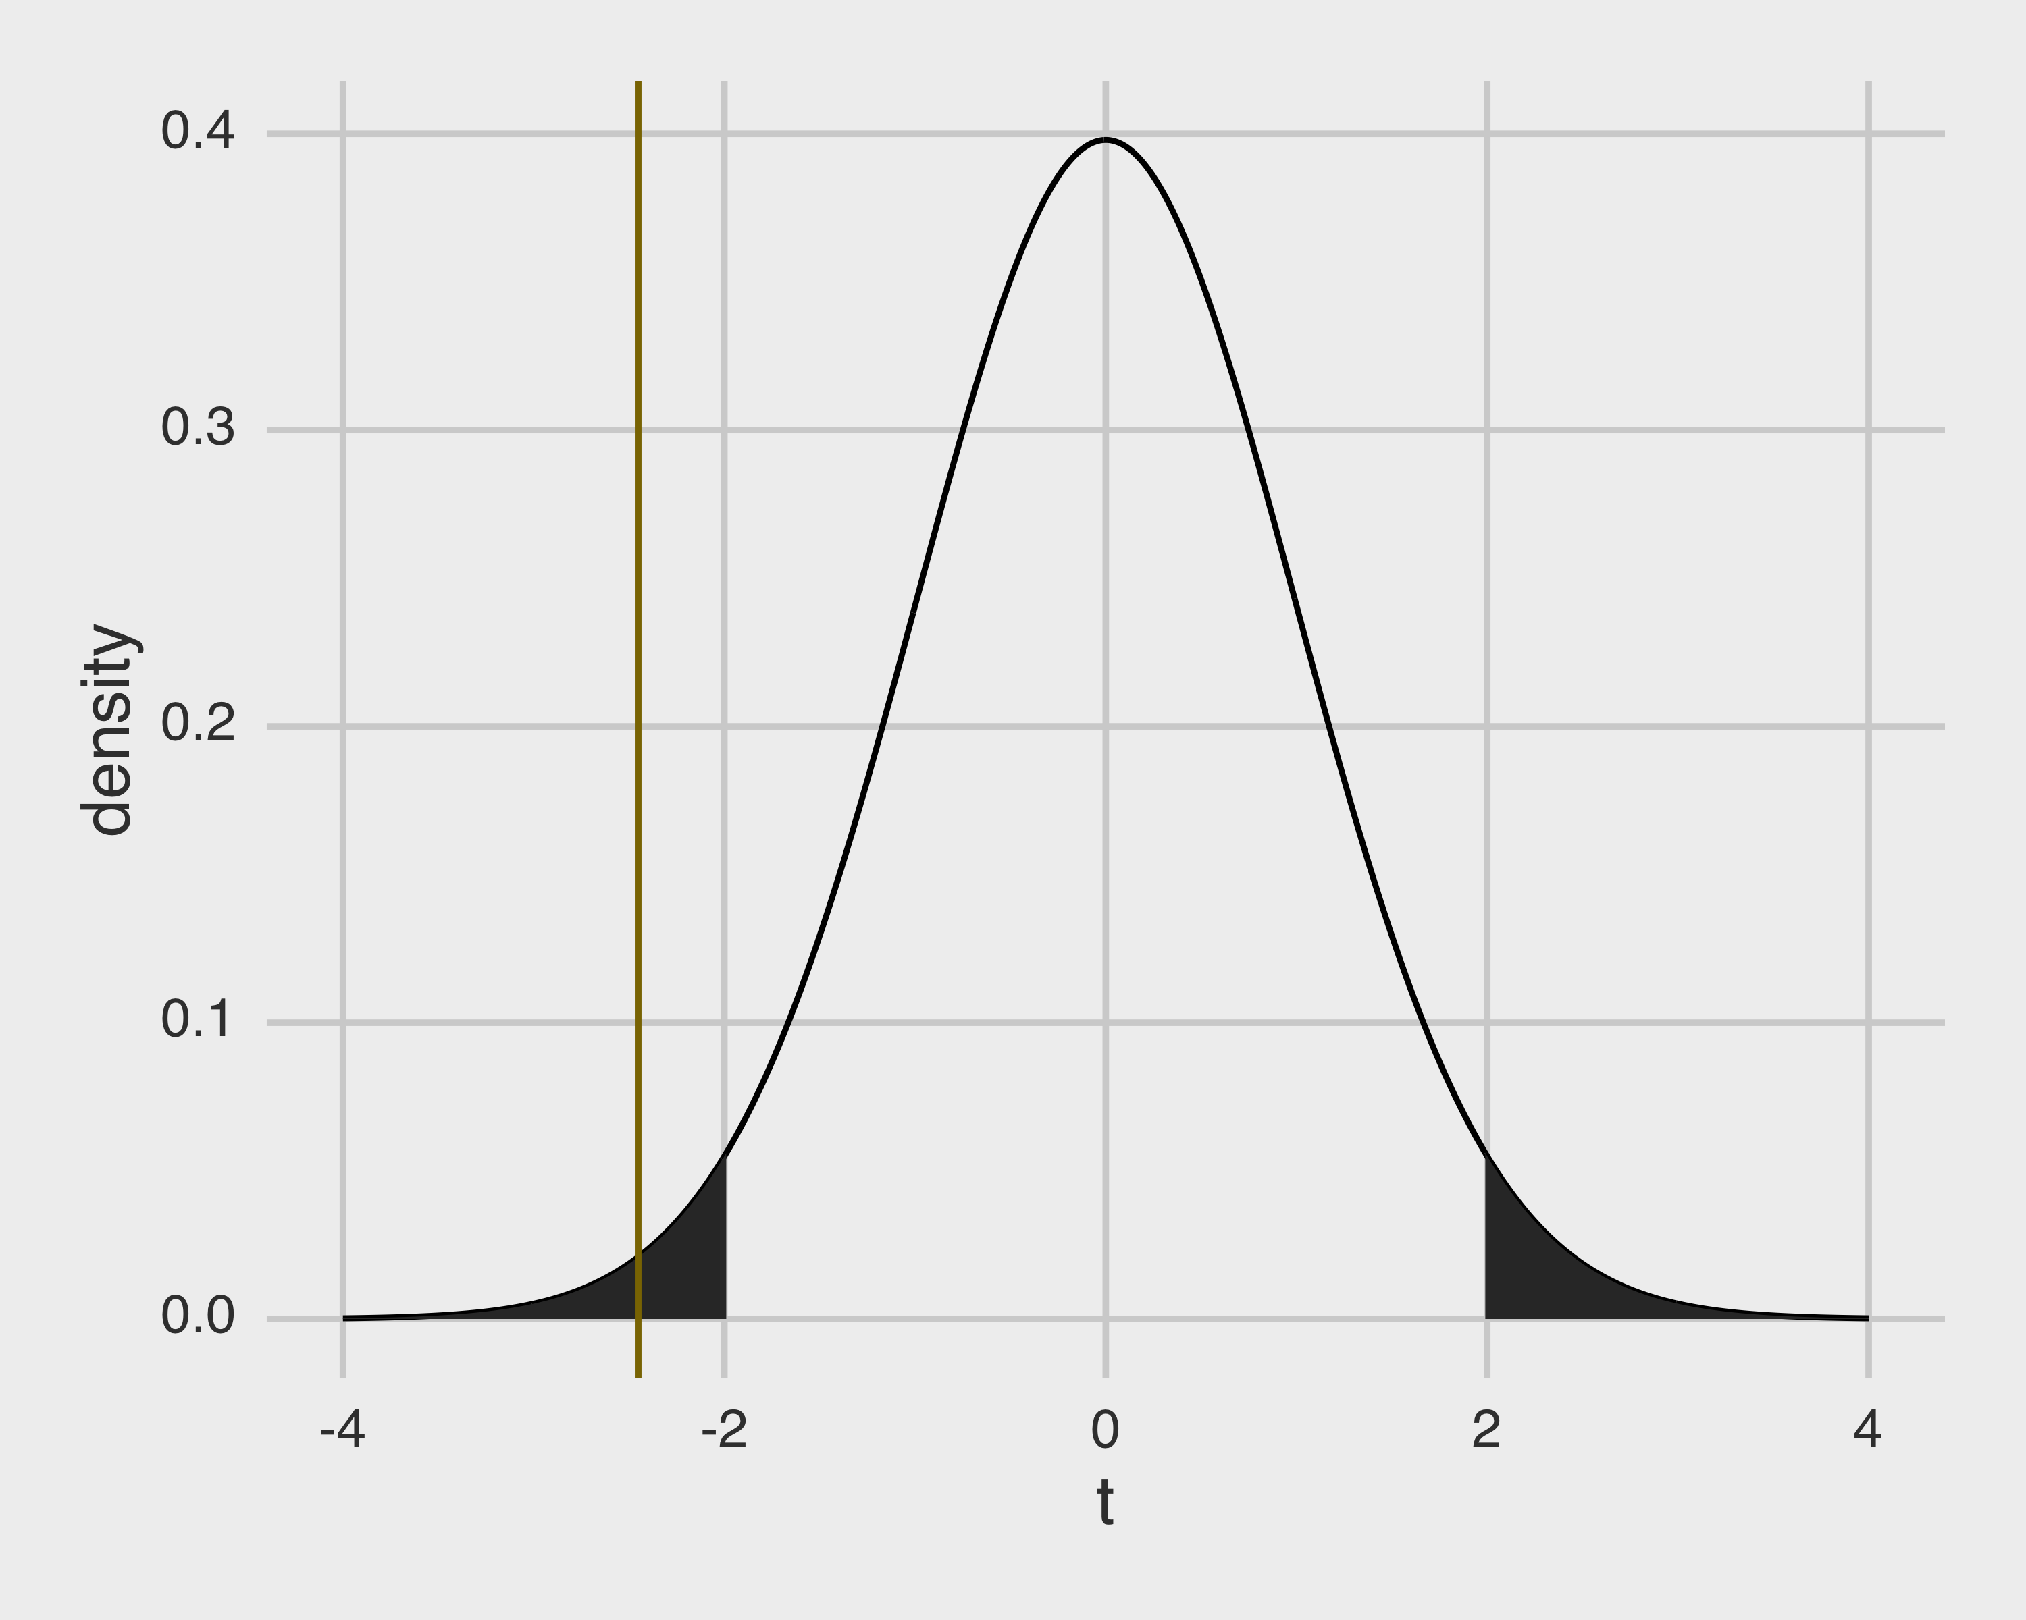
Hypothesis tests on coefficients

Slide 46
Hypothesis tests on coefficients
Since the two-sided p-value for a $t_{98}$ of $−2.45$ is $0.016$, we can reject the null hypothesis that women and men live equally long given these data.

Slide 47
The regression and ANOVA results are identical when the data are balanced
 | df | SS | MS | F | P
Groups | 1 | 781 | 781 | 6.00 | 0.016
Error | 98 | 12749 | 130
Total | 99 | 13530
In this case, the design is balanced and all of the ANOVA assumptions are met.
As a result, the regression t-test and ANOVA F-test P values are identical.
In general the regression approach is much more flexible but will give the same results as ANOVA if the assumptions are met. So you will probably not need ANOVA very often.

Slide 48
Confidence intervals for the coefficients
Similarly to the case of estimating a confidence interval for parameters like the population mean or population proportion based on data we have sampled, we can estimate confidence intervals for the regression coefficients.
Using a hat to estimate that the $\hat{β_{i}}$ we have is an estimate, the confidence interval
$$\hat{β_{i}}±t_{crit}SE(\hat{β_{i}})$$
Will contain the true underlying value of $β_{i}$ at least 95% of the time. Note here that $t_{crit}$ is the critical value of $t$ for whatever $n$ and $α$ you are using - in R this would be qt(0.975,98) $≈$ 1.98 if $n$ = 100 and $α$ = 0.05. For short, some authors just approximate the critical value with the number 2 in all cases.

Slide 49
Outline
Linear regression model
Solving a regression problem with an ANOVA
Solving a regression problem with regression
Fitting model parameters
Making inferences
Implementation in software
Model fit

Slide 50
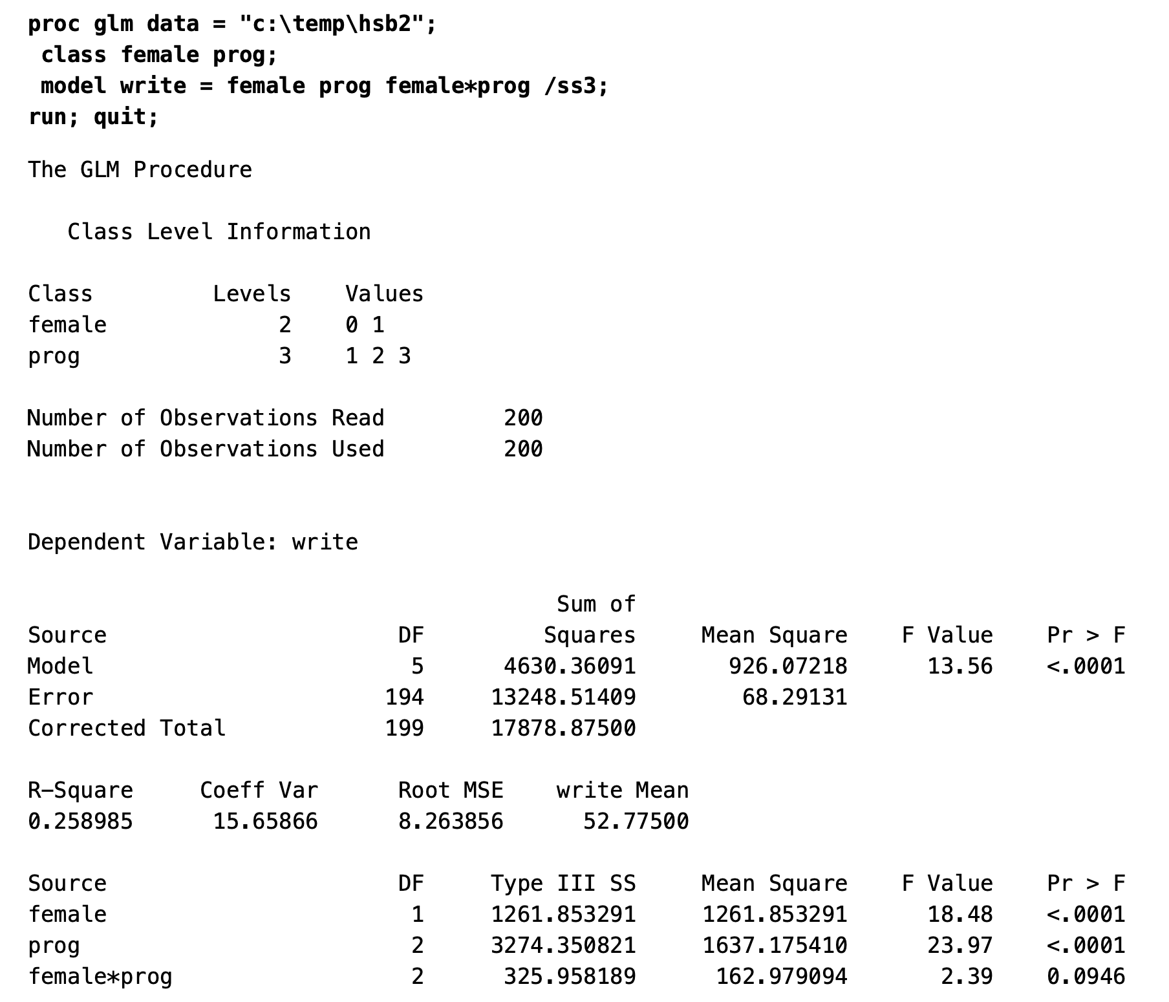
How this is implemented in software
In dedicated statistics software like SAS, the fitted model coefficients are supplied with estimates of their standard errors and p-values from hypothesis tests comparing the values to zero.
Depending on the type of model used, these tests may be presented as F, t, Wald, or other types.
The broom package in R will produce this type of behavior for you.
https://stats.idre.ucla.edu/sas/output/glm/

Slide 51
Assessing the accuracy of the model
Once we have rejected the null hypothesis $β_{i}=0$ in favor of the alternative hypothesis $β_{i}≠0$, it is natural to want to quantify the extent to which the model fits the data.
The quality of a linear regression fit is typically assessed using two closely related quantities: the residual standard error $RSE$ and the $R^{2}$ statistic.

Slide 52
Assessing the accuracy of the model
Recall that associated with each observation is an error term $ε$. Due to the presence of these error terms, even if we knew the true regression line (i.e. even if $β_{0}$ and $β_{1}$ were known), we would not be able to perfectly predict $y$ from $x$.
This error represents the fundamental, irreducible biological variability in the data. (Even after accounting for gender, for example, there remains some variance in height in our data from last class.)
The $RSE$ is an estimate of the standard deviation of this error or noise process.

Slide 53
Assessing the accuracy of the model
The $RSE$ is an estimate of the standard deviation of this error or noise process. As the residual variance is:
$$s^{2}=\frac{RSS}{n−p}$$
The residual standard error is:
$$RSE=s=\sqrt{\frac{RSS}{n−p}}$$

Slide 54
The R² statistic
The $RSE$ is in units of the $y$ variable, which is not always interpretable.
Therefore, we often express this variation as a fraction of the total sum of squares:
$$TSS=\sum_{i}^{​}{{\left(y_{i}−\overline{y}\right)}^{2}}$$
$$R^{2}=\frac{TSS−RSS}{TSS}=1−\frac{RSS}{TSS}$$
Note that the quantity $TSS−RSS$ is the “sum of squares due to groups” or otherwise explained by the model.

Slide 55
Relationship to the correlation coefficient
In simple linear regression, the $R^{2}$ statistic is exactly equal to $r^{2}$, the square of Pearson’s correlation coefficient between $y$ and $x$. When the conditions for correlation are met - e.g., both $y$ and $x$ are normally distributed and there are no other terms in the model, both the $R^{2}$ and $r^{2}$ are bounded between 0 (no variation of $y$ is explained at all by $x$) and 1 (all of the variation in $y$ is explained by $x$).
In almost all practical situations this relationship does not hold.
In particular, note that if we calculate $RSS$ based on model residuals: $RSS=∑(y_{i}−\hat{y_{i}})^{2}$, if the predictions are created by a complex model the residual sum of squares might exceed the total sum of squares, creating negative values for $R^{2}$.

