Slide 1

BMI 510: Classifiers
J. Lucas McKay, Ph.D., M.S.C.R.
Departments of Biomedical Informatics and Neurology, Emory University, Atlanta, GA USA
Department of Biomedical Engineering, Georgia Institute of Technology, Atlanta, GA, USA

Slide 2
Acknowledgments
Some of this material is adapted from MSCR 510, Mitch Klein, Ph.D.

Slide 3
Outline
Classifier concept
Priors and successive tests
Screening tests
Evaluation
  Confusion matrices
  Sensitivity, Specificity, F1, etc.
ROC curves
Naïve Bayes classifiers
ROC lab exercise

Slide 4
Classifier Concept

Slide 5
Classifier Concept
In machine learning, binary classification is a supervised learning problem that categorizes new observations into one of two classes.

Slide 6
Classifier Concept
In machine learning, binary classification is a supervised learning problem that categorizes new observations into one of two classes.
This can be extended to multiclass but the fundamentals are the same.

Slide 7
Classification problems: diagnostic
Consider:
A patient presents at the emergency department with symptoms consistent with any of three medical conditions. (Let’s say, Marburg,* influenza, or a common cold.) Which of the three conditions does the individual have?
An online banking service needs to determine whether or not a transaction being performed on the site is fraudulent, on the basis of the user’s IP address and past transaction history.
Both of these scenarios involve using training data to create a classifier that can aid decision making for "out of sample” incoming test data.
*Scary!

Slide 8
Classification problems: predictive
In ML, we also often use classifiers to predict outcomes for a given patient based on other variables. e.g.:
Given DNA sequence data for a number of patients with and without a given disease, how could we identify which DNA mutations are associated with developing the disease in a new patient?
Given the raw purchase history of a large number of people who did and did not default on their mortgage, how could we identify which new mortgage applicants were likely to default?
Both of these scenarios also involve using training data to create a classifier that can aid decision making for "out of sample” incoming test data.
For convenience, we often use prediction to describe classifier assessments of events in the past, present, and future. This drives some people crazy.

Slide 9

Two types of predictions
Classification models usually generate two types of predictions:
A predicted continuous value, usually in the form of a probability (i.e., the predicted values of class membership, where predicted values for any individual sample sum to 1).
A predicted class, which comes in the form of a discrete category. For most practical applications, a discrete category prediction is required in order to make a decision. (email is/is not spam, patient is/is not in trouble).
Often the focus is on the discrete prediction rather than the continuous prediction. However, the probability estimates for each class can be very useful for gauging the model's confidence about the predicted classification.

Slide 10
Computations on predictions
Some applications use the predicted class probabilities as inputs for other calculations.

Slide 11
Computations on predictions
Some applications use the predicted class probabilities as inputs for other calculations.
An insurance company that wants to find fraudulent claims might combine the probability of fraud with other variables to decide whether the probability of investigation would be worthwhile (net profitable).

Slide 12
Decision rules
Even after the probability of an investigation being worthwhile is calculated, a decision rule is still needed to turn the continuous variable into a categorical Yes/No or multi-level variable.
In medical contexts, this rule is often informed by the gravity of effects of making a mistake.

Slide 13
Human intervention
The later stages often incorporate more and more policy decisions from subject matter experts.
For example, the insurance company policy might be to have a human adjudicate hard/borderline decisions and to have a simple rule adjudicate others.
The “have the machine do the easy ones” model is encountered frequently in clinical decision support systems (CDSS).

Slide 14
Human intervention
Kuhn and Johnson refer to this scenario as enforcing an “equivocal zone” rule, where the classifier essentially refuses to make a decision.
This language is not really standard but this situation is common.

Slide 15
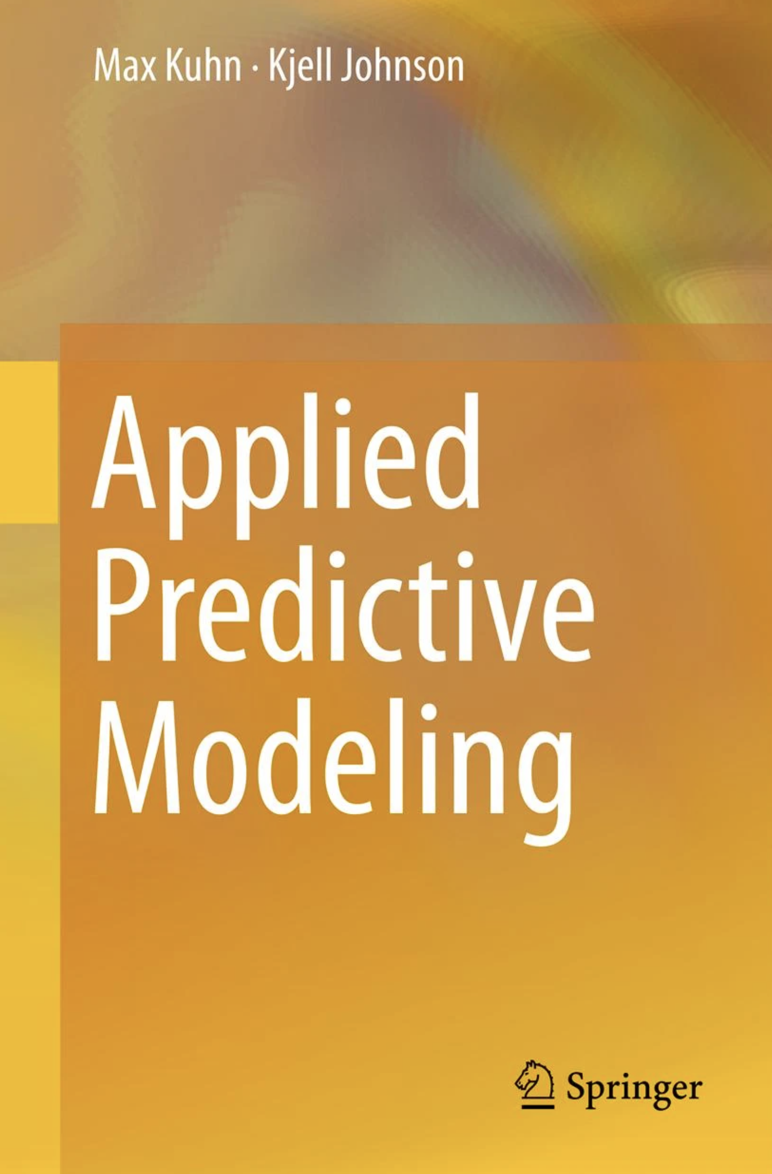
Human intervention
Kuhn and Johnson refer to this scenario as enforcing an “equivocal zone” rule, where the classifier essentially refuses to make a decision.
This language is not really standard but this situation is common.

Slide 16

Predictions that are not strictly probabilities
Often, we will modify the computation of a classifier or use an architecture in which the predicted "class probabilities" do not strictly adhere to the definition of probability.
These predictions may be continuous values that are not necessarily between 0 and 1 and do not sum to 1.
For such classification models, a transformation is required to adjust the predictions into a form suitable for classification. One common approach is the softmax transformation.

Slide 17
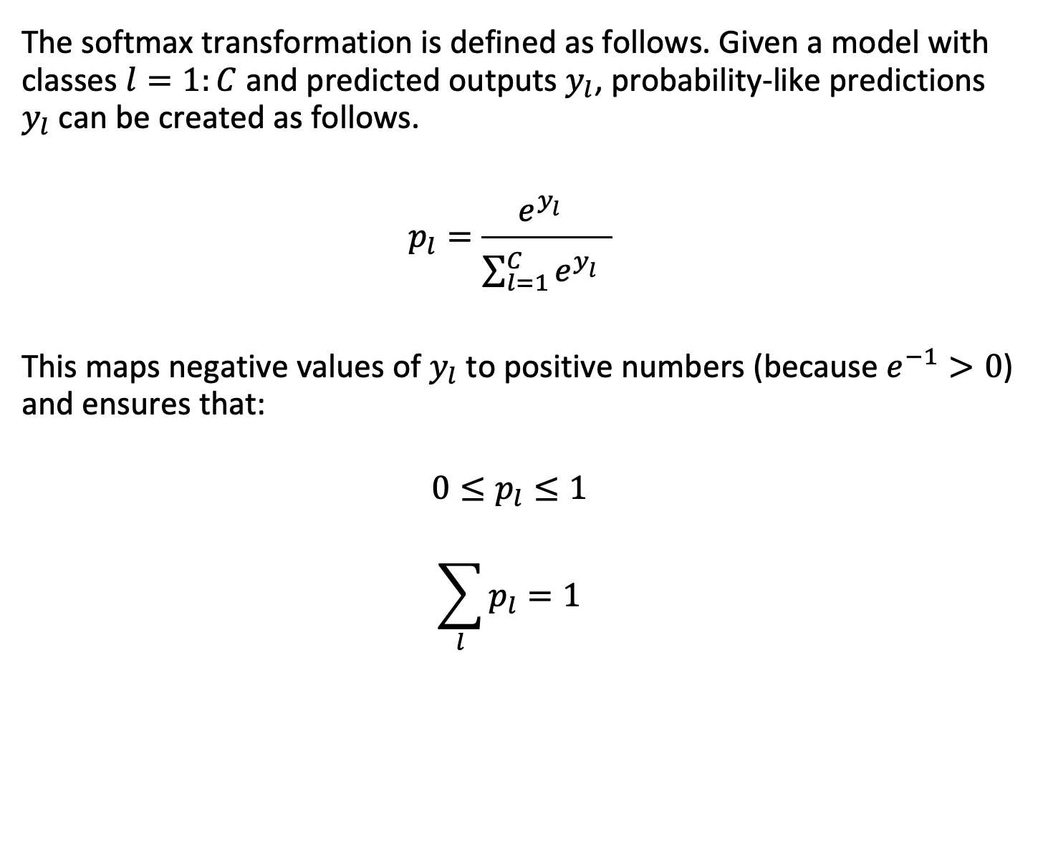
Softmax
The softmax transformation is defined as follows. Given a model with classes $l=1:C$ and predicted outputs $y_{l}$, probability-like predictions $y_{l}$ can be created as follows.
$$p_{l}=\frac{e^{y_{l}^{}}}{\sum_{l=1}^{C}{e^{y_{l}^{}}}}$$
This maps negative values of $y_{l}$ to positive numbers (because $e^{−1}>0$) and ensures that:
$$0≤p_{l}≤1$$
$$\sum_{l}{p_{l}=1}$$

Slide 18
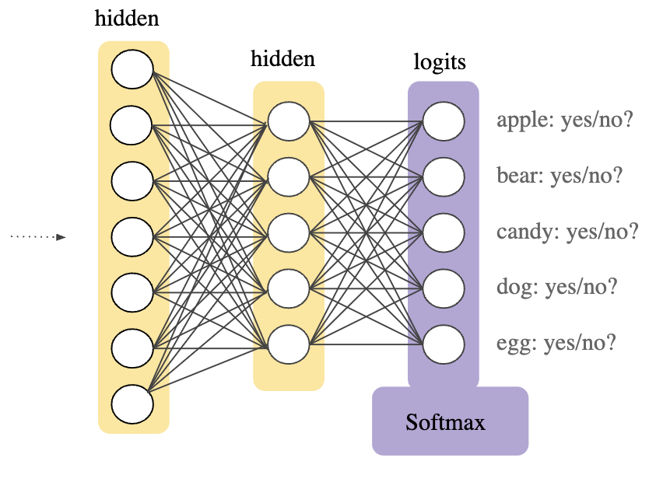
Softmax
We often see the softmax function as the last, normalizing layer in a neural network classifier.
This allows us to interpret the class outputs as relative probabilities within a sure proposition, even if they are not strictly probabilities by construction.
google

Slide 19
Priors and successive tests

Slide 20

Diagnostic tests
Imagine a study evaluating a test that diagnoses people for a disease. Each person taking the test either has ($D$) or does not have ($\overline{D}$) the disease.
The test outcome can be positive ($+$, classifying the person as having the disease) or negative ($−$, classifying the person as not having the disease).
The test results for each subject may or may not match the subject's actual status.

Slide 21
Diagnostic tests
The test results for each subject may or may not match the subject's actual status.
True positive: Sick people correctly identified as sick
False positive: Healthy people incorrectly identified as sick
True negative: Healthy people correctly identified as healthy
False negative: Sick people incorrectly identified as healthy

Slide 22
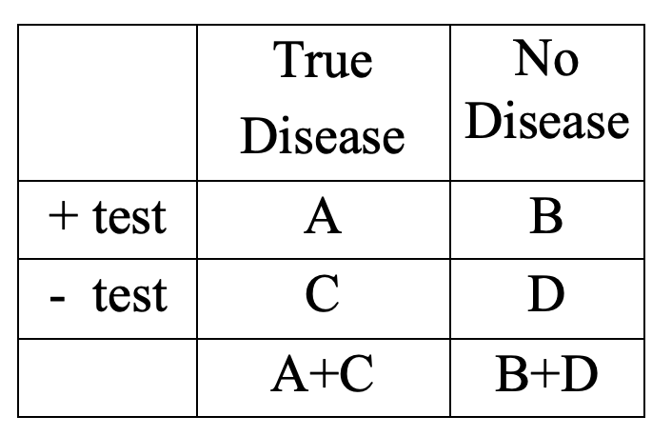
Where are the true positives?
Where are the true negatives?
Where are the false positives?
Where are the false negatives?

Slide 23
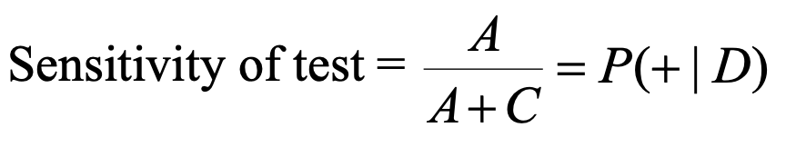
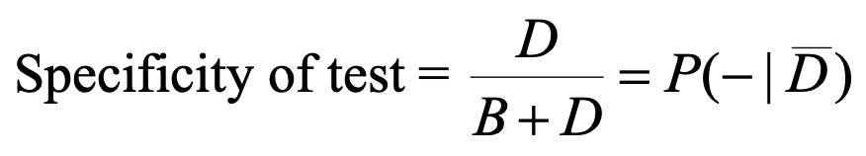
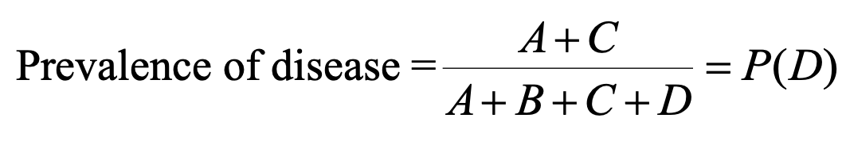

Slide 24
Diagnostic tests
Questions:
How can we force a test have a sensitivity of 100%?
How can we force a test have a specificity of 100%?
If everybody tests positive what is the specificity?
If everybody tests negative what is the sensitivity?

Slide 25
Priors and Successive Tests
In the diagnostic testing example, we begin with a prior probability (the disease prevalence) and update it based on the testing results.
We can use Baye’s rule to formalize this.

Slide 26
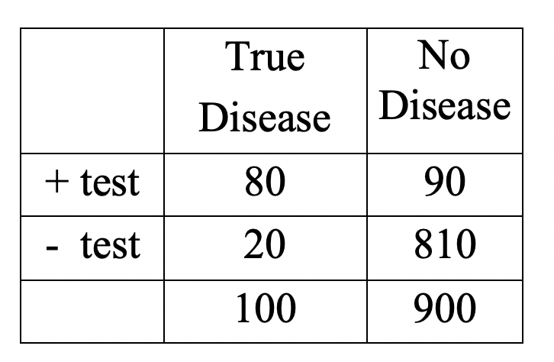
Priors and Successive Tests
What is the prevalence?
What is the sensitivity?
What is the specificity?
What is P(D|+)?
What is P(D|++), the probability of disease given two successive (independent) tests?

Slide 27
Priors and Successive Tests
What is the prevalence?
100/1000=0.1
What is the sensitivity?
80/100=0.8
What is the specificity?
810/900=0.9
What is P(D|+)?
What is P(D|++), the probability of disease given two successive (independent) tests?

Slide 28
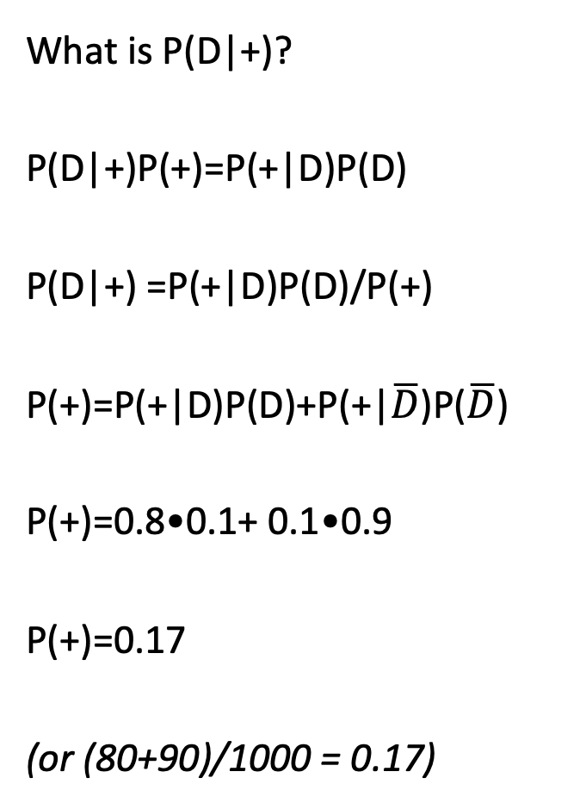
Priors and Successive Tests
What is P(D|+)?
P(D|+)P(+)=P(+|D)P(D)
P(D|+) =P(+|D)P(D)/P(+)
P(+)=P(+|D)P(D)+P(+|$\overline{D}$)P($\overline{D}$)
P(+)=0.8•0.1+ 0.1•0.9
P(+)=0.17
(or (80+90)/1000 = 0.17)

Slide 29
Priors and Successive Tests
What is P(D|+)?
P(D|+) =P(+|D)P(D) /P(+)
P(+)=0.17
P(D|+)=0.8•0.1/0.17=8/17

Slide 30
Priors and Successive Tests
The prior probability was the disease prevalence, P(D).
The posterior probability is the prior revised after applying Baye’s theorem.
If we do a second test, the prior is now the posterior, 8/17.

Slide 31
Priors and Successive Tests
The prior probability was the disease prevalence, P(D).
The posterior probability is the prior revised after applying Baye’s theorem.
If we do a second test, the prior is now the posterior, 8/17.
What is P(D|++)?

Slide 32
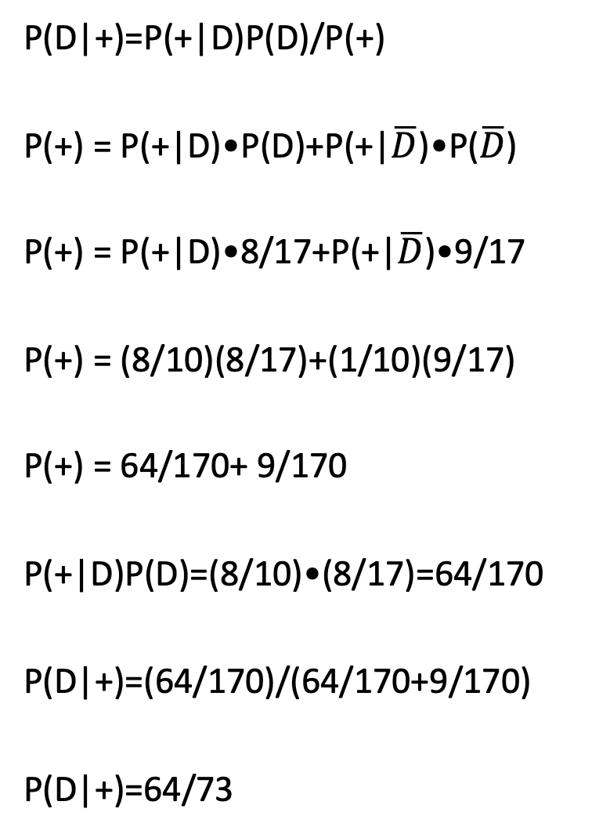
Priors and Successive Tests
P(D|+)=P(+|D)P(D)/P(+)
P(+) = P(+|D)•P(D)+P(+|$\overline{D}$)•P($\overline{D}$)
P(+) = P(+|D)•8/17+P(+|$\overline{D}$)•9/17
P(+) = (8/10)(8/17)+(1/10)(9/17)
P(+) = 64/170+ 9/170
P(+|D)P(D)=(8/10)•(8/17)=64/170
P(D|+)=(64/170)/(64/170+9/170)
P(D|+)=64/73

Slide 33
Priors and Successive Tests
Prior: 8/10
Posterior (1): 8/17
Posterior (2): 64/73

Slide 34
Screening tests

Slide 35
Screening Tests
When you screen (rather than test) for a disease, in the context of an observational study, when you compare a screened group to an unscreened group, you get:
Prognostic selection bias
Those who volunteer to get screened will differ in many ways from those who refuse to be screened. Some of these differences may be related to the outcome.
Lead-time bias
The success of a treatment (e.g., for cancer) is often measured in terms of survival time. Screening will move ahead the time of diagnosis. Therefore, screening can appear to lengthen the survival time from diagnosis even if the treatment has no effect.
Length-biased sampling
Diseases progress at various rates. Screening tends to select slower progressing cases (the more aggressive cases have less person-time to be screened), so the screened patients may appear to live longer.

Slide 36
Screening Tests
When you screen (rather than test) for a disease, in the context of an observational study, when you compare a screened group to an unscreened group, you get:
Prognostic selection bias
Those who volunteer to get screened will differ in many ways from those who refuse to be screened. Some of these differences may be related to the outcome.
Lead-time bias
The success of a treatment (e.g., for cancer) is often measured in terms of survival time. Screening will move ahead the time of diagnosis. Therefore, screening can appear to lengthen the survival time from diagnosis even if the treatment has no effect.
Length-biased sampling
Diseases progress at various rates. Screening tends to select slower progressing cases (the more aggressive cases have less person-time to be screened), so the screened patients may appear to live longer.

Slide 37
Evaluation

Slide 38
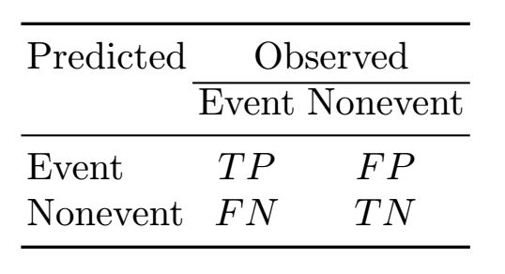
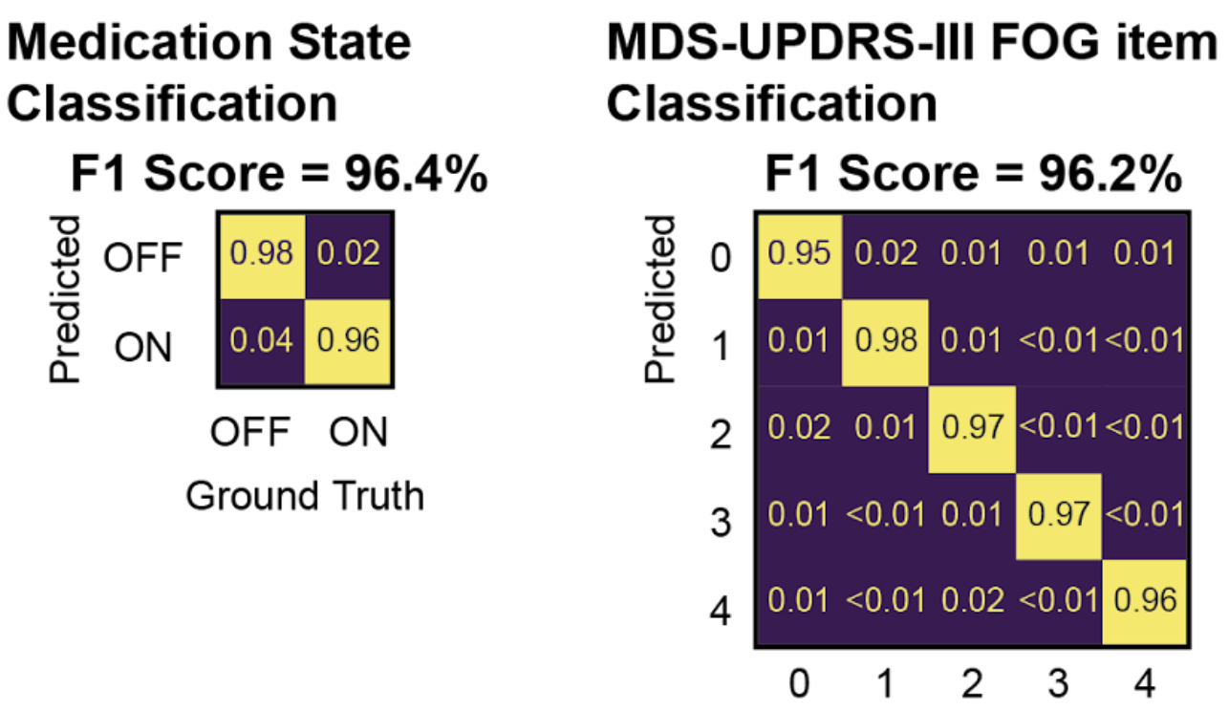
Confusion matrices
The most straightforward way to assess classifier performance is to examine the confusion matrix.
The matrix compares the actual target values with those predicted by the machine learning model.
Binary classification confusion matrices are 2x2; multi-class problems produce matrices essentially the same.

Slide 39
Confusion matrices
Confusion matrices provide most of the information on the main diagonal, but the structure of the matrix can provide valuable insight into how a classifier is working.
What do you notice about this classifier?
What would you do about it?
 | Maine Coon | Siamese | Labrador | Frenchie | Dachshund
Maine Coon | 22 | 3
Siamese |  | 24 |  | 1
Labrador |  |  | 25
Frenchie |  | 20 |  | 2 | 3
Dachshund |  | 18 |  | 3 | 4

Slide 40
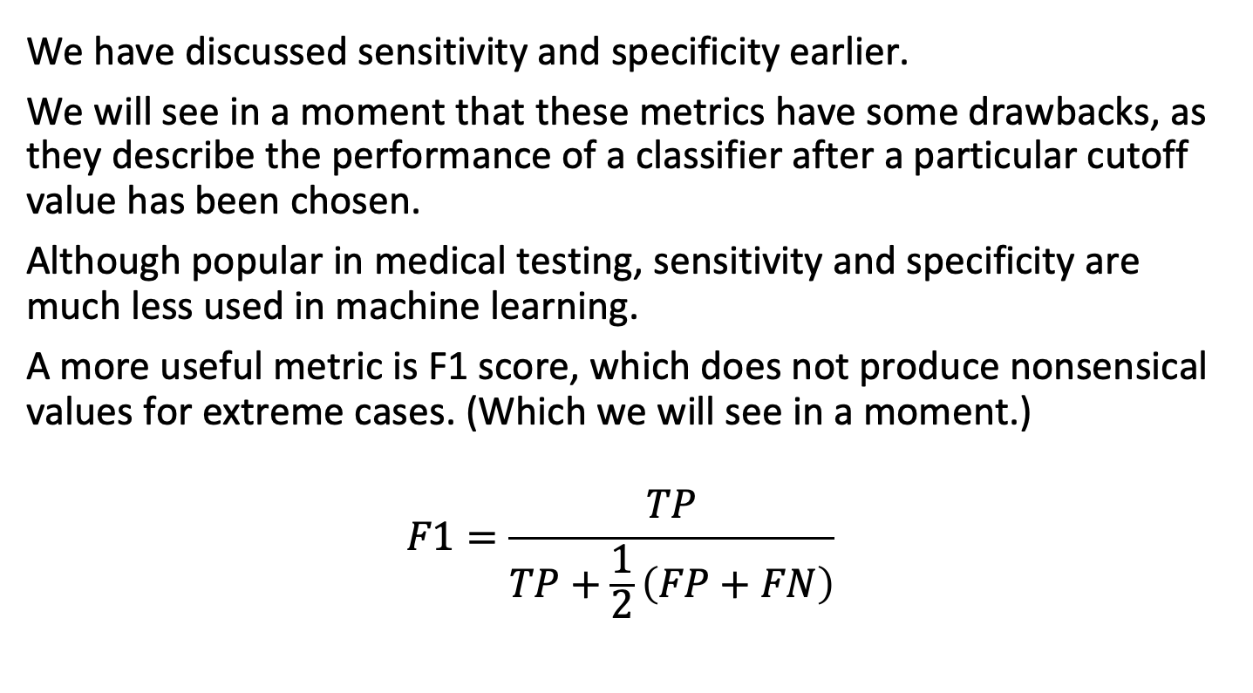
F1 score
We have discussed sensitivity and specificity earlier.
We will see in a moment that these metrics have some drawbacks, as they describe the performance of a classifier after a particular cutoff value has been chosen.
Although popular in medical testing, sensitivity and specificity are much less used in machine learning.
A more useful metric is F1 score, which does not produce nonsensical values for extreme cases. (Which we will see in a moment.)
$$F1=\frac{TP}{TP+\frac{1}{2}\left(FP+FN\right)}$$

Slide 41
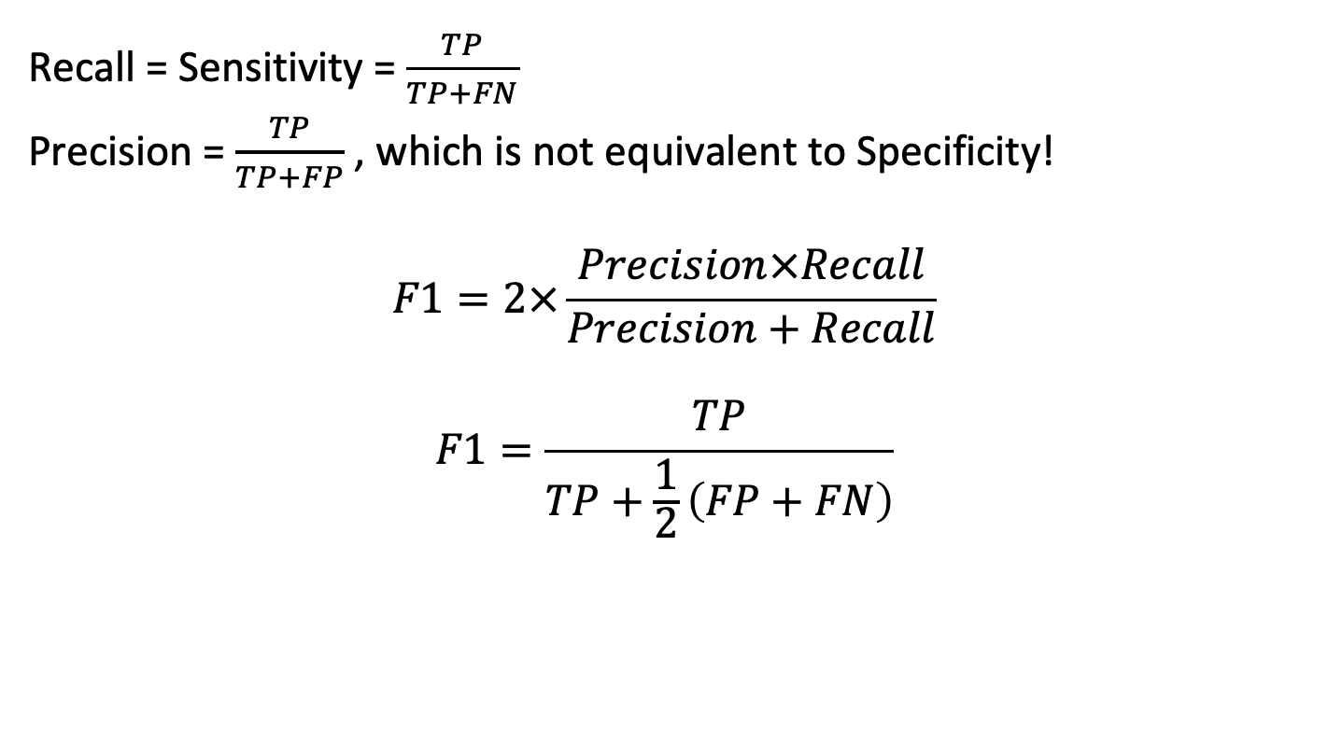
Relationship between F1 and cell counts
Recall = Sensitivity = $\frac{TP}{TP+FN}$
Precision = $\frac{TP}{TP+FP}$ , which is not equivalent to Specificity!
$$F1=2×\frac{Precision×Recall}{Precision+Recall}$$
$$F1=\frac{TP}{TP+\frac{1}{2}\left(FP+FN\right)}$$

Slide 42
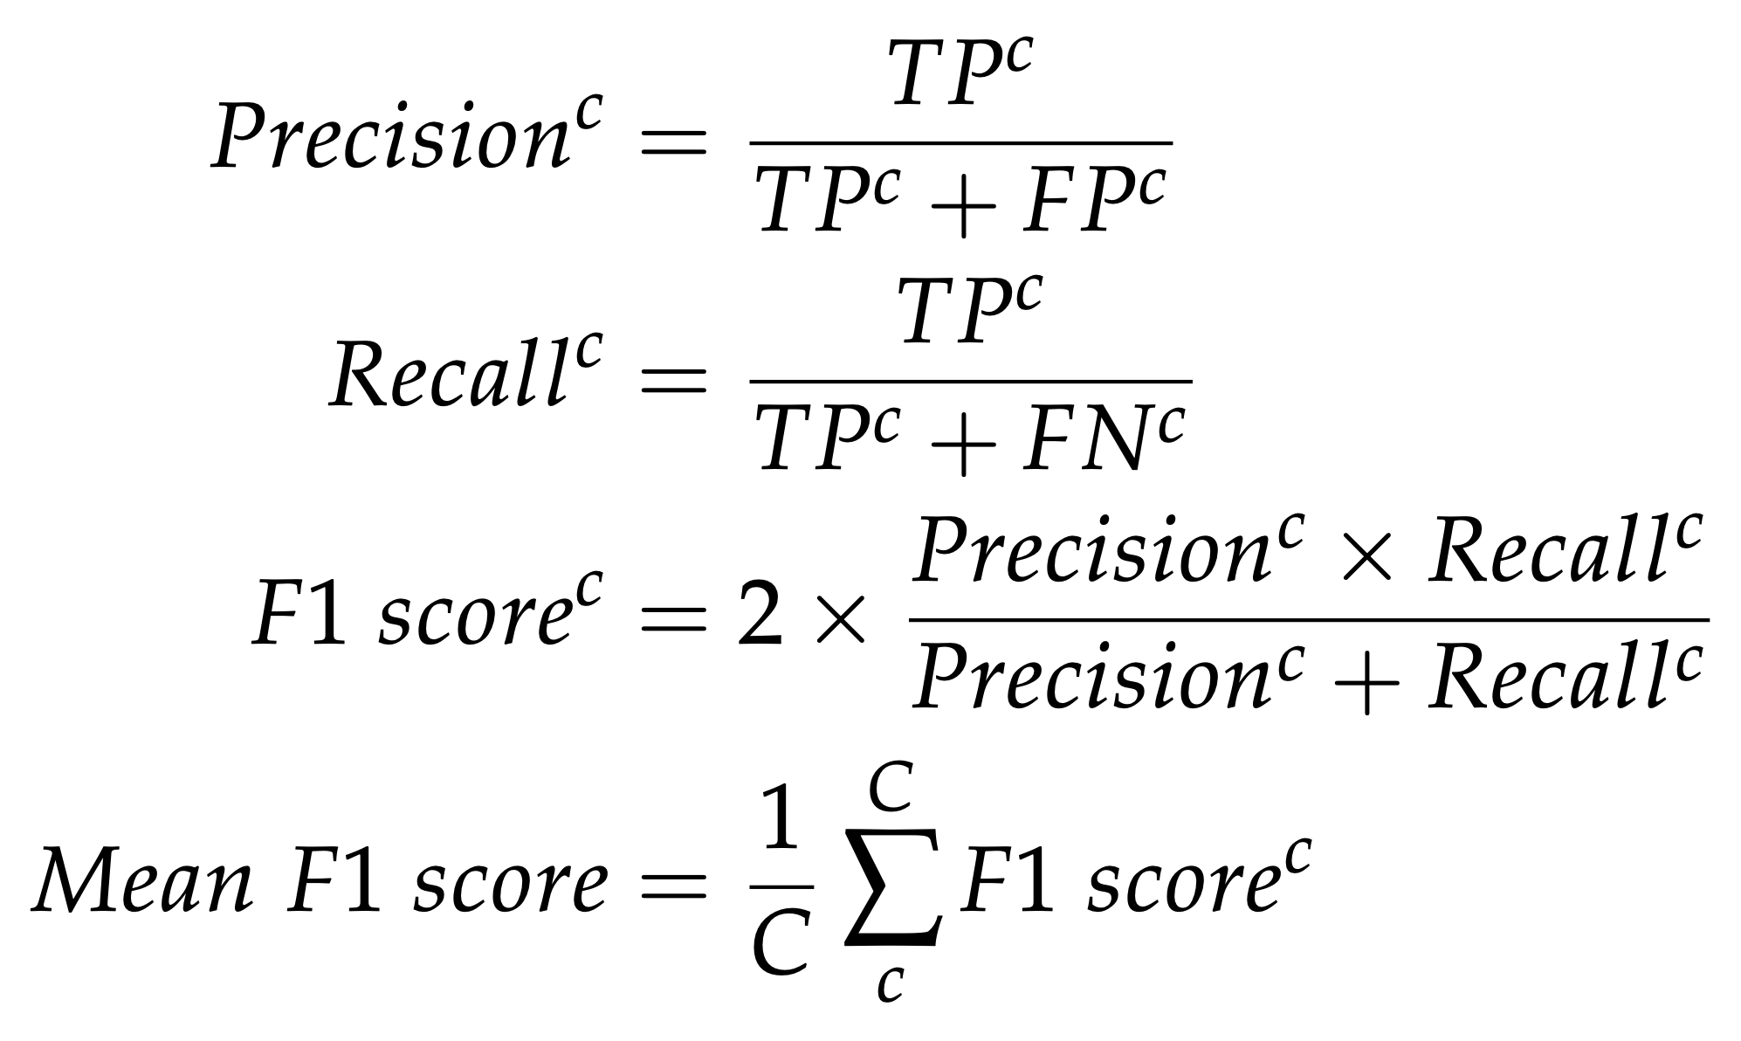
Multi-class F1
Multi-class prediction is a straightforward extension of binary prediction.
Precision, Recall, and F1 are calculated separately for each predicted class and averaged to produce an overall F1 score.
There is no absolute reason to weight classes equally here; if you are more concerned about one class you may use a weighted average during training.

Slide 43
Receiver-Operator Characteristics

Slide 44
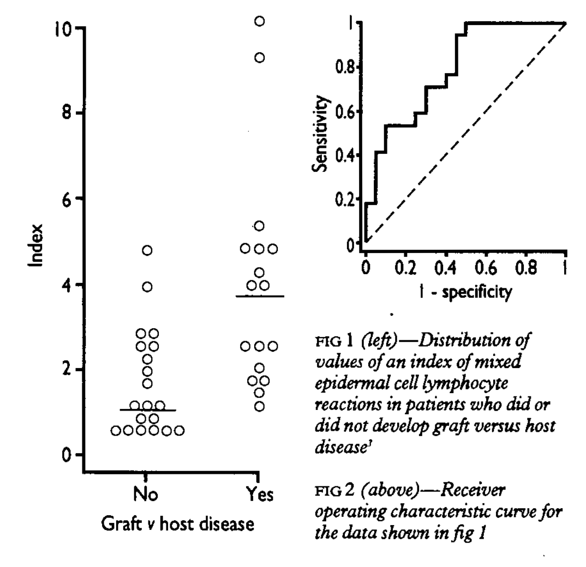
Receiver-operator characteristic (ROC) curves
An ROC curve describes the performance of a decision rule on a continuous predictor variable.
Bland and Altman

Slide 45
Receiver-operator characteristic (ROC) curves
An ROC curve describes the performance of a decision rule on a continuous predictor variable.
Although the units are a little funny (1-specificity?) they can easily be constructed by hand.
Bland and Altman

Slide 46
Receiver-operator characteristic (ROC) curves
Let’s start with these data. It appears that patients (dots) with higher values of an index of lymphocyte reactions (y axis) are more likely to be diagnosed with graft vs. host disease (x axis).
We could therefore use this index as a disease predictor.
But where do we put the cutoff value?
Bland and Altman

Slide 47
Receiver-operator characteristic (ROC) curves
Let’s try 0.
TP: 17
FP: 20
TN: 0
FN: 0
Sensitivity: TP/(TP+FN)=17/17=1
Specificity: TN/(TN+FP)=0/(0+20)=0
F1: TP/(TP+(1/2)(FP+FN))
F1: 17/(17+20/2)
F1: 17/27
F1: 0.64
Bland and Altman

Slide 48
Receiver-operator characteristic (ROC) curves
Let’s try 3.5.
TP: 9
FP: 2
TN: 18
FN: 8
Sensitivity: TP/(TP+FN)=9/17=0.53
Specificity: TN/(TN+FP)=18/26=0.69
F1: TP/(TP+(1/2)(FP+FN))
F1: 9/(9+10/2)
F1: 9/14
F1: 0.64
Bland and Altman

Slide 49
Receiver-operator characteristic (ROC) curves
Let’s try 12.
TP: 0
FP: 0
TN: 20
FN: 17
Sensitivity: TP/(TP+FN)=0
Specificity: TN/(TN+FP)=1
F1: TP/(TP+(1/2)(FP+FN))
F1: 9/(9+10/2)
F1: 9/14
F1: 0.64
Bland and Altman

Slide 50
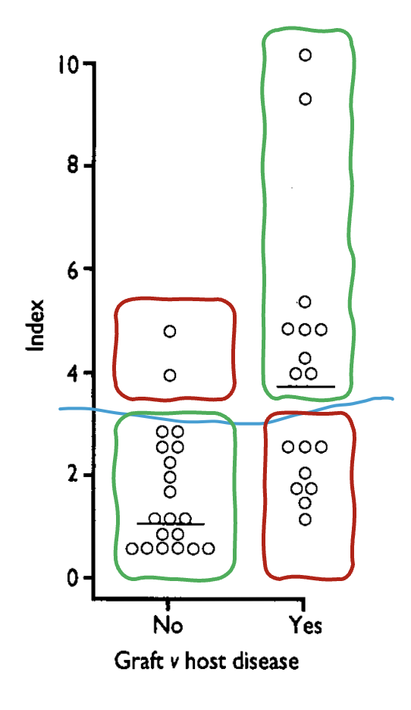
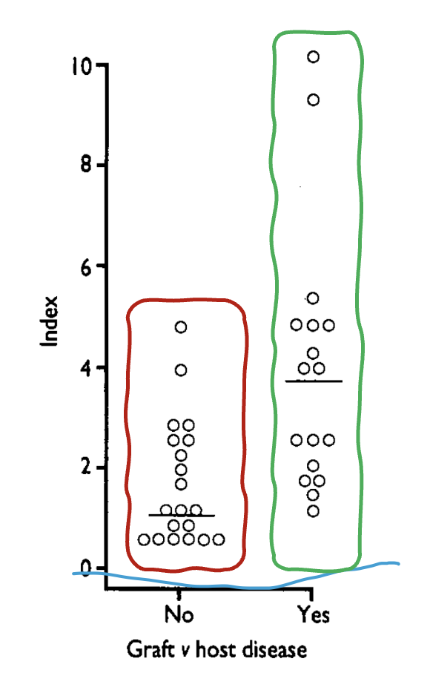
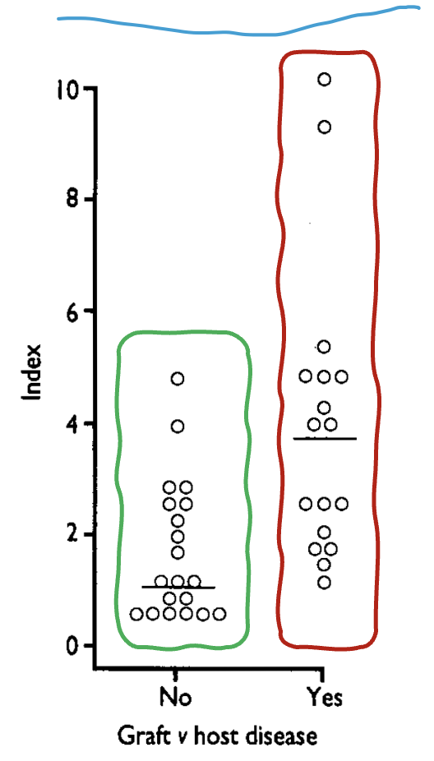

Receiver-operator characteristic (ROC) curves
Bland and Altman

Slide 51
Visual interpretation of ROC curves
A perfect classifier with a large sample size will result in an ROC curve that fills the top left of the graph.
A random classifier ROC curve will fall on the unity line.
An ROC curve with large steps should tell you that the sample size is inadequate, because additional samples at intermediate values could strongly influence the area under the curve (AUC).
(Let’s draw a few.)

Slide 52
Naïve Bayes

Slide 53
Naïve Bayes
A Naïve Bayes classifier is a probabilistic machine learning model based on Bayes' theorem with the assumption of conditional independence between features. It is commonly used for classification tasks such as spam filtering, text classification, and medical diagnosis.

Slide 54
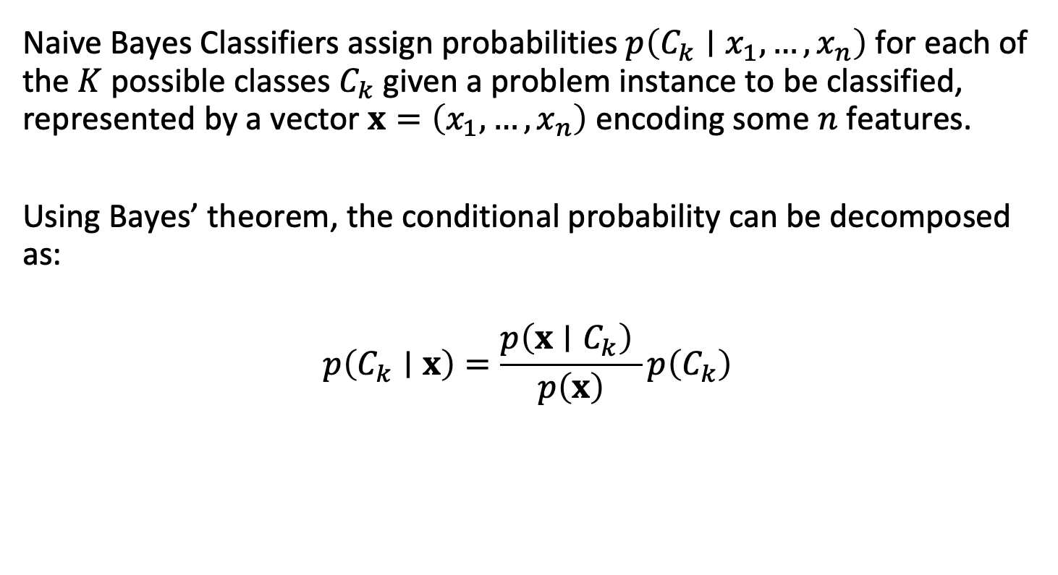
Naïve Bayes Classifiers
Naive Bayes Classifiers assign probabilities $p\left(C_{k}∣x_{1},…,x_{n}\right)$ for each of the $K$ possible classes $C_{k}$ given a problem instance to be classified, represented by a vector $x=\left(x_{1},…,x_{n}\right)$ encoding some $n$ features.
Using Bayes’ theorem, the conditional probability can be decomposed as:
$$p\left(C_{k}∣x\right)=\frac{p\left(x∣C_{k}\right) }{p\left(x\right)}p\left(C_{k}\right)$$

Slide 55

Naïve Bayes Classifiers
With a little rearranging, we can describe this as:
$$p\left(C_{k}∣x\right)=\frac{p\left(x∣C_{k}\right)}{p\left(x\right)}p\left(C_{k}\right)$$
or:
$$\text{posterior}=\frac{\text{likelihood}}{\text{evidence}}×\text{p}\text{rior}$$

Slide 56
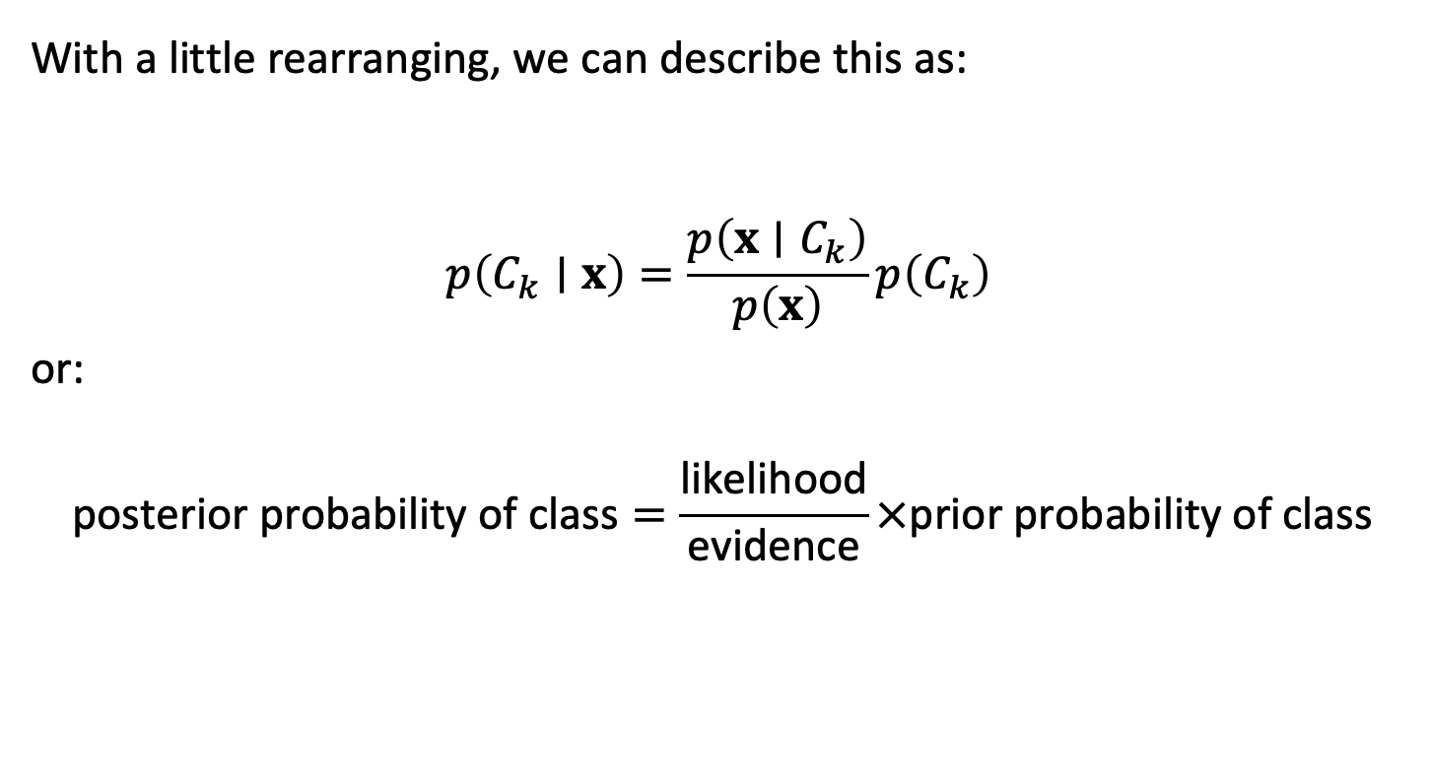
Naïve Bayes Classifiers
With a little rearranging, we can describe this as:
$$p\left(C_{k}∣x\right)=\frac{p\left(x∣C_{k}\right)}{p\left(x\right)}p\left(C_{k}\right)$$
or:
$$\text{posterior} \text{probability} \text{of} \text{class}=\frac{\text{likelihood}}{\text{evidence}}×\text{prior} \text{probability} \text{of} \text{class}$$

Slide 57
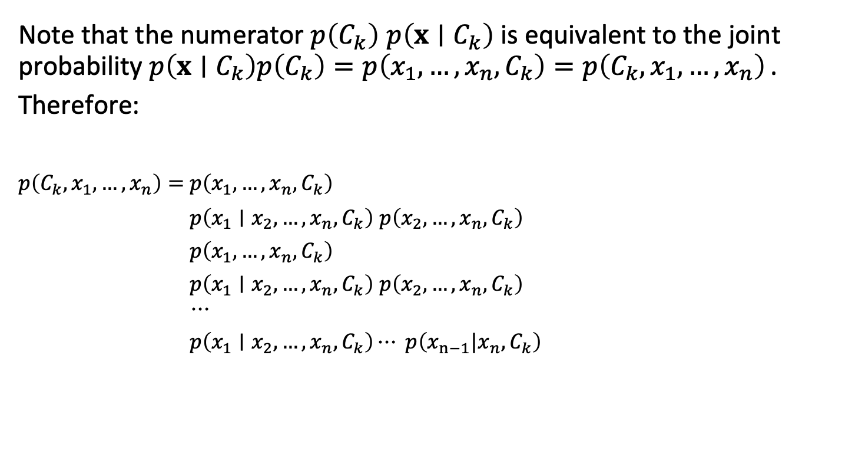
Naïve Bayes Classifiers
Note that the numerator $p\left(C_{k}\right) p\left(x∣C_{k}\right)$ is equivalent to the joint probability $p\left(x∣C_{k}\right)p\left(C_{k}\right)=p\left(x_{1},…,x_{n},C_{k}\right)=p\left(C_{k},x_{1},…,x_{n}\right)$.
Therefore:
$p\left(C_{k},x_{1},…,x_{n}\right)=$ $p\left(x_{1},…,x_{n},C_{k}\right)$
$p\left(C_{k},x_{1},…,x_{n}\right)=$ $p\left(x_{1}∣x_{2},…,x_{n},C_{k}\right) p\left(x_{2},…,x_{n},C_{k}\right)$
$p\left(C_{k},x_{1},…,x_{n}\right)=$ $p\left(x_{1},…,x_{n},C_{k}\right)$
$p\left(C_{k},x_{1},…,x_{n}\right)=$ $p\left(x_{1}∣x_{2},…,x_{n},C_{k}\right) p\left(x_{2},…,x_{n},C_{k}\right)$
$$p\left(C_{k},x_{1},…,x_{n}\right)=⋯$$
$p\left(C_{k},x_{1},…,x_{n}\right)=$ $p\left(x_{1}∣x_{2},…,x_{n},C_{k}\right)⋯ p\left(x_{n−1}|x_{n},C_{k}\right)$

Slide 58
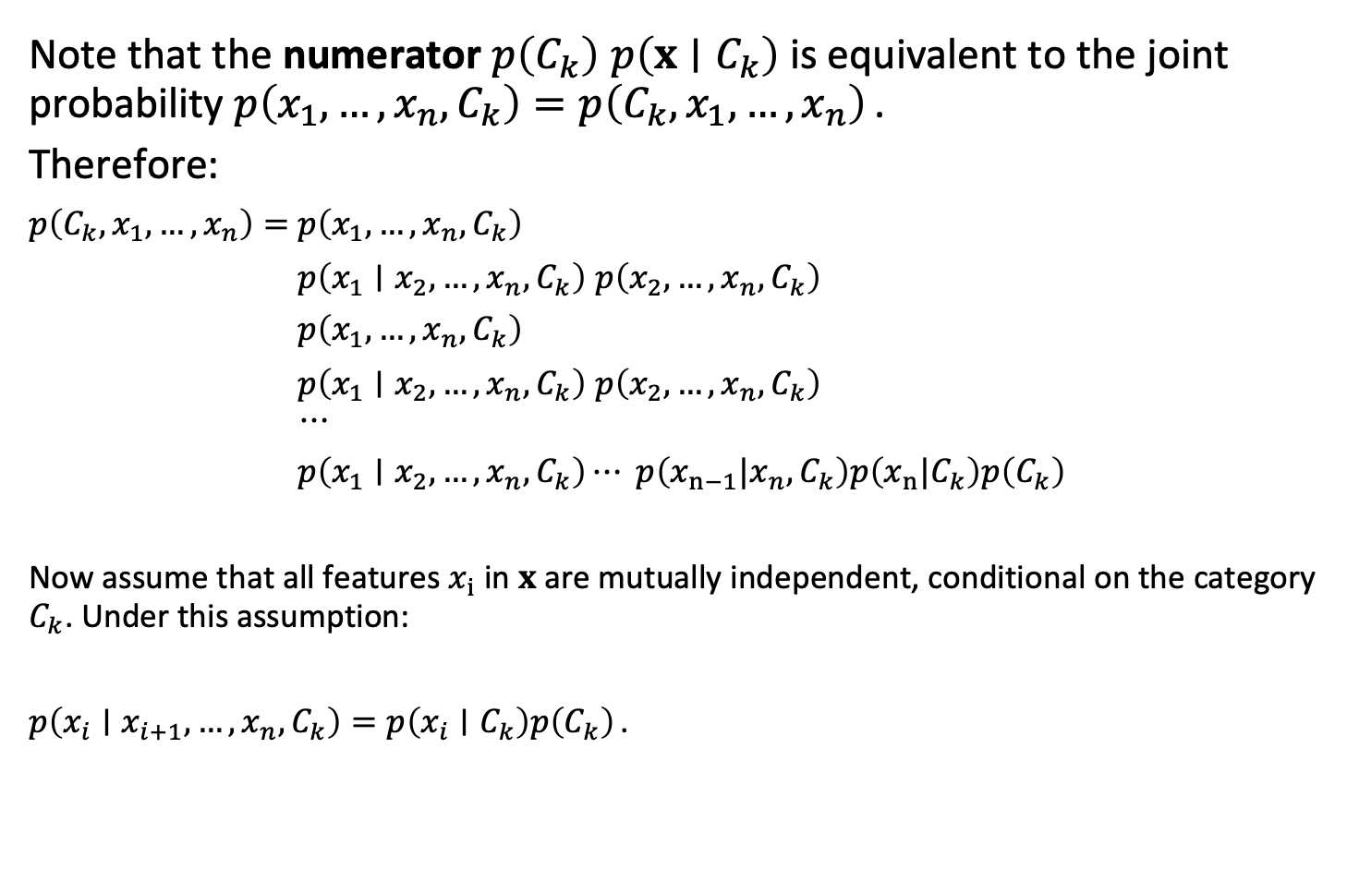
Naïve Bayes Classifiers
Note that the numerator $p\left(C_{k}\right) p\left(x∣C_{k}\right)$ is equivalent to the joint probability $p\left(x_{1},…,x_{n},C_{k}\right)=p\left(C_{k},x_{1},…,x_{n}\right)$.
Therefore:
$p\left(C_{k},x_{1},…,x_{n}\right)=$ $p\left(x_{1},…,x_{n},C_{k}\right)$
$p\left(C_{k},x_{1},…,x_{n}\right)=$ $p\left(x_{1}∣x_{2},…,x_{n},C_{k}\right) p\left(x_{2},…,x_{n},C_{k}\right)$
$p\left(C_{k},x_{1},…,x_{n}\right)=$ $p\left(x_{1},…,x_{n},C_{k}\right)$
$p\left(C_{k},x_{1},…,x_{n}\right)=$ $p\left(x_{1}∣x_{2},…,x_{n},C_{k}\right) p\left(x_{2},…,x_{n},C_{k}\right)$
$$p\left(C_{k},x_{1},…,x_{n}\right)=⋯$$
$p\left(C_{k},x_{1},…,x_{n}\right)=$ $p\left(x_{1}∣x_{2},…,x_{n},C_{k}\right)⋯ p\left(x_{n−1}|x_{n},C_{k}\right)p\left(x_{n}|C_{k}\right)p\left(C_{k}\right)$
Now assume that all features $x_{i}$ in $x$ are mutually independent, conditional on the category $C_{k}$. Under this assumption:
$p\left(x_{i}∣x_{i+1},…,x_{n},C_{k}\right)=p\left(x_{i}∣C_{k}\right)p\left(C_{k}\right)$.

Slide 59


Naïve Bayes Classifiers
The source of the naïveté:
Assume that all features in $x$ are mutually independent, conditional on the category $C_{k}$.
Are blood pressure and age independent once you account for sex? Probably not!
This assumption is certainly naïve, but makes designing the classifier much easier.

Slide 60
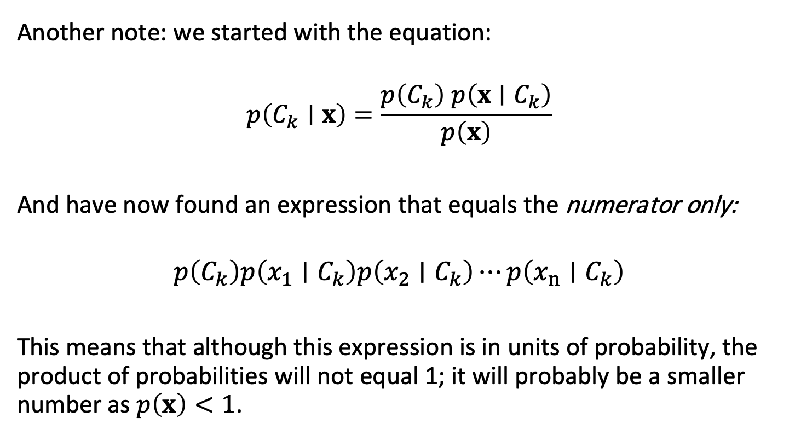
Naïve Bayes Classifiers
Another note: we started with the equation:
$$p\left(C_{k}∣x\right)=\frac{p\left(C_{k}\right) p\left(x∣C_{k}\right)}{p\left(x\right)}$$
And have now found an expression that equals the numerator only:
$$p\left(C_{k}\right)p\left(x_{1}∣C_{k}\right)p\left(x_{2}∣C_{k}\right)⋯p\left(x_{n}∣C_{k}\right)$$
This means that although this expression is in units of probability, the product of probabilities will not equal 1; it will probably be a smaller number as $p\left(x\right)<1$.

Slide 61
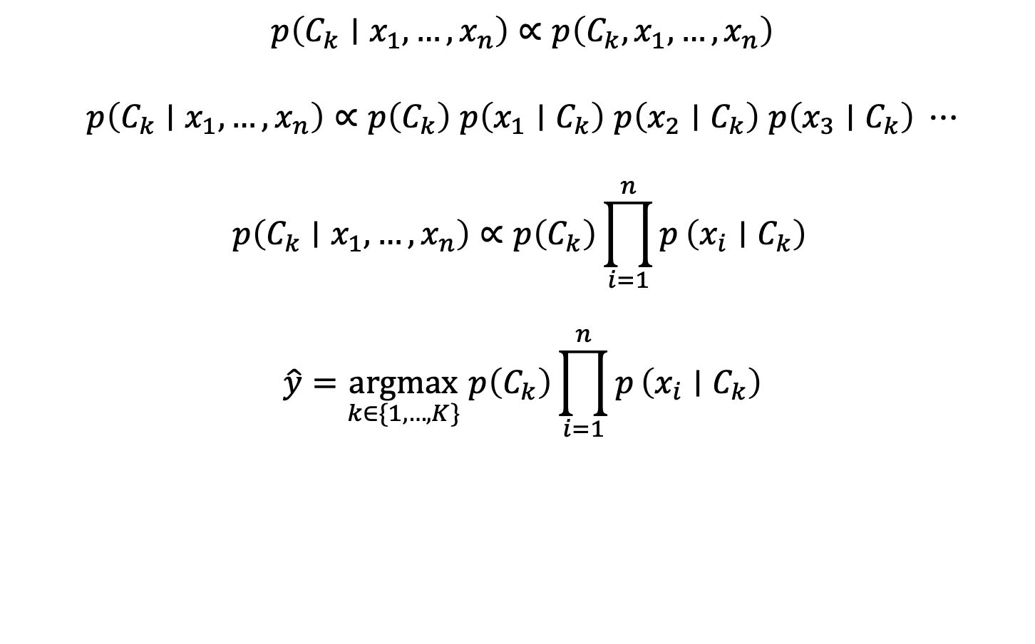
Naïve Bayes Classifiers
$$p\left(C_{k}∣x_{1},…,x_{n}\right)∝p\left(C_{k},x_{1},…,x_{n}\right)$$
$$p\left(C_{k}∣x_{1},…,x_{n}\right)∝p\left(C_{k}\right) p\left(x_{1}∣C_{k}\right) p\left(x_{2}∣C_{k}\right) p\left(x_{3}∣C_{k}\right) ⋯$$
$$p\left(C_{k}∣x_{1},…,x_{n}\right)∝p\left(C_{k}\right)\prod_{i=1}^{n}{p}\left(x_{i}∣C_{k}\right)$$
$$\hat{y}=\underset{k∈\{1,…,K\}}{argmax} p\left(C_{k}\right)\prod_{i=1}^{n}{p}\left(x_{i}∣C_{k}\right)$$

Slide 62
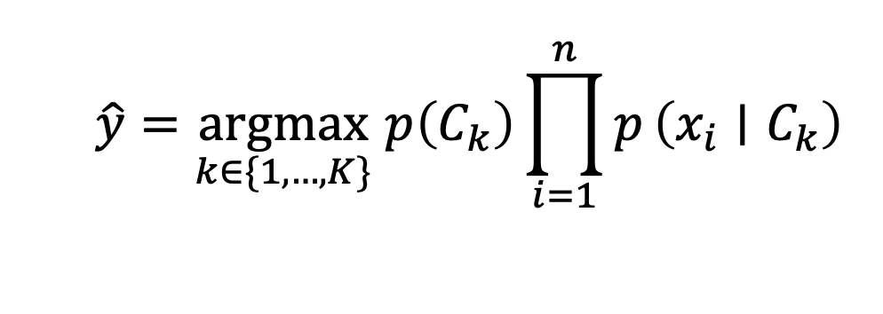

Naïve Bayes Classifiers
The predicted class
is the one that maximizes
The prior probability
of the class
$$×$$
The likelihood of the data
under the class

Slide 63

Naïve Bayes Classifiers
What happens when the likelihood goes up for class k?
What happens when the prior goes down for class k?

Slide 64
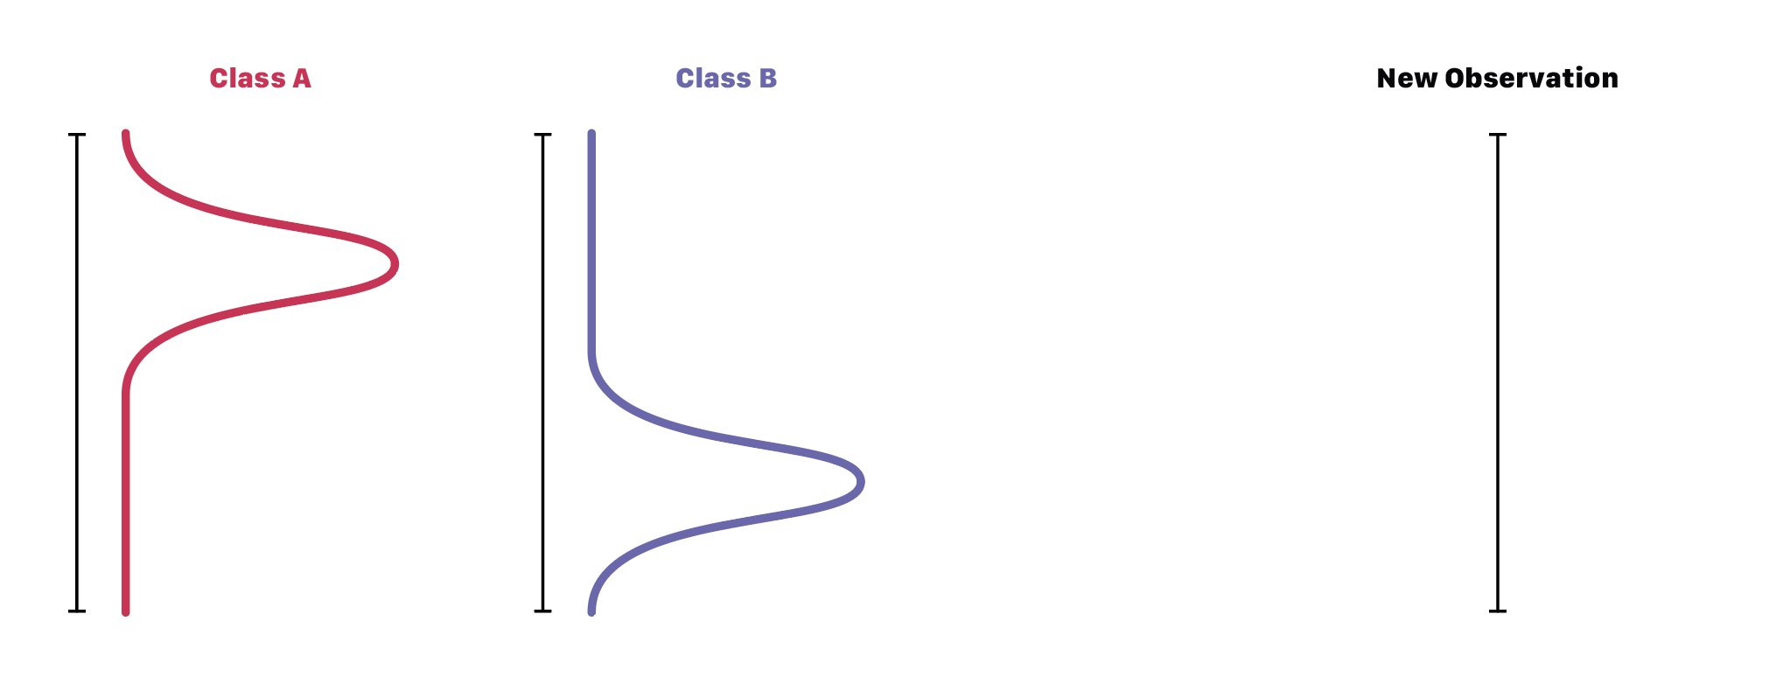

Slide 66
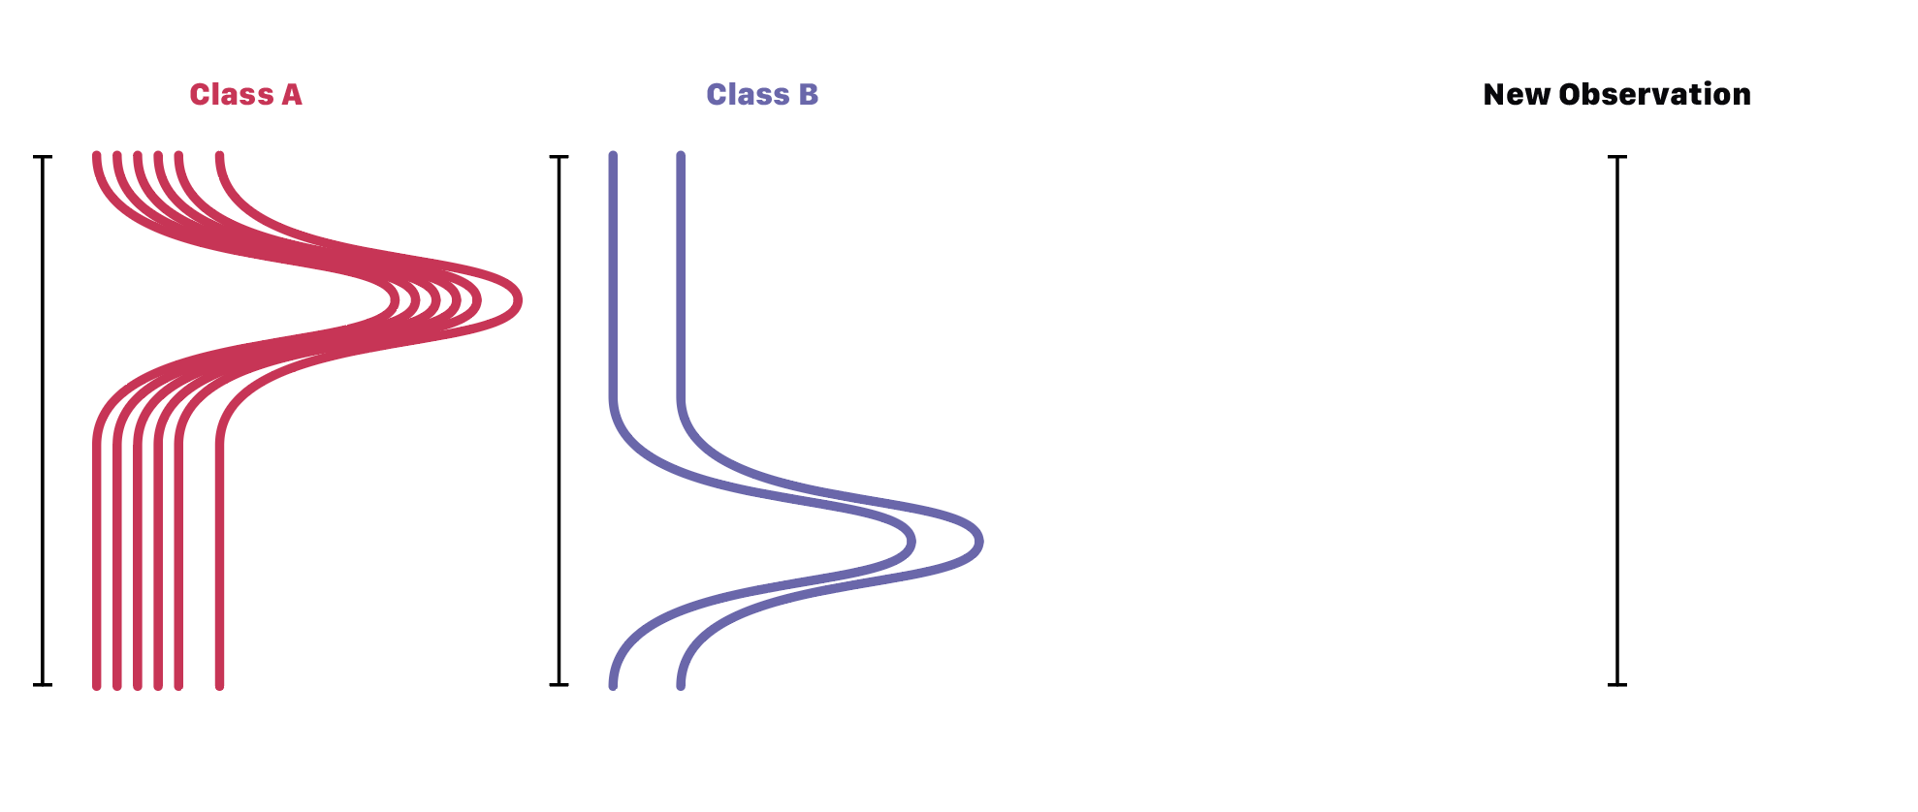

Slide 67
Outline
Classifier concept
Priors and successive tests
Screening tests
Evaluation
  Confusion matrices
  Sensitivity, Specificity, F1, etc.
ROC curves
Naïve Bayes classifiers
ROC lab exercise

