Slide 1
BMI 510: Table One
J. Lucas McKay, Ph.D., M.S.C.R.
Departments of Biomedical Informatics and Neurology, Emory University, Atlanta, GA USA
Department of Biomedical Engineering, Georgia Institute of Technology, Atlanta, GA, USA

Slide 2
Outline
Table one in an observational study
Table one in a randomized trial
Table two
Table one pitfalls
Interactive lab
Arsenal package

Slide 3
Table one in an observational study
Establishes general study power
Establishes (lack of) external validity

Slide 4
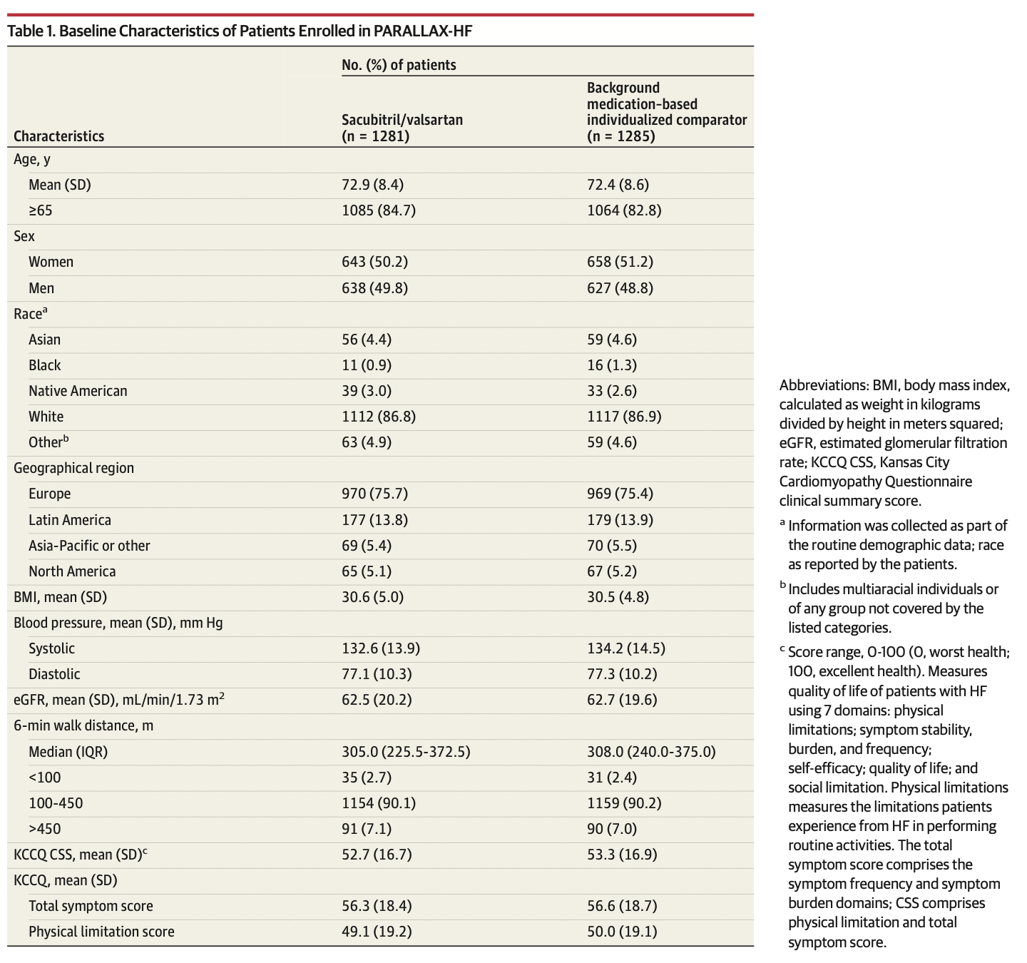
Table one in a Clinical Trial
Reports (im)balance between groups

Slide 5
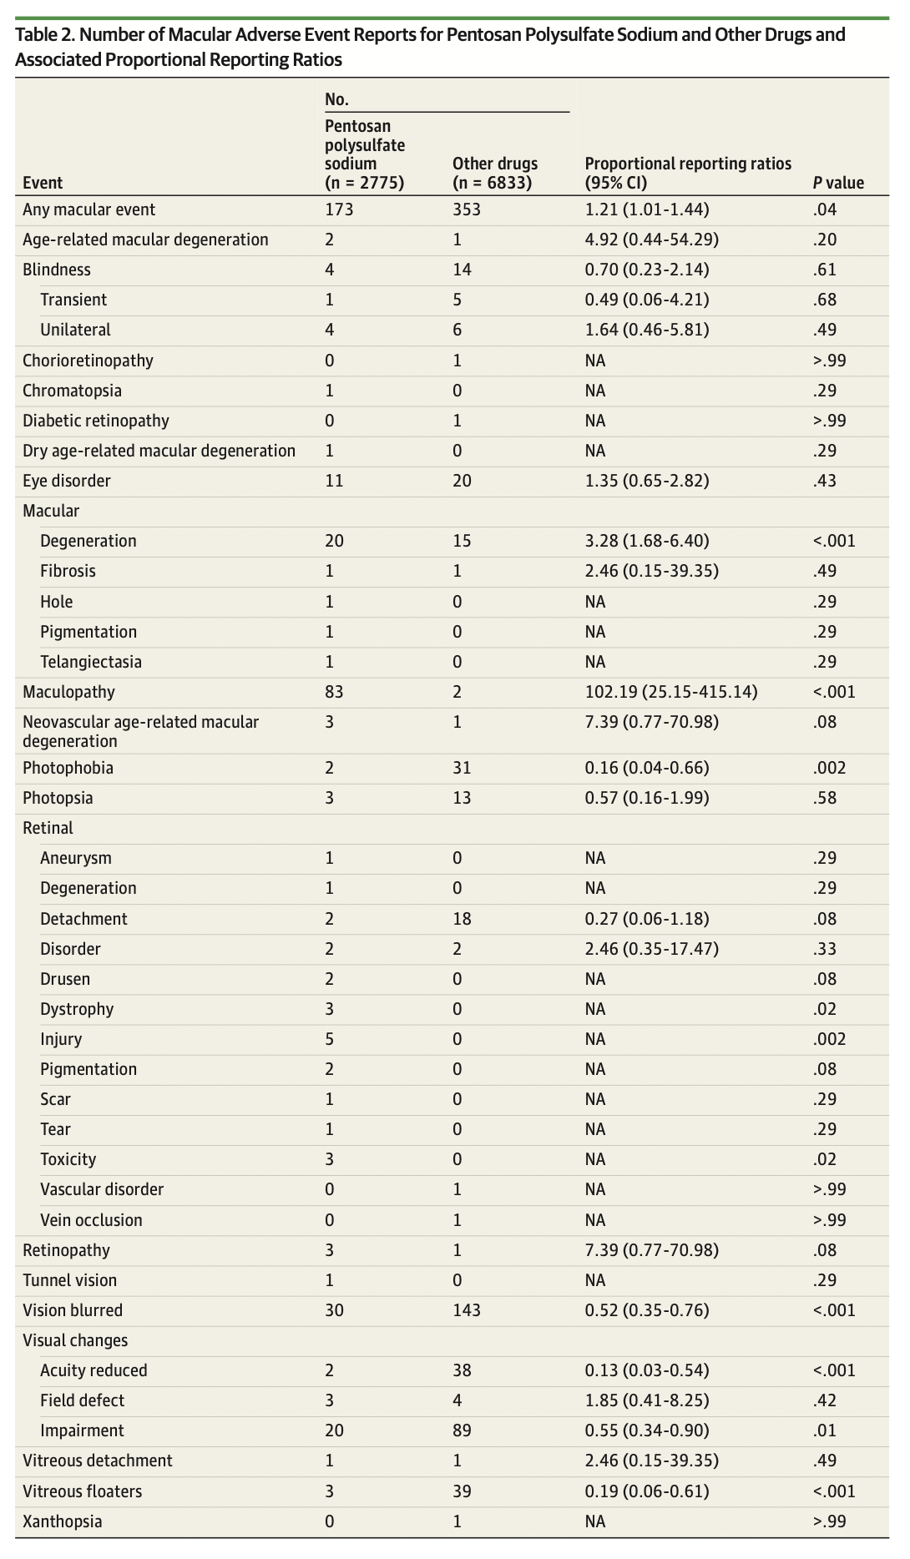
Table two
Reports main outcome stratified by independent variable

Slide 6
Table two
10.1212/WNL.0000000000012869

Slide 7
Table One Pitfalls
Table One can require dozens of revisions as you work on a clinical project.
Different elements of data will be discovered to be missing, some variables will need to be revised, some patients will turn out to have a different disease and need to be excluded. These changes are difficult to track precisely.
Trading spreadsheets with colleagues will create versioning problems.
Reviewers will add up the N’s in your Table One. If there are missing patients, you will have to track down the error.

Slide 8
This is a much bigger problem than you might think

Slide 9
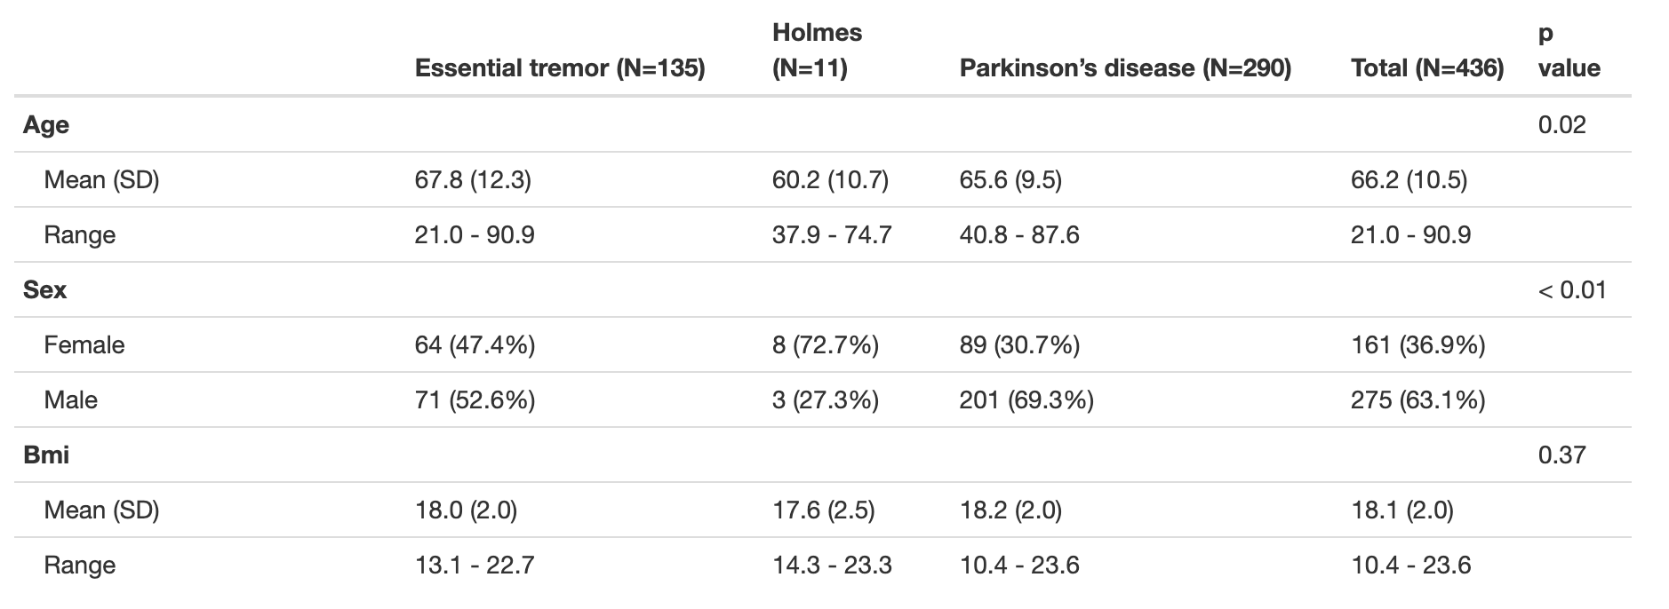
arsenal::tableby
The arsenal package will programmatically create a Table One for you from hot-off-the-presses data.
It can be easily integrated with repositories like REDCap to prevent versioning errors.

Slide 10
tableone::CreateTableOne
Similar functionality to arsenal::tableby

Slide 11
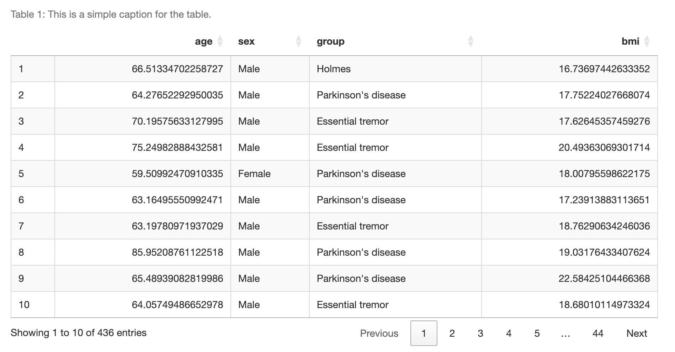
DT::datatable
Creates sortable JavaScript tables in markdown format, very useful for display of tabular data
Can enable manual hand correction

