Slide 1
BMI 510: Confidence Intervals
J. Lucas McKay, Ph.D., M.S.C.R.
Departments of Biomedical Informatics and Neurology, Emory University, Atlanta, GA USA
Department of Biomedical Engineering, Georgia Institute of Technology, Atlanta, GA, USA

Slide 2
Notes from maximum likelihood
Probability density functions vs. probability mass functions “come out in the wash” in maximum likelihood
Mass function: p(x)
Density function: p(x)=f(x)Δx
When we calculate likelihood of one hypothesized value for a parameter (say, μ), it is with respect to other hypothesized values for that parameter.
If in strict probabilities p(data|μ=6)≥ p(data|μ=4) then in terms of densities p(data|μ=6)Δdata ≥ p(data|μ=4)Δdata
Δdata cancels out

Slide 3
Notes from maximum likelihood
Minimizing error
error(data₁|μ=6) + error(data₂|μ=6) + error(data₃|μ=6) + …
vs. error(data₁|μ=9) + error(data₂|μ=9) + error(data₃|μ=9) + …
Maximizing likelihood
density(data₁|μ=6) × density(data₂|μ=6) × density(data₃|μ=6) × …
vs. density(data₁|μ=9) × density(data₂|μ=9) × density(data₃|μ=9) + …
When you convert to log, you turn:
Product into sum
Maximize probability, maximize log(probability), however
log(number less than 1) is always negative

Slide 4
Outline
Concept
Confidence interval for the population mean (t-type)
Closed form confidence intervals
Resampling confidence intervals
Confidence interval for the population proportion
Wald and Wilson confidence intervals
Add4 and similar confidence intervals
Lab

Slide 5
Concept
Given a sample $x$, we sometimes would like to calculate a confidence interval for some parameter $θ$ of the underlying population that generated $x$.
Most of the time we are interested in generating confidence intervals for the population mean $μ$, but it is possible to create a confidence interval for any parameter using resampling / boostrapping approaches or, in fewer circumstances, closed form equations.
Our best estimate of $μ$ is $\overline{x}$. But the idea of a confidence interval is to express the range of values that the true underlying population $μ$ could take on, given the size and variability of our sample.

Slide 6
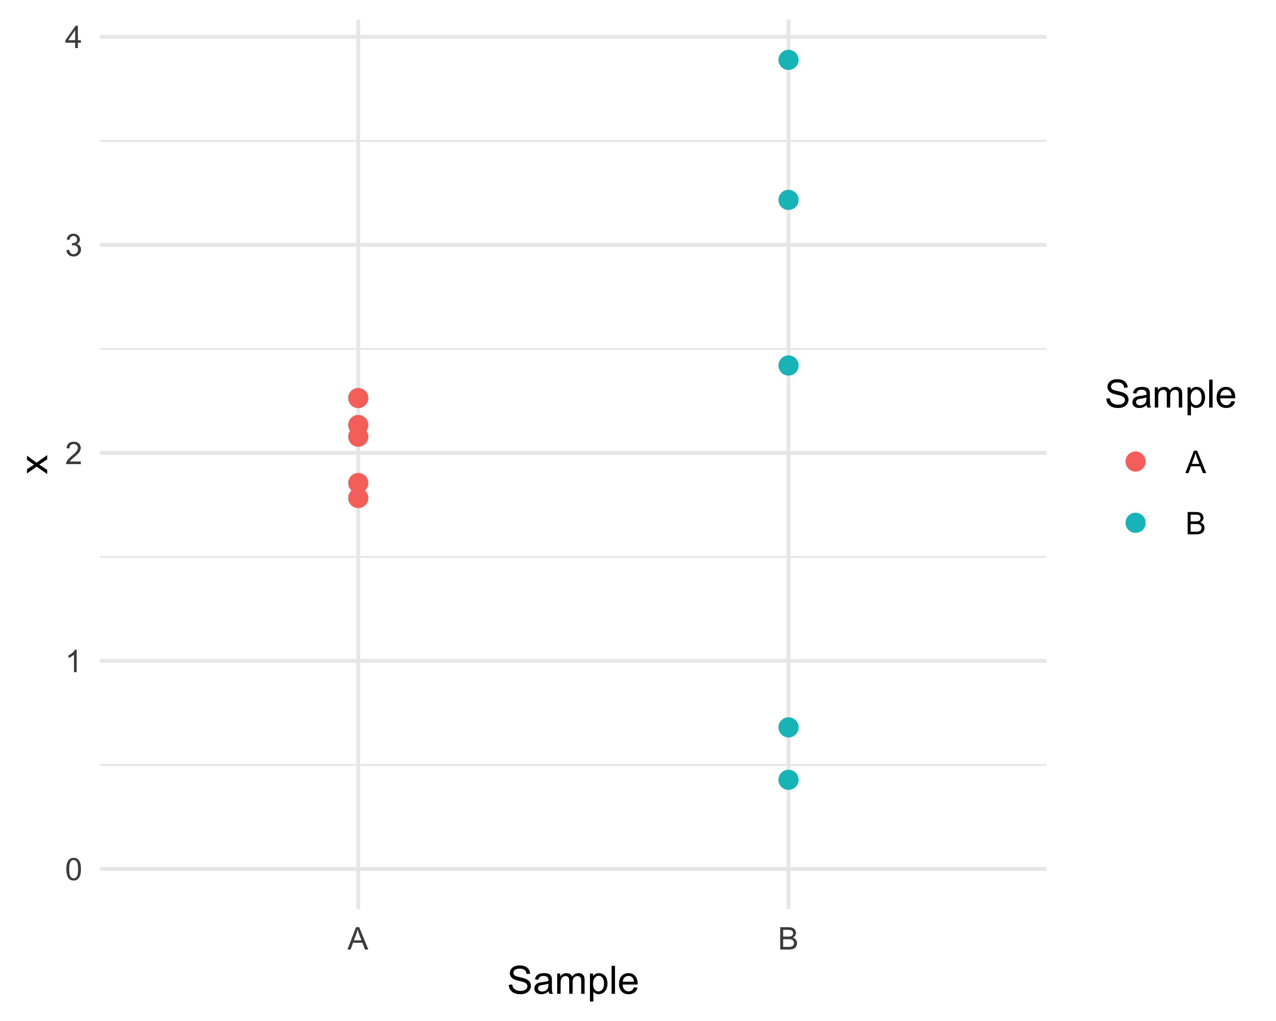
Where do you think the means are?

Slide 7
Definition
A confidence interval is a random interval, calculated from the sample, that contains $θ$ (e.g, the mean or some other population parameter) with some specified probability.
For example, a 95% confidence interval for $μ$ is a random interval that contains $μ$ with probability 0.95.
If we were to take many random samples from the population and form a confidence interval from each one, 95% of these intervals would contain $μ$.
19/20 times your CI contains the parameter of interest; the probability itself is either 0 or 1.
If the coverage probability is $1−α$, the interval is called a $100⋅(1−α)\%$ confidence interval.

Slide 8
Confidence interval for the population mean: closed form
Given a sample $x$ with a sample mean $\overline{x}$, assuming that the underlying population is normally distributed, a $95\%$ ($(1−α)⋅100\%$) confidence interval for $μ$ is given by:
$$\overline{x}±t_{n−1,\frac{α}{2}}\frac{s}{\sqrt{n}}$$
Where $t$ is an appropriate percentile of the $t$ distribution, $s$ is the sample standard deviation, and $\frac{s}{\sqrt{n}}$ is the standard error of the mean.
Usually we are interested in a $95\%$ confidence interval, so if the sample has, say, 12 observations, we use the $t_{11}$ distribution. In R, this would be qt(0.975,11).
We divide the $α$ in half to ensure that half of it lies above and half of it lies below the confidence interval.

Slide 9
Confidence interval for the population mean: bootstrapped
If you have a larger sample (no strict rules on this), you may of course resample from it many times, calculate the mean of each sample, sort them, trim off the bottom and top 2.5%, and report the lowest and highest values as your 95% CI.
There are variants (bias-corrected, accelerated, studentized) of this technique that provide narrower (and more symmetric, less skewed) intervals for the same amount of cycles, but that is the basic idea.
Note that with the closed-form solution, the confidence interval will be symmetric. This is not guaranteed with the bootstrapped interval.

Slide 10
Variability is often expressed as standard deviations, standard errors, or 95% CI
Depending on the field, using one or the other of these may be more or less favored.
You often see Mean±SD or Mean [95%CI: x-x] quoted.
Quoting SEM is discouraged because it can be confused with SD, depending on audience.
Sample | Sample Mean | Sample SD | Sample SEM | Sample 95%CI
A | 2.0 | 0.2 | 0.1 | 0.2
B | 2.1 | 1.5 | 0.7 | 1.9

Slide 11
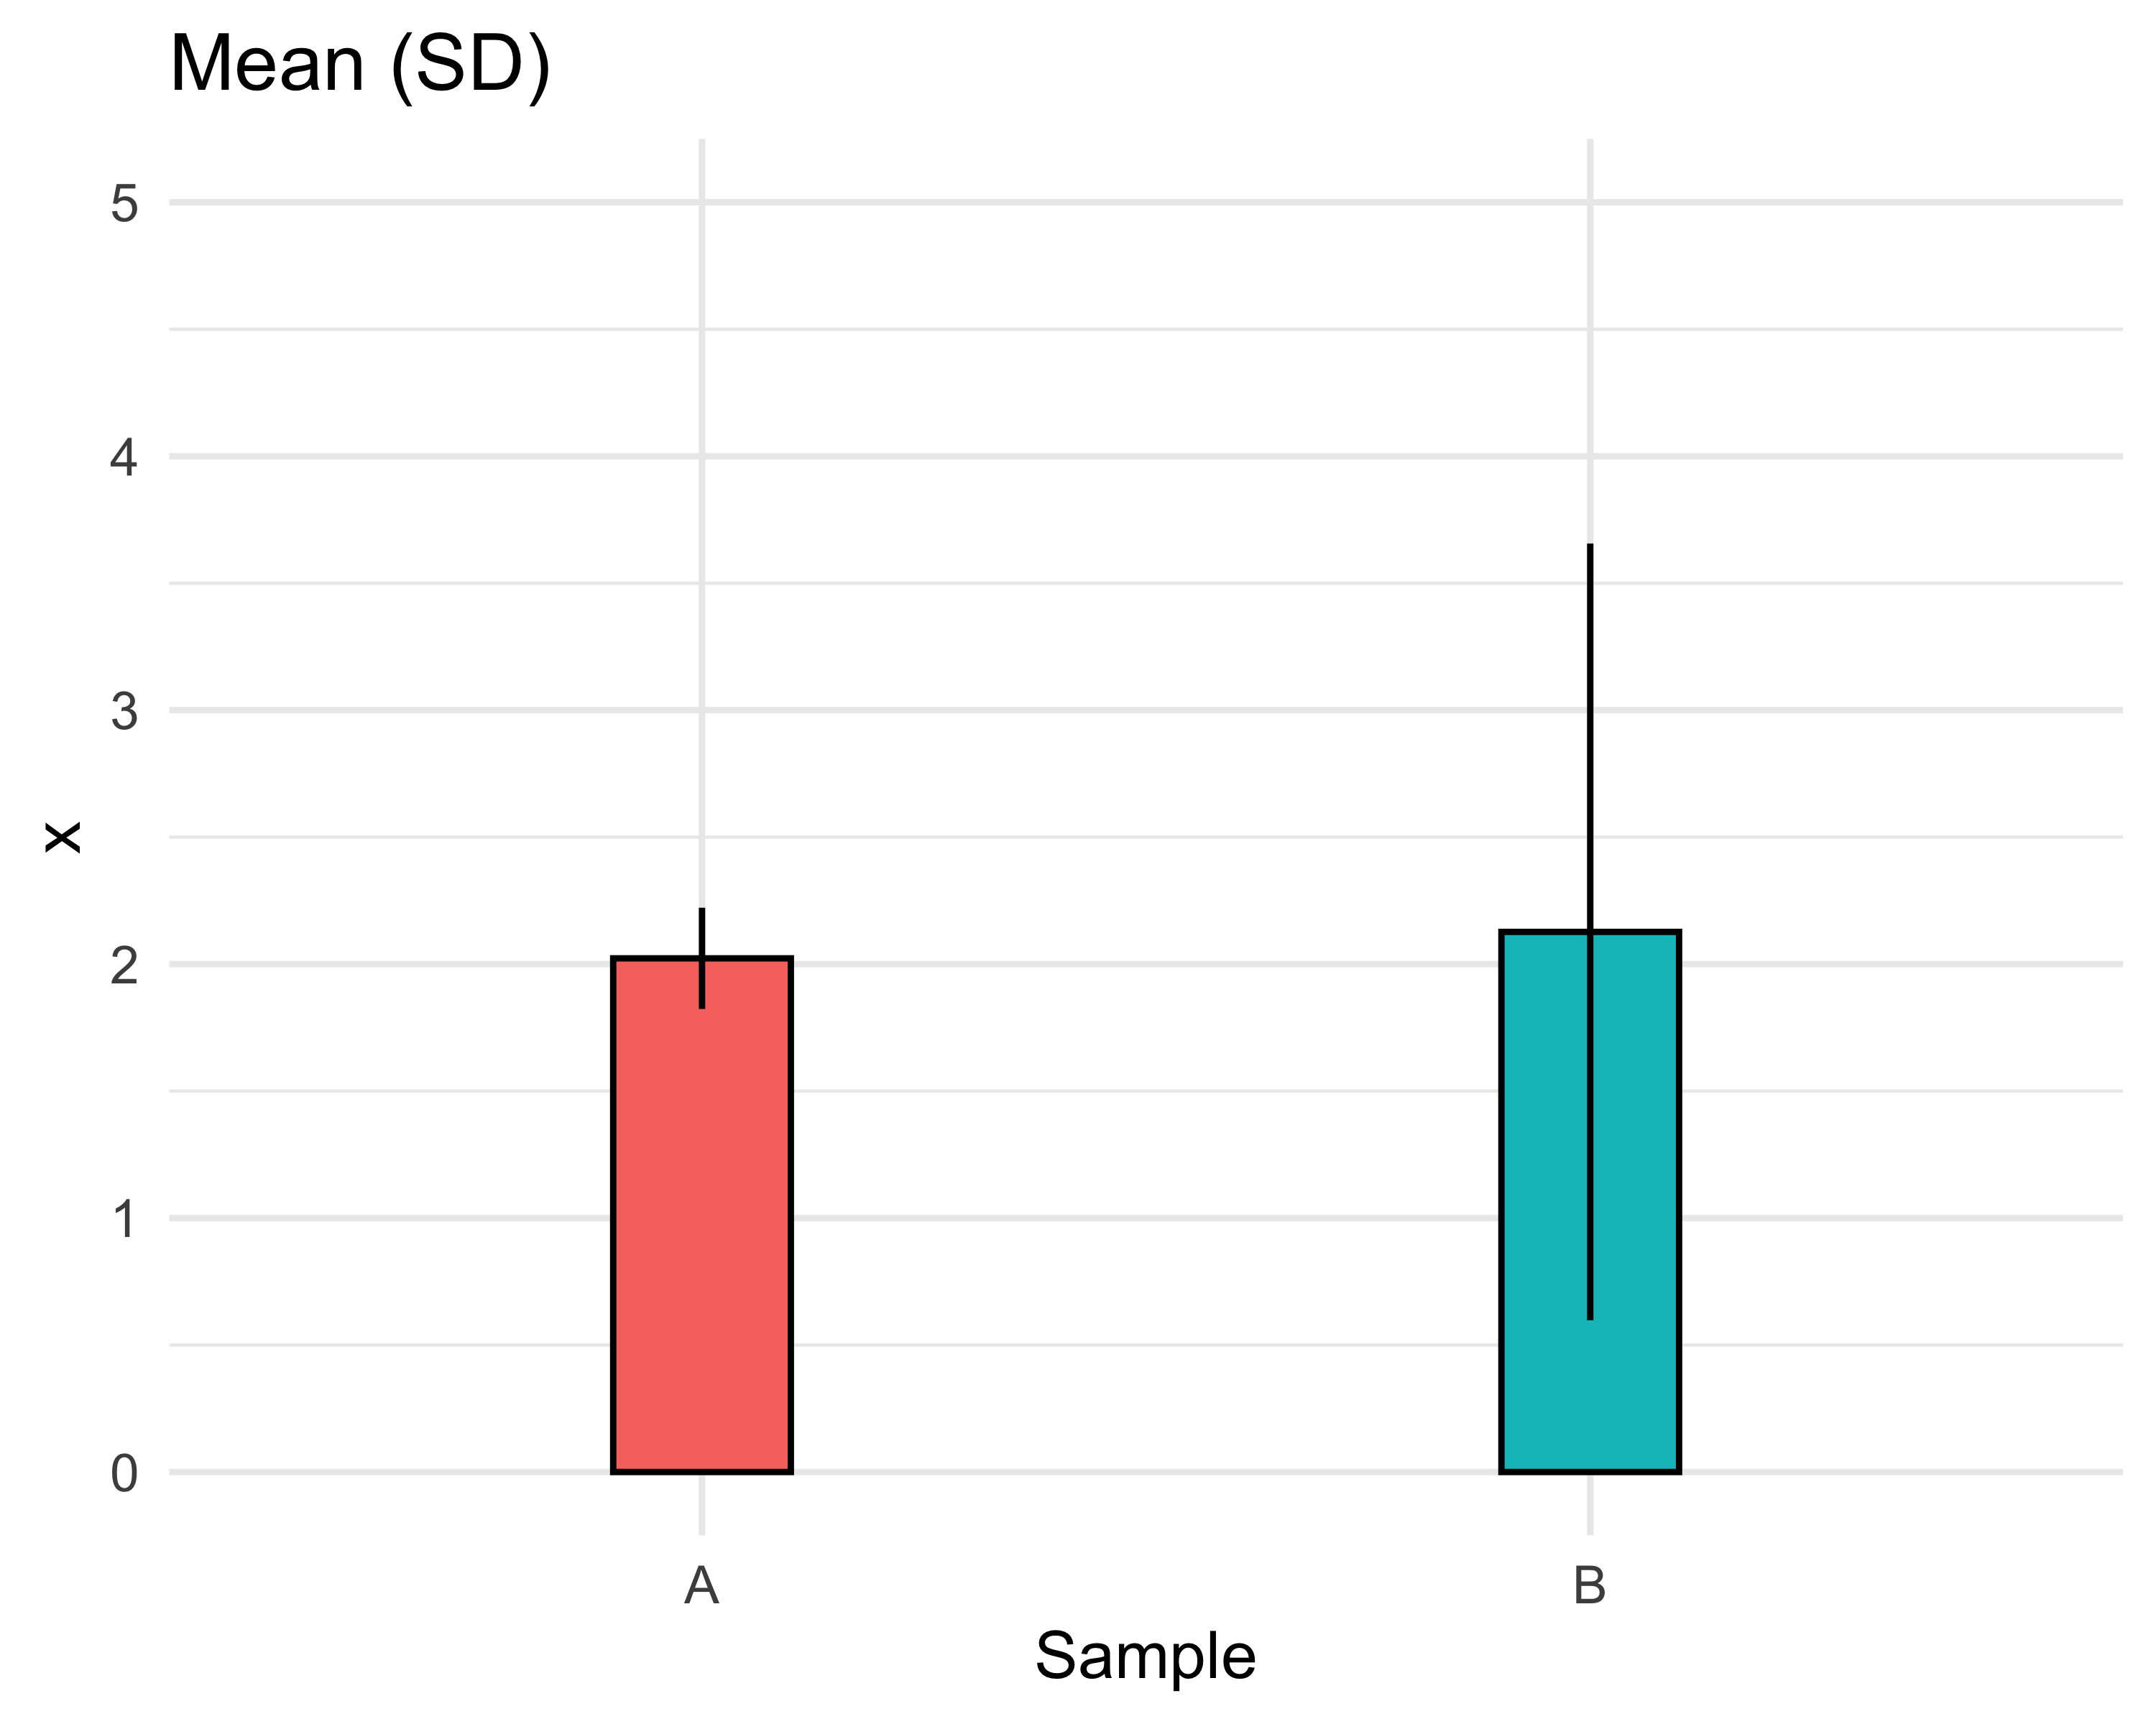
Mean ± sample standard deviation

Slide 12
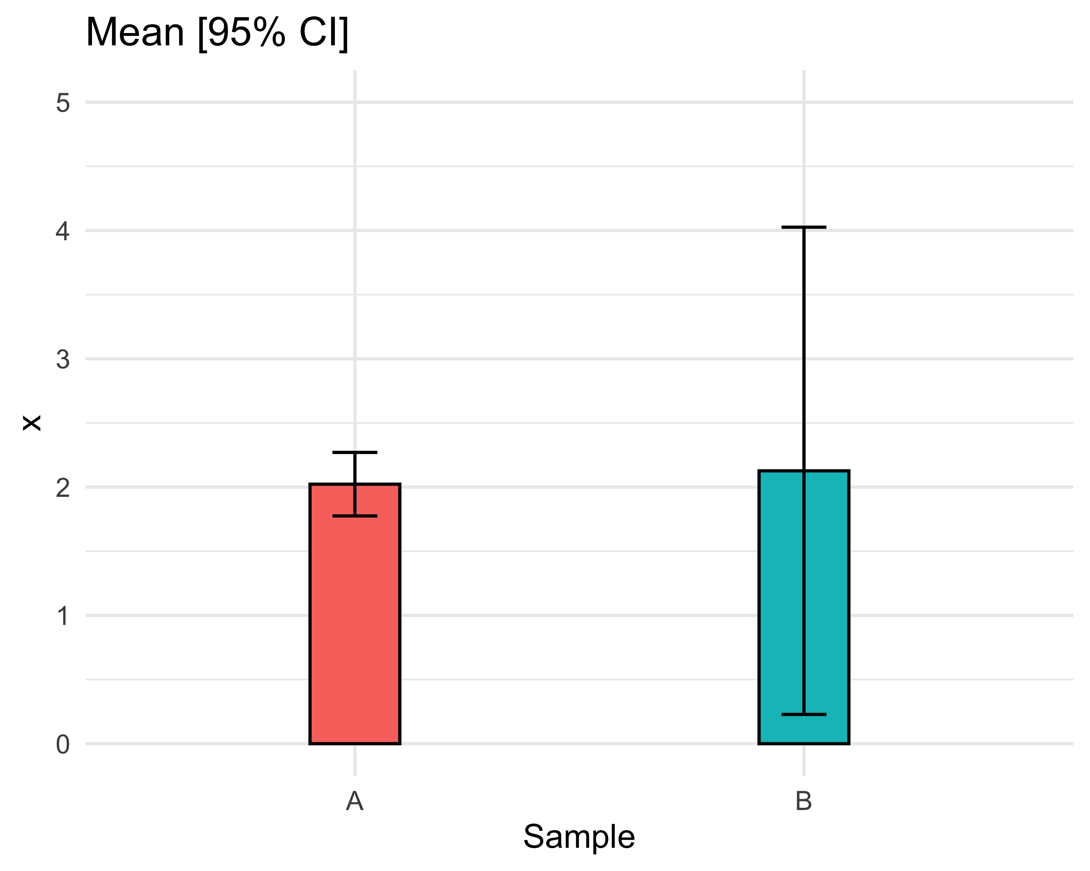
Mean [95% CI]

Slide 13
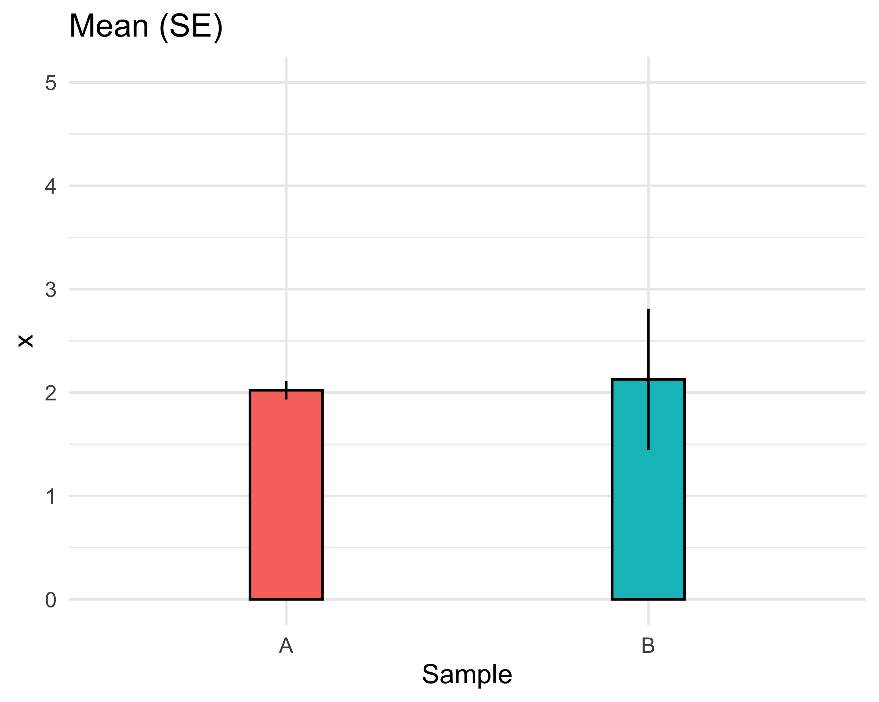
Mean ± sample standard error

Slide 14
Outline
Concept
Confidence interval for the population mean (t-type)
Closed form confidence intervals
Resampling confidence intervals
Confidence interval for the population proportion
Wald and Wilson confidence intervals
Add4 and similar confidence intervals

Slide 15
Confidence interval for a proportion
We are sometimes interested in estimating a population proportion $p$ based on a sampled estimate $\hat{p}$. In the large sample case, the sample proportion $\hat{p}$ approximately follows a normal distribution with mean $p$ and variance $\frac{p(1−p)}{n}$.
If we use the sample proportion $\hat{p}$ to estimate the mean and variance as described above, then a confidence interval can be created based on the $Z$ distribution.

Slide 16
Confidence interval for a proportion
The confidence interval can be constructed as:
$$\hat{p}±Z_{\frac{α}{2}}SD$$
or, because the SD is the root of the variance described above,
$$\hat{p}±Z_{\frac{α}{2}}\sqrt{\frac{p(1−p)}{n}}$$
This is generally appropriate if the expected number of successes ($np$) and failures ($n(1−p)$) are both over 5 or so.

Slide 17
We have been discussing “Wald” intervals:
The confidence interval can be constructed as:
$$\hat{p}±Z_{\frac{α}{2}}SD$$
or, because the SD is the root of the variance described above,
$$\hat{p}±Z_{\frac{α}{2}}\sqrt{\frac{\hat{p}(1−\hat{p})}{n}}$$
This is generally appropriate if the expected number of successes ($np$) and failures ($n(1−p)$) are both over 5 or so.

Slide 18
We have been discussing “Wald” intervals:
Note one piece of additional notation. If $\hat{p}$ is the probability of success, $\hat{q}=(1−\hat{p})$ is the probability of failure, so that:
$$\hat{p}±Z_{\frac{α}{2}}\sqrt{\frac{\hat{p}(1−\hat{p})}{n}}=\hat{p}±Z_{\frac{α}{2}}\sqrt{\frac{\hat{p}\hat{q}}{n}}$$

Slide 19
Wald vs. Wilson intervals
The Wald and Wilson Score CIs both assume that the variable of interest (the number of successes) can be modeled as a Binomial random variable.
The Wald interval is based on a large sample approximation (notice the z density), and so has reduced accuracy for small samples.
The Wald interval, being based on z, is also symmetric. For samples with very high or very low success probabilities, this can lead to distortion. (Values outside of the range of probability.)

Slide 20
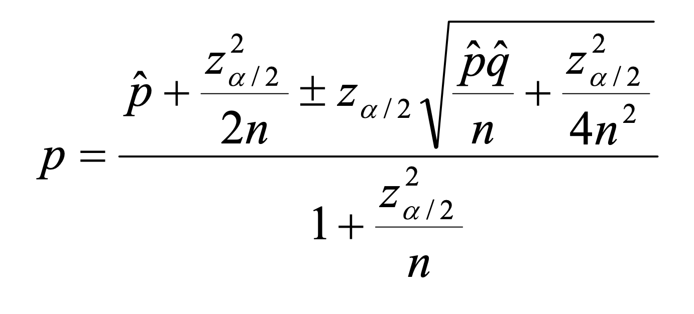
Wald vs. Wilson intervals
The Wilson approach is more complex, but considers the probabilities of success $\hat{p}$and failure $\hat{q}=(1−\hat{p})$separately.
This yields asymmetric confidence intervals that perform better for extreme values of $\hat{p}$and $\hat{q}=(1−\hat{p})$.
Wilson intervals are generally preferable, but we will usually allow software to calculate them for us.

Slide 21
Coverage probability
The coverage probability for a confidence interval for a population proportion is nominally, say, 95%; however, it actually depends on both the observed $\hat{p}$ and the sample size $n$.
If the $n$is larger than a few hundred, the nominal coverage will be fairly accurate.
If not, the coverage will be substantially lower, particularly for extreme values of $\hat{p}$.
We can show this through simulation.

Slide 22
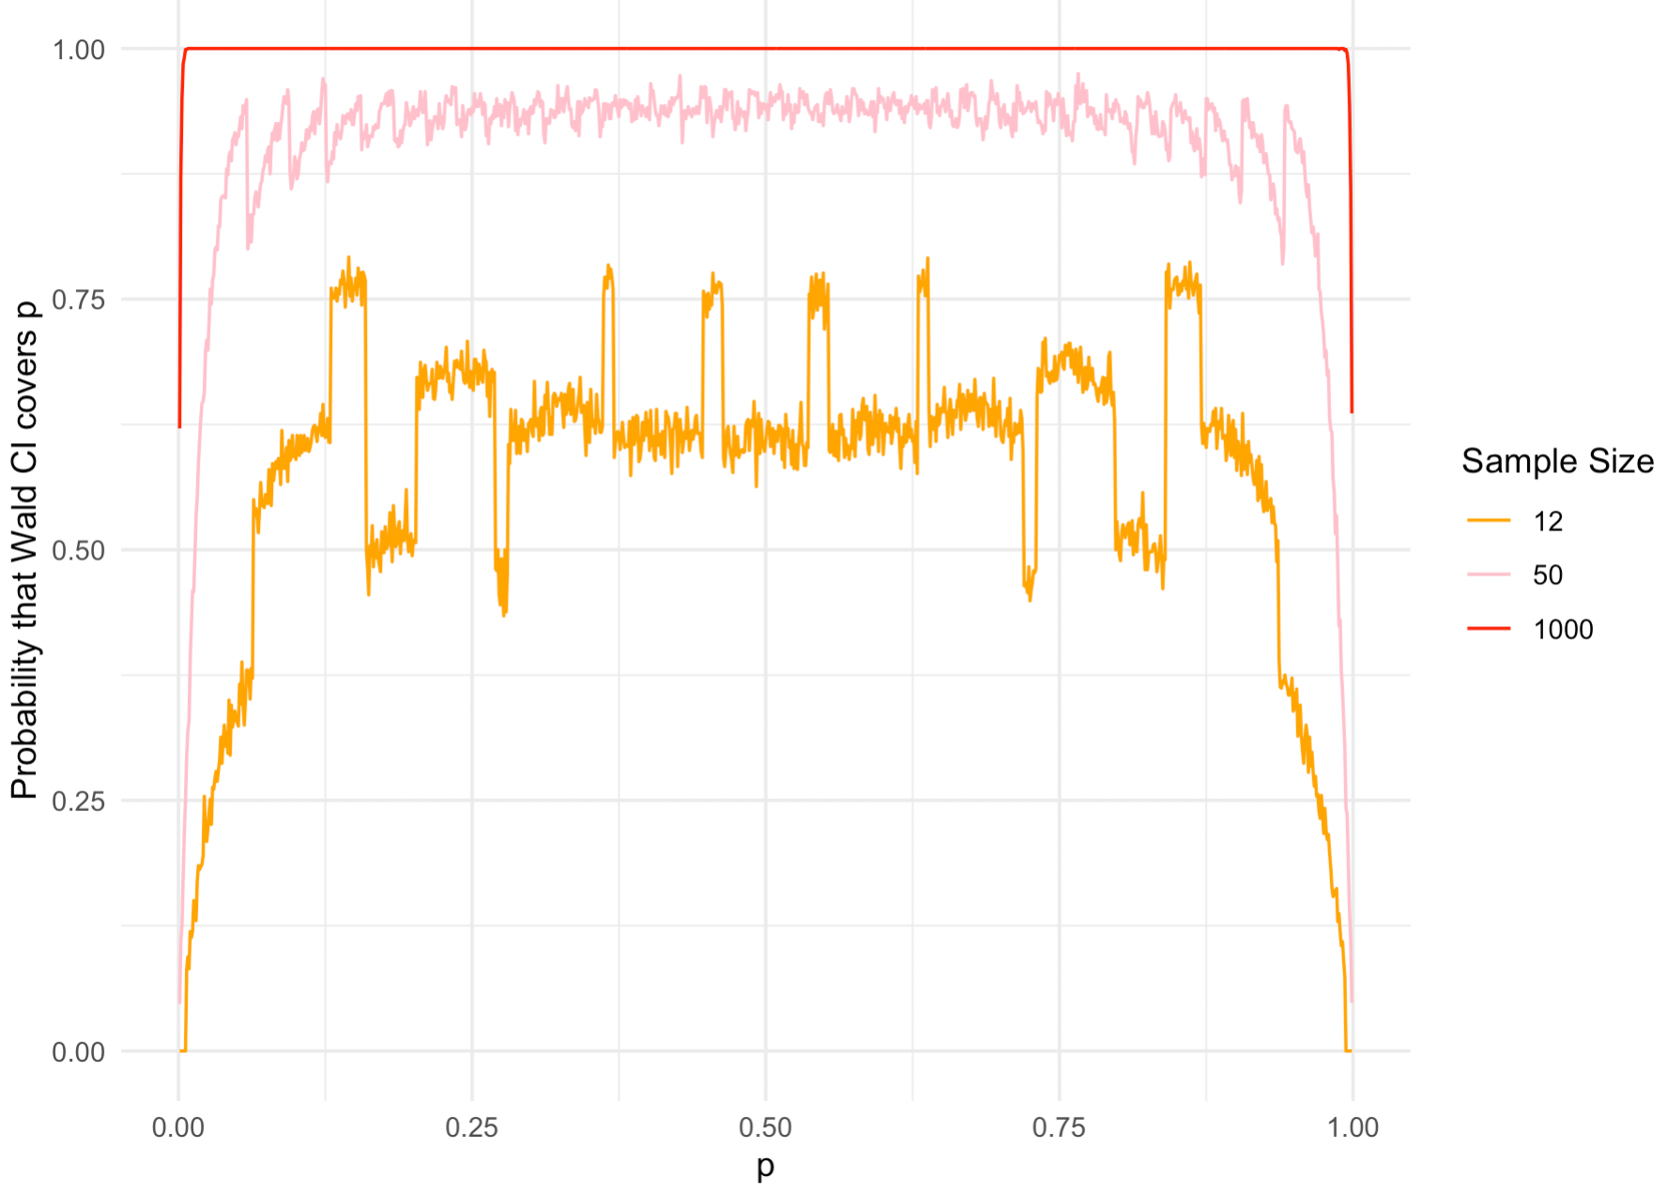
Coverage probability

Slide 23
Outline
Concept
Confidence interval for the population mean (t-type)
Closed form confidence intervals
Resampling confidence intervals
Confidence interval for the population proportion
Wald and Wilson confidence intervals
Add4 and similar confidence intervals

Slide 24
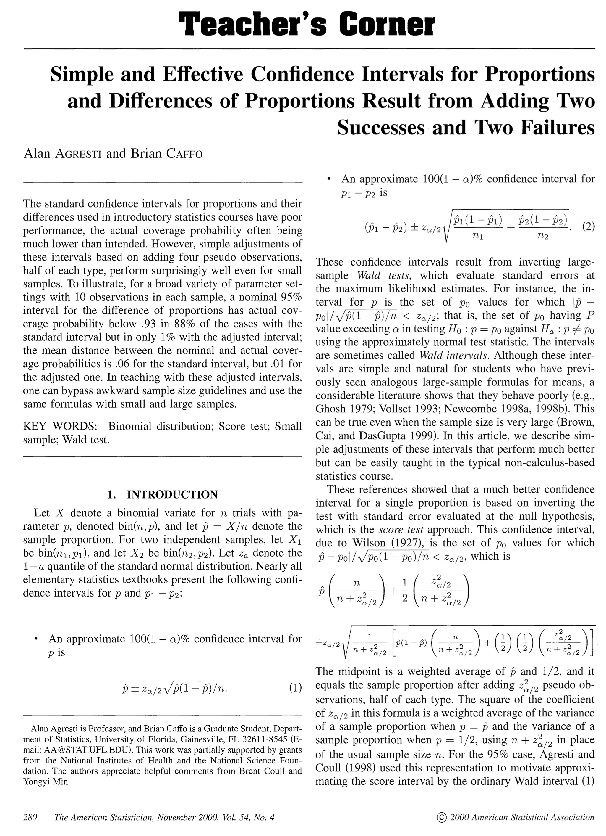

Slide 25
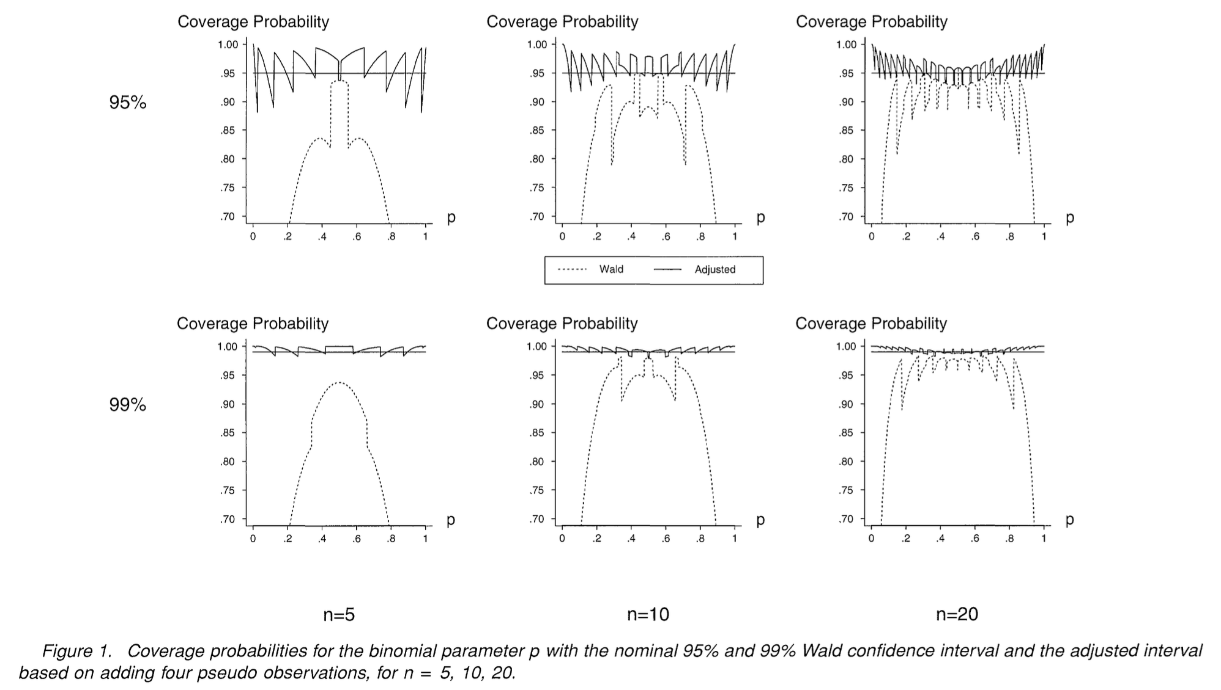

Slide 26
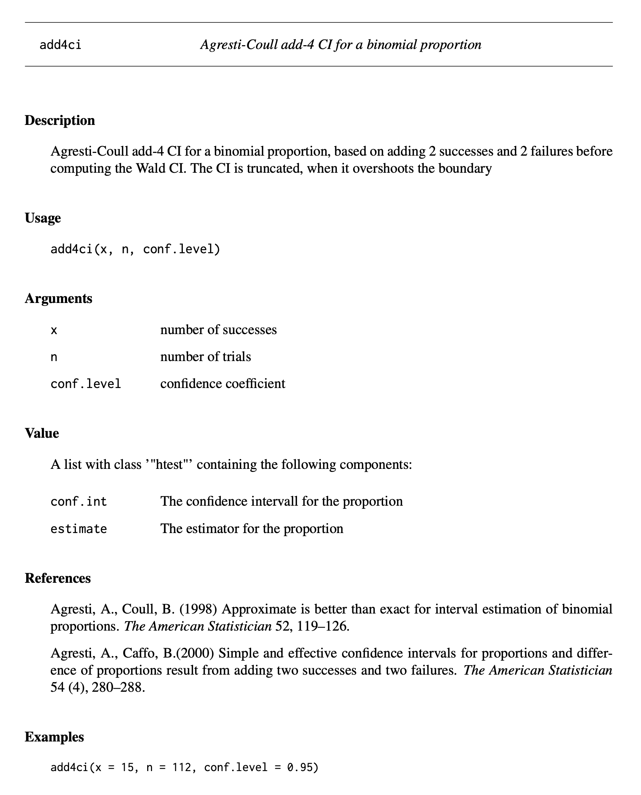

Slide 27
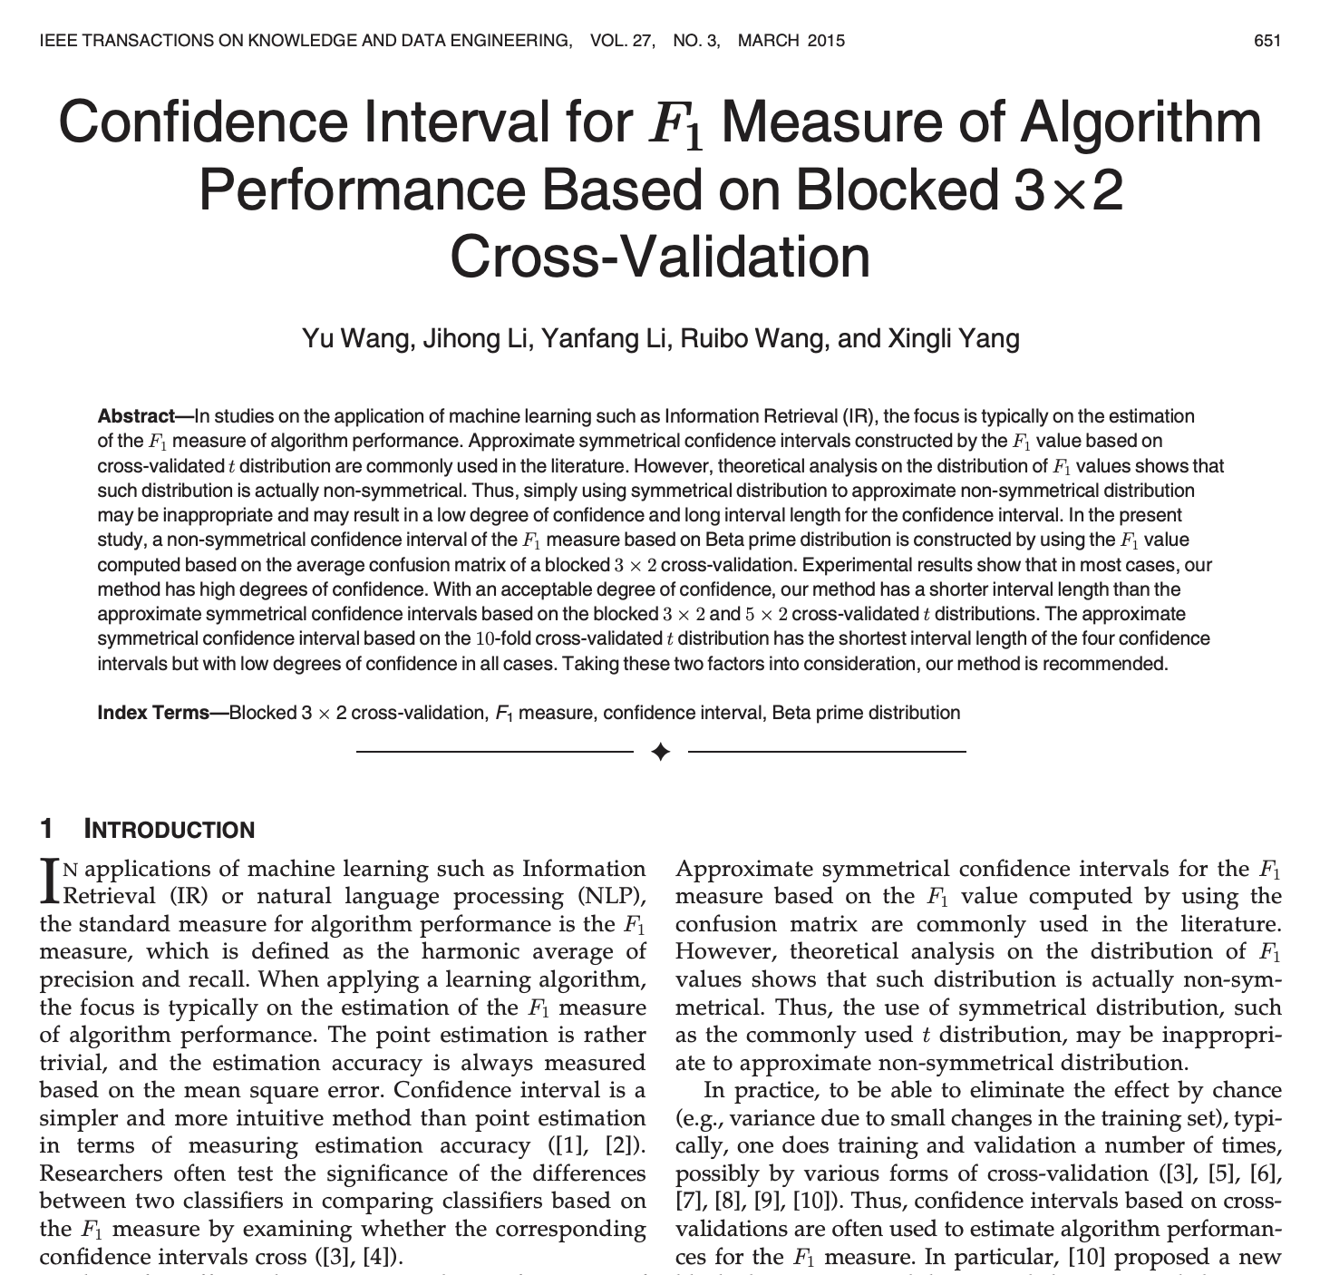
Final note
Confidence intervals for model fit metrics like F1 score are still very much in development.
Often, we see z-approximations (Wald or Wilson) in the literature. We will cover these with classifiers.

