Slide 1
BMI 510: Useful distributions and fitting distributions to data
J. Lucas McKay, Ph.D., M.S.C.R.
Departments of Biomedical Informatics and Neurology, Emory University, Atlanta, GA USA
Department of Biomedical Engineering, Georgia Institute of Technology, Atlanta, GA, USA

Slide 2
The big picture: two fundamental statistical modeling steps
Fit model parameters to data
Make inferences about models

Slide 3
Outline
Expected values and measures of center / spread
Measurement error and bias
Parameters of useful distributions
Introduction to maximum likelihood

Slide 4
Expected values and measures of center and spread

Slide 5
The expected value of a discrete random variable
If $X$ is a discrete random variable with frequency function $p(x)$, the expected value of $X$, denoted by $E(X)$, is
$$E(X)=\sum_{i}^{​}{x_{i}}p(x_{i})$$
This is also referred to as the mean of $X$ and denoted $μ$ or $μ_{x}$.
What is the maximum value of $p(x_{i})$?
What is $\sum_{i}^{​}{p(x_{i})}$?

Slide 6
The expected value of a discrete random variable
If $X$ is a discrete random variable with frequency function $p(x)$, the expected value of $X$, denoted by $E(X)$, is
$$E(X)=\sum_{i}^{​}{x_{i}}p(x_{i})$$
This is also referred to as the mean of $X$ and denoted $μ$ or $μ_{x}$.
What is the maximum value of $p(x_{i})$?
What is $\sum_{i}^{​}{p(x_{i})}$?

Slide 7
The expected value of a discrete random variable
If $X$ is a discrete random variable with frequency function $p(x)$, the expected value of $X$, denoted by $E(X)$, is
$$E(X)=\sum_{i}^{​}{x_{i}}p(x_{i})$$
This is also referred to as the mean of $X$ and denoted $μ$ or $μ_{x}$.
What is the maximum value of $p(x_{i})$?
What is $\sum_{i}^{​}{p(x_{i})}$?

Slide 8
The expected value of a continuous random variable
If $X$ is a continuous random variable with density function $f(x)$, the expected value of $X$, denoted by $E(X)$, is
$$E(X)=\int_{−∞}^{∞}{x}f(x)dx$$
This is also referred to as the mean of $X$ and denoted $μ$ or $μ_{x}$, analogous to the discrete case.
What is the maximum value of $f(x)$?
What is $\int_{−∞}^{∞}{f(x)}dx$?

Slide 9
The expected value of a continuous random variable
If $X$ is a continuous random variable with density function $f(x)$, the expected value of $X$, denoted by $E(X)$, is
$$E(X)=\int_{−∞}^{∞}{x}f(x)dx$$
This is also referred to as the mean of $X$ and denoted $μ$ or $μ_{x}$, analogous to the discrete case.
What is the maximum value of $f(x)$?
What is $\int_{−∞}^{∞}{f(x)}dx$?

Slide 10
The expected value of a continuous random variable
If $X$ is a continuous random variable with density function $f(x)$, the expected value of $X$, denoted by $E(X)$, is
$$E(X)=\int_{−∞}^{∞}{x}f(x)dx$$
This is also referred to as the mean of $X$ and denoted $μ$ or $μ_{x}$, analogous to the discrete case.
What is the maximum value of $f(x)$?
What is $\int_{−∞}^{∞}{f(x)}dx$?

Slide 11
The expected value is sometimes useful as a measure of center
The expected value of a random variable is its average value and is often useful as a measure of the central tendency.
This may not be the case, and data visualization during exploratory analyses is very important.
What are the mean and median of a random variable distributed uniformly on $(0,1)$? Is the expected value any more likely than any other value on the unit interval?

Slide 12
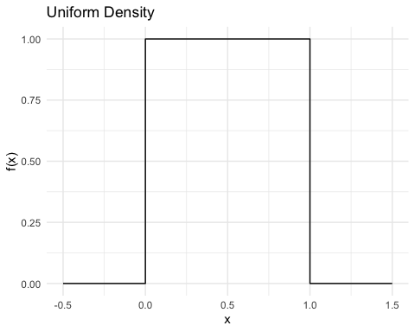
The expected value of a uniform random variable
$$E(X)=\int_{−∞}^{∞}{x}f(x)dx$$
$$E(X)=\int_{0}^{1}{x}dx$$
$$E(X)=\frac{1^{2}}{2}−\frac{0^{2}}{2}$$
$$E(X)=\frac{1}{2}$$

Slide 13
Exercise - expected values
Back to a coin example, let’s say we flip three even coins and the outcome $X$ is the number of heads.

Slide 14
Sample space and number of heads
Result | Heads
hhh | 3
hht | 2
hth | 2
htt | 1
thh | 2
tht | 1
tth | 1
ttt | 0

Slide 15
Probability distribution of number of heads
Heads | Probability
0 | 0.125
1 | 0.375
2 | 0.375
3 | 0.125
Total | 1.0

Slide 16
What is the expected value?
So what is $E(X)$?
$$E(X)=\sum_{i}^{​}{x_{i}}p(x_{i})$$
$$0⋅0.125+1⋅0.375+2⋅0.375+3⋅0.125$$
$$E(X)=1.125$$
Do we ever actually expect to come up with that value for $X$?
Can you think of a better estimate for the expected value?

Slide 17
What is the expected value?
So what is $E(X)$?
$$E(X)=\sum_{i}^{​}{x_{i}}p(x_{i})$$
$$0⋅0.125+1⋅0.375+2⋅0.375+3⋅0.125$$
$$E(X)=1.125$$
Do we ever actually expect to come up with that value for $X$?
Can you think of a better estimate for the expected value?

Slide 18
Measures of shape or spread
The variance and standard deviation are the most common measures of spread we will use for normally-distributed variables.
Other densities have other parameterizations, which can be fit to measured data using the same methods.

Slide 19
Variance and standard deviation
If $X$ is a random variable with expected value $E(X)$, the variance of $X$ is
$$Var(X)=E\{[X−E(X{)]}^{2}\}$$
$$Var(X)=E\{[X−E(X)][X−E(X)]\}$$
The standard deviation is the square root of the variance; these two are often designated $σ$ and $σ^{2}$.

Slide 20
Alternative formula for variance
$$Var(X)=E(X^{2})−[E(X)]^{2}$$

Slide 21
Covariance and correlation
Similar to how the variance of a random variable is a measure of its variability, the covariance of two random variables is a measure of their joint variability.
When fitting model parameters to data, the linkages between, say, clinical covariates must be estimated, typically from the data.
Covariance and correlation are also two ways to measure and report associations between measurements.

Slide 22
Equation for covariance
$$Cov(X,Y)=E\{[X−E\left[X\right]][Y−E\left[Y\right]]\}$$

Slide 23
Alternative expression for covariance
Note that if we expand this expression out, because $E(⋅)$ is a linear operator,
$$Cov(X,Y)=E[(X−μ_{X})(Y−μ_{Y})]$$
$$Cov(X,Y)=E[XY]−E[X]E[Y]$$

Slide 24
Correlation
Defined in terms of the covariance between random variables $X$ and $Y$, correlation is a unitless quantity, and is therefore unchanged when the units of $X$ or $Y$ are changed.
Correlation is one measure of association that can be useful, but that can also obscure paradoxical relationships when the underlying data do not follow well-behaved normal distributions.
$$ρ=\frac{Cov(X,Y)}{\sqrt{Var(X)Var(Y)}}$$

Slide 25
Correlations in bivariate normal data

Slide 26
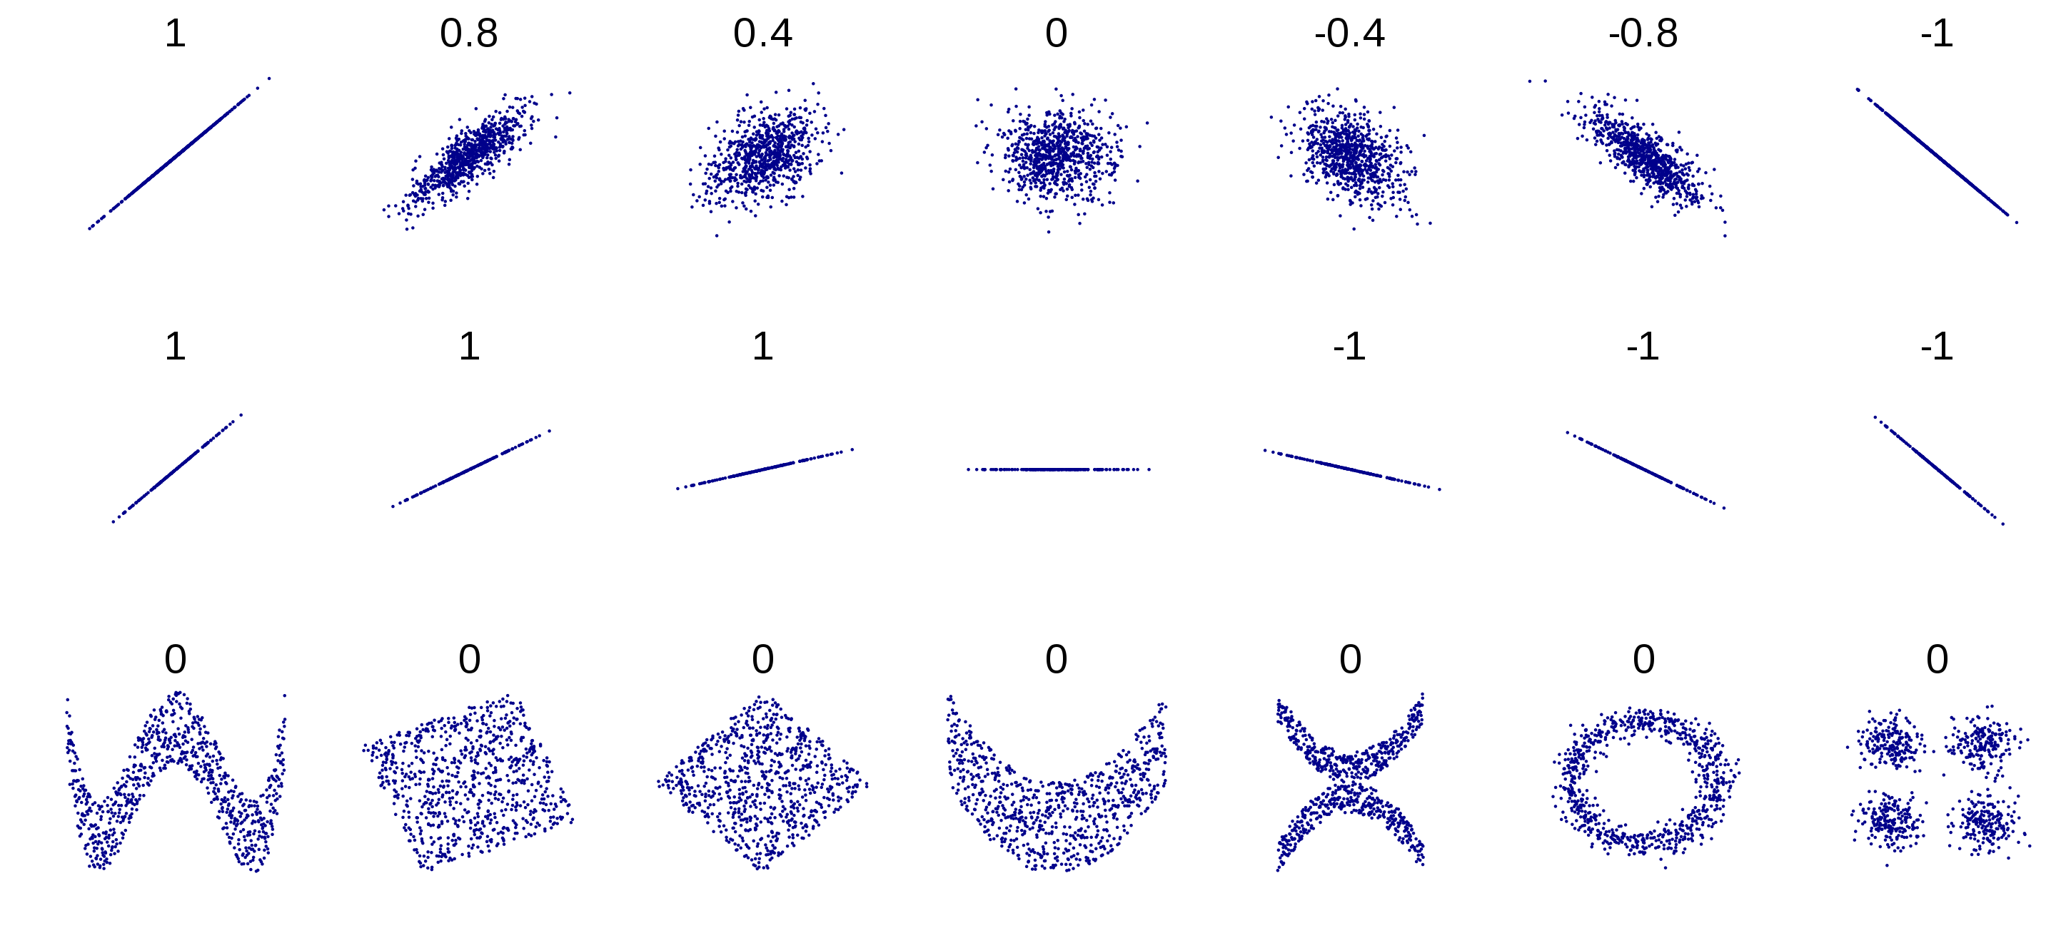
Edge cases
Wikipedia

Slide 27
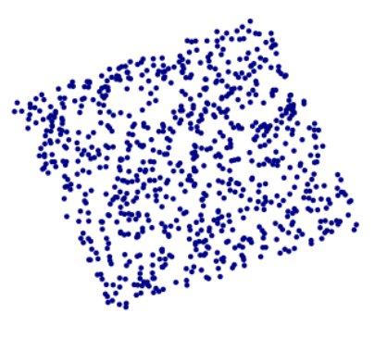
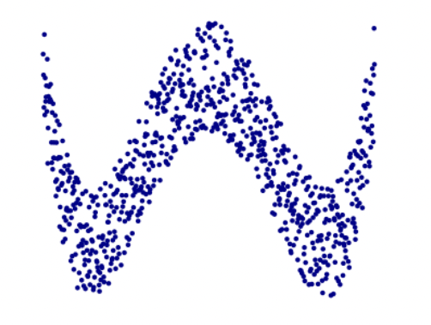
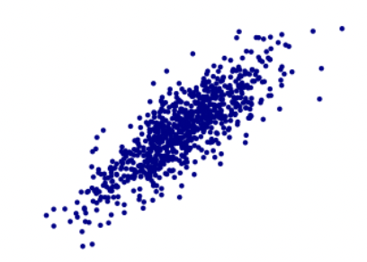
Edge cases: what does the value of X tell you about the value of Y?
A lot
A little
A lot
rho = 0.8
rho = 0.0
rho = 0.0
Wikipedia

Slide 28
Turns out these relationships appear in nature

Slide 29
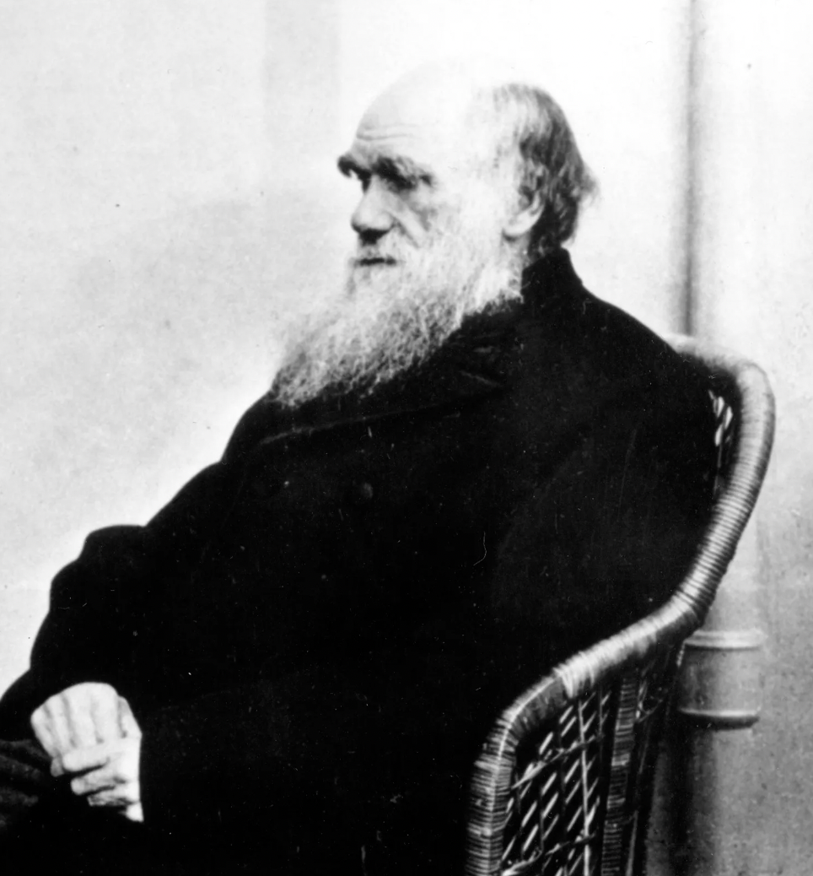
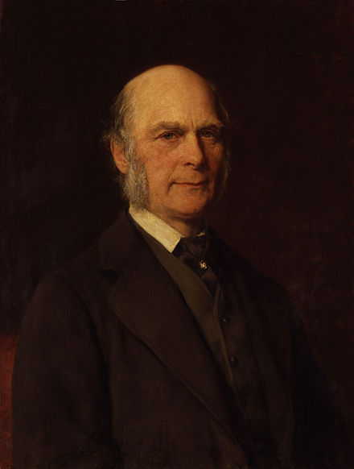
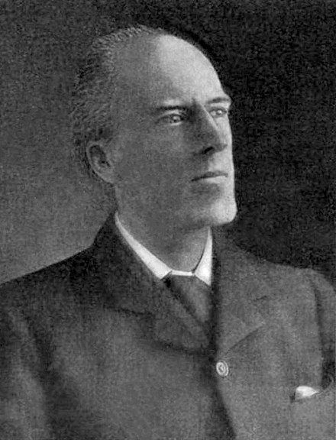
Historical note
Darwin, published
“On the Origin of Species by Means of
Natural Selection, or the Preservation of
Favoured Races in the Struggle for Life”
Galton, Darwin’s cousin,
introduced correlation,
published
“Hereditary Genius”
Pearson, first Galton chair
of Eugenics at
University College London,
formalized rho

Slide 30
Measurement error

Slide 31
Measurement error
Experimental measurements can involve both random and systematic errors.
All measurements involve random errors - for example, consider a single measurement of a patient’s blood pressure. If we are interested in assessing hypertension, a single measurement has a random element that will cause it to deviate from the “true” average blood pressure.

Slide 32
Measurement error
In some cases, measurements have systematic errors or biases. For example, attrition bias refers to systematic differences in the proportion of patients in two arms of a clinical trial who withdraw before the trial is completed.
If patients being treated with an experimental drug who are not experiencing improved symptoms are more likely to drop out, which way will the estimated effect of treatment be biased?

Slide 33
Attrition bias (1)
Let's say the study outcome is reduction in tumor volume in a cancer trial.
The people in the treatment group have a reduction of 10%.
The people in the control group have a reduction of -4%, because patients' tumors are actually getting bigger.
If everyone completes the trial, the difference in outcomes is:
10% - -4% = 14%.

Slide 34
Attrition bias (2)
Let's say the people in the control group who are getting worse (i.e., their tumors are increasing in size) stop the trial.
Then:
The people in the treatment group have a reduction of 10%.
The people in the control group have a reduction of 0%.
The difference in outcomes is:
10% - 0% = 10%.
If the null hypothesis is that $μ_{treat}=μ_{control}$, the attrition has biased this result towards the null.

Slide 35
Measurement error
If the true value of the quantity being measured is denoted by $x_{0}$, the measurement, $X$, is modeled as $X=x_{0}+β+ε$, where $β$ is the bias and $ε$ is the random component of the error.

Slide 36
Measurement error

Slide 37
Parameters of useful distributions

Slide 38
Fitting parameters to data
Many families of probability laws depend on a small number of parameters.
For example, the Poisson family depends on the parameter $λ$ (the mean number of counts), and the Gaussian family depends on two parameters, $μ$ and $σ$.
Typically, these parameters must be estimated from data in order to fit the probability law.

Slide 39
Parameterizing a Normal distribution
$$E(X)=μ$$
$$Var(X)=σ^{2}$$

Slide 40
Parameterizing a Poisson distribution
$$E(X)=λ$$
$$Var(X)=λ$$

Slide 41
Parameterizing a Beta distribution
$$α>0$$
$$β>0$$
$$E(X)=\frac{1}{1+\frac{β}{α}}$$
$$Var(X)=\frac{αβ}{(α+β)^{2}(α+β+1)}$$

Slide 42
Introduction to maximum likelihood

Slide 43
Methods of fitting model parameters
In the first lecture, we saw that there were two main ways of identifying model parameters.
Minimizing error
Maximizing likelihood

Slide 44
Cholesterol vs. Exercise

Slide 45
How to identify the best-fit slope $β$? One way is to find the value that minimizes the error between model predictions and data.
-0.8

Slide 46
A second way is to find the value that maximizes the likelihood of the data given the model.
-0.8

Slide 47
The concept of "error" does not really apply when fitting a density
Since we are simply parameterizing a density to represent data well, the concept of "error" is not really applicable.
This is a big contrast to many scientific / engineering problems where minimizing sum squared error is a natural approach to parameterization

Slide 48
Definition of the likelihood
Suppose that random variables $X$ (or set of random variables $X_{1},X_{2},...,X_{n}$) has a (joint) density function $f(x|θ)$.
Given an observed value $X=x$, the likelihood of $θ$ as a function of $x$ is
$$\text{lik}(θ)=f(x|θ)$$
The maximum likelihood estimate (mle) of $θ$ is the value that makes the observed data “most probable” or “most likely.”
Here, $f(x|θ)$ can be a probability mass or density function. Some authors designate the likelihood $𝕃(θ|x)$.

Slide 49
A simple example
Consider our even coin. Each flip of the coin is an independent, identically distributed (i.i.d.) experiment with a random outcome.
You can imagine doing many of these experiments in sequence with the same coin, or many identical coin experiments performed at the same time.
The "parameter" in question here is $P(Heads)$.
What is the likelihood of the result HHTH given the parameter P(Heads) = 0.5?
$$\text{lik}(θ)=f(x|θ)$$
$$\text{lik}\left(θ\right)=f\left(HHTH | P\left(Heads\right)=0.5\right)=?$$

Slide 50
A simple example
$\text{lik}\left(θ\right)=f\left(HHTH | P\left(Heads\right)=0.5\right)$=?
If the trials are independent and identically distributed (i.i.d.), then the joint probability of a particular series of results (given some parameter) is equal to the product of each individual result (given some parameter).
$$f\left(HHTH | P\left(Heads\right)=0.5\right)=$$
$p(H|P\left(Heads\right)=0.5)$•$p\left(H | P\left(Heads\right)=0.5\right)•p\left(T | P\left(Heads\right)=0.5\right)•p(H|P\left(Heads\right)=0.5)$
This is due to the nature of independent events, as we discussed before.

Slide 51
Additional rules
The probability of the joint event $A$ and $B$ can be written several ways:
$P\left(A and B\right)=P\left(A,B\right)=P\left(A∩B\right)$
Because $A$ and $¬A$ together comprise a "sure proposition,"
$P\left(A\right)+P\left(¬A\right)=1$
$P\left(¬A\right)=1−P(A)$
If $A$ and $B$ are independent,
$P\left(A,B\right)=P\left(A\right)P(B)$
Pearl, 1988

Slide 52
A simple example
What is the likelihood of the result HHTH given the parameter P(H)=0.5?
$$\text{lik}(θ)=f(x|θ)$$
$$\text{lik}\left(θ\right)=f\left(HHTH | 0.5\right)=0.5•0.5•0.5•0.5=0.0625$$
What is the likelihood of the result HHTH given the parameter P(H)=0.6?
$$\text{lik}\left(θ\right)=f\left(HHTH | 0.5\right)=0.6•0.6•0.4•0.6=0.0864$$
So given just the data HHTH, it seems more likely that the coin is biased so that P(H) = 0.6

Slide 53
Formal extension to joint densities
Typically, we assume that the random variables $X_{1},X_{2},...,X_{n}$ are independent and identically distributed (i.i.d.).
If this holds, then $f(x_{1}|x_{2},...,x_{n},θ)$ = $f(x_{1}|θ)$, and the joint density is the product of the marginal densities:
$$\text{lik}(θ)=\prod_{i=1}^{n}{f}(X_{i}|θ)$$
So if the observed data are, say, $3,4,5$, the likelihood of the data given parameters $θ$ is:
$$f(3|θ)⋅f(4|θ)⋅f(5|θ)$$

Slide 54
The log likelihood
Rather than maximizing the likelihood itself, it is usually easier to maximize its natural logarithm (which is equivalent since the logarithm is a monotonic function).
This transforms the product into a sum, so that for an i.i.d. sample, the log likelihood is (always using natural logs)
$$l(θ)=\sum_{i=1}^{n}{\text{log}}[f(X_{i}|θ)]$$
So if the observed data are, say, $3,4,5$, the log likelihood is
$$log\left[f\left(3 | θ\right)\right]+log\left[f\left(4 | θ\right)\right]+log[f\left(5 | θ\right)]$$

Slide 55
An example – radioactive decay
One common example of a natural phenomenon that is very well described by a Poisson process is alpha particle emission during radioactive decay.
(These data are taken from the Rice text.)
In 18 ten-second windows, 2 or fewer particles were emitted, in 101 windows, 11 particles were emitted, etc.
Events | n
≤2 | 18
3 | 28
4 | 56
5 | 105
6 | 126
7 | 146
8 | 164
9 | 161
10 | 123
11 | 101
12 | 74
13 | 53
14 | 23
15 | 15
16 | 9
≥17 | 5

Slide 56
An example – radioactive decay
The average number of events in a 10 second window is therefore ≈ 8.37.
Since we know that $λ=E[X]$ in a Poisson process, we could just use this number directly, calling it something like $\hat{λ}$. (The variance is 8.53; this is a very Poisson process.)
But when we are fitting more complex models, this will not be the case.
So let's have a look at the likelihood.
Events | n
≤2 | 18
3 | 28
4 | 56
5 | 105
6 | 126
7 | 146
8 | 164
9 | 161
10 | 123
11 | 101
12 | 74
13 | 53
14 | 23
15 | 15
16 | 9
≥17 | 5

Slide 57
An example – radioactive decay
If you unwrap the events in the table, you get a series like (in random order): 16 8 8 10 8 7 2 4 8 9 ...
So the likelihood is, for a given $λ$:
$f(16|λ)f(8|λ)$ $f(8|λ)f(10|λ)$...
Where $f(∙|λ)$is the Poisson distribution; and the log likelihood is the sum of the logs of same.
Events | n
≤2 | 18
3 | 28
4 | 56
5 | 105
6 | 126
7 | 146
8 | 164
9 | 161
10 | 123
11 | 101
12 | 74
13 | 53
14 | 23
15 | 15
16 | 9
≥17 | 5

Slide 58
An example – radioactive decay

Slide 59
Identifying the maximum likelihood estimator
If we were doing a closed-form solution to identify the optimal lambda, we would take the derivative of the likelihood, set it to zero, and solve for lambda. (what would this look like?)
Most of the time software will do this for you, and closed form solutions are somewhat rare in real informatics applications.
There are numerous ways to approach gradient descent problems of this type. We will touch on a little bit of it, but will often simply use a grid search and find the maximum.
The main idea is to gain insight about likelihood functions – not to learn numerical solution methods, which are their own topic.

Slide 60
Some maximum likelihood estimators are biased estimates of the population parameters
In order to obtain, for example, the MLE for variance of a normal distribution, we would obtain an expression for $\text{lik}(θ)$, take the derivative, and find $θ$the for which the derivative is zero.
This method leads to a slightly different estimate than the typical equations for the sample standard deviation:
$$σ_{MLE}=\sqrt{\frac{1}{n}\sum_{i=1}^{n}{{(X_{i}−μ_{X}^{})}^{2}}}$$
This is slightly smaller than the equation for sample variance with n-1.

Slide 61
Outline
Expected values and measures of center / spread
Measurement error and bias
Parameters of useful distributions
Introduction to maximum likelihood

