Slide 1
BMI 510: One- and Two-Sample Tests
Selen Bozkurt Ph.D., MSc
J. Lucas McKay, Ph.D., M.S.C.R.

Slide 2
Outline
Key definitions
The sample mean
One-sample hypothesis tests
Two-sample hypothesis tests
Additional topics

Slide 3
Key definitions

Slide 4
Key definitions
Hypothesis testing - follows a structured process to determine whether there is enough statistical evidence to reject a null hypothesis.
Null hypothesis
The conditions under which an analyst proposes chance alone might generate (or have generated) a group of observations
Alternative hypothesis
Usually all conditions other than those specified by the null hypothesis
Statistical test
A tool used to help make a decision about a null hypothesis
$t$, $χ^{2}$, $F$, likelihood ratio, Wald
Probability
A numerical parameter signifying the degree of belief in a given proposition under some body of knowledge
P value
The p-value is the probability that chance alone could have produced the observed results, assuming that the null hypothesis (H₀​) is true.

Slide 5
Hypothesis Testing Steps
If your P-value is smaller than your chosen significance level (α), you reject the null hypothesis.

Slide 6
Consequences of Statistical Decisions
Actual state
 | Null hypothesis true | Null hypothesis false
Null hypothesis accepted | Correct | Type II error
Null hypothesis rejected | Type I error $$α$$ | Correct (1-β=power)
Decision

Slide 7
Understanding $α$in Hypothesis Testing
$α$is the significance level, representing the probability of rejecting the null hypothesis when it is actually true (Type I error).
It defines the threshold for statistical significance in a hypothesis test.
Researchers determine before conducting a study based on the acceptable risk of Type I errors.
0.05 (5%): Most commonly used in scientific research.
0.01 (1%): Used in studies requiring higher confidence.
0.10 (10%): Sometimes used in exploratory research.
If p-value < $α$, reject the null hypothesis (statistically significant result).
If p-value ≥ $α$, fail to reject the null hypothesis (not statistically significant).

Slide 8
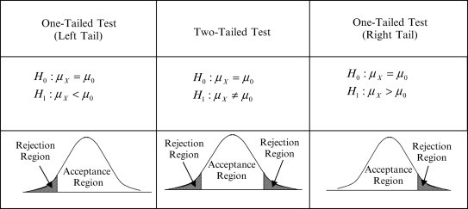
One-Tailed vs. Two-Tailed Tests

Slide 9
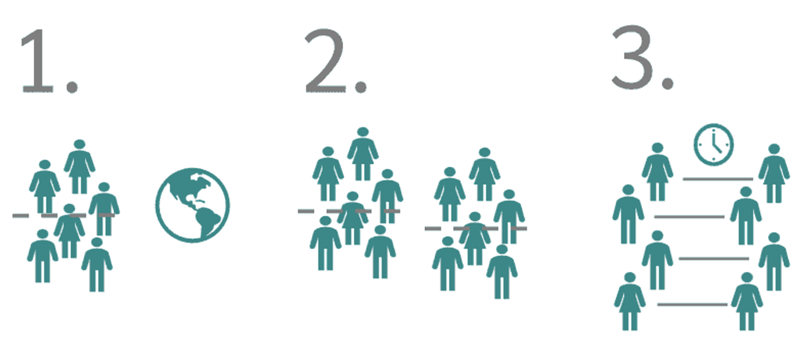
Hypothesis tests for
One sample
Two samples
Paired samples

Slide 10
Normality Assumption
Many parametric tests (e.g., t-test, $χ2$-test, F-test) assume that the population follows a normal distribution.
This assumption is strong and may not always hold for real-world data.
How to Check for Normality?
Visual Inspection:
Histograms
Q-Q Plots (Quantile-Quantile Plots)
Statistical Tests:
Shapiro-Wilk Test (Best for small samples)
Kolmogorov-Smirnov Test
Anderson-Darling Test
Affects the Choice of Test:
If Data is Normal → Use parametric tests (e.g., t-test, ANOVA).
If Data is Not Normal → Consider non-parametric tests (e.g., Mann-Whitney U test, Kruskal-Wallis test).

Slide 11
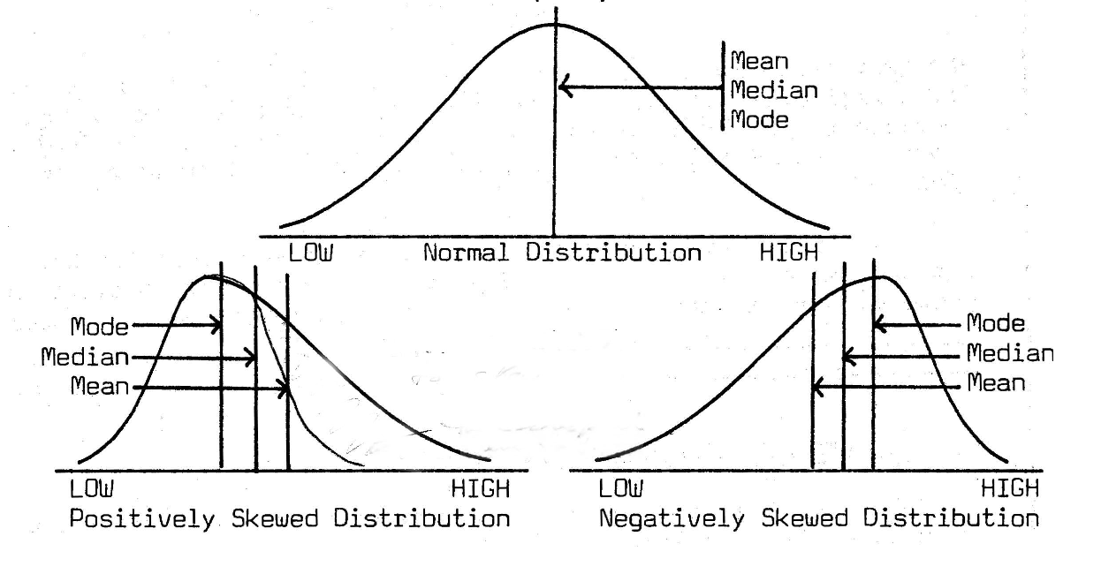
Mean, Median, and Mode

Slide 12
Z scores
We often normalize variables prior to analysis. One way to do this is to subtract off the mean value and divide by the standard deviation:
$$Z=\frac{Y−μ_{Y}}{σ_{Y}}$$
This gives you a variable that - if it follows a normal distribution already - is distributed as a standard normal variable:
$$Z∼N(0,1)$$
Note that the variance is 1 and the standard deviation is 1. We refer to these variables as z-scores because if the variable itself follows a normal density, $P(Z≤z)=$pnorm(z).
Notes:
Z-score tells us how far a data point is from the mean, measured in standard deviations. Z-scores are essential in normality testing and probability calculations.

Slide 13
The sample mean

Slide 14
The sample mean
We are typically going to be interested in how far the expected value of the mean is from some potential value. Therefore we will be interested in the expected value and variance of the sample mean.
If $X_{1},X_{2},...,X_{n},$ are independent $N(μ,σ^{2})$ random variables representing a sample of some normally distributed random variable, then sample mean is given by the familiar formula:
$$\overline{X}=\frac{1}{n}\sum_{i=1}^{n}{X_{i}}$$

Slide 15
The expected value and variance of the sample mean
The sample mean $\overline{X}$ itself is another random variable related to all of the $X_{i}$'s.
The expected value of the sample mean $\overline{X}$ is the population mean $μ$, and the variance of the sample mean is related to the population variance $σ^{2}$:
$$E(\overline{X})=μ$$
$$Var(\overline{X})=\frac{σ^{2}}{n}$$
Note that we do not usually know $σ$, so we do not have a firm estimate of $Var(\overline{X})$. This piece of information will lead us from using the normal distribution to the $t$ distribution.

Slide 16
The expected value of the sample mean
If we consider some random variable $Z=Y_{1}+Y_{2}+…+Y_{n}$, then by linearity:
$$E\left(Z\right)=E\left(Y_{1}\right)+E\left(Y_{2}\right)+…+E(Y_{n})$$
Therefore, if $X_{1},X_{2},...,X_{n},$ are independent $N(μ,σ^{2})$ random variables each representing a sample of some random variable, then the expected value of the sample mean is
$$E\left(\overline{X}\right)=E\left[\frac{1}{n}\left(X_{1}+X_{2}+…+X_{n}\right)\right]=$$
$$\frac{1}{n}\left(E\left(X_{1}\right)+E\left(X_{2}\right)+…+E\left(X_{n}\right)\right) =\frac{1}{n}(μ+μ+...+μ)=μ$$

Slide 17
The expected value of the sample mean
It shows that the expected value of the sample mean is always equal to the population mean μ.
Interpretation
On average, if we repeatedly take samples and compute their means, the means will center around μ.
This is why the sample mean is an unbiased estimator of the population mean.
This concept is crucial in statistical inference, confidence intervals, and hypothesis testing.

Slide 18
The variance of the sample mean
If we consider some random variable $Z=Y_{1}+Y_{2}+…+Y_{n}$, then, if the $Y_{i}$’s are independent,
$$Var\left(Z\right)=Var\left(Y_{1}\right)+Var\left(Y_{2}\right)…+Var(Y_{n})$$
and, recall that
$$Var\left(\frac{1}{a}Y\right)=\frac{1}{a^{2}}Var\left(Y\right)$$
Therefore, the variance of the sample mean is
$$Var(\overline{X})=Var(\frac{1}{n}(X_{1}+X_{2}+…+X_{n}))=\frac{1}{n^{2}}Var(X_{1}+X_{2}+…+X_{n})$$
$$Var(\overline{X})=\frac{1}{n^{2}}(σ^{2}+σ^{2}+…+σ^{2})=\frac{σ^{2}}{n}$$

Slide 19
The standard deviation (or standard error) of the sample mean
It is common to refer to the standard deviation of the sample mean $Std(\overline{X})$ as the standard error of the mean to avoid confusion with the standard deviation of the random variable $X$.
We saw the equation for the variance of $\overline{X}$ - the standard error of $\overline{X}$ is simply the square root of the variance of $\overline{X}$:
$$Std(\overline{X})=\sqrt{Var(\overline{X})}=\sqrt{\frac{σ^{2}}{n}}=\frac{σ}{\sqrt{n}}$$

Slide 20
The sample variance
The sample variance (not the variance of the sample mean!) is also calculated by the familiar formula:
$$S^{2}=\frac{1}{n−1}\sum_{i=1}^{n}{(}X_{i}−\overline{X})^{2}$$
Where the sample standard deviation $S$ is the square root.
Note that the use of $n−1$ instead of $n$ here is called Bessel’s correction.

Slide 21
Test Statistic for the Sample Mean: The t-Distribution
When we compare the sample mean to the population mean, adjusting for expected variation, the result follows a t-distribution.
$$\frac{\overline{X}−μ}{S/\sqrt{n}}∼t_{n−1}$$
We will use this information to test hypotheses about the population parameter $μ$ given sample values $\overline{X}$, $S$, and $n$.
$n−1$ = degrees of freedom of $t$distribution

Slide 22
Choosing the Right Distribution for the Test Statistic
Note that any units attached to the test statistic cancel out:
$$\frac{\overline{X}−μ}{S/\sqrt{n}}$$
Since the test statistic is unitless, the analyst must choose an appropriate probability distribution to determine how likely a given test statistic value (e.g., 2.0, 4.5, or 0.05) is.
If the test statistic is 2.0,
In a t-distribution with 5 df (t₅), about 10% of the total area falls beyond |2.0|.
In a standard normal (z) distribution, only 5% of the area falls beyond |2.0|.
This means the t-distribution has wider tails, leading to higher probabilities for extreme values compared to the normal distribution.

Slide 23
Test statistics at different densities

Slide 24
A more in-depth look
$$\frac{\overline{X}−μ}{S/\sqrt{n}}∼t_{n−1}$$
$\overline{X}$: measured from sample
$μ$: usually hypothesized
$S$: measured from sample
$Std(\overline{X})$: $\frac{σ}{\sqrt{n}}$ $\frac{\overline{X}−μ}{σ/\sqrt{n}}∼Z\sim N\left(0,1\right)$
We would be doing a $Z$ test here, but the population standard deviation $σ$ is unknown. As a result, we'll use the $t$.

Slide 25
One-sample hypothesis tests

Slide 26
Hypothesis tests for
One sample
Two samples
Paired samples
Notes:
we want to compare the mean of a sample with a known reference mean.

Slide 27
Two fundamental statistical modeling steps
Fit model parameters to data
Make inferences about models

Slide 28
Two fundamental statistical modeling steps
Fit model parameters to data
Make inferences about models
Measure $\overline{X}$ and $S$, assume
a distribution (t) for $\overline{X}$
Decide how likely it would be for a t distribution with some hypothesized value $μ$to have produced $\overline{X}$and $S$

Slide 29
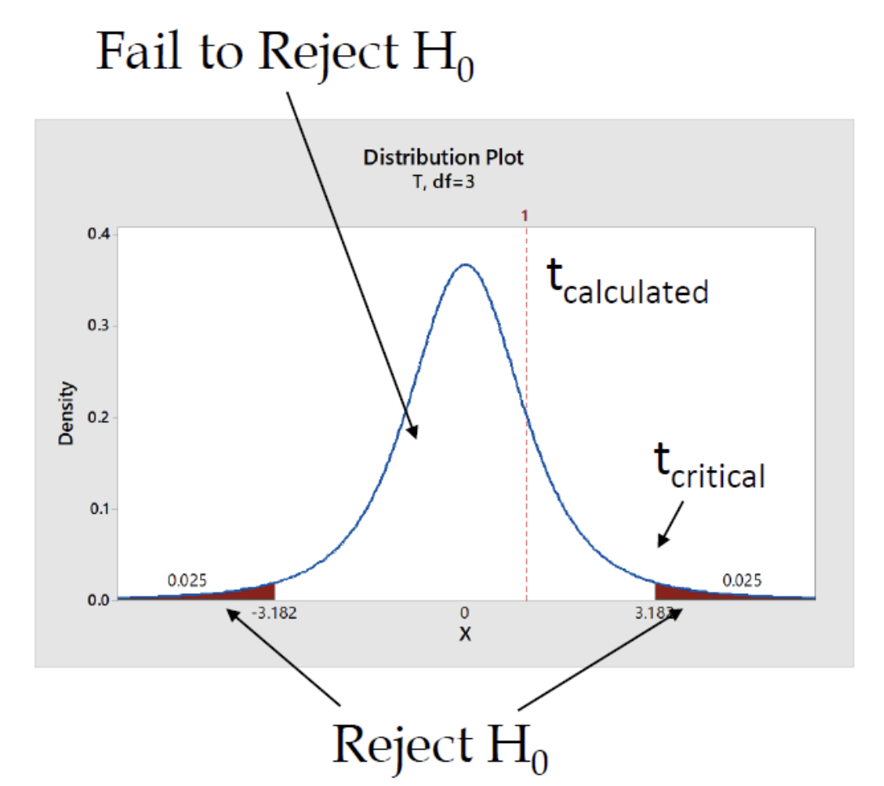
One-sample hypothesis tests
A one-sample hypothesis test is used to determine whether the mean of a single sample differs significantly from a known or hypothesized population mean.
Typically uses the $t$-test when population variance is unknown or the z-test when variance is known.
Example: A hospital claims that patients undergoing a minimally invasive knee surgery recover in an average of 6 weeks.
$$t= \frac{\overline{X}−μ}{S/\sqrt{n}}$$

Slide 30
One-sample hypothesis tests - A paired-sample test

Slide 31
Hypothesis tests for
One sample
Two samples
Paired samples

Slide 32
A paired-sample test
A paired-sample test (also called a dependent t-test) compares two related measurements from the same subjects.
It is used to determine whether a significant change has occurred between two time points.
Example: Blood Pressure Study
In this design, each patient has two blood pressure measurements:
BP₀: Blood pressure at study entry
BP₁: Blood pressure at the end of the trial
The goal is to assess whether the average blood pressure changed after treatment.
Patient | BP0 | BP1
A | 205 | 190
B | 164 | 162
C | 180 | 178
D | 190 | 192
E | 156 | 156
What is n? sample size?

Slide 33
A paired-sample test
In this design, the outcome is the difference between BP₀ and BP₁.
It is fairly natural to use "wide" format data for this design –although if there are drop outs there will be empty cells.
(And there is always at least one unusual patient with >2 measurements for some reason.)
Patient | BP0 | BP1 | BP Change
A | 205 | 190 | -15
B | 164 | 162 | -2
C | 180 | 178 | -2
D | 190 | 192 | +2
E | 156 | 156 | 0

Slide 34
A paired-sample test
$n$: $5$
sample mean $\overline{X}$: $−3.4$
sample sd $S$: $6.7$
standard error of the mean: $S/{\sqrt{n}}$
standard error of the mean: ${6.7}/{\sqrt{5}}$
standard error of the mean: $3.0$
Patient | BP0 | BP1 | BP Change
A | 205 | 190 | -15
B | 164 | 162 | -2
C | 180 | 178 | -2
D | 190 | 192 | +2
E | 156 | 156 | 0

Slide 35
A paired-sample test
How likely are we to observe a sample mean of $\overline{X}=−3.4$ (or one more extreme) due to chance alone, assuming that the drug has no real effect?
To evaluate this, we formulate it as a null hypothesis, and then calculate the probability of the data that we've got.
Patient | BP0 | BP1 | BP Change
A | 205 | 190 | -15
B | 164 | 162 | -2
C | 180 | 178 | -2
D | 190 | 192 | +2
E | 156 | 156 | 0

Slide 36
Key definitions
Null hypothesis
The conditions under which an analyst proposes chance alone might generate (or have generated) a group of observations
Alternative hypothesis
Usually all conditions other than those specified by the null hypothesis
Statistical test
A tool used to help make a decision about a null hypothesis
$t$, $χ^{2}$, $F$, likelihood ratio, Wald
Probability
A numerical parameter signifying the degree of belief in a given proposition under some body of knowledge
P value
The p-value is the probability that chance alone could have produced the observed results, assuming that the null hypothesis (H₀​) is true.

Slide 37
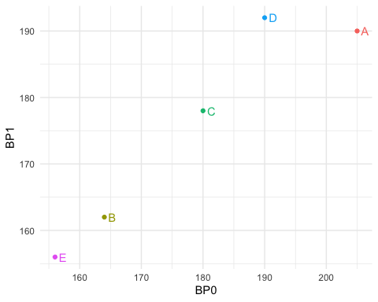
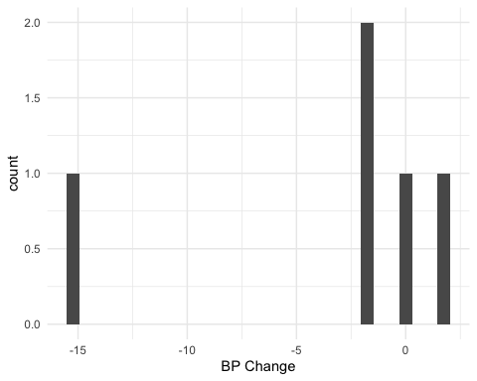
Do the BP data look normal?
At N=5, it is really difficult to make a judgment about this.
It is clear that subject A is exerting a lot of influence on the sample mean. If this was due to a technical equipment error or similar you might be in danger of being led to a very inaccurate conclusion. NB: It is always a good idea to double-check original records for numbers like this. Often a field has been left blank and defaulted to zero.
We will discuss sample size criteria later; but for now, reviewers might take issue with you using a t-test on data with this few samples. (Which is of course just an exercise.)
Often, when the data exhibit a large variance like this the test results will fail to reject the null.
However, if the null is rejected there is a major concern that it is because the normality assumptions were not met, not because the population mean is nonzero.
For now, let's proceed as though normality assumptions are reasonable.

Slide 38
The null hypothesis
We can make the explicit null hypothesis that because the drug has no effect, the data are sampled from a distribution with mean 0.
Specifically, $H_{0}:μ=0$, vs. $H_{A}:μ≠0$.
Then we can calculate a test statistic to evaluate how likely the sample mean we have here would be under the null ($μ=0$):
$\frac{\overline{X}−μ}{S/\sqrt{n}}∼t_{n−1}$
$\frac{−3.4−0}{3.0}=−1.1\sim t_{4}$

Slide 39
Understanding the Test Statistic
$\frac{\overline{X}−μ}{S/\sqrt{n}}∼t_{n−1}$
$\frac{−3.4−0}{3.0}=−1.1\sim t_{4}$
The test statistic quantifies how far our sample mean is from the hypothesized population mean.
A larger absolute value indicates a greater deviation from the null hypothesis.
Here, our test statistic is -1.1, meaning our sample mean is slightly below the hypothesized mean.

Slide 40
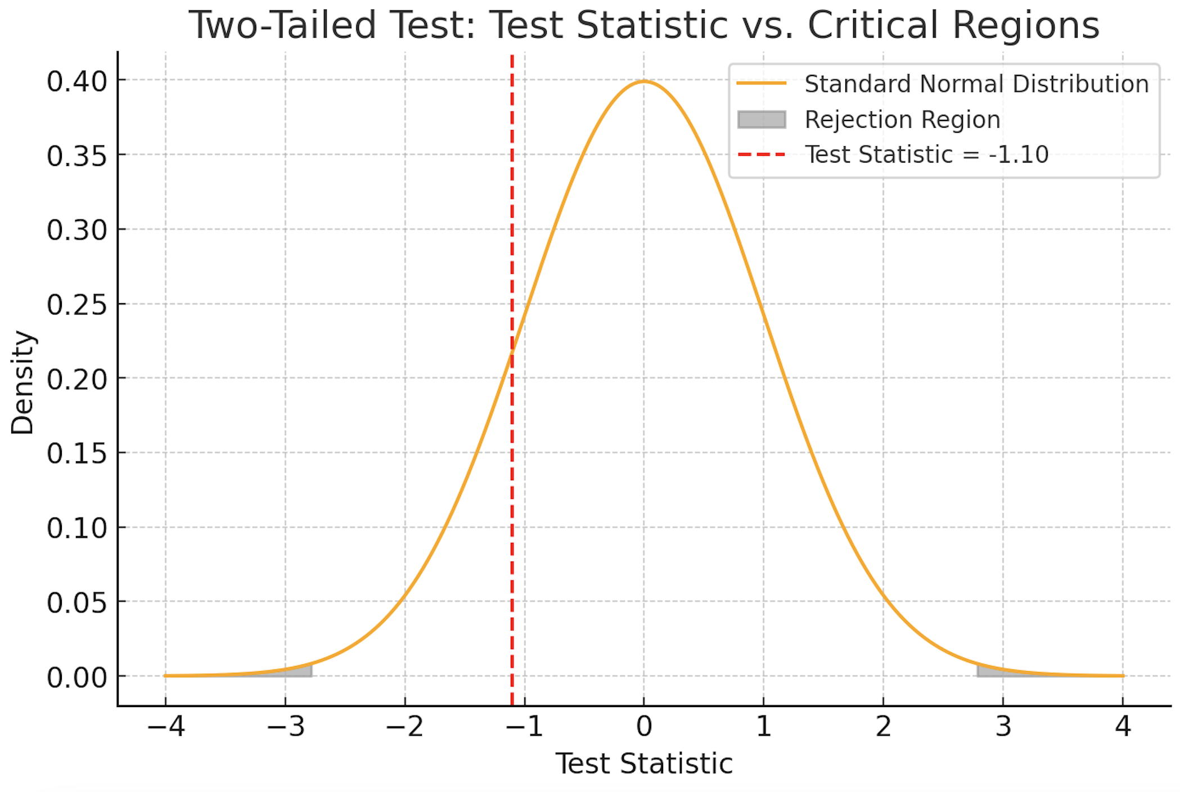
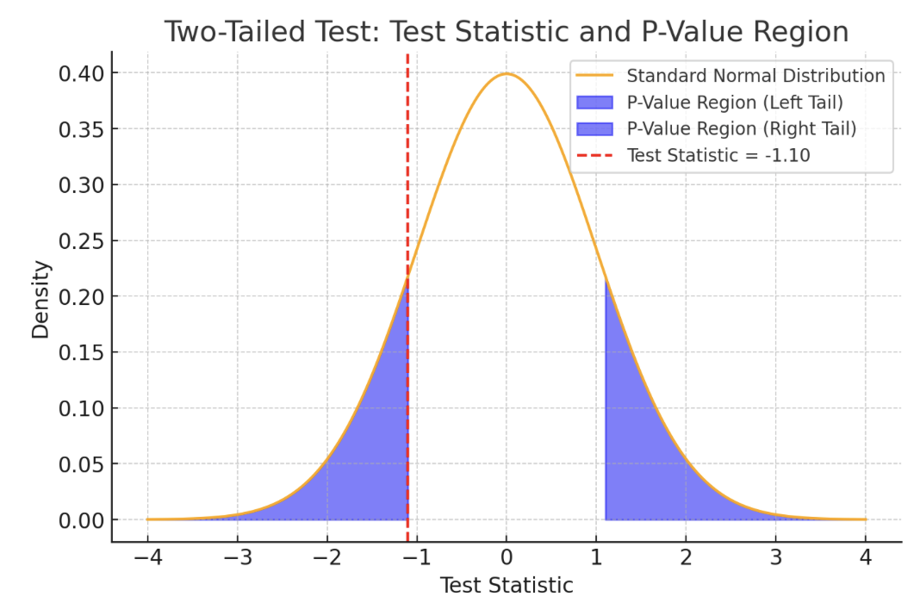
We compare our test statistic to the chosen distribution
Roughly 32% of the $t4$ density is located at values equal to or more extreme than our test statistic, -1.1.
Note that here we are doing a "two-sided test" – this is always recommended unless you have a strong rationale for one-sided tests.
t.test(c(-15,-2,-2,2,0))
## ## One Sample t-test ## t = -1.1359, df = 4, p-value = 0.3195 ## alternative hypothesis: true mean is not equal to 0

Slide 41
So did the drug work?
With a $P value$of 0.32, our observed values are not really surprising at all.
If the $P value$had been very small, like 0.02, it might have cast doubt on the null hypothesis, because it would mean that the data would be very rare under the null. (Of course, not impossible.)
We often use a cutoff value of $α$ = 0.05 for this kind of decision.
So for now, we have no evidence (at $α$ = 0.05) that we should reject the null hypothesis that $μ=0$.

Slide 42
Understanding $α$in Hypothesis Testing
$α$is the significance level, representing the probability of rejecting the null hypothesis when it is actually true (Type I error).
It defines the threshold for statistical significance in a hypothesis test.
Researchers determine before conducting a study based on the acceptable risk of Type I errors.
0.05 (5%): Most commonly used in scientific research.
0.01 (1%): Used in studies requiring higher confidence.
0.10 (10%): Sometimes used in exploratory research.
If p-value < $α$, reject the null hypothesis (statistically significant result).
If p-value ≥ $α$, fail to reject the null hypothesis (not statistically significant).

Slide 43
Two-sample hypothesis tests

Slide 44
The independent-samples t test
It is much more common to have two samples, $a$ and $b$, of a variable like blood pressure, and to want to know whether the difference in means across the samples is greater than you might expect by chance.
This is typically evaluated with an independent-samples t test.
Note that there are several variants! In fact, the default in R is not the simplest one. We will investigate further.

Slide 45
Entering independent samples data
You will often see data from two groups entered like this:
This is misleading!
It implies that observation 4 in group 1 has something to do with observation 4 in group 2, and this is usually not the case.
Group 1 | Group 2
106 | 98
102 | 104
112 | 104
113 | 108

Slide 46
Entering independent samples data
Especially when used in plots, it can give the sense that these are two separate outcome variables, when in reality the outcome is one variable, and the group is a second variable.
You will note that data organized like this (melted) is ready for plotting in ggplot2 or similar – it is also ready for analysis in any of the main statistical libraries.
Outcome | Group
106 | 1
102 | 1
112 | 1
113 | 1
98 | 2
104 | 2
104 | 2
108 | 2

Slide 47
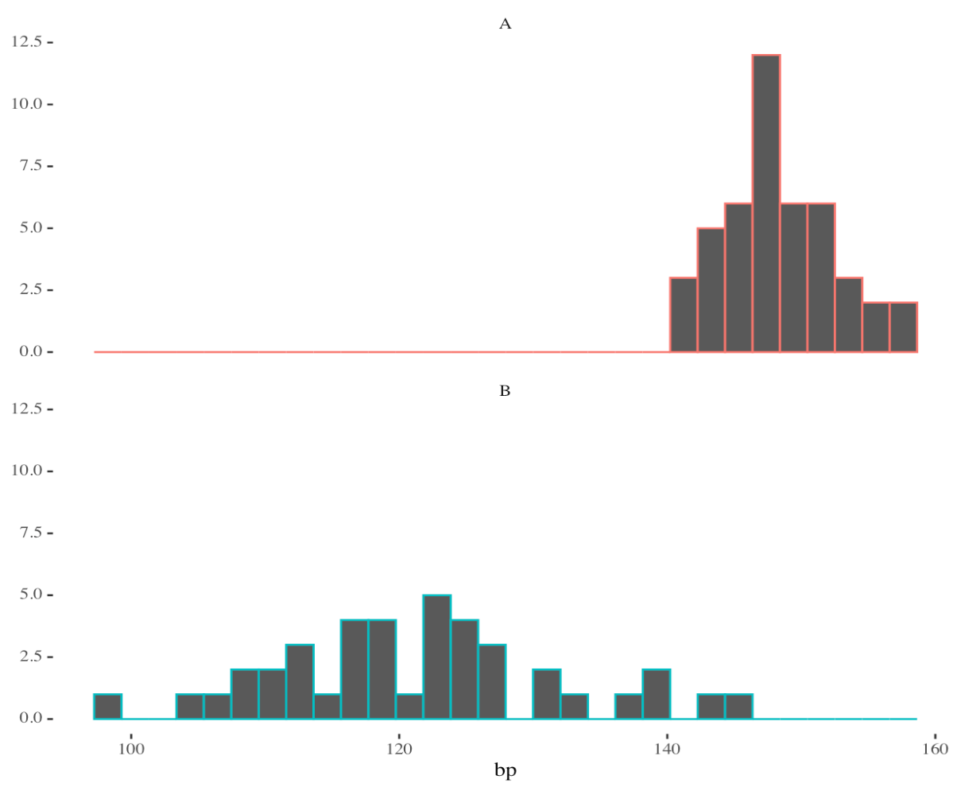
The independent-samples t test
Let's say that we have two samples of blood pressures, with 40 observations of group A and 45 observations of group B.
The traditional t test estimates the difference in means.

Slide 48
The independent-samples t test
In the basic test, under the null $H_{0}:μ_{A}=μ_{B}$ we can evaluate the statistic
$$\frac{\overline{X}−μ}{S/\sqrt{n}}∼t_{n−1}$$
Where the numerator is
$$|μ_{A}−μ_{B}|$$
Under the null, the population standard deviation $σ$ is the same for both groups.

Slide 49
The independent-samples t test
Group | A | B
N | 45 | 40
Mean | 148.3 | 121.4
SD | 4.1 | 10.7
SEM | 0.6 | 1.7
It is clear that we can calculate the difference in means:
$$\overline{X_{A}}−\overline{X_{B}}=26.9$$
Under $H_{0}$, this value should be 0 (on average).
(It is possible to hypothesize other values of $μ_{A}−μ_{B}$, for example, in non-inferiority trials; but 0 is the most common case.)

Slide 50
Methods to estimate variance / SEM
Conservative Approach:
Use the larger sample variance and the smaller degrees of freedom in the $t$-distribution.
This is essentially a one-sample test, with the test statistic distributed as $t_{(n_{min}−1)}$.
Ensures a more cautious inference, which is useful for planning studies.

Slide 51
Methods to estimate variance / SEM
Pooled Variance Method:
Assumes equal population variances and pools sample variances weighted by their sizes.
$$S_{p}^{2}=\frac{\left(n_{A}−1\right)S_{A}^{2}+\left(n_{B}−1\right)S_{B}^{2}}{\left(n_{A}−1\right)+\left(n_{B}−1\right)}$$
The test statistic:
$$T=\frac{\overline{X_{A}}−\overline{X_{B}}}{S_{p}\sqrt{\frac{1}{n_{A}}+\frac{1}{n_{B}}}}$$
Is distributed as $t_{\left(n_{A}−1\right)+\left(n_{B}−1\right)}$. This is called the pooled t test.

Slide 52
Remember the t density: Z over a chi-square
Definition: if $Z$ follows a standard normal density such that $Z∼N(0,1)$
and $U$ follows a chi-square density with $n$ degrees of freedom such that $U∼χ_{n}^{2}$ $∼ Z_{1}^{2}+Z_{2}^{2}+...+Z_{n}^{2}$
then the density $\frac{Z}{\sqrt{U/n}}$ is called the $t$ density with $n$ degrees of freedom.

Slide 53
Methods to estimate variance / SEM
Satterthwaite Approximation:
When population variances are unequal, we cannot assume pooled variance.
Instead, we estimate an adjusted degrees of freedom for the t-distribution.
Test Statistic Formula:
$$T=\frac{\overline{X_{A}}−\overline{X_{B}}}{\sqrt{\frac{s_{A}^{2}}{n_{A}}+\frac{s_{B}^{2}}{n_{B}}}}$$
Here, the issue is that although the variance of $\overline{X_{A}}$ is distributed as a chi-squared, the variance of the difference of the two means is not.

Slide 54
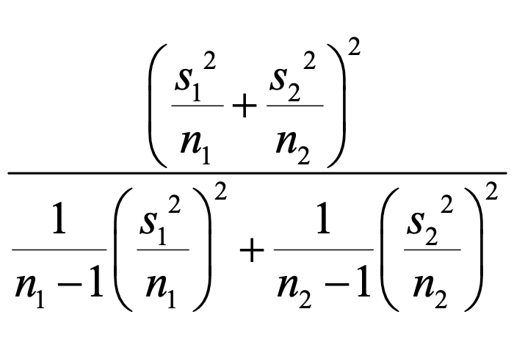
Satterwaithe's formula
Here, the issue is that although the variance of $\overline{X_{A}}$, that shows up in the denominator, is distributed as a chi-squared, the variance of the difference of the two means is not. So the denominator is no longer chi-squared, and the test statistic does not follow a t distribution.
Satterwaithe cleverly figured a way to figure out the "effective" degrees of freedom for the t distribution under which the denominator would be distributed approximately as a chi-squared. This is:

Slide 55
Assessing normality

Slide 56
Assessing normality
Most of the parametric tests derived from the normal distribution ($t$, $χ^{2}$, $F$) assume that the population quantities are normally distributed.
This assumption is very strong, and may not be reasonable for your data. Data visualization is very important to evaluate whether you think the population is normal or not.
There are two schools of thought on assessing normality:
Formal tests
Visual inspection

Slide 57
Assessing normality with formal tests
The Shapiro-Wilk test can be used to assess normality (shapiro.test() in R).
$H_{0}$ is that the data in a given sample are normally distributed; small P-values cast doubt on this.
There is no formal derivation of the test statistic, for which critical values are determined via Monte-Carlo methods.

Slide 58
Visual inspection
Because the sample mean will be normally distributed - even if the data themselves are not - if the sample size is over 30, many statisticians suggest a quick visual inspections to evaluate the assumptions of normality.
Since many of the questions we ask involve changes in mean values, it is often not necessary to go much beyond that.

Slide 59
Non-parametric alternatives
It is possible to use the Wilcoxon family of tests (wilcox.test() in R) to deal with data for which the mean may not be normally distributed.
This is a test of central tendency based on the difference in ranks of the the groups in the sample once it is sorted, rather than based on the absolute difference in mean values across groups. It is similar but usually less powerful than the parametric alternative.
The multi-group analog is the Kruscal-Wallis tests (kruskal.test).

Slide 60
Two additional notes

Slide 61
Moore and McCabe’s guidelines for sample size
The $t$-distribution formula for the population mean $μ$ is exactly correct when the underlying population is normal.
Whether or not this assumption is reasonable is the decision of the analyst. Data visualization is very important to evaluate whether you think the population is normal or not.
"Moore and McCabe" recommend using the following guidelines for determining whether the $t$ distribution procedure is ok to use in the presence of non-normal populations.
n < 15: use t-distribution only if the data indicate that the population is very close to normal.
15 < n < 39: use t-distribution except in the presence of outliers or strong skewness.
n > 40: use t-distribution regardless of the shape of the population distribution.

Slide 62
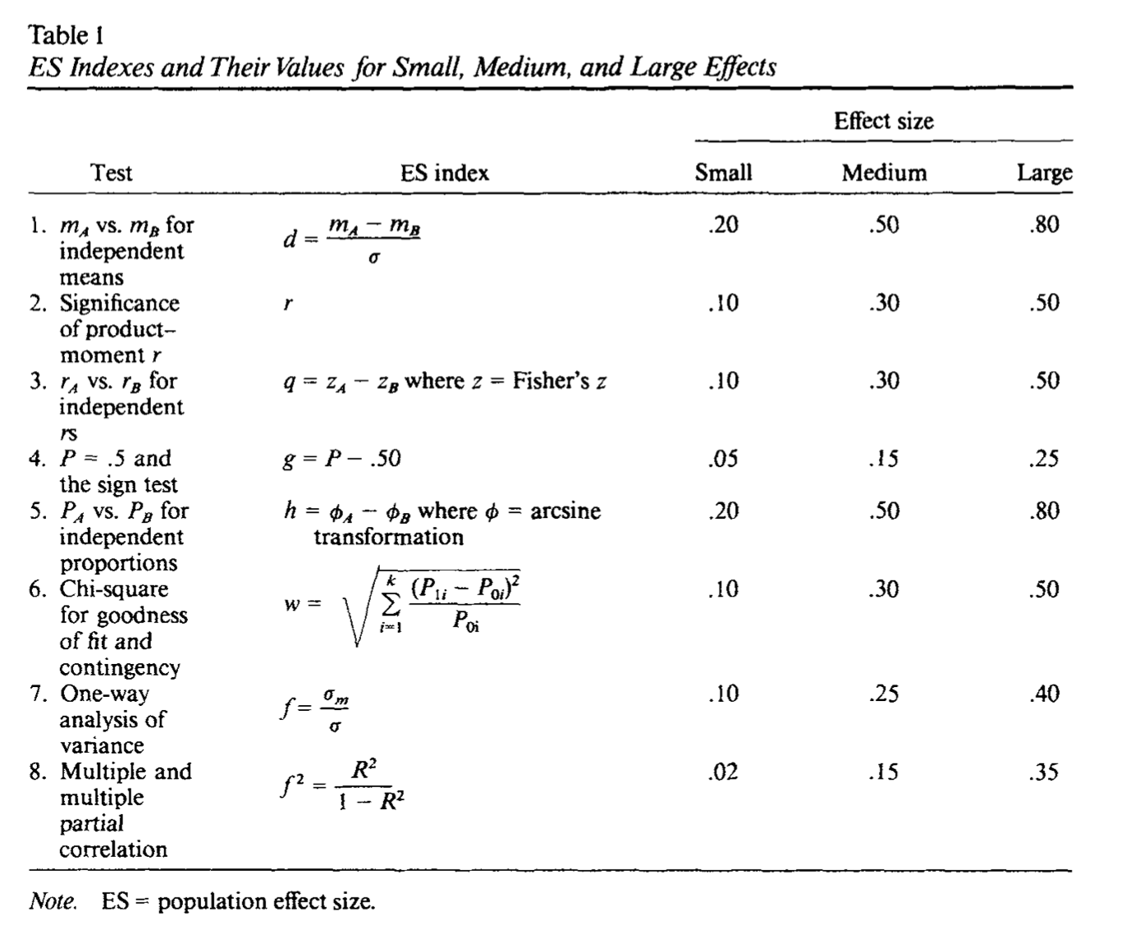
Effect sizes

Slide 63
Outline
Key definitions
The sample mean
One-sample hypothesis tests
Two-sample hypothesis tests
Additional topics

