Slide 1

BMI 510: Data Wrangling
J. Lucas McKay, Ph.D., M.S.C.R.
Departments of Biomedical Informatics and Neurology, Emory University, Atlanta, GA USA
Department of Biomedical Engineering, Georgia Institute of Technology, Atlanta, GA, USA

Slide 2

Sign up for Journal Club!
We will start next week.
https://docs.google.com/spreadsheets/d/19nfVdJLGrNOyC3cNul5e-7NvBiZiHOp8yFAAjKDzsKY/edit?usp=sharing

Slide 3
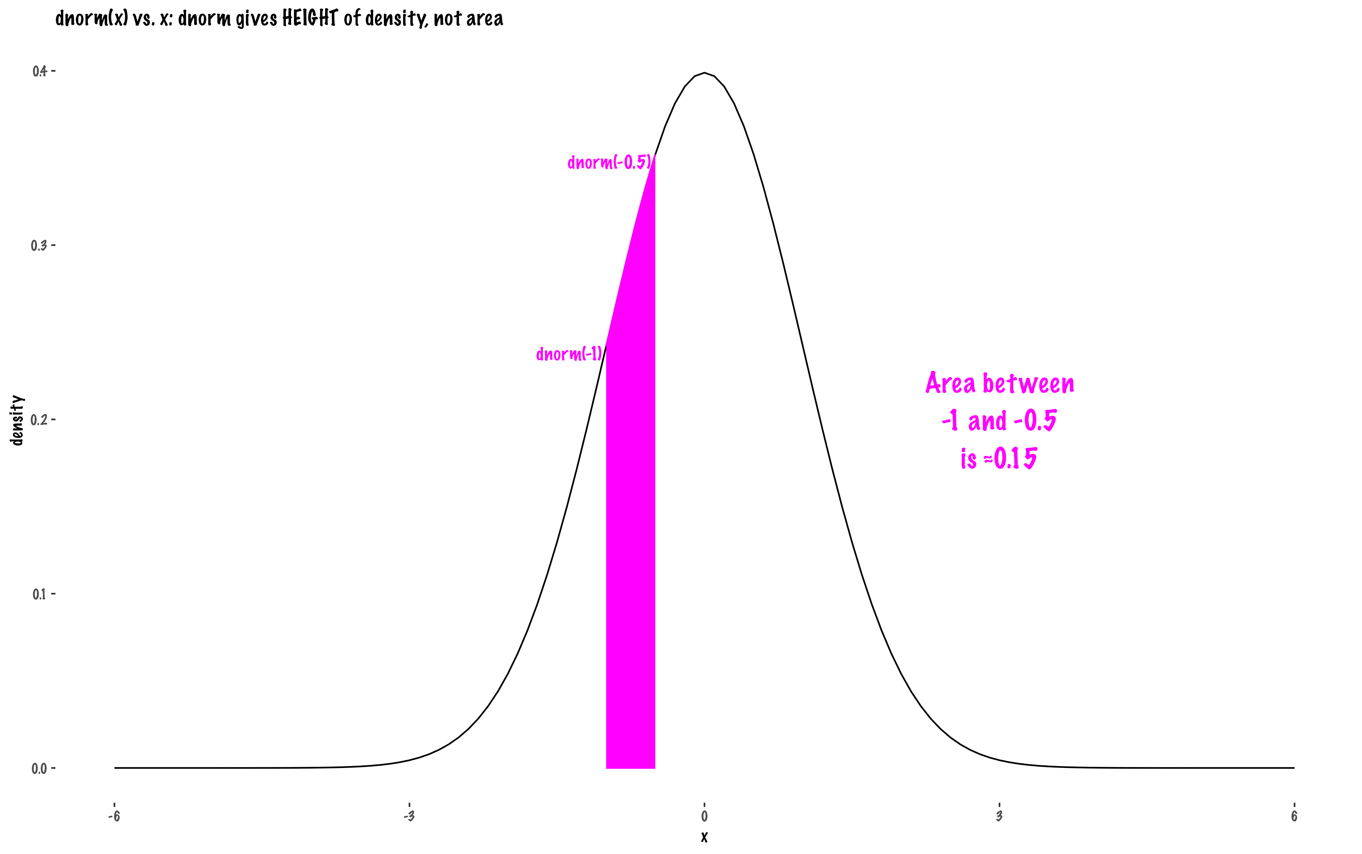

Slide 4
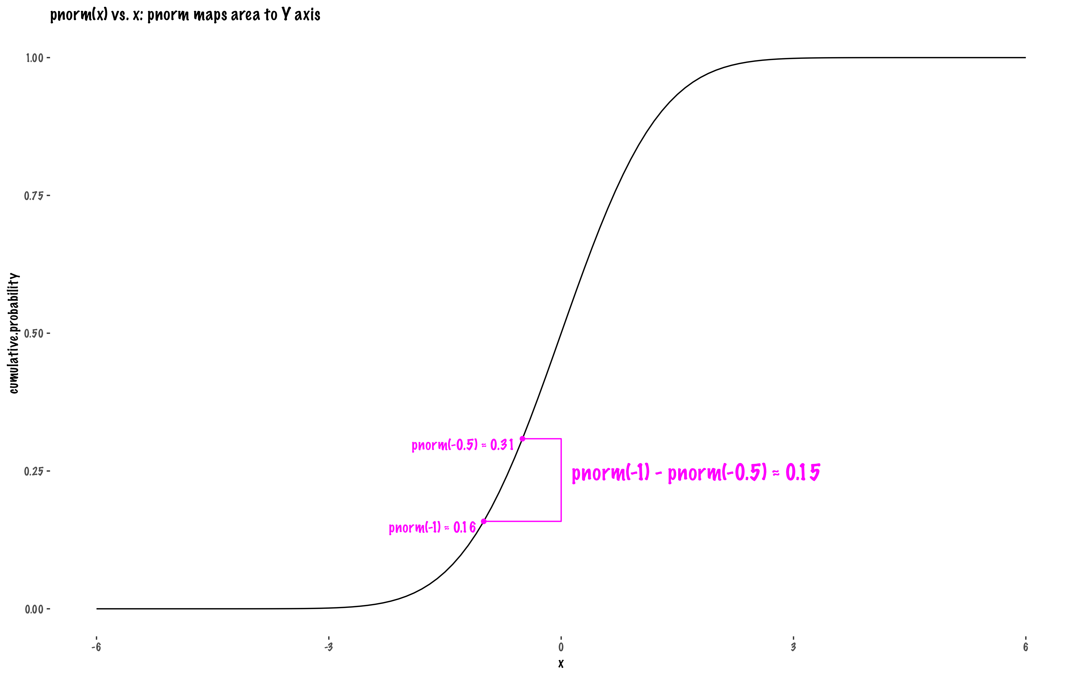

Slide 5
Data wrangling is usually the first step of a data science workflow
data wrangling

Slide 6
Data wrangling and database models
Data wrangling is essentially the process of shoehorning whatever data you have into a reasonable database model. As such, the technical rules really come from database models.

Slide 7
Today
Database fundamentals
Tidy data standards
Lab

Slide 8
Database models
A database is a collection of digitized information (“data”), which is kept in storage of some kind.
Databases can be in-memory or disk-optimized. For our purposes, we will consider in-memory centralized (vs. distributed) databases.
People or programs can insert new information into a database, and delete, change, or retrieve existing information in the database, by issuing requests or commands to the Database Management System (DBMS) software that manages the database.

Slide 9
Database types
Flat files
Hierarchical
Relational

Slide 10
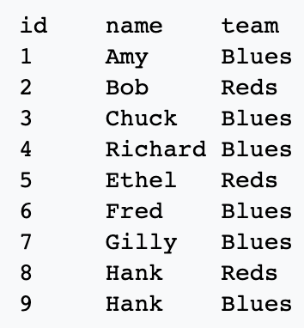
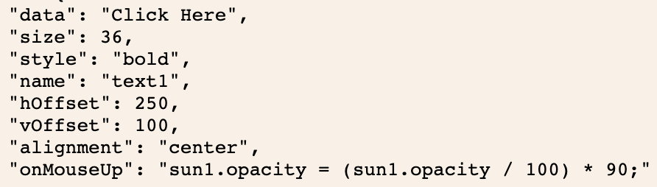
Flat file
Often small, but not always
Human readable or binary
Database structure can be inferred (e.g., one record per row), but is not enforced
Common examples
CSV spreadsheet
simple JSON file
wikipedia; https://json.org/example.html

Slide 11
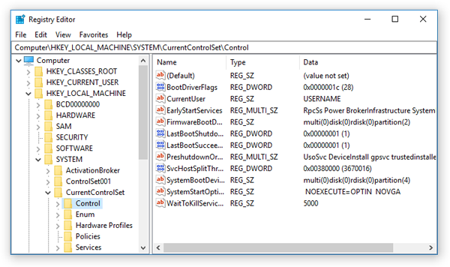
Hierarchical database
Tree structure with strict parent–child (or, key–(subkey)–multiple value) relationships
Common example: Windows registry
wikipedia

Slide 12
Relational database
Data are presented (not stored, this is subtle) in the form of rows (“tuples”) with different columns (“attributes”) grouped into tables.
You can imagine a table as a spreadsheet with more rules.
In terms of actual files:
SQLite stores the entire database in a single .sqlite or .db file.
MySQL, PostgreSQL, and SQL Server store databases across multiple files, including data files, transaction logs, and index files.
wikipedia

Slide 13
Key Variables
Each row is designated by a key variable that allows linkage across tables. We’ll see some examples.
Various left_join and similar statements in python and R are really SQL ports.
wikipedia

Slide 14
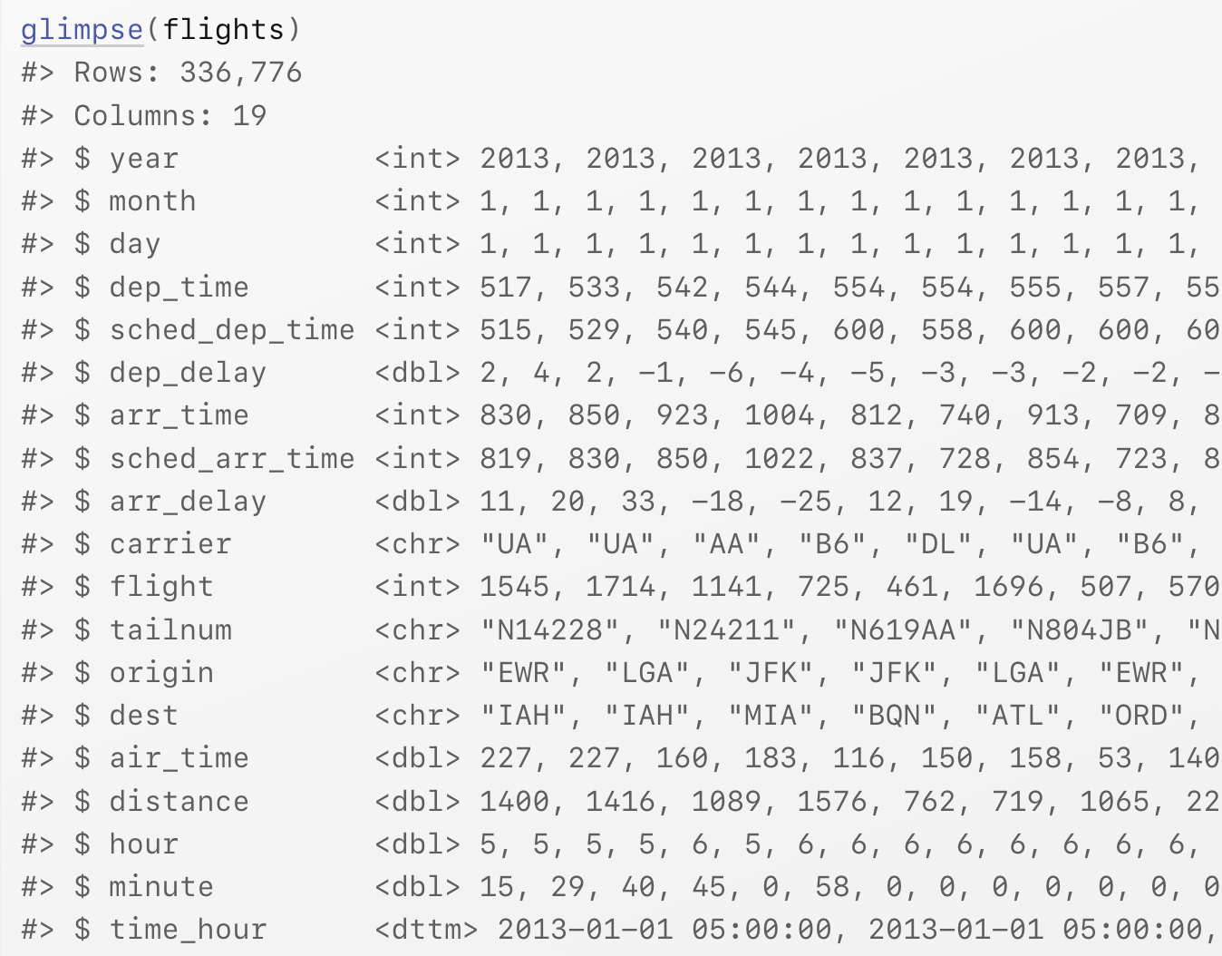
Example table (nycflights)
13 Relational data | R for Data Science (had.co.nz)

Slide 15
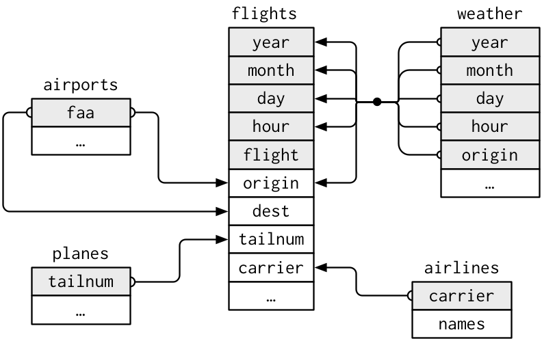
Keys (nycflights)
13 Relational data | R for Data Science (had.co.nz)

Slide 16
Keys (nycflights)
flights connects to planes via a single variable, tailnum.
flights connects to airlines through the carrier variable.
flights connects to airports in two ways: via the origin and dest variables.
flights connects to weather via origin (the location), and year, month, day and hour (the time).
13 Relational data | R for Data Science (had.co.nz)

Slide 17
Keys
The variables used to connect each pair of tables are called keys.
A key is a variable (or set of variables) that uniquely identifies an observation.
There are two types of keys:
  A primary key uniquely identifies an observation in its own table. For example, planes$tailnum is a primary key because it uniquely identifies each plane in the planes table.
  A foreign key uniquely identifies an observation in another table. For example, flights$tailnum is a foreign key because it appears in the flights table where it matches each flight to a unique plane.
13 Relational data | R for Data Science (had.co.nz)

Slide 18
Choosing a database structure for statistical analysis
Statistical analyses (almost?) always use in-memory flat files.
There are a few built-in types that are amenable to statistical analysis in common languages you might use for scientific computing.
R data.frame or tibble; pandas.DataFrame; Matlab table
They have in common:
Observations in rows and variables in columns
Strict type enforcement along columns
There is no data loss upon reordering rows or columns, because columns are named and keys ensure that row order is arbitrary.

Slide 19
What is borrowed from SQL
The concept that each row of each table has a unique key (e.g., patient id, trial number, concatenation of patient id and trial number) is critical.
This enables cross-referencing.
One critical difference between a database and a numerical matrix is that – although both might be 2D grids – the order of rows and columns in the database should not matter!
For purposes of statistical inference, if the column or row number is relevant, then those numbers are data and should be stored within the database.

Slide 20
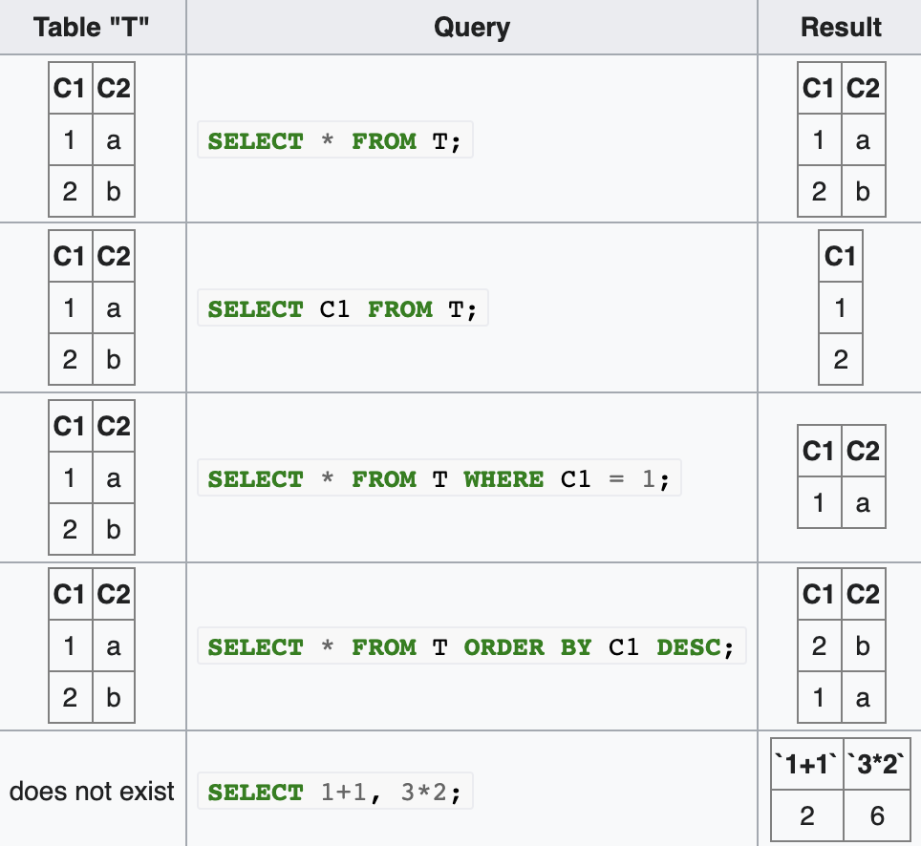
“Selecting” in SQL always returns a table
https://en.wikipedia.org/wiki/Select_(SQL)

Slide 21
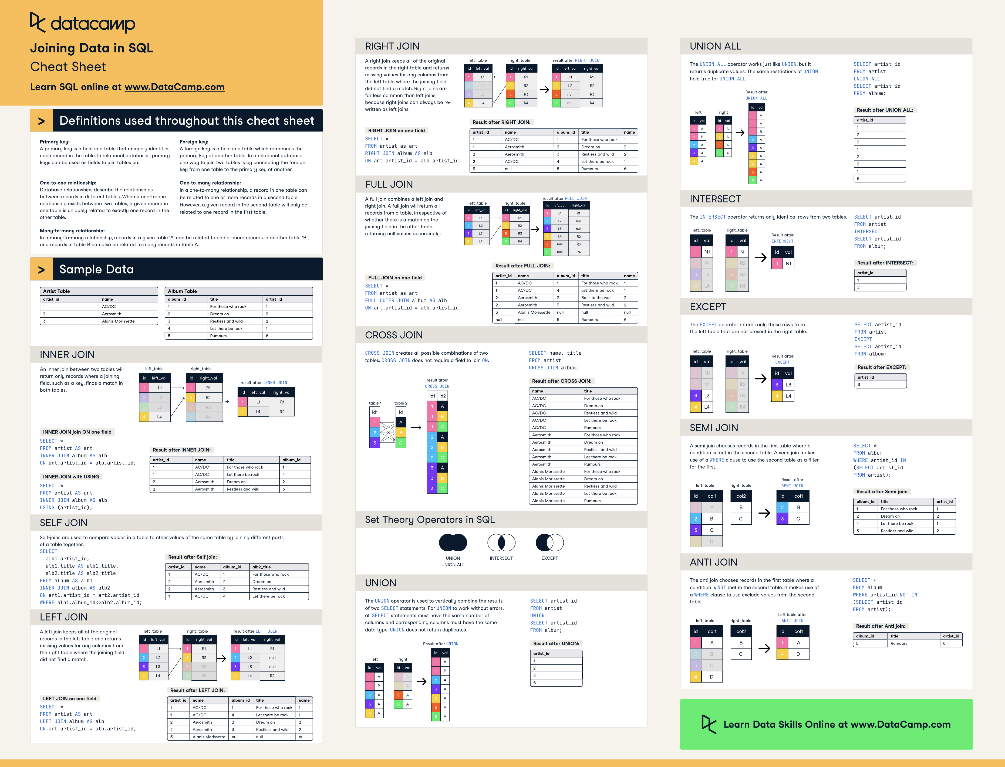

Slide 22
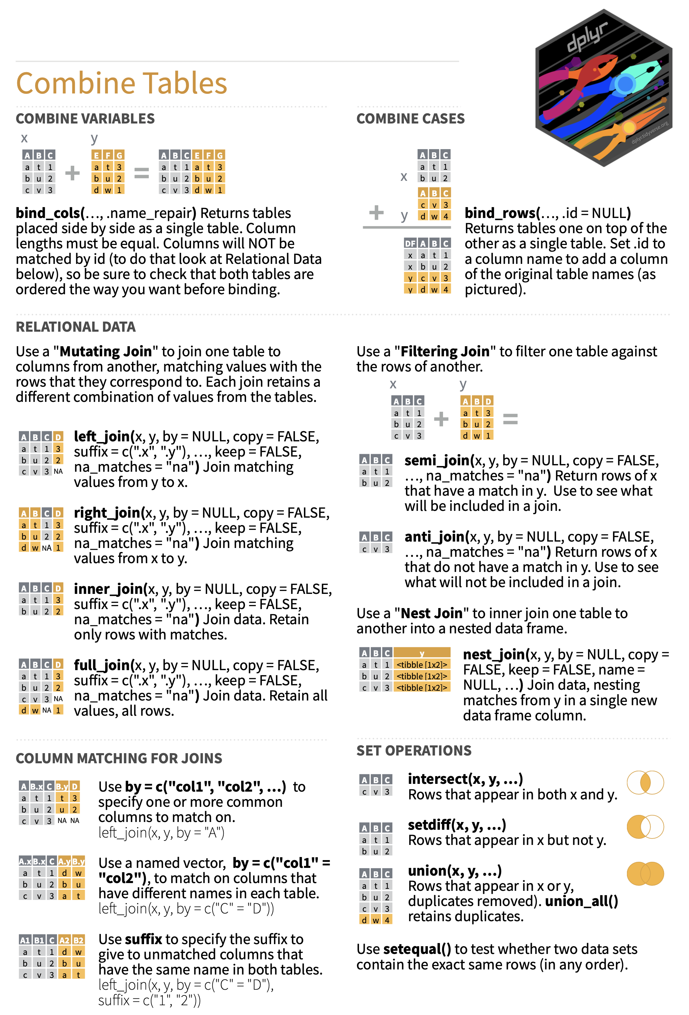

Slide 23
Tibble
The main data format in tidy R is a “tibble.”
All of the columns have the same data type. (A column containing lists can have different types – but if this comes up, really consider doing it another way.)
Columns have names. Rows do not.
Tbl$varname
Tbl$`Variable Name with Spaces`
Tbl[, “Variable Name with Spaces”] (returns a vector)
Tbl[“Variable Name with Spaces”] (returns a one-column tibble)
Tbl |> select(mpg,cyl,everything()) (a tibble)
Tbl |> select(-mpg) (a tibble)

Slide 24
Objective of data wrangling
key | name | value
pat001tr0006 | iL1beta | 7600
pat001 | height | 34
pat001 | MRN | 17
pat001tr0006 | Ab42 | 700
If you can get your data into a tall format database formatted as it is to the right, you can certainly pivot/filter/facet them into any other format.
(Imagine here that any categorical variables, like cancer stage, have been mapped to numbers)
“Completely melting” the data into this format is a common intermediate step during data rectangularization.

Slide 25
Formatting flat files
Use *.csv or similar files. Pre-calculating in Excel is ok, but it is easier and more accurate in R or python.
Formatting with color, etc., cannot be read by a computer. Create a boolean variable to represent this information.
Avoid special characters or spaces in variable names.
Never, ever mix number data with notes (e.g., “no blood data, hard stick.”). Create another column to explain missing data.
In very, very limited cases it may be allowable to use missing data codes like -999 to indicate patient refusal or truncation. This should be documented on data entry forms. If data are really missing, leave the cell blank.

Slide 26
Warning signs for data formatting
You have a post-it or similar on your desk mapping variables to column numbers.
  Use a dataframe-type structure. The analysis code will be much more robust to changes in data configuration.
You are working from intermediate (*.mat, *.csv, *.etc.) files.
  Analysis routines should operate on raw data and central study databases to the furthest extent possible. This prevents data loss and errors.
  It also protects participant privacy as local copies are not stored. (And potentially lost.)
You are using a spreadsheet to assist analyses.
  If you have analysis data (subgroup filtering is a common one) stored in a spreadsheet these filters should be incorporated into analysis code.

Slide 27
Tidy Data
“It is often said that 80% of data analysis is spent on the process of cleaning and preparing the data. Data preparation is not just a first step, but must be repeated many times over the course of analysis as new problems come to light or new data is collected. Despite the amount of time it takes, there has been surprisingly little research on how to clean data well. Part of the challenge is the breadth of activities it encompasses: from outlier checking, to date parsing, to missing value imputation. To get a handle on the problem, this paper focusses on a small, but important, aspect of data cleaning that I call data tidying: structuring datasets to facilitate analysis.
“The principles of tidy data provide a standard way to organize data values within a dataset. A standard makes initial data cleaning easier because you don’t need to start from scratch and reinvent the wheel every time. The tidy data standard has been designed to facilitate initial exploration and analysis of the data, and to simplify the development of data analysis tools that work well together. Current tools often require translation. You have to spend time munging the output from one tool so you can input it into another. Tidy datasets and tidy tools work hand in hand to make data analysis easier, allowing you to focus on the interesting domain problem, not on the uninteresting logistics of data.”
Wickham. https://vita.had.co.nz/papers/tidy-data.pdf

Slide 28
Guide for Tidy Data
Each variable forms a column.
Each observation forms a row.
Each type of observational unit forms a table.
Wickham. https://vita.had.co.nz/papers/tidy-data.pdf

Slide 29
Guide for Tidy Data
Each variable forms a column. (Straightforward)
Each observation forms a row. (Straightforward)
Each type of observational unit forms a table.
Study Day
0
0
Patient | Sys | Dias | Pulse
1 | 140 | 16 | 66
2 | 160 | 25 | 75
“Baseline
Table”
Study Day
0
0
Patient | Sys | Dias | Pulse
3 | 140 | 16 | 66
4 | 160 | 25 | 75
Study Day
36
28
Patient | Sys | Dias | Pulse
1 | 140 | 16 | 66
2 | 160 | 25 | 75
More timepoints
or patients
add rows

Slide 30
Guide for Tidy Data
Each variable forms a column. (Straightforward)
Each observation forms a row. (Straightforward)
Each type of observational unit forms a table.
Study Day
0
0
Patient | Sys | Dias | Pulse
1 | 140 | 16 | 66
2 | 160 | 25 | 75
Study Day
36
28
Patient | Sys | Dias | Pulse
1 | 140 | 16 | 66
2 | 160 | 25 | 75
Study Day
0
0
Patient | Sys | Dias | Pulse
3 | 140 | 16 | 66
4 | 160 | 25 | 75
Switching from rows to columns
breaks rule 3!

Slide 31
Guide for Tidy Data
No empty spaces are used for missing observational units.

Slide 32
The five most common problems with messy datasets
Column headers are values, not variable names.
Multiple variables are stored in one column.
Variables are stored in both rows and columns.
Multiple types of observational units are stored in the same table.
A single observational unit is stored in multiple tables.
Wickham. https://vita.had.co.nz/papers/tidy-data.pdf

Slide 33
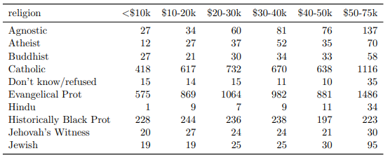
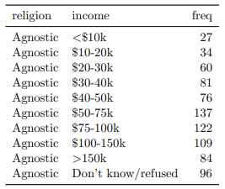
Column headers are values, not variable names
Messy (albeit useful
with complete data)
Tidy
Wickham. https://vita.had.co.nz/papers/tidy-data.pdf

Slide 34
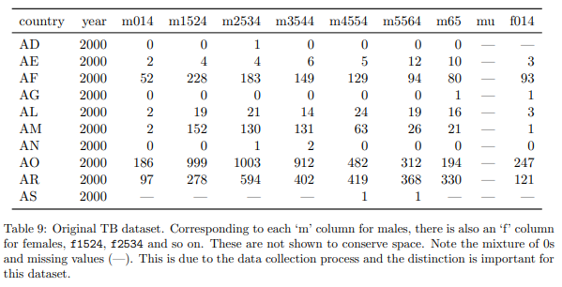
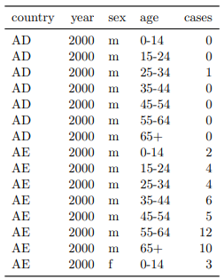
Multiple variables are stored in one column
Messy
Tidy
Wickham. https://vita.had.co.nz/papers/tidy-data.pdf

Slide 35
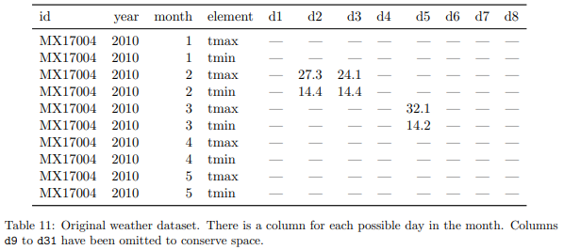
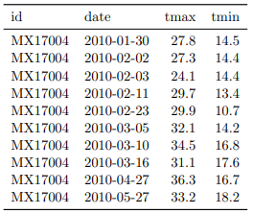
Variables are stored in both rows and columns
Messy
Tidy
Wickham. https://vita.had.co.nz/papers/tidy-data.pdf

Slide 36
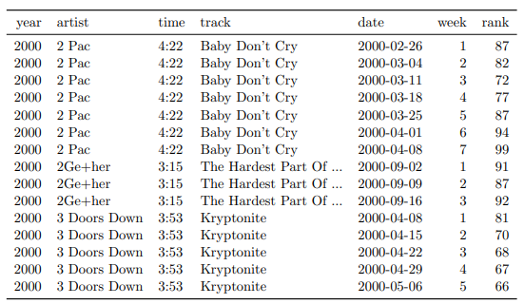
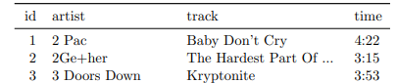
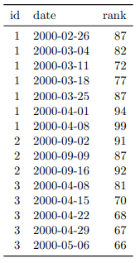
Multiple types of observational units are stored in the same table
Messy (song-level and week-level)
Tidy (actually two tables)
Wickham. https://vita.had.co.nz/papers/tidy-data.pdf

Slide 37
Multiple types of observational units are stored in the same table: LOCF
This type of inefficient layout happens a lot, in particular because most common analysis tools do not work directly with multiple simultaneous relational tables.
Do not do this for large format storage!
One half-measure to remedy this is the “last-observation-carry-forward” structure.

Slide 38
A single observational unit is stored in multiple tables (files)
Messy
Tidy
study_data_2021_06_01.csv
study_data_aggregated.csv
Patient | Sys | Dias | Pulse
1 | 140 | 16 | 66
2 | 160 | 25 | 75
Date | Patient | Sys | Dias | Pulse
2021/06/01 | 1 | 140 | 16 | 66
2021/06/01 | 2 | 160 | 25 | 75
2021/06/03 | 3 | 140 | 16 | 66
2021/06/03 | 4 | 160 | 25 | 75
2021/06/17 | 7 | 140 | 16 | 66
2021/06/17 | 9 | 160 | 25 | 75
study_data_2021_06_03.csv
Patient | Sys | Dias | Pulse
3 | 140 | 16 | 66
4 | 160 | 25 | 75
study_data_2021_06_17.csv
Patient | Sys | Dias | Pulse
7 | 140 | 16 | 66
9 | 160 | 25 | 75
R> paths <- dir("data", pattern = "\\.csv$", full.names = TRUE) R> names(paths) <- basename(paths)
R> ldply(paths, read.csv, stringsAsFactors = FALSE)
Wickham. https://vita.had.co.nz/papers/tidy-data.pdf

Slide 39
Lab

