Slide 1
BMI 510: Useful Distributions
Selen Bozkurt, Ph.D., M.Sc.
Departments of Biomedical Informatics, Emory University, Atlanta, GA USA
J. Lucas McKay, Ph.D., M.S.C.R.
Departments of Biomedical Informatics and Neurology, Emory University, Atlanta, GA USA
Department of Biomedical Engineering, Georgia Institute of Technology, Atlanta, GA, USA

Slide 2
The big picture: two fundamental statistical modeling steps
Fit model parameters to data
Make inferences about models

Slide 3
Standard Normal Distribution $$Z \sim N(0,1)$$
Notes:
It is often essential to normalize data prior to the analysis z=x−μ/σ

Slide 4
Degrees of Freedom (df)
The number of independent values that can vary in a statistical calculation before constraints force the remaining values.
Example 1: Coin Toss
Toss a coin 100 times
If 62 are heads, the number of tails is automatically 38
What is df?

Slide 5
Degrees of Freedom
The number of independent values that can vary in a statistical calculation before constraints force the remaining values.
Example 1: Coin Toss (df = 1)
Toss a coin 100 times
If 62 are heads, the number of tails is automatically 38
Only one value (heads count) is free to vary → df = 1

Slide 6
Degrees of Freedom
The number of independent values that can vary in a statistical calculation before constraints force the remaining values.
Example 1: Coin Toss (df = 1)
Toss a coin 100 times
If 62 are heads, the number of tails is automatically 38
Only one value (heads count) is free to vary → df = 1
Example 2: Rolling a Die
Roll a die 1000 times
If we know counts for 1s, 2s, 3s, 4s, and 5s, the count for 6s is already determined
What is df?

Slide 7
Degrees of Freedom
The number of independent values that can vary in a statistical calculation before constraints force the remaining values.
Example 1: Coin Toss (df = 1)
Toss a coin 100 times
If 62 are heads, the number of tails is automatically 38
Only one value (heads count) is free to vary → df = 1
Example 2: Rolling a Die (df = 5)
Roll a die 1000 times
If we know counts for 1s, 2s, 3s, 4s, and 5s, the count for 6s is already determined
Five values are free to vary → df = 5
Degrees of freedom represent how many values can change independently before all values are determined.

Slide 8
Distributions derived from the normal density

Slide 9
These distributions show up all the time
The chi-square density shows up all the time in tests of frequency tables and logistic regression
The t density shows up all the time when comparing sample means
The F density shows up all the time in ANOVA procedures

Slide 10
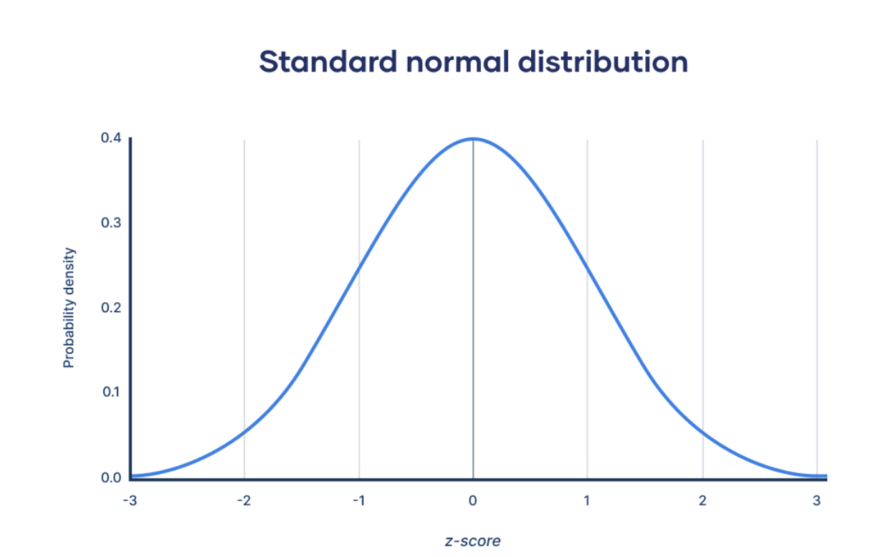
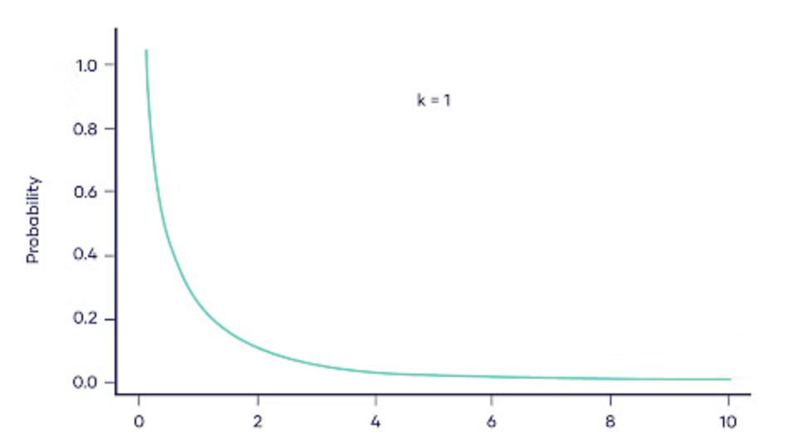
The chi-square density: sum of $Z2$
Definition: if $Z$ is ONE standard normal random variable, the Density of $U$ = $Z^{2}$ is called the chi-square Density with 1 degree of freedom.
This is often written as $χ_{1}^{2}$.
$$Z \sim N\left(0,1\right)$$
$U$ ~ $χ_{1}^{2}$
Df = 1
$U$ = $Z^{2}$

Slide 11
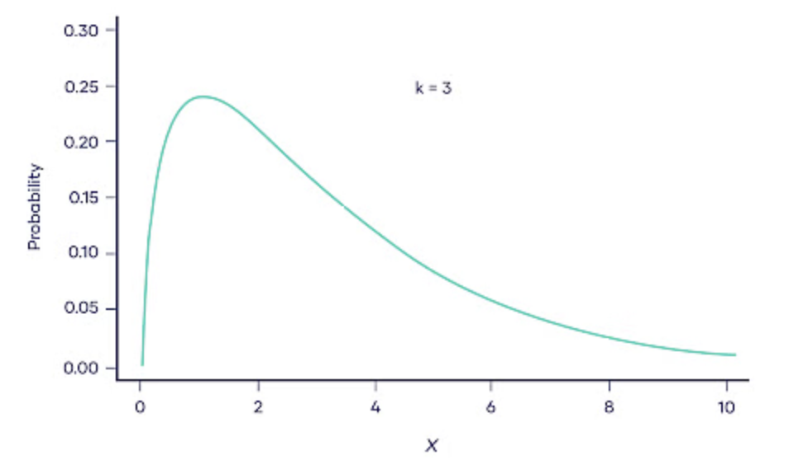
The chi-square density: sum of $Z2$
Definition: if $U_{1},U_{2},...,U_{n}$ are $n$ independent chi-square variables with 1 degree of freedom – meaning that each variable is $U$ = $Z^{2}$ – the Density of $V=U_{1}+U_{2}+...+U_{n}$ is called the chi-square Density with $n$ degrees of freedom.
This is often written as $χ_{n}^{2}$. So if you have a quantity that represents the sum of n squared normal variables, it will be distributed as $χ_{n}^{2}$.
$$V=U1+U2+U3$$
$V$ ~ $χ_{3}^{2}$
$$Z \sim N\left(0,1\right)$$
$U1$ = $Z^{2}$
Df = 3
$U2$ = $Z^{2}$
$U3$ = $Z^{2}$

Slide 12
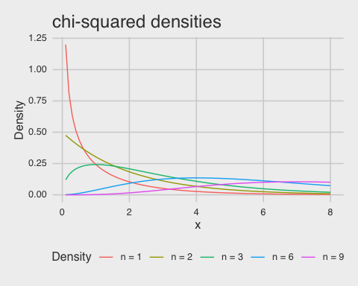
The chi-square density: sum of $Z2$

Slide 13
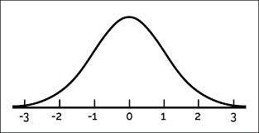
The chi-square density: sum of Z²
Recall that $χ^{2}$ is the distribution of the sum of squared normal variables $Z_{1}^{2}+Z_{2}^{2}+...+Z_{n}^{2}$.
So for $n=1$, there is non-zero probability of obtaining a value of 0; but this drops off steeply.
For $n=6$, you are most likely to get a sum around 4.
$$Z \sim N(0,1)$$

Slide 14
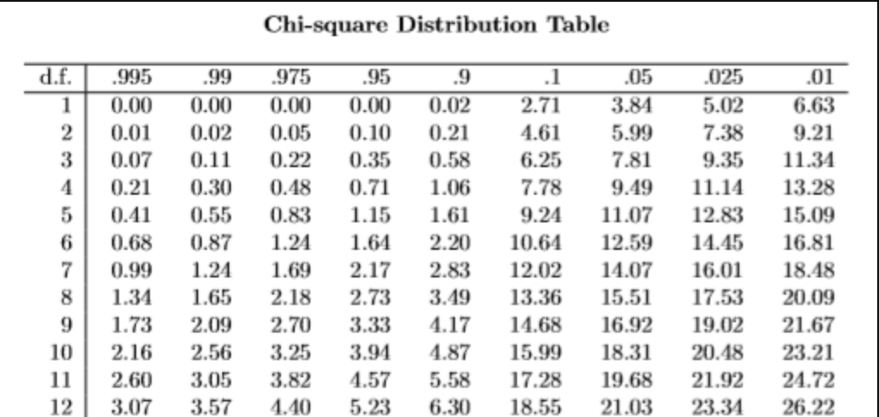
Question
What is the probability that a chi-square random variable with 10 degrees of freedom is greater than 18.31?
Probability
$$P(X>18.31)≈0.05$$

Slide 15
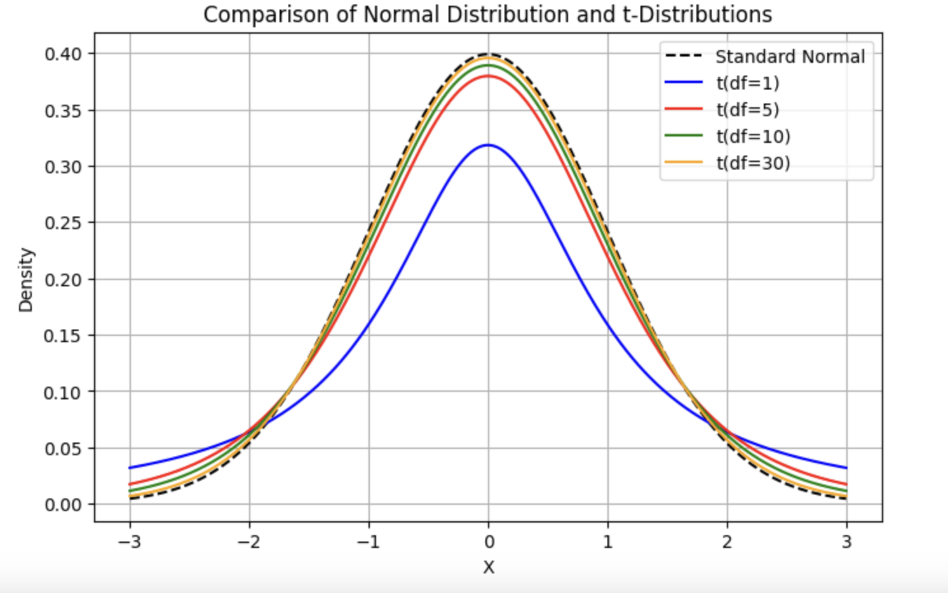
The t density: Z over a chi-square
Also known as Student’s t-distribution

Slide 16
$$t vs Z distribution$$
Similarities
Both are bell-shaped.
Both are symmetrical around the mean.
The curve never touches the x-axis.
Both have a mean, median, and mode equal to zero and located at the center of the distribution.
Differences
The variance for t-distribution is greater than 1.
The t-distribution shape is different for different sample sizes.
As the sample size increases, the t-distribution approaches the standard normal distribution.
The t-distribution has more probability in the tails.

Slide 17
The t density: Z over a chi-square
Definition: if $Z$ follows a standard normal density such that $Z∼N(0,1)$
and $U$ follows a chi-square density with $n$ degrees of freedom such that $U∼χ_{n}^{2}$
then the density $\frac{Z}{\sqrt{U/n}}$ is called the $t$ density with $n$ degrees of freedom.

Slide 18
The t density: Z over a chi-square
Why would we want to know the Density of $\frac{Z}{\sqrt{U/n}}$?
The denominator $\sqrt{{(Z}_{1}^{2}+Z_{2}^{2}+...+Z_{n}^{2})/n}$ may remind you of the “standard error of the mean” from the first lecture:
$$σ/{\sqrt{N}}=\sqrt{{σ^{2}}/N}$$
So this density is useful for one- and two- sample tests, which we will discuss next.

Slide 19
The t density: Z over a chi-square

Slide 20
The t density: Z over a chi-square
Note the heavier tails for smaller degrees of freedom.
For smaller samples, there is more uncertainty in estimating the population variance, leading to a greater likelihood of extreme values compared to the standard normal distribution.
After around df = 30, the $t$ and $z$ densities are quite close.

Slide 21
The F density: ratio of chi-squares
Definition: if $U$ and $V$ are independent $χ^{2}$ variables with $m$ and $n$ degrees of freedom,
the distribution of the ratio
$$F=\frac{U/m}{V/n}$$
is called the $F$ distribution with $m$ and $n$ degrees of freedom: $F_{m,n}$.

Slide 22
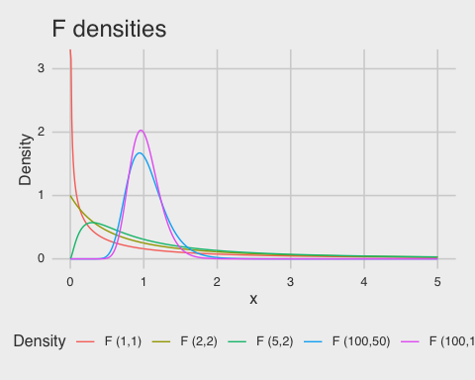
The F density: ratio of chi-squares

Slide 23
The F density: ratio of chi-squares
The F-distribution is crucial in Analysis of Variance (ANOVA), where we compare:
$$\frac{\text{Variance} \text{due} \text{to} \text{Group} \text{Differences}}{\text{Variance} \text{due} \text{to} \text{Random} \text{Variation}}$$
A high F-ratio suggests that the group means differ significantly.
A low F-ratio suggests the differences between groups could be due to chance.
For small df $(df1=df2=2),$extreme ratios like 5 are highly unlikely: Because for the ratio $\frac{Z_{1}^{2}+Z_{2}^{2}}{Z_{3}^{2}+Z_{4}^{2}}, the e$xpected value of the numerator is around 2, expected value of the denominator is around 2.
For large df, the F-ratio is much more stable: as the number of random variables in the numerator and denominator increases, the ratio approaches 1. This happens because large sample sizes make the estimates of variance more accurate, reducing fluctuations.

