Slide 1
BMI 510: Random variables
J. Lucas McKay, Ph.D., M.S.C.R.
Departments of Biomedical Informatics and Neurology, Emory University, Atlanta, GA USA
Department of Biomedical Engineering, Georgia Institute of Technology, Atlanta, GA, USA

Slide 2
Outline
Basic definition and link to probability
Introduction to random variables
Discrete
Continuous
Empirical
Density/mass functions and cumulative distribution functions
A few useful cases
Functions of random variables

Slide 3
A basic definition
A random variable is a "random" number. More specifically, it is a number whose next value cannot be predicted exactly, even if we knew all of its previous values.
Although we do not know the next value of a random variable, we typically know enough about the processes governing or generating the values of the variable that we are able to state the probabilities with which it will assume a given value or range of values.
In physics you might hear of the number of atoms of a gas in a cubic meter; in clinical contexts you might think of heart rate or the volume of a tumor.

Slide 4
The next patient who walks in the door
It is sometimes instructive to think about a random variable as a number that walks in the door of the clinic.
You know they will probably be between 1-2 meters tall. But you do not know for sure.

Slide 5
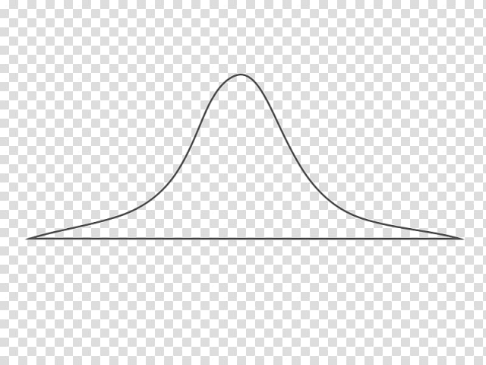
The next patient who walks in the door
It is sometimes instructive to think about a random variable as a number that walks in the door of the clinic.
You know they will probably be between 1-2 meters tall. But you do not know for sure.

Slide 6
A link from probabilities
Although heart rate, tumor size, etc. are bounded by physical laws (e.g., all must be ≥ 0), the laws are complex. A simpler way to describe a random variable is as a (random) outcome of one of the random probability experiments we discussed previously.
Consider a coin-tossing experiment with three coins. The sample space is:
$$Ω=\{hhh,hht,hth,htt,thh,tht,tth,ttt\}$$
Let's say that the random variable $H$ is the number of heads that will occur on the next experiment.
Adapted from Rice

Slide 7
The probability mass function of a discrete random variable
Outcome | H
hhh | 3
hht | 2
hth | 2
htt | 1
thh | 2
tht | 1
tth | 1
ttt | 0
It is clear that the random variable $H$ can take on only four possible values: 0, 1, 2, or 3, based on the pattern of outcomes shown.
Adapted from Rice

Slide 8
The probability mass function of a discrete random variable
Outcome | H
hhh | 3
hht | 2
hth | 2
htt | 1
thh | 2
tht | 1
tth | 1
ttt | 0
Assuming for now that all outcomes are equally likely:
$$P\left(H=3\right)=\frac{1}{8}$$
$$P\left(H=2\right)=\frac{3}{8}$$
$$P\left(H=1\right)=\frac{3}{8}$$
$$P\left(H=0\right)=\frac{1}{8}$$
Adapted from Rice

Slide 9
The probability mass function of a discrete random variable
In general, there exists some function $p$ such that
$p\left(h_{i}\right)=P(H=h_{i})$
$$\sum_{i}{p\left(h_{i}\right)=1}$$
This is called the probability mass function of $H$.

Slide 10
The probability mass function of a discrete random variable
What is $P(H=1)$?
What is $P(H=0)$?
What is $P(H=0.5)$?
What is $P(H=10)$?

Slide 11
The probability density function of a continuous random variable
Exactly analogously, for a continuous random variable $X$, in general, there exists some function $f$ such that, for (VERY) small $ε$,
$$P\left(x−\frac{ε}{2}≤X≤x+\frac{ε}{2}\right)=\int_{x−\frac{ε}{2}}^{x+\frac{ε}{2}}{f\left(u\right)du}≈εf(x)$$
$f\left(x\right)≥0$,
$\int_{x=−∞}^{x=∞}{f\left(x\right)dx}=1$.
This is called the probability density function of $X$.
Densities are not probabilities! You might think of $f(4)$ the way we would with a discrete variable, but the y axis is not bounded between 0 and 1. It is in units of probability/x.

Slide 12
Probability density functions vs. probability mass functions
Densities are not probabilities - you might think of $f(4)$ the way we would with a discrete variable, but the y axis is not bounded between 0 and 1. It is in units of probability/x.
With that said, a histogram with bin width 1 unit does indeed approximate the density – but as the bins get reduced in size the probability of the random variable being in any particular bin gets smaller and smaller.
Hence, $P(X=any particular value)$ is 0 for a continuous random variable.

Slide 13
The probability density function of a continuous random variable
Exactly analogously, for a continuous random variable $X$, in general, there exists some function $f$ such that, for (VERY) small $ε$,
$$P\left(x−\frac{ε}{2}≤X≤x+\frac{ε}{2}\right)=\int_{x−\frac{ε}{2}}^{x+\frac{ε}{2}}{f\left(u\right)du}≈εf(x)$$
$f\left(x\right)≥0$,
$\int_{x=−∞}^{x=∞}{f\left(x\right)dx}=1$.
This is called the probability density function of $X$.
Densities are not probabilities! You might think of $f(4)$ the way we would with a discrete variable, but the y axis is not bounded between 0 and 1. It is in units of probability/x.
HEIGHT
WIDTH

Slide 14
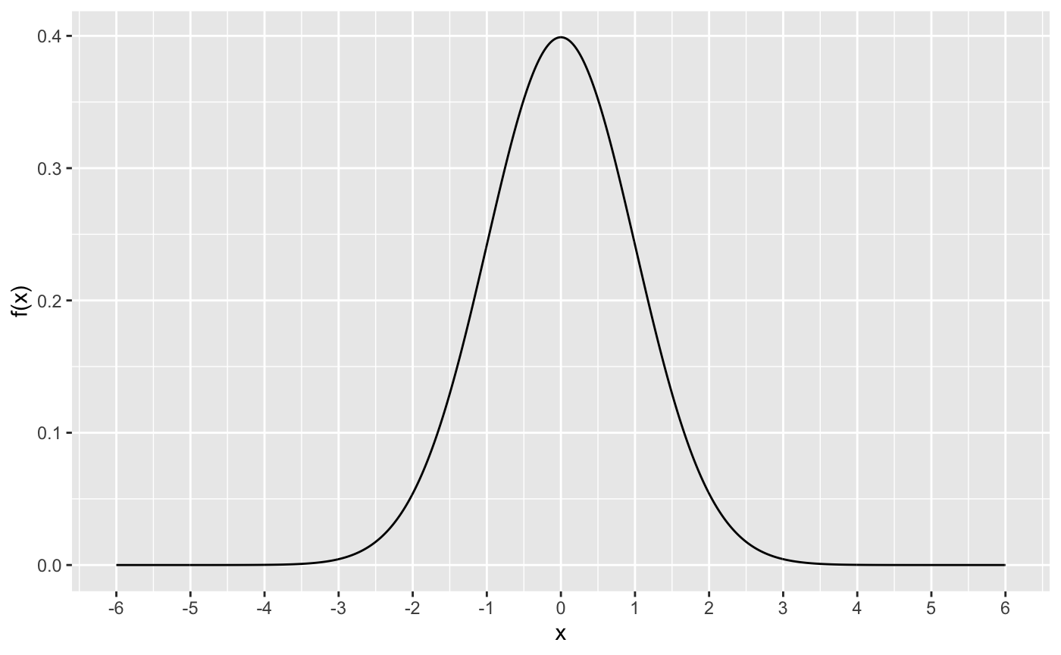
Probability density functions vs. probability mass functions

Slide 15
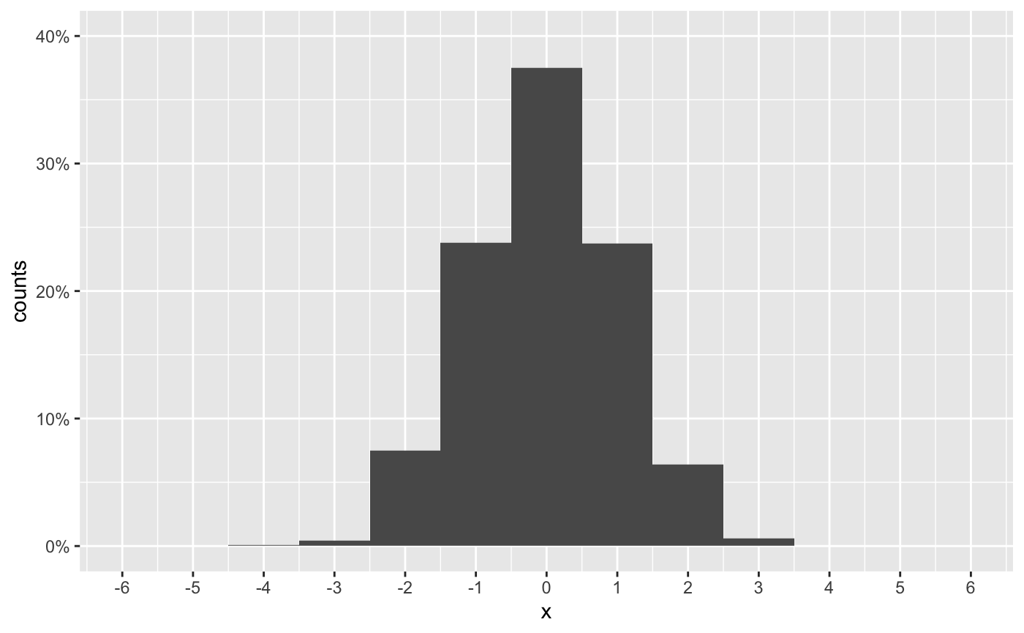
Probability density functions vs. probability mass functions
1 Unit Bins

Slide 16
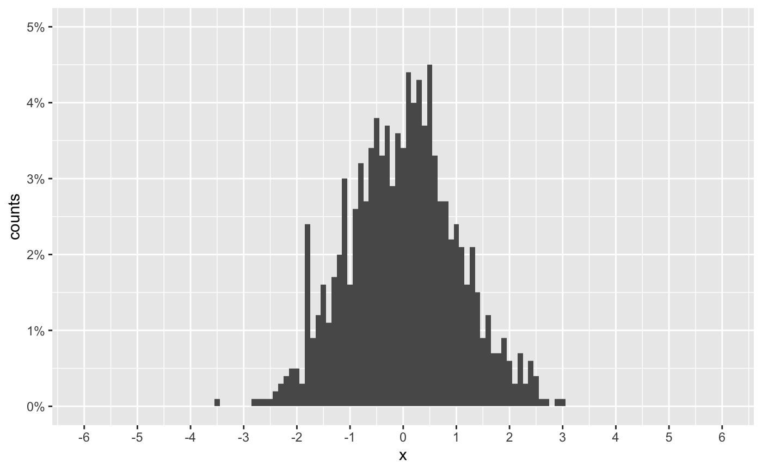
Probability density functions vs. probability mass functions
0.1 Unit Bins

Slide 17
There are many useful probability density functions for continuous variables
dnorm()
dgamma()
dbeta()
dbeta()

Slide 18
Probability density functions of continuous random variables
What is $P(x=1)$?
What is $P(x=0)$?
What is $P(x=10)$?
What is $P(x=−1)$?

Slide 19
Probability density functions of continuous random variables
What is $P(x=1)$?
0, no area under curve
What is $P(x=0)$?
0, no area under curve
What is $P(x=10)$?
≈0, no density
What is $P(x=−1)$?
0, no area under curve

Slide 20
Probability density functions of continuous random variables
What is $f(x=10)$?
≈0, no density
What is $f(x=1)$?
around 0.2
What is $f(x=0)$?
around 0.4
What is $f(x)=−1)$?
same as $f(x=1)$

Slide 21
Probability density functions of continuous random variables
What is $P(x>0)$?
What is $P(x<0)$?
What is $P(x>10)$?
What is $P(x<−10)$?

Slide 22
Probability density functions of continuous random variables
What is $P(0.9≤X≤1.1)$?
This is a slice around X=1
pnorm(1.1)-pnorm(0.9)
≈0.05
What is $P(−0.1≤X≤0.1)$?
This is the same slice around X=0
pnorm(0.1)-pnorm(-0.1)
≈0.08
≈$\frac{f\left(0\right)}{f\left(1\right)}P(0.9≤X≤1.1)$
≈(dnorm(0)/dnorm(1))(pnorm(1.1)-pnorm(0.9))
≈(dnorm(0)/dnorm(1))•0.05
≈1.6•0.05
≈0.08

Slide 23
Probability density functions of continuous random variables
What is $P(x>1)$?
0, no density
What is $P(x<0)$?
0, no density
What is $P(x<10)$?
1, all density to left
What is $P(x<−1)$?
0, no density

Slide 24
We will discuss two fundamental statistical modeling steps
Fit model parameters to data
Make inferences about models

Slide 25
Empirical probability density functions and resampling or "boostrapping"
In many practical cases we do not know the processes or rules that generate random variables we measure. (A lot of science is essentially the process of inferring those rules.)
We will discuss methods for fitting density functions to data – however, here is a good time to mention the concepts underlying "boostrapping."
"Bootstrapping" refers to an English idiom of "pulling oneself up by their boostraps" – this (clearly impossible) task implies the process of making something meaningful out of very little.

Slide 26
Empirical probability density functions and resampling or "boostrapping"
Sample
Resample with replacement
assuming the sample is an
"empirical density"
Calculate
some derived statistic
±95% CI, for example

Slide 27
Outline
Basic definition and link to probability
Introduction to random variables
Discrete
Continuous
Empirical
Densities and cumulative densities
A few useful cases
Functions of random variables

Slide 28
The cumulative distribution function of a discrete random variable
Back to our coin example, the cumulative distribution function of a random variable is often used in hypothesis testing.
In general, there exists some function $F(h)$ such that
$$F\left(h\right)=P\left(H≤h\right)$$
$$−∞<h<∞$$
That expresses the area under the mass function to the left of a given value $h$.
Adapted from Rice

Slide 29
The cumulative distribution function of a discrete random variable
In the discrete case, the relationship between the probability mass function and the cumulative density function is straightforward:
$$f(h)\overset{⇒}{cumsum\left(f(h)\right)}F(h)$$
$$f(h)\overset{⇐}{diff(F\left(h\right))}F(h)$$

Slide 30
The cumulative distribution function of a continuous random variable
In general, there exists some function $F(x)$ such that
$$F\left(x\right)=P\left(X≤x\right)=\int_{−∞}^{x}{f\left(d\right)du}$$
That expresses the area under the density function to the left of a given value $x$.
The cdf can be used to estimate the probability that $x$ falls in an interval:
$$P\left(a≤X≤b\right)=\int_{a}^{b}{f\left(x\right)dx=F\left(b\right)−F(a)}$$

Slide 31
The cumulative distribution function of a continuous random variable
In the continuous case, the relationship between the probability density function and the cumulative density function is also straightforward:
$$f(x)\overset{⇒}{integrate}F(x)$$
$$f(x)\overset{⇐}{differentiate}F(x)$$

Slide 32
The cumulative distribution function of a continuous random variable

Slide 33
Calculating the cumulative distribution of a uniform random variable
Let's say $X$ is a uniform random variable on [0,1], such that
$$f(x)=\left\{\begin{matrix}0, & X<0 \\ 1, & 0≤X≤1 \\ 0, & 1<X\end{matrix}\right.$$
What is the cumulative distribution $F(x)$?

Slide 34
Calculating the cumulative distribution of a uniform random variable
Let's say $X$ is a uniform random variable on [0,1], such that
$$f(x)=\left\{\begin{matrix}0, & X<0 \\ 1, & 0≤X≤1 \\ 0, & 1<X\end{matrix}\right.$$
What is $F\left(x\right)$ for $x>1$?
What is $F\left(x\right)$ for $x<0$?
What is $F\left(x\right)$ for $0≤x≤1$?

Slide 35
Calculating the cumulative distribution of a uniform random variable
Let's say $X$ is a uniform random variable on [0,1], such that
$$f(x)=\left\{\begin{matrix}0, & X<0 \\ 1, & 0≤X≤1 \\ 0, & 1<X\end{matrix}\right.$$
What is $F\left(x\right)$ for $x>1$?
What is $F\left(x\right)$ for $x<0$?
What is $F\left(x\right)$ for $0≤x≤1$?
$$F\left(x\right)=x$$
$$f\left(x\right)=1$$

Slide 36
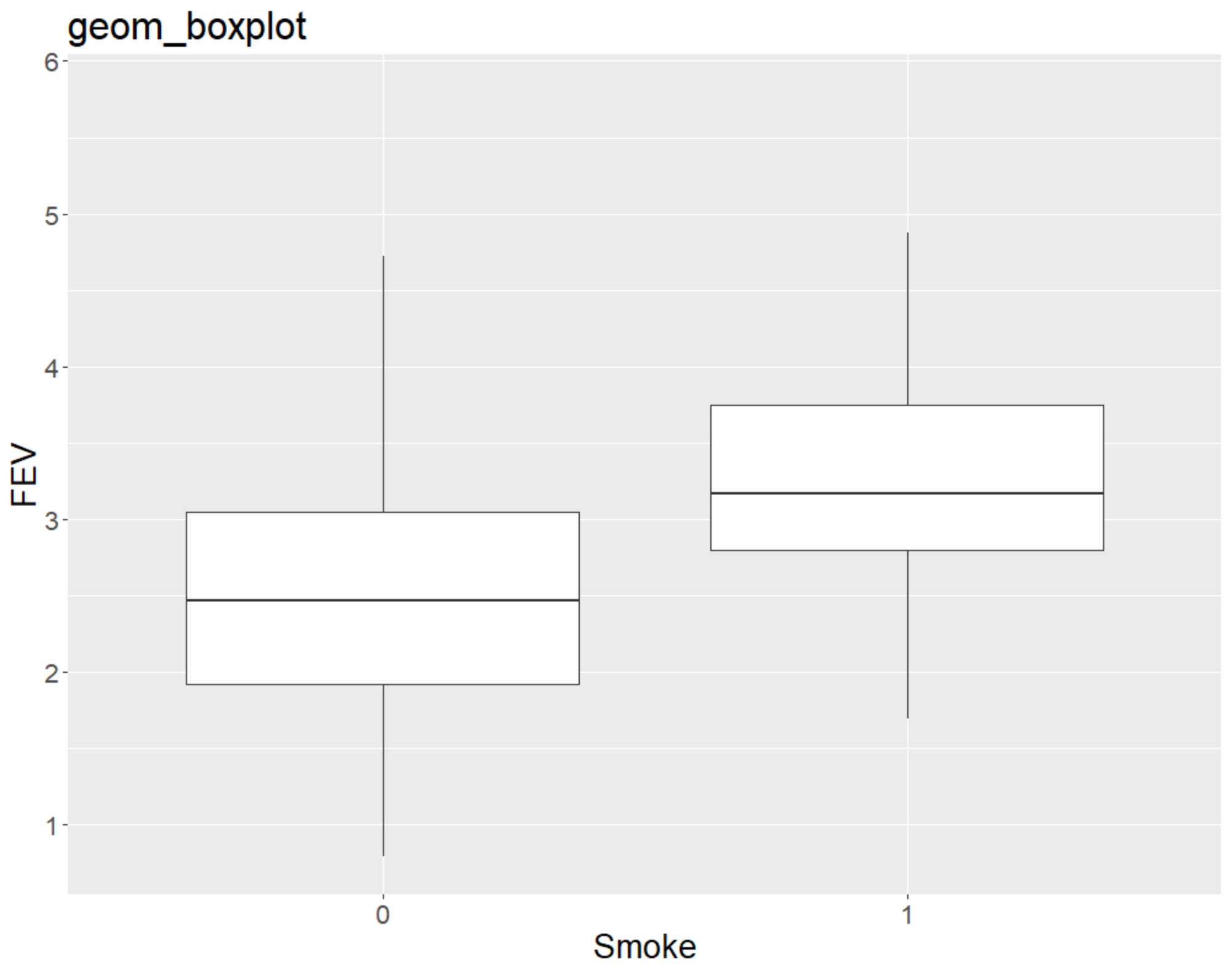
Quantiles and empirical cumulative distribution functions
For a given random variable with cumulative distribution function $F(x)$, the $p^{th}$ quantile is defined to be the value $x_{p}$ such that $F\left(x_{p}\right)=p$.
The hinges on a boxplot are the 25th and 75th percentiles; for most practical purposes quantile and percentile can be used interchangeably.
In R, ecdf() and quantile() are the relevant functions that handle ties.

Slide 37
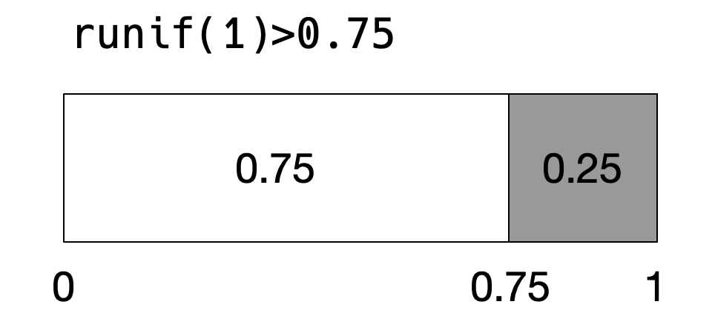
Simulating a loaded coin
If we would like to simulate flipping a coin that is not equally likely to land on heads or tails, we can do so with the uniform distribution.
The cdf of the uniform distribution within the unit interval is simply $f\left(x\right)=x$, so we can set the loaded coin to an arbitrary value.

Slide 38
True or false
The maximum value of a probability density function must be ≤ 1.
The area of a histogram == the number of samples in the data.
A histogram can be normalized into a density by dividing by the maximum number of samples in any of the bins.
If $X\sim U(0,1)$ then $p(−1)$ is undefined.

Slide 39
Outline
Basic definition and link to probability
Introduction to random variables
Discrete
Continuous
Empirical
Densities and cumulative densities
A few useful cases
Functions of random variables

Slide 40
Back to coin flips
A Bernoulli trial is a random experiment with exactly two outcomes, success and failure. It is basically a coin flip.
The probability of a success is $p$. The probability of a failure, therefore, is $1−p$.
Each flip is independent.
So among three flips, the probability of obtaining the pattern success, failure, success is: $p\left(1−p\right)p$.
Note that the probability of obtaining exactly two successes among three flips is:
$\left(1−p\right)pp+p\left(1−p\right)p+pp\left(1−p\right)$

Slide 41
The binomial density
The number of successes among $n$ independent Bernoulli trials, where each trial has probability of "success" $p$ and probability of failure $1−p$, is a binomial random variable with parameters $n$ and $p$.
Any particular pattern of $k$ successes occurs with probability $p^{k}{(1−p)}^{n−k}$; since there are $\left(\begin{matrix}n \\ k\end{matrix}\right)$ ways to assign the successes:
$$p\left(k\right)=\left(\begin{matrix}n \\ k\end{matrix}\right)p^{k}{(1−p)}^{n−k}$$

Slide 42
The geometric and negative binomial densities
The geometric density describes a series of $(k−1)$ independent failures followed by a single success, for a total of $k$ Bernoulli trials.
Since there is only one possible order:
$$p\left(k\right)={(1−p)}^{k−1}p$$
Shown to the right is a geometric distribution for p=1/10. Let's say that's the success probability of a lottery ticket. What's the probability you'll have to buy more than one ticket to win?

Slide 43
The geometric and negative binomial densities
The negative binomial distribution density a series composed of $(k−r)$ failures with $r$ successes, of which the last is a success.
This shows up very commonly in outcomes research, for frequencies of events like falls or heart attacks.
$$X\sim NB(r,p)$$
This is essentially a binomial distribution multiplied by a geometric distribution:
$$p\left(k\right)={\left(\begin{matrix}k−1 \\ r−1\end{matrix}\right)(1−p)}^{k−r}p^{r}$$

Slide 44
The Poisson density
The Poisson density is very useful both as an approximation to the binomial distribution (n choose k used to be prohibitive) and a density in its own right.
It has only one parameter $λ$, and represents many natural processes well.
$$p\left(k\right)=\frac{λ^{k}}{k!}e^{−λ}$$
It can approximate the binomial distribution with $λ=np$ for large n and small p. What is $λ$ in this case?

Slide 45
The Poisson process as a rate
We will see later that both the mean and variance of a Poisson process are equal to the parameter $λ$, which is in units of number of events.
It is common to see the parameter expressed as:
$$λ=r\frac{events}{time}×time$$
In this case, if a call center receives a call every 12 minutes on average, how many can we expect in 30 minutes?
$$λ=\frac{1 call}{12 minutes}×30 minutes=2.5 events$$

Slide 46
The exponential density
The exponential density (-ies) are often used to model time data like lifetimes or waiting times.
Note these are non-negative.
It has only one parameter $λ$, and represents many natural processes well similar to Poisson.
$$f\left(t\right)=\left\{\begin{matrix}λe^{−λt}, & t≥0 \\ 0, & t<0\end{matrix}\right.$$

Slide 47
The normal density
All of the previous densities we examined in depth were for non-negative data like numbers of events or time to failure.
For a large class of physiological measurements, the random variables can take on any value among the real numbers.
The fundamental density we will use for these data is the normal density, parameterized by mean $μ$ and standard deviation $σ$.
$$f\left(x\right)=\frac{1}{σ\sqrt{2π}}e^{{−{(x−μ)}^{2}}/{2σ^{2}}}$$

Slide 48
The cumulative distribution of the normal density
The cumulative distribution of the standard normal is:
$$Φ\left(x\right)= \frac{1}{\sqrt{2π}}\int_{−∞}^{x}{e^{{−t^{2}}/2}dt}$$

Slide 49
Exercises with cumulative distribution functions
As we mentioned earlier, the cdf can be used to estimate the probability that $x$ falls in an interval:
$$P\left(a≤X≤b\right)=\int_{a}^{b}{f\left(x\right)dx=F\left(b\right)−F(a)}$$
So the probability that $X<−1σ$ is $Φ(−1)$.
What is the probability that $X>2σ$? It is usually easier to calculate
$$1−Φ(2)$$

Slide 50
Outline
Basic definition and link to probability
Introduction to random variables
Discrete
Continuous
Empirical
Densities and cumulative densities
A few useful cases
Functions of random variables

Slide 51
Functions of random variables
Let's call the cumulative distribution functions of two variables $X$ and $Y$ $F_{X}$ and $F_{Y}$, respectively.
Let's say that $X\sim N(μ,σ^{2})$, and $Y=aX+b$, for $a>0$.
$F_{Y}\left(y\right)=P\left(Y≤y\right)$
$F_{Y}\left(y\right)=P\left(aX+b≤y\right)$
$F_{Y}\left(y\right)=P\left(X≤\frac{y−b}{a}\right)$
$F_{Y}\left(y\right)=F_{X}\left(X≤\frac{y−b}{a}\right)$
Recalling that the density is the derivative of the cumulative distribution,
$f_{Y}\left(y\right)=\frac{d}{dx}F_{X}\left(X≤\frac{y−b}{a}\right)=\frac{1}{a}f_{x}\left(\frac{y−b}{a}\right)$

Slide 52
Functions of random variables
In general, if $X\sim N(μ,σ^{2})$, and $Y=aX+b$,
$$Y\sim N(aμ+b,a^{2}σ^{2})$$
Note that this expression really refers to a change of variables - there is no additional error attributed to the transformation between $X$ and $Y$.

Slide 53
Functions of random variables
An arguably more common problem is when we have a function of multiple random variables.
We have not discussed expected values, but for now note the contrast between "function" as defined on the last slide and the expected value of the sum of two random variables $X$ and $Y$:
$$E\left(X+Y\right)=E\left(X\right)+E\left(Y\right)$$
$$Var\left(X+Y\right)=Var\left(X\right)+Var\left(Y\right)+2Cov(X,Y)$$

Slide 54
Outline
Basic definition and link to probability
Introduction to random variables
Discrete
Continuous
Empirical
Densities and cumulative densities
A few useful cases
Functions of random variables

Slide 55
Reference material on random variables from Neter textbook

Slide 56
Random variables
Expected value
Let $Y$ assume outcomes $Y_{1},⋯,Y_{k}$ with probabilities given by
$$f\left(Y_{s}\right)=P\left(Y=Y_{s}\right)$$
The expected value is defined:
$$E\left(Y\right)=\sum_{s=1}^{k}{Y_{s}{f(Y}_{s}) }$$
Note that where $a,c$ are constants,
$$E\left(a+cY\right)=a+cE(Y)$$
Neter

Slide 57
Random variables
Variance
The variance of random variable $Y$ is:
$$σ^{2}\left(Y\right)=E\{{\left[Y−E\left(Y\right)\right]}^{2}\}$$
or, equivalently (important!),
$$σ^{2}\left(Y\right)=E\left(Y^{2}\right)−{\left[E\left(Y\right)\right]}^{2}$$
Neter

Slide 58
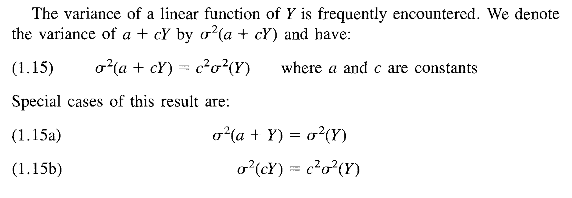
Random variables
Variance special cases
Neter

Slide 59
Random variables
Covariance
The covariance of $Y$ and $Z$ is:
$$σ\left(Y,Z\right)=E\{\left[Y−E\left(Y\right)\right]\left[Z−E\left(Z\right)\right]\}$$
Or, equivalently:
$$σ\left(Y,Z\right)=E\left(YZ\right)−[E\left(Y\right)][E\left(Z\right)]$$
Note that$σ^{2}\left(Y\right)=σ\left(Y,Y\right).$
For constants $a,b,c,d$,
$$σ\left(a+bY,c+dZ\right)=bdσ\left(Y, Z\right)$$
Neter

Slide 60
Random variables
Independence
Neter

