Slide 1

BMI 510: Probability
J. Lucas McKay, Ph.D., M.S.C.R.
Departments of Biomedical Informatics and Neurology, Emory University, Atlanta, GA USA
Department of Biomedical Engineering, Georgia Institute of Technology, Atlanta, GA, USA
Selen Bozkurt, Ph.D., M.Sc.
Departments of Biomedical Informatics, Emory University, Atlanta, GA USA

Slide 2
Outline
Basic definitions and results in probabilities (and odds)
Bayes’ rule
Check for time
Directed acyclic graphs (DAG) as representations of probabilities

Slide 3
Basic definitions and results in probabilities

Slide 4
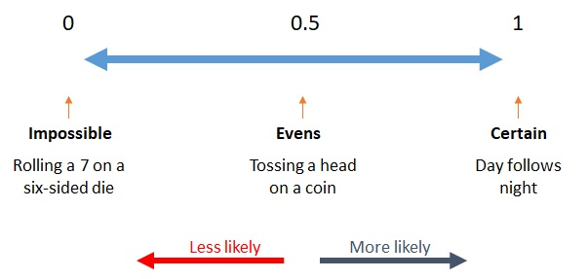
A definition of probability
A probability is a numerical parameter signifying the degree of belief in a given proposition under some body of knowledge.
Source: https://www.mathematics-monster.com/lessons/probability_about_probability.html
Pearl, 1988

Slide 5
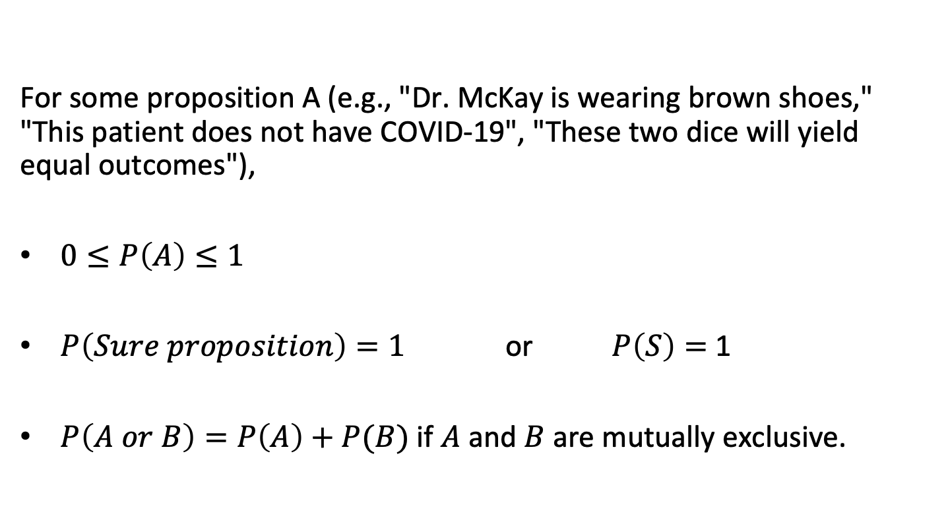
The three basic axioms of probability
For some proposition A (e.g., "Dr. McKay is wearing brown shoes," "This patient does not have COVID-19", "These two dice will yield equal outcomes"),
$0≤P\left(A\right)≤1$
$P\left(Sure proposition\right)=1$ or $P\left(S\right)=$ 1
$P\left(A or B\right)=P\left(A\right)+P(B)$ if $A$ and $B$ are mutually exclusive.
Pearl, 1988
Notes:
The three axioms ensure probabilities are logical

Slide 6
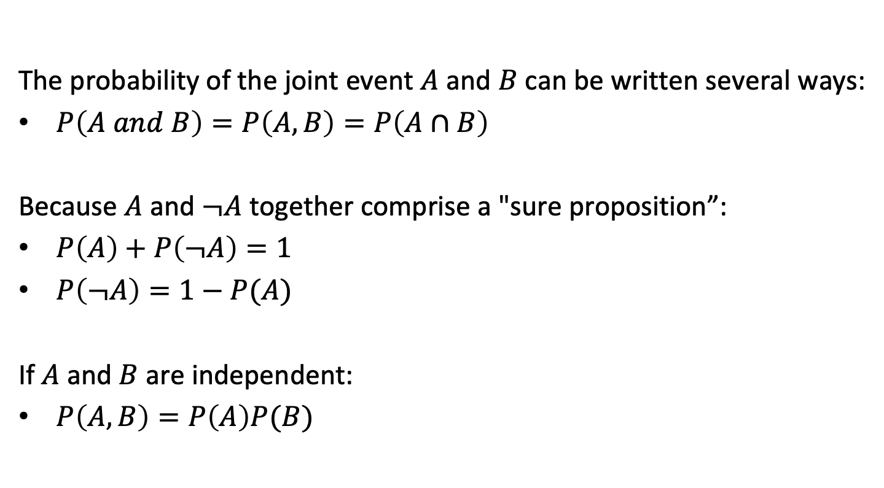
Additional rules
The probability of the joint event $A$ and $B$ can be written several ways:
$P\left(A and B\right)=P\left(A,B\right)=P\left(A∩B\right)$
Because $A$ and $¬A$ together comprise a "sure proposition”:
$P\left(A\right)+P\left(¬A\right)=1$
$P\left(¬A\right)=1−P(A)$
If $A$ and $B$ are independent:
$P\left(A,B\right)=P\left(A\right)P(B)$
Pearl, 1988

Slide 7
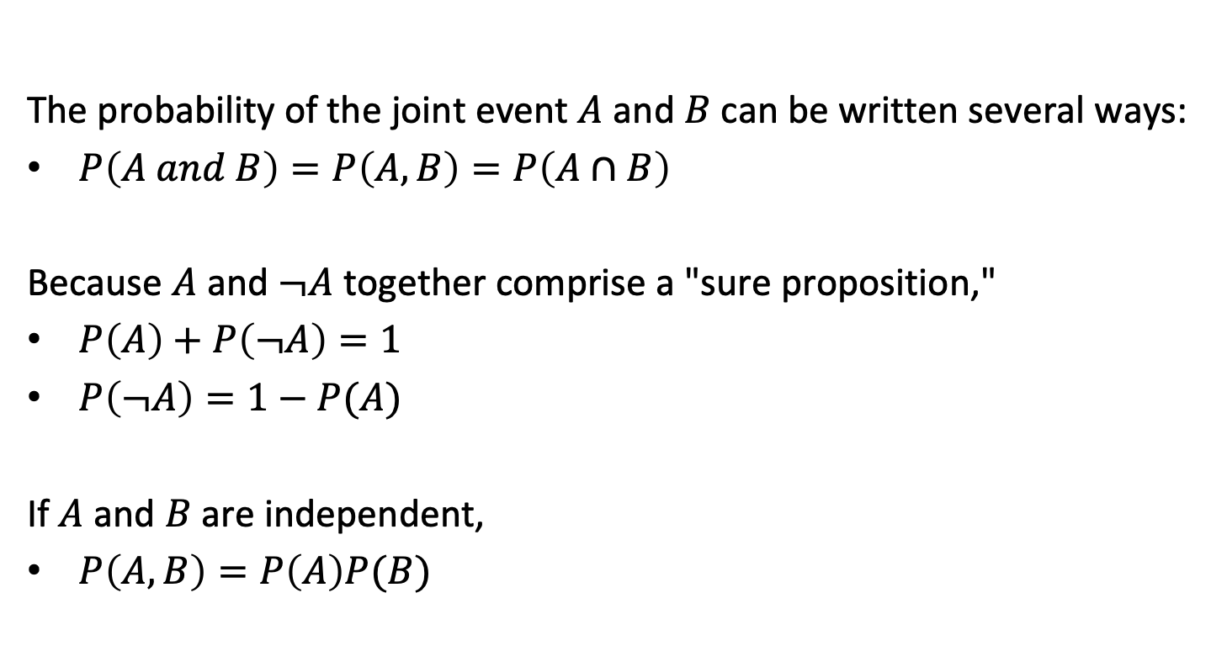
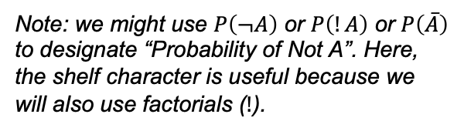
Additional rules
The probability of the joint event $A$ and $B$ can be written several ways:
$P\left(A and B\right)=P\left(A,B\right)=P\left(A∩B\right)$
Because $A$ and $¬A$ together comprise a "sure proposition,"
$P\left(A\right)+P\left(¬A\right)=1$
$P\left(¬A\right)=1−P(A)$
If $A$ and $B$ are independent,
$P\left(A,B\right)=P\left(A\right)P(B)$
Note: we might use $P\left(¬A\right)$ or $P\left(!A\right)$ or $P\left(\overline{A}\right)$ to designate “Probability of Not A”. Here, the shelf character is useful because we will also use factorials ($!$).
Pearl, 1988
Notes:
flipping a coin and rolling a die.

Slide 8
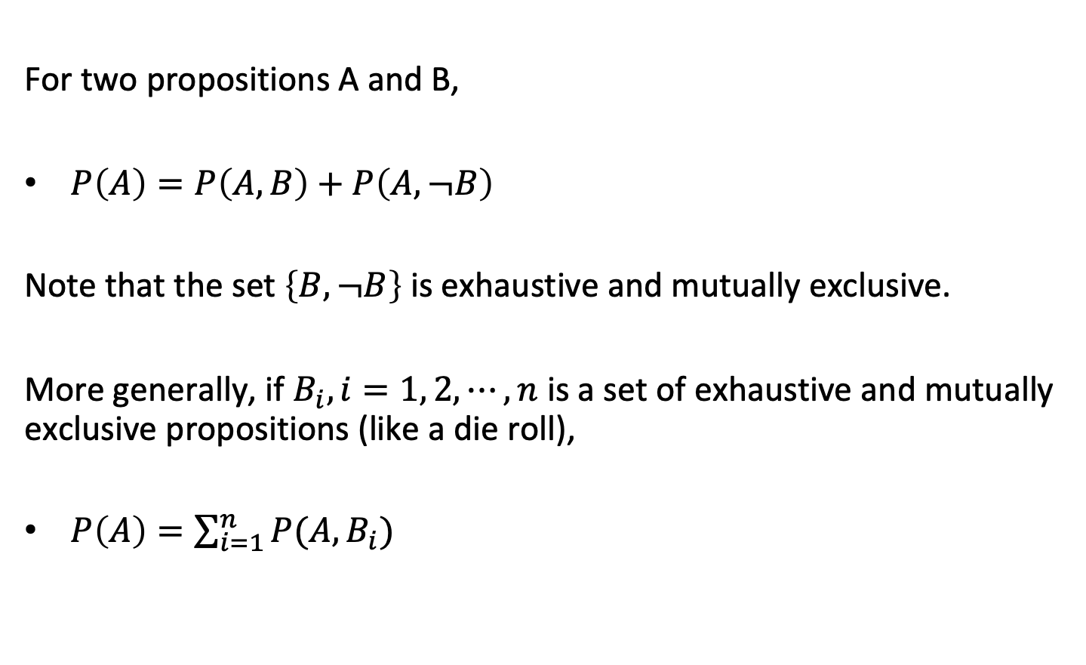
The rule of total probability
For two propositions A and B,
$P\left(A\right)=P\left(A,B\right)+P\left(A,¬B\right)$
Note that the set $\left\{B,¬B\right\}$ is exhaustive and mutually exclusive.
More generally, if $B_{i}, i=1, 2, ⋯,n$ is a set of exhaustive and mutually exclusive propositions (like a die roll),
$P\left(A\right)=\sum_{i=1}^{n}{P(A,B_{i})}$
Pearl, 1988

Slide 9
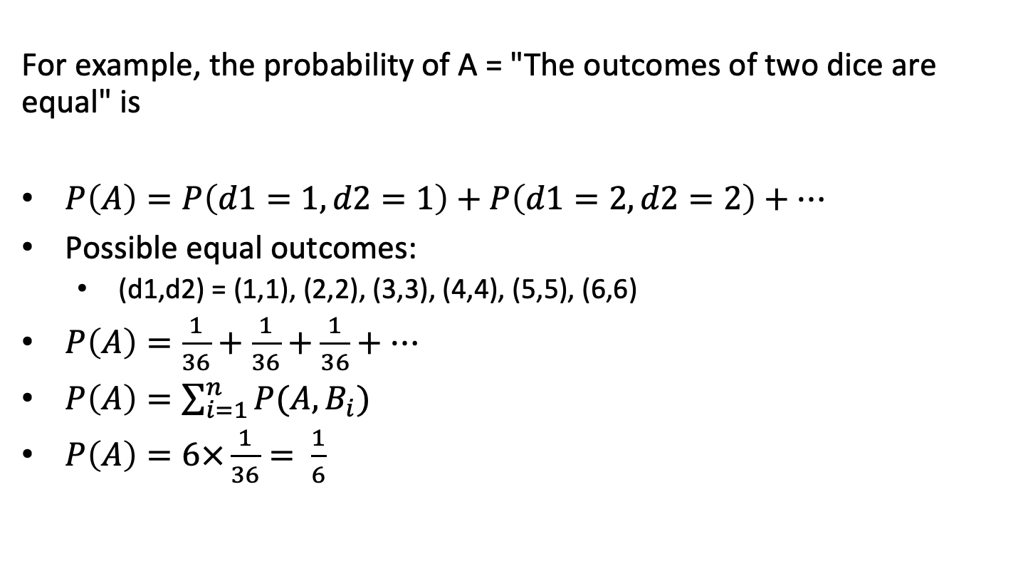
A dice example
For example, the probability of A = "The outcomes of two dice are equal" is
$P\left(A\right)=P\left(d1=1,d2=1\right)+P\left(d1=2,d2=2\right)+⋯$
Possible equal outcomes:
  (d1,d2) = (1,1), (2,2), (3,3), (4,4), (5,5), (6,6)
$P\left(A\right)=\frac{1}{36}+\frac{1}{36}+\frac{1}{36}+⋯$
$P\left(A\right)=\sum_{i=1}^{n}{P(A,B_{i})}$
$P\left(A\right)=6×\frac{1}{36}= \frac{1}{6}$
Pearl, 1988

Slide 10
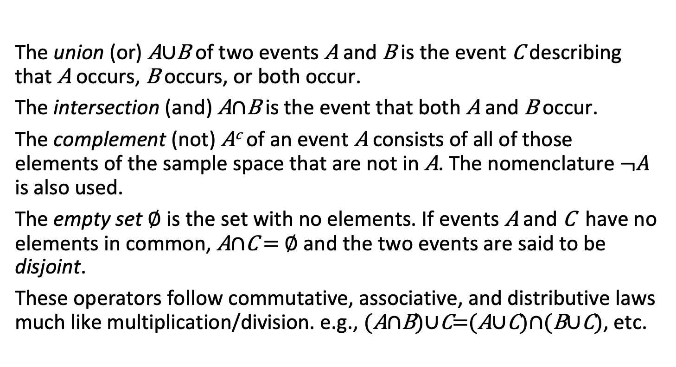
Combining events
The union (or) A$∪$B of two events A and B is the event C describing that A occurs, B occurs, or both occur.
The intersection (and) A$∩$B is the event that both A and B occur.
The complement (not) A^{c} of an event A consists of all of those elements of the sample space that are not in A. The nomenclature $¬A$ is also used.
The empty set $∅$ is the set with no elements. If events A and C have no elements in common, A$∩$C = $∅$ and the two events are said to be disjoint.
These operators follow commutative, associative, and distributive laws much like multiplication/division. e.g., (A$∩$B)$∪$C=(A$∪$C)$∩$(B$∪$C), etc.
Rice

Slide 11
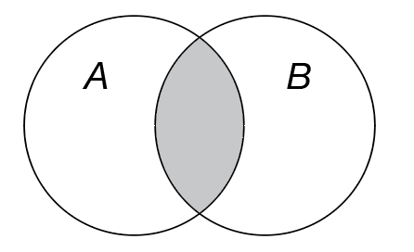
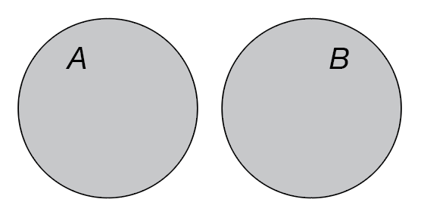
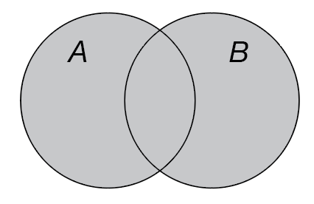
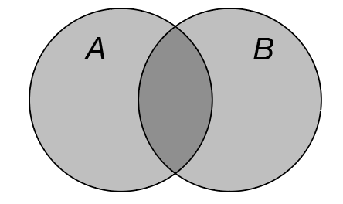



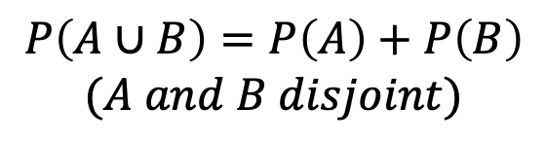
Combining events
$$A∩B$$
$$P\left(A∪B\right)=P\left(A\right)+P\left(B\right)$$
$$(A and B disjoint)$$
$$A∪B$$
$$P\left(A∪B\right)=P\left(A\right)+P\left(B\right)−P(A∩B)$$

Slide 12
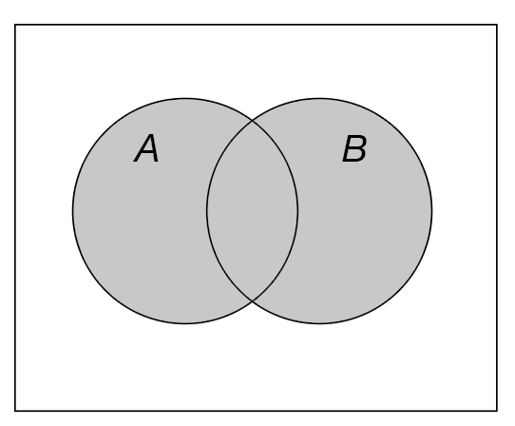
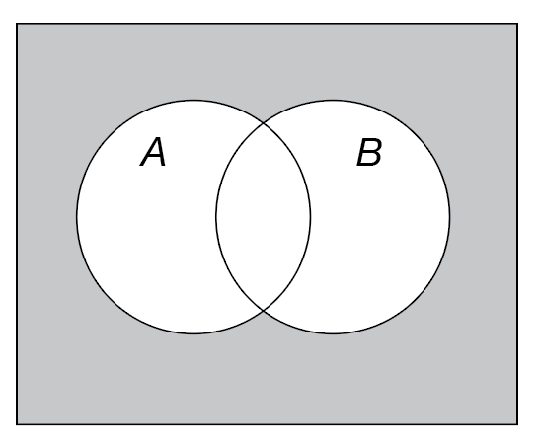


Combining events
$$A∪B$$
$$¬\left(A∪B\right)=¬A∩¬B$$

Slide 13
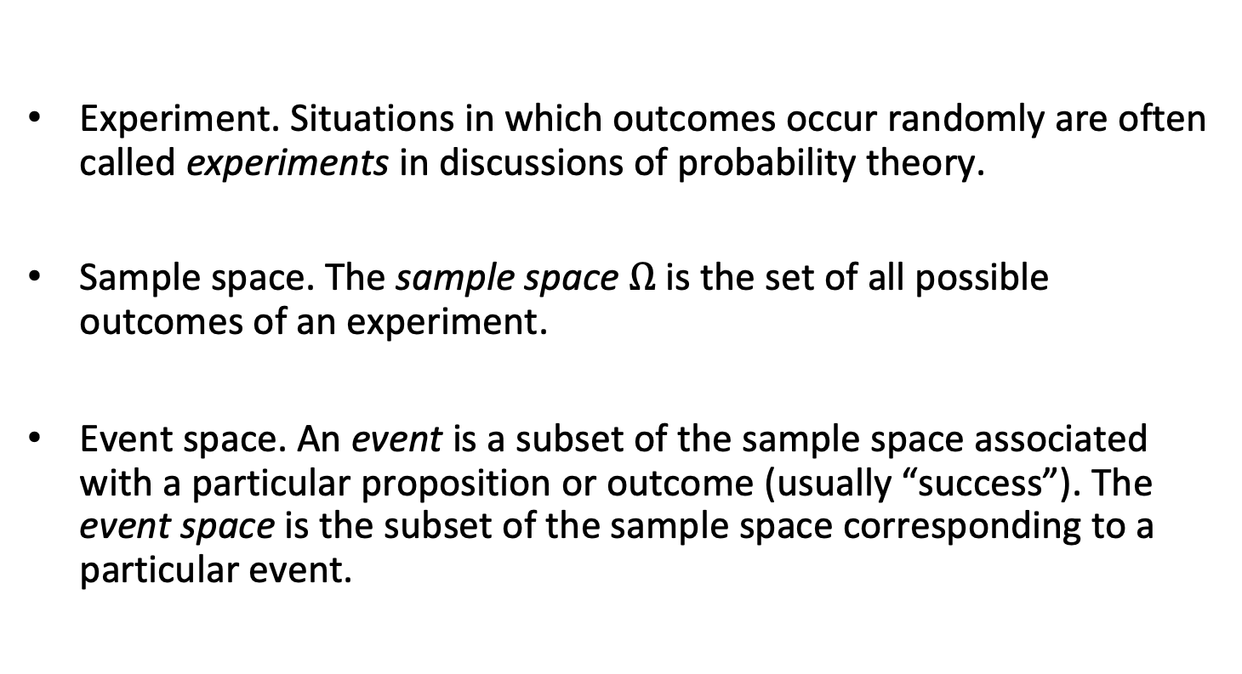
More definitions from classical probability
Experiment. Situations in which outcomes occur randomly are often called experiments in discussions of probability theory.
Sample space. The sample space $Ω$ is the set of all possible outcomes of an experiment.
Event space. An event is a subset of the sample space associated with a particular proposition or outcome (usually “success”). The event space is the subset of the sample space corresponding to a particular event.
Rice

Slide 14
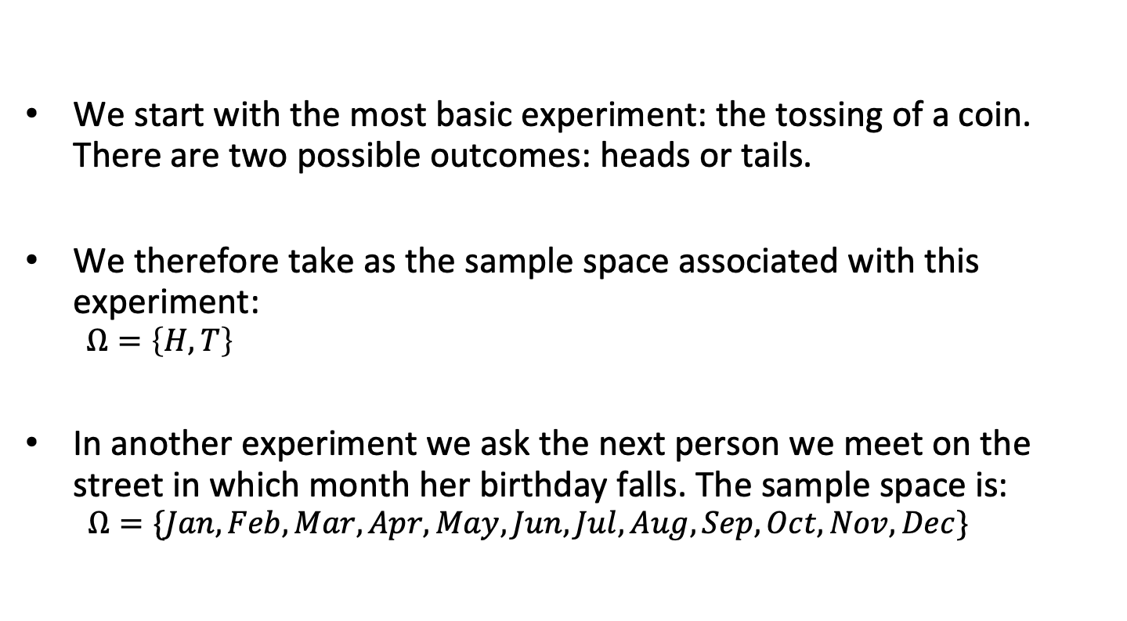
Discrete sample spaces
We start with the most basic experiment: the tossing of a coin. There are two possible outcomes: heads or tails.
We therefore take as the sample space associated with this experiment:
  $$Ω=\left\{H,T\right\}$$
In another experiment we ask the next person we meet on the street in which month her birthday falls. The sample space is:
  $$Ω=\{Jan,Feb,Mar,Apr,May,Jun,Jul,Aug,Sep,Oct,Nov,Dec\}$$
Dekking
Notes:
rolling a die

Slide 15
Permutations of discrete sample spaces
In another experiment, we find on our doormat three envelopes, sent to us by three different persons, and we look in which order the envelopes lie on top of each other. Coding them 1, 2, and 3, what would the sample space be?
What about four persons?
Dekking

Slide 16
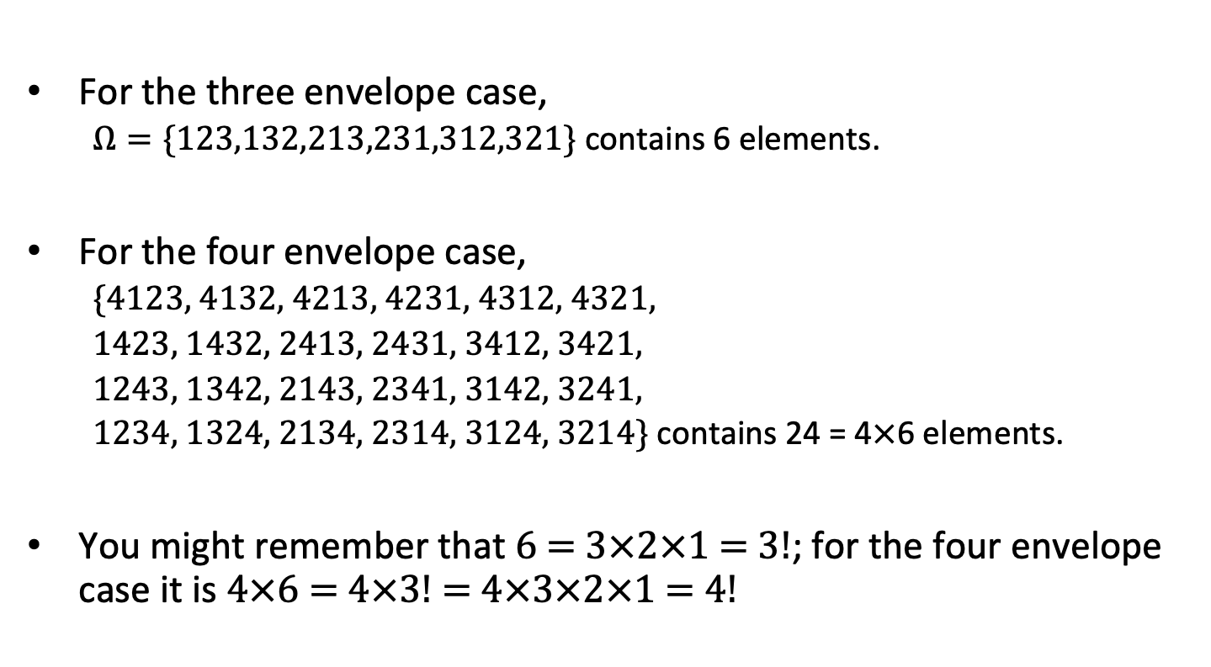
Permutations of discrete sample spaces
For the three envelope case,
  $Ω=\{123,132,213,231,312,321\}$ contains 6 elements.
For the four envelope case,
  {4123, 4132, 4213, 4231, 4312, 4321,
  1423, 1432, 2413, 2431, 3412, 3421,
  1243, 1342, 2143, 2341, 3142, 3241,
  1234, 1324, 2134, 2314, 3124, 3214} contains 24 = 4$×$6 elements.
You might remember that 6 = 3$×$2$×$1 = 3!; for the four envelope case it is 4$×$6 = 4$×$3! = 4$×$3$×$2$×$1 = 4!
Dekking
Notes:
Can you think of other scenarios where permutations like these might come up? For example, arranging books on a shelf or assigning tasks to people.

Slide 17
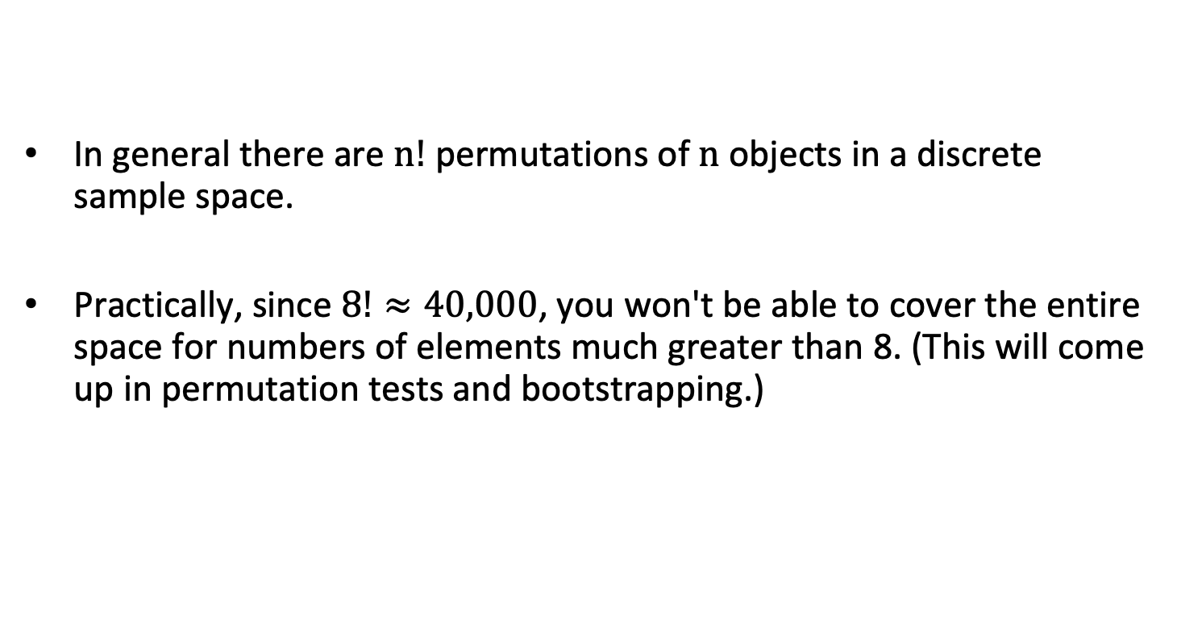
Permutations of discrete sample spaces
In general there are $n!$ permutations of $n$ objects in a discrete sample space.
Practically, since $8!≈40,000$, you won't be able to cover the entire space for numbers of elements much greater than 8. (This will come up in permutation tests and bootstrapping.)
Dekking

Slide 18
Events in discrete sample spaces
A commuter passes through a sequence of three intersections with traffic lights. At each light, she either stops, s, or continues, c. What is the sample space?
Rice

Slide 19
Events in discrete sample spaces
A commuter passes through a sequence of three intersections with traffic lights. At each light, she either stops, s, or continues, c. What is the sample space?
Ω = {ccc,ccs,csc,css,scc,scs,ssc,sss}
Rice

Slide 20
Events in discrete sample spaces
Carrying on with the commuter example, if the "Event" S might be that the commuter makes all of the lights, it corresponds to this subset:
Ω = {ccc,ccs,csc,css,scc,scs,ssc,sss}
If the event M corresponds to making at least two (most) of the lights, it corresponds to the subset:
Ω = {ccc,ccs,csc,css,scc,scs,ssc,sss}
Assuming that all 8 outcomes are equally likely, what are P(S) and P(M)?

Slide 21
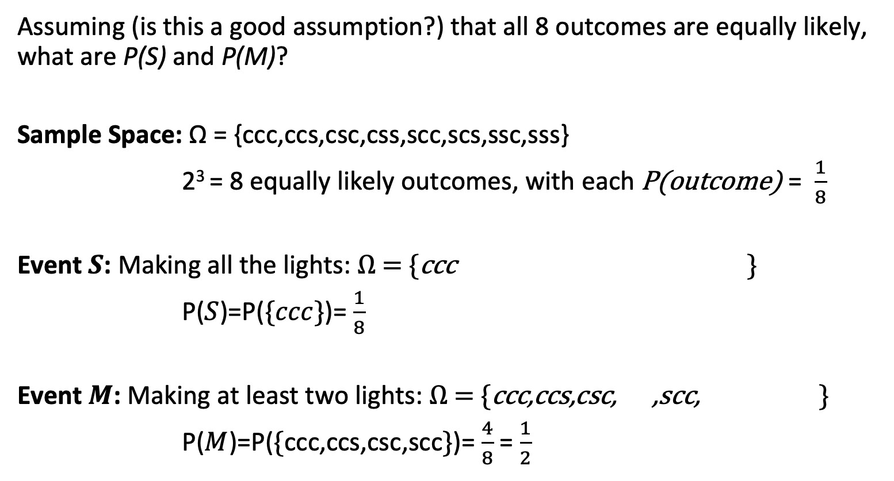
Events in discrete sample spaces
Assuming (is this a good assumption?) that all 8 outcomes are equally likely, what are P(S) and P(M)?
Sample Space: Ω = {ccc,ccs,csc,css,scc,scs,ssc,sss}
2³ = 8 equally likely outcomes, with each P(outcome) = $\frac{1}{8}$
Event $S$: Making all the lights: Ω = {ccc,ccs,csc,css,scc,scs,ssc,sss}
P($S$)=P($\{ccc\}$)= $\frac{1}{8}$
Event $M$: Making at least two lights: Ω = {ccc,ccs,csc,css,scc,scs,ssc,sss}
P($M$)=P($\{\text{ccc}\text{,}\text{ccs}\text{,}\text{csc}\text{,}\text{scc}\}$)= $\frac{4}{8}$ = $\frac{1}{2}$
Notes:
Can you think of a scenario where outcomes might not be equally likely, and how that would change our calculations?

Slide 22
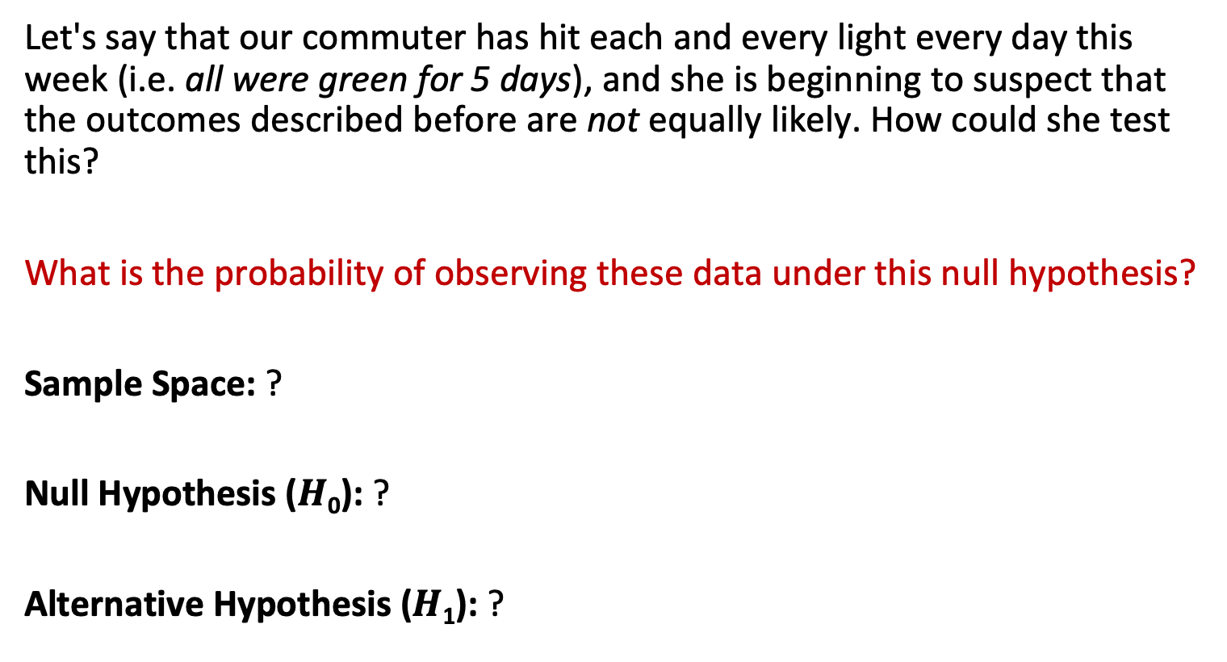
Events in discrete sample spaces
Testing the Null Hypothesis for Unequal Outcomes
Let's say that our commuter has hit each and every light every day this week (i.e. all were green for 5 days), and she is beginning to suspect that the outcomes described before are not equally likely. How could she test this?
What is the probability of observing these data under this null hypothesis?
Sample Space: ?
Null Hypothesis ($H$₀): ?
Alternative Hypothesis ($H$₁​): ?

Slide 23
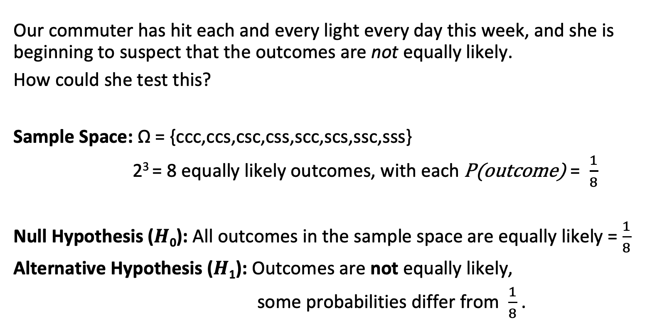
Events in discrete sample spaces
Testing the Null Hypothesis for Unequal Outcomes
Our commuter has hit each and every light every day this week, and she is beginning to suspect that the outcomes are not equally likely.
How could she test this?
Sample Space: Ω = {ccc,ccs,csc,css,scc,scs,ssc,sss}
2³ = 8 equally likely outcomes, with each P(outcome) = $\frac{1}{8}$
Null Hypothesis ($H$₀): All outcomes in the sample space are equally likely = $\frac{1}{8}$​
Alternative Hypothesis ($H$₁​): Outcomes are not equally likely,
some probabilities differ from $\frac{1}{8}$​​.

Slide 24
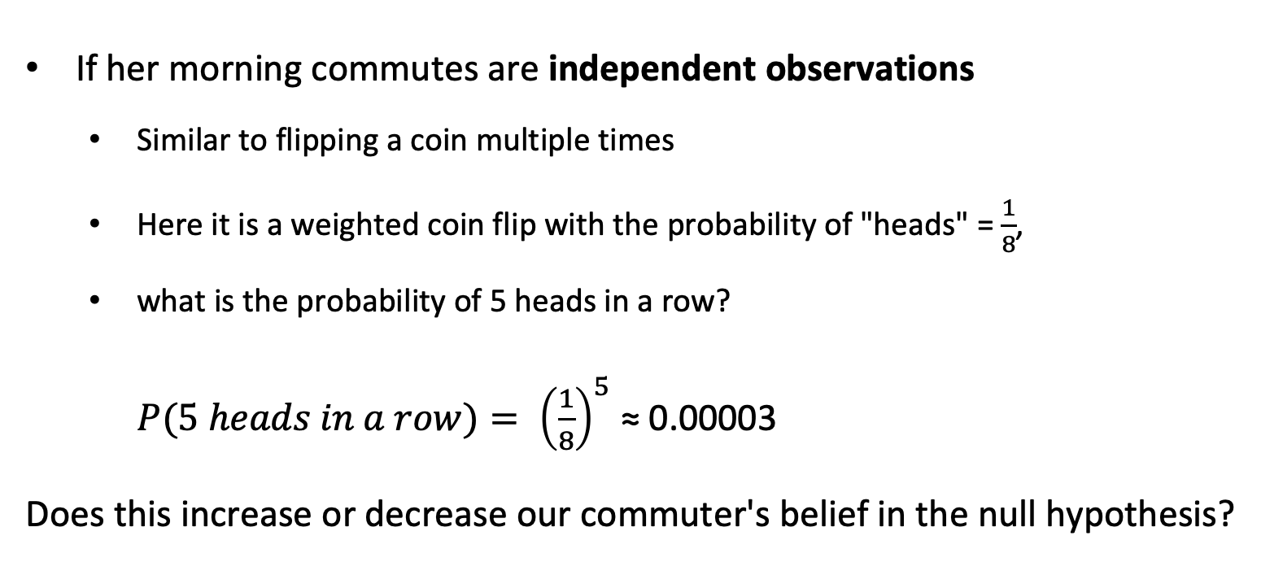
Events in discrete sample spaces
Testing the Null Hypothesis for Unequal Outcomes
If her morning commutes are independent observations
  Similar to flipping a coin multiple times
  Here it is a weighted coin flip with the probability of "heads" = $\frac{1}{8}$,
  what is the probability of 5 heads in a row?
$P(5 heads in a row)= {\left(\frac{1}{8}\right)}^{5}$ ≈ 0.00003
Does this increase or decrease our commuter's belief in the null hypothesis?
Note: This type of experiment is called a "Bernoulli trial," where there are a series of independent (weighted) coin flips with the same probability of success each time.

Slide 25
Preview of likelihood
One of the main reasons we study probability is its application in likelihood, which allows us to connect observed data with the parameters of a model.
Joint probability of a set of events occurring together; like hitting any 3/4 lights or similar.
Likelihood is the probability of data (say, a series like ¾, ¾, ¼, ¾, ¼ lights over a week) given a parameter (say, the probability of hitting a single light).

Slide 26
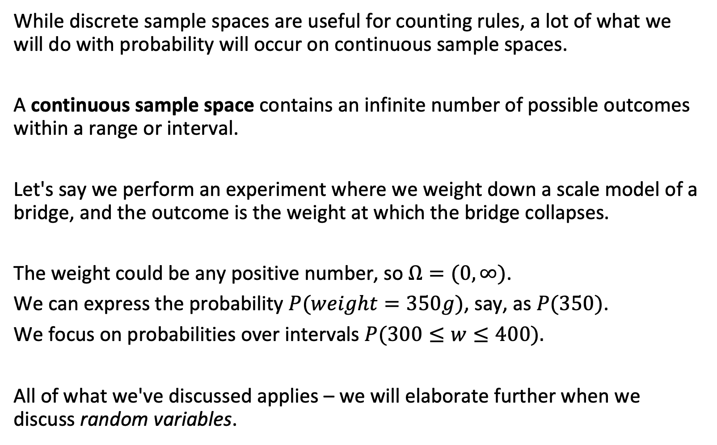
Continuous sample spaces
While discrete sample spaces are useful for counting rules, a lot of what we will do with probability will occur on continuous sample spaces.
A continuous sample space contains an infinite number of possible outcomes within a range or interval.
Let's say we perform an experiment where we weight down a scale model of a bridge, and the outcome is the weight at which the bridge collapses.
The weight could be any positive number, so $Ω=(0,∞)$.
We can express the probability $P(weight=350g)$, say, as $P(350)$.
We focus on probabilities over intervals $P(300≤w≤400).$
All of what we've discussed applies – we will elaborate further when we discuss random variables.
Dekking

Slide 27
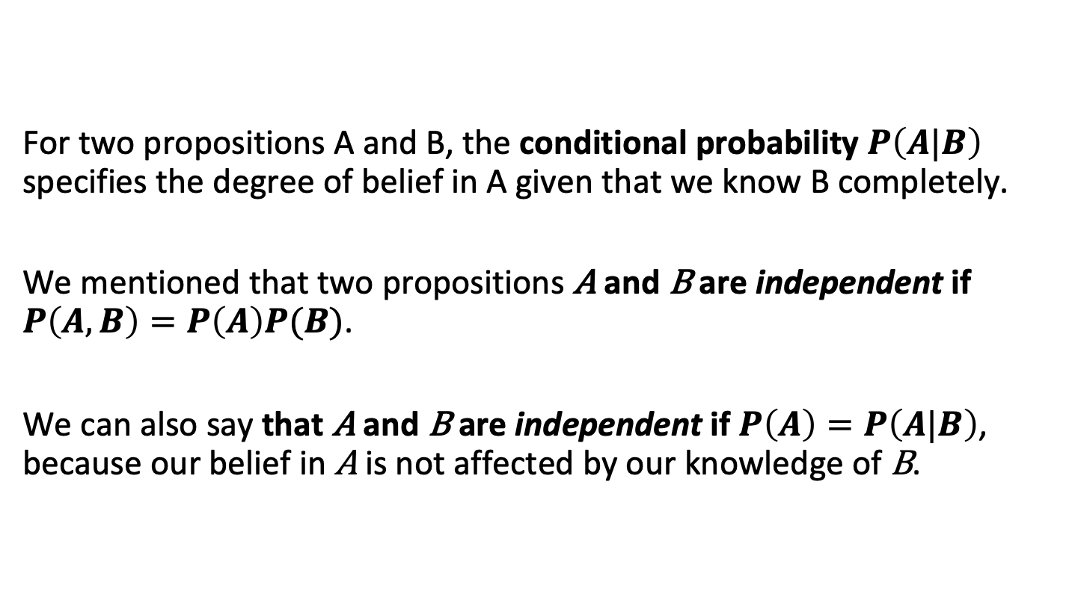
Conditional probabilities and independence
For two propositions A and B, the conditional probability $P\left(A|B\right)$ specifies the degree of belief in A given that we know B completely.
We mentioned that two propositions A and B are independent if $P\left(A,B\right)=P\left(A\right)P(B)$.
We can also say that A and B are independent if $P\left(A\right)=P\left(A|B\right)$, because our belief in A is not affected by our knowledge of B.
Pearl, 1988

Slide 28
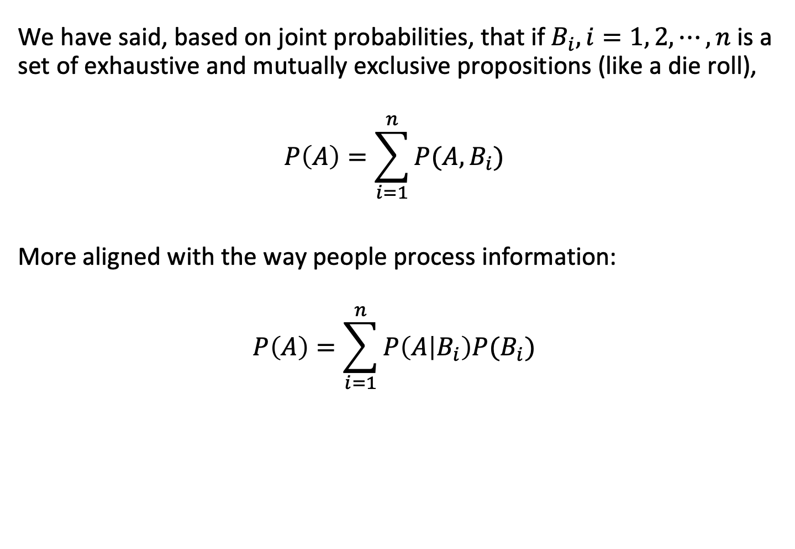
Conditional probabilities and total probability
We have said, based on joint probabilities, that if $B_{i}, i=1, 2, ⋯,n$ is a set of exhaustive and mutually exclusive propositions (like a die roll),
$$P\left(A\right)=\sum_{i=1}^{n}{P(A,B_{i})}$$
More aligned with the way people process information:
$$P\left(A\right)=\sum_{i=1}^{n}{P\left(A | B_{i}\right)P(B_{i})}$$
Pearl, 1988

Slide 29
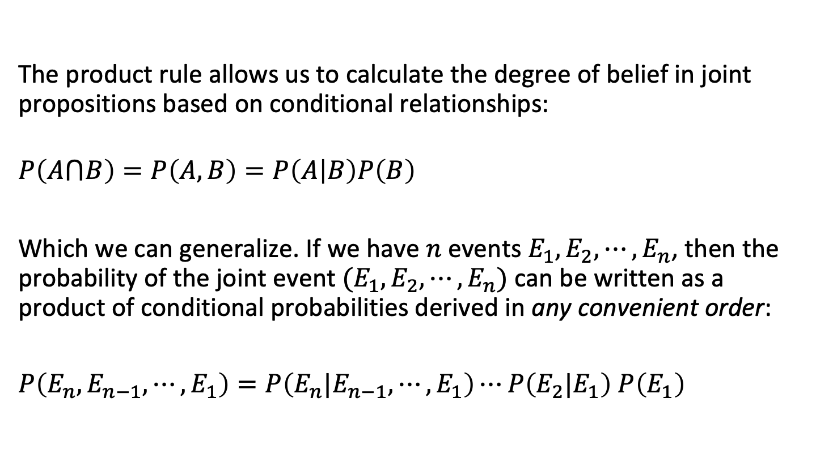
Product and chain rules for conditional probabilities
The product rule allows us to calculate the degree of belief in joint propositions based on conditional relationships:
$$P\left(A⋂B\right)=P\left(A,B\right)=P\left(A | B\right)P\left(B\right)$$
Which we can generalize. If we have $n$ events $E_{1},E_{2},⋯,E_{n}$, then the probability of the joint event $(E_{1},E_{2},⋯,E_{n})$ can be written as a product of conditional probabilities derived in any convenient order:
$P\left(E_{n},E_{n−1},⋯,E_{1}\right)=P\left(E_{n}{|E}_{n−1},⋯,E_{1}\right)⋯P\left(E_{2}|E_{1}\right)$ $P\left(E_{1}\right)$
Pearl

Slide 30
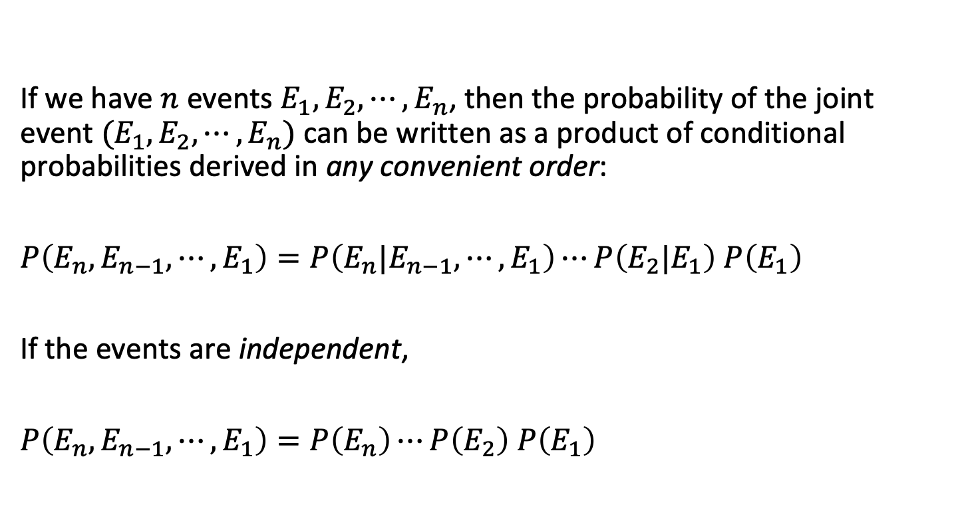
Conditional probabilities of independent events
If we have $n$ events $E_{1},E_{2},⋯,E_{n}$, then the probability of the joint event $(E_{1},E_{2},⋯,E_{n})$ can be written as a product of conditional probabilities derived in any convenient order:
$P\left(E_{n},E_{n−1},⋯,E_{1}\right)=P\left(E_{n}{|E}_{n−1},⋯,E_{1}\right)⋯P\left(E_{2}|E_{1}\right)$ $P\left(E_{1}\right)$
If the events are independent,
$P\left(E_{n},E_{n−1},⋯,E_{1}\right)=P\left(E_{n}\right)⋯P\left(E_{2}\right)$ $P\left(E_{1}\right)$

Slide 31
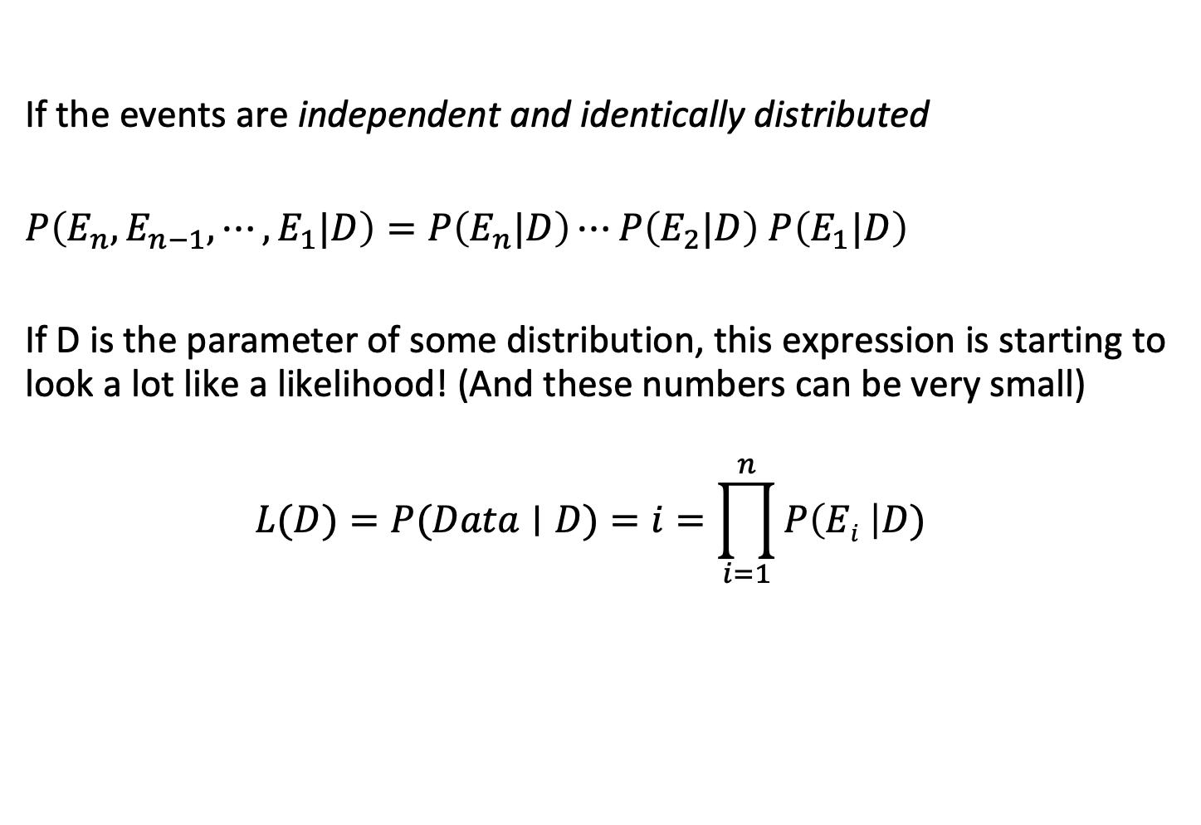
Another link to likelihood
If the events are independent and identically distributed
$P\left(E_{n},E_{n−1},⋯,E_{1}|D\right)=P\left(E_{n}|D\right)⋯P\left(E_{2}|D\right)$ $P\left(E_{1}|D\right)$
If D is the parameter of some distribution, this expression is starting to look a lot like a likelihood! (And these numbers can be very small)
$$L(D)=P(Data∣D)=i=\prod_{i=1}^{n}{P\left(Ei \right|D)}$$

Slide 32
Probability and odds

Slide 33
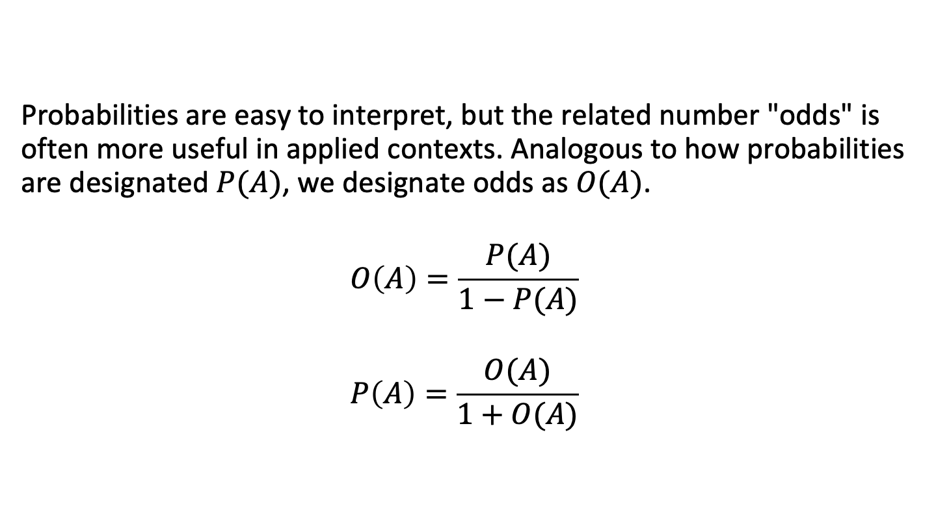
Probability and odds
Probabilities are easy to interpret, but the related number "odds" is often more useful in applied contexts. Analogous to how probabilities are designated $P(A)$, we designate odds as $O(A)$.
$$O\left(A\right)=\frac{P(A)}{1−P(A)}$$
$$P\left(A\right)=\frac{O(A)}{1+O(A)}$$

Slide 34
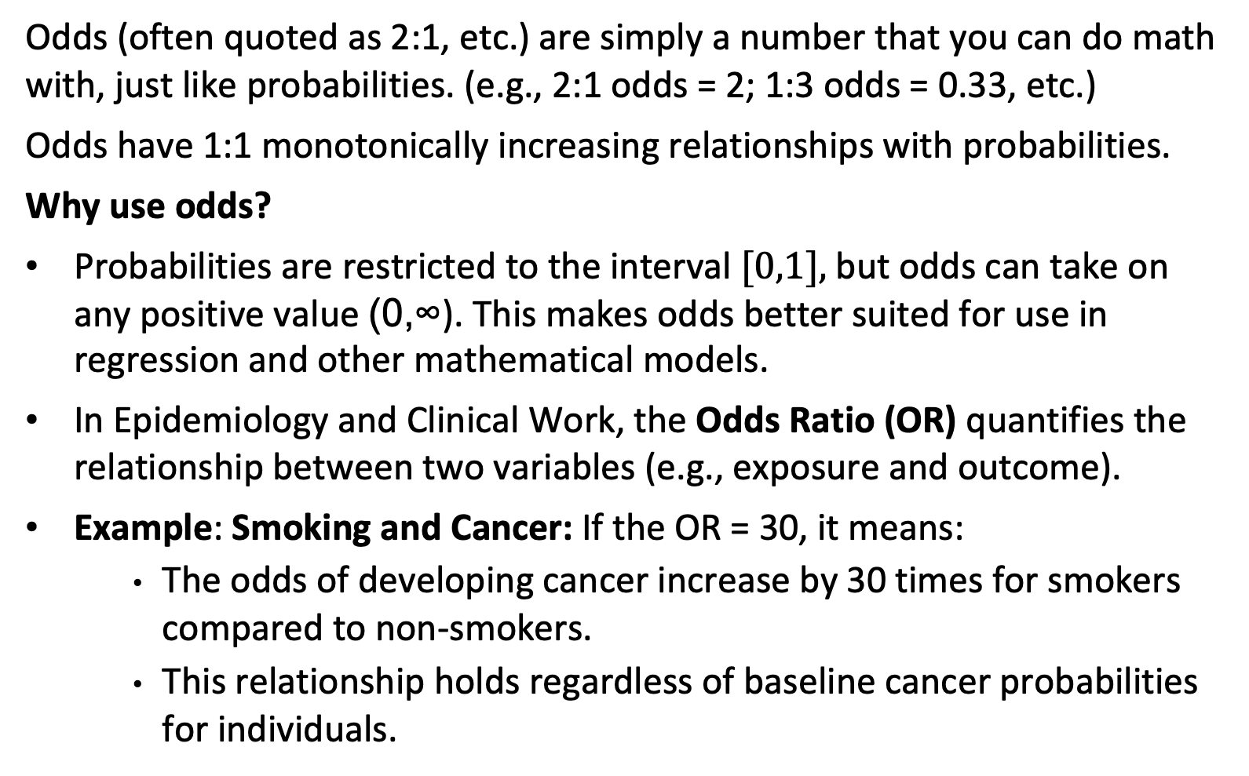
Probability and odds
Odds (often quoted as 2:1, etc.) are simply a number that you can do math with, just like probabilities. (e.g., 2:1 odds = 2; 1:3 odds = 0.33, etc.)
Odds have 1:1 monotonically increasing relationships with probabilities.
Why use odds?
Probabilities are restricted to the interval $[0,1],$but odds can take on any positive value (0,∞). This makes odds better suited for use in regression and other mathematical models.
In Epidemiology and Clinical Work, the Odds Ratio (OR) quantifies the relationship between two variables (e.g., exposure and outcome).
Example: Smoking and Cancer: If the OR = 30, it means:
    The odds of developing cancer increase by 30 times for smokers compared to non-smokers.
    This relationship holds regardless of baseline cancer probabilities for individuals.
Notes:
Odds are monotonically related to probabilities (as one increases, so does the other

Slide 35
Bayes’ rule

Slide 36
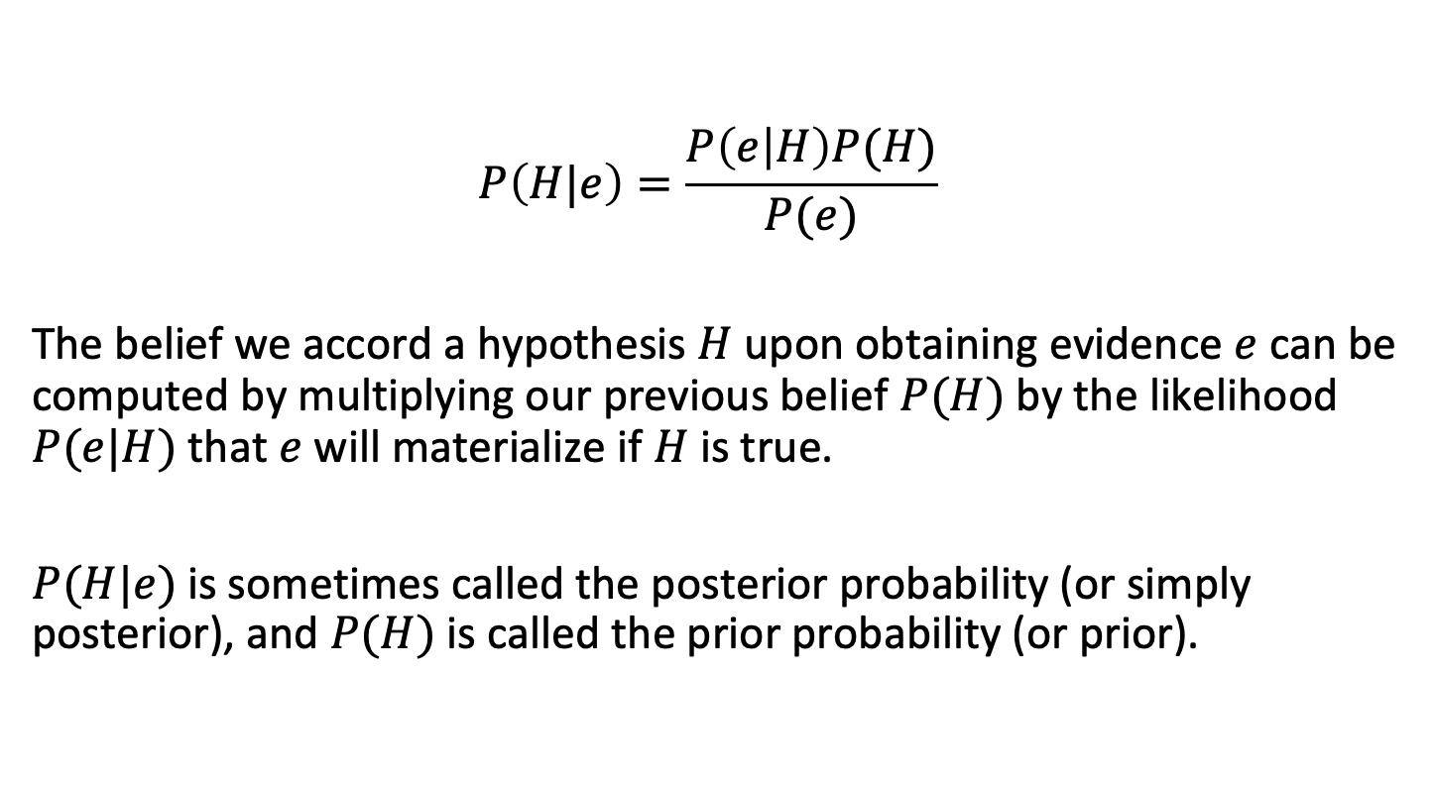
Bayes’ rule
$$P\left(H|e\right)=\frac{P\left(e | H\right)P(H)}{P(e)}$$
The belief we accord a hypothesis $H$ upon obtaining evidence $e$ can be computed by multiplying our previous belief $P(H)$ by the likelihood $P(e|H)$ that $e$ will materialize if $H$ is true.
$P(H|e)$is sometimes called the posterior probability (or simply posterior), and $P(H)$ is called the prior probability (or prior).
Pearl

Slide 37
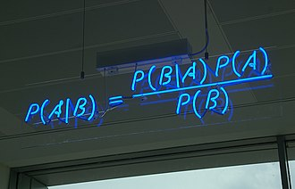
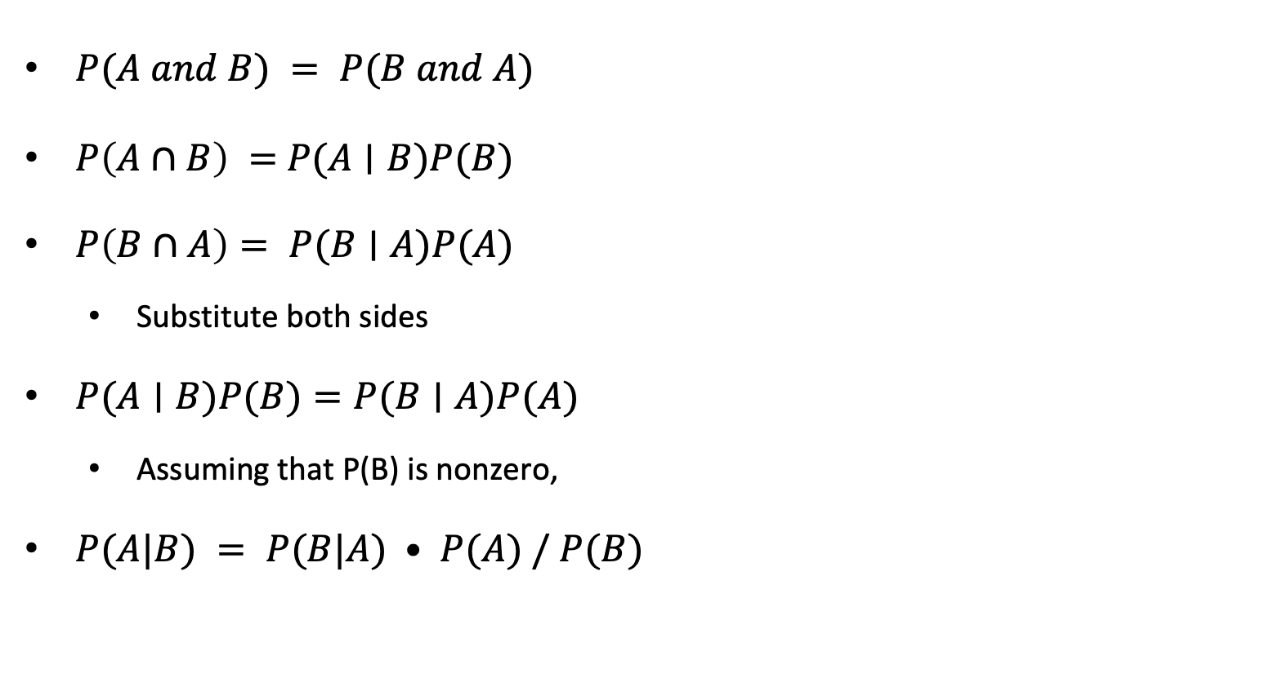
Deriving Bayes’ Rule from Joint Probabilities
$P(A and B) = P(B and A)$
$P\left(A∩B\right) =$ $P(A∣B)P(B)$
$P\left(B∩A\right)= P(B∣A)P(A)$
  Substitute both sides
$P(A∣B)P(B)=P(B∣A)P(A)$
  Assuming that P(B) is nonzero,
$P(A|B) = P(B|A) • P(A) / P(B)$
wikipedia

Slide 38
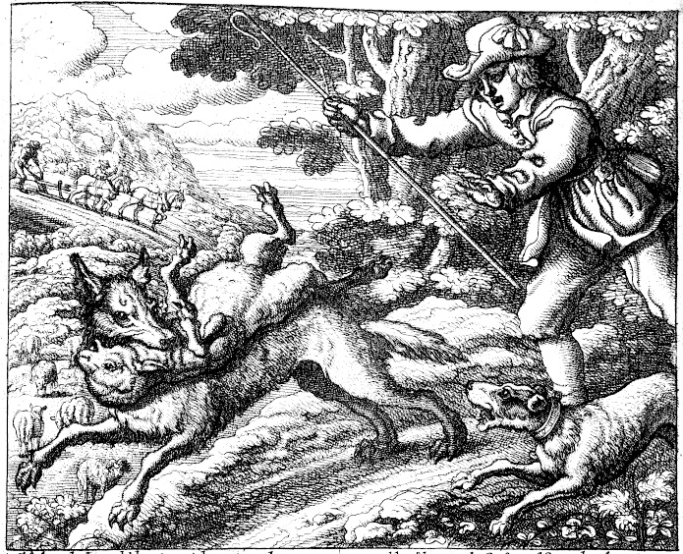
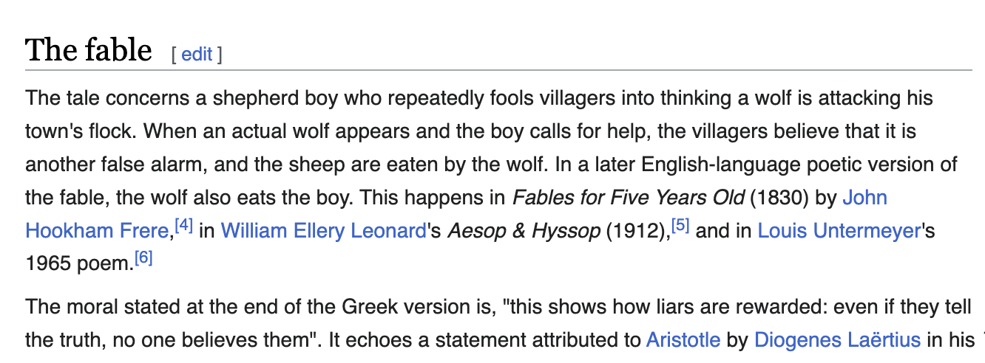
The boy who cried wolf (I)
Francis Barlow; wikipedia

Slide 39
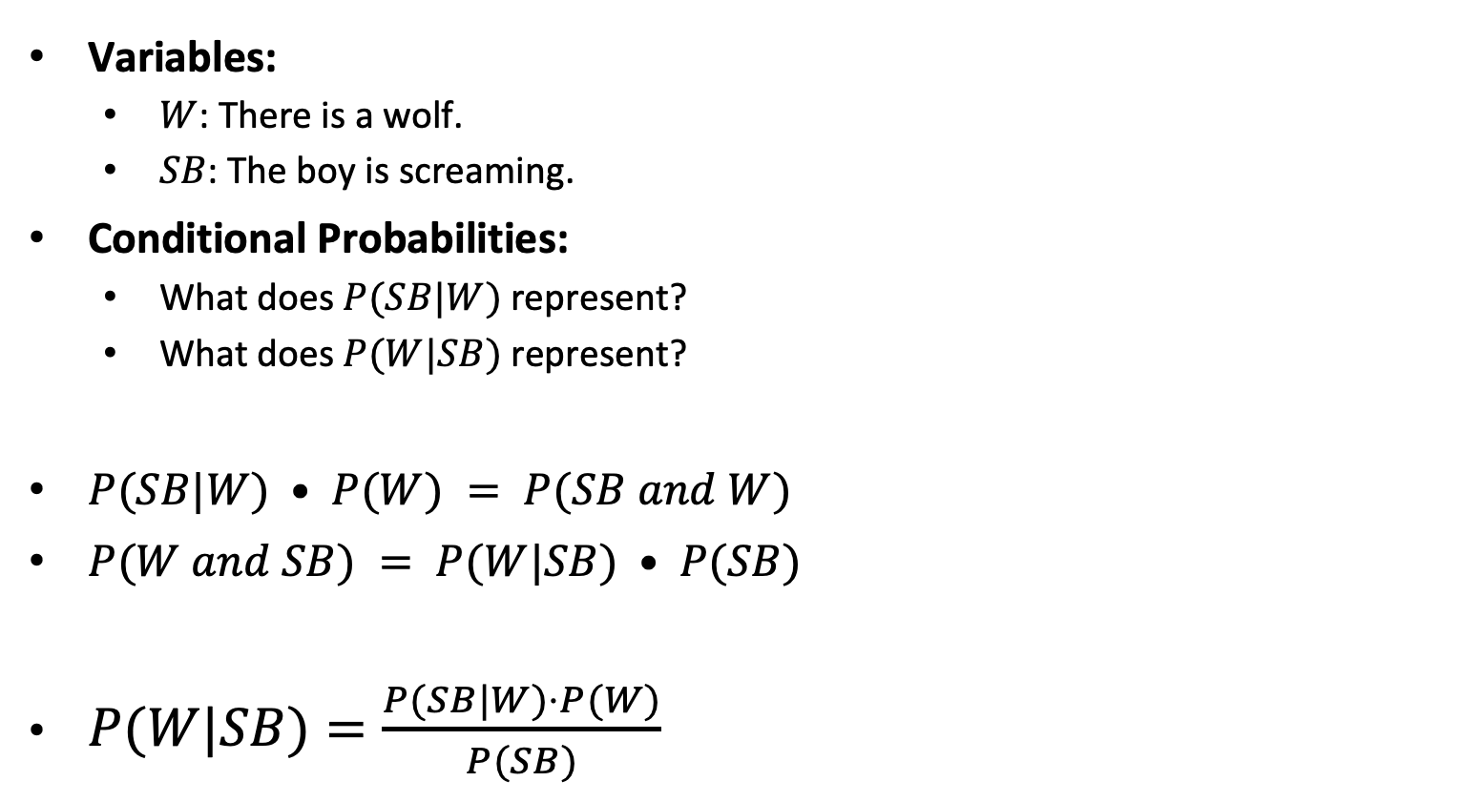
The boy who cried wolf (II): Bayesian Analysis
Variables:
  $W$: There is a wolf.
  $SB$: The boy is screaming.
Conditional Probabilities:
  What does $P(SB|W)$represent?
  What does $P(W|SB)$ represent?
$P(SB|W) • P(W) = P(SB and W)$
$P(W and SB) = P(W|SB) • P(SB)$
$P(W|SB)=\frac{P(SB|W)⋅P(W)​}{P(SB)}$
Francis Barlow; wikipedia

Slide 40

The boy who cried wolf (III): Bayesian Analysis
What happens to $P(W|SB)$when:
The wolf population decreases?
The boy screams less often?
Francis Barlow; wikipedia

Slide 41
Positive Predictive Value (PPV)

Slide 42
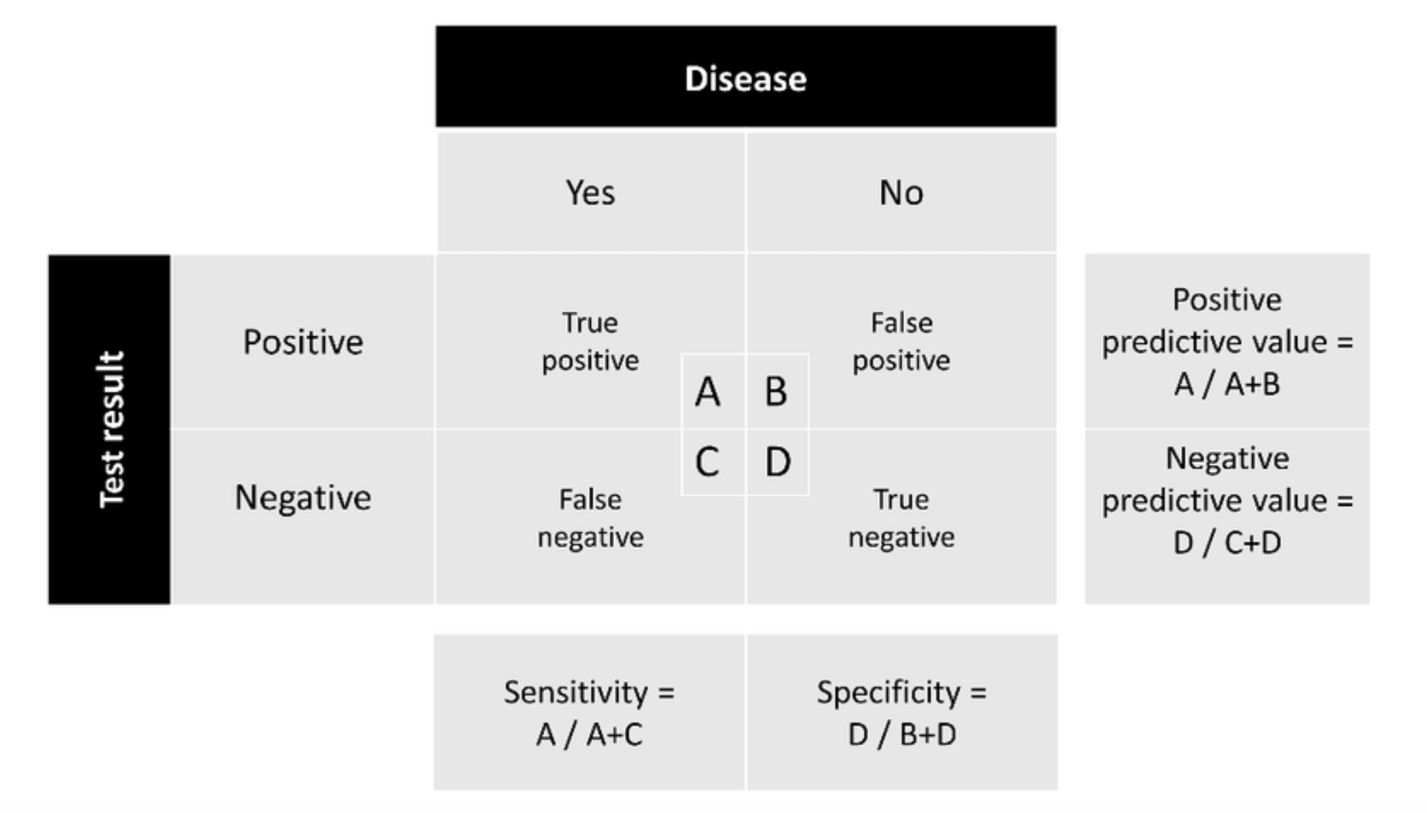
True and False Positive Rates

Slide 43
True and False Positive Rates
 | Sick | Not Sick
Positive | A | B
Negative | C | D
Positive Rate | A+B
False Positive Rate | B/(A+B)
Sensitivity/True Positive Rate | A/(A+C)
Specificity/True Negative Rate | D/(B+D)
Precision | A/(A+B)
Accuracy | TP + TN / (P + N)
F1 Score | 2 TP / (2 TP + FP + FN)

Slide 44
Positive Predictive Value (PPV)
PPV of a screening test for a particular condition is the probability that a subject truly has the condition given that they tested positive.
PPV will be of great interest to patients whose screening test result is positive.
We can use Bayes’ Rule to calculate PPV.
Notes:
Positive Predictive Value, or PPV, tells us how reliable a positive test result is in identifying true cases of a condition. It’s the probability that a person actually has the condition given that they tested positive

Slide 45
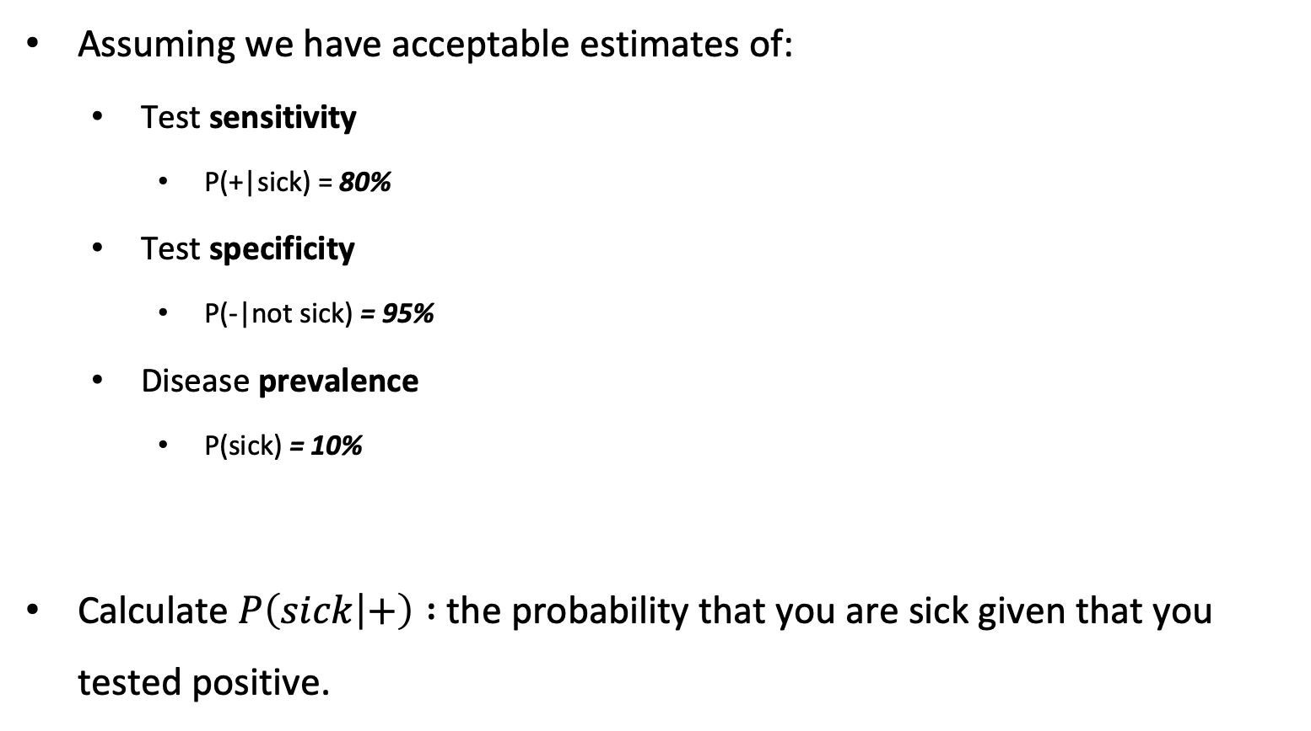
Exercise: calculate PPV
Assuming we have acceptable estimates of:
  Test sensitivity
    P(+|sick) = 80%
  Test specificity
    P(-|not sick) = 95%
  Disease prevalence
    P(sick) = 10%
Calculate $P\left(sick | +\right) :$ the probability that you are sick given that you tested positive.

Slide 46

Exercise: calculate PPV (I)
  $$P(sick|+)=\frac{P(+|sick)⋅P(sick)​}{P(+)}$$
  Test sensitivity $P(+∣sick$) = 80% = 0.80
  Disease prevalence $P(sick)=$ 10% = 0.10
  $P(+)=$ ?

Slide 47
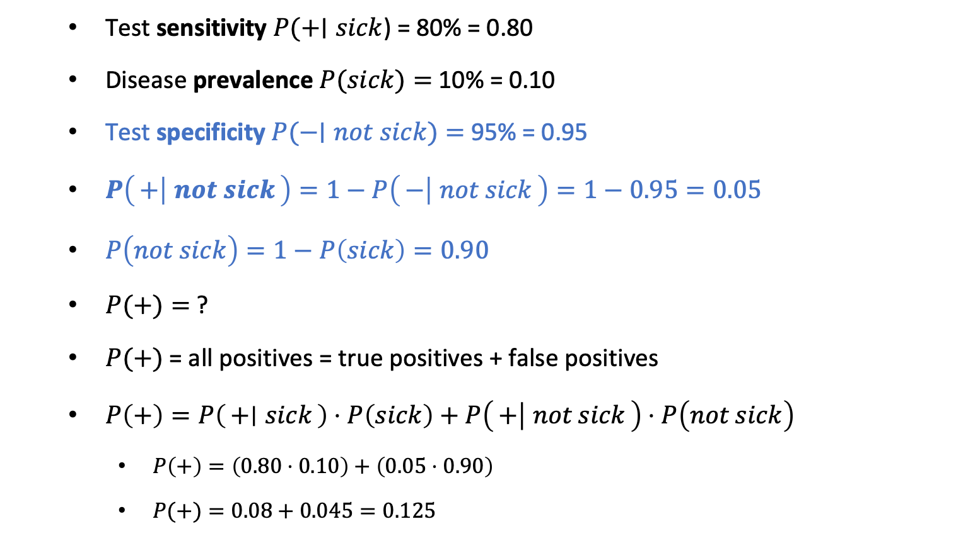

Exercise: calculate PPV (II)
  $$P(sick|+)=\frac{P(+|sick)⋅P(sick)​}{P(+)}$$
  Test sensitivity $P(+∣sick$) = 80% = 0.80
  Disease prevalence $P(sick)=$ 10% = 0.10
  Test specificity $P(−∣not sick)=$ 95% = 0.95
  $P\left(+ ∣ not sick\right)=1−P\left(− ∣ not sick\right)=1−0.95=0.05$
  $P\left(not sick\right)=1−P\left(sick\right)=0.90$
  $P(+)=$ ?
  $P(+)$= all positives = true positives + false positives
  $P\left(+\right)=P\left(+ ∣ sick\right)⋅P\left(sick\right)+P\left(+ ∣ not sick\right)⋅P\left(not sick\right)$
    $P\left(+\right)=\left(0.80⋅0.10\right)+\left(0.05⋅0.90\right)$
    $P(+)=0.08+0.045=0.125$

Slide 48

Exercise: calculate PPV (III)
$$P(sick|+)=\frac{P(+|sick)⋅P(sick)​}{P(+)}$$
$$P(sick|+)=\frac{0.80⋅0.10​}{0.125}$$
= 0.64
Notes:
This means that given a positive test result, the probability that the person is actually sick is 64%64%. This calculation demonstrates how sensitivity, specificity, and prevalence influence diagnostic interpretations.

Slide 49
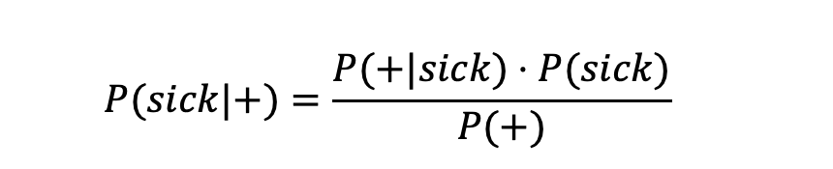
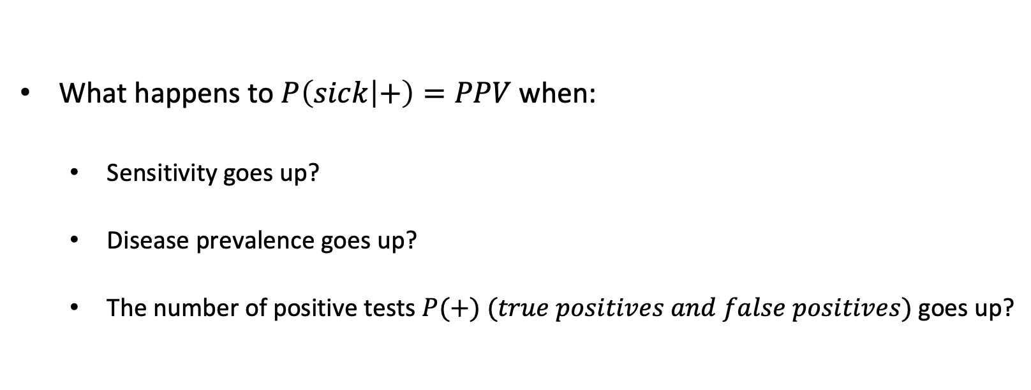
Back to the boy who cried wolf
What happens to $P\left(sick | +\right)=PPV$ when:
  Sensitivity goes up?
  Disease prevalence goes up?
  The number of positive tests $P(+) (true positives and false positives)$goes up?
  $$P(sick|+)=\frac{P(+|sick)⋅P(sick)​}{P(+)}$$

Slide 50
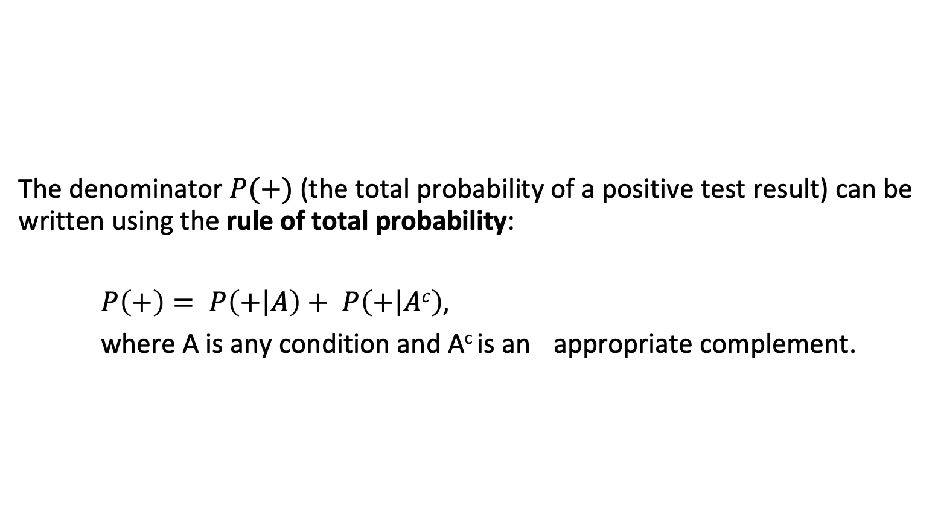
The more general case
The denominator $P(+)$(the total probability of a positive test result) can be written using the rule of total probability:
$P\left(+\right)= P\left(+ | A\right)+ P\left(+ | Ac\right),$
where A is any condition and A^{c} is an appropriate complement.

Slide 51
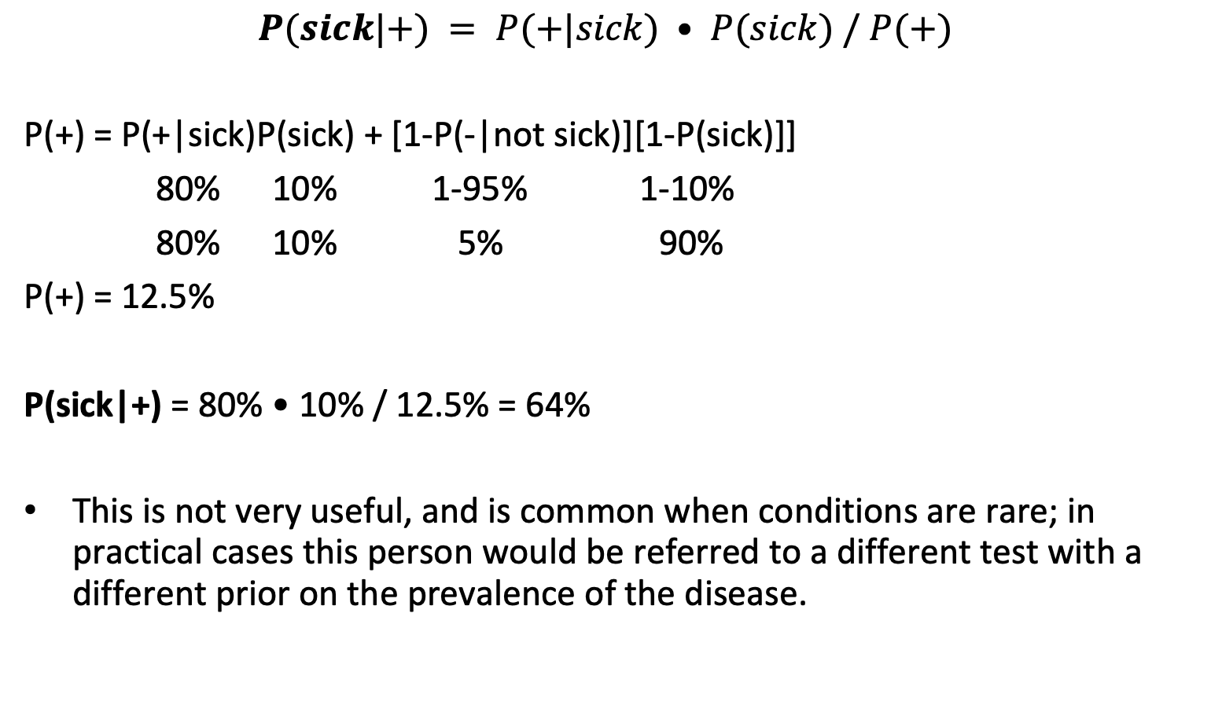
Numerical solution
$$P(sick|+) = P(+|sick) • P(sick) / P(+)$$
P(+) = P(+|sick)P(sick) + [1-P(-|not sick)][1-P(sick)]]
P(+) = 80% 10% 1-95% 1-10%
P(+) = 80% 10% 5% 90%
P(+) = 12.5%
P(sick|+) = 80% • 10% / 12.5% = 64%
This is not very useful, and is common when conditions are rare; in practical cases this person would be referred to a different test with a different prior on the prevalence of the disease.

Slide 52
Interpretation
The probability of being sick after a positive test result is 64%.
When conditions are rare, even a test with high sensitivity and specificity often has a low Positive Predictive Value (PPV) and
The PPV is not sufficient for conclusive diagnosis and would typically require follow-up with a confirmatory test or further investigation.

Slide 53
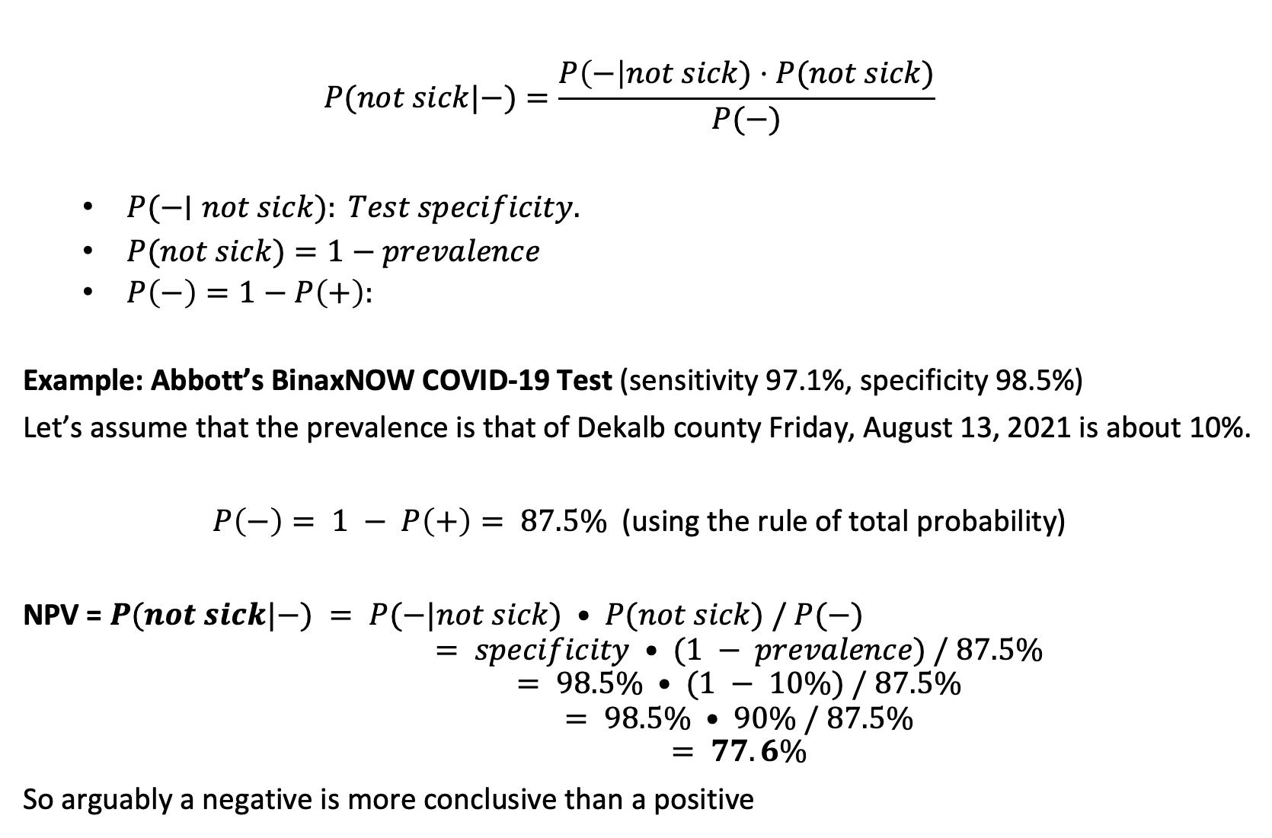
Negative predictive value may be more useful
$$P(not sick|−)=\frac{P\left(−\right|not sick)⋅P(not sick)​}{P(−)}$$
  $P(−∣not sick): Test specificity.$
  $P(not sick)=1−prevalence$
  $P\left(−\right)=1−P\left(+\right):$
Example: Abbott’s BinaxNOW COVID-19 Test (sensitivity 97.1%, specificity 98.5%)
Let’s assume that the prevalence is that of Dekalb county Friday, August 13, 2021 is about 10%.
$P\left(−\right)= 1 − P\left(+\right)= 87.5\%$ (using the rule of total probability)
NPV = $P(not sick|−) = P(−|not sick) • P(not sick) / P(−)$
$$P(not sick|−) = specificity • (1 − prevalence) / 87.5\%$$
$$P(not sick|−) = 98.5\% • (1 − 10\%) / 87.5\%$$
$$P(not sick|−) = 98.5\% • 90\% / 87.5\%$$
$$P(not sick|−) = 77.6\%$$
So arguably a negative is more conclusive than a positive

Slide 54
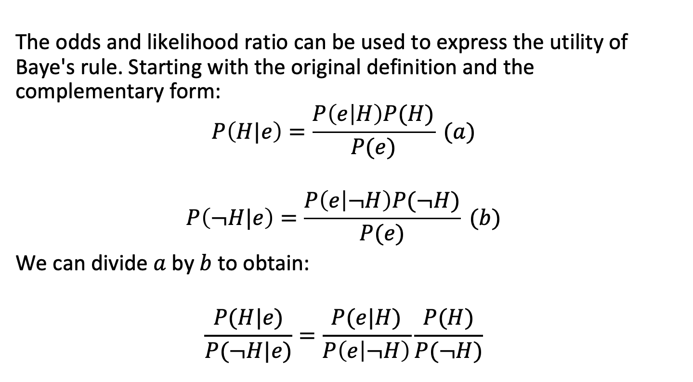
Bayes’ rule and odds ratios
The odds and likelihood ratio can be used to express the utility of Baye's rule. Starting with the original definition and the complementary form:
$$P\left(H|e\right)=\frac{P\left(e | H\right)P(H)}{P(e)} (a)$$
$$P\left(¬H|e\right)=\frac{P\left(e | ¬H\right)P(¬H)}{P(e)} (b)$$
We can divide $a$ by $b$ to obtain:
$$\frac{P(H|e)}{P(¬H|e)}=\frac{P(e|H)}{P\left(e | ¬H\right)}\frac{P(H)}{P(¬H)}$$
Pearl

Slide 55
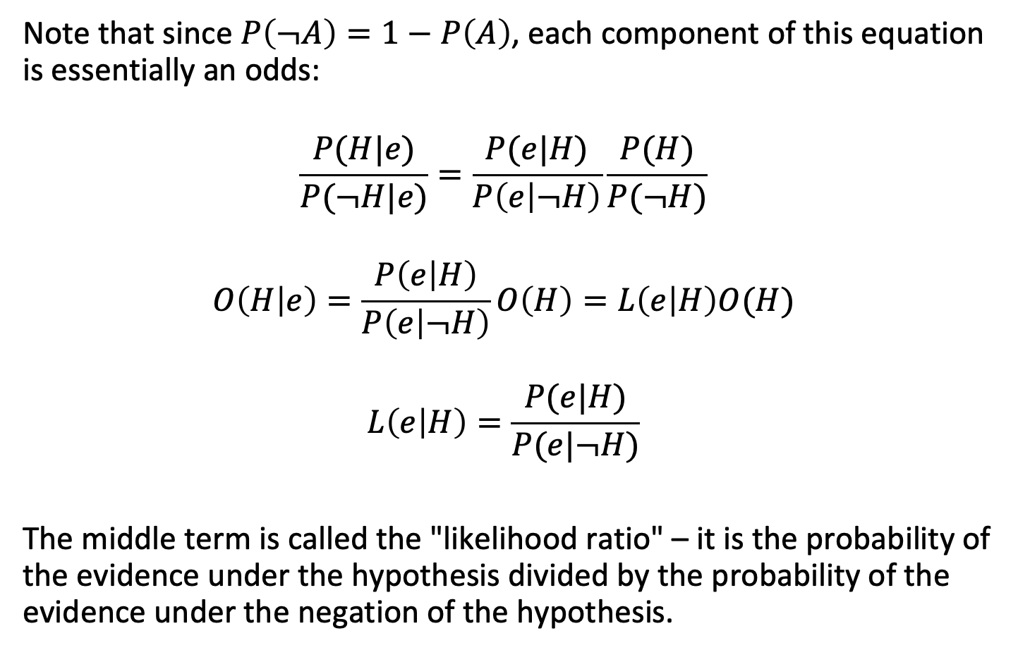
Baye's rule and odds ratios
Note that since $P\left(¬A\right)=1−P\left(A\right)$, each component of this equation is essentially an odds:
$$\frac{P(H|e)}{P(¬H|e)}=\frac{P(e|H)}{P\left(e | ¬H\right)}\frac{P(H)}{P(¬H)}$$
$$O\left(H | e\right)=\frac{P\left(e | H\right)}{P\left(e | ¬H\right)}O\left(H\right)=L\left(e | H\right)O(H)$$
$$L\left(e | H\right)=\frac{P(e|H)}{P(e|¬H)}$$
The middle term is called the "likelihood ratio" – it is the probability of the evidence under the hypothesis divided by the probability of the evidence under the negation of the hypothesis.
Pearl

Slide 56

A fire alarm example (I)
Let's say that you've worked in the same building for 8 years, and there have been 12 fire alarms and no real fires.
What is the upper bound for the probability of a fire on a given day?
$$P(fire)<1/{365×8}≈1/{3000}$$
What is the probability of a false alarm on a given day?
$$P\left(false alarm\right)=P\left(alarm | ¬fire\right)={12}/{3000}=4/{1000}$$
Let's say the sensitivity of the system is quite high, so
$$P\left(alarm | fire\right)={999}/{1000}$$

Slide 57

A fire alarm example (II)
The prior odds of a fire on a given day are:
$$O\left(fire\right)={P(fire)}/{1−P(fire)}={\frac{1}{3000}}/{1−\frac{1}{3000}}=1/{2999}$$
What is the likelihood ratio associated with the new evidence?
$$L\left(alarm|fire\right)=\frac{P\left(alarm | fire\right)}{P\left(alarm | ¬fire\right)}=\frac{{999}/{1000}}{4/1000}={999}/4$$
Notes:
The likelihood ratio compares how much more likely the alarm is to occur when there is a fire vs. when there isn’t one:

Slide 58

A fire alarm example (III)
The posterior odds of a fire given the evidence are:
$$O\left(fire|alarm\right)=L\left(alarm | fire\right)O(fire)$$
$$O\left(fire|alarm\right)={999}/4×1/{2999}≈0.08$$
The posterior probability of a fire given the evidence is:
$$P\left(fire | alarm\right)=\frac{O(fire|alarm)}{1+O(fire|alarm)}=\frac{0.08}{1+0.08}=7.4\%$$
So, even though a fire is unlikely given the alarm, the probability has raised significantly – from $1/{3000}$ to 7%.
Does this align with your intuition when you hear a fire alarm?

Slide 59
Directed acyclic graphs as representations of joint probabilities

Slide 60
Directed acyclic graphs
Complex conditional dependencies in a probabilistic model can be represented with directed graphs.
In particular, directed acyclic graphs (DAGs) are used for process modeling in epidemiological and clinical studies.
In a DAG, each vertex/node represents a random variable (often discrete) and each edge represents a conditional probability.

Slide 61

DAGs represent a surprising crossover from computer science to epidemiology

Slide 62

Recall the product rule for conditional probabilities
The product rule allows us to calculate the degree of belief in joint propositions based on conditional relationships:
$$P\left(A⋂B\right)=P\left(A,B\right)=P\left(A | B\right)P\left(B\right)$$
If we have $n$ events $E_{1},E_{2},⋯,E_{n}$, then the probability of the joint event $(E_{1},E_{2},⋯,E_{n})$ can be written as a product of conditional probabilities derived in any convenient order:
$P\left(E_{n},E_{n−1},⋯,E_{1}\right)=P\left(E_{n}{|E}_{n−1},⋯,E_{1}\right)⋯P\left(E_{2}|E_{1}\right)$ $P\left(E_{1}\right)$
Pearl

Slide 63

Joint probabilities in DAGs
A joint probability distribution $p(x_{1},x_{2},⋯,x_{n})$ factorizes with respect the the directed graph $G$ ($G=(V,D)$) if, when we multiply the conditional probabilities of each node $x_{i}$ given its parents $x_{parents(i)}$:
$$p\left(x_{1},x_{2},⋯,x_{n}\right)=p\left(x_{1} | x_{parents\left(1\right)}\right)p(x_{2}|x_{parents\left(2\right)})⋯$$
$$p\left(x_{1},x_{2},⋯,x_{n}\right)=\prod_{i∈V}{p(x_{i}|x_{parents\left(i\right)})}$$
Note that if a node $x_{j}$ does not depend on any other nodes, it does not have "parents": $p\left(x_{j} | whatever\right)=p(x_{j})$. These may be called "roots."

Slide 64



Joint probabilities in DAGs
Roots:
Parents of X1:
$$p\left(x_{1},x_{2}\right)=p\left(x_{2} | x_{1}\right)p(x_{1})$$
Roots:
Parents of X2:
$$p\left(x_{1},x_{2},x_{3}\right)=p\left(x_{2} | x_{1},x_{3}\right)p\left(x_{1}\right)p\left(x_{3}\right)$$

Slide 65

Markovian parents
One key concept here is that $x_{parents(i)}$ satisfy the relationship:
$$p\left(x_{j}|x_{1},⋯,x_{j−1}\right)=p\left(x_{j} | x_{parents\left(j\right)}\right)$$
You recall that the Markov property is that the probability distribution for a given variable depends only on its present state; similarly, the distribution $p(x_{j})$ depends only on its parents $x_{parents(j)}$.
In an undirected graph each node could (would) depend on all other nodes, increasing the number of parameters substantially.

Slide 66

A DAG example
William Farr suggested an association between residence elevation and cholera rate in London. The underlying hypothesis was that cholera was an airborne pathogen. (The "miasma" hypothesis.)
Low Elevation
Socioeconomic
Status
Cholera
Bad Water
Bingham et al., Public Health 2004

Slide 67
A DAG example
William Farr suggested an association between residence elevation and cholera rate in London. The underlying hypothesis was that cholera was an airborne pathogen. (The "miasma" hypothesis.)
John Snow, a competitor, eventually identified contaminated water as the culprit. Cholera is not airborne.
Cholera
Bad Water
Bingham et al., Public Health 2004

Slide 68
A DAG example
William Farr suggested an association between residence elevation and cholera rate in London. The underlying hypothesis was that cholera was an airborne pathogen. (The "miasma" hypothesis.)
John Snow, a competitor, eventually identified contaminated water as the culprit. Cholera is not airborne.
The association between elevation and cholera was due to a “back-door” (non-causal – note the directions of arrows) path via SES.
Low Elevation
Socioeconomic
Status
Cholera
Bad Water
Bingham et al., Public Health 2004

Slide 69
A DAG example
William Farr suggested an association between residence elevation and cholera rate in London. The underlying hypothesis was that cholera was an airborne pathogen. (The "miasma" hypothesis.)
John Snow, a competitor, eventually identified contaminated water as the culprit. Cholera is not airborne.
The association between elevation and cholera was due to a “back-door” (non-causal – note the directions of arrows) path via SES.
If Farr had selected people from various elevations and provided them with clean drinking water, would there he have seen an association between elevation and cholera?
Low Elevation
Socioeconomic
Status
Cholera
Bad Water
Bingham et al., Public Health 2004

Slide 70
A DAG example
If we wanted to simulate a population of people under this causal structure, what would cholera depend on?
Water?
SES?
Elevation?
What about Elevation?
Water?
SES?
Cholera?
Low Elevation
Socioeconomic
Status
Cholera
Bad Water
Bingham et al., Public Health 2004

Slide 71
A DAG example
If we wanted to simulate a population of people under this causal structure, what would cholera depend on?
Water?
SES?
Elevation?
What about Elevation?
Water?
SES?
Cholera?
What are the root(s) in this graph?
Low Elevation
Socioeconomic
Status
Cholera
Bad Water
Bingham et al., Public Health 2004

Slide 72
Outline
Basic definitions and results in probabilities (and odds)
Baye's rule
Directed acyclic graphs as representations of probabilities

