Slide 1

BMI 510: Introduction
J. Lucas McKay, Ph.D., M.S.C.R.
Departments of Biomedical Informatics and Neurology, Emory University, Atlanta, GA USA
Department of Biomedical Engineering, Georgia Institute of Technology, Atlanta, GA, USA

Slide 2
Course concept
Design a (single) statistics course for machine learning students with technical backgrounds to cover more material
Lighten focus on proofs
Use simulations to develop intuition about statistical problems
Develop programming skills and documentation practices

Slide 3
Biostatistics for machine learning

Slide 4
Biostatistics for machine learning
Statistics play a critical role in many areas of science, engineering, and medicine.
Here are some questions statistics can help answer:
How likely is a particular person to have a heart attack within 12 months, given that they have recently had one, and given what we know about them?
What are the most important factors in determining how long a person diagnosed with cancer will live?
Which cytokines are associated with a certain disease presentation?
Do two different treatments work differently?
What variables are associated with treatment success?

Slide 5
Data science workflow
Adapted from https://r4ds.had.co.nz/explore-intro.html

Slide 6
Data science workflow
Some Wednesdays, homeworks
Mondays and Wednesdays
Adapted from https://r4ds.had.co.nz/explore-intro.html

Slide 7
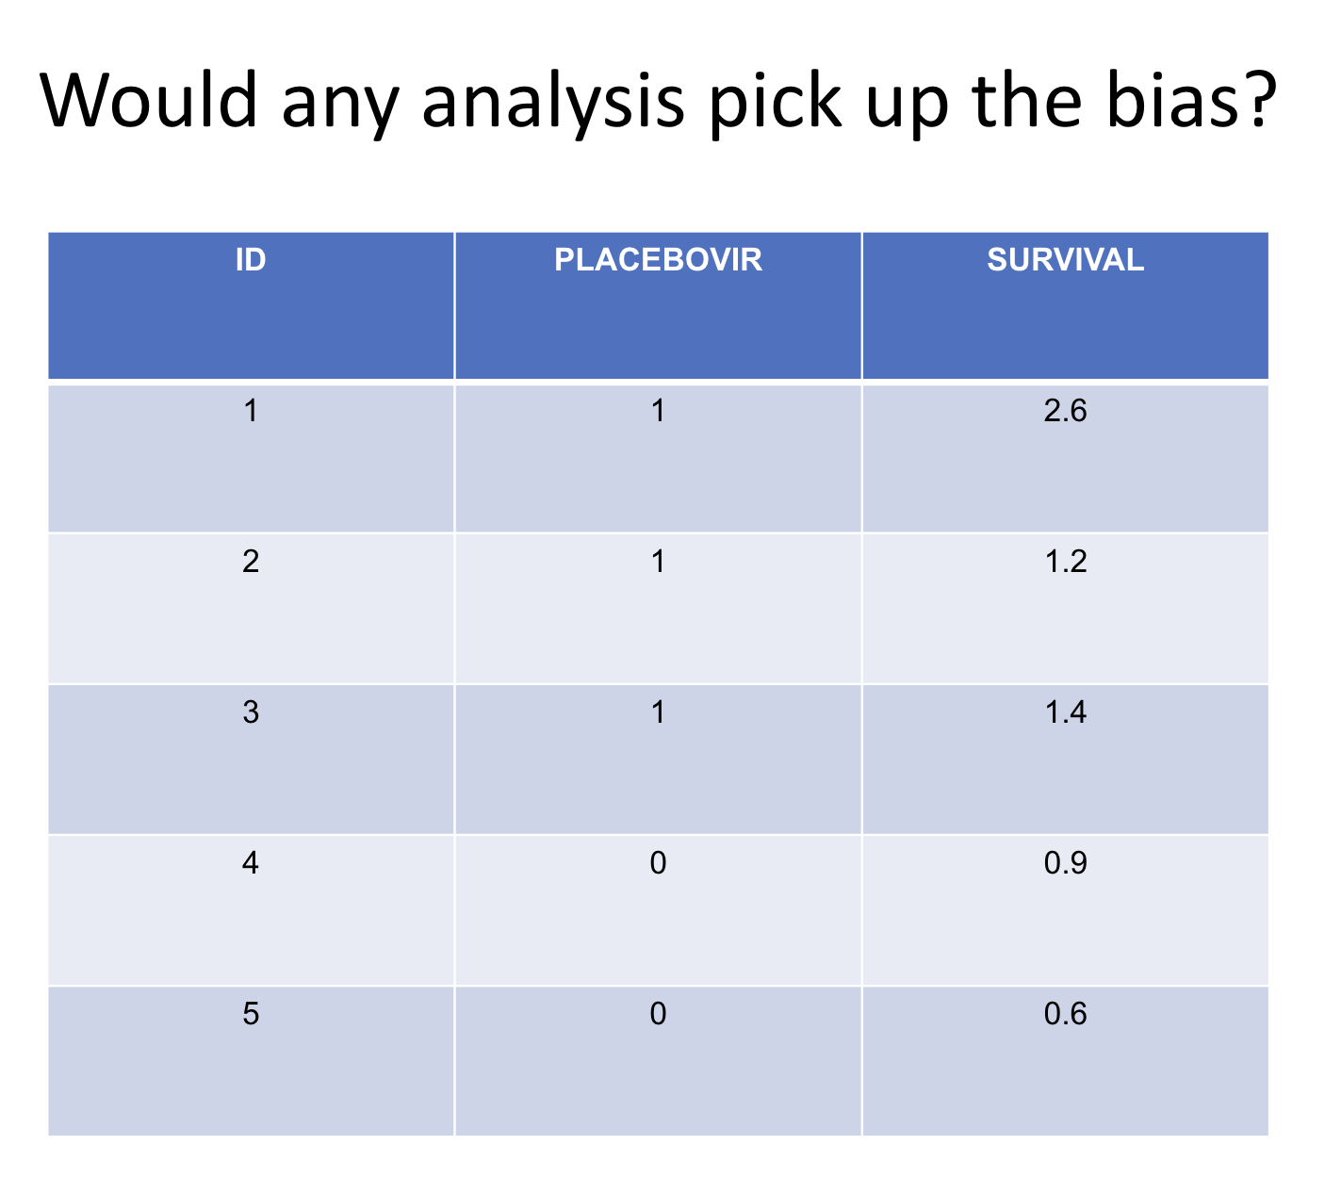

Slide 8
No.

Slide 9
Biostatistics for machine learning
Statistics play a critical role in many areas of science, engineering, and medicine.
Here are some questions statistics can help answer:
How likely is a particular person to have a heart attack within 12 months, given that they have recently had one, and given what we know about them?
What are the most important factors in determining how long a person diagnosed with cancer will live?
Which cytokines are associated with a certain disease presentation?
Do two different treatments work differently?
What variables are associated with treatment success?
Here are some questions that statistics may not be able to answer:
How do the biases inherent in the way the data were collected influence the results?

Slide 10
Data science workflow
Some Wednesdays, homeworks
Mondays and Wednesdays
Discussions on Thursdays
Adapted from https://r4ds.had.co.nz/explore-intro.html

Slide 11
We will discuss two fundamental statistical modeling steps
Machine
Learning
Biostatistics
Image
Classification
Closed
Form
Solutions
Designing
more powerful
tests
Deep
Learning
(Meta)
Learning
Algorithms
1. Fit model
parameters
to data
Frequentists
vs.
Bayesians
Write
Production
Code
Null
Hypothesis
Testing
2. Make inferences
about fitted
models
Shallow
Learning
Clinical
Trial
Design
Natural
Language
Processing
Proofs

Slide 12
We will discuss two fundamental statistical modeling steps
Fit model parameters to data
Make inferences about models

Slide 13
Outline
Fundamental definitions
Types of measurements
A regression example

Slide 14
Key definitions
Null hypothesis
The conditions under which an analyst proposes chance alone might generate (or have generated) a group of observations
Statistical test
A tool used to help make a decision about a null hypothesis
Permutation and simulation tests
“Non parametric” tests: Kruskal-Wallis, ranked sums
“Parametric” tests: t, chi-squared, F, likelihood ratio, Wald, score
Confound
A variable that is associated with the exposure and the outcome that is not a consequence of the outcome

Slide 15
How might you simulate what these data would look like under the null hypothesis?

Slide 16
Key definitions
Null hypothesis
The conditions under which an analyst proposes chance alone might generate (or have generated) a group of observations
Statistical test
A tool used to help make a decision about a null hypothesis
Permutation and simulation tests
“Non parametric” tests: Kruskal-Wallis, ranked sums
“Parametric” tests: t, chi-squared, F, likelihood ratio, Wald, score
Confound
A variable that is associated with the exposure and the outcome that is not a consequence of the outcome

Slide 17
How might you simulate what these data would look like under the null hypothesis?
Fit a single normal distribution to the survival numbers (e.g., find the mean and SD), simulate it 1000 times, then take the difference between the first three and the last two numbers for each. Compare the observed value to the simulated values.
Resample from the survival numbers with replacement, simulate it 1000 times, then take the difference between the first three and the last two numbers. Compare the observed value to the simulated values.
Assume the sample is drawn from a single normally-distributed population (the z). Compare the observed value to what you would expect under a z distribution.

Slide 18
How might you simulate what these data would look like under the null hypothesis?
Fit a single normal distribution to the survival numbers (e.g., find the mean and SD), simulate it 1000 times, then take the difference between the first three and the last two numbers for each. Compare the observed value to the simulated values.
Resample from the survival numbers with replacement, simulate it 1000 times, then take the difference between the first three and the last two numbers. Compare the observed value to the simulated values.
Assume the sample is drawn from a single normally-distributed population (the z). Compare the observed value to what you would expect under a z distribution.
All of them - test: compare the observed to the null behaviorthe null

Slide 19
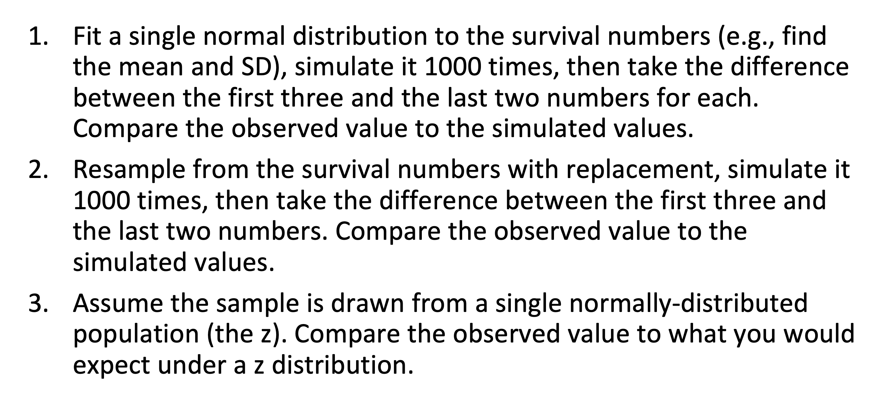
“Parametric” – assumes some structure of generating process under Null
“Simulation” – use a random number generator to simulate behavior under Null
“Closed form” – uses an equation to simulate behavior under null

Slide 20
“Parametric” – assumes some structure of generating process under Null
1, 3
“Simulation” – use a random number generator to simulate behavior under Null
1, 2
“Closed form” – uses an equation to simulate behavior under null
3

Slide 21
How might you simulate what these data would look like under the null hypothesis?
Fit model parameters to data
Fit a single normal distribution to the survival numbers (1)
Simulate the experiment 1000 times
Take the difference between the first three and the last two numbers
Make inferences about (how likely the data are under the) model
Rank the observed results within the simulated results

Slide 22
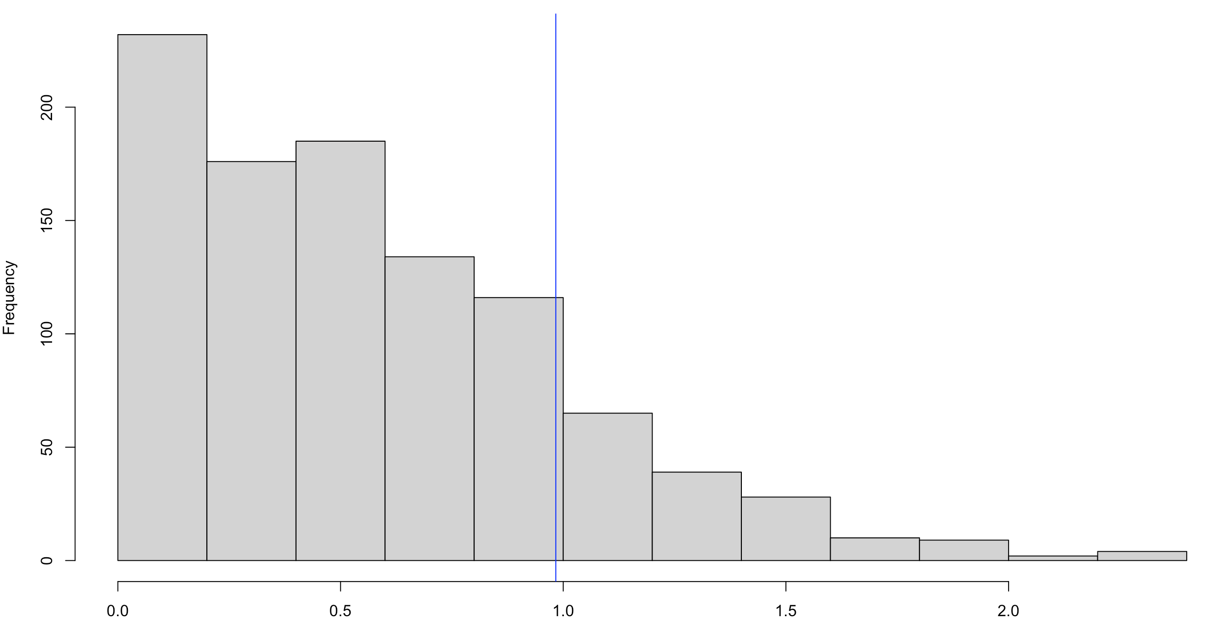
How might you simulate what these data would look like under the null hypothesis?
Observed:
Difference = 0.98
Rank = 833/1000
“p” value = 1-0.833 = 0.17
Difference between means of first three and last three numbers

Slide 23
How might you simulate what these data would look like under the null hypothesis?
Fit model parameters to data
Resample from the survival numbers with replacement (2)
Simulate the experiment 1000 times
Take the difference between the first three and the last two numbers
Make inferences about (how likely the data are under the) model
Rank the observed results within the simulated results

Slide 24
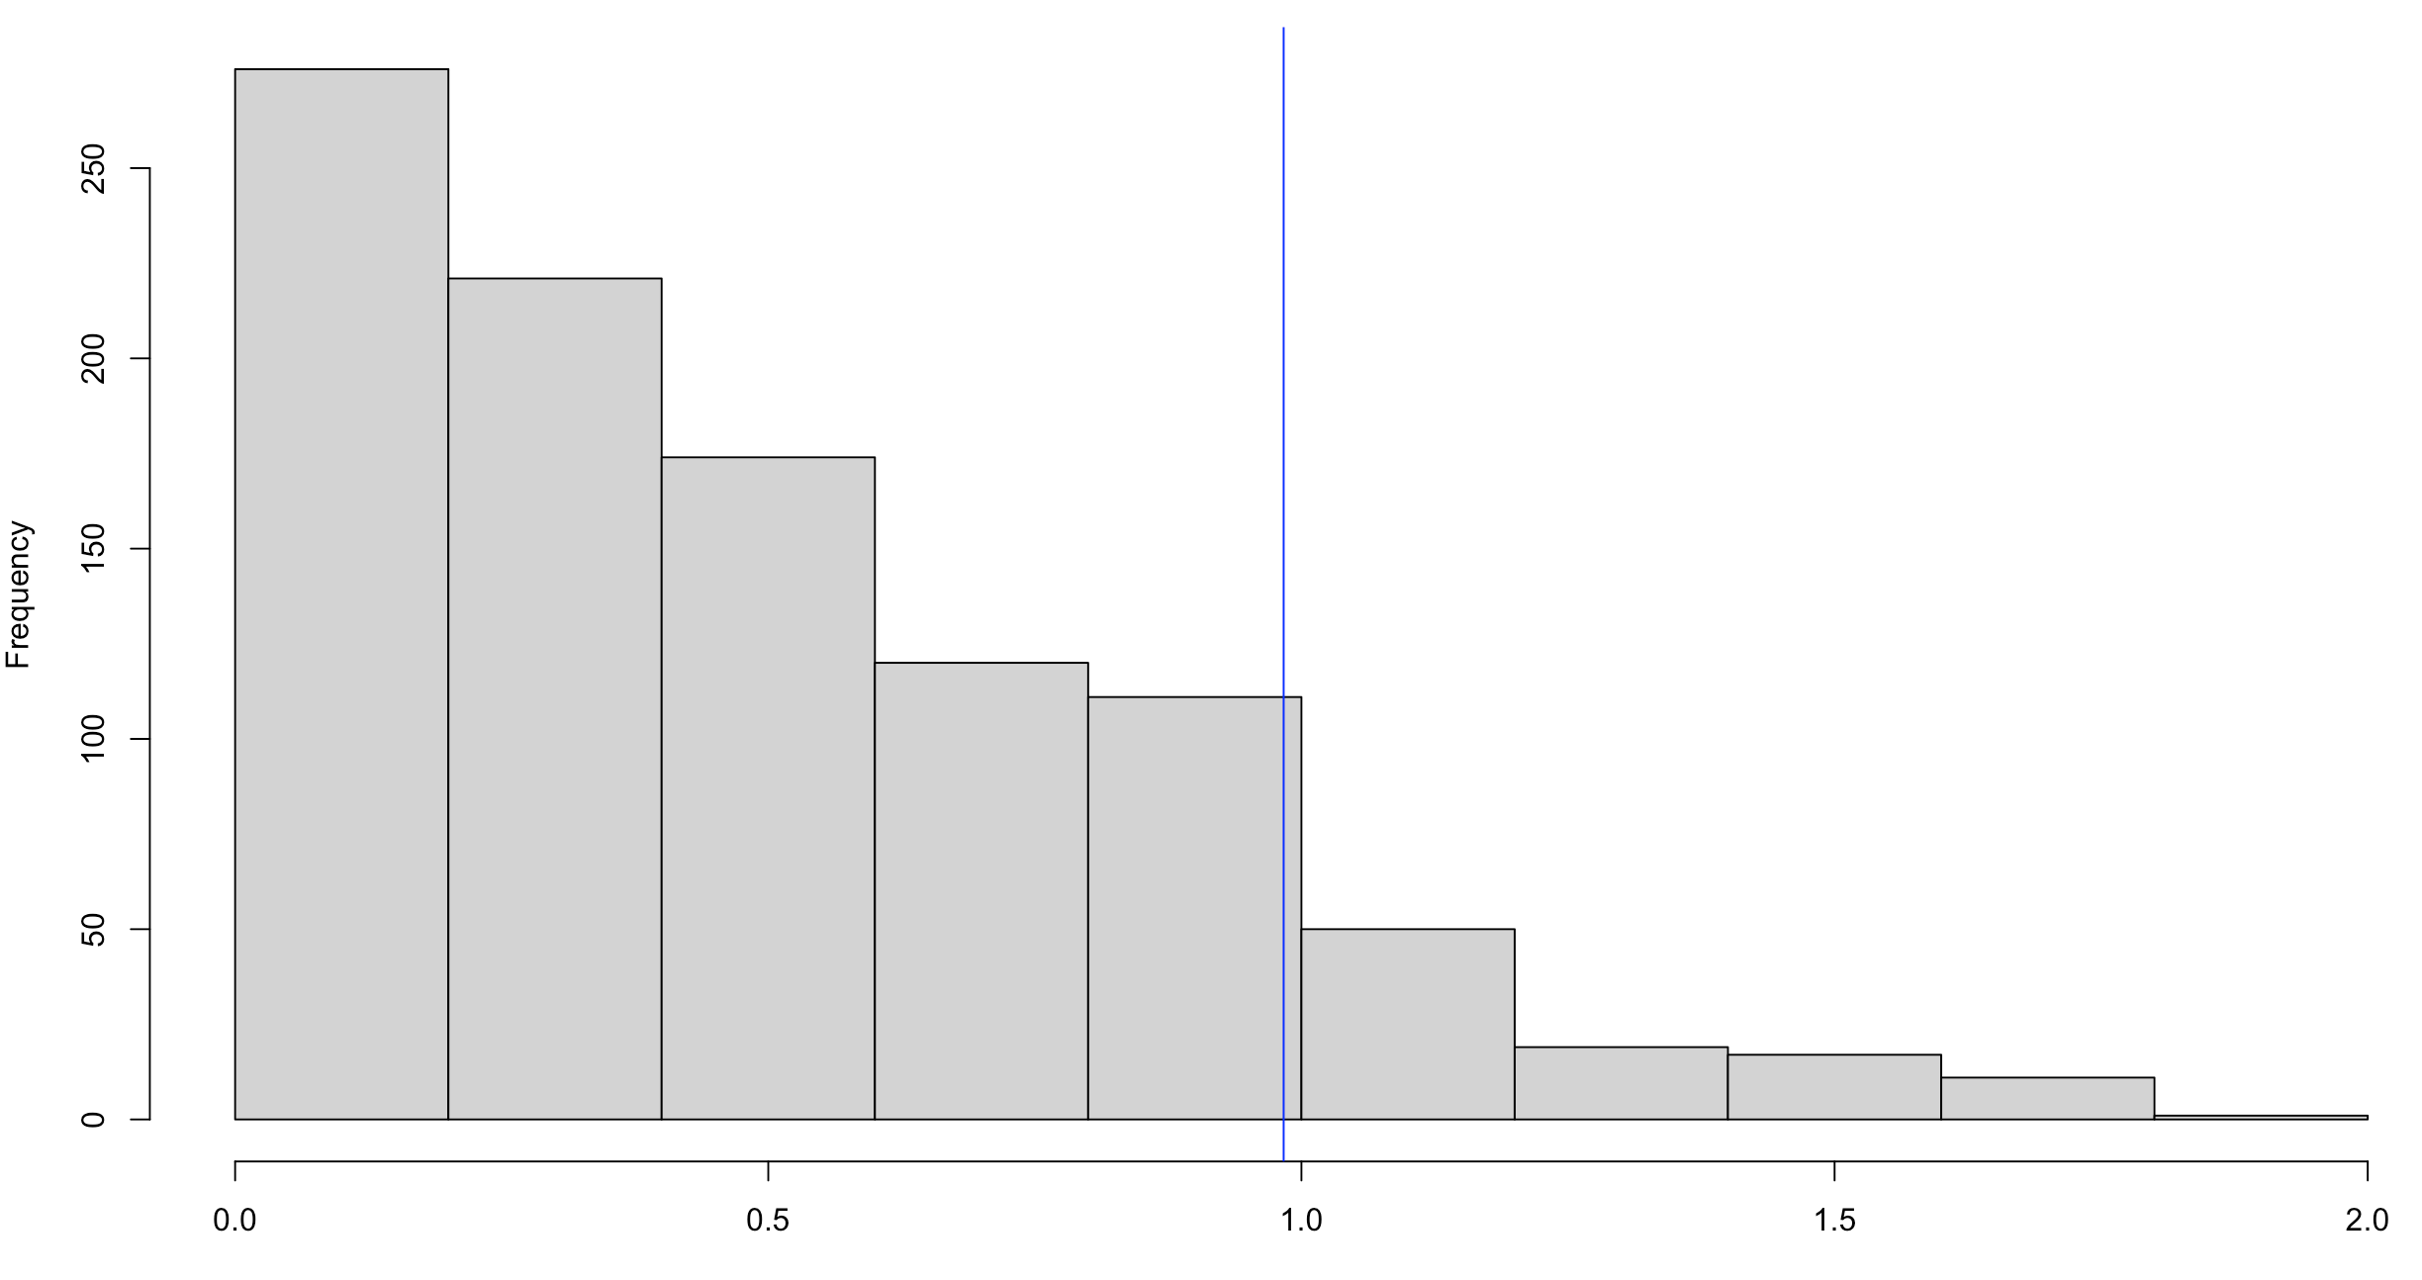
How might you simulate what these data would look like under the null hypothesis?
Observed:
Difference = 0.98
Rank = 885/1000
“p” value = 1-0.885 = 0.12
Difference between means of first three and last three numbers

Slide 25
How might you simulate what these data would look like under the null hypothesis?
Fit model parameters to data
Fit a single normal distribution to the survival numbers (3)
Assume the sample is drawn from a single normally-distributed population (the z)
Make inferences about (how likely the data are under the) model
Figure out how often you would observe a result as or more extreme than the one we have by chance

Slide 26
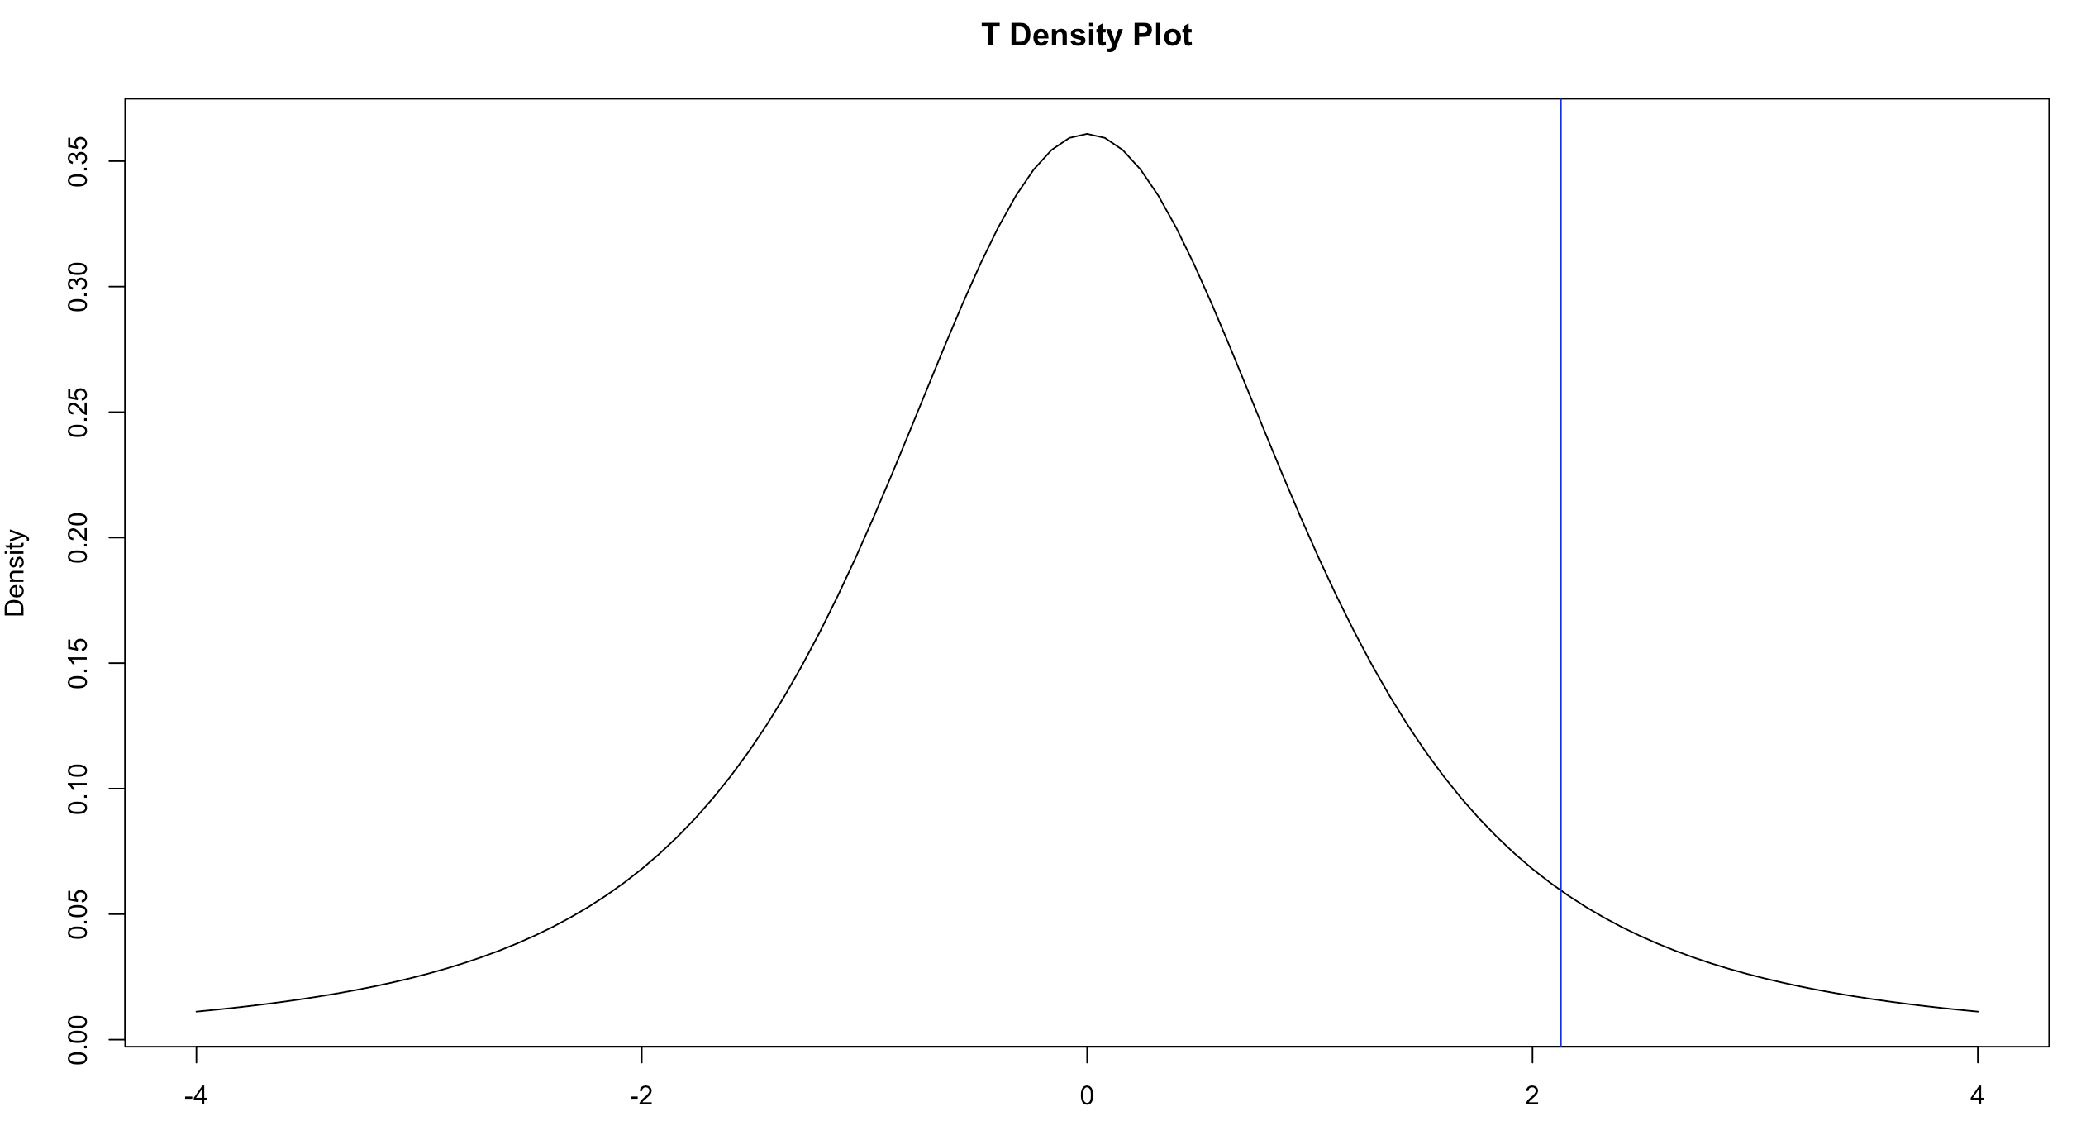
How might you simulate what these data would look like under the null hypothesis?
Observed:
Difference = 0.98
t = 2.43
“p” value = 0.14

Slide 27
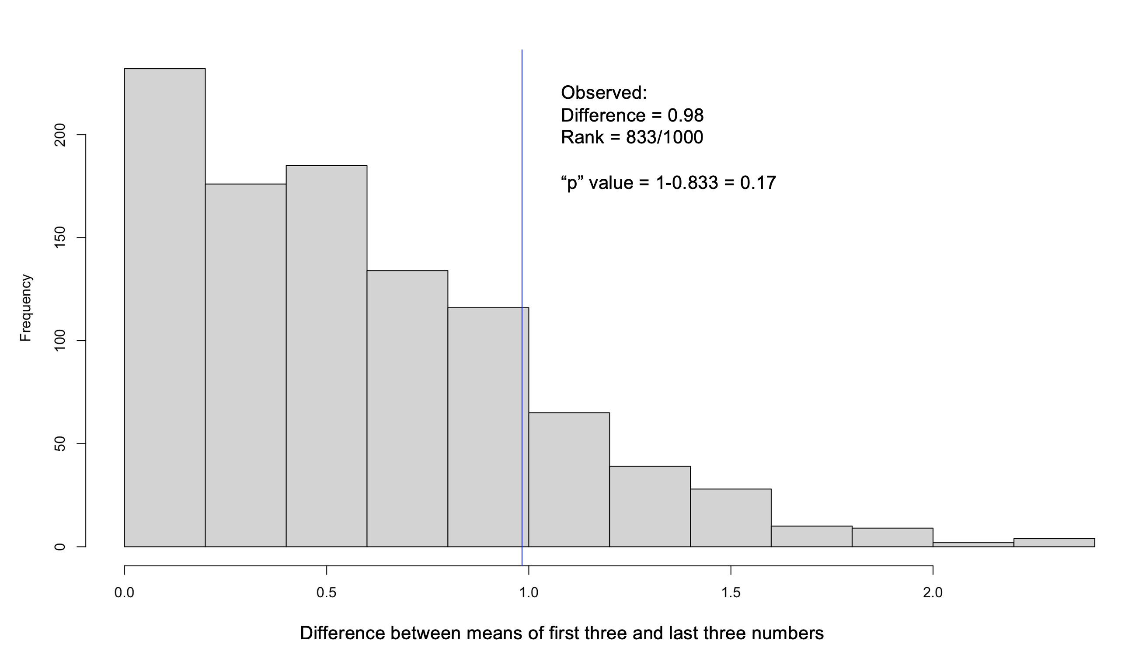
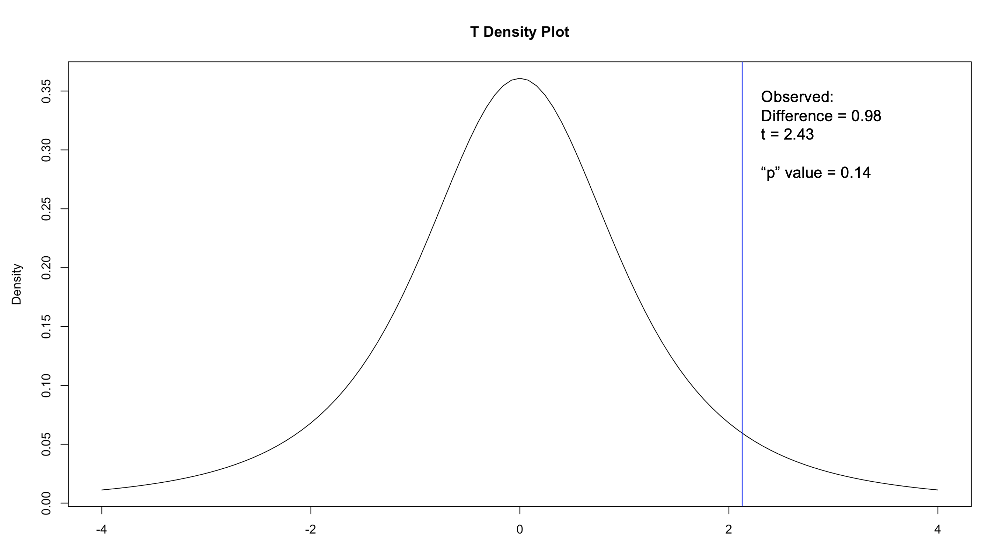
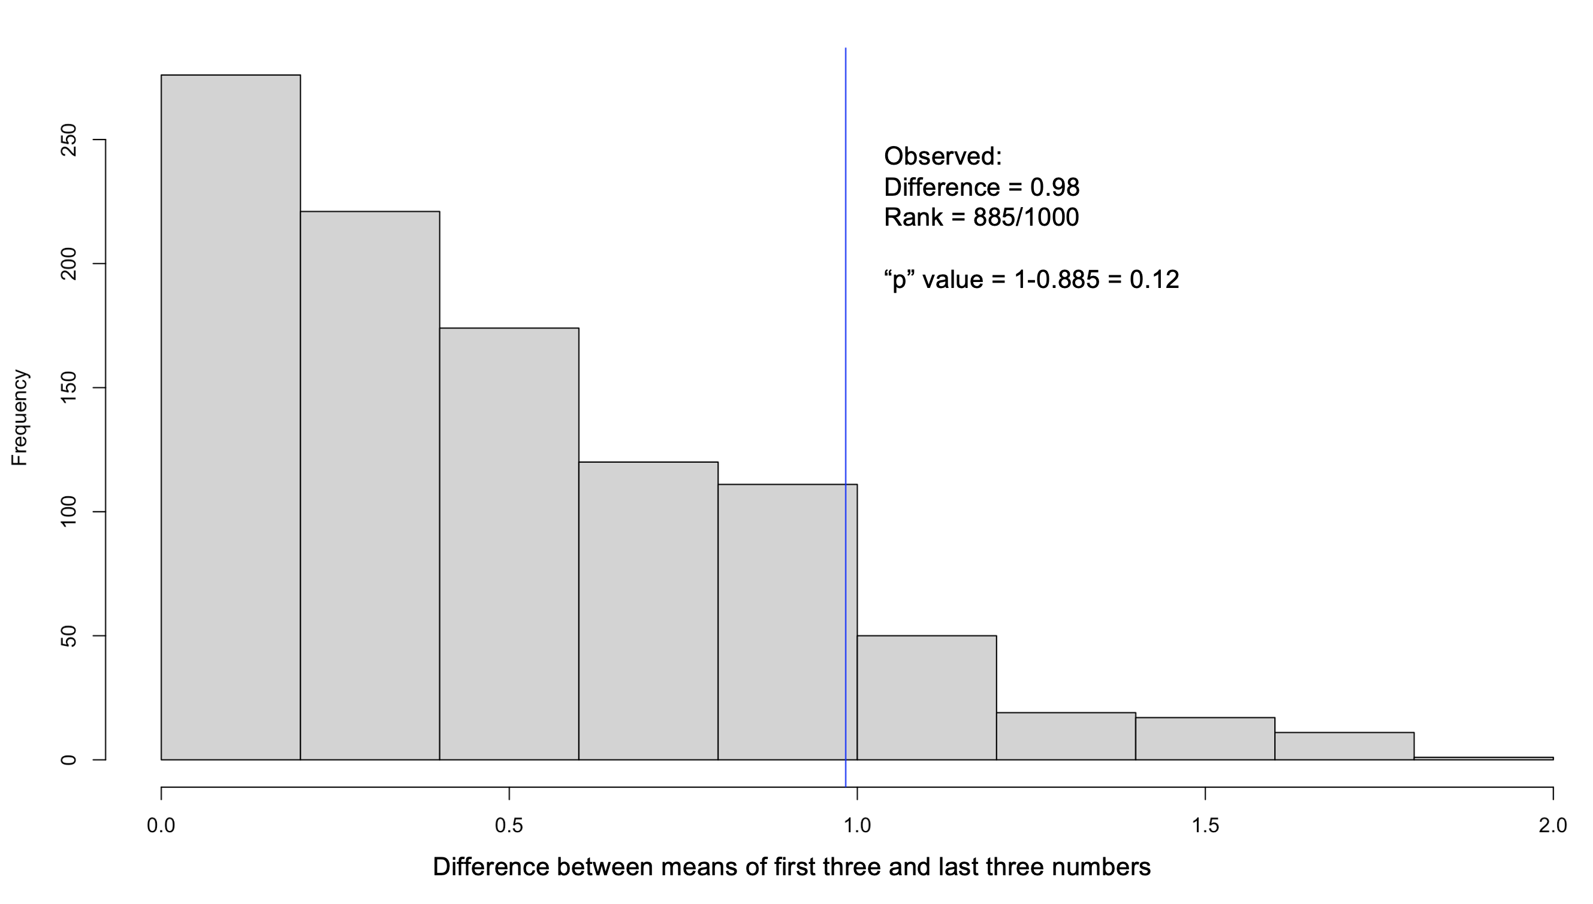
Are the results that different?

Slide 28
Outline
Fundamental definitions
Types of measurements
A regression example

Slide 29
Types of measurements

Slide 30
We will use two types of measurements
Individual-level
Sample- or population-level

Slide 31
Measures at an individual level describe a single person or patient
Qualitative
Quantitative

Slide 32
Measures at an individual level describe a single person or patient
Qualitative. An example of qualitative data could be a natural language description of how a patient is doing, say:
“Mr. Redacted is a 74-year-old gentleman with Parkinson's disease since 2006. He is a patient of Dr. Elided, last seen in clinic by me 4 months ago. At his last visit, no changes were made to his Sinemet, but we did start trospium for urinary frequency. I also recommended that he follow up with his psychologist for treatment of anxiety. He tells me that he is unsure if the trospium is helping with his urinary frequency. He has not seen his psychologist yet. He tells me that his mood is about the same; still depressed. He does not socialize much. He has had several family members pass away in the last year. Sleep continues to be an issue. He usually goes to bed around 5 PM and wakes up around 3 AM (waking up several times to use bathroom). Thanking and memory are good; still driving. He's taking Sinemet 3 tabs QID. He has some off time about 15-30 mins before next dose. He has never tried taking a dose early. Tremors worst with stress and anxiety. Denies hallucinations. He endorses mild occasional dyskinesias (some swaying). Denies falls. Some FOG. Uses cane to walk sometimes.”

Slide 33
Measures at an individual level describe a single person or patient
Quantitative. We will primarily consider quantitative data:

Slide 34
What is the difference between a discrete numerical variable and an ordinal categorical variable?

Slide 35
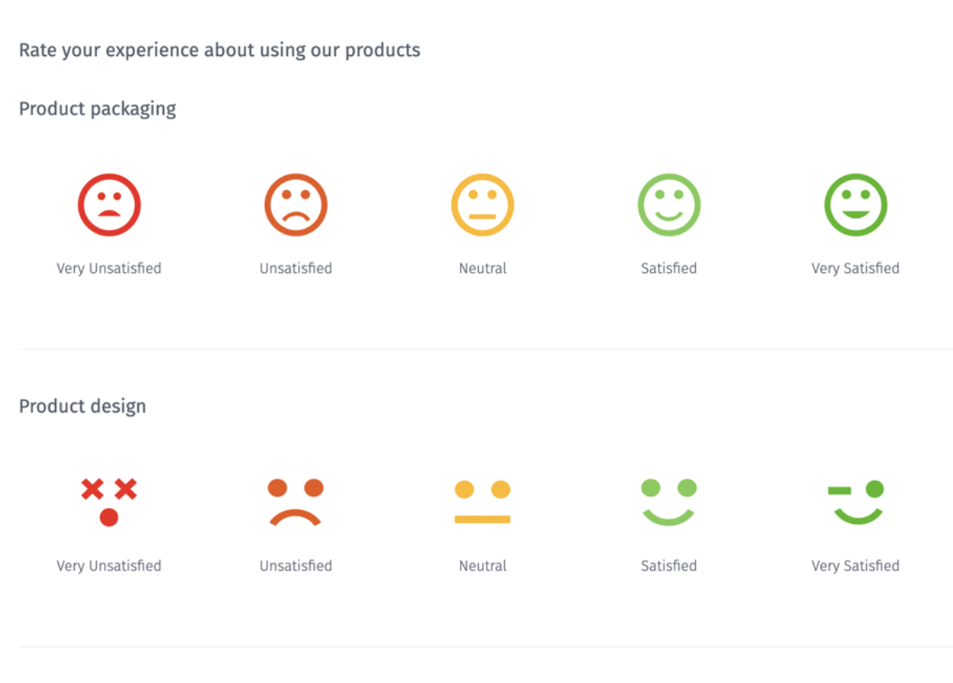
What type of data does this instrument measure?
https://www.questionpro.com/article/likert-scale-survey-questions.html

Slide 36
Special note – Likert scales
The Likert Scale (e.g., “on a scale of 1 to 10”) is a variable type created by Rensis Likert. It is the most common type of variable in social science research (e.g., questionnaires).
These variables are quantitative.
It is arguable that they may be "subjective," as they are based on individuals' experience rather than directly measurable phenomena. But they are quantitative and should be acknowledged as such.
They may be treated as nominal or continuous depending on the circumstances, usually with fairly similar results.
Note special case of special case:

Slide 37
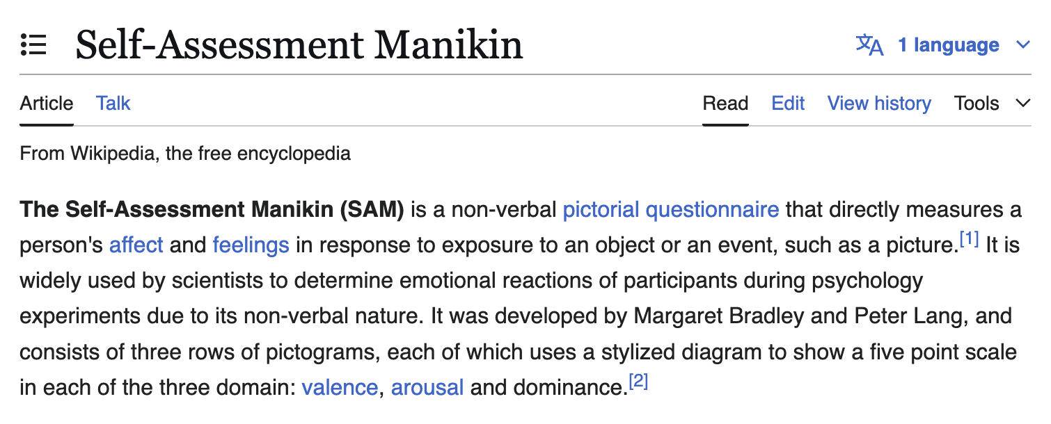
Special note – Likert scales
The Likert Scale (e.g., “on a scale of 1 to 10”) is a variable type created by Rensis Likert. It is the most common type of variable in social science research (e.g., questionnaires).
These variables are quantitative.
It is arguable that they may be "subjective," as they are based on individuals' experience rather than directly measurable phenomena. But they are quantitative and should be acknowledged as such.
They may be treated as nominal or continuous depending on the circumstances, usually with fairly similar results.
Note special case of special case:

Slide 38
Measurements at the population level describe the distribution of the individual measurements
For a given country, what measurements of center and spread could you use to describe:
How common cancer is
Typical income
Typical home value
Typical number of children in a family
The difference in assets between the wealthiest and least wealthy

Slide 39
Outline
Fundamental definitions
Types of measurements
A regression example

Slide 40
A regression example

Slide 41
(Bad) Cholesterol vs. Exercise

Slide 42
(Bad) Cholesterol vs. Exercise

Slide 43
Key definitions
Null hypothesis
The conditions under which an analyst proposes chance alone might generate (or have generated) a group of observations
Statistical test
A tool used to help make a decision about a null hypothesis
Permutation and simulation tests
“Non parametric” tests: Kruskal-Wallis, ranked sums
“Parametric” tests: t, chi-squared, F, likelihood ratio, Wald, score
Confound
A variable that is associated with the exposure and the outcome that is not a consequence of the outcome

Slide 44
Confounding in this case
The association between exercise and (good) cholesterol is confounded by age. Why?
Confound
A variable that is associated with the exposure and the outcome that is not a consequence of the outcome
Older people exercise more (these data must be from Oregon)
Older people have higher cholesterol
As age increases, cholesterol increases, even though for a given age (within a “stratum” of age) the slope is opposite!
This is called Simpson’s paradox.
It occurs all the time in medical data.

Slide 45
(Bad) Cholesterol vs. Exercise

Slide 46

(Bad) Cholesterol vs. Exercise
$${Cholesterol}_{i}=β_{C}{Exercise}_{i}+ε_{i}$$
$$ε_{i}\sim N(0,σ^{2})$$

Slide 47
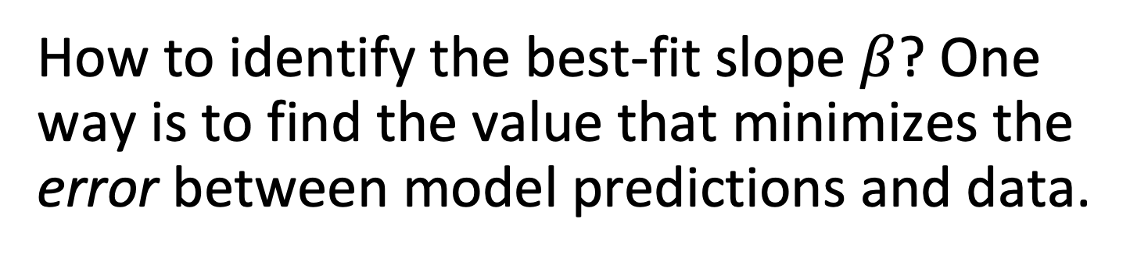
How to identify the best-fit slope $β$? One way is to find the value that minimizes the error between model predictions and data.
-0.8

Slide 48
A second way is to find the value that maximizes the likelihood of the data given the model.
-0.8

Slide 49
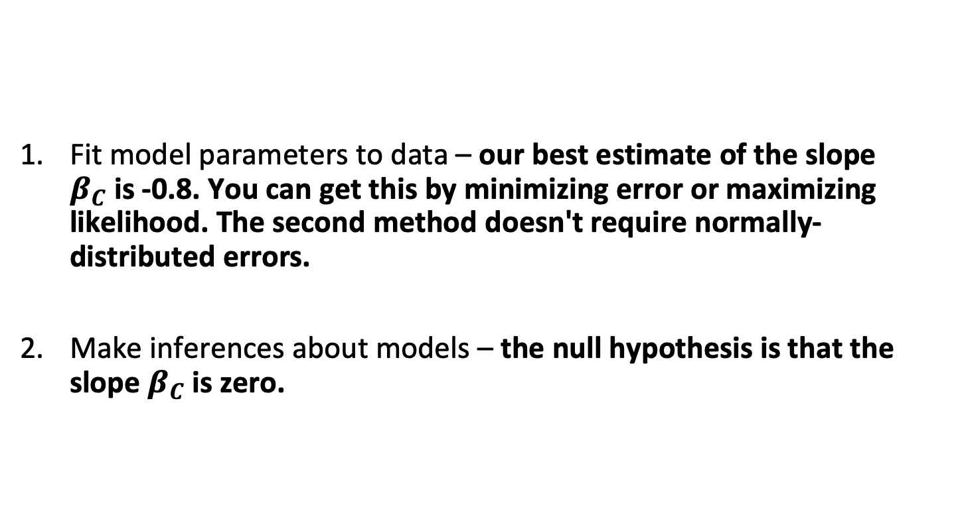
We will discuss two fundamental statistical modeling steps
Fit model parameters to data – our best estimate of the slope $β_{C}$is -0.8. You can get this by minimizing error or maximizing likelihood. The second method doesn't require normally-distributed errors.
Make inferences about models – the null hypothesis is that the slope $β_{C}$is zero.

Slide 50
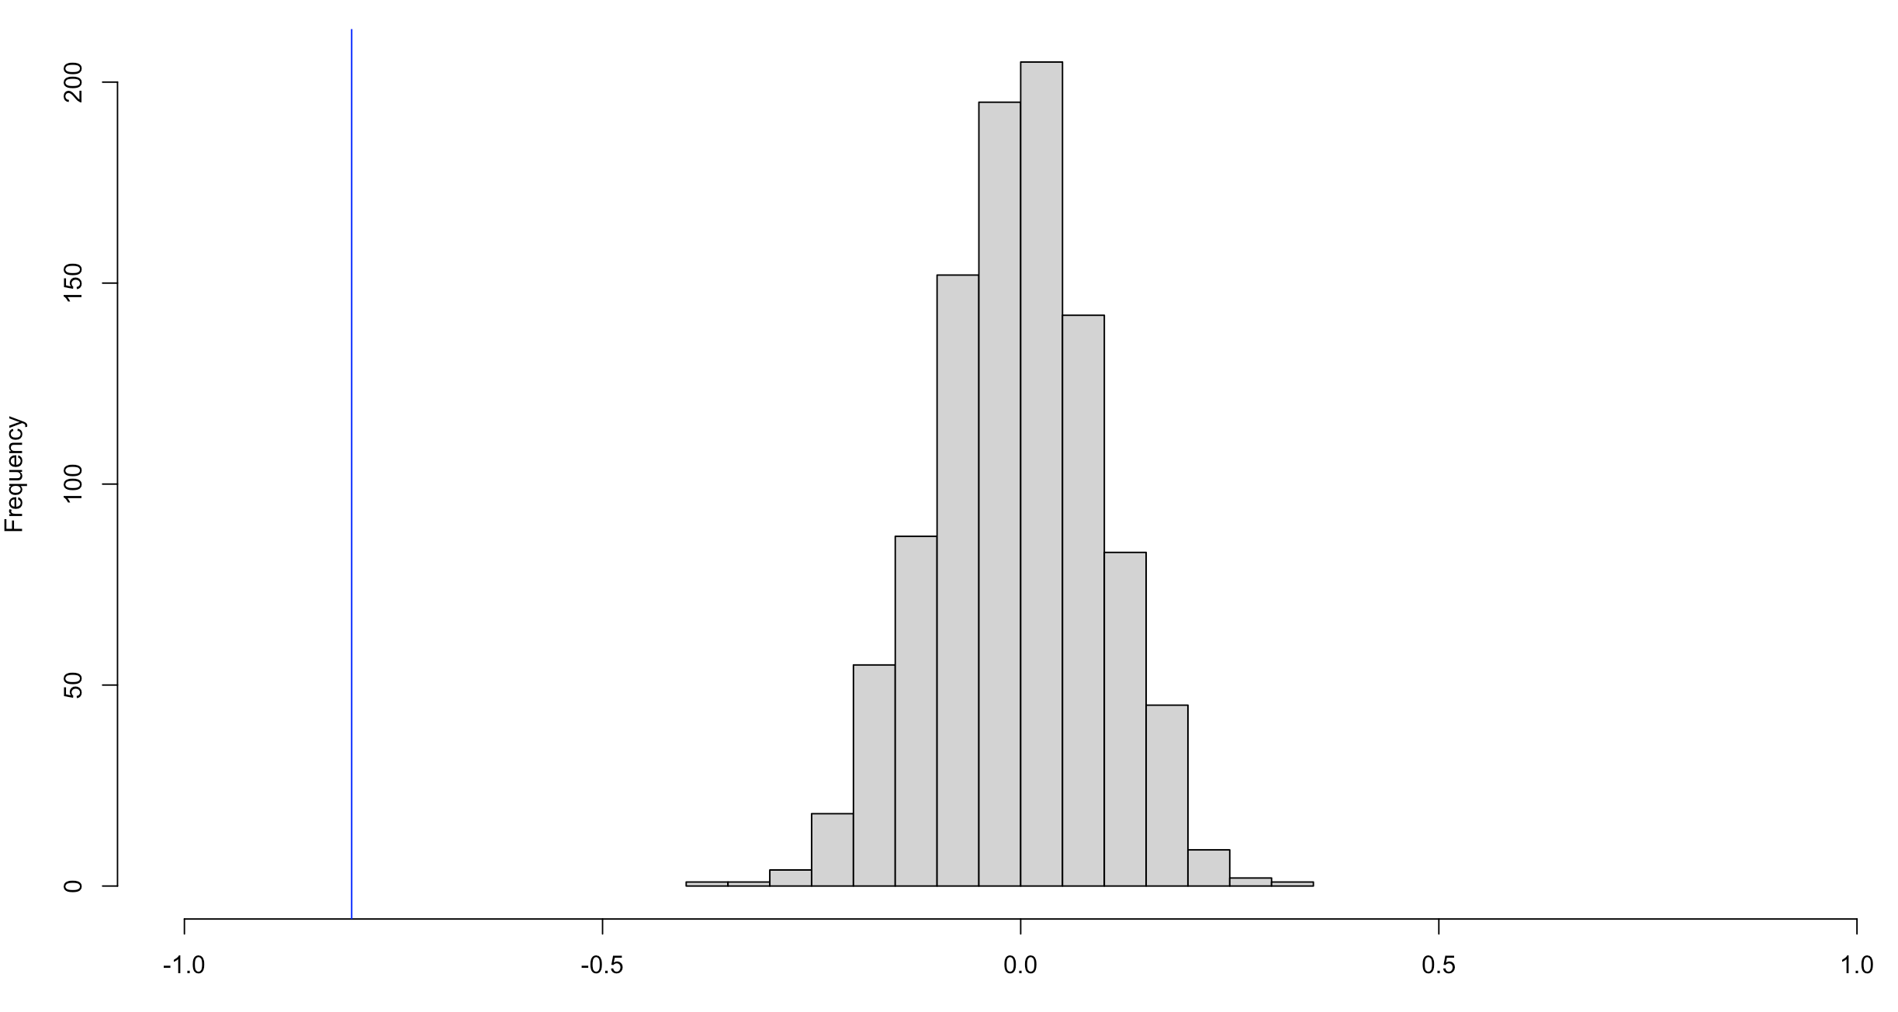
What do you think the p-value is?
Observed:
Slope = -0.8

Slide 51
Outline
Fundamental definitions
Types of measurements
A regression example

Slide 52
Housekeeping
HW0 is due Today at 5
We will discuss Fairness Definitions Explained Thursday at noon
HW1 is due Wednesday, 5 PM

Slide 53
Amolodipine trial example

Slide 54
What null hypothesis might be of interest here?
Change in
Systolic
Blood Pressure
Placebo
(-0.2)
Amlodipine
(-5.2)

Slide 55
Amlodipine clinical trial
H₀: The average difference in systolic blood pressure between hypertensive patients randomized to amlodipine and those randomized to placebo is 0.
Steps to test:
Find the difference in average blood pressure between the two groups
Find an estimate of the typical difference in averages expected by chance alone (under the null)
Divide (1) by (2) – what units is it in?
See how likely it is to find a difference that size or larger under the null, assuming that (3) follows some distribution

Slide 56
What is the difference in average blood pressure between groups?
Change in
Systolic
Blood Pressure
(mmHg)
Placebo
(-0.2)
Amlodipine
(-5.2)
-5.2 – -0.2 = -5

Slide 57
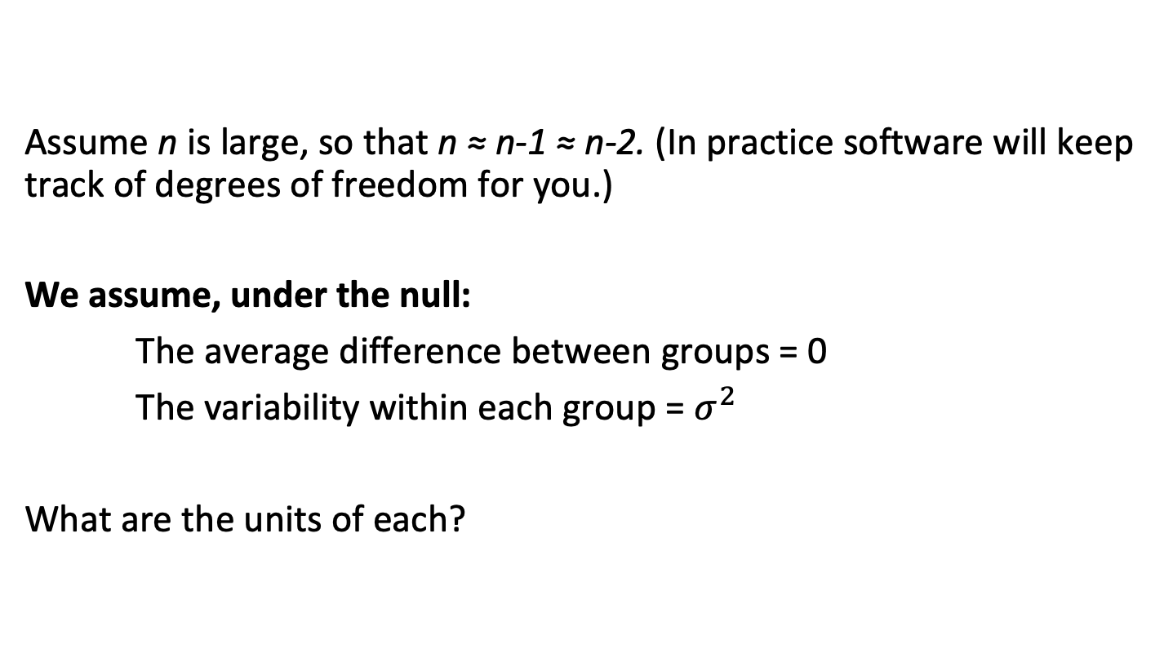
What is the typical difference expected by chance alone?
Assume n is large, so that n ≈ n-1 ≈ n-2. (In practice software will keep track of degrees of freedom for you.)
We assume, under the null:
The average difference between groups = 0
The variability within each group = $σ^{2}$
What are the units of each?

Slide 58
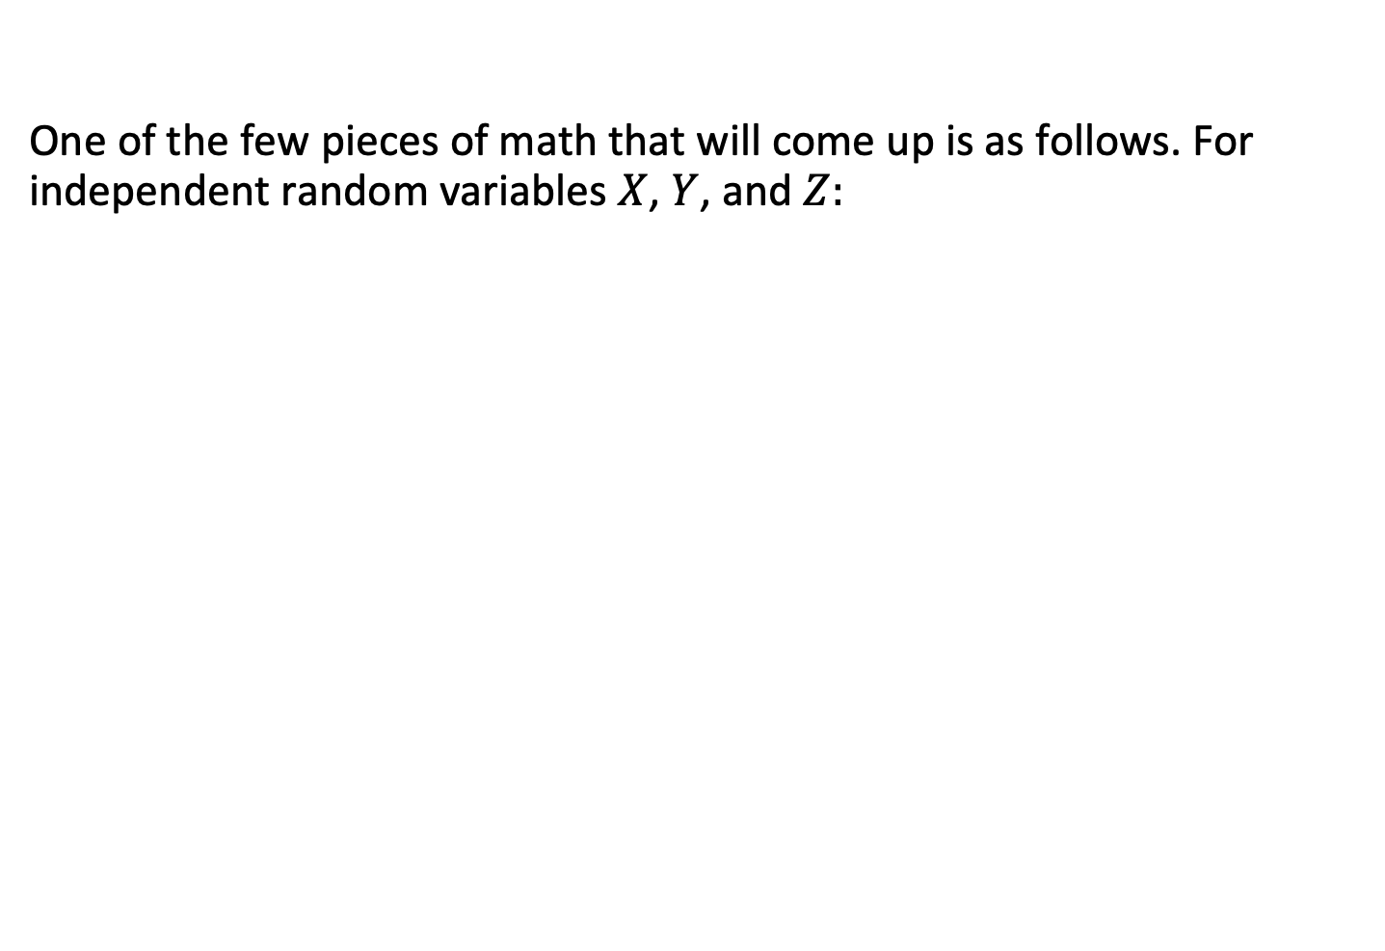
What is the typical difference expected by chance alone?
One of the few pieces of math that will come up is as follows. For independent random variables $X$, $Y$, and $Z:$
$$var\left(X+Y+Z\right)=var\left(X\right)+var\left(Y\right)+var(Z)$$
…and so on, when the number of variables increases to $n$:
$$var\left(\sum_{i=1}^{n}{X_{i}}\right)=\sum_{i=1}^{n}{var(X_{i})}$$

Slide 59
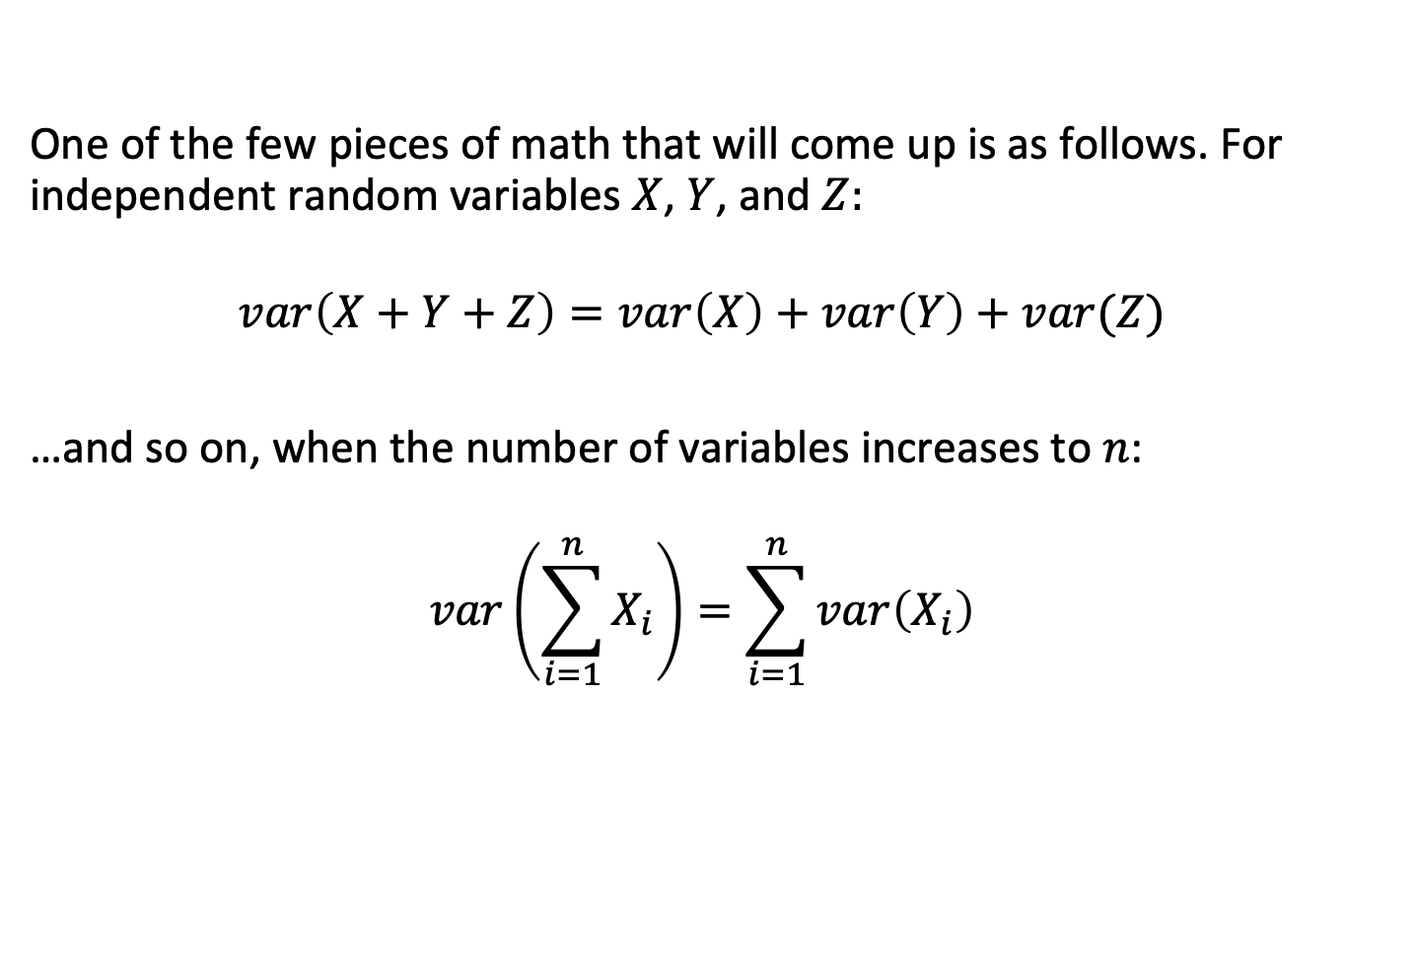
What is the typical difference expected by chance alone?
One of the few pieces of math that will come up is as follows. For independent random variables $X$, $Y$, and $Z:$
$$var\left(X+Y+Z\right)=var\left(X\right)+var\left(Y\right)+var(Z)$$
…and so on, when the number of variables increases to $n$:
$$var\left(\sum_{i=1}^{n}{X_{i}}\right)=\sum_{i=1}^{n}{var\left(X_{i}\right)}$$

Slide 60

What is the typical difference expected by chance alone?
When all of the variables $X_{i}$ have the same variance $σ^{2}$:
$$var\left(\sum_{i=1}^{n}{X_{i}}\right)=nσ^{2}$$
(This holds when variables are “independent and identically distributed”.)

Slide 61
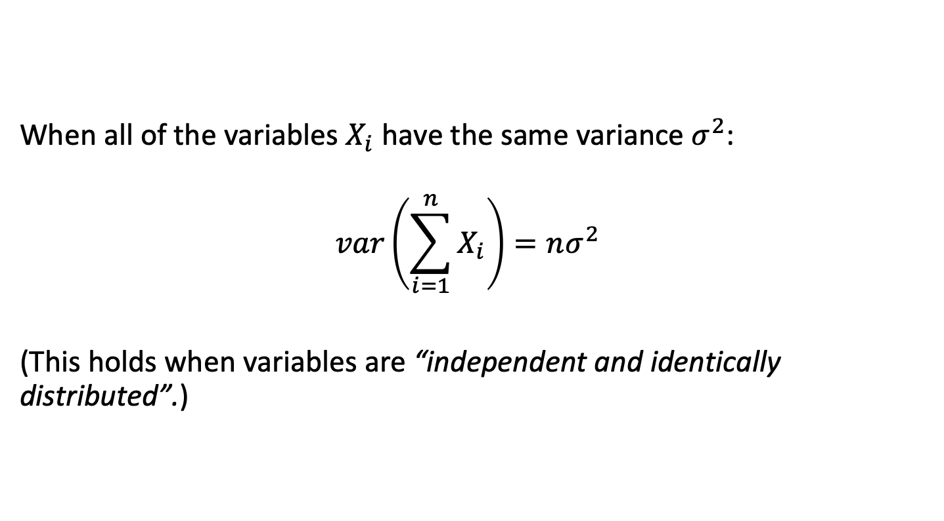
What is the typical difference expected by chance alone?
When all of the variables $X_{i}$ have the same variance $σ^{2}$:
$$var\left(\sum_{i=1}^{n}{X_{i}}\right)=nσ^{2}$$
(This holds when variables are “independent and identically distributed”.)

Slide 62
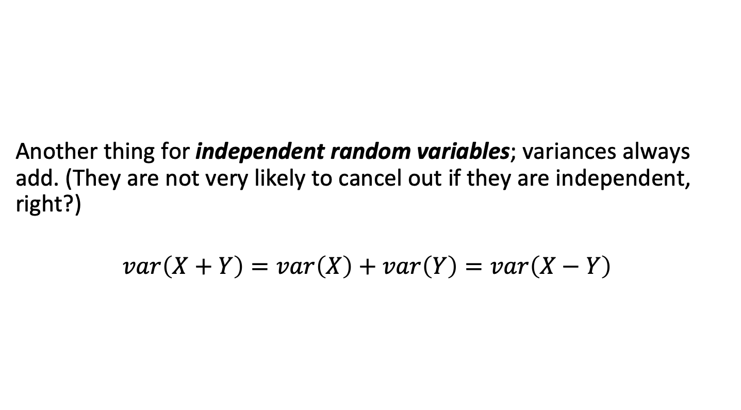
What is the typical difference expected by chance alone?
Another thing for independent random variables; variances always add. (They are not very likely to cancel out if they are independent, right?)
$$var\left(X+Y\right)=var\left(X\right)+var\left(Y\right)=var\left(X−Y\right)$$

Slide 63
What is the typical difference expected by chance alone?
Change in
Systolic
Blood Pressure
(mmHg)
Placebo
(-0.2)
Amlodipine
(-5.2)
We saw the difference: -5.2 – -0.2 = -5

Slide 64
What is the typical difference expected by chance alone?
Change in
Systolic
Blood Pressure
(mmHg)
Placebo
(-0.2)
Amlodipine
(-5.2)
What difference is expected under the null?

Slide 65
What is the typical difference expected by chance alone?
Change in
Systolic
Blood Pressure
(mmHg)
Placebo
(-0.2)
Amlodipine
(-5.2)
What variance is expected under the null?

Slide 66
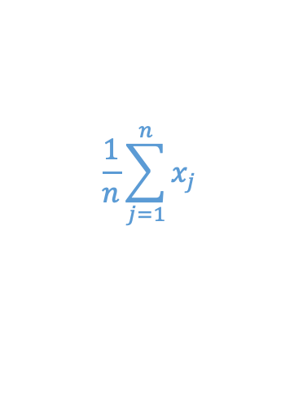

What is the typical difference expected by chance alone?
$$\frac{1}{n}\sum_{i=1}^{n}{x_{i}}$$
$$\frac{1}{n}\sum_{j=1}^{n}{x_{j}}$$
Change in
Systolic
Blood Pressure
(mmHg)
Placebo
(-0.2)
Amlodipine
(-5.2)

Slide 67
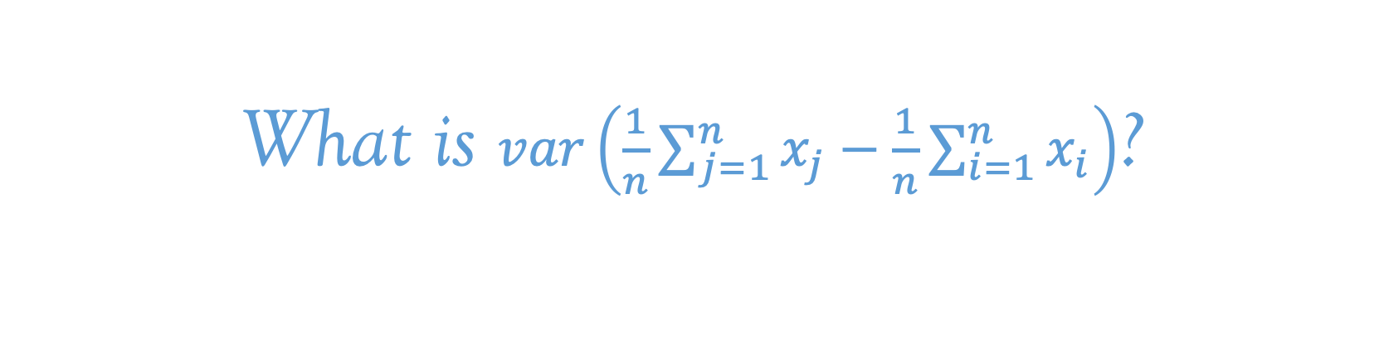
What is the typical difference expected by chance alone?
$$\frac{1}{n}\sum_{i=1}^{n}{x_{i}}$$
$$\frac{1}{n}\sum_{j=1}^{n}{x_{j}}$$
Change in
Systolic
Blood Pressure
(mmHg)
Placebo
(-0.2)
Amlodipine
(-5.2)
What is $var\left(\frac{1}{n}\sum_{j=1}^{n}{x_{j}}−\frac{1}{n}\sum_{i=1}^{n}{x_{i}}\right)$?

Slide 68

What is the typical difference expected by chance alone?
Another little piece of math that will come up: for random variable $X$:
$$var\left(\frac{1}{a}X\right)=\frac{1}{a^{2}}var\left(X\right)$$
…does this make sense, given the units?

Slide 69

What is the typical difference expected by chance alone?
Another little piece of math that will come up: for random variable $X$:
$$var\left(\frac{1}{a}X\right)=\frac{1}{a^{2}}var\left(X\right)$$
…does this make sense, given the units?

Slide 70
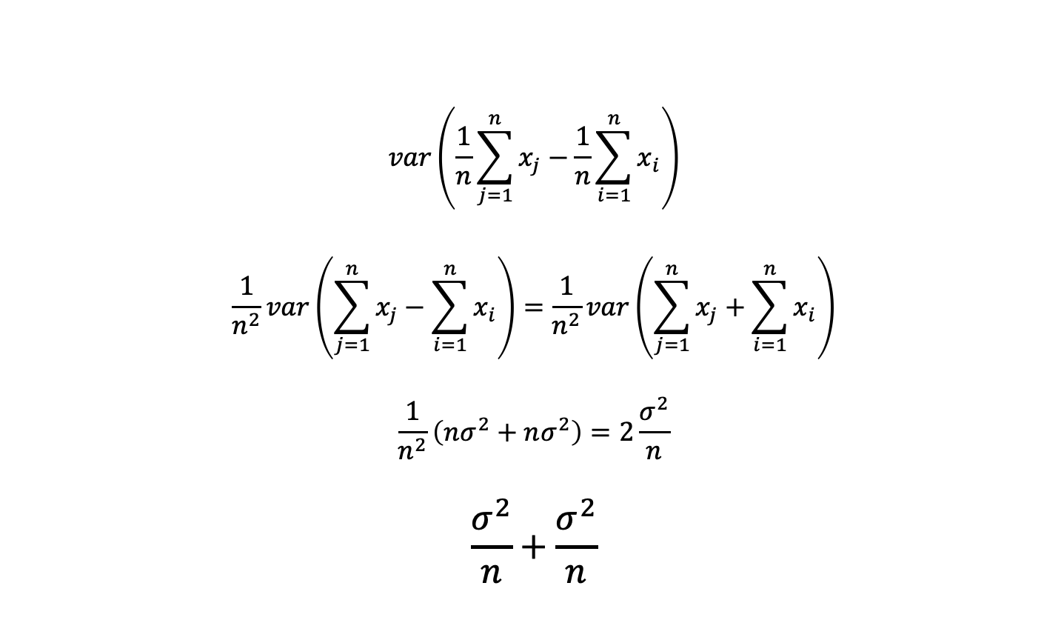
What is the typical difference expected by chance alone?
$$var\left(\frac{1}{n}\sum_{j=1}^{n}{x_{j}}−\frac{1}{n}\sum_{i=1}^{n}{x_{i}}\right)$$
$$\frac{1}{n^{2}}var\left(\sum_{j=1}^{n}{x_{j}}−\sum_{i=1}^{n}{x_{i}}\right)=\frac{1}{n^{2}}var\left(\sum_{j=1}^{n}{x_{j}}+\sum_{i=1}^{n}{x_{i}}\right)$$
$$\frac{1}{n^{2}}\left(nσ^{2}+nσ^{2}\right)=2\frac{σ^{2}}{n}$$
$$\frac{σ^{2}}{n}+\frac{σ^{2}}{n}$$
Variance expected from group 1 + Variance expected from group 2

Slide 71
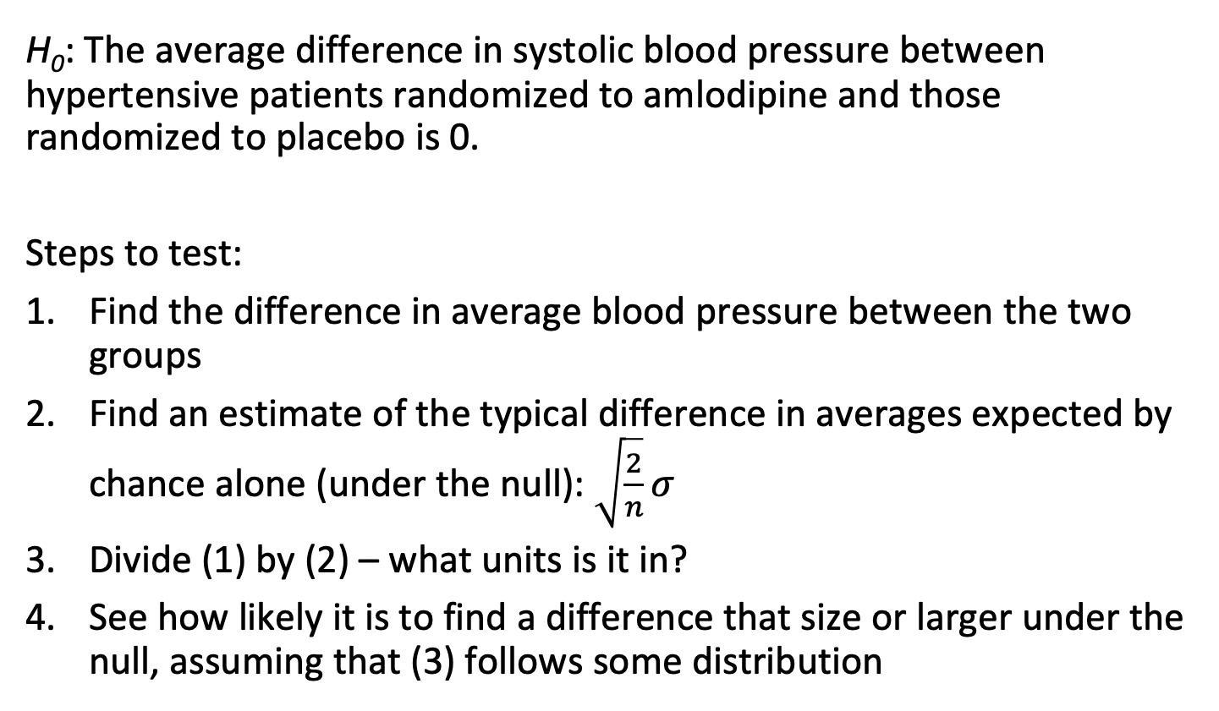
Amlodipine clinical trial
H₀: The average difference in systolic blood pressure between hypertensive patients randomized to amlodipine and those randomized to placebo is 0.
Steps to test:
Find the difference in average blood pressure between the two groups
Find an estimate of the typical difference in averages expected by chance alone (under the null): $\sqrt{\frac{2}{n}}σ$
Divide (1) by (2) – what units is it in?
See how likely it is to find a difference that size or larger under the null, assuming that (3) follows some distribution

Slide 72
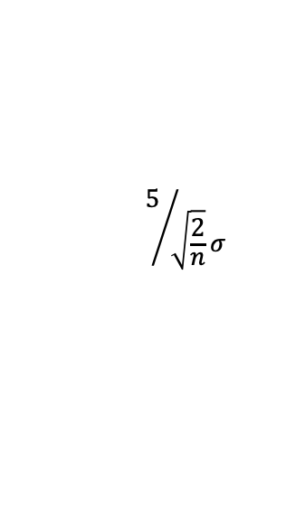
For large N, this is often a z/normal distribution
If z is large, p is small, reject H₀.
Otherwise, let H₀ stand. (For now.)
$$5/{\sqrt{\frac{2}{n}}σ}$$

Slide 73
For large N, this is often a z/normal distribution
If z is large, p is small, reject H₀.
Otherwise, let H₀ stand. (For now.)
$$5/{\sqrt{\frac{2}{n}}σ}$$
NB: Bigger n or bigger difference (5) increases
likelihood of statistical significance

Slide 74
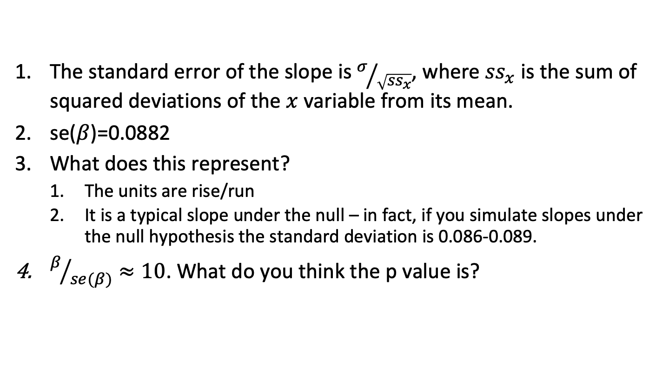
Typical variation in slope
The standard error of the slope is $σ/{\sqrt{{ss}_{x}}}$, where ${ss}_{x}$ is the sum of squared deviations of the $x$ variable from its mean.
se($β$)=0.0882
What does this represent?
The units are rise/run
It is a typical slope under the null – in fact, if you simulate slopes under the null hypothesis the standard deviation is 0.086-0.089.
$β/{se(β)}≈10$. What do you think the p value is?

