Slide 1
BMI 510: Bias
J. Lucas McKay, Ph.D., M.S.C.R.
Departments of Biomedical Informatics and Neurology, Emory University, Atlanta, GA USA
Department of Biomedical Engineering, Georgia Institute of Technology, Atlanta, GA, USA

Slide 2
BMI 510 Journal Club Overview
One component of this course is critical review of literature (primary / secondary / tertiary) for bias:
In systems created by humans (e.g., hiring practices in large firms)
In automated versions of those systems (e.g., monster.com trying to automate hiring practices in large firms, warts and all)
Each week, a pair of students will submit an article, some supporting research, and 3-5 discussion questions. (The instructor will go first.)
Students are expected to present once in the semester, but attend and contribute to all discussions.
Students are expected to read all articles in order to facilitate discussion.

Slide 3
Today
Types of biases
Examples of bias
Bias in machine learning

Slide 4
Types of biases
Cognitive biases
Systematic flaws in our reasoning
Data biases
Systematic flaws in the data we use to reason with

Slide 5
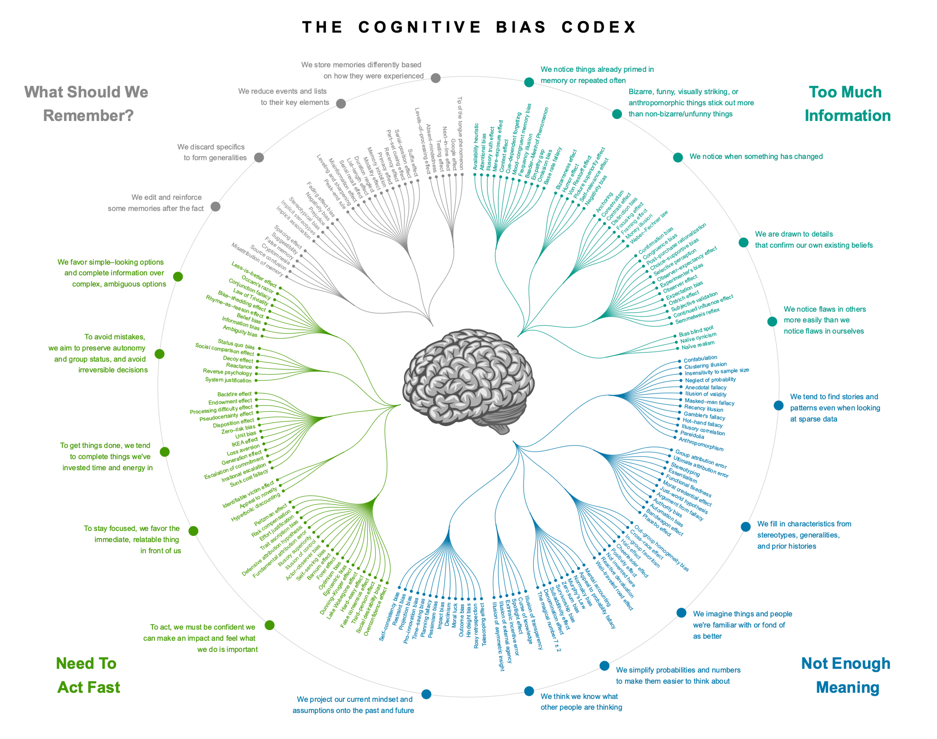

Slide 6
Types of biases
Cognitive biases
Systematic flaws in our reasoning
Unconscious / Implicit biases are critical to consider in hiring: https://www.youtube.com/watch?v=I4RCe1g2EoE
Data biases*
Systematic flaws in the data we use to reason with
Selection (e.g., survivorship)
Information (e.g., lying to the dentist)
*I use this term loosely; formal epidemiological courses have more precise language related to data or information biases, please defer to other sources in cases of disagreement

Slide 7
Why are we biased?

Slide 8
Why are we biased?
A lot of research in cognitive psychology, economics, and even basic neuroscience looks into what benefits biased decision making might confer. Some have included:
More efficient use of computational resources (e.g., Huffman codes in a computer scheme)
Quicker judgements in critical situations

Slide 9
Why are we biased?
A lot of research in cognitive psychology, economics, and even basic neuroscience looks into what benefits biased decision making might confer. Some have included:
More efficient use of computational resources (e.g., Huffman codes in a computer scheme)
Quicker judgements in critical situations
But this reasoning itself is based on the shortcut thinking that if humans do something, it must’ve been “optimized” over evolutionary time to serve some purpose. Instead, these biases might reflect:
An artifact of the way we learn at the neuronal level (“neurons wire together if they fire together,” Lowel and Singer 1992)
That we simply haven’t had enough training data to cover edge cases.

Slide 10
Types of biases
Cognitive biases
Systematic flaws in our reasoning
Unconscious / Implicit biases are critical to consider in hiring: https://www.youtube.com/watch?v=I4RCe1g2EoE
Data biases
Systematic flaws in the data we use to reason with
Selection (e.g., survivorship)
Information (e.g., lying to the dentist)

Slide 11
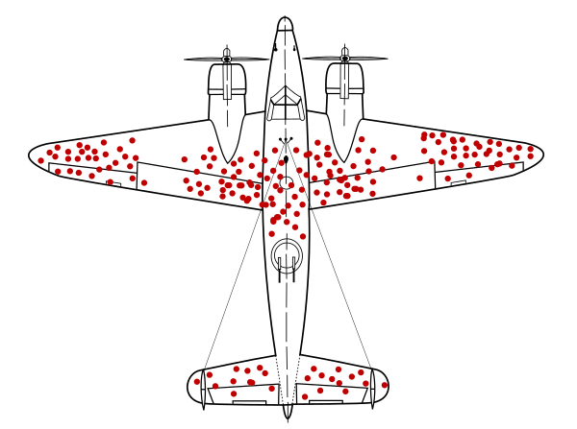
One data bias: Survivorship
wikipedia

Slide 12
One data bias: Survivorship
An example from the second world war:
You are tasked with figuring out where to put additional armor on planes based on the pattern of damage observed on planes returning from missions.
Where do you put the armor?

Slide 13
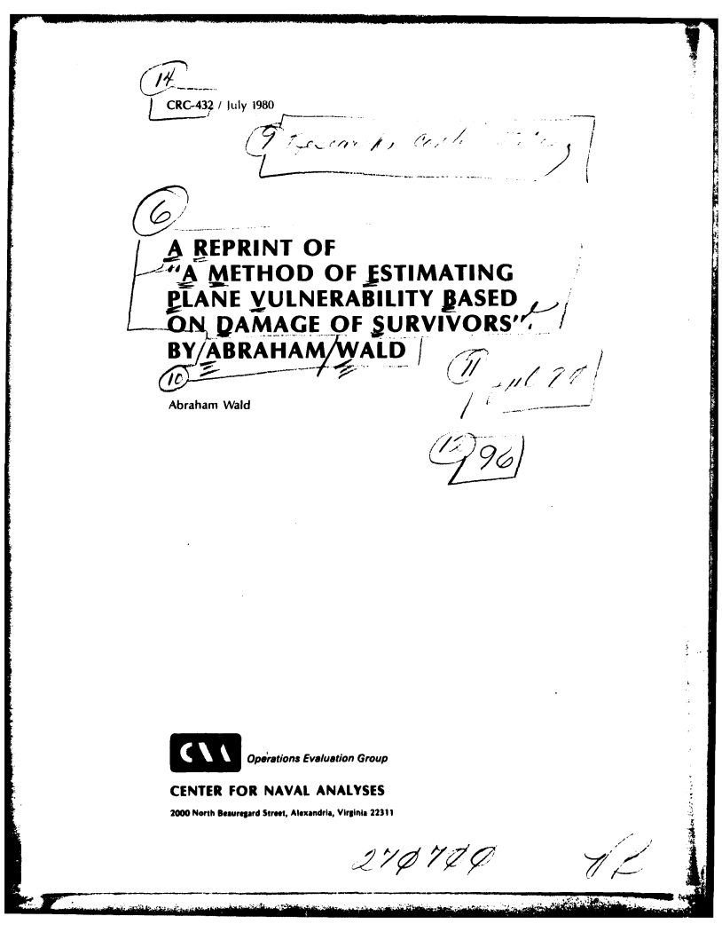
One data bias: Survivorship
“The greatest probability of being destroyed is .534, and occurs when a plane is hit by a 20-mm cannon shell on the engine area. The next most vulnerable event is a hit by a 7.9-mm machine gun bullet on the cockpit. These, and other conclusions that can be made from the table of vulnerabilities derived by the method of analysis of part VIII, can be used as guides for locating protective armor and can be used to make a prediction of the estimated loss of a future mission.”

Slide 14
One data bias: Survivorship
“The greatest probability of being destroyed is .534, and occurs when a plane is hit by a 20-mm cannon shell on the engine area. The next most vulnerable event is a hit by a 7.9-mm machine gun bullet on the cockpit. These, and other conclusions that can be made from the table of vulnerabilities derived by the method of analysis of part VIII, can be used as guides for locating protective armor and can be used to make a prediction of the estimated loss of a future mission.”

Slide 15
One data bias: Survivorship
“The greatest probability of being destroyed is .534, and occurs when a plane is hit by a 20-mm cannon shell on the engine area. The next most vulnerable event is a hit by a 7.9-mm machine gun bullet on the cockpit. These, and other conclusions that can be made from the table of vulnerabilities derived by the method of analysis of part VIII, can be used as guides for locating protective armor and can be used to make a prediction of the estimated loss of a future mission.”

Slide 16
One data bias: Survivorship
Be sure to think about what data you do not have.
In data sampled by convenience (which includes the vast majority of ML/AI datasets, web scraping, pulling medical records) there is always going to be bias.

Slide 17
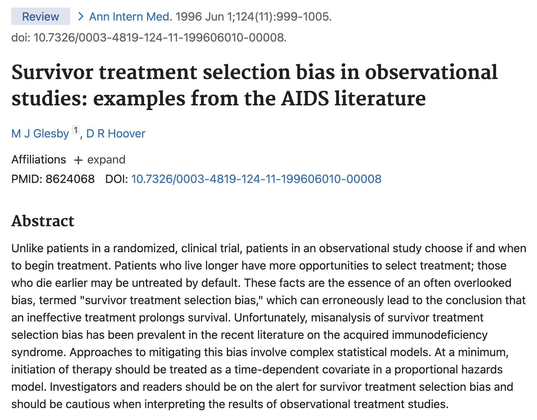

Slide 18
Consider the following extreme example of a hypothetical observational cohort of patients with the acquired immunodeficiency syndrome (AIDS), none of whom are using antiretroviral therapy at the start of the study. After 1 year of observation, a hypothetical new antiretroviral drug called placebovir becomes available.

Slide 19
Consider the following extreme example of a hypothetical observational cohort of patients with the acquired immunodeficiency syndrome (AIDS), none of whom are using antiretroviral therapy at the start of the study. After 1 year of observation, a hypothetical new antiretroviral drug called placebovir becomes available.
All patients who are alive at 1 year begin receiving treatment with placebovir, and all patients who have died by 1 year are untreated by default.

Slide 20
Consider the following extreme example of a hypothetical observational cohort of patients with the acquired immunodeficiency syndrome (AIDS), none of whom are using antiretroviral therapy at the start of the study. After 1 year of observation, a hypothetical new antiretroviral drug called placebovir becomes available.
All patients who are alive at 1 year begin receiving treatment with placebovir, and all patients who have died by 1 year are untreated by default.
In reality, placebovir has absolutely no therapeutic benefit.

Slide 21
Consider the following extreme example of a hypothetical observational cohort of patients with the acquired immunodeficiency syndrome (AIDS), none of whom are using antiretroviral therapy at the start of the study. After 1 year of observation, a hypothetical new antiretroviral drug called placebovir becomes available.
All patients who are alive at 1 year begin receiving treatment with placebovir, and all patients who have died by 1 year are untreated by default.
In reality, placebovir has absolutely no therapeutic benefit.
If we compare survival in treated and untreated patients, the use of placebovir will obviously correlate strongly with longer survival: All of the patients surviving for more than 1 year and none of the patients dying within 1 year use placebovir.

Slide 22
How would you analyze these data?
ID | PLACEBOVIR | SURVIVAL
1 | 1 | 2.6
2 | 1 | 1.2
3 | 1 | 1.4
4 | 0 | 0.9
5 | 0 | 0.6

Slide 23
Would any analysis pick up the bias?
ID | PLACEBOVIR | SURVIVAL
1 | 1 | 2.6
2 | 1 | 1.2
3 | 1 | 1.4
4 | 0 | 0.9
5 | 0 | 0.6

Slide 24
Consider the following extreme example of a hypothetical observational cohort of patients with the acquired immunodeficiency syndrome (AIDS), none of whom are using antiretroviral therapy at the start of the study. After 1 year of observation, a hypothetical new antiretroviral drug called placebovir becomes available.
All patients who are alive at 1 year begin receiving treatment with placebovir, and all patients who have died by 1 year are untreated by default.
In reality, placebovir has absolutely no therapeutic benefit.
If we compare survival in treated and untreated patients, the use of placebovir will obviously correlate strongly with longer survival: All of the patients surviving for more than 1 year and none of the patients dying within 1 year use placebovir.
Attributing this improved survival of treated patients to placebovir, however, is obviously erroneous and is an illustration of survivor treatment selection bias.

Slide 25
Other selection biases
Non-response bias
What happens when your polling data for an election are taken from landline phone numbers?
What happens when the sickest patients in your cancer prognosis dashboard dataset can’t answer all of the questions on the questionnaire?
Healthy cohort bias
What happens when all of the free text responses in the usability questionnaire dataset for your new technology are from early adopter tech bros?

Slide 26
Content notice
In the Journal Club component, we will be discussing bias, which has profound consequences for everyone.
We will likely discuss systematic racism, sexism, colorism, and similar topics.
Please let the Instructor know if the nature of these topics interferes in some way with your learning, and we will figure it out.

Slide 27
Other selection biases
Non-response bias
What happens when your polling data for an election are taken from landline phone numbers?
What happens when the sickest patients in your cancer prognosis dashboard dataset can’t answer all of the questions on the questionnaire?
Healthy cohort bias
What happens when all of the free text responses in the usability questionnaire dataset for your new technology are from early adopter tech bros?
Systemic inequity bias
What happens when you use hiring data from an organization that has been (not on purpose) discriminating against women for 50 years to create a hiring model?

Slide 28
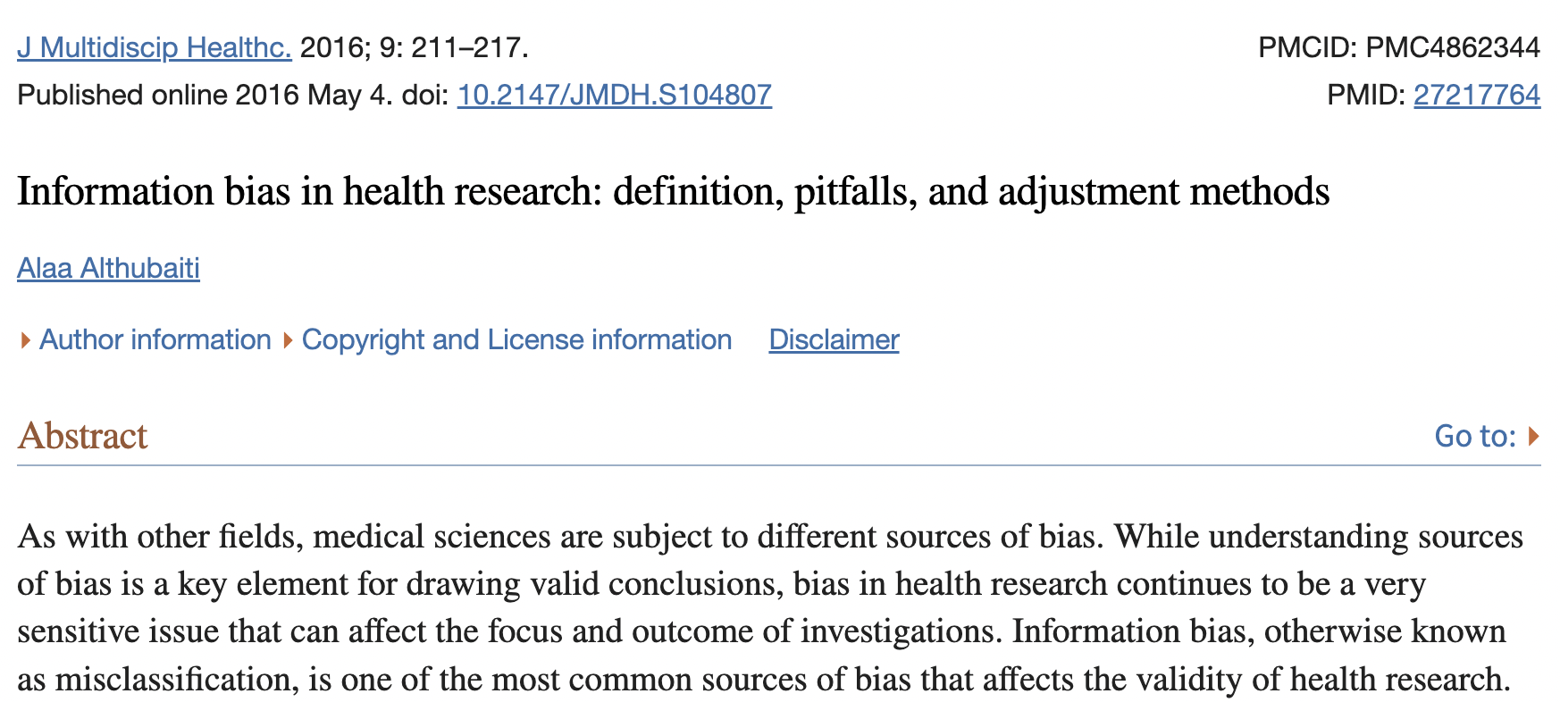
Information biases
All of these biases are selection biases, because the sample differs from the population in a systematic way.
Another type of data bias is information bias, which leads to misclassification:
Recall bias
Study participants can erroneously provide responses that depend on his/her ability to recall past event.
Social desirability bias
Study participants may under-report socially undesirable behaviors (smoking, drug use, etc.)

Slide 29
Today
Types of biases
Examples of bias
Bias in machine learning

Slide 30
Bias in machine learning

Slide 31
Bias in machine learning
Biased data and systems are an immense problem in machine learning, largely because our systems approximate biased human processes.
These biases may or may not be intentional.
A lot of these concepts fall under “Fairness in Machine Learning” but have been studied for many years in epidemiological contexts.
There are ethical reasons to mitigate bias. There are also major performance reasons.

Slide 32
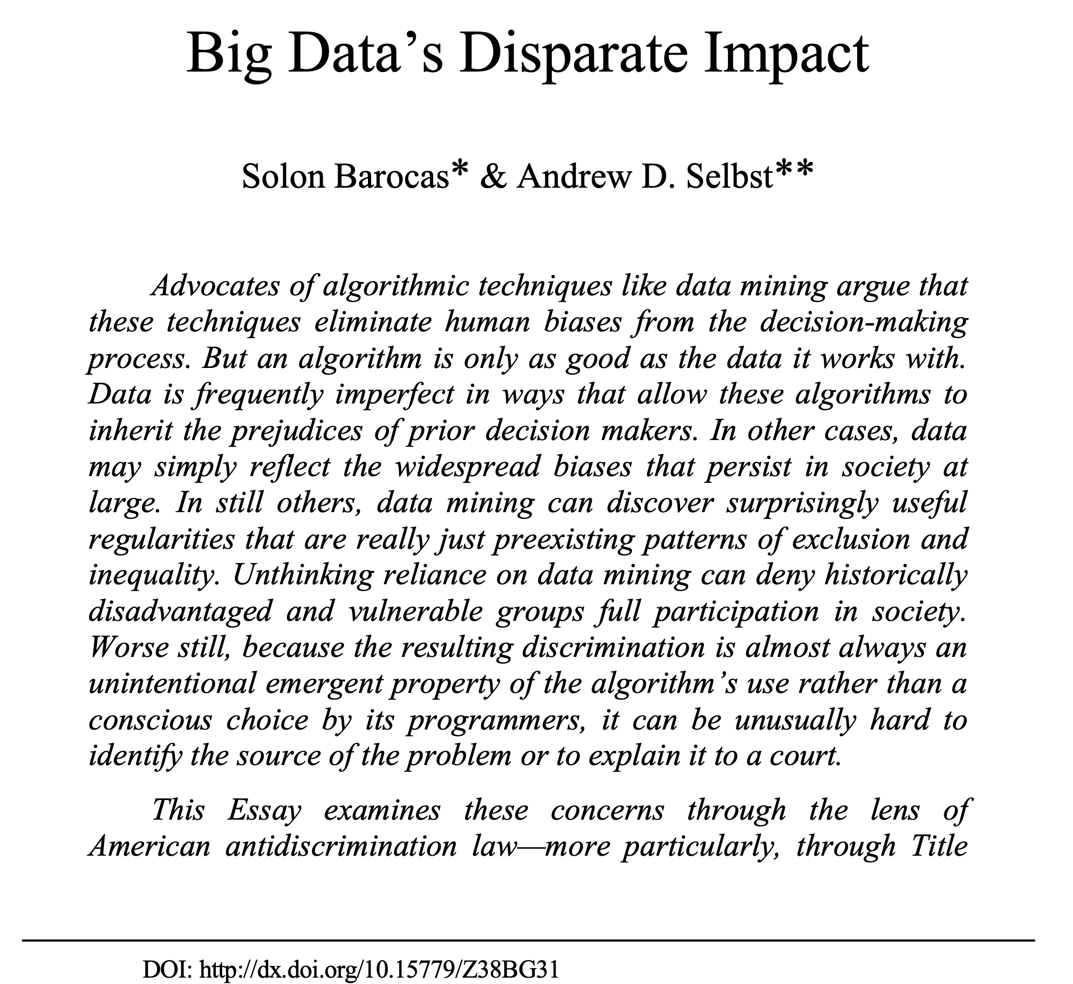
…we will also see that ML applications can amplify biases

Slide 33
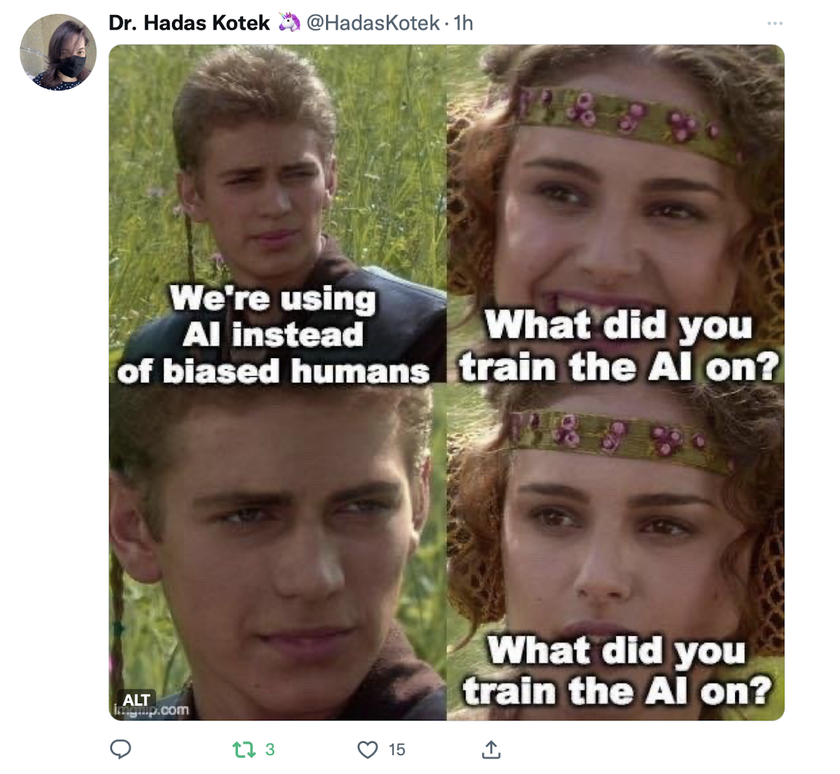

Slide 34
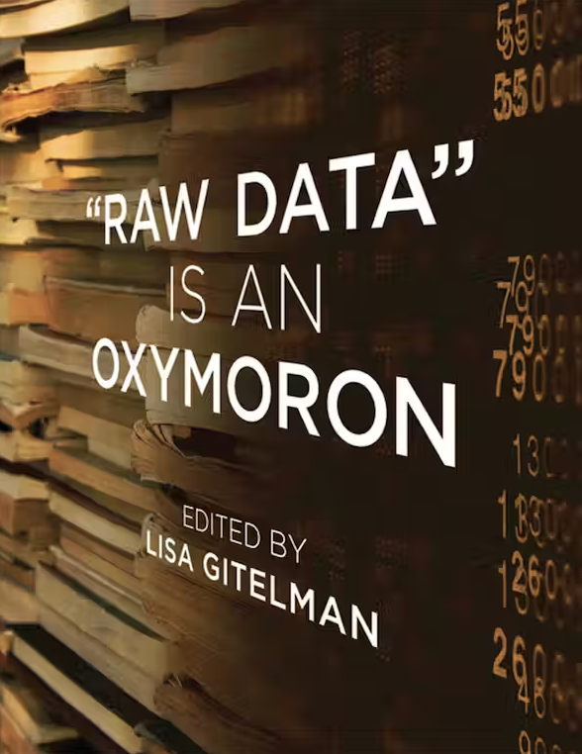

Slide 35
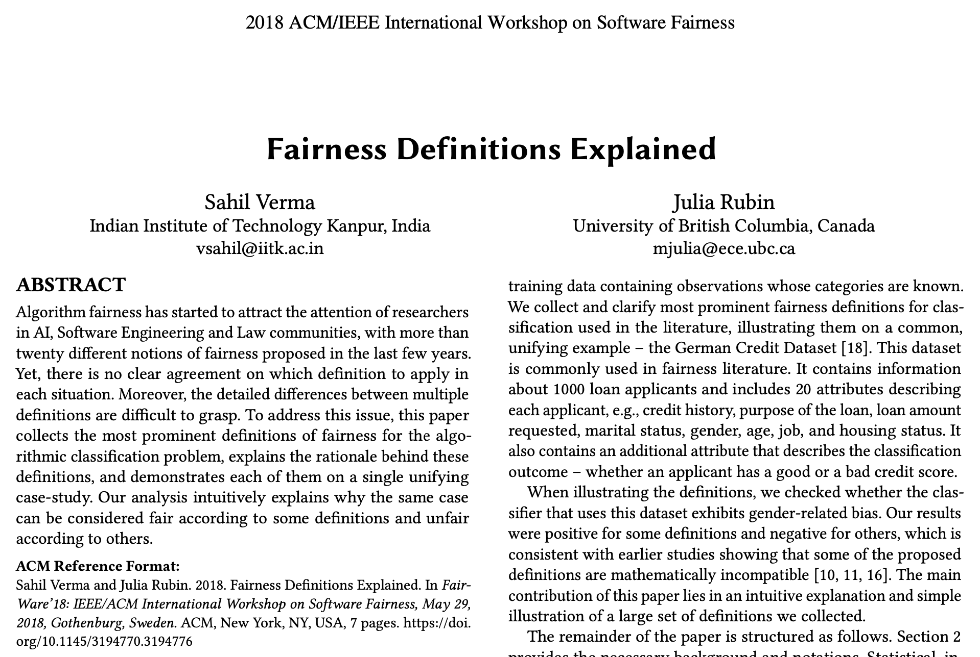

Slide 36
BMI 510 Journal Club Overview
One component of this course is critical review of literature (primary / secondary / tertiary) for bias:
In systems created by humans (e.g., hiring practices in large firms)
In automated versions of those systems (e.g., monster.com trying to automate hiring practices in large firms, warts and all)
Each week, a pair of students will submit an article, some supporting research, and 3-5 discussion questions. (The instructor will go first.)
Students are expected to present once in the semester, but attend and contribute to all discussions.
Students are expected to read all articles in order to facilitate discussion.

Slide 37
Today
Types of biases
Examples of bias
Bias in machine learning

Slide 38
Next week
Please turn in Homework 0 by 5 PM Wednesday.
Please prepare to discuss “Fairness definitions explained” by Verma and Rubin (Thursday).
Some sample articles are available on my website.

